Slide 1

Veritas Claims pipeline
A Modular Healthcare Claims & Clinical Data Processing Pipeline
Pranava Pai N
14-07-2026

Slide 2
Proposed architecture
A structured deep-dive into the ingestion layers, data standardisation, database design, and monitoring system of Veritas Claims.

Slide 3




System Architecture Overview
Robust Ingestion & Parsing
API & Monitoring Interface
Designed a fully automated file ingestion layer that reads unstructured JSON claim batches, implements trace ID tracking for deduplication, and routes system flow dynamically based on semantic rule evaluation matrices.
Constructed an analytical interface backed by FastAPI async triggers and a Streamlit operational control panel. This provides administrative analytics, system throughput graphs, and instant database querying capabilities.

Slide 4
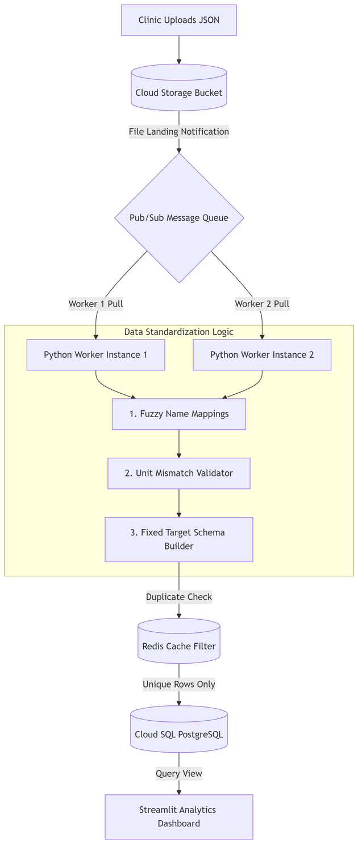
Data Ingestion & Quality Filters
Staging Ingestion: Continuous parsing of raw clinical payloads dropping into localized, configurable processing directories.
Validation Engine: Ensures completeness of demographic details and provider National Provider Identifiers (NPI).
Trace ID Deduplication: Instantly evaluates payload identifiers to block redundant claims from hitting the datastore.
Isolated DeDup Queue: Isolates corrupt, structurally invalid, or duplicate records into a distinct hold folder.

Slide 5









Key Core Functionalities
Parsing Layer
Standardization
SQLite Storage
Accepts and translates complex clinical JSON elements, isolating core billing records, patient identity maps, and lab metadata cleanly.
Normalizes chaotic lab test nomenclature and units of measure into standard canonical codes using rule-based dictionary maps via fuzzy matching.
Commits validated records, process logs, and clean normalized claims instantly into an indexed, relationally optimized transactional database.

Slide 6

Semantic Test Classification
Translating Data into Utility
5
Raw lab metrics are highly messy. The pipeline parses values and classifies them to make claims clinically actionable.
Within / Out of Range: Maps results cleanly to predefined healthy boundaries.
Extreme Outliers: Signals highly anomalous results for critical review.
STATUS STATES
Invalid / Non-Numeric: Filters corrupt formats for data-hygiene safety.

Slide 7

The Technical Core Stack
Architecture Layer | Technology Chosen | Role & Architectural Objective
Core Language | Python (OOPS) | Handles data extraction logic, validations, dictionary mapping, and overall ingestion control loops.
API Layer | FastAPI | Exposes asynchronous triggers to programmatically start validation tasks and fetch normalized dataset states.
Data Store | SQLite3 | Offers transactional database storage with structured indexing, optimized for fast and local validation runs.
Dashboard & Charts | Streamlit & Plotly | Empowers real-time quality control monitoring, analytical reports, and system pipeline volume distributions.

Slide 8
Project Goals & Tradeoffs
A summary of system validation performance, architectural compromises, and technical milestones hit by Veritas Claims.

Slide 9
Key Project Achievements
End-to-End Execution: Successfully constructed a seamless, automated file-to-dashboard workflow capable of taking messy raw medical JSON inputs and mapping them into standardized, clean relational metrics tables.
Interoperable Standardization: Developed a highly structured, rule-based dictionary engine that maps chaotic multi-format lab nomenclature and inconsistent measurement units into perfectly aligned target profiles.
Practical Data Hygiene: Built real-world filters addressing common healthcare integration friction points - namely schema invalidity, structural payload omissions, and duplication anomalies.
Modular Design Patterns: Leveraged clean OOP and configuration separation, creating a prototype pipeline that is instantly ready to scale into a enterprise containerized cloud environment.

Slide 10


Tradeoffs & Production Improvements
Prototype Tradeoffs
Enterprise Growth Roadmap
Local Storage Limitation: Opted for SQLite to guarantee zero-configuration and simplified localized data state validation over heavier, high-maintenance cluster setups.
Cloud Native Scale: Ready to swap SQLite with PostgreSQL or BigQuery and implement distributed compute wrappers (such as Apache Spark) for petabyte claims parsing.
Config-Based Mapping: Leveraged deterministic, declarative rule mappings. While highly reliable and audit-ready, it requires configuration maintenance compared to dynamic semantic AI parsing models.
AI-Ready Enhancements: Transition the standardization rules engine into a Clinical LLM (like AWS Medical Comprehend) to intelligently map unfamiliar, non-standard lab codes to LOINC schemas.

Slide 11
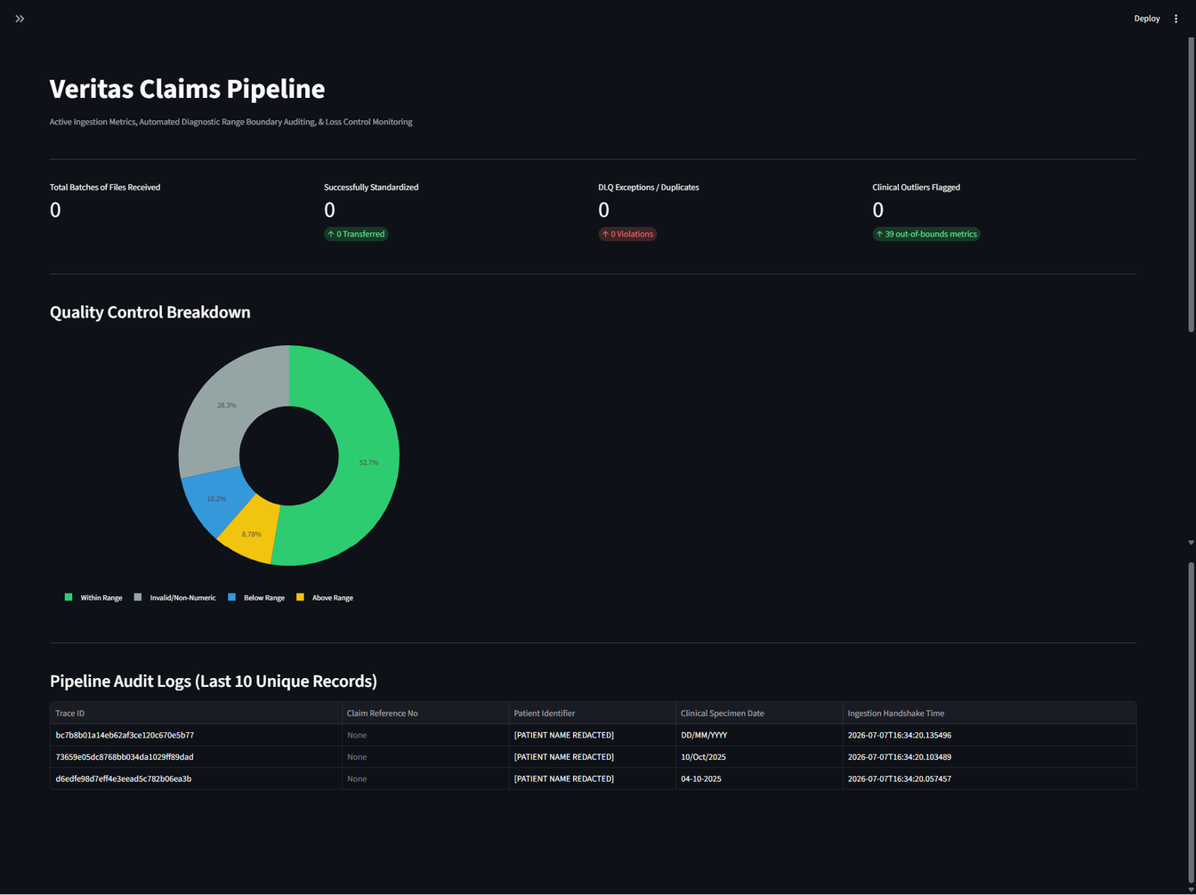



project outcomes
Veritas Claims acts as an explicit demonstration of foundational software architecture, demonstrating capacity to engineer scalable backends, deploy structural data validations, translate complex business parameters into logic, and build polished analytic layers.
Monitoring Dashboard

Slide 12

Thank You
Veritas Claims Data Processing Pipeline • Q&A Session
github.com/veritas-claims
pranavpai0309@gmail.com

