Slide 1

CONCURRENCY CONTROL MECHANISMS
By
Mrs. Ch. Sujatha
Assistant Professor

Slide 2

TOPICS
Introduction to Concurrency Control
Concurrency Control Techniques
Deadlock Handling
Isolation Levels (as part of concurrency control)
Concurrency Control in Distributed Databases
Comparison of Concurrency Control Methods

Slide 3
INTRODUCTION TO CONCURRENCY CONTROL
Concurrency refers to the execution of multiple transactions at the same time in a multi-user database system.
Concurrency Control ensures that concurrent transactions do not violate the consistency and integrity of data.
Goals:
Preserve data consistency.
Ensure serializability (concurrent schedule = some serial schedule).
Prevent problems like lost updates, dirty reads, and unrepeatable reads.
Common problems due to concurrency:
Lost update: Two transactions overwrite each other's changes.
Temporary update/Dirty read: A transaction reads data modified by another uncommitted transaction.
Incorrect summary: One transaction reads partial updates of another.
Unrepeatable read: A transaction reads the same data twice and gets different results.

Slide 4
CONCURRENCY CONTROL TECHNIQUES(TO BE CONT...)
Lock-based Protocols:
Transactions must acquire a lock before accessing data.
Shared locks (S) for reading, Exclusive locks (X) for writing.
Follows Two-Phase Locking (2PL) to ensure serializability.
Timestamp Ordering:
Each transaction gets a unique timestamp.
Operations are ordered based on timestamps.
If a conflict occurs with timestamp order, the newer transaction is aborted or delayed.
Optimistic Concurrency Control:
Assumes conflicts are rare.
Transactions execute without restrictions, but check for conflicts before commit.
Has three phases: Read, Validation, Write.

Slide 5
CONCURRENCY CONTROL TECHNIQUES
Multiversion Concurrency Control (MVCC):
Maintains multiple versions of data.
Readers can access an older version while a writer is updating the data.
Used in databases like PostgreSQL, Oracle.
Validation-Based Protocols:
Similar to Optimistic, but uses a validation phase more strictly.
Checks if a transaction’s read and write sets overlap with others.

Slide 6
DEADLOCK HANDLING(TO BE CONT...)
Deadlock occurs when a set of transactions are waiting for each other’s resources indefinitely.
Conditions for deadlock:
Mutual Exclusion
Hold and Wait
No Preemption
Circular Wait
Methods to handle:
Deadlock Prevention:
Ensure at least one of the deadlock conditions never holds.
Use protocols like Wait-Die and Wound-Wait.
Deadlock Avoidance:
Use Banker’s Algorithm to evaluate safe states before granting resources.
Requires information about future resource needs.

Slide 7
DEADLOCK HANDLING
Methods to handle
Deadlock Detection:
Use Wait-for Graph (WFG) to detect cycles.
If a cycle exists, deadlock is present.
Deadlock Recovery:
Abort one or more transactions.
Rollback transactions partially or completely.
Preempt resources from some transactions.

Slide 8
ISOLATION LEVELS (AS PART OF CONCURRENCY CONTROL)
Isolation is one of the ACID properties of a transaction.
It ensures that the operations of one transaction are isolated from the effects of other concurrent transactions.
The level of isolation defines how much a transaction is allowed to see intermediate results of other transactions.
Problem | Description
Dirty Read | Transaction reads data written by another transaction that has not yet committed.
Non-Repeatable Read | A row is read twice, and the data changes in between reads due to another transaction.
Phantom Read | A transaction re-executes a query and finds new rows inserted by another transaction.

Slide 9
ISOLATION LEVELS (AS PART OF CONCURRENCY CONTROL)
Isolation Level | Problems Prevented
Read Uncommitted | None (allows dirty reads, non-repeatable reads, and phantom reads)
Read Committed | Prevents dirty reads only
Repeatable Read | Prevents dirty reads and non-repeatable reads
Serializable | Prevents dirty reads, non-repeatable reads, and phantom reads

Slide 10
CONCURRENCY CONTROL IN DISTRIBUTED DATABASES
Distributed DBs store data at multiple networked sites.
Issues:
Network delays, partial failures, data replication.
Techniques:
Two-Phase Commit (2PC):
Ensures atomicity across sites.
Phase 1: Prepare (Vote to commit).
Phase 2: Commit (Coordinator sends final decision).
Distributed Lock Manager:
Manages locks across multiple nodes.
Quorum-Based Protocols:
A read/write operation must be approved by a quorum (subset of nodes).

Slide 11
COMPARISON OF CONCURRENCY CONTROL METHODS
Methods | Advantages | Disadvantages
Lock-Based | Simple to implement | Can cause deadlocks
Timestamp Ordering | No deadlocks | May cause starvation
MVCC | High concurrency | Storage overhead
Optimistic | Good for read-heavy systems | Costly rollbacks
Validation-Based | Efficient for short transactions | Complex validation logic

Slide 12
LOCKS

Slide 13
TOPICS
Introduction to Locks
Types of Locks
Locking Protocols
Deadlocks in Locking
Lock Granularity
Lock Management
Starvation and Fairness
Locks in SQL Databases

Slide 14
INTRODUCTION TO LOCKS
A lock is a synchronization mechanism used to control access to shared data or resources in a multi-user or multi-process environment.
It is a fundamental concept in database systems and operating systems to ensure data consistency and concurrency control.
In a multi-user system, several transactions or processes may try to read or write the same data simultaneously, leading to problems like:
Lost Update: Two transactions update the same data, and one overwrites the other.
Dirty Read: One transaction reads uncommitted data of another.
Non-repeatable Read: Same query gives different results in the same transaction.
Phantom Read: New data appears in repeated queries unexpectedly.

Slide 15
TYPES OF LOCKS
Binary Lock: Locked or Unlocked (0/1).
Shared Lock (S-lock): Multiple transactions can read but not write.
Exclusive Lock (X-lock): Only one transaction can write (and no one else can read).
Intention Locks:
IS (Intention Shared): Intent to acquire S-lock at lower level.
IX (Intention Exclusive): Intent to acquire X-lock at lower level.
SIX (Shared + Intention Exclusive): Shared lock on the node, exclusive on descendants.

Slide 16
LOCKING PROTOCOLS
Two-Phase Locking (2PL):
Phase 1: Acquires all required locks (Growing).
Phase 2: Releases locks (Shrinking).
Ensures serializability.
Strict 2PL:
All exclusive locks are released only after commit/abort.
Prevents cascading rollbacks.
Rigorous 2PL:
Releases both shared and exclusive locks only at commit.
Conservative 2PL:
Acquires all locks at once before transaction begins.
Prevents deadlock but reduces concurrency.

Slide 17
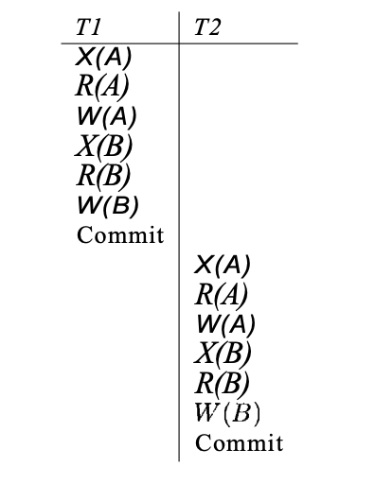
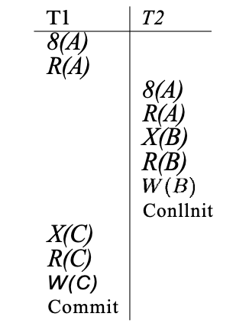
Schedule Illustrating Strict 2PL with Serial Execution
Schedule Following Strict 2PL with Interleaved Actions

Slide 18
DEADLOCKS IN LOCKING
Occurs when a set of transactions wait indefinitely due to circular lock dependencies.
Example: T1 holds lock A and waits for B; T2 holds B and waits for A.
Handling:
Use timeout mechanisms.
Use deadlock detection algorithms.
Apply deadlock prevention techniques.

Slide 19
LOCK GRANULARITY
Refers to the level at which locking is performed:
Database-level: Only one transaction at a time → Low concurrency.
Table-level: Whole table is locked.
Page-level: Locks a page (block of records).
Row-level: Locks specific rows → High concurrency.
Field-level: Lock a single field → Rare.
Trade-off: Finer granularity = higher concurrency but more overhead.

Slide 20
LOCK MANAGEMENT
Managed using a Lock Table maintained by DBMS.
Entries include:
Transaction ID
Lock type (S or X)
Data item locked
Lock manager handles:
Granting/Denying lock requests.
Detecting deadlocks.
Implementing protocols.

Slide 21
STARVATION AND FAIRNESS
Starvation: A transaction keeps getting denied access to a resource due to higher-priority transactions.
Causes:
Biased scheduling.
Repeated preemption.
Solutions:
FIFO queues for lock requests.
Priority aging to increase waiting transaction’s priority over time.
Fair lock managers that ensure every request gets a chance.

Slide 22
LOCKS IN SQL DATABASES
Implicit Locks: Automatically applied by DBMS.
E.g., during SELECT, UPDATE, DELETE.
Explicit Locks:
LOCK TABLE table_name IN mode – Locks entire table.
SELECT ... FOR UPDATE – Locks specific rows.
Isolation Level Configuration:
In SQL: SET TRANSACTION ISOLATION LEVEL SERIALIZABLE;
Each isolation level affects the internal locking behavior.

Slide 23
THANK YOU

