Slide 1
Data Encryption Using Efficient Combination of AES Cryptography and Compression Steganography Techniques
Under the esteemed guidance of
Mrs. T.Madhavi Kumari
Associate Professor in ECE
JNTUHUCEH
Submitted by
Konda Pranavendra 18011P0410

Slide 2
CONTENTS
Introduction
Aim
Objectives
Proposed Approach
Flow Diagram
References

Slide 3
INTRODUCTION
In this modern era, technology is increasing at a rapid rate and making new developments. The growing use of the Internet amongst people around the world and availability of digital data and its sharing has driven researchers to pay particular attention to information security.
Users frequently need to store, send, or receive private information and the information needs to be protected against unauthorized access and attacks from intruder.
The process of hiding data and information is known to be steganography it is done to provide information security. By using steganography, one can hide thousands of words even in an average sized image.

Slide 4
INTRODUCTION
Cryptographic methods enhances the security level.
Data compression is an important part of information security because compressed data is more secure and easy to handle.
Effective data compression technology creates efficient, secure, and easy-to-connect data.
There are two types of compression algorithm techniques, lossy and lossless.
These technologies can be used on any data format such as text, audio, video, or image file.

Slide 5
Cryptography vs Coding
Cryptography is the discipline concerned with communication security (eg, confidentiality of messages, integrity of messages, sender authentication, non-repudiation of messages, and many other related issues),while coding is the process of encoding or decoding.
The goal of cryptography is to render data unintelligible to all but the intended recipient whereas error-correcting codes attempt to ensure data is decodable despite any disruptions introduced by the medium.
Data compression and error correction also contrast one another in that the former involves compaction and the latter data expands the data.
A basic problem of coding theory is that noise over a network can distort a message, so the ultimate goals of the coding theory are error detection, then error correction.

Slide 6
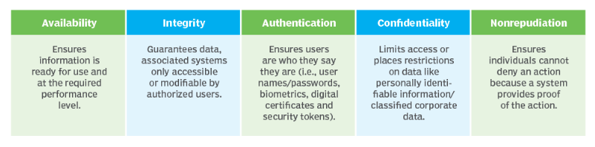
Goals of Cryptography

Slide 7
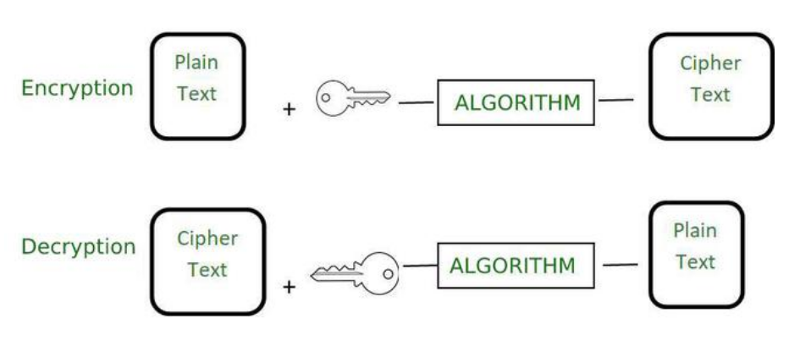
Encryption
It is a process used to convert simple readable data known as plain text to unreadable data known as ciphertext which can only be converted to plain text if the user knows the encryption key.
It is used basically to keep our data safe. The main purpose of the encryption is to convert our data in such a form that it is garbage for the person who does not know the encryption key.
The reverse of encryption is decryption and it is used to get back the plain text from the ciphertext. For decryption, we must know the encryption key and the encryption algorithm.

Slide 8
Encoding
It is the process to transform data in such a format that it can be easily used by different types of systems.
The algorithm used to encode the data is publicly available and it can be easily decoded in the readable form if the person knows the algorithm.
It does not require any key to decode the information. The main purpose is data usability instead of confidentiality. The main aim of encoding is to transform the data so that it can be properly used by a different type of system.
It is not used to protect the data as it is easy to reverse in comparison to encryption.
This process is used to ensure the integrity and usability of data. The main goal is data usability.
Examples of Encoding Algorithms: ASCII, UNICODE, Huffman Encoding

Slide 9
Aim
The main aim of this project is to design a hybrid encryption algorithm which compresses the given data thus reducing the time of sending data over the Internet with a complete guarantee of encrypting this data and hiding it from intruders.

Slide 10
Objectives
To implement the proposed approach in Python software.
Data compression scheme:
Huffman coding
Data encryption scheme :
RSA+ Vigenere Cipher Algorithm.
Data embedding scheme :
LSB(Least Significant Bit) Technique.
To evaluate the performance of the proposed model based on criteria such as Compression time,Compression Ratio,Savings Percentage,SSIM.

Slide 11
Proposed Approach
Embedding Process :
First,the plain text is encrypted by using Extended Vigenere Cipher algorithm and RSA algorithm.
The cover image is compressed by Discrete wavelet transform DWT which compacts the cover image through lossy compression in order to reduce the cover image’s dimensions.
The encrypted text is compressed by the Huffman coding algorithm which is a lossless compression technique.
The least significant bit LSB will then be used to implant the compressed data in the compacted cover image.
The LSB embedding technique suggests that data can be hidden in such a way that even the naked eye is unable to identify the hidden information in the LSBs of the cover file.

Slide 12
Extracting Process
To get the secret message(plain text), the following steps must be followed:
Read the compressed stego image.
Obtain the compressed encrypted message from the stego image.
The next step is to perform Huffman decoding on the compressed encrypted message to obtain the encrypted message.
Finally, decrypt the encrypted message using RSA decryption followed by Vigenere decryption and output the secret message.

Slide 13
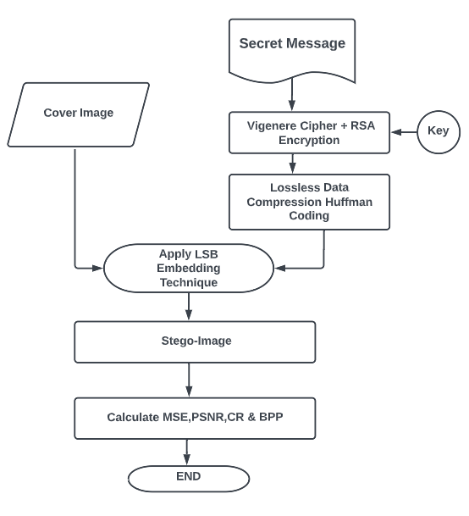
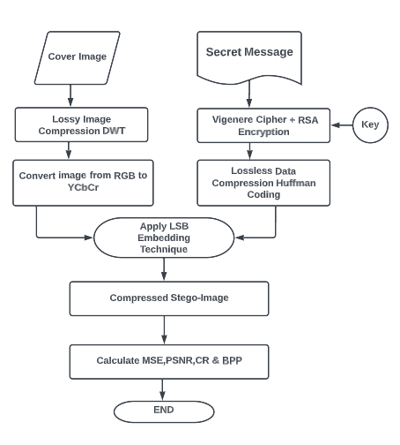
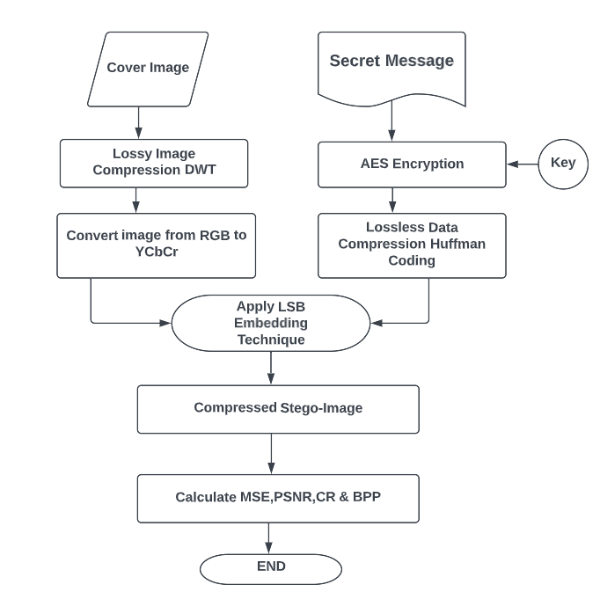
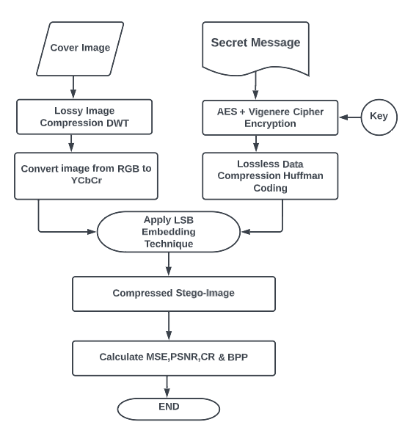
Flow Diagram of Embedding Process

Slide 14
Vigenere Cipher
Vigenere Cipher is a method of encrypting alphabetic text.
It uses a simple form of polyalphabetic substitution.
A polyalphabetic cipher is any cipher based on substitution, using multiple substitution alphabets.
The encryption of the original text is done using the Vigenere square or Vigenere table.
At different points in the encryption process, the cipher uses a different alphabet from one of the rows.
The alphabet used at each point depends on a repeating keyword.

Slide 15
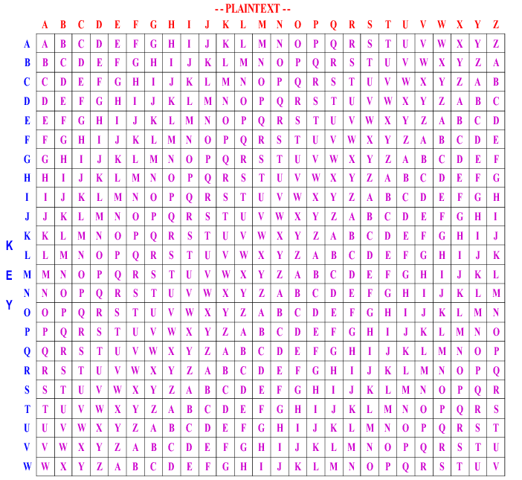
Vigenere table
Example :
Plain text - SSBSC
Key- DSBSC
Cipher text- VKCKE

Slide 16
Extended Vigenere Cipher
The Extended Vigenere Cipher algorithm intends to extend the original 26 character Vigenere cipher to a 92 characters case sensitive cipher including digits and some other symbols commonly used in the English language which can be written from a computer keyboard.
In Extended Vigenere Cipher algorithm we use a Cipher table of dimensions 92 X 92 for encryption and decryption.
The sequence order of the characters used in this algorithm is shown below:

Slide 17
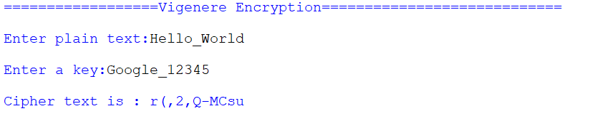
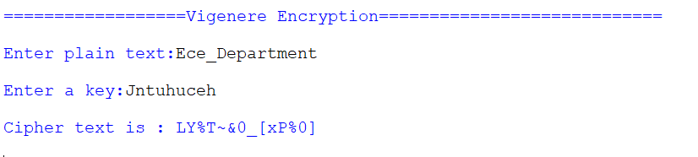
Examples:

Slide 18
COMPARISON WITH THE EXISTING VERSION
The greater character set allows more messages to be encrypted and other documents whereas the original version covered plain text involving only the 26 English characters.
The messages can now allow digits and symbols which if used with a wisely chosen key will increase the complexity as the alphabets may even be written as digits or symbols. The same applies for digits and symbols, therefore providing greater masking and any third person trying to understand the cipher text will find it confusing.
Larger character set also means larger key domain. While the set of possible keys in case of the original Vigenère cipher for length m was 26^{m} the extended Vigenère cipher will have a much larger key domain of 92^{m} for a key of length of m.

Slide 19
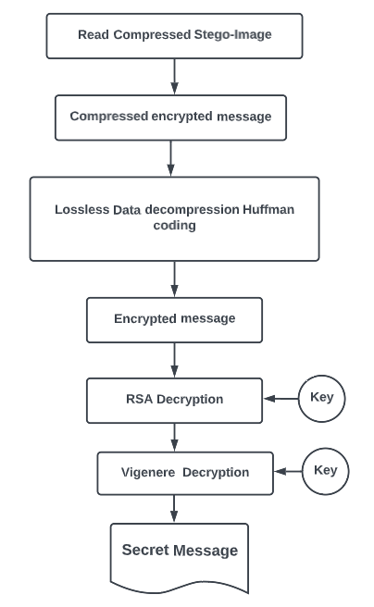
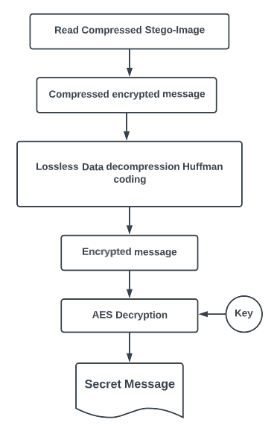
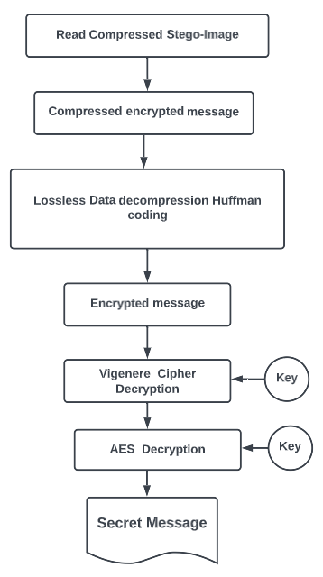
Flow Diagram of Extracting Process

Slide 20
Advantages of the proposed Hybrid Encryption algorithm
Cryptography and Steganography algorithms combined together provides a double layer of security.
Vigenere cipher makes the message more secure as compared to various other techniques as it is a polyalphabetic cipher technique.
The proposed model can be used to decrease the amount of every transmitted data aiding fast transmission while using slow internet or take a small space on different storage media ensuring data encryption.

Slide 21
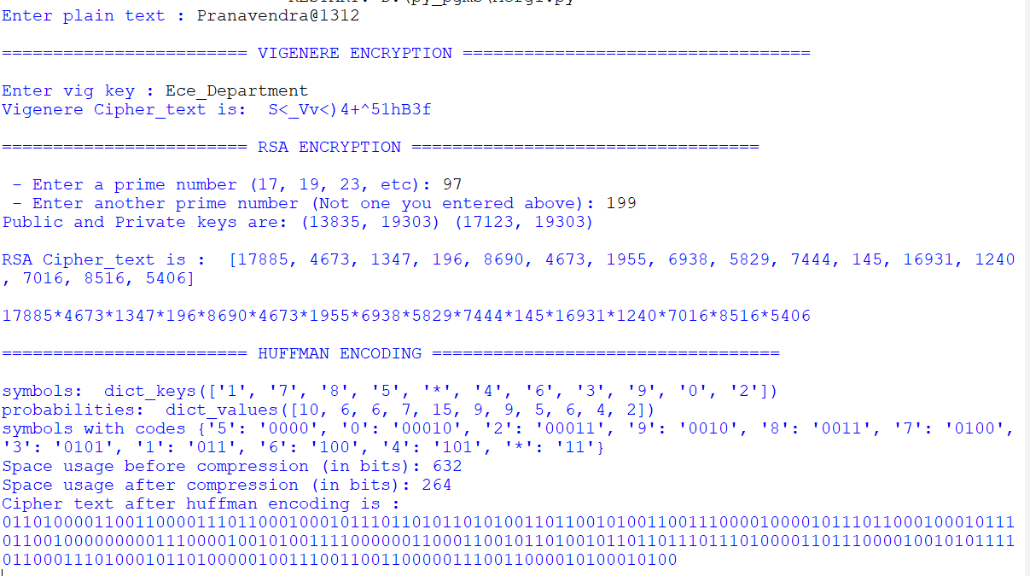
Results:

Slide 22
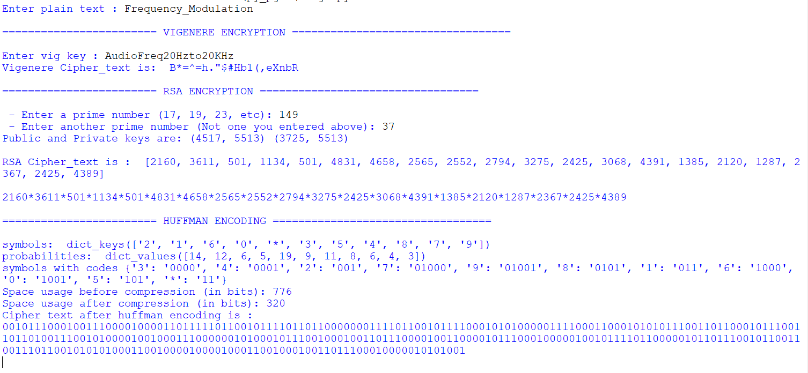
Results:

Slide 23
REFERENCES
O. F. A. Wahab, A. A. M. Khalaf, A. I. Hussein and H. F. A. Hamed, "Hiding Data Using Efficient Combination of RSA Cryptography, and Compression Steganography Techniques," in IEEE Access, vol. 9, pp. 31805-31815, 2021, doi: 10.1109/ACCESS.2021.3060317.
A. Bose, A. Kumar, M. K. Hota and S. Sherki, "Steganography Method Using Effective Combination of RSA Cryptography and Data Compression," 2022 First International Conference on Electrical, Electronics, Information and Communication Technologies (ICEEICT), 2022, pp. 1-5, doi: 10.1109/ICEEICT53079.2022.9768402.
C. Biswas, U. D. Gupta and M. M. Haque, "An Efficient Algorithm for Confidentiality, Integrity and Authentication Using Hybrid Cryptography and Steganography," 2019 International Conference on Electrical, Computer and Communication Engineering (ECCE), 2019, pp. 1-5, doi: 10.1109/ECACE.2019.8679136.

Slide 24
THANK YOU

