Slide 1
Data Encryption Using Efficient Combination of AES Cryptography and Compression Steganography Techniques
Under the esteemed guidance of
Mrs. T.Madhavi Kumari
Associate Professor in ECE
JNTUHUCEH
Submitted by
Konda Pranavendra 18011P0410

Slide 2
CONTENTS
Introduction
Aim
Objectives
Proposed Approach
Flow Diagram
References

Slide 3
INTRODUCTION
In this modern era, technology is increasing at a rapid rate and making new developments. The growing use of the Internet amongst people around the world and availability of digital data and its sharing has driven researchers to pay particular attention to information security.
Users frequently need to store, send, or receive private information and the information needs to be protected against unauthorized access and attacks from intruder.
The process of hiding data and information is known to be steganography it is done to provide information security. By using steganography, one can hide thousands of words even in an average sized image.

Slide 4
INTRODUCTION
Cryptographic methods enhances the security level.
Data compression is an important part of information security because compressed data is more secure and easy to handle.
Effective data compression technology creates efficient, secure, and easy-to-connect data.
There are two types of compression algorithm techniques, lossy and lossless.
These technologies can be used on any data format such as text, audio, video, or image file.

Slide 5
Aim
The main aim of this project is to design a hybrid encryption algorithm which compresses the given data thus reducing the time of sending data over the Internet with a complete guarantee of encrypting this data and hiding it from intruders.

Slide 6
Objectives
To implement the proposed approach in Python software.
Data compression scheme:
Huffman coding
Data encryption scheme :
AES (Advanced Encryption Standard) + Vigenere Cipher Algorithm.
Data embedding scheme :
LSB(Least Significant Bit) Technique.
To evaluate the performance of the proposed model based on criteria such as Compression time,Compression Ratio,Savings Percentage,SSIM.

Slide 7
Proposed Approach
Embedding Process :
First,the plain text is encrypted by using AES(Advanced Encryption Standard ) algorithm and Vigenere Cipher algorithm.
The cover image is compressed by Discrete wavelet transform DWT which compacts the cover image through lossy compression in order to reduce the cover image’s dimensions.
The encrypted text is compressed by the Huffman coding algorithm which is a lossless compression technique.
The least significant bit LSB will then be used to implant the compressed data in the compacted cover image.
The LSB embedding technique suggests that data can be hidden in such a way that even the naked eye is unable to identify the hidden information in the LSBs of the cover file.

Slide 8
Extracting Process
To get the secret message(plain text), the following steps must be followed:
Read the compressed stego image.
Obtain the compressed encrypted message from the stego image.
The next step is to perform Huffman decoding on the compressed encrypted message to obtain the encrypted message.
Finally, decrypt the encrypted message using Vigenere decryption followed by AES decryption and output the secret message.

Slide 9
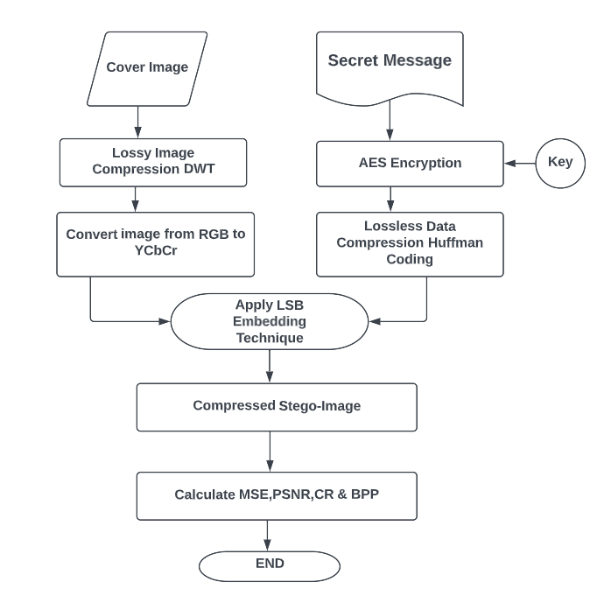
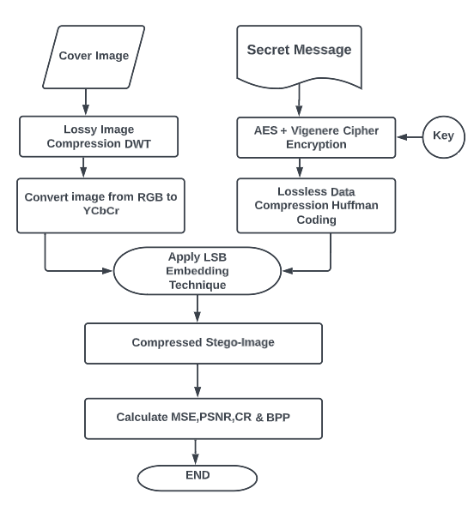
Flow Diagram of Embedding Process

Slide 10
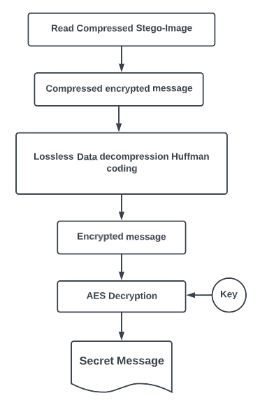
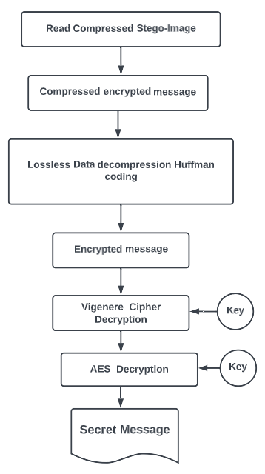
Flow Diagram of Extracting Process

Slide 11
Advantages
Cryptography and Steganography algorithms combined together provides a double layer of security.
Vigenere cipher makes the message more secure as compared to various other techniques as it is a polyalphabetic cipher technique.
The proposed model can be used to decrease the amount of every transmitted data aiding fast transmission while using slow internet or take a small space on different storage media ensuring data encryption.

Slide 12
REFERENCES
O. F. A. Wahab, A. A. M. Khalaf, A. I. Hussein and H. F. A. Hamed, "Hiding Data Using Efficient Combination of RSA Cryptography, and Compression Steganography Techniques," in IEEE Access, vol. 9, pp. 31805-31815, 2021, doi: 10.1109/ACCESS.2021.3060317.
A. Bose, A. Kumar, M. K. Hota and S. Sherki, "Steganography Method Using Effective Combination of RSA Cryptography and Data Compression," 2022 First International Conference on Electrical, Electronics, Information and Communication Technologies (ICEEICT), 2022, pp. 1-5, doi: 10.1109/ICEEICT53079.2022.9768402.
C. Biswas, U. D. Gupta and M. M. Haque, "An Efficient Algorithm for Confidentiality, Integrity and Authentication Using Hybrid Cryptography and Steganography," 2019 International Conference on Electrical, Computer and Communication Engineering (ECCE), 2019, pp. 1-5, doi: 10.1109/ECACE.2019.8679136.

Slide 13
THANK YOU

