Slide 1
http://www.vidyanidhi.com/
ketkiacharya.net@gmail.com
Ketki Acharya
From: SM VITA ATC of CDAC
9769201036
ketkiacharya.net@gmail.com

Slide 2
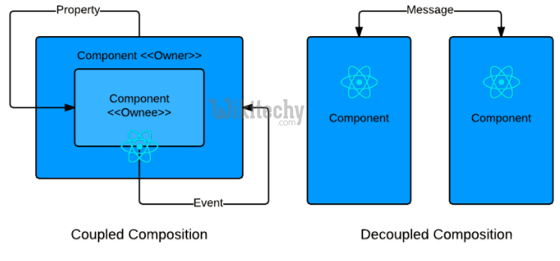

Slide 3
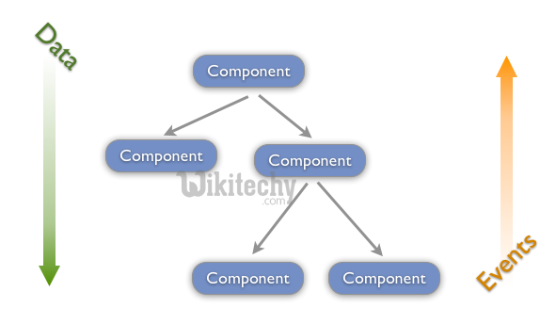

Slide 4
Lifecycle Methods
componentWillMount is executed before rendering, on both the server and the client side.
componentDidMount is executed after the first render only on the client side. This is where AJAX requests and DOM or state updates should occur. This method is also used for integration with other JavaScript frameworks and any functions with delayed execution such as setTimeout or setInterval. We are using it to update the state so we can trigger the other lifecycle methods.
componentWillReceiveProps is invoked as soon as the props are updated before another render is called. We triggered it from setNewNumber when we updated the state.
shouldComponentUpdate should return true or false value. This will determine if the component will be updated or not. This is set to true by default. If you are sure that the component doesn't need to render after state or props are updated, you can return false value.
componentWillUpdate is called just before rendering.
componentDidUpdate is called just after rendering.
componentWillUnmount is called after the component is unmounted from the dom. We are unmounting our component in main.js.[from server]

Slide 5
we will set the initial state in the constructor function. The setNewnumber is used to update the state. All the lifecycle methods are inside the Content component.
client
server
class Content extends React.Component {
componentWillMount() {
console.log('Component WILL MOUNT!')
}
componentDidMount() {
console.log('Component DID MOUNT!')
}
componentWillReceiveProps(newProps) {
console.log('Component WILL RECIEVE PROPS!')
}
shouldComponentUpdate(newProps, newState) {
return true;
}
componentWillUpdate(nextProps, nextState) {
console.log('Component WILL UPDATE!');
}
componentDidUpdate(prevProps, prevState) {
console.log('Component DID UPDATE!')
}
componentWillUnmount() {
console.log('Component WILL UNMOUNT!')
}
render() {
return (
<div>
<h3>{this.props.myNumber}</h3>
</div>
);
}
}
export default App;
import React from 'react';
class App extends React.Component {
constructor(props) {
super(props);
this.state = {
data: 0
}
this.setNewNumber = this.setNewNumber.bind(this)
};
setNewNumber() {
this.setState({data: this.state.data + 1})
}
render() {
return (
<div>
<button onClick = {this.setNewNumber}>INCREMENT</button>
<Content myNumber = {this.state.data}></Content>
</div>
);
}
}
{myNumber:{this.state.data}}
import React from 'react';
import ReactDOM from 'react-dom/client';
import './index.css';
import App from './App';
import reportWebVitals from './reportWebVitals';
const root = ReactDOM.createRoot(document.getElementById('root'));
root.render(
<React.StrictMode>
<App />
</React.StrictMode>);

Slide 6
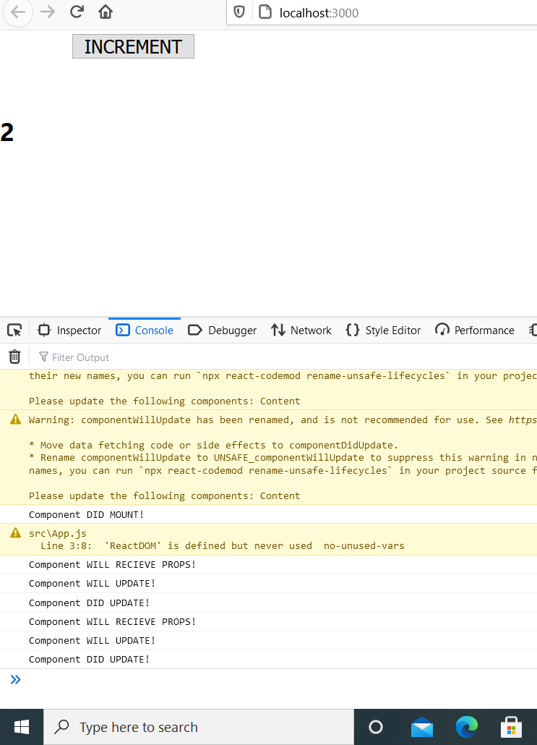
When you run you will see
Component WILL MOUNT! [and warning]
After clicking on button you will see
Component WILL RECIEVE PROPS!
Component WILL UPDATE!
Component DID UPDATE!

Slide 7
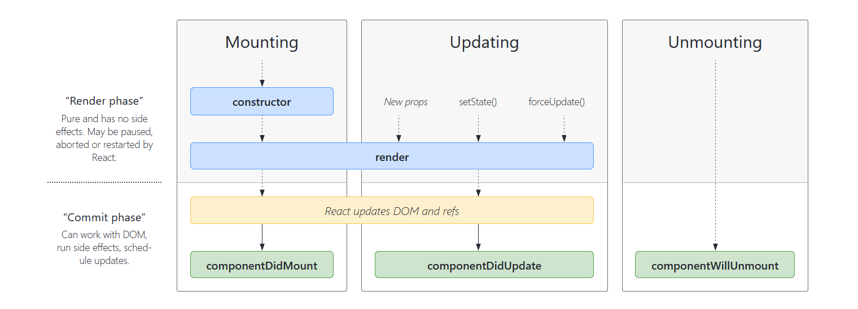

Slide 8
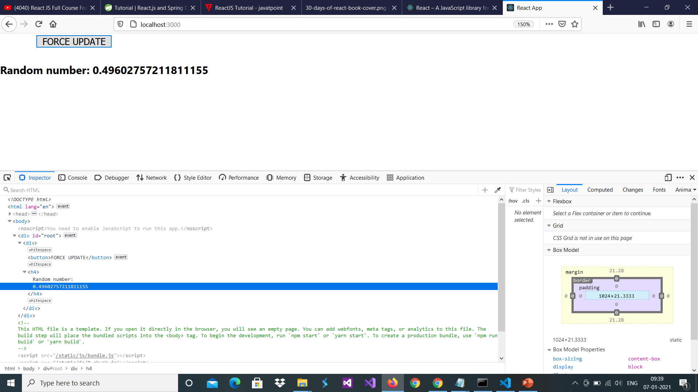
Sometimes we might want to update the component manually. This can be achieved using the forceUpdate() method.
import React from 'react';
class App extends React.Component {
constructor() {
super();
this.forceUpdateHandler = this.forceUpdateHandler.bind(this);
};
forceUpdateHandler() {
this.forceUpdate();//
};
render() {
return (
<div>
<button onClick = {this.forceUpdateHandler}>FORCE UPDATE</button>
<h4>Random number: {Math.random()}</h4>
</div>
);
}}
export default App;
We are setting a random number that will be updated every time the button is clicked.

Slide 9
Find Dom Node For DOM manipulation, we can use ReactDOM.findDOMNode() method. First we need to import react-dom.
import React from 'react';
import ReactDOM from 'react-dom';
class App extends React.Component {
constructor() {
super();
this.findDomNodeHandler = this.findDomNodeHandler.bind(this);
};
findDomNodeHandler() {
var myDiv = document.getElementById('myDiv');
ReactDOM.findDOMNode(myDiv).style.color = 'green';
}
render() {
return (
<div>
<button onClick = {this.findDomNodeHandler}>FIND DOME NODE</button>
<div id = "myDiv">NODE</div>
</div>
);
}
}
export default App;
The color of myDiv element changes to green, once the button is clicked.

Slide 10
Spread
import {React,Component} from 'react'
class App extends Component{
render(){
const myobj={color:"red", fontSize:"25"}
return (
<div>
<h1 style={{...myobj}}>hello</h1>
</div>
);
}
}

