Slide 1

Object Oriented Analysis and Design with Java
UE19CS353
Prof.J.Ruby Dinakar
Department of Computer Science and Engineering

Slide 2

UE19CS353: Object Oriented Analysis and Design with Java
OO Design Patterns & Anti-Patterns with Sample implementation in Java
Prof. J.Ruby Dinakar
Department of Computer Science and Engineering

Slide 3
Unit-5
Behavioral Patterns – Chain of Responsibility Pattern

Slide 4
Behavioral patterns
Behavioral design patterns are design patterns that identify common communication patterns between objects and realize these patterns.
These patterns increase flexibility in carrying out this communication.
Behavioral patterns influence how state and behavior flow through a system.
By optimizing how state and behavior are transferred and modified, you can simplify, optimize, and increase the maintainability of an application

Slide 5
List of common behavioral design patterns
Chain of responsibility: Command objects are handled or passed on to other objects by logic-containing processing objects
Command: Command objects encapsulate an action and its parameters
Interpreter: Implement a specialized computer language to rapidly solve a specific set of problems
Iterator: Iterators are used to access the elements of an aggregate object sequentially without exposing its underlying representation
Mediator: Provides a unified interface to a set of interfaces in a subsystem
Memento: Provides the ability to restore an object to its previous state (rollback)
Observer: also known as Publish/Subscribe or Event Listener. Objects register to observe an event that may be raised by another object
State: A clean way for an object to partially change its type at runtime
Strategy: Algorithms can be selected on the fly
Template Method: Describes the program skeleton of a program
Visitor: A way to separate an algorithm from an object

Slide 6
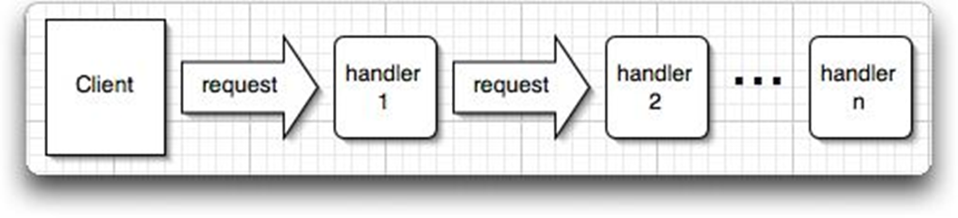
Chain of Responsibility Pattern
The Chain of Responsibility pattern establishes a chain within a system, so that a message can either be handled at the level where it is first received, or be directed to an object that can handle it.
It is used to manage algorithms, relationships and responsibilities between objects

Slide 7
Intent
Avoid coupling sender of request to its receiver by giving more than one object a chance to handle request.
Chain receiving objects and pass request along until an object handles it.

Slide 8
Motivation
The Chain of Responsibility is intended to promote loose coupling between the sender of a request and its receiver by giving more than one object an opportunity to handle the request.
The receiving objects are chained and pass the request along the chain until one of the objects handles it.
The set of potential request handler objects and the order in which these objects form the chain can be decided dynamically at runtime by the client depending on the current state of the application.

Slide 9
We know that we can have multiple catch blocks in a try-catch block code.
Here every catch block(nested) is kind of a processor to process that particular exception.
So when any exception occurs in the try block, its send to the first catch block to process. If the catch block is not able to process it, it forwards the request to next object in chain i.e next catch block. If even the last catch block is not able to process it, the exception is thrown outside of the chain to the calling program.

Slide 10
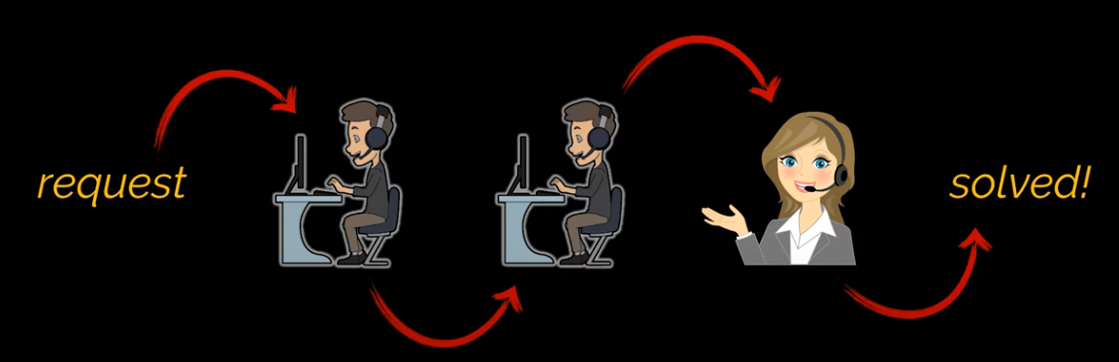

Slide 11
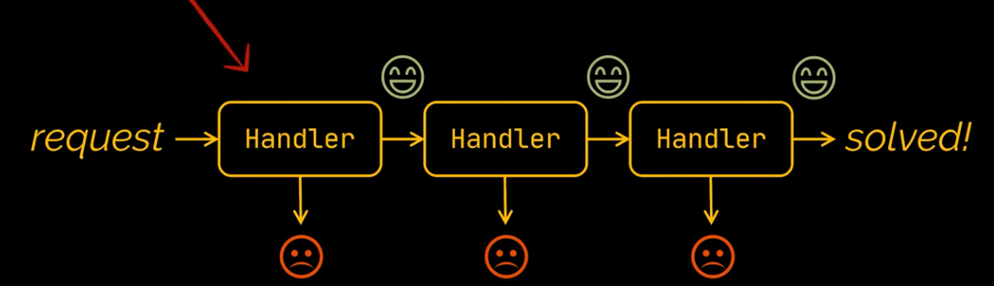

Slide 12
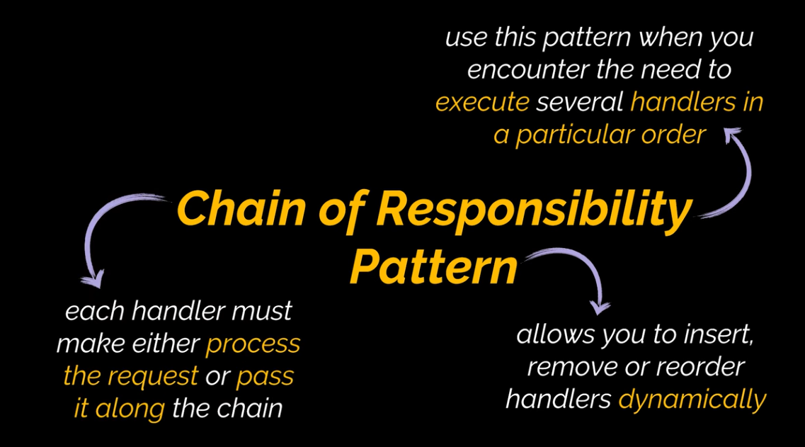

Slide 13
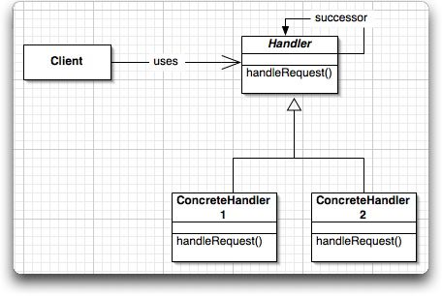
Structure

Slide 14
Participants
Handler:
defines an interface for handling the requests
implements the successor link
ConcreteHandler:
handles requests it is responsible for
can access its successor
if it does not handle the request, forwards the request to its successor
Client:
initiates the request to a ConcreteHandlerobject on the chain

Slide 15
Implementation – Example Scenario 1
Let us consider the transaction approval process in a company. Suppose we want to approve the transactions based on certain conditions?
For instance, in the transaction approval application user keys in transaction details into the application and this transaction need to be processed by any one of the higher level employee in the company.
All transactions lesser than 1,00,000 amount can be approved by manager, lesser than 10,00,000 can be approved by vice president and lesser than 25,00,000 can be approved by CEO.

Slide 16
The transaction approval behavior can be implemented with a simple if else conditions, by checking if amount is less than 1,00,000 or else if amount is less than 10,00,000 and so on. But this approach is static, means we cannot change these conditions dynamically. Chain of responsibility design pattern can be used in this situation.
In the transaction processing application, approval process acts like a chain of responsibilities.
First, manager acts on the transaction, if the amount is higher than his approval limit then the transaction is transferred to vice president and so on.

Slide 17
We need to design processing and command objects. Based on the above example, processing objects are employees like Manager, Vice President because they process the transaction by approving and command object is the transaction. Once processing objects are created then we need to chain them together like manager -> vice president -> CEO and pass the transaction at the beginning of the chain. Transaction continues to flow in the chain until it reaches the employee, who’s limit allows to approve it.

Slide 18
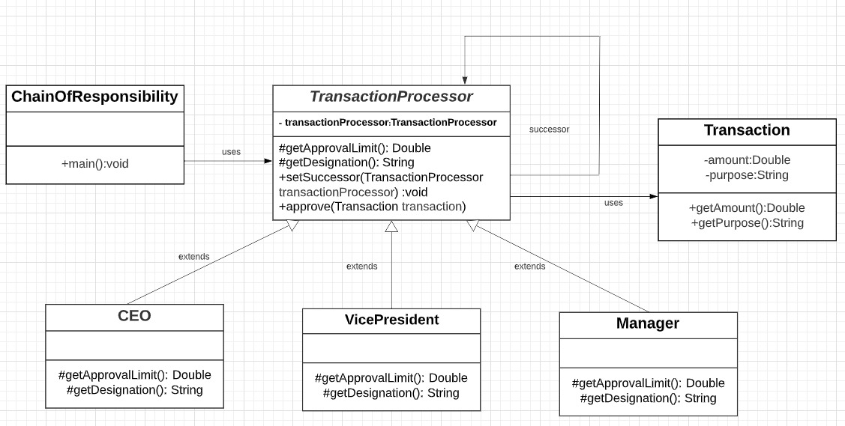

Slide 19
First create an abstract class for processing the transactions.
If the transaction can be processed then it should.
If transaction is with in the limit then it prints the message.
If it is out of range then passes it to next processor by calling ‘approve’ method,
before calling approve check for null if processor is last in the chain.

Slide 20
abstract class TransactionProcessor{
private TransactionProcessor transactionProcessor;
abstract protected Double getApprovalLimit();
abstract protected String getDesignation();
public void setSuccessor(TransactionProcessor transactionProcessor) {
this.transactionProcessor = transactionProcessor;
}
public void approve(Transaction transaction) {
if(transaction.getAmount() <=0.0 )
{
System.out.println("Invalid Amount. Amount should be > 0");
return;}
if(transaction.getAmount() <= getApprovalLimit()) {
System.out.println("Transaction for amount "+transaction.getAmount()+ " approved by "+getDesignation());
}else {
if(transactionProcessor == null){
System.out.println("Invalid Amount. Amount should not exceed 25lacs!");
return; }
transactionProcessor.approve(transaction);
}
}
}

Slide 21
Now we need to create concrete class for each approver (Manager, Vice President, CEO) and this class will extend TransactionProcessor.
Each processing class sets its limit and designation.
class Manager extends TransactionProcessor{
@Override
protected Double getApprovalLimit() {
return 100000.0;
}
@Override
protected String getDesignation() {
return "manager";
}
}

Slide 22
class VicePresident extends TransactionProcessor{
@Override
protected Double getApprovalLimit() {
return 1000000.0;
}
@Override
protected String getDesignation() {
return “Vice President";
}
}

Slide 23
class CEO extends TransactionProcessor{
@Override
protected Double getApprovalLimit() {
return 2500000.0;
}
@Override
protected String getDesignation() {
return "CEO";
}
}

Slide 24
Next Create a transaction class.
class Transaction{
private Double amount;
private String purpose;
Transaction(Double amount, String purpose){
this.amount = amount;
this.purpose = purpose;
}
public Double getAmount() {
return amount;
}
public String getPurpose() {
return purpose;
}
}

Slide 25
Now let us glue all these classes together to form chain of responsibility pattern using ChainOfResponsibility class.
Create processing objects. We have three processing objects in the chain.
Chain together all the processing objects. Order of the objects is important because manager handover transaction to vice president.
Because the chain starts from the manager so transactions are pushed using the manager instance.
public class ChainOfResponsibility {
public static void main(String[] args) {
Manager manager = new Manager();
VicePresident vicePresident = new VicePresident();
CEO ceo = new CEO();
manager.setSuccessor(vicePresident);
vicePresident.setSuccessor(ceo);
manager.approve(new Transaction(2600000.0, "general"));
manager.approve(new Transaction(50000.0, "general"));
manager.approve(new Transaction(120000.0, "general"));
manager.approve(new Transaction(1500000.0, "general"));
manager.approve(new Transaction(0.0, "general"));
}
}

Slide 26
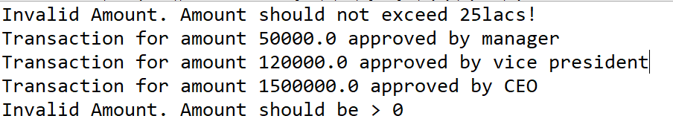
Output

Slide 27
Example – Scenario 2
Scenario
An enterprise has been getting more email than they can handle. The enterprise gets 4 types of e-mail.
They are:
Fan mail with complements,
Complaints,
Requests for new features,
Spam.
Your task:
The enterprise has already written the AI detectors that can tell whether an email is fan, complaint, request or spam,
You need to create a design that can use the detectors to handle incoming email.

Slide 28
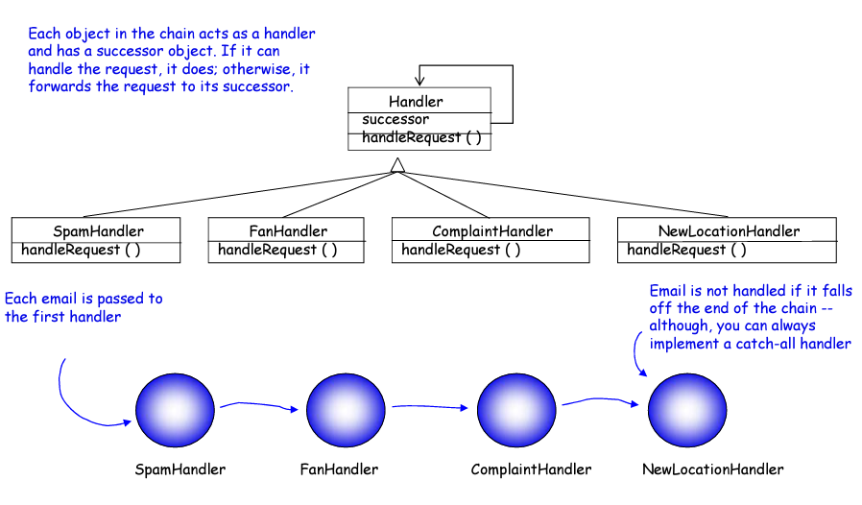

Slide 29
Consequences
Reduced Coupling
Objects are free from knowing what object handles the request
Added Flexibility in assigning responsibilities to objects
Can change chain at runtime
Can subclass for special handlers
Receipt is guaranteed
Request could fall off the chain
Request could be dropped with bad chain

Slide 30
Applicability
Use Chain of Responsibility
when
More than one object may handle a request and the handler isn’t known a priori.
You want to issue a request to one of several objects without specifying the receiver explicitly
The Set of objects than can handle a request should be specified dynamically

Slide 31
Benefits, Uses and Drawbacks
Benefits:
Decouples the sender of the request and its receivers,
Simplifies your object because it doesn’t have to know the chain’s structure and keep direct reference to its members,
Allows you to add or remove responsibilities dynamically by changing the members or the order of the chain.
Uses:
Commonly used in Windows systems to handle events like mouse clicks and keyboard events.
In java it is used in handling chain of Exceptions
Drawbacks:
Execution of the request isn’t guaranteed; it may fall off the end of the chain if no object handles it (this can be an advantage or a disadvantage),
Can be hard to observe the runtime characteristics and debug.

Slide 32
Text Reference
Design Patterns: Elements of Reusable Object-Oriented Software, GOF
Web Reference
https://www.cs.uah.edu/~rcoleman/CS307/DesignPatterns/DP17-ChainOfResponsibility.html
https://refactoring.guru/design-patterns
https://thetechstack.net/chain-of-responsibility-design-pattern/

Slide 33
THANK YOU
J.Ruby Dinakar
Department of Computer Science and Engineering
rubydinakar@pes.edu

