Slide 1
UE20CS302 MACHINE INTELLIGENCE PROJECT PHASE 1
Project Title : Adaptive Diversity Based
Ensemble Classifier
Project ID : 13
Project Team :
Bhargav M V SRN: PES1UG20CS660
Manoj Kumar D SRN: PES1UG20CS661
Pranav K Hegde SRN: PES1UG20CS672

Slide 2


PROJECT ABSTRACT
SYNOPSIS
Introduction
i
In supervised learning techniques, ensemble learning method is the technique that uses multiple single models to construct a hybrid model in order to achieve better performance compared to that of using a single model.
A workflow for solving classification problems by applying ensemble methods consists of the following.
First, raw data usually need to be pre-processed for initializing a training dataset, during which feature extraction and normalization are applied.
Second, training sets for each individual single model are derived from the initialized dataset.
Third, single models are trained from different training datasets or by different algorithms.
Finally, all the single models are combined to construct the ensemble and then the final [hybrid] model is constructed based on the results of individual models and the hybrid model is further validated and tested.

Slide 3
PROJECT ABSTRACT
SYNOPSIS
Objective
i.a
The ensemble model involves the selecting of base models from the single trained classifiers and use their predictions to train a meta model with the labels relabeled with the classifier names.
Select base models that are based on the pairwise diversity of the classifiers.
Recognize the best base model for each data instance.
Predict each unknown instance using a suitable base model (best base model for that instance)

Slide 4
PROJECT ABSTRACT
SYNOPSIS
Problem Statement
ii
How to Minimize the weakness of single models the base model used for ensemble learning and to achieve better performance?

Slide 5
PROJECT ABSTRACT
SYNOPSIS
Proposed Solution
iii
Depending on the datasets and instances, dynamic adjustment of the single models in ensemble learning and adaptively select the most suitable single model to predict each instance is needed to avoid weaknesses of single models.
Thus only those single models with the highest pairwise diversities should be selected to construct the ensemble model. Ensemble methods, an important type of machine learning technique, have drawn a lot of attention in both academic research and practical applications, and they use multiple single models to construct a hybrid model.
A hybrid model generally performs better compared to a single individual model. The proposed approach in this paper based on a hybrid model has been validated on Repeat Buyers Prediction dataset, and the experiment results show up to 18.5% improvement on F1 score, compared to the best individual model. In addition, the proposed method outperforms two other commonly used ensemble methods (Averaging and Stacking) in terms of improved F1 score.

Slide 6
OUR CONTENT
CONTENTS OF
Literature Survey
An Adaptive Diversity-Based Ensemble Method for Binary Classification
XGBoost: A Scalable Tree Boosting System
A
B
Tianqi Chen
Carlos Guestrin
Xing Fan
Chung-Horng Lung
Samuel A. Ajila
XGBoost: eXtreme Gradient Boosting
Imbalanced Hyperspectral Image Classification With an Adaptive Ensemble Method Based on SMOTE and Rotation Forest With Differentiated Sampling Rates
C
Empirical comparison of bagging-based ensemble classifiers
E
D
Tianqi Chen
Tong He
Ren Ye
P. N. Suganthan
.
Wei Feng, Wenjiang Huang, Wenxing Bao

Slide 7
OUR CONTENT
CONTENTS OF
A Divide-and-Conquer-Based Ensemble Classifier Learning by Means of Many-Objective Optimization
A Divide-and-Conquer-Based Ensemble Classifier Learning by Means of Many-Objective Optimization
Literature Survey
F
G
Md Asafuddoula, Brijesh Verma,
Mengjie Zhang
Andrew P Bailey
Robust mislabel logistic regression without modeling mislabel probabilities.
I
Robustness of logistic regression model
H
Luca Insolia, Ana Kenney, Martina Calovi, Francesca Chiaromonte, R. J. Carroll, Shane Pederson
Massimiliano Russo, Luca Greco,
And Shinto Eguchi, Osamu Komori, Shinto Eguchi, Osamu Komori

Slide 8
LITERATURE SURVEY
Understanding….
An Adaptive Diversity-Based Ensemble Method for Binary Classification
A
This paper proposes a novel ensemble method to improve the performance of binary classification. The proposed method is a non-linear combination of base models and an application of adaptive selection of the most suitable model for each data instance.
There ensemble learning techniques could be categorized into two types: Type I techniques focus on deriving new training sets from the initial training set to train multiple different single models. Type II techniques focus on finding ways to blend the individual models [1]. In this paper, we are interested in Type II techniques as method for improving predictive performance in binary classification problems
The objectives of this research are therefore to find an ensemble model that can: (i) select base models that are based on their pairwise diversities; (ii) recognize the best suitable base model for each data instance; and (iii) predict each unknown instance using a suitable base model.

Slide 9
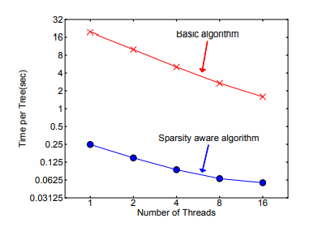
LITERATURE SURVEY
B
XGBoost: A Scalable Tree Boosting System
A scalable tree boosting system is widely used by data scientists and provides state-of-the-art results on many problems.
They have proposed that a novel sparsity aware algorithm for handling sparse data and a theoretically justified weighted quantile sketch for approximate learning.
It shows that cache access patterns, data compression and sharding are essential elements for building a scalable end-to-end system for tree boosting.
These can be applied to other machine learning systems as well. By combining these insights, XGBoost is able to solve real world scale problems using a minimal amount of resources.
The sparsity aware algorithm is more than 50 times faster than the naive version that does not take sparsity into consideration.

Slide 10
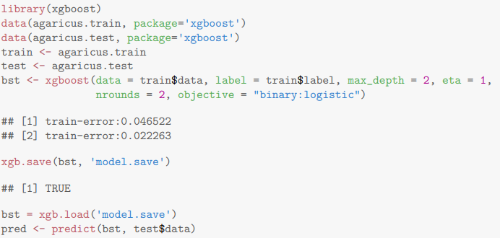
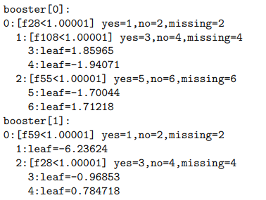
LITERATURE SURVEY
C
xgboost: eXtreme Gradient Boosting
xgboost is short for eXtreme Gradient Boosting package. It is an efficient and scalable implementation of gradient boosting framework by (Friedman, 2001) (Friedman et al., 2000). The package includes efficient linear model solver and tree learning algorithm.
It supports various objective functions, including regression, classification and ranking. The package is made to be extendible, so that users are also allowed to define their own objectives easily.
xgboost is the main function to train a Booster, i.e. a model. predict does prediction on the model. Here we can save the model to a binary local file, and load it when needed. We can’t inspect the trees inside. However we have another function to save the model in plain text.

Slide 11
LITERATURE SURVEY
Empirical comparison of bagging-based ensemble classifiers
D
This paper compares empirically four bagging-based ensemble classifiers, namely the ensemble adaptive neuro-fuzzy inference system (ANFIS), the ensemble support vector machine (SVM), the ensemble extreme learning machine (ELM) and the random forest.
The classifiers are evaluated with thirteen binary class datasets and the empirical results show that the ensemble methods employed in the four ensemble classifiers boost the testing accuracy by 1-5% on average from their base classifiers. In addition, the testing accuracy can be improved by increasing the number of base classifiers. The empirical results also show that the bagging SVM is the most favorable ensemble classifier among them.
The objective of this paper is to evaluate four bagging-based ensemble classifiers: the bagging ANFIS, the bagging SVM, the bagging ELM and the random forest. The performance of these four bagging ensemble methods are compared. The evaluation is based on thirteen UCI binary class datasets. To the authors' knowledge, the comparison of the four ensemble classifiers has not been studied in the existing literature.

Slide 12
LITERATURE SURVEY
Imbalanced Hyperspectral Image Classification With an Adaptive Ensemble Method Based on SMOTE and Rotation Forest With Differentiated Sampling Rates
E
This paper uses adaptive ensemble method based on SMOTE and RoF with differentiated sampling rates (AdaSRoF) for the multiclass imbalance problem.
It adaptively generates several balanced data sets with more diversity and less noise by using SMOTE and a dynamic data sampling ratio for base classifiers.
It increases the diversity of base classifiers via producing several different
training sets with a dynamic sampling rate β% and decreases the risk of artificial
noise in SMOTE by an adaptive weight function.
the results of F-measure, Gmean, and minimum Recall also prove that AdaSRoF significantly outperforms the reference methods for the classification of the multiclass imbalanced hyperspectral data sets.
DATA SET : To assess the effectiveness of the proposed AdaSRoF, the experiments are performed on two publicly available hyperspectral images.

Slide 13
LITERATURE SURVEY
F
A Divide-and-Conquer-Based Ensemble Classifier Learning by Means of Many-Objective Optimization
In this paper, they have proposed a framework for ECL by means of many-objective optimization. The proposed framework includes an SSC via a DTE, which divides the data into multiple clusters and trains a set of heterogeneous base classifiers.
Methods used are..
A. Ensemble Classifier Learning by Manipulating Training Data
B. Ensemble Classifier Learning by Combining Heterogeneous Base Classifiers
C. Ensemble Classifier Learning by Multi-objective Optimization
The proposed framework also brings the capability of reusing the old and expensive classifier without wasting the resource completely.
A generalized fitness ranking based on multiple criteria has been proposed for classifier selection. The multicriteria selection process further enhances the method to be robust in the presence of class-imbalances.

Slide 14
LITERATURE SURVEY
G
The use of the area under the ROC curve in the evaluation of machine learning algorithms.
It has been known for some time that AUC actually represents the probability that a randomly chosen positive example is correctly rated ranked with greater suspicion than a randomly chosen negative example Moreover this probability of correct ranking is the same quantity estimated by the non parametric Wilcoxon statistic We use this equivalence to show that the standard deviation of AUC estimated as shown below.
The raw data produced by a classification scheme during testing are counts of the correct and incorrect classifications from each class This information is then normally displayed in a confusion matrix A confusion matrix is a form of contingency table showing the differences between the true and predicted classes for a set of labelled examples.
The data sets used in this experiment all have two output classes and have between four and thirteen primarily continuous input variables.
The datasets used in this paper was gathered by Ross Walker as part of a study into the use of nuclear texture analysis for the diagnosis of cervical cancer

Slide 15
LITERATURE SURVEY
H
Robustness of logistic regression model
This paper investigate robustness in the logistic regression model. Copas has studied two forms of robust estimator: A robust-resistant estimate of Pregibon and an estimate based on a misclassification model.
He concluded that robust-resistant estimates are much more biased in small samples than the usual logistic estimate is and recommends a bias-corrected version of the misclassification estimate.
This paper shows that there are other versions of robust-resistant estimates which have bias often approximately the same as and sometimes even less than the logistic estimate; these estimates belong to the Mallows class.

Slide 16
LITERATURE SURVEY
I
Robust mislabel logistic regression without modeling mislabel probabilities.
Logistic regression is among the most widely used statistical methods for linear discriminant analysis. In many applications, we only observe possibly mislabeled responses. Fitting a conventional logistic regression can then lead to biased estimation. One common resolution is to fit a mislabel logistic regression model, which takes into consideration of mislabeled responses. Another common method is to adopt a robust M-estimation by down-weighting suspected instances.
The proposed methodology in this paper possesses two advantageous features: (1) It does not need to model the mislabel probabilities. (2) The minimum estimation leads to a weighted estimating equation without the need to include any bias correction term, that is, it is automatically bias-corrected.
These features make the proposed regression more robust in model fitting and more intuitive for model interpretation through a simple weighting scheme.

Slide 17
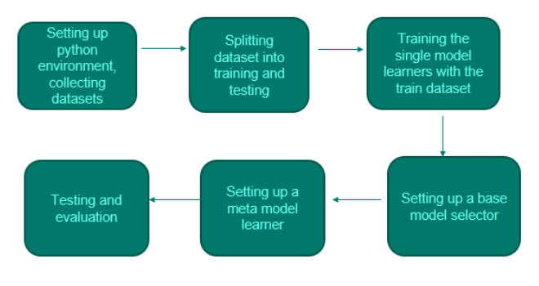
LITERATURE SURVEY
SOLUTION WORKFLOW
Design Approach

Slide 18
LITERATURE SURVEY
Referenced from…
References
Xing Fan, Chung-Horng Lung, Samuel A. Ajila, “An Adaptive Diversity-Based Ensemble Method for Binary Classification”, 2017 IEEE 41st Annual Computer Software and Applications Conference (COMPSAC), DOI: 10.1109/COMPSAC.2017.49
Reference url: https://ieeexplore.ieee.org/document/8029703
Tianqi Chen, Tong He, “xgboost: eXtreme Gradient Boosting”, January 4, 2017
Reference url: https://cran.microsoft.com/snapshot/2017-12-11/web/packages/xgboost/vignettes/xgboost.pdf
Ren Ye, P. N. Suganthan, “Empirical comparison of bagging-based ensemble classifiers”,
2012 15th International Conference on Information Fusion
Reference url: https://ieeexplore.ieee.org/abstract/document/6289900
Tianqi Chen, Carlos Guestrin, “XGBoost: A Scalable Tree Boosting System”,
Reference url: 2939672.2939785 (acm.org)
Wei Feng, Wenjiang Huang, Wenxing Bao, Imbalanced Hyperspectral Image Classification With an Adaptive Ensemble Method Based on SMOTE and Rotation Forest With Differentiated Sampling Rates”, IEEE Geoscience and Remote Sensing Letters ( Volume: 16, Issue: 12, December 2019), DOI: 10.1109/LGRS.2019.2913387

Slide 19
LITERATURE SURVEY
Referenced from…
References
Md Asafuddoula, Brijesh Verma, Mengjie Zhang, “A Divide-and-Conquer-Based Ensemble Classifier Learning by Means of Many-Objective Optimization”, 2012 15th International Conference on Information Fusion
Reference url: https://ieeexplore.ieee.org/abstract/document/8194855
“The use of the area under the ROC curve in the evaluation of machine learning algorithms.”
Reference link: https://espace.library.uq.edu.au/data/UQ_8925/pr-t.pdf
Authors: Andrew P Bailey, Year of publication:1993
“H’s”, Citations: Luca Insolia, Ana Kenney, Martina Calovi, Francesca Chiaromonte, R. J. Carroll, Shane Pederson,Robust Variable Selection with Optimality Guarantees for High-Dimensional Logistic Regression, Stats, 10.3390/stats4030040, Year of publication - 1993.
Reference link: https://rss.onlinelibrary.wiley.com/doi/abs/10.1111/j.2517-6161.1993.tb01934.x
“I’s”, Citations: Massimiliano Russo, Luca Greco, Robust Bayesian Regression for Mislabeled Binary Outcomes, Building Bridges between Soft and Statistical Methodologies for Data Science, 10.1007/978-3-031-15509-3_44, (334-342), (2023) And Shinto Eguchi, Osamu Komori, Shinto Eguchi, Osamu Komori, Regression Model, Minimum Divergence Methods in Statistical Machine Learning, 10.1007/978-4-431-56922-0, (153-178), (2022), Year of publication: 2022.
Reference link: https://onlinelibrary.wiley.com/doi/abs/10.1111/biom.12726

Slide 20
LITERATURE SURVEY
Have a Good Day…
Thank You

