Slide 1

STOCK MARKET ANALYSER

Slide 2

Introduction & Objective
1
Stock Prediction
2
Objective
Forecasting future stock prices based on historical data and market trends.
Provide accurate and trustworthy stock predictions using advanced AI models to assist investors.
3
Informed Decisions
Help investors make well-informed investment decisions to maximize returns.

Slide 3


Challenges in Stock Prediction
Stock Predictions
Market Volatility and Unpredictability
Non-Linear and Complex Nature of Financial Markets
Noise in Data
Lack of Complete Information
High-Dimensional Data
Sentiment and Behavioral Factors
Competition and Market Efficiency
WHY AI & ML?
AI and machine learning enhance stock prediction by efficiently processing large datasets and identifying complex patterns that traditional methods may overlook. They excel in recognizing trends in time-series data and can adapt to new information, improving prediction accuracy over time. Additionally, these technologies enable automation, allowing for real-time analysis and decision-making

Slide 4
Technology & Model Used
LSTM Model
Deep Learning
Time-Series Analysis
Long Short-Term Memory (LSTM) is a type of recurrent neural network well-suited for time-series data like stock prices.
The LSTM model leverages deep learning techniques to identify complex patterns in historical stock data.
The model is trained to capture the temporal dependencies and dynamics of stock market fluctuations.

Slide 5

Model Architecture
Input Layer
Output Layer
Takes in historical stock data (prices, volume, etc.) as time-series input.
Generates the predicted future stock prices based on the LSTM model's analysis.
1
2
3
LSTM Layer
Processes the data through multiple LSTM cells to capture temporal dependencies.

Slide 6
WHY LSTM?
Effective Handling of Sequential Data:
Long-Term Memory Capability:
LSTMs are specifically designed for time-series data, allowing them to learn from the temporal dependencies in stock prices, where past values influence future outcomes.
LSTMs excel at capturing long-term dependencies, enabling them to retain and utilize information from many previous time steps, which is essential for accurate stock price forecasting.
Robustness to Vanishing Gradients:
Flexibility in Feature Integration:
Unlike traditional recurrent neural networks, LSTMs mitigate the vanishing gradient problem, facilitating the learning of complex patterns over longer sequences, leading to improved prediction accuracy.
LSTMs can easily incorporate multiple input features, such as technical indicators and external variables, allowing for a more comprehensive approach to predicting stock prices.

Slide 7
Dataset
The dataset for this stock prediction project is sourced from Yahoo Finance and comprises essential financial data, including:
1
Daily Stock Prices
2
Trading Volume
Open, high, low, close, and adjusted close prices, crucial for analyzing price movements.
The total number of shares traded, indicating market activity.
3
Time Index
4
Advanced Analysis Facilitation
Dates associated with each data entry for chronological analysis.
The dataset enables sophisticated analyses, such as time series forecasting using LSTM models, enhancing prediction accuracy and decision-making.

Slide 8
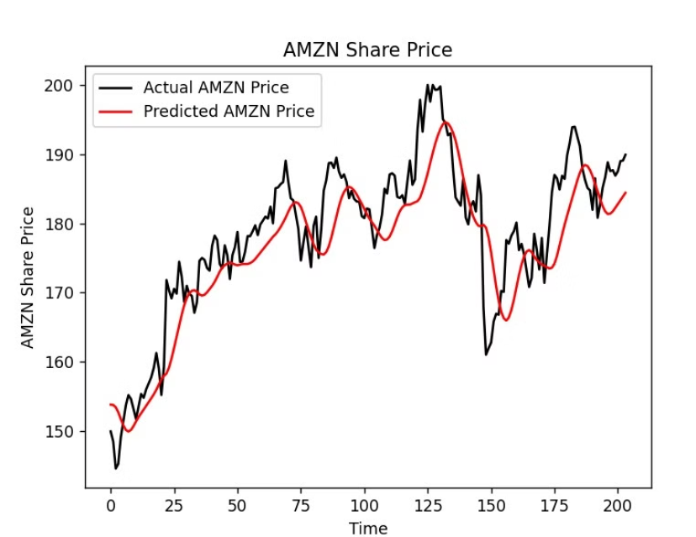
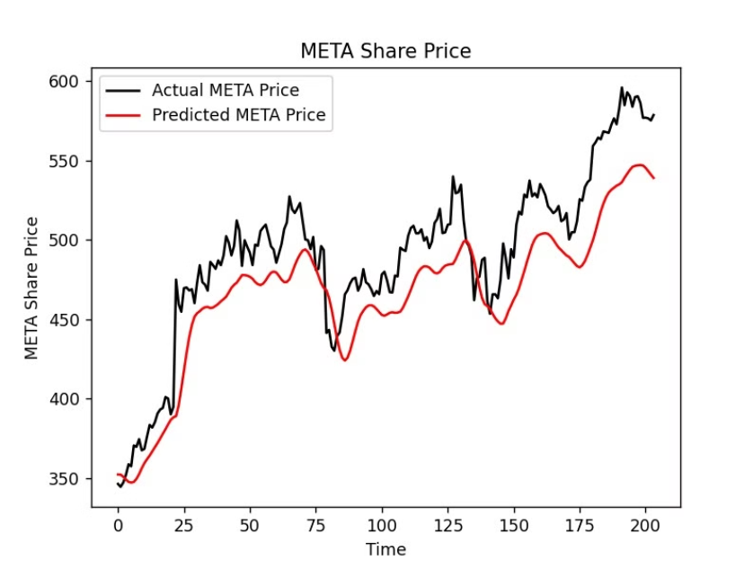
Evaluation Metrics
MAPE: 2.28% RMSE: 5.26
MAPE: 5.25% RMSE: 30.01
MAPE: Mean Absolute Percentage Error
RMSE: Root Mean Squared Error

Slide 9

Conclusion & Next Steps
In summary, this stock prediction project leverages advanced machine learning techniques, specifically LSTM networks, to generate accurate forecasts of future stock prices. By effectively integrating multiple features, such as historical price data and technical indicators, the model captures the intricate patterns and trends in the market
Looking ahead, we plan to incorporate sentiment analysis by analyzing data from news articles and social media to gauge market sentiment. Additionally, we will strive to optimize predictions based on company growth metrics, such as earnings reports and revenue trends. This multifaceted approach will allow us to refine our predictions further and provide deeper insights into market trends and the factors influencing stock prices

Slide 10
Team Members:
Chandana Daravath (22BCS073)
Srija Juttukonda (22BCS117)
Ragavula Madhumita(22BCS202)
S.M Harshitha (22BCS220)
Srinivasula Pranavi (22BCS238)

