Slide 1

01
Molecular biology and basic cellular physiology(24AIM112)& Ethics, innovative research, businesses & IPR(24AIM115)
SIMULATION OF TUMOR GROWTH
Team members:
CB.AI.U4AIM24007- Arnita N
CB.AI.U4AIM24021- Thanmai Sai K
CB.AI.U4AIM24035- Sai Pranavi R
CB.AI.U4AIM24040- Shreenidhi G

Slide 2
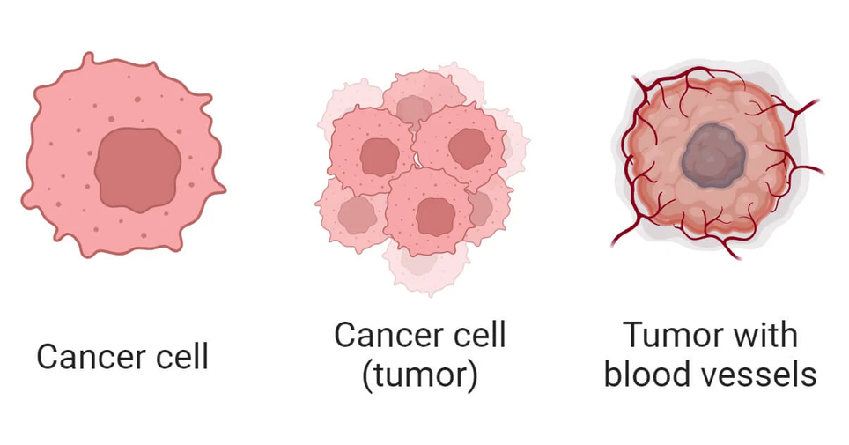
02
3
INTRODUCTION
Tumor growth is influenced by mechanofeedback, oxygen availability, and necrosis.
Computational simulations help in understanding tumor progression and treatment strategies.
This project models tumor behavior using Python-based simulations.

Slide 3
Problem statement
03
Key questions we want to tackle
How does oxygen affect tumor growth and necrosis?
What role does mechanofeedback play?
How do benign and malignant tumors differ?
How do normal and tumor cells respond to oxygen and mechanical forces?
By simulating these factors, we gain insights into tumor behavior.

Slide 4
04
Objectives
Simulate tumor growth in Python, considering oxygen, mechanofeedback, and necrosis.
Compare benign and malignant tumors based on growth and invasion.
Study normal vs. tumor cells in response to oxygen and mechanical stress.
Visualize tumor progression to enhance understanding.
Address biological and ethical aspects of cancer research

Slide 5
05
Computational Aspects of Tumor Growth Simulation in Python
Mathematical Modeling
Python Libraries
Simulation Techniques
Output

Slide 6
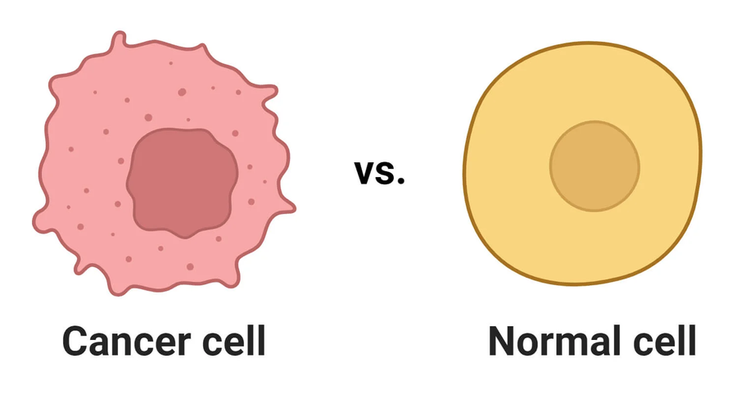
NORMAL VS TUMOR CELLS:
06
Normal Cells:
Strict regulation of the Cell Cycle.
Limited proliferation and Apoptosis when damaged.
Responsive to external signals(growth factors, oxygen).
Tumor Cells:
Uncontrolled division, bypassing checkpoints.
Resistance to Apoptosis.
Altered Metabolism(Warbug Effect) and immune evasion.
Angiogenesis.

Slide 7
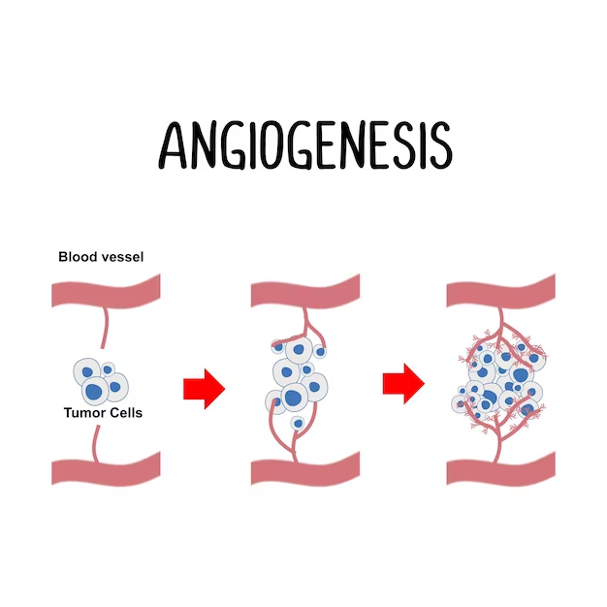
Oxygen-Based Cycle in Tumor Growth
07
Oxygen Supply
Hypoxia Effects:
Slows Down Cell Growth
Triggers Angiogenesis
Angiogenesis (Formation of New Blood Vessels)
Why It Happens?
What Happens Next?

Slide 8
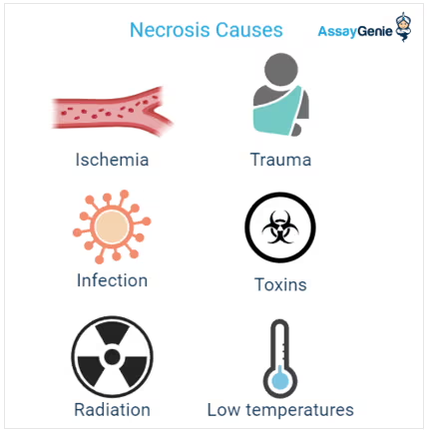
08
Necrosis (Cell Death Due to Lack of Oxygen)
What Is Necrosis?
Impact on Tumor Growth:
Space for New Growth
Aggressive Behaviors.
Mechanofeedback (Sensing Pressure)
Normal Mechanofeedback
Tumor Cells Ignore Pressure
How It Affects Growth

Slide 9
LITERATURE REVIEW:
09
Name | Year | Methodology/link
Multiscale modelling and nonlinear simulation of vascular tumour growth | 2009 | Develops a multiscale mathematical model that integrates tumor invasion and tumor-induced angiogenesis. by using ghost-cell/level-set method to solve the nonlinear systems.
Immortal Life of the Common Rule: Ethics, Consent, and the Future of Cancer Research | 2017 | https://www.ncbi.nlm.nih.gov/pmc/articles/PMC5791844/
The Ethics of Patenting the BRCA Genes for Breast Cancer Research | 2017 | https://link.springer.com/article/10.1007/s10790-017-9592-y

Slide 10
7
10
ETHICAL CONSIDERATIONS :
1. Informed Consent
"Applied laboratory scientists have a moral and ethical obligation to respect and honor the person from whom biospecimens were derived."
2. Privacy and Confidentiality
"Human tissue removed during the course of clinical procedures without explicit research consent... is ethically defensible and associated with minimal risk."
3. Balancing Research Advancement with Ethical Standards
"The intent of the proposal... was to respect participant autonomy, but it raised the possibility of serious unintended consequences."

Slide 11
Right to Bodily Ownership
"One generally owns one’s own physical body and parts of one’s physical body. Unless consent is given, others cannot claim ownership over them."
Ethical Exclusion in Patents
"The European Patent Convention states that inventions must not threaten ordre public or morality, linking legal protection to ethical considerations."
IPR and Scientific Advancement
"Patent monopolies on naturally occurring biological entities can hinder research, restricting access to essential diagnostic tools and potential medical breakthroughs."
11

Slide 12
•Focuses on cancer immunotherapy using tumor-associated T-cell peptide epitopes
• Peptides can be used for:
- Cancer vaccines
- T-cell stimulation and transfer
- Monoclonal antibody development
• Targets tumor-associated peptides bound to MHC molecules.
Example Peptides:
• LLLPLLPPLSPSLG (A*02)
• NYIPVKNGKQF (A*24)
• FYINGQYQF (A*24)
• YVLPKLYVKL (A*02)
Used in various cancers such as lung, breast, pancreatic, and glioblastoma

Slide 13
References:
1.
THANK YOU

Slide 14
Method for Treating Cancer with Activated T Cells
By Immatics Biotechnologies GmbH
•Patent Number: US 10,335,471 B2
• Date of Patent: July 2, 2019
• Assignee: Immatics Biotechnologies GmbH
• Inventors: Andrea Mahr, Toni Weinschenk, Oliver Schoor, Jens Fritsche, Harpreet Singh
• Field: Cancer Immunotherapy

