Slide 1

01
Molecular biology and basic cellular physiology(24AIM112)& Ethics, innovative research, businesses & IPR(24AIM115)
OXYGEN-BASED TUMOUR GROWTH MODEL
TEAM MEMBERS:
CB.AI.U4AIM24007- ARNITA N
CB.AI.U4AIM24021- THANMAI SAI K
CB.AI.U4AIM24035- SAI PRANAVI R
CB.AI.U4AIM24040- SHREENIDHI G

Slide 2
INTRODUCTION
02
Develop a Python-based model to visualize tumor growth dynamically.
Correlation between the features in the data.
Research Paper: “Oxygen-Driven Tumour Growth Model: A Pathology-Relevant Mathematical Approach “.
BIOLOGICAL FOUNDATION
Tumor Cells:
Uncontrolled division, bypassing checkpoints.
Resistance to Apoptosis.
Altered Metabolism and immune evasion.
Angiogenesis.

Slide 3
Role of Oxygen in Tumour Growth:
High Oxygen → Proliferation.
Low Oxygen (Hypoxia) → Quiescence.
Severe Oxygen Deprivation → Necrosis - The premature death of cells due to lack of oxygen or nutrients.
03
RESEARCH PAPER:
The paper presents the Oxygen-Driven Model (ODM), a mathematical model aimed at understanding tumor growth, hypoxia, and necrosis based on oxygen diffusion.
The model was tested using 38 xenografted cell lines and 5 patient-derived xenograft-like models.
Tumors were classified into two groups based on oxygen uptake and proliferation rate:
Group 1: Slow-growing, poorly oxygenated tumors.
Group 2: Tumors with similar oxygen supply but varying intrinsic growth rates.

Slide 4
04
SI.NO | Software/Tool | Issue Encountered
1 | PhysiCell | Lack of proper guidance on usage
2 | VCell (Virtual Cell) | Installation and execution issues
3 | CompuCell3D | latest Version not supported by Laptops
4 | MATLAB(simulink) | No Proper libraries for cell simualation

Slide 5
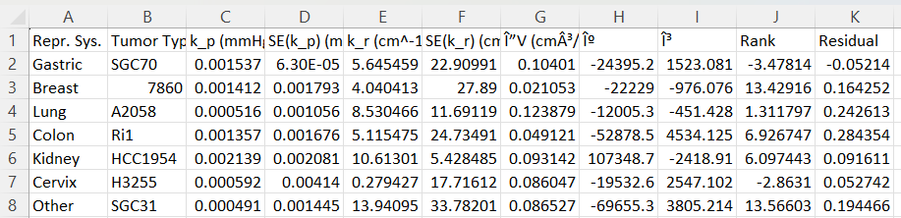
MODELLING
7
05
Correlation:
Correlation is a way of measuring the relationship between two factors (also called features or variables). It tells us how changes in one factor are linked to changes in another.
Correlation Coefficent
Data Set Used:
This dataset captures tumor specific growth and oxygen dependency across multiple cancer types.
Key Parameters
k_p (mmHg) → Proliferation rate
k_r (cm⁻¹ s) →oxygen uptake rate
V (cm³) → Tumor volume
doi:10.1371/journal.pcbi.1004550.t003

Slide 6
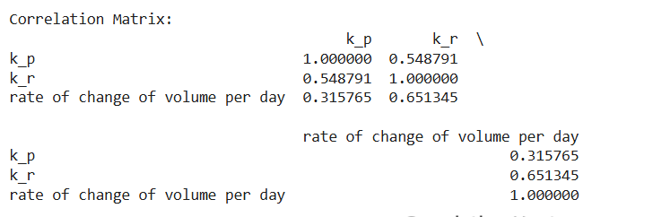
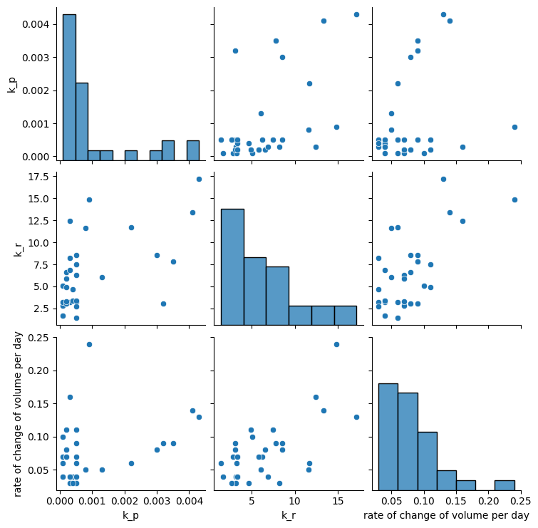
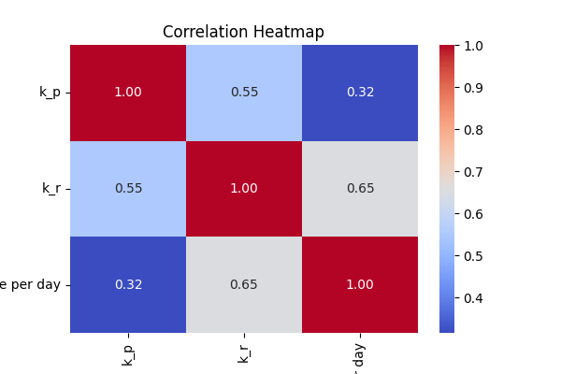
OUTPUTS
7
Correlation Matrix:
06

Slide 7
ETHICS AND IPR
07
Patent 1 :
SYSTEM AND METHOD FOR DETECTING FORESTALLING AND TREATING CANCER PATIENTS USING ARTIFICIAL INTELLIGENCE
AI-Powered Detection – Uses deep learning (Back Propagation Network) to analyze cancer test results.
Patient Data Collection – Collects data from the two patients and processes data .
Cancer Stage Detection: Compares new results with past cases.
Patient Classification: Groups patients based on disease severity.
Outcome: Enables personalized, accurate, and efficient cancer care.

Slide 8
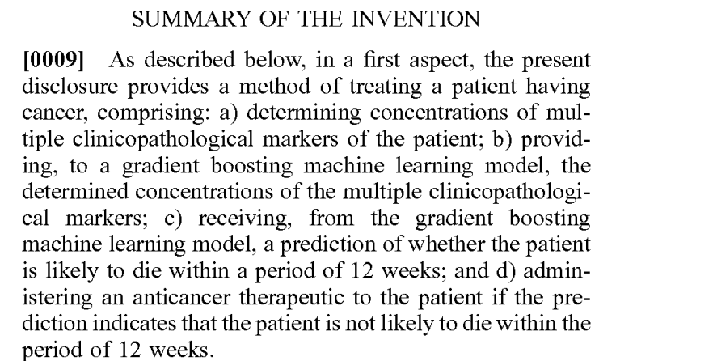
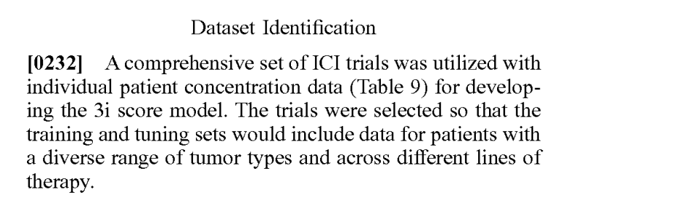
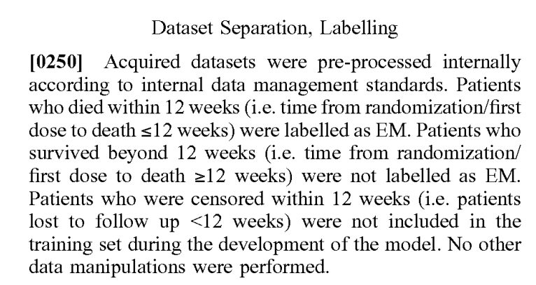
Patent 2:
7
08
METHODS FOR DETERMINING TREATMENTS FOR CANCER PATIENTS
Determination of Clinicopathological Markers.
Input into a Gradient Boosting Machine Learning Model: The model is trained to analyze the markers to assess the patient's prognosis.
Prediction of Short-Term Mortality.
Therapeutic Decision-Making based on the prediction.

Slide 9
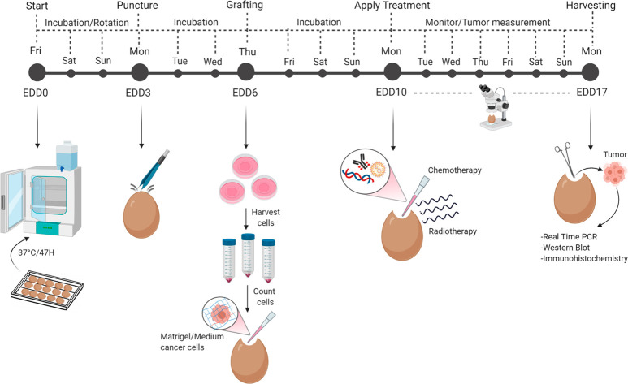
CLINICAL PROTOCOL & LEARNING APPROACH
7
09
Active & Transverse Learning in Tumor Growth Modeling:
Active Learning: Iterative model refinement by adjusting tumor growth parameters (progression/regression rates) and observing outcomes.
Transverse Learning: Applying oxygen diffusion insights to tumor proliferation modeling, improving prediction accuracy.
Clinical Protocol: CAM Model for Tumor Growth (Shortened Overview)
Embryonic Day 0 (EDD0): Start incubation.
EDD3: Puncturing to reposition the air sac.
EDD6: Graft 2 × 10⁶ SCC-25 tumor cells (tumor forms by EDD10).
EDD10: Topical treatment applied.
EDD10–EDD17: Tumor growth monitored until harvesting.
Source: (https://pmc.ncbi.nlm.nih.gov/articles/PMC8205242/)
Sarogni P, Mapanao AK, Marchetti S, Kusmic C, Voliani V. A Standard Protocol for the Production and Bioevaluation of Ethical In Vivo Models of HPV-Negative Head and Neck Squamous Cell Carcinoma

Slide 10
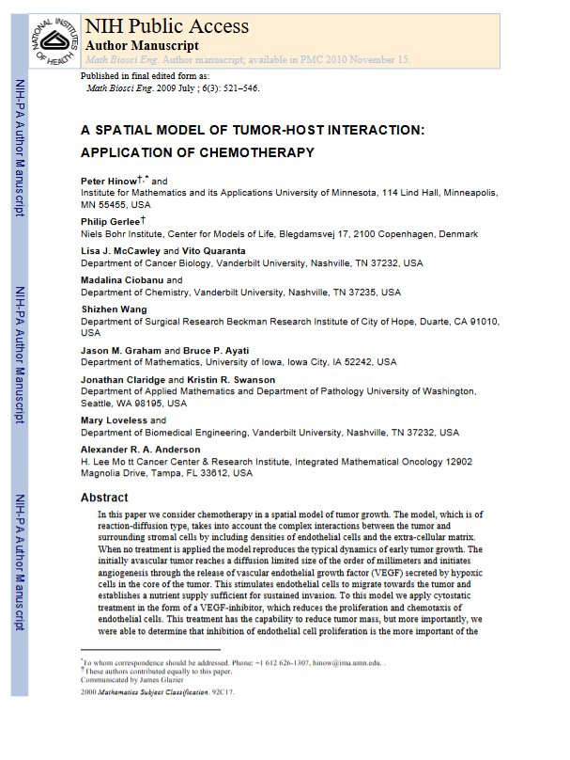
CASE STUDY
10
Key Points: Spatial Tumor-Host Interaction Model (Hinow et al., Math Biosci Eng. 2009)
Mathematical Model of Tumor Growth: Uses reaction-diffusion equations to model oxygen-dependent tumor expansion.
Oxygen & Hypoxia Influence: Shows how low oxygen (hypoxia) slows tumor growth and triggers angiogenesis.
Tumor-Host Interaction: Models the balance between tumor proliferation and oxygen supply in the microenvironment.
Extension to Chemotherapy: Explores how oxygen availability affects treatment response, linking tumor growth to drug diffusion.

Slide 11
1.
THANK YOU

