Slide 1

01
Molecular biology and basic cellular physiology (24AIM112)
Ethics, innovative research, businesses & IPR (24AIM115)
OXYGEN-BASED TUMOUR GROWTH MODEL
TEAM MEMBERS:
CB.AI.U4AIM24007- ARNITA N
CB.AI.U4AIM24021- THANMAI SAI K
CB.AI.U4AIM24035- SAI PRANAVI R
CB.AI.U4AIM24040- SHREENIDHI G

Slide 2
02
INTRODUCTION
3D python model to show how tumor growth changes with oxygen levels.
Correlation analysis between the factors.
BIOLOGICAL COMPONENTS
Tumor cells grow without control and need oxygen to survive.
High Oxygen → cell growth fast
Low oxygen (hypoxia) → Slow or no growth
No oxygen → Cell death (necrosis)
Tumor cells avoid death (apoptosis) and grow blood vessels for oxygen (angiogenesis).

Slide 3
RESEARCH PAPER:
03
TITLE :Oxygen-Driven Tumour Growth Model: A Pathology-Relevant Mathematical Approach
Developed a model that explains tumor growth based on oxygen diffusion and consumption.
Used data from 38 animal tumors and 5 human-like models to analyze growth patterns.
Estimated key factors like oxygen uptake rate and cell proliferation to classify tumors.
Highlighted differences between animal and human tumors.
Results showed tumors could be grouped by oxygen transport efficiency and growth rate differences.
https://journals.plos.org/ploscompbiol/article?id=10.1371/journal.pcbi.1004550

Slide 4
04
SI.NO | Software/Tool | Issue Encountered
1 | PhysiCell | Lack of proper guidance on usage
2 | VCell (Virtual Cell) | Installation and execution issues
3 | CompuCell3D | latest Version not supported by Laptops
4 | MATLAB(simulink) | No Proper libraries for cell simualation

Slide 5
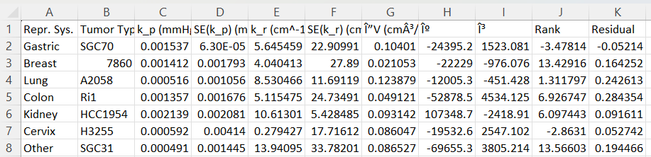
MODELLING
7
05
Correlation:
Correlation is a way of measuring the relationship between two factors (also called features or variables). It tells us how changes in one factor are linked to changes in another.
Correlation Coefficent
Data Set Used:
This dataset captures tumour specific growth and oxygen dependency across multiple cancer types.
Key Parameters
k_p (mmHg) → Proliferation rate
k_r (cm⁻¹ s) →oxygen uptake rate
V (cm³) → Tumor volume
doi:10.1371/journal.pcbi.1004550.t003

Slide 6
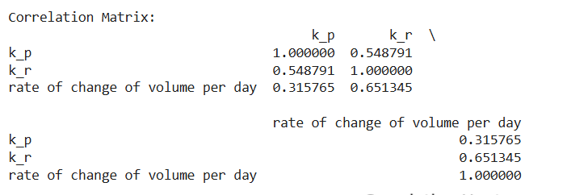
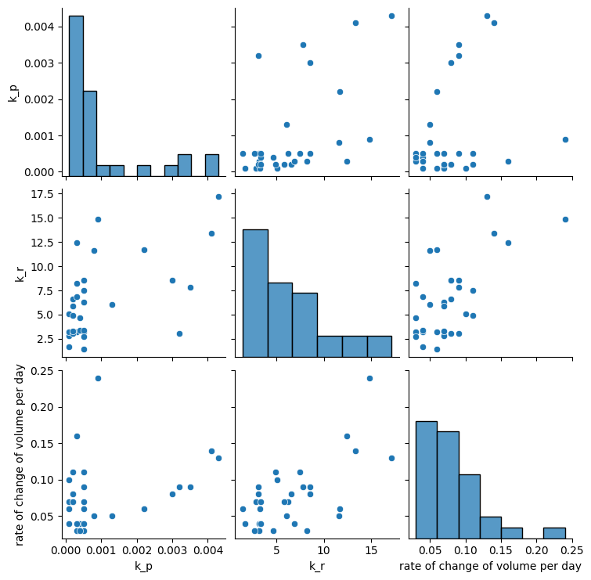
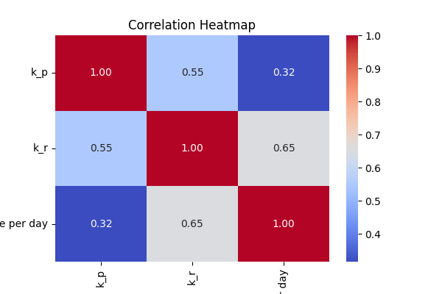
OUTPUT
7
Correlation Matrix:
06

Slide 7
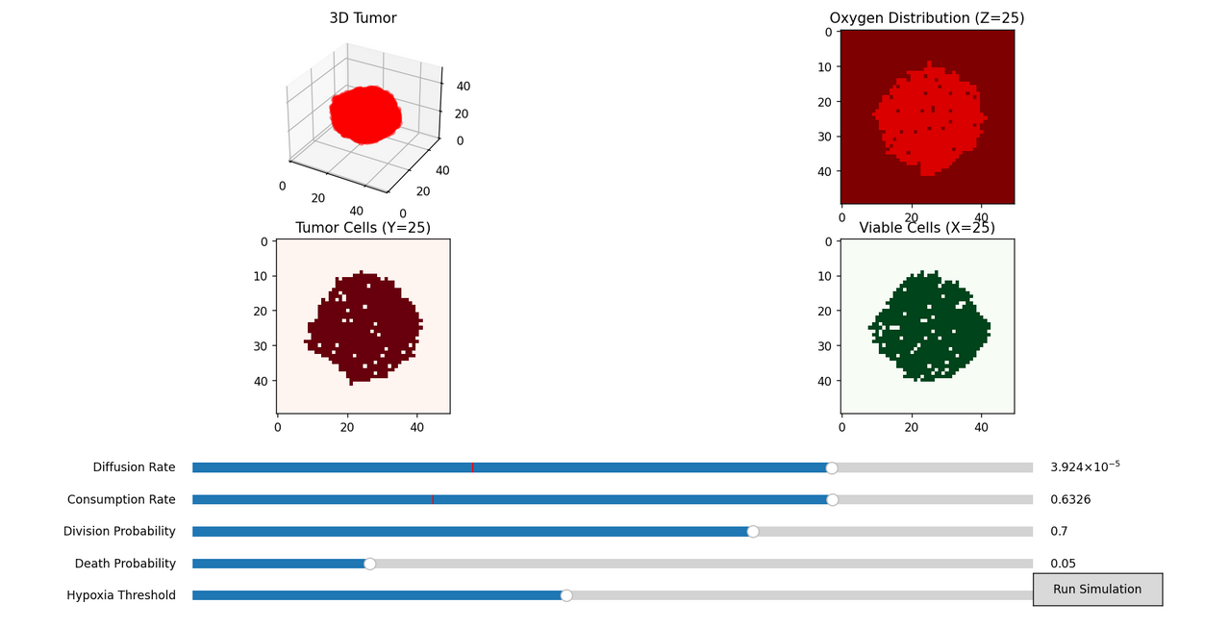
07
3D TUMOR GROWTH & OXYGEN DIFFUSION MODEL
Goal: Simulate tumor growth based on oxygen and cell dynamics
Highlights:
Interactive sliders: Control diffusion, consumption, division, death, hypoxia
Time series: Stepwise tumor growth with slider
Grimes, D. R., Kelly, C., (2015). Oxygen-Driven Tumour Growth Model: A Pathology-Relevant Mathematical Model of Tumour Growth. PLOS Computational Biology, 11(10), e1004550.

Slide 8
ETHICS AND IPR
08
Patent 1:
SYSTEM AND METHOD FOR DETECTING FORESTALLING AND TREATING CANCER PATIENTS USING ARTIFICIAL INTELLIGENCE
AI-Powered Detection – Uses deep learning (Back Propagation Network) to analyze cancer test results.
Patient Data Collection – Collects data from the two patients and processes data .
Cancer Stage Detection- Compares new results with past cases.
Patient Classification- Groups patients based on disease severity.
Outcome-Enables personalized, accurate, and efficient cancer care.

Slide 9
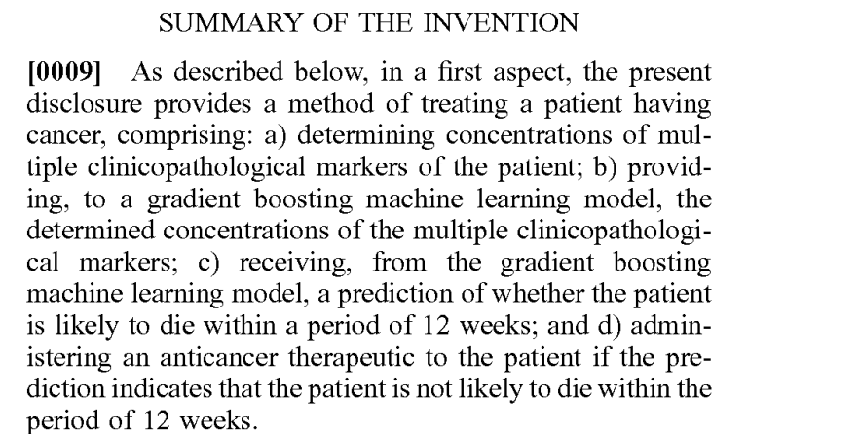
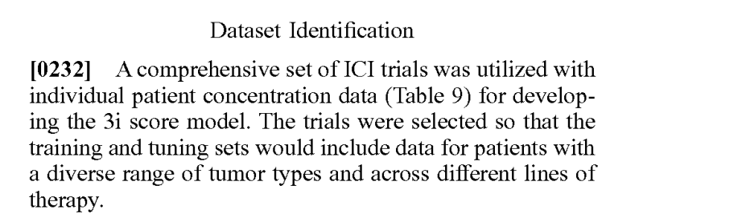
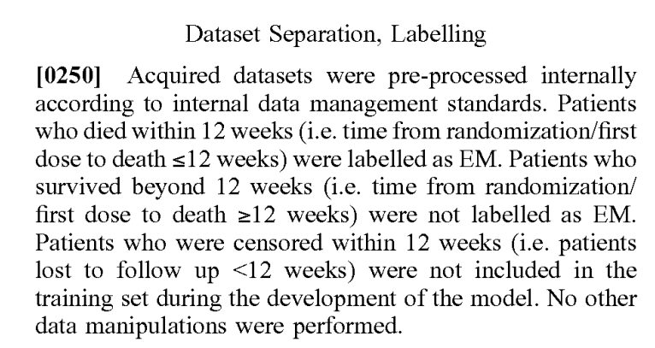
7
Patent 2:
08
09
METHODS FOR DETERMINING TREATMENTS FOR CANCER PATIENTS
Determination of Clinicopathological Markers.
Input into a Gradient Boosting Machine Learning Model: The model is trained to analyze the markers to assess the patient's prognosis.
Prediction of Short-Term Mortality.
Therapeutic Decision-Making based on the prediction.

Slide 10
7
PATIENT-SPECIFIC, MECHANISTIC MODELS OF TUMOR GROWTH
INCORPORATING ARTIFICIAL INTELLIGENCE AND BIG DATA
09
10
Core Innovation
AI + mechanistic models for personalized tumor prediction
Oxygen levels as key factor to tumor progression
Technical Framework
Radiomics: Image feature extraction
Deep Learning: Tumor segmentation
ODE Models: Oxygen-based tumor growth
Clinical Applications
Fast testing of treatments
Supports personalized therapy
Predicts outcomes with uncertainty estimates
Source: Lorenzo A, et al. (2023). Patient-specific, mechanistic models of tumor growth incorporating artificial intelligence approaches for cancer progression assessment. PMC10491321.
Link: https://pmc.ncbi.nlm.nih.gov/articles/PMC10491321/

Slide 11
ETHICAL ISSUES IN ONCOLOGY PRACTICE: A QUALITATIVE STUDY OF STAKEHOLDERS’ EXPERIENCES AND EXPECTATIONS
11
The paper explores ethical problems faced in cancer treatment by talking to doctors, nurses, and others working in a cancer hospital in Italy.
Common ethical issues include:
Telling patients bad news
End-of-life decisions
Making sure patients understand their treatment options
Everyone agrees that a Clinical Ethics Committee (CEC) should be started to:
Give advice on tough cases
Train staff in communication and ethics with proper ethical guidlines
https://bmcmedethics.biomedcentral.com/articles/10.1186/s12910-022-00803-x

Slide 12
THANK YOU

Slide 13
