Slide 1

01
Introduction to NN, CNN and GNN (24AIM113) & Analog System Design (24AIM114)
SMART POSTURE CORRECTION SYSTEM
TEAM MEMBERS:
CB.AI.U4AIM24007- Arnita N CB.AI.U4AIM24021- Thanmai Sai K CB.AI.U4AIM24035- Sai Pranavi R CB.AI.U4AIM24040- Shreenidhi G
FACULTY :
Dr. SnigdhaTanu Acharya
Dr. Amrutha V

Slide 2
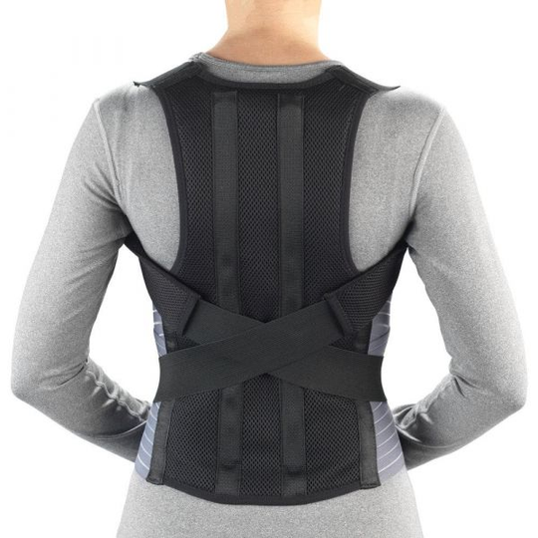
INTRODUCTION
02
Why is Posture Correction Important?
Poor posture can lead to spinal misalignment, chronic back pain, neck strain, and long-term musculoskeletal disorders.
Correct posture reduces stress on joints and muscles.
What are the Main Causes of Poor Posture?
Incorrect posture habits such as slouching and leaning to one side

Slide 3
LITERATURE REVIEW
03
S.no | Title | Methodology | Sensors | Key contributions
1. | A Hybrid Posture Detection Framework: Integrating Machine Learning and Deep Neural Networks | Hybrid of Machine Learning (SVM, Logistic Regression, KNN, Decision Tree, Naive Bayes) and Deep Learning (1D-CNN, 2D-CNN, LSTM, BiLSTM) | Multisensory system with LoRa technology | They got an accuracy (>98%), by focusing on sitting, standing, and walking postures​
2. | Rehabilitation Posture Correction Using Deep Neural Network | Deep Neural Network (DNN) analyzing human skeleton data extracted from Microsoft Kinect | Microsoft Kinect (RGB camera, IR depth sensor, microphone array) | Developed a DNN model for correcting improper rehabilitation postures, emphasizing real-time feedback for solo rehabilitation exercises​
3. | Design and Experimental Verification of a Posture Correction System | Artificial Neural Network (ANN), Regression Analysis, Paired T-test | Flex sensor, Arduino Nano, Bluetooth module, Vibration motors | Created a wearable system using ANN to predict posture correction effectiveness, achieving a 56.27% improvement in posture habits through experimental validation​

Slide 4
S.no | Title | Methodology | Sensors | Key contributions
4. | FitNet: A deep neural network driven architecture for real time posture rectification | convolutional neural networks (CNNs) and LBCNet, integrating pressure and ultrasonic sensor | cameras for capturing real-time video feeds of individuals during exercises. | This system achieved an accuracy of 82.14% in recognizing different sitting positions​
5. | Physical Exercise Form Correction Using Neural Networks​ | Convolutional Neural Networks (CNNs) for image classification | Smartphone camera (commodity hardware) | Mobile application that provides real-time feedback on exercise posture correction using CNNs and a labeled dataset of 2400 images.
6. | Sitting posture prediction and correction system using arduino-based chair and deep learning model | Deep convolutional neural networks (CNNs) and LBCNet (Lower-Balanced Check Network) | Pressure sensors and ultrasonic sensors | Intelligent chair that classifies sitting postures and provides corrective feedback
7. | Upper Body Posture Recognition Using Inertial Sensors and Recurrent Neural Networks​ | Long Short-Term Memory-based Recurrent Neural Networks (LSTM-RNN) | Inertial Measurement Units (IMUs) (9-axis MEMS sensors) | Wearable system for classifying seven static sitting postures
04

Slide 5

05
RESEARCH GAPS
Limited Real-Time Implementation: Most studies focus on model accuracy but lack real-time posture correction applications
Limited Wearable Solutions for Continuous Monitoring:Only a few studies propose wearable systems, and those that do have limited validation on long-term usability.
Integration of Multiple Sensor Modalities: While some papers use multisensor setups (e.g., IMUs, pressure sensors, Kinect), the fusion of these sensors for enhanced accuracy is still underexplored.

Slide 6


PROBLEM STATEMENT
06
Office workers, students, and professionals spend 6-10 hours daily in incorrect posture!
Poor posture contributes to chronic pain, fatigue, and long-term spinal damage.
Existing Solutions Lack Adaptability: Most wearables provide only data logging without real-time correction.

Slide 7
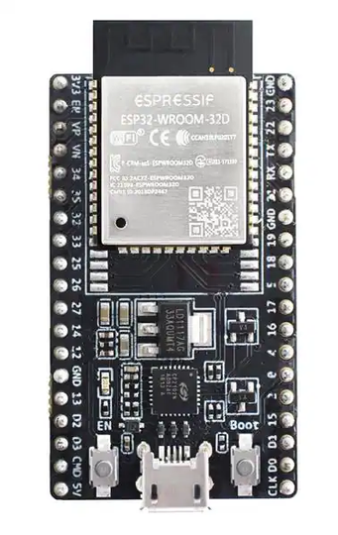
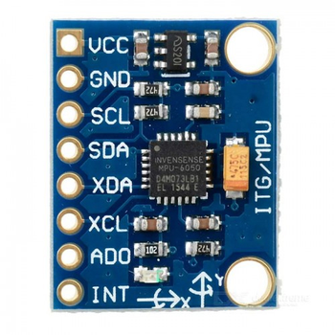
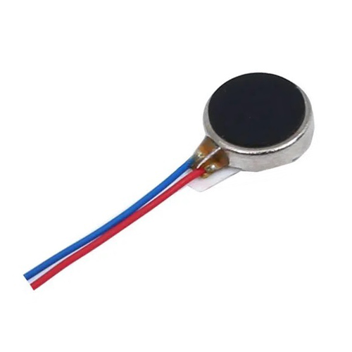
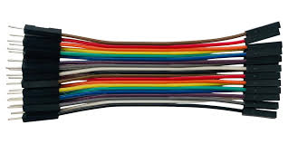
COMPONENTS
07
MPU6050- motion tracking sensor module that combines a 3-axis gyroscope and a 3-axis accelerometer.
ESP32-WROOM-32D- Used to interface with sensors to collect data and analyze posture.
Jumper Wires
Vibration Motors

Slide 8
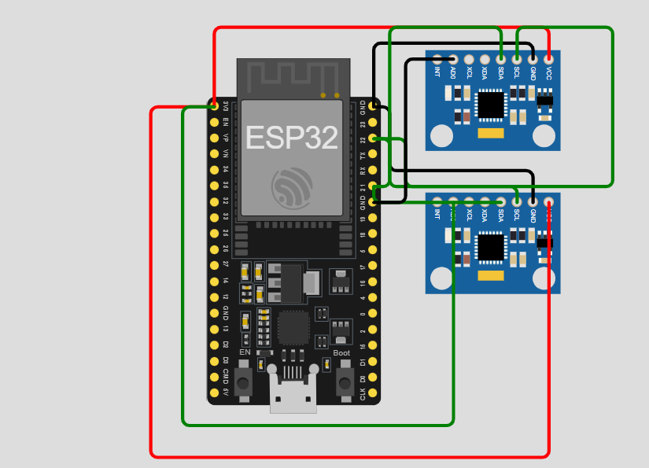
CIRCUIT DIAGRAM
08
https://wokwi.com/projects/422158056135560193

Slide 9
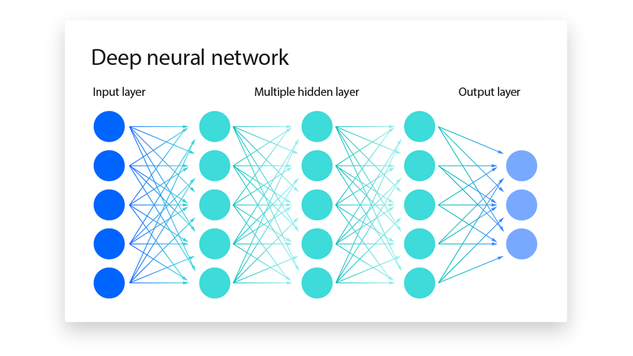
NEURAL NETWORKS:
09
Neural networks play a crucial role in analyzing sensor data and making real-time posture predictions.
The collected sensor data is processed and fed into a Feedforward Neural Network (FNN) for classification.
Why Feedforward Neural Network:
Pattern recognition: FNNs can effectively map input sensor data to posture labels.
Accuracy: FNNs offer better accuracy compared to traditional threshold-based methods.
Hardware compatibility : FNNs can be efficiently implemented on microcontrollers, making them ideal for real time estimations.

Slide 10
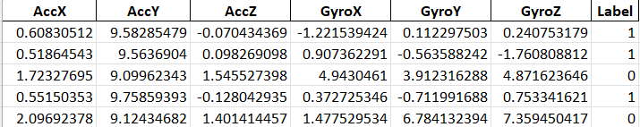
Dataset Used:
10
Data Preprocessing and Training:
Raw data from the MPU6050 sensors is preprocessed to remove noise and extract meaningful features.
The neural network is trained on labeled data containing various postures (good and bad).
Prediction and real time correction :
The trained FNN model is deployed on the ESP32-WROOM-32D, where it classifies real-time posture data.
If the model detects bad posture, a vibration motor is activated to alert the user.

Slide 11
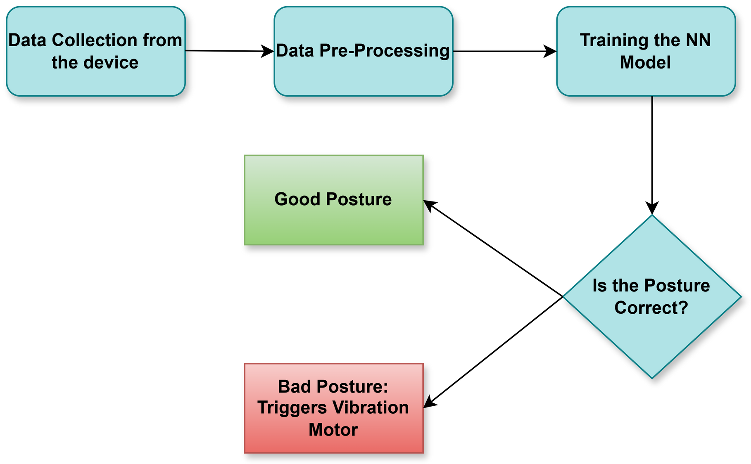
11
WORKFLOW

Slide 12
NN architecture for plotting:
12
No. of points in dataset:500
Input Layer: 6 neurons (AccX, AccY, AccZ, GyroX, GyroY, GyroZ).
Hidden Layer: 10 neurons.
Output Layer: 1 neuron (binary classification: 0 or 1).
Activation Functions: Sigmoid for all layers.
Learning rate: 0.01
Epochs: 50 (number of iterations over the entire dataset).

Slide 13
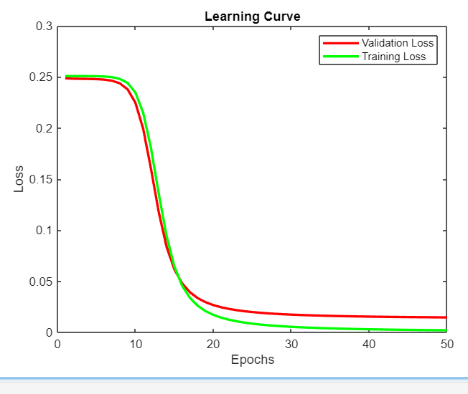

13
Result
For this learning curve we stimulated Data by using reference data.
A learning curve shows how a model's performance improves with more training data or iterations.
It typically plots training and validation accuracy (or error) to help identify underfitting, overfitting, or optimal model performance.

Slide 14
TIMELINE
14
1
2
3
4
Till Feb 15
Feb 16 - Feb 29
March 1 - March 31
April 1 - April 10
Create the actual hardware circuit
Collect data
Deploy trained model on ESP32/Arduino for real-time MPU6050 data processing.
Conduct real-world testing with posture variations.
Identify & fix misclassifications in detection.
Preprocess and handle the data
Train the NN model

Slide 15
REFERENCES
15
https://ieeexplore.ieee.org/document/9343347
https://ieeexplore.ieee.org/document/7881743
https://ieeexplore.ieee.org/document/1234567
https://ieeexplore.ieee.org/document/9582113
https://www.mdpi.com/2076-3417/11/24/12101
https://dl.acm.org/doi/10.1145/3395035.3425302
https://ieeexplore.ieee.org/document/8953010

