Slide 1

Visualization and Analysis –
Tutorial Presentation for Feedback
Date: 01/12/2025
Group Id: A154 Name of Student Presenting: Pranavi kondamadugula

Slide 2
Part 1: VISUALISATION

Slide 3
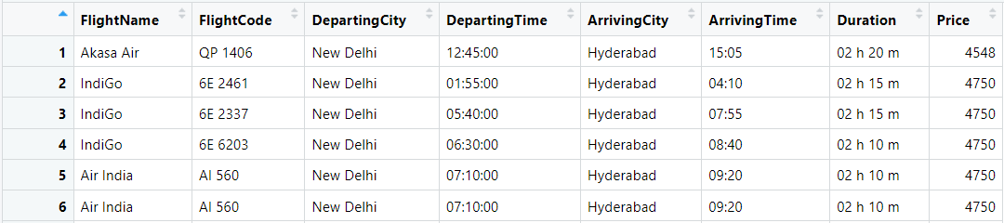
We are using the dataset DS289 (flight_data_DEL_HYD.csv) to answer our Research Question “Is there a difference in the mean of prices between flights arriving in Hyderabad and Delhi?”
“the dataset has 59rows and the variables we use are Price(dependent variable3) and ArrivingCity (independent variable4).

Slide 4
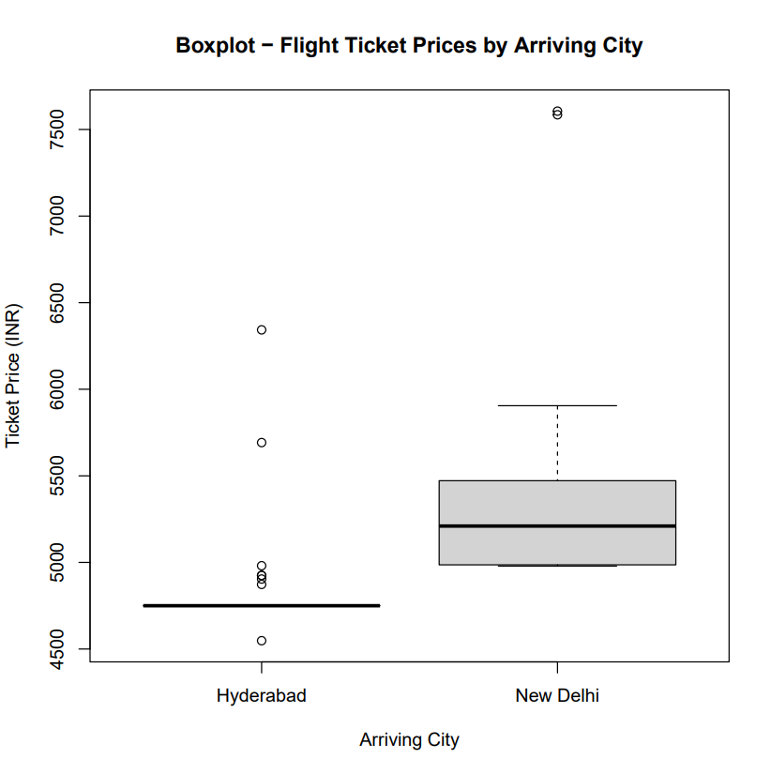
Comparison of means/medians: Boxplot

Slide 5
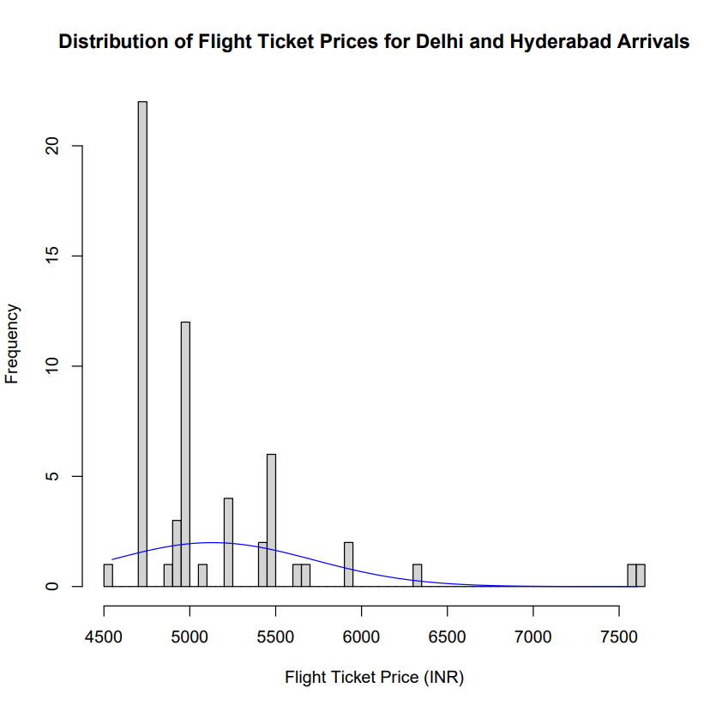
Comparison of means/medians:Histogram

Slide 6
Part 2: Analysis (building on your Visualizations)

Slide 7
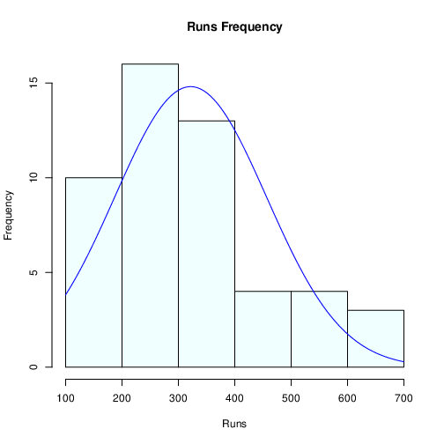
Here is a Histogram showing the frequencies of our dependent variable to include the normal curve overlay (shown in blue).
Our RQ asks about Differences in means/ medians
For example:
The normal curve overlay does not follow the shape of the underlying data, so we use the non-parametric test that does not assume normality: Wilcoxon also known as the Mann Whitney U Test.
7

Slide 8
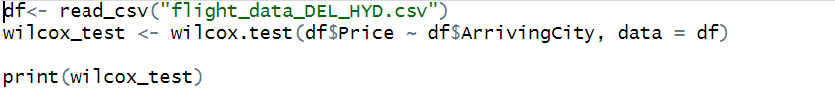
R Script and Results (For ALL types of test) – The Analysis
PRE 7COM1079-2022 Student Group No: ?????
8
W = 53, p-value = 2.55e-09
Yes, the p-value is < 0.05.
Yes, the result is significant.
We reject the null hypothesis’.
There is a real, statistically significant difference in ticket prices between flights arriving in Hyderabad and Delhi.
Notes:
8

