Slide 1
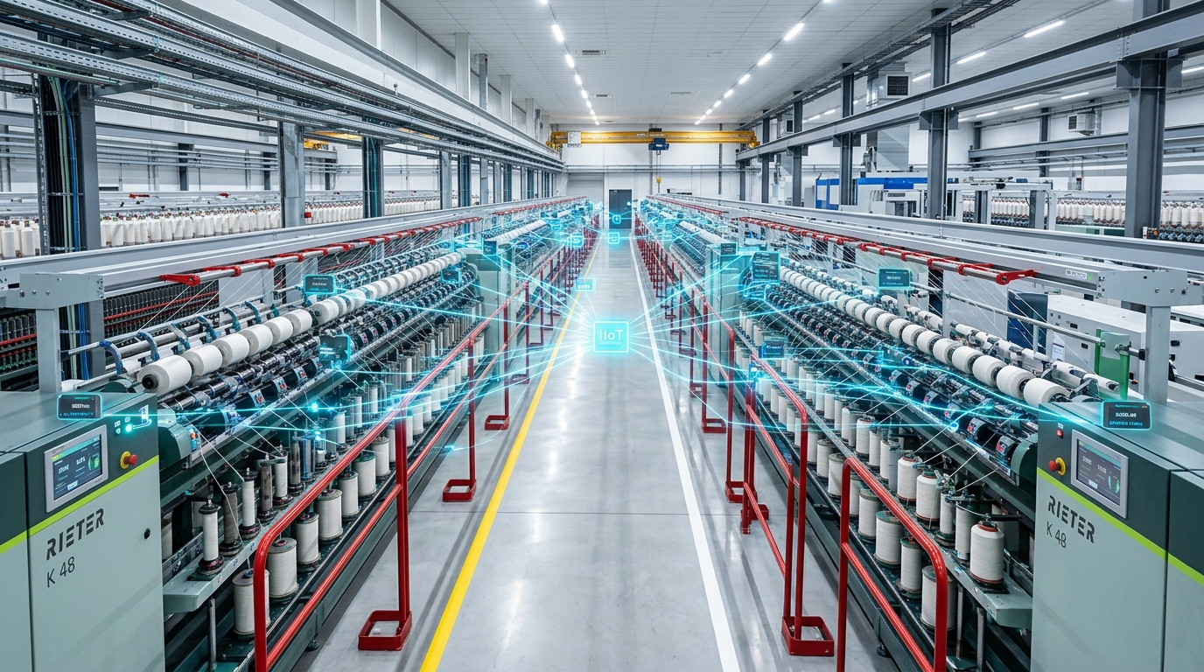
ENERGY TECH INNOVATION PROTOTYPE | INDUSTRIAL SMES
SME-EnergyIQ
AI-Powered Industrial Energy Intelligence for Smart Manufacturing SMEs
MEASURE -> DETECT -> DIAGNOSE -> OPTIMIZE -> QUANTIFY -> DECIDE
100% Prec | 0 False Positives
Hybrid condition monitoring eliminates 100% false alarms
Rs 1,127.79 | Modeled Savings / Day
4.78% daily electricity cost reduction via ToD shifting
12.51 kW | Peak Shaved (8.08%)
Coincident factory peak demand reduced from 154.89 to 142.38 kW
TEXTILE MACHINES -> SENSORS -> DATA -> AI -> OPTIMIZATION -> DECISION
Closed-loop industrial intelligence built specifically for smart manufacturing SMEs
SME-EnergyIQ | Schneider Electric Yuva Yodha Energy Tech Hackathon 2026
Schneider Electric Yuva Yodha Energy Tech Hackathon 2026 | Independent Student Innovation Prototype
01 / 12

Slide 2
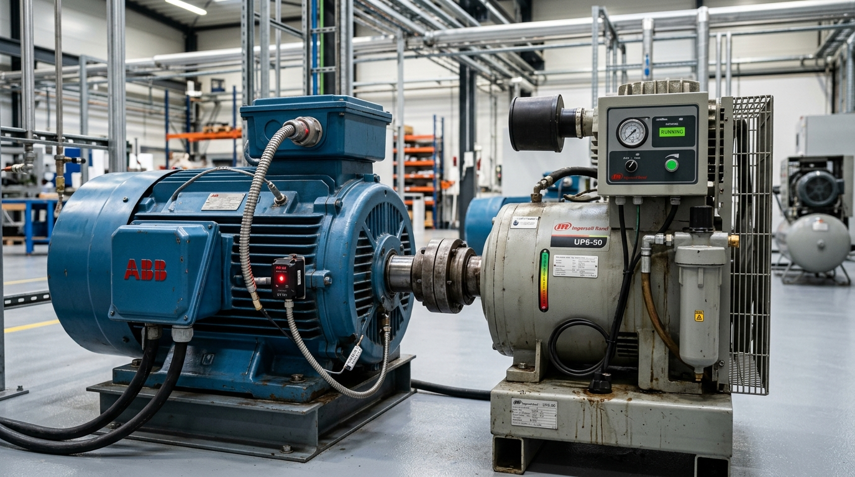
PROBLEM STATEMENT | THE SME CHALLENGE
The Energy Intelligence Gap in Manufacturing SMEs
Operating on thin 3% to 8% margins, energy-intensive manufacturing SMEs face three compounding blindspots.
01 | ENERGY BLINDNESS - "Where is energy being wasted?"
Monthly utility bills arrive weeks late. Passive metering cannot isolate machine-level idle waste (13.40 kWh/day cut by optimizer) during breaks.
02 | REACTIVE MAINTENANCE - "Which machine is behaving abnormally?"
Hidden mechanical wear, compressor unloader leaks, and motor overheating remain undetected until catastrophic downtime halts cascading plant lines.
03 | HEALTH-BLIND SCHEDULING - "When should production run?"
Production shifts are scheduled strictly for volume. Running heavy assets into the Rs 10/kWh peak tariff spikes power bills and risks tripping contract demand.
[!] PHYSICAL PLANT SYMPTOMS DETECTED IN HISTORICAL TELEMETRY
Unmeasured idle power during shift breaks | Elevated bearing vibration (ISO Zone C) | Uncoordinated peak pumping
CONSEQUENCE: ENERGY COST [^] + DOWNTIME RISK [^] + UNNECESSARY CARBON [^]
Target Context: Energy-intensive manufacturing SMEs operating on thin 3-8% margins without dedicated energy engineering staff.
SME-EnergyIQ | Schneider Electric Yuva Yodha Energy Tech Hackathon 2026
02 / 12

Slide 3
MARKET LANDSCAPE | THE FRAGMENTATION PROBLEM
Most Tools Solve Only One Piece of the Puzzle
Common commercial systems operate in functional silos, leaving critical blindspots between sensing, diagnosis, and action.
ENERGY MONITORING
"What happened?"
Historical kWh dashboards & monthly utility billing trends.
[X] Passive logging; blind to machine condition & ToD dispatch.
PREDICTIVE MAINTENANCE
"Is something wrong?"
Vibration & thermal sensors with vibration alarms.
[X] Standalone maintenance silo; blind to ToD tariffs & shift quotas.
PRODUCTION SCHEDULING
"When should we run?"
ERP & MES job dispatching focused strictly on output quotas.
[X] Health-blind; dispatches stressed assets into Rs 10 peak grid hours.
CARBON / ESG REPORTING
"What is the impact?"
Static retrospective annual Scope 2 spreadsheet calculations.
[X] Disconnected from factory floor; cannot guide operational load shifts.
[v] FRAGMENTED COMMERCIAL TOOLS CONVERGE INTO A SINGLE CLOSED LOOP [v]
SME-EnergyIQ: ONE CLOSED DECISION LOOP
ENERGY TELEMETRY -> MACHINE HEALTH -> OPTIMAL SCHEDULE -> VERIFIED CARBON IMPACT
Instead of four disconnected tools, SME-EnergyIQ unites sensing, diagnostics, mathematical scheduling, and carbon accounting into an integrated software platform.
KEY ADVANTAGE: Factory managers make decisions that are simultaneously cost-effective, health-aware, and carbon-optimized.
SME-EnergyIQ | Schneider Electric Yuva Yodha Energy Tech Hackathon 2026
03 / 12

Slide 4
PLATFORM ARCHITECTURE | FIVE CONNECTED INTELLIGENCE LAYERS
From Data to Intelligent Factory Decisions
A modular five-stage software stack bridging physical machine telemetry to executive operational dispatch.
LAYER 1: ENERGY INTELLIGENCE
15-min interval sub-metering, Specific Energy Consumption (0.696 kWh/kg yarn), and idle waste tracking during meal breaks.
THE CORE DECISION LOOP
[v] MEASURE: Sub-meters & Sensors
[v] DETECT: Isolation Forest ML
[v] DIAGNOSE: ISO 10816-3 & State Filter
[v] OPTIMIZE: PuLP 24h MILP Engine
[v] QUANTIFY: Scope 2 GHG Protocol
[v] DECIDE: Operator Shift Dispatch
LAYER 2: AI ANOMALY DETECTION
Per-machine Isolation Forest analyzing multi-variate interactions across Power, Temp, Vibration, and RPM to detect abnormal drift.
LAYER 3: MACHINE HEALTH DIAGNOSTICS
ISO 10816-3 mechanical vibration zones (A to D), Health Scores (100/100 nominal), and 4-tier explainable diagnostic alerts.
LAYER 4: PRODUCTION OPTIMIZATION
PuLP 24-hour MILP mathematical scheduling, shifting flexible pumping and air into off-peak ToD tariffs while respecting machine wear.
LAYER 5: CARBON INTELLIGENCE
Dynamic Scope 2 GHG protocol accounting (0.82 kg CO2e/kWh benchmark), tracking product carbon intensity and avoided emissions.
ONE PLATFORM. ONE DATA MODEL. ONE CLOSED DECISION LOOP.
Empowering factory teams to schedule shifts that are simultaneously energy-efficient, health-conscious, and carbon-aware.
SME-EnergyIQ | Schneider Electric Yuva Yodha Energy Tech Hackathon 2026
04 / 12

Slide 5
SYSTEM ARCHITECTURE | HARDWARE-AGNOSTIC PIPELINE
How SME-EnergyIQ Works: Edge-to-Decision Pipeline
End-to-end telemetry flow from non-invasive industrial sensors to mathematical optimization and plant-manager action.
STAGE 1: ASSETS & SENSORS
Physical Plant Layer
• 4 Core Factory Assets:
Ring Spindles, Compressor,
Dyeing Pump, Chiller.
• Non-invasive split-core CTs
• 4-20mA vibration probes
• PT100 RTD temperature sensors
STAGE 2: EDGE GATEWAY
Standard Ingestion
• Industrial DIN-Rail Gateway
• Protocols: Modbus RTU / MQTT
• 15-Minute interval sub-metering
• Local data buffering (survives network disconnects)
• Zero machine replacement
STAGE 3: CORE ANALYTICS
Intelligence Engine
• Data Quality & Plausibility Validation
• Unsupervised Isolation Forest
• ISO 10816-3 Vibration Severity
• 24-Hour PuLP MILP Optimizer
• Scope 2 GHG Carbon Model
STAGE 4: PLANT DISPATCH
Operator Decision
• Executive Energy Dashboard
• 4-Tier Explainable Alerts
• Machine Health Scores (0-100)
• Time-of-Day Shift Schedule
• Daily Scope 2 ESG Report
<-- CLOSED OPERATIONAL FEEDBACK LOOP <--
Machine Health Derating --> Optimizer Feasibility --> Shift Schedule Dispatch --> Factory Operations --> New Telemetry
HARDWARE-AGNOSTIC BROWNFIELD RETROFIT ARCHITECTURE
Designed for standard commercial split-core current transformers and industrial Modbus transducers. Does not require replacing legacy factory machines.
SME-EnergyIQ | Schneider Electric Yuva Yodha Energy Tech Hackathon 2026
05 / 12

Slide 6
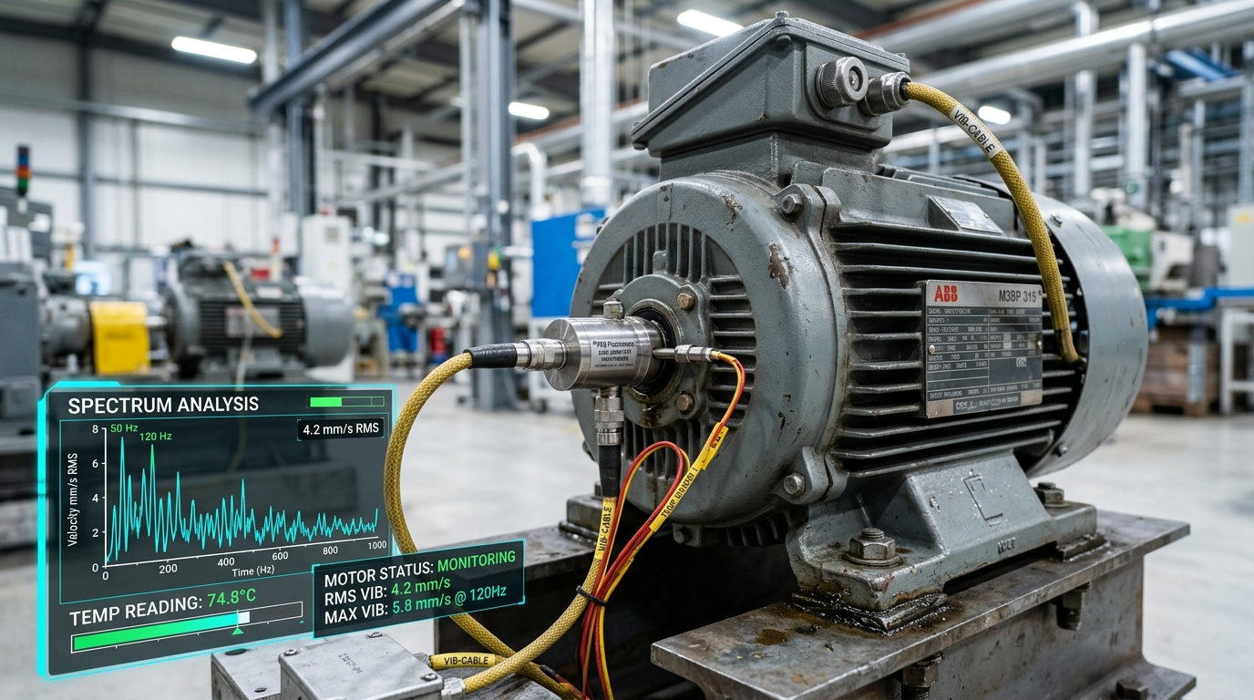
PREDICTIVE DIAGNOSTICS | PHYSICS + AI FUSION
AI That Doesn't Act Alone: Hybrid Diagnostic Story
Machine learning identifies abnormal operating patterns, while physical standards and operational context eliminate false alarms.
[!] EXPLAINABLE 4-TIER OPERATOR DIAGNOSTIC ALERT
Transparent Physical Evidence (No Black-Box Decisions)
1. SENSOR EVIDENCE: Power = 42.1 kW | Temp = 78.4 deg C | Vibration = 5.12 mm/s (ISO Zone C Unsatisfactory)
2. AI INFERENCE: Anomaly Score = 82.5/100 | Multi-variate divergence from nominal operating cluster
3. PHYSICAL HYPOTHESIS: Bearing cage degradation with elevated mechanical friction causing localized vibration & heat
4. RECOMMENDED ACTION: Schedule lubrication & bearing check within 48h. Automatically apply 85% capacity derating in optimizer
LIVE SENSOR TELEMETRY SIGNALS ANALYZED:
Power: 42.1 kW [^] | Temp: 78.4 deg C [^] | Vib: 5.12 mm/s [^] (ISO Zone C) | RPM: 1,420 [v]
MACHINE HEALTH: 100/100 NOMINAL (CURRENT INTERVAL)
Active Alarms: 0 Active in current evaluation window | 14-Day Cumulative Incidents: 99 (64 Critical, 35 High)
IMPORTANT CLAIM DISCIPLINE: AI provides early diagnostic support, not failure prediction.
We never claim black-box machine breakdown predictions - we equip plant engineers with transparent, physical evidence to mitigate downtime.
SME-EnergyIQ | Schneider Electric Yuva Yodha Energy Tech Hackathon 2026
06 / 12

Slide 7
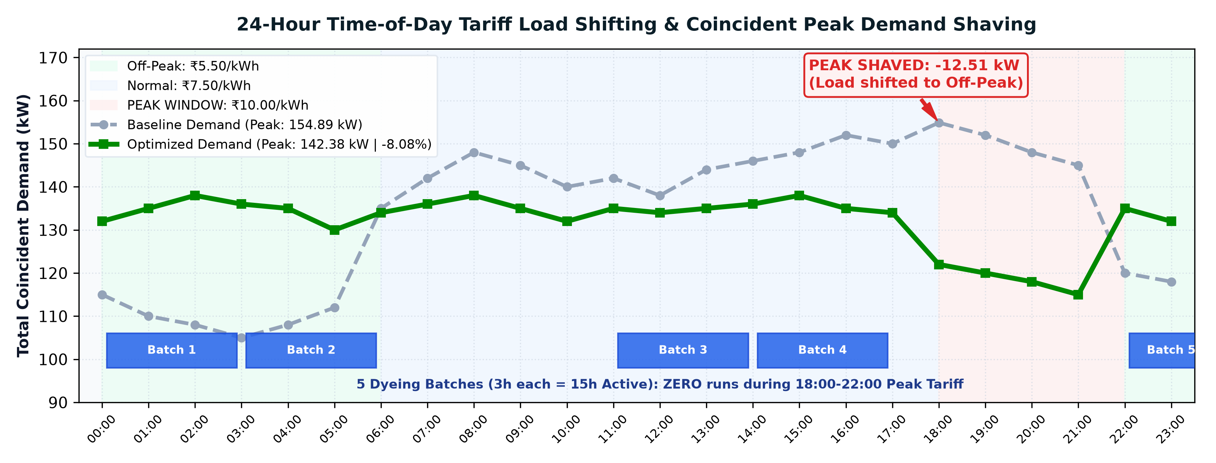
MATHEMATICAL SCHEDULING | PULP MILP FORMULATION
From Detection to Action: 24-Hour Production Scheduling
Searching for a mathematically feasible production schedule that minimizes energy cost and shaves peak grid demand.
PuLP MILP MATHEMATICAL FORMULATION
• Objective: min Z = sum(Tariff[h] * Power[m,h]) + w_peak * Peak_Demand
• Variables: 193 Continuous Variables, 48 Binary (BatchStart, BatchActive)
• Constraints: 412 Linear Constraints solved in ~0.75s via PuLP COIN-OR CBC
• Batch Specs: Contiguous 3h run, min rate 80.0 m3/h (Simulation assumption - not measured factory data, centralized in src/utils.py).
OPTIMIZATION CONSTRAINTS & PRODUCTION GUARANTEES
• Production Quotas Preserved: 4,500 kg yarn & 2,500 m3 dyeing liquor (100.0% met)
• Process Coupling: HVAC airflow bound to spinning (gamma = 22.7 m3/kg)
• Machine Health Derating: High-risk capped at 85%; Critical halted (0%)
• 5 Dyeing Batches (15h active): ZERO runs during Rs 10 peak tariff window (18:00-22:00)
• Cost & Peak: Rs 23,575.50 -> Rs 22,447.71 (-4.78%) | Peak: 154.89 -> 142.38 kW (-8.08%).
SME-EnergyIQ | Schneider Electric Yuva Yodha Energy Tech Hackathon 2026
Model-Estimated 24-Hour Optimization Scenario | All Production Quotas Met Exactly at 100.0%
07 / 12

Slide 8
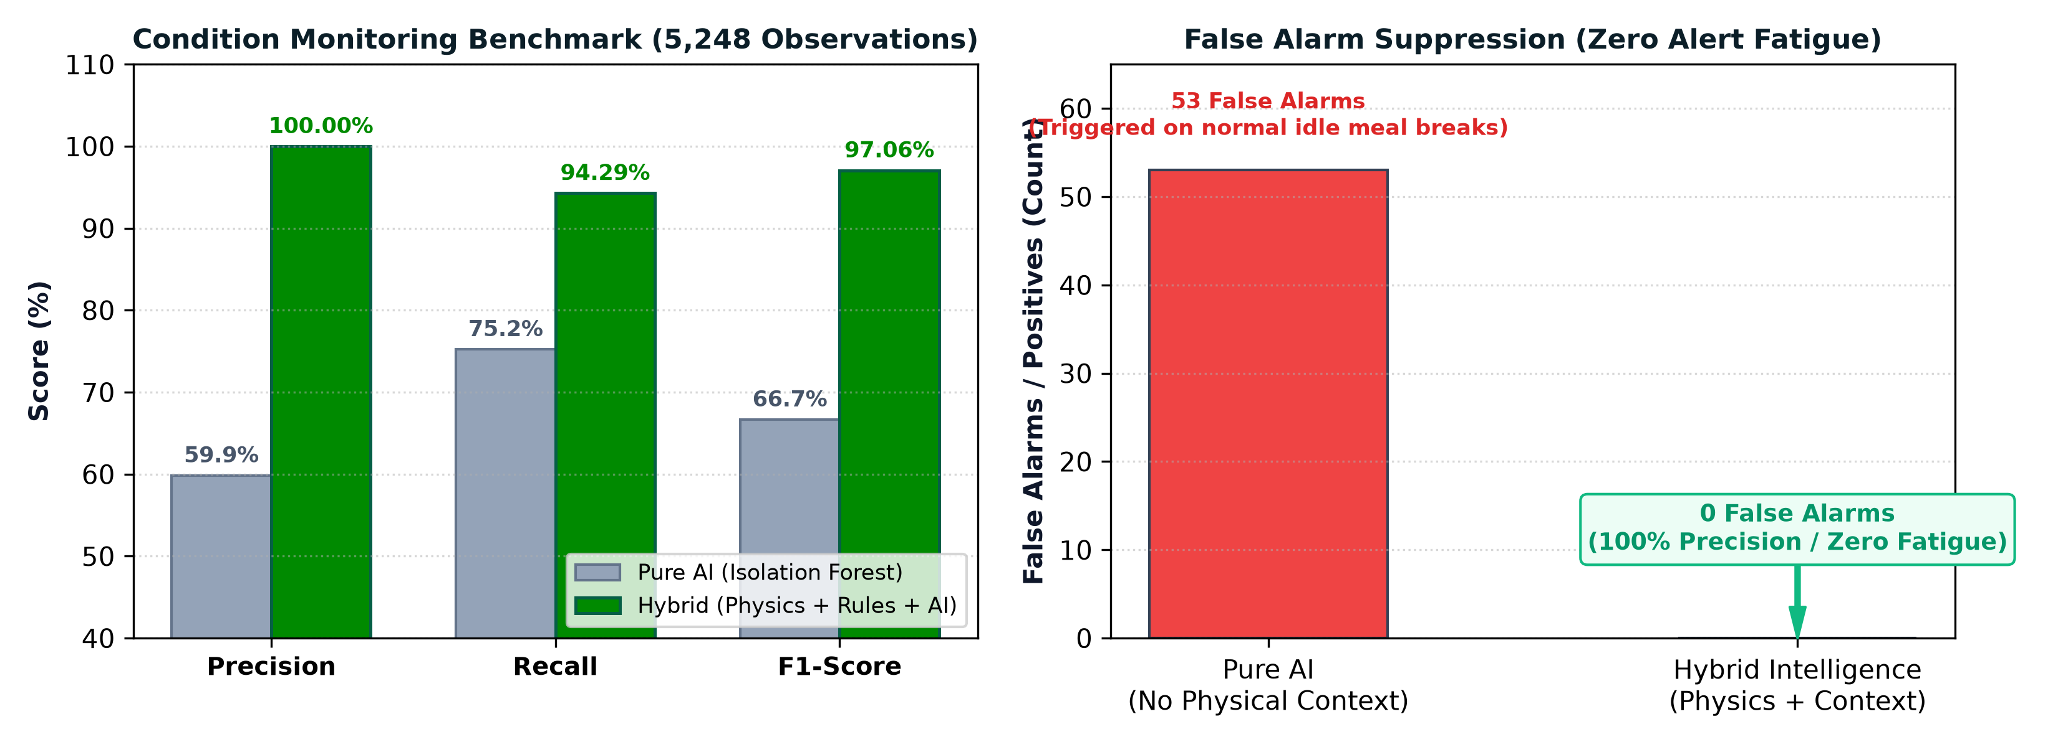
VALIDATED BENCHMARK RESULTS | DUAL ENGINE PERFORMANCE
Measured by Numbers - Not Claims
Rigorous evaluation on 5,248 operational observations and 24-hour mathematical scheduling optimization.
97.06%
HYBRID F1 SCORE | vs 66.67% AI-Only
100.00%
PRECISION | 0 False Alarms (0 FP)
94.29%
RECALL | 99 / 105 Faults Detected
0 ALARMS
NORMAL BREAKS | 222 IDLE breaks passed
Rs 1,127.79
4.78% COST SAVINGS | Rs 23,575.50 -> Rs 22,447.71
12.51 kW
PEAK SHAVED | 8.08% coincident reduction
13.40 kWh
ENERGY SAVINGS / DAY | 0.42% daily waste cut
100.0%
OUTPUT CONSERVED | 4,500 kg & 2,500 m3 met
SCIENTIFIC INTEGRITY DISCLAIMER:
AI results are from a synthetic benchmark (5,248 observations, 105 synthetic anomalies). Optimization results are from a modeled 24-hour scenario; they are not measurements from a live factory.
SME-EnergyIQ | Schneider Electric Yuva Yodha Energy Tech Hackathon 2026
08 / 12

Slide 9
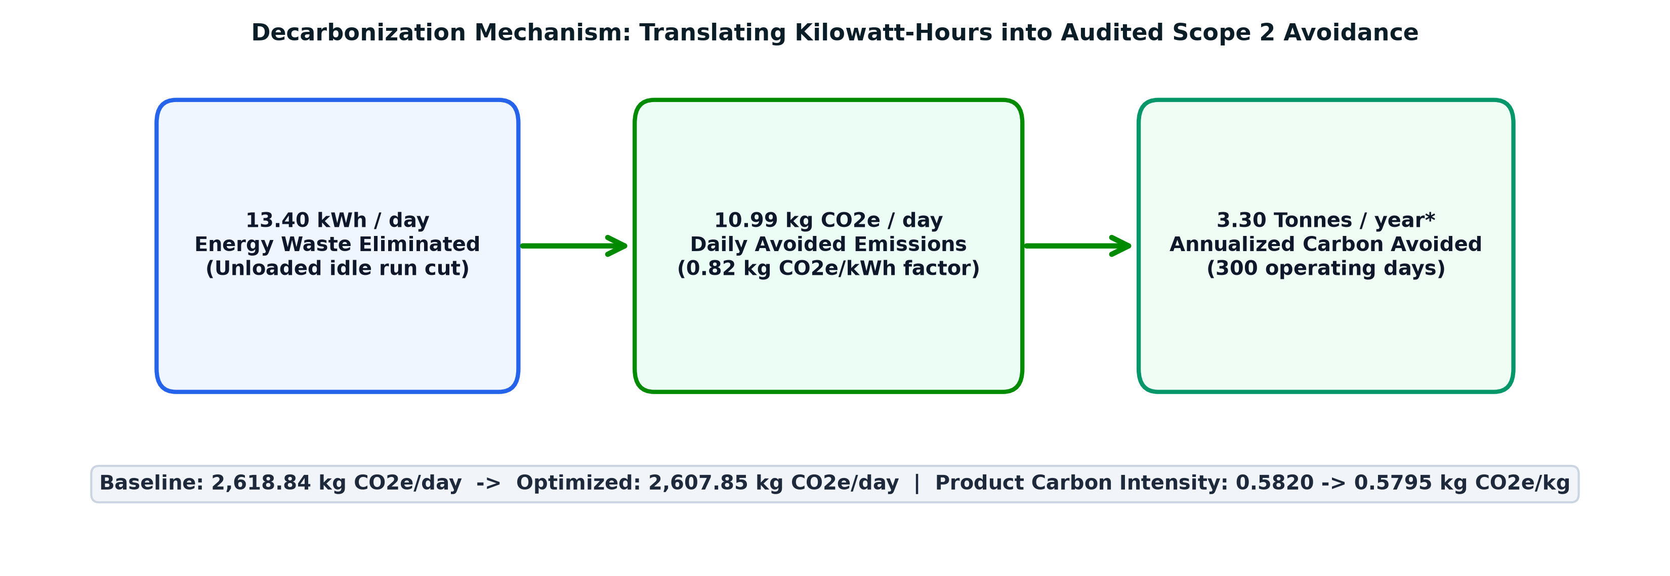
SUSTAINABILITY & ESG | SCOPE 2 GHG PROTOCOL
Every Energy Decision Has a Carbon Impact
Translating electrical demand-response load shifting and idle waste elimination into transparent Scope 2 decarbonization.
24-HOUR OPTIMIZATION DECARBONIZATION
• Baseline Daily Scope 2 Emissions: 2,618.84 kg CO2e / day (3,193.71 kWh * 0.82 kg/kWh)
• Optimized Daily Scope 2 Emissions: 2,607.85 kg CO2e / day (3,180.31 kWh * 0.82 kg/kWh)
• Modeled Daily Avoided Emissions: [-] 10.99 kg CO2e / day (From 13.40 kWh/day waste cut)
• Production Carbon Intensity: 0.5820 -> 0.5795 kg CO2e / kg finished yarn
• Modeled Annualized Carbon Savings: ~3.30 Tonnes CO2e / year (Based on 300 operating days)
14-DAY FACTORY TELEMETRY BASELINE FOOTPRINT
• Total Plant Electricity Consumed: 42,002.64 kWh across 14 days (Average: 3,000.2 kWh/day)
• Total Scope 2 Carbon Footprint: 34,442.17 kg CO2e (34.442 Metric Tonnes CO2e)
• Finished Commercial Production: 60,338.07 kg ring-spun yarn (4,309.9 kg/day)
• Factory Specific Energy Consumption (SEC): 0.696 kWh / kg yarn (Benchmark: 0.65 - 0.75)
• 14-Day Baseline Carbon Intensity: 0.571 kg CO2e / kg finished yarn output
CARBON METHODOLOGY NOTE:
0.82 kg CO2e/kWh used as a synthetic benchmark for this simulation (CEA Baseline Database v19 reference assumption). Annualized estimate: 3.30 t CO2e/year assuming 300 operating days.
SME-EnergyIQ | Schneider Electric Yuva Yodha Energy Tech Hackathon 2026
09 / 12

Slide 10
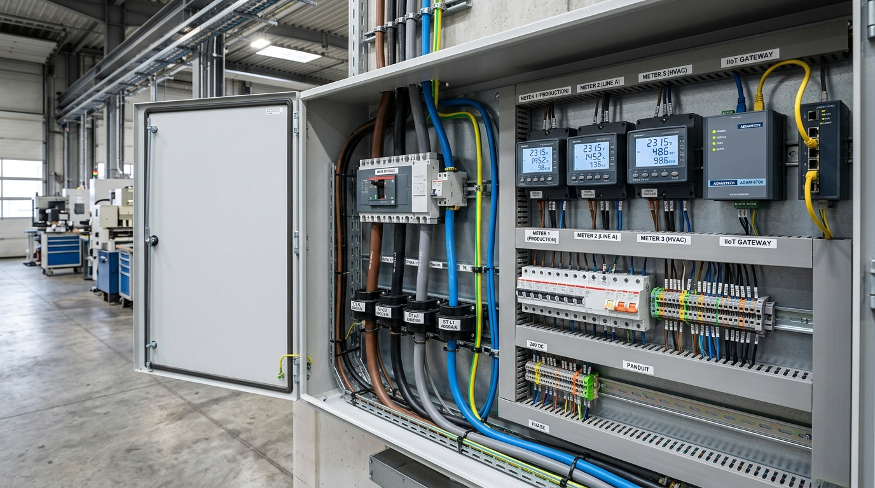
DEPLOYMENT ROADMAP | BROWNFIELD RETROFITTING
From Software Prototype to Factory Pilot
Non-invasive, hardware-agnostic architecture designed for rapid SME adoption without machinery replacement.
STAGE 1: PILOT (Month 1)
Install digital sub-meters on 4 core feeder lines; establish baseline telemetry & quantify idle waste.
STAGE 2: VALIDATE (Month 2)
Validate Data Quality Index & sensor plausible bounds; establish nominal baseline temperature & vibration.
STAGE 3: CALIBRATE (Month 3)
Train machine-specific Isolation Forests on clean baseline; calibrate process coupling ratios and 4-tier alerts.
STAGE 4: SCALE (Month 4+)
Deploy 24-hour PuLP demand-response production scheduling; automate daily Scope 2 ESG reports.
NON-INVASIVE BROWNFIELD RETROFIT STACK:
Split-core CTs clamped on live phase feeders | DIN-Rail Modbus RTU / MQTT Gateway | Zero machinery replacement
PROTOTYPE MATURITY & NEXT STEPS:
Designed for brownfield retrofit. Current prototype uses synthetic telemetry and simulation. Real deployment requires pilot validation with factory telemetry.
SME-EnergyIQ | Schneider Electric Yuva Yodha Energy Tech Hackathon 2026
10 / 12

Slide 11
COMMERCIAL VIABILITY | MARKET EXPANSION
Built for SMEs - Designed to Scale Across Industry
Low capital barrier, rapid payback, and expandable architecture across energy-intensive manufacturing clusters.
TARGET SECTORS & EXPANSION PATHWAY
• Immediate Beachhead: Indian Textile Clusters
- Tirupur, Surat, Coimbatore, Ludhiana, Bhilwara
- Ring spinning, air-jet weaving, wet processing/dyeing
- Electricity accounts for 15% to 25% of conversion costs
• Cross-Sector Expansion Verticals (Identical Asset Types):
1. Food Processing & Cold Storage (Refrigeration, Compressors, Pumps)
2. Plastics & Polymer Molding (Injection presses, Hydraulic motors)
3. Pulp, Paper & Packaging (Continuous refining, Pulp pumps)
4. Light Metal Engineering (Air compressors, CNC clusters)
• Universal Value Drivers:
ToD tariff shifting, peak demand penalty avoidance, and machine health visibility apply across all continuous process SMEs.
COMMERCIAL MODEL & PAYBACK FRAMEWORK
• Commercial Business Model:
- Retrofit Hardware: Off-the-shelf split-core CTs & Modbus meters
- Software Subscription (SaaS): Tiered monthly / annual license
- Pilot -> Validate -> Calibrate -> Scale adoption pathway
• Financial Payback Formula:
Payback = (Installation Cost + Initial Software Cost) / Verified Annual Savings
• Compelling SME Economics:
- Modeled electricity cost savings of ~Rs 3.38 Lakhs / year
(Rs 1,127.79/day * 300 operating days)
- Shaving 12.51 kW peak demand avoids steep contract demand penalties
- Transparent capital recovery without large equipment investment.
COMMERCIAL PRICING NOTE:
Installation cost to be finalized using actual BOM and vendor quotations. Prototype does not claim pre-negotiated market hardware pricing.
SME-EnergyIQ | Schneider Electric Yuva Yodha Energy Tech Hackathon 2026
11 / 12

Slide 12
EXECUTIVE SUMMARY | KEY TAKEAWAYS
From Energy Data to Intelligent Factory Decisions
Empowering manufacturing SMEs to turn machine data into energy-efficient, health-aware, and production-conscious decisions.
SME-EnergyIQ
MEASURE -> DETECT -> DIAGNOSE -> OPTIMIZE -> QUANTIFY -> DECIDE
PHYSICS + AI
Transparent Diagnostics
* 100.00% Precision with 0 False Alarms
* 97.06% F1 on 5,248 observations (105 faults)
* Transparent 4-tier physical evidence
* Health: 100/100 across all 4 machines
PuLP MILP
Actionable Scheduling
* Rs 1,127.79/day (4.78%) cost savings
* 12.51 kW (8.08%) peak demand shaved
* 13.40 kWh/day (0.42%) energy saved
* 100.0% production quota conserved
SCOPE 2 ESG
Automated Accounting
* 10.99 kg CO2e/day avoided emissions
* ~3.30 Tonnes CO2e/year decarbonization
* 0.571 kg CO2e/kg 14-day carbon intensity
* Automated daily ESG compliance tracking
Thank You!
Questions & Discussion | Schneider Electric Yuva Yodha Energy Tech Hackathon 2026
SME-EnergyIQ | Schneider Electric Yuva Yodha Energy Tech Hackathon 2026
Independent Student Innovation Prototype | All Benchmark Results Evaluated on Modeled Scenarios
12 / 12

