Slide 1

MAZE SOLVER

Slide 2

TEAM MEMBERS DETAILS:
PRANAV SINGH [RA2211003010540]
MANISH TIWARI [RA2211003010546]
SWASTK RANA [RA2211003010564]
RAHUL DEV MANNA[RA2211003010570]

Slide 3

PROBLEM STATEMENT
Design and analyze an efficient maze-solving algorithm using principles of design analysis and algorithmic techniques. The algorithm should be capable of finding the shortest path from a starting point to the endpoint within a given maze. Through rigorous analysis, evaluate the algorithm's performance in terms of time complexity, space complexity, and scalability. This project aims to develop a robust maze solver with applications in various domains, such as robotics, gaming, and navigation, emphasizing the importance of effective algorithmic design in addressing complex spatial problems.

Slide 4

OBJECTIVE
The objective of the maze solver utilizing Breadth First Search (BFS) is to develop an efficient algorithm capable of determining the shortest path through a given maze. This algorithm takes a maze as input and systematically explores it using BFS until it reaches the endpoint. The output of this process includes not only the shortest path from the starting point to the endpoint but also the sequence of steps taken to achieve this route. This project holds significant relevance across diverse domains such as robotics, gaming, and navigation. For instance, in robotics, the ability to find the shortest path through a maze enables robots to navigate through complex environments and obstacles with optimal efficiency. Similarly, in gaming, this algorithm serves as a fundamental tool for guiding characters through various levels or scenarios, enhancing the gaming experience. Moreover, in navigation applications, the maze solver using BFS can be leveraged to identify the shortest route between two points on a map, facilitating efficient travel and logistics planning. Overall, the application of BFS-based maze solving algorithms extends to a wide array of practical scenarios, underscoring its importance in streamlining processes and enhancing decision-making across multiple fields.

Slide 5

TIME COMPLEXITY ANALYSIS
The time complexity of the given code that converts an image of a maze into a 2D array and solves it using breadth-first search can be analyzed as follows:
1. Reading and manipulating the maze image file using the PIL library takes O(n) time, where n is the number of pixels in the image.
2. Converting the image into a 2D array takes O(n) time, as each pixel needs to be processed.
3. The breadth-first search algorithm used to solve the maze has a time complexity of. O (V + E), where V is the number of vertices (or cells) in the maze, and E is the number of edges (or paths) between those vertices. In the worst case, where the maze is a perfect grid and every cell is connected to its four neighbours, V = n and E = 2n - 2, giving a time complexity of O(n).
4. Drawing the output image using the PIL Image Draw library takes O(n) time, as each pixel needs to be processed.
Therefore, the overall time complexity of the code can be approximated as O(n) for large mazes.

Slide 6

Applications and Use Cases
Robotics: Navigation in complex environments, exploration missions, and competitions.
Gaming: Level design, procedural generation, and NPC pathfinding.
Navigation: GPS route planning, delivery logistics, and indoor navigation.
Education: Teaching algorithmic thinking and organizing competitions.
Engineering: IC layout, warehouse logistics, and obstacle avoidance.
Architecture: Pedestrian flow planning, emergency evacuation, and recreational design.
Healthcare: Biological pathway modeling, patient flow optimization, and cognitive rehabilitation.
Environmental Science: Animal navigation studies, wildlife corridor design, and agricultural analysis.

Slide 7

Future Directions
Integration of machine learning for adaptive pathfinding.
Exploration of parallel and distributed algorithms for faster computation.
Incorporation of sensor data for real-time navigation.
Development of hybrid algorithms combining BFS with other techniques for improved performance.
Research into optimization techniques to handle large and complex mazes more efficiently.
Investigation of algorithms capable of dynamically adapting to changing maze environments.
Collaboration with industry partners to implement maze-solving algorithms in real-world applications.
Continued exploration of interdisciplinary applications and novel use cases for maze-solving algorithms.

Slide 8

Conclusion and Result
Conclusion:
In conclusion, the implementation of a Python program utilizing the Breadth First Search (BFS) algorithm effectively solves mazes depicted as images. Leveraging the PIL library for image manipulation and visualization, the program seamlessly converts maze images into 2D arrays and visualizes the solution path using the ImageDraw library. By prompting user input for the maze image file name and the desired output file name, the program offers flexibility and ease of use. The resulting solved maze image demonstrates the shortest path from the start point to the end point, highlighted in red, thereby showcasing the successful application of the BFS algorithm for maze-solving tasks.
Result:
The Python program successfully converts maze images into 2D arrays and solves them using the Breadth First Search (BFS) algorithm. The resulting output is a visually appealing representation of the solved maze, where the shortest path from the start point to the end point is highlighted in red. This demonstrates the effectiveness of the BFS algorithm in navigating through mazes and finding optimal solutions. Overall, the program provides a practical and efficient solution for solving mazes depicted as images, catering to various applications such as robotics, gaming, and navigation.

Slide 9
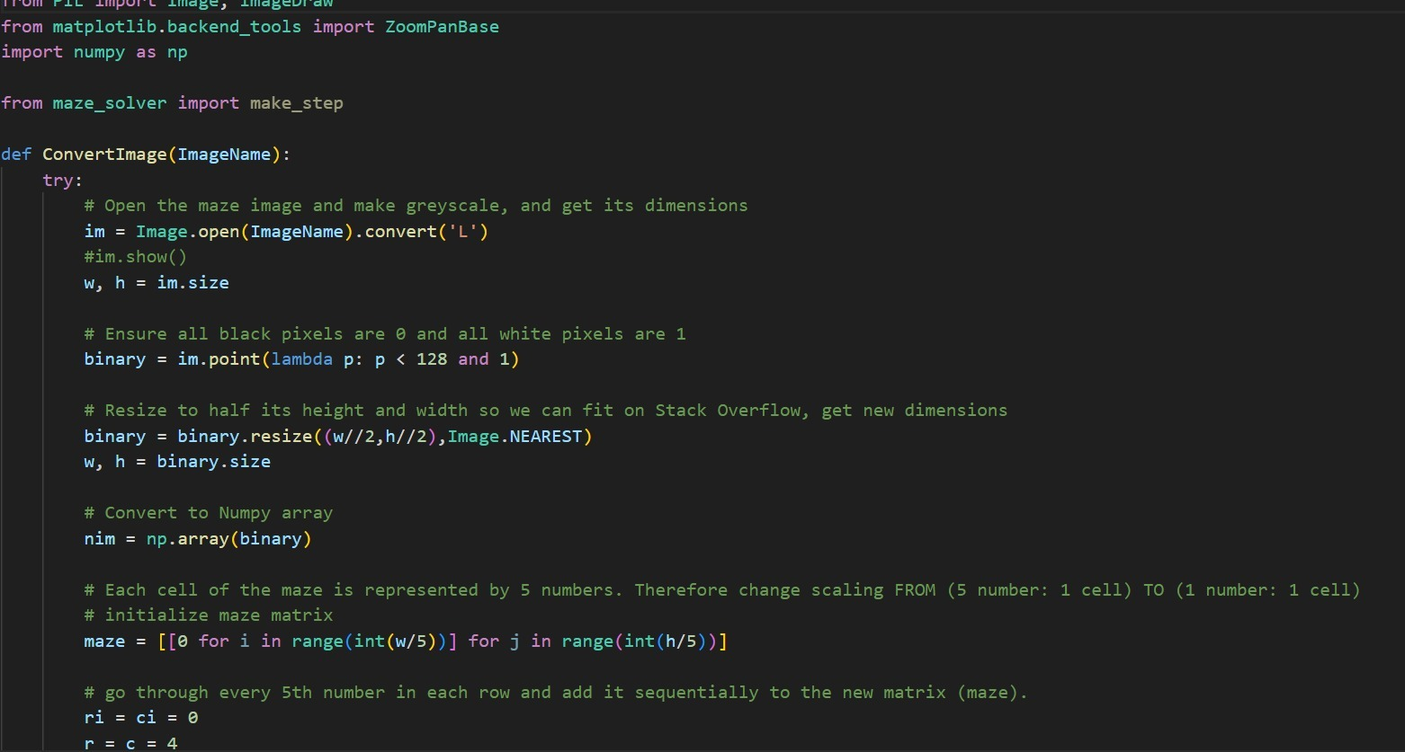
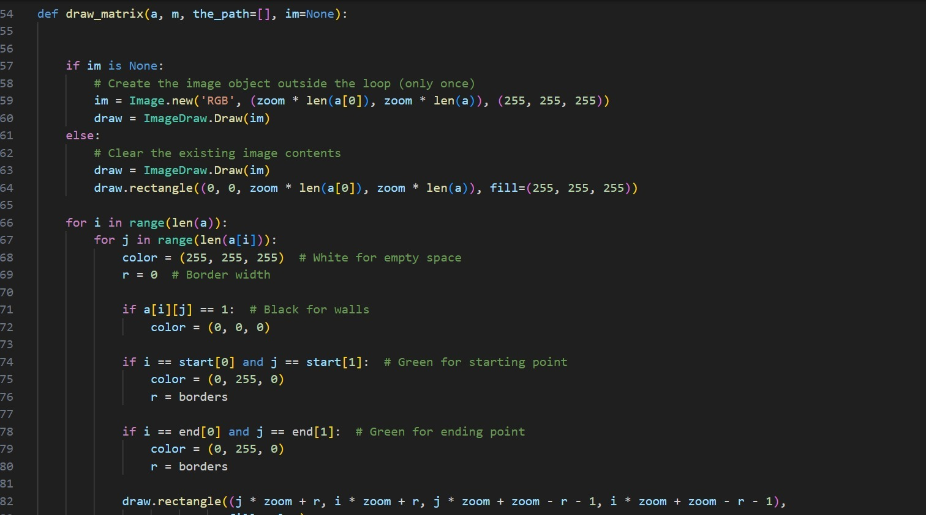
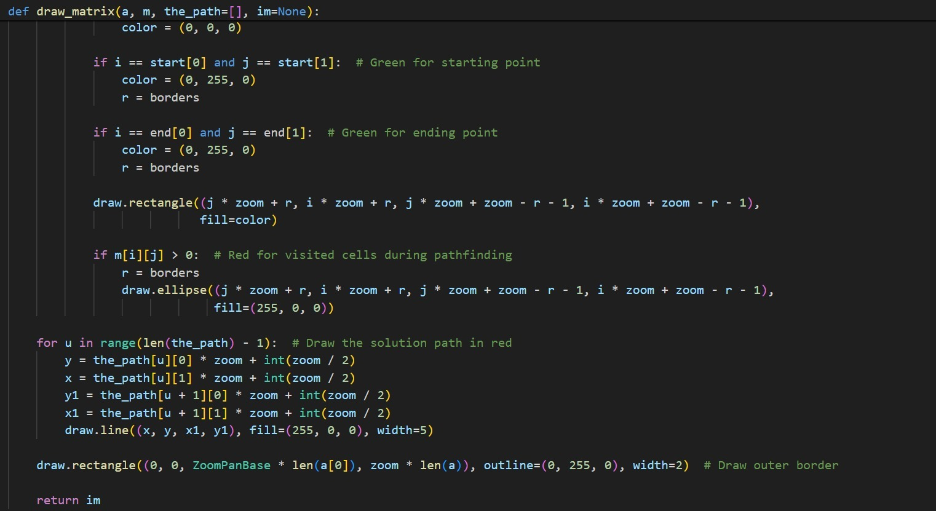
CODE SNIPPET

Slide 10
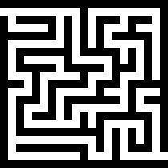
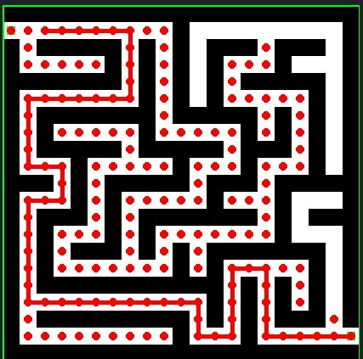
INPUT
OUTPUT

Slide 11

THANK YOU

