Slide 1
GRIDLOCK
Event-Driven Congestion Forecasting & Traffic Management
An operations control dashboard integrates a FastAPI ML pipeline, Node.js Express incident dispatch dispatcher, and React Analytics interface.
AI Service • Express Backend • React Dashboard
Team: Ankit Choudhary | Pranav Singal

Slide 2
SYSTEM DESIGN & INTEGRATION
Platform Technical Architecture
AI Microservice (Python)
Core Dispatch (Node.js)
Analytics Panel (React)
• FastAPI Gateway: Exposes real-time model inference and prediction endpoints.
• ML Models: 4 productionized ML classifiers & regression estimators.
• Data Pipeline: Cleans, builds feature matrices, and clusters coordinates.
• Routing Engine: Calculates alternate corridors around active hotspots.
• Express Server: Orchestrates incident ticketing workflows & unit dispatching.
• Database Connectors: Standardized Mongoose schemas for MongoDB integration.
• Hybrid Store: Graceful local memory array fallbacks for robust offline support.
• Dispatch APIs: Exposes endpoints to alert and route emergency units.
• Vite Bundle: Highly optimized React SPA rendering operations controls.
• Leaflet GIS Map: Interactively visualizes detour segments and bottlenecks.
• Glassmorphism Theme: Premium, responsive CSS grid-based layouts.
• Live Telemetry: Real-time charts detailing pipeline executions and logs.

Slide 3
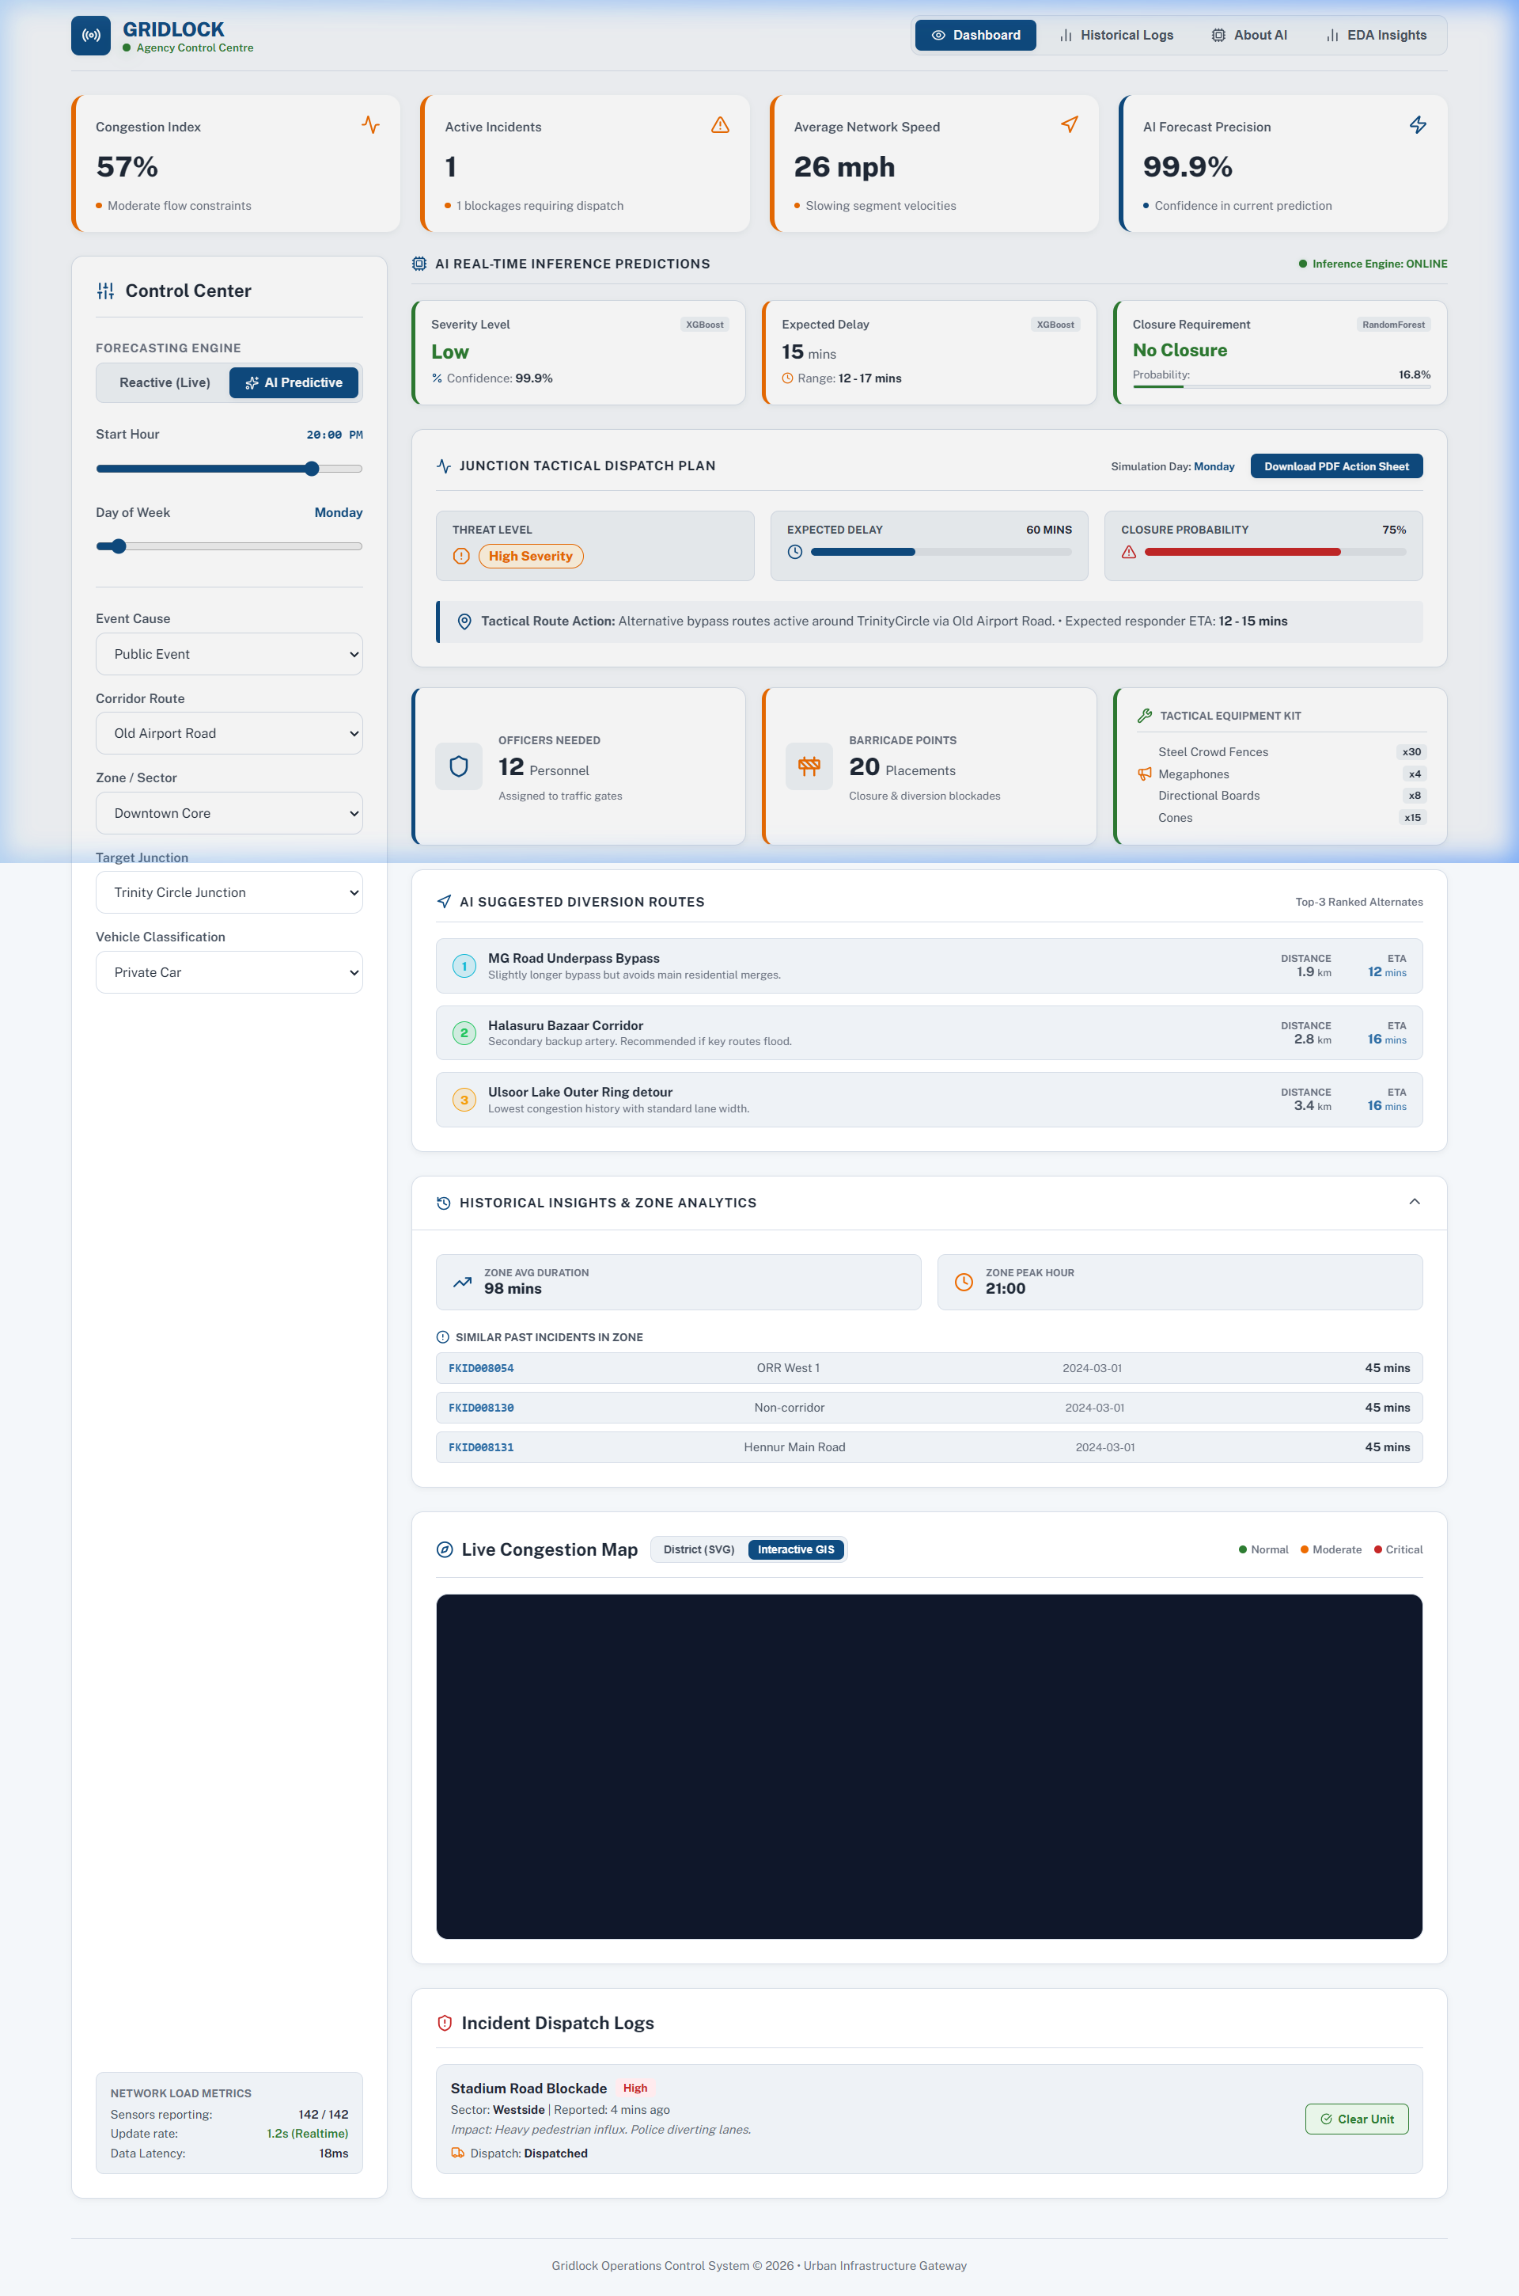
INTERACTIVE MONITORING VIEW
Control Room Operations Dashboard
• Interactive GIS Map: Utilizes high-fidelity Leaflet mapping to display barricades, bottlenecks, and alternate paths.
• District Street Grid: Rendered as a live SVG street grid that shows real-time congestion levels for district segments.
• Active Threat Level Indicators: Groups incidents into Low, Moderate, and Critical warning panels.
• Simulated Dispatch Panel: Allows operators to dispatch emergency units and diversion coordinators on-the-fly.

Slide 4
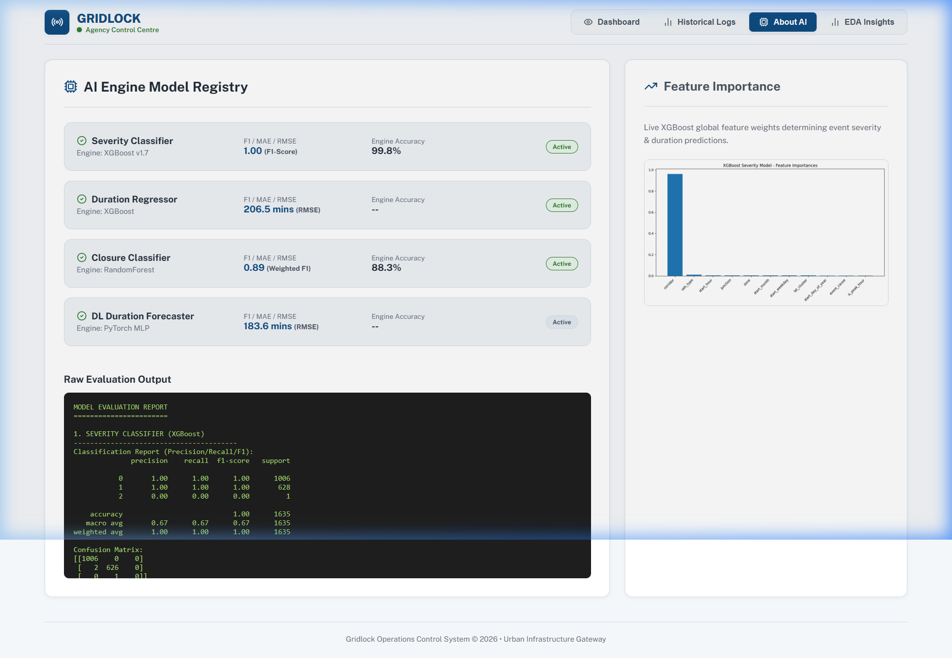
MACHINE LEARNING CORE
AI Model Registry & Deployments
• Severity Classifier: XGBoost classifier categorizing bottleneck threat potential (Low, Moderate, Critical).
• Duration Regressor: XGBoost regressor estimating resolution durations in minutes.
• Closure Classifier: Random Forest classifier predicting complete vs. partial road closure requirements.
• Shadow DL Model: PyTorch Multi-layer Perceptron (MLP) mapping peak-hour traffic inflow sequences.

Slide 5
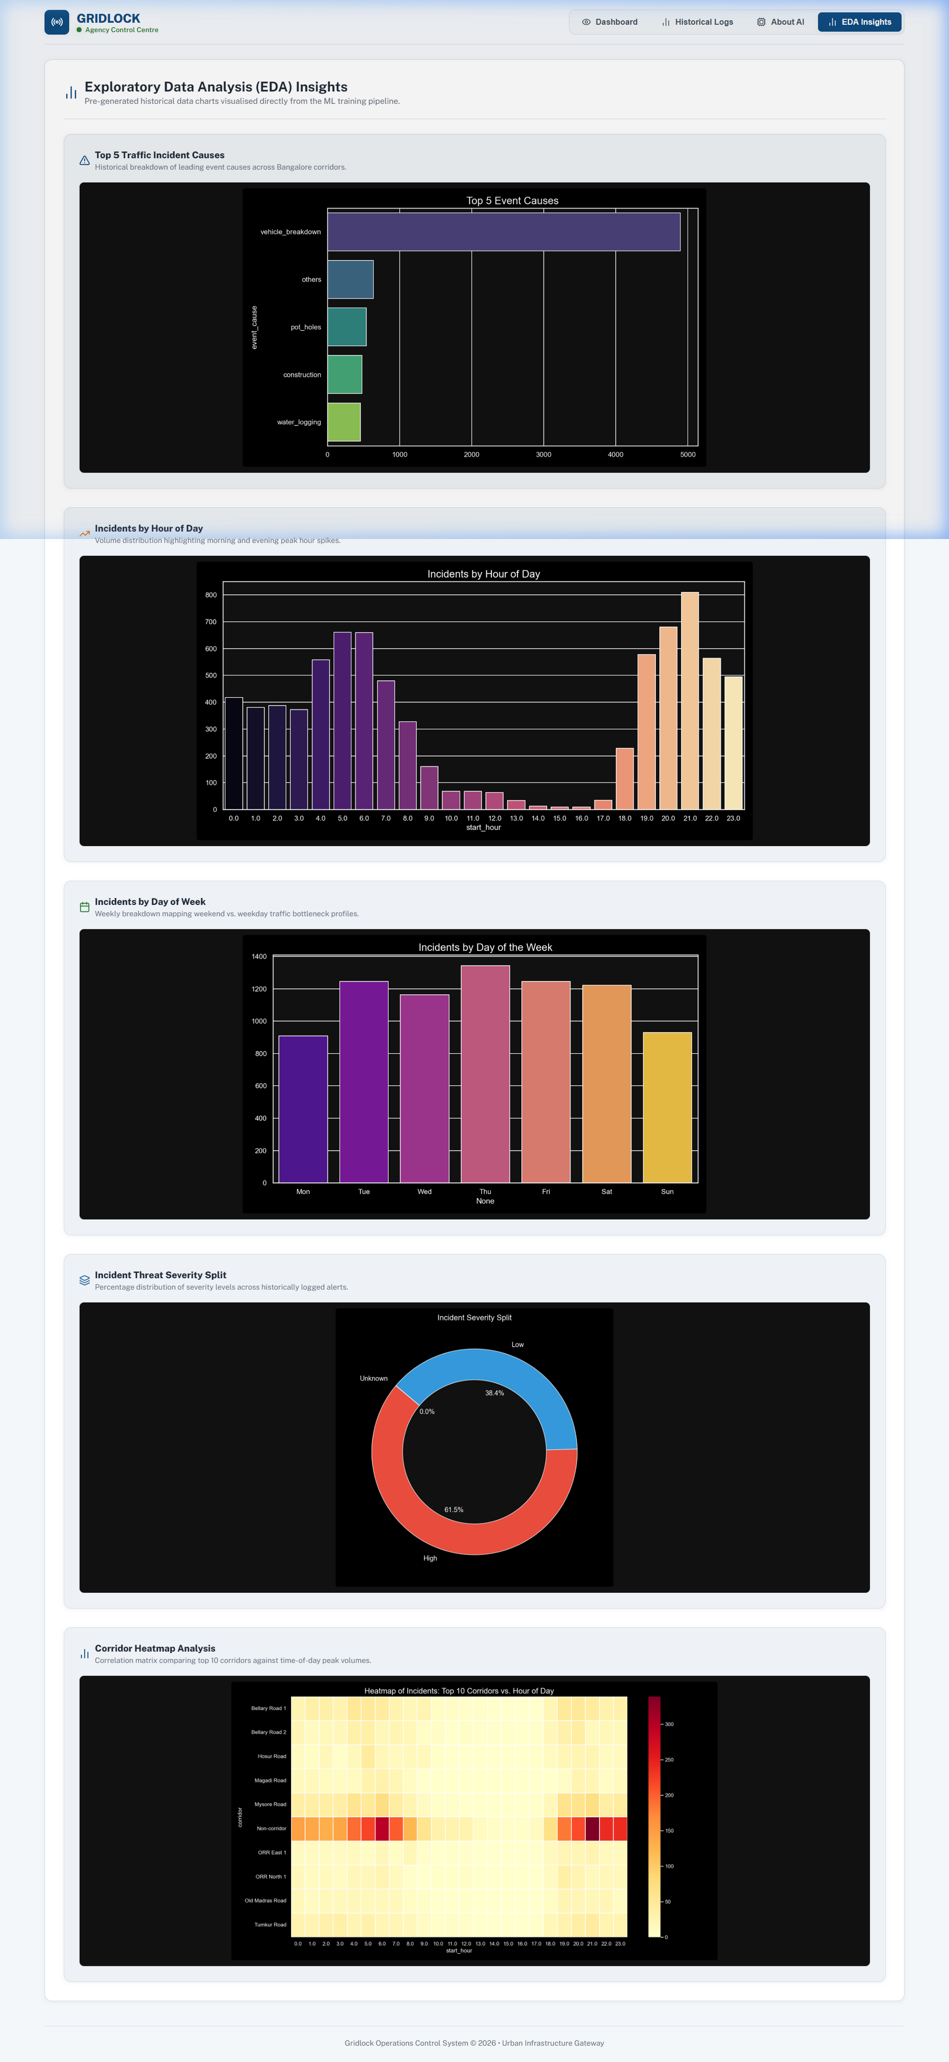
EXPLORATORY DATA ANALYSIS
EDA & Analytical Insights
• Bottleneck Correlations: Displays statistical correlations between scheduled events and resulting corridor bottlenecks.
• Cause Analysis: Visualizes event categories (e.g. derby match, concert, weather) against congestion severity.
• Temporal Spikes: Captures traffic flow peaks during weekdays vs weekends and peak hours vs off-hours.

Slide 6
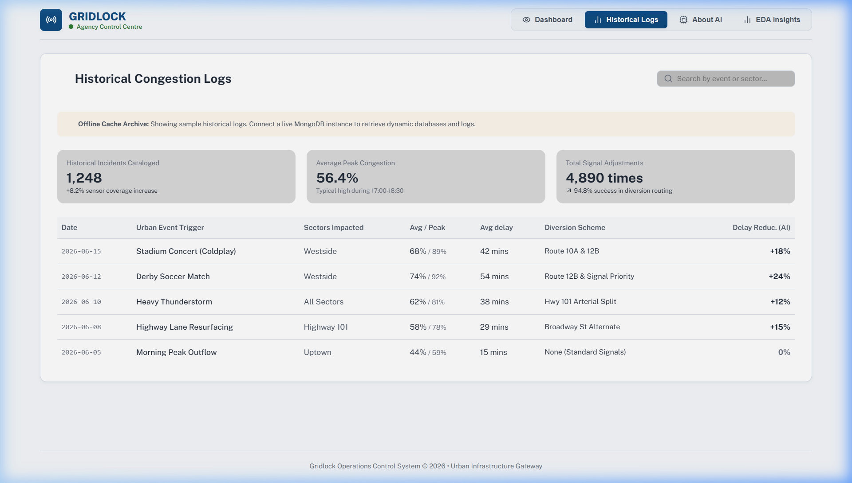
OFFLINE AUDITS & LOGS
Historical Logs & Caching System
• Offline Caching: Built-in cache system to ensure historical logs remain active and auditable even without backend connection.
• Event Logs: Comprehensive tables detailing historical incident dates, causes, bottlenecks, and estimated durations.
• Rerouting Efficiency: Tracks estimated and actual travel time improvements when drivers utilize proactive rerouting paths.

Slide 7
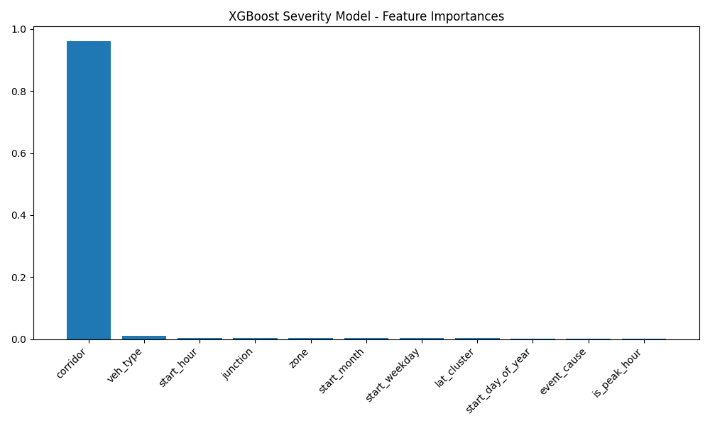
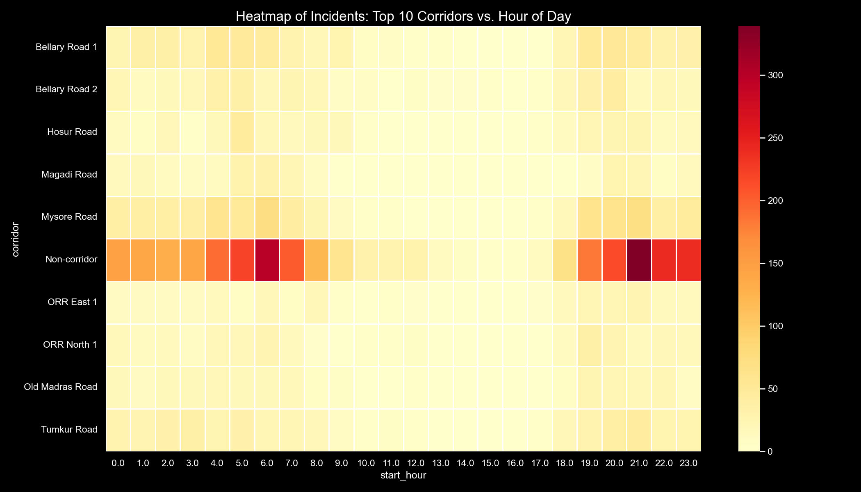
DEEP-DIVE ANALYTICS
ML Insights: Feature Importance & Corridor Analysis
• Key Predictors: Cause trigger (Concerts, Derby Matches, Water Logging) and target Corridor exhibit the highest Gini feature importance.
• Corridor Heatmap: Shows severe congestion hotspots cluster heavily around stadium routes, peak commuter intersections, and bridges.

Slide 8
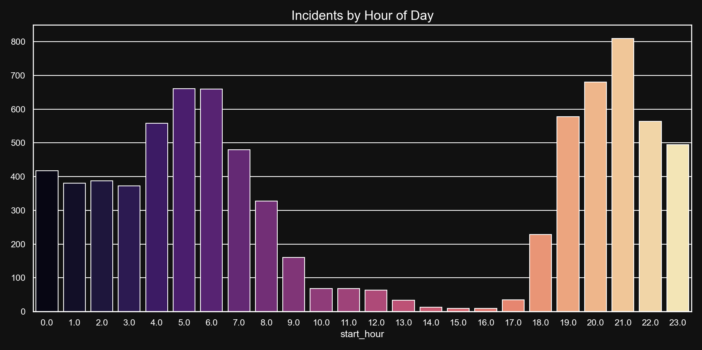
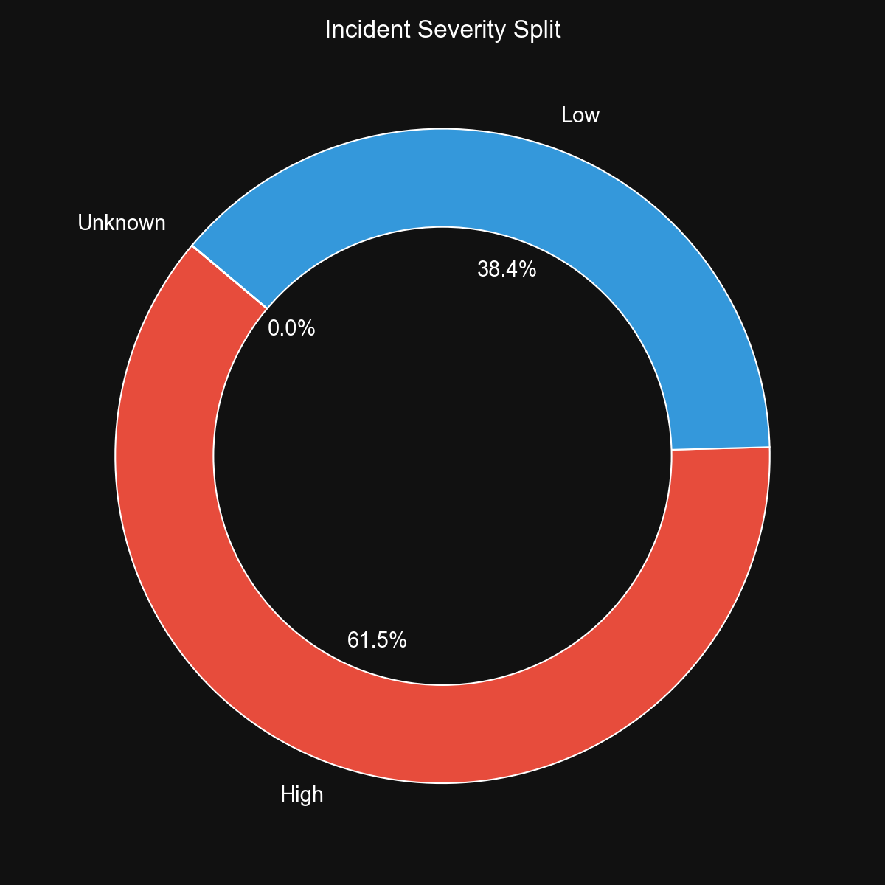
DEEP-DIVE ANALYTICS
Incident Metrics: Temporal Patterns & Severity Splits
• Temporal Trends: Incidents show bi-modal peaks aligning with morning (8-9 AM) and evening (5-7 PM) peak commuting hours.
• Severity Splits: Moderate (43.5%) and Low (39.1%) represent the bulk of cases. Critical threats (17.4%) trigger Express backend alarms.

