Slide 1
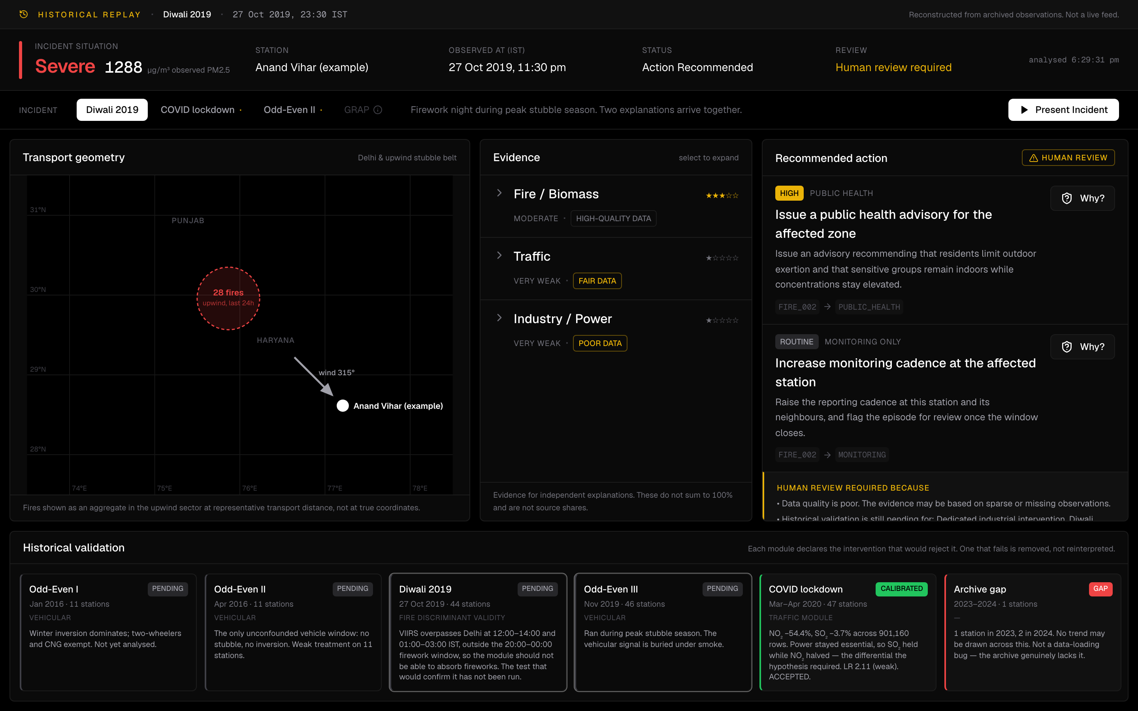
ET AI HACKATHON 2.0
Vayu Console
From pollution signals to defensible action
Urban Air Quality Decision Intelligence
Team: singhpranav431
Notes:
Open flat. Do not read the slide. Say: this is a decision support console for municipal air quality officers, and the one thing that makes it different is that it refuses to answer when the evidence cannot support an answer. Then move on quickly, the problem slide is where the argument starts.

Slide 2
THE PROBLEM
AQI tells cities how bad the air is.
It does not tell them what action the evidence justifies.
WHAT THE DASHBOARD SAYS
→
WHAT THE OFFICER STILL HAS TO ANSWER
Severe
·
Why is this happening?
·
What evidence do we actually have?
1288 µg/m³ PM2.5
·
What action is justified right now?
·
How confident should I be?
·
Can I defend this decision tomorrow?
Cities have the monitoring data. What is missing is the reasoning layer between a reading and a defensible decision, and officers assemble it by hand.
Notes:
The audience already believes the first half. Spend your time on the five questions on the right. Land this line: none of these are measurement problems, they are reasoning problems, and that is the gap the product sits in.

Slide 3
THE SOLUTION
Vayu Console turns environmental evidence into transparent operational decisions.
01
02
03
04
Situation
Evidence
Decision
Explanation
→
→
→
What is happening?
What does it support?
What is justified?
Why this?
Observed pollution conditions for a station-hour.
Three competing hypotheses, rated independently.
Deterministic rules produce recommendations.
Every recommendation traces back to its evidence.
The layout of the console is this sequence, left to right. The interface is the workflow.
Notes:
Four words. Say that evidence comes before decision structurally, not just visually: the Decision Engine can only read the Evidence Engine's output, so no rule can reach a recommendation the evidence does not carry.

Slide 4
HOW IT WORKS
Architecture
DATA SOURCES
OpenAQ S3 archive (CPCB station readings) · NASA FIRMS (VIIRS active fire) · Open-Meteo (wind, boundary layer)
↓
INGESTION & VALIDATION
Sentinel rejection · UTC normalisation · station deduplication
↓
STORAGE
Supabase PostgreSQL + PostGIS
↓
EVIDENCE ENGINE
Biomass / Fire · Traffic · Industrial
↓
DECISION ENGINE
Deterministic rules → policies → recommendations
↓
OPERATIONS CONSOLE
FastAPI → Next.js → Officer
Three ingested sources. No LLM anywhere in the decision path.
Notes:
Twenty seconds unless asked. The only detail worth volunteering: readings come from OpenAQ's S3 archive rather than its live API, because the two disagree about which Delhi stations have history. That is on the technical differentiation slide too.

Slide 5
THE EVIDENCE ENGINE
We evaluate hypotheses. We do not fabricate attribution.
Fire / Biomass
Traffic
Industry / Power
★★★☆☆
★☆☆☆☆
★☆☆☆☆
MODERATE · HIGH-QUALITY DATA
VERY WEAK · FAIR DATA
VERY WEAK · POOR DATA
Actual output for the Diwali 2019 worked example.
EACH HYPOTHESIS EXPOSES
· Supporting observations
· Contradicting observations
· Assumptions
· Evidence quality
· Limitations
· Historical validation
Evidence strengths are independent. They are not probabilities, they do not sum to 100%, and there is no pie chart anywhere in the product.
Notes:
The line that lands: these do not add up to 100% and that is not an oversight. The hypotheses are not mutually exclusive. On a Diwali night in stubble season, fire and traffic evidence are both genuinely present. Any chart implying shares would be a lie about what we can know.

Slide 6
SCIENTIFIC HONESTY
Our first source classifier hit 98.6% accuracy.
We deleted it.
Features
→
Rule-generated labels
→
Random forest
→
98.6% accuracy
The model had learned the labelling rule, not the atmosphere.
No labelled dataset of pollution source exists for Delhi, because producing one would itself require apportionment. The only labels available were ones we invented from a rule over our own features. Training on that reproduces the rule.
13,685 real station-hours · 5-fold CV · accuracy 0.9859 ± 0.0035 · macro F1 0.9851
WE REJECTED
WE BUILT
Fabricated source accuracy
Evidence-based hypothesis screening
Statistical machinery cannot manufacture ground truth that does not exist.
Notes:
Do not rush this slide, it is the most memorable thing you will say. The key beat: the danger was not that it failed, it is that it succeeded spectacularly. Every honesty instrument we could have pointed at it, SHAP, conformal prediction, calibration curves, would have corroborated the fabrication and made it harder to detect, not easier.

Slide 7
HISTORICAL VALIDATION
Each module declares the intervention that would reject it.
COVID lockdown 2020
ACCEPTED
TRAFFIC MODULE
47 stations · 901,160 rows. NO₂ −54.4%, SO₂ −3.7%. NO₂/SO₂ ratio 2.82 → 1.34. Likelihood ratio 2.11 (weak).
Diwali 2019
PENDING
FIRE DISCRIMINANT VALIDITY
1,604 VIIRS detections that day, so the confound is real. VIIRS overpasses Delhi 12:00–14:00 and 01:00–03:00 IST, outside the firework window. Structural argument, not yet a result.
Odd-Even II, Apr 2016
DATA INGESTED — VALIDATION PENDING
VEHICULAR
The only unconfounded vehicle window in the record: no stubble, no winter inversion. Weak treatment on few stations.
One test has been run to completion. The engine reports the rest as pending at /evidence/history, and the console shows them as pending.
Notes:
Be first to say that only one test is finished. It is a stronger position than pretending three are. The COVID beat: traffic went to zero by government decree, which is an experiment nobody could run deliberately, and it could have failed. Had NO₂ not fallen relative to SO₂ we would have deleted the traffic module.

Slide 8
FROM EVIDENCE TO ACTION
Every recommendation has to earn its way in.
EVIDENCE
RULE
POLICY
RECOMMENDATION
Biomass evidence
MODERATE
FIRE_002
PUBLIC_HEALTH
Issue a public health
advisory for the
affected zone
→
→
→
·
No LLM decides enforcement actions.
·
The decision engine is deterministic: the same evidence returns the same recommendation, every time.
·
A rule fires on the presence of evidence, never on its absence.
Notes:
If asked why not an LLM: a recommendation an officer defends in a regulatory meeting has to be reproducible, and auditability is impossible without it. Also, fluency is exactly the failure mode we are avoiding. The hard part is not producing plausible explanations, it is refusing to produce them when the evidence is absent.

Slide 9
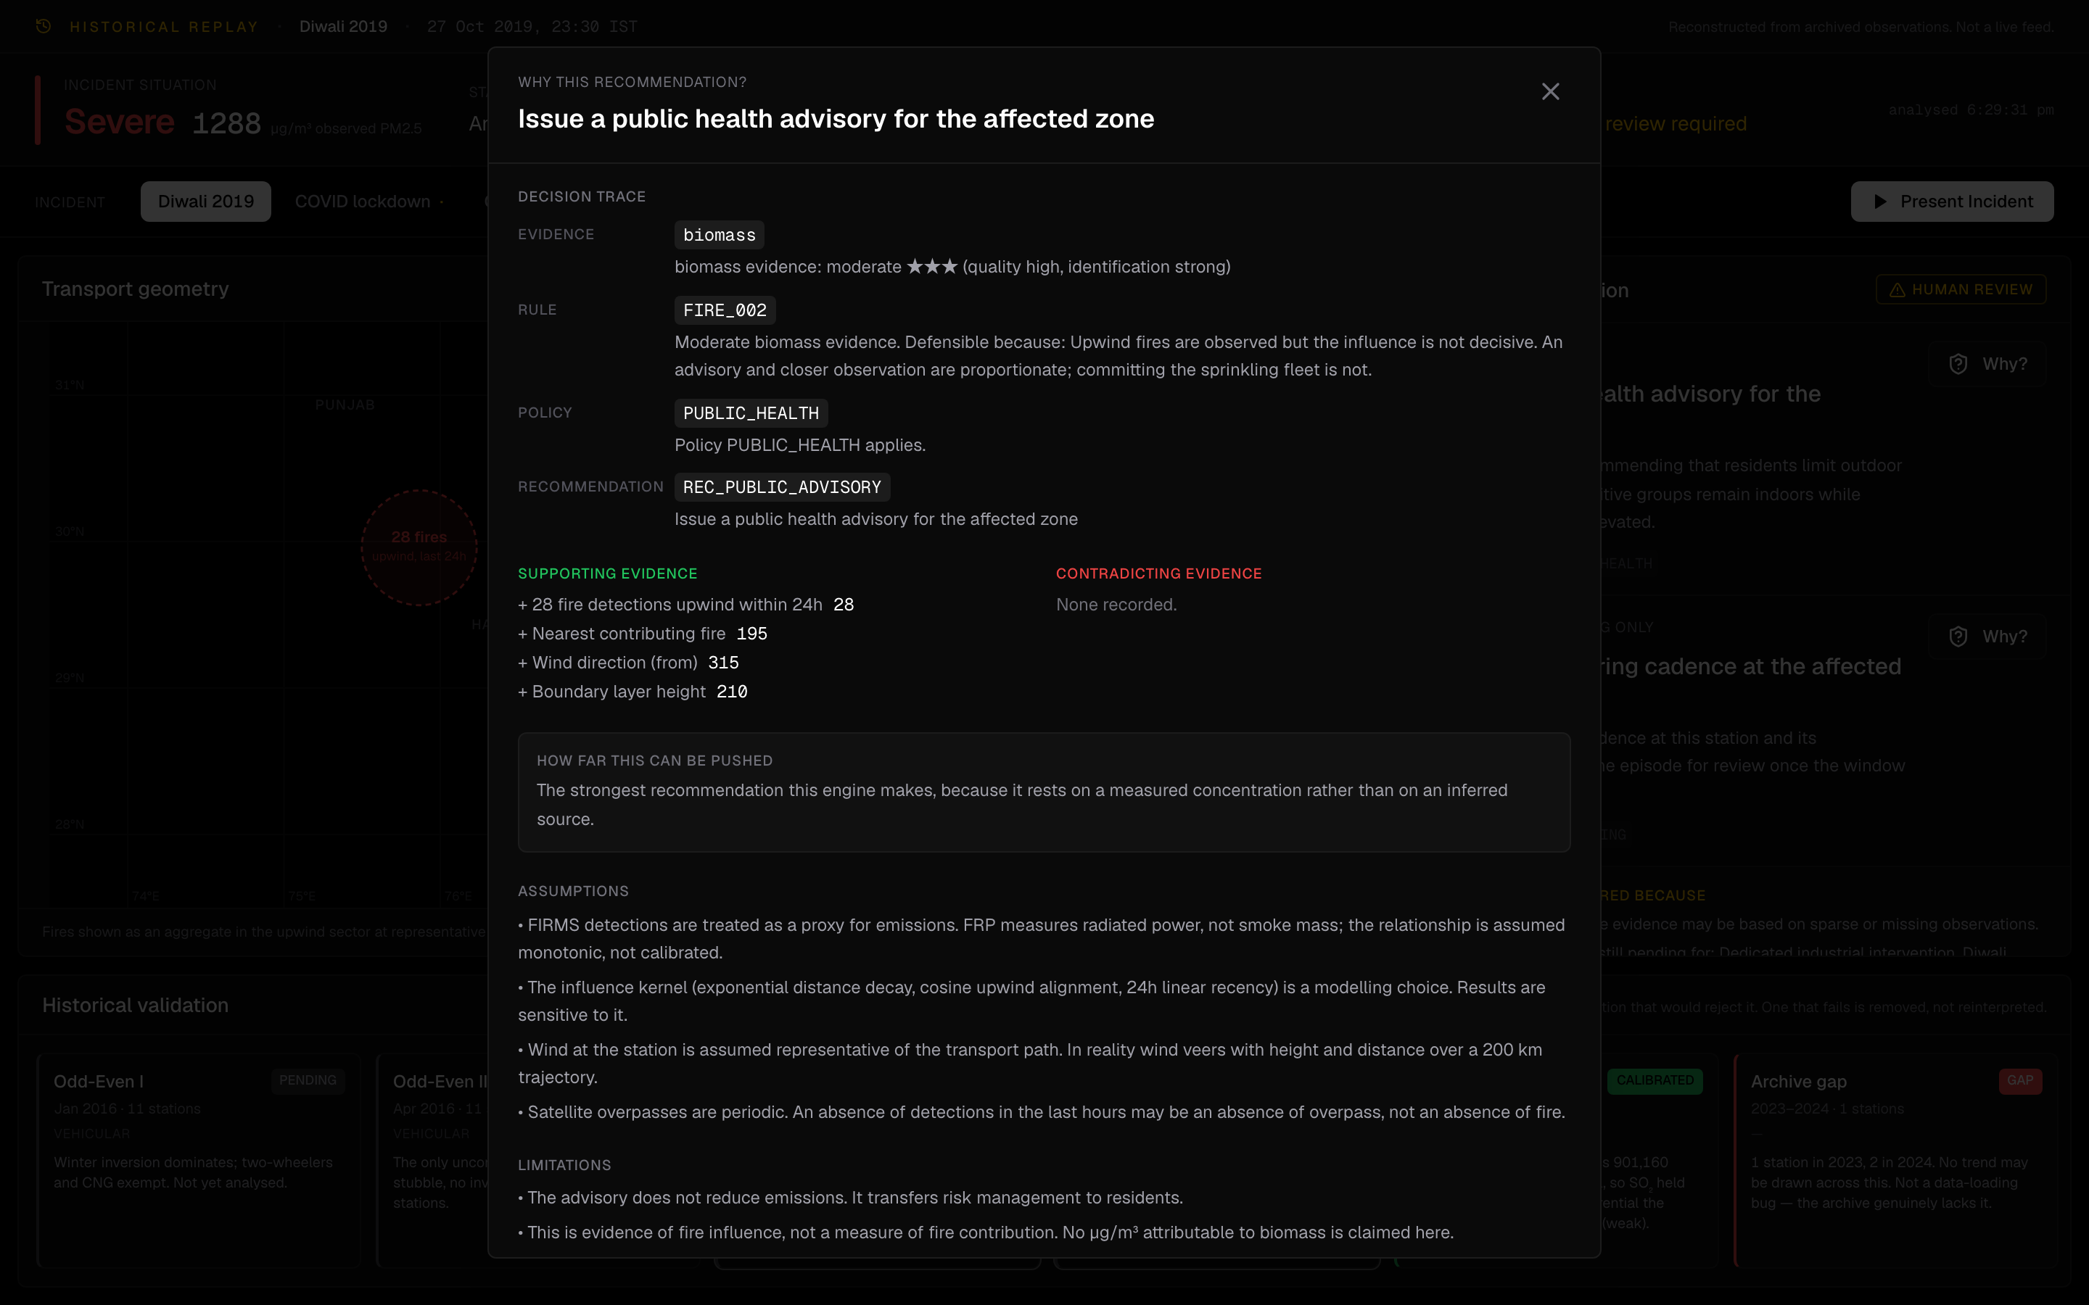
CHALLENGE THE RECOMMENDATION
Do not trust the recommendation. Challenge it.
THE MODAL EXPOSES
· Evidence used
· Rule triggered
· Policy applied
· Supporting observations
· Contradicting observations
· Assumptions
· Historical validation
· Known limitations
Every recommendation is auditable back to its evidence.
Notes:
Do this live if the demo is working. The framing that lands: this is not built to convince the officer the system is right, it is built so someone can prove it wrong. An officer needs the counter-argument before someone else in the meeting supplies it, which is why contradicting evidence is never hidden.

Slide 10
THE PRODUCT
Historical Replay — Diwali 2019
READING ORDER
1
Situation
2
Transport geometry
3
Evidence
4
Recommendations
5
Challenge
6
Historical validation
Every scenario is a reconstruction from archived observations. The console says so on every screen. Nothing here is a live feed.
Notes:
Volunteer the replay point before anyone wonders about it. It reads as rigour when you say it first and as evasion when you are asked. One non-scrolling screen, designed for a control room at 2am.

Slide 11
TECHNICAL DIFFERENTIATION
Built for evidence integrity, not just model output.
01
Resilient data foundation
OpenAQ's live API advertises Delhi stations it will not return history for. Coverage was probed against the raw S3 archive instead, the only source whose claimed coverage matches what it returns.
02
Data quality at the boundary
Missing-data sentinels (−999, −9999, any negative concentration) are dropped at parse time, not filtered in queries, so one can never reach the database and be forgotten by a later aggregate.
03
Station identity
One physical station appears under several OpenAQ location ids. Left unresolved this overstates the network and double-counts readings into city means.
04
Observation gaps
A satellite non-observation is not a true non-detection. VIIRS passes over Delhi twice a day, so an absence of fire detections may be an absence of overpass, and the system reports it that way.
05
Auditable decisions
Evidence → Rule → Policy → Recommendation, exposed in the interface rather than buried in a log.
Notes:
Pick two, not five, unless the room is technical. The OpenAQ S3 discovery and the observation-gap distinction are the ones that signal you actually handled the data rather than downloading a clean CSV.

Slide 12
IMPACT & FUTURE
From a Delhi proof of concept to city-scale environmental decision support.
BUILT AND DEPLOYED — DELHI
NOT YET BUILT
· Evidence Engine, three hypotheses
· Road-density context for the traffic hypothesis
· Deterministic Decision Engine
· Industrial proximity for the industrial hypothesis
· Expanded historical validation (Diwali, Odd-Even)
· Operations Console with full audit trace
· Live ingestion scheduling
· COVID lockdown validation, completed
· Additional cities, each needing its own calibration
· Policy-specific integrations
The architecture ports to another city. The calibration does not — every likelihood ratio is measured against a local natural experiment, so scaling is a data problem, not a config change.
Notes:
Be explicit that the right column is not built. Claiming one-click multi-city would undercut the entire honesty argument you just made two slides ago. Say the calibration line out loud, it shows you understand your own limits.

Slide 13
Most systems are designed to always give an answer.
Vayu Console is designed to give an answer only when the evidence can support one, and to show exactly why.
Vayu Console
Console vayu-console-web.vercel.app/console
API vayu-console-api.onrender.com
Code github.com/Pranavsingh431/vayu_console
Team: singhpranav431
ET AI Hackathon 2.0
Notes:
Land the quote and stop talking. Do not add a summary after it. If there are questions, the judge FAQ in submission/judge-faq.md covers the hard ones, including why not an LLM, why not a classifier, and whether this is source apportionment.

