Slide 1


Object Oriented Analysis and Design using UML – Project Review
AIRPORT MANAGEMENT SYSTEM
Team No : - 7
Team Members :
1.PRANAV VEDULA– 24B11CS355
2.POSA KAVERI – 24B11CS352
3.M SATYA HARSHA VARDHAN REDDY – 24B11CS275
4.BODHANAPU SUHAS – 24B11CS049

Slide 2

Abstract
The Airport Management System is designed to streamline and automate airport operations from passenger check-in to final boarding.
The system enables passengers to register, check in online or at the counter, generate boarding passes, track flight and gate status, manage baggage, complete security and immigration clearance, and receive boarding notifications.
Airport staff can manage flight schedules, passengers, gates, baggage, security clearance, traveller buses, special assistance and lounge access through role-based access.
The system also handles flight delays, cancellations, gate allocation, passenger flow and operational reporting.
The project follows Object-Oriented Analysis and Design (OOAD) principles. UML diagrams are used to represent the system's actors, structure, workflows, interactions, components and deployment architecture.
Notes:
Introduce UML and its significance in software engineering.

Slide 3
About UML Diagrams
Use Case Diagram
Represents the actors and functionalities of the Airport Management System.
Class Diagram
Represents system classes, attributes, methods and relationships.
Sequence Diagram
Represents the chronological interaction between actors and system objects.
Activity Diagram
Represents the workflow of airport operations.
State Diagram
Represents changes in the state of an object during its lifecycle.
Component Diagram
Shows the major software components and their dependencies.
Deployment Diagram
Shows how the software components are deployed across physical devices and servers.
Notes:
Explain purpose and classification of UML diagrams.

Slide 4
About UML Diagrams
UML Modeling of the Airport Management System
Diagram | What it represents
Use Case | Actors and airport system functionalities
Class | Passengers, flights, baggage, gates and other objects
Sequence | Interaction during airport operations
Activity | End-to-end airport workflows
State | Lifecycle of flights, bookings and baggage
Component | Software architecture of the system
Deployment | Physical deployment of the airport application
Notes:
Explain purpose and classification of UML diagrams.

Slide 5
Use Case Diagram
Major Functions
Register/Login
Check-in
Generate Boarding Pass
Manage Baggage
Security Clearance
Immigration Clearance
Allocate Gate
Board Passenger
Manage Traveller Bus
Track Flight
Request Assistance
Manage Lounge Access
Manage Flights
Generate Reports
Use Case Diagram
A Use Case Diagram represents the functional requirements of the Airport Management System and shows how different actors interact with the system.
Major Actors:
Passenger
Check-in Staff
Security Personnel
Immigration Officer
Gate Agent
Bus Driver
Administrator
Notes:
Present definition, components, steps, and a sample diagram.

Slide 6
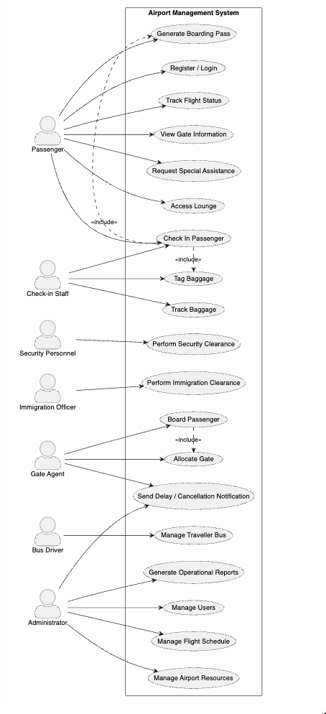
Use Case Diagram
Notes:
Present definition, components, steps, and a sample diagram.

Slide 7
Class Diagram
Class Diagram
A Class Diagram represents the static structure of the Airport Management System.
Major Classes
Passenger
AirportStaff
CheckInStaff
SecurityPersonnel
ImmigrationOfficer
GateAgent
BusDriver
Administrator
Flight
Booking
BoardingPass
Baggage
Gate
TravellerBus
AssistanceRequest
Lounge
Transaction/Notification
Relationships
The diagram represents:
Inheritance
Association
Composition
Dependency
Notes:
Cover key elements, relationships, and a class diagram example.

Slide 8
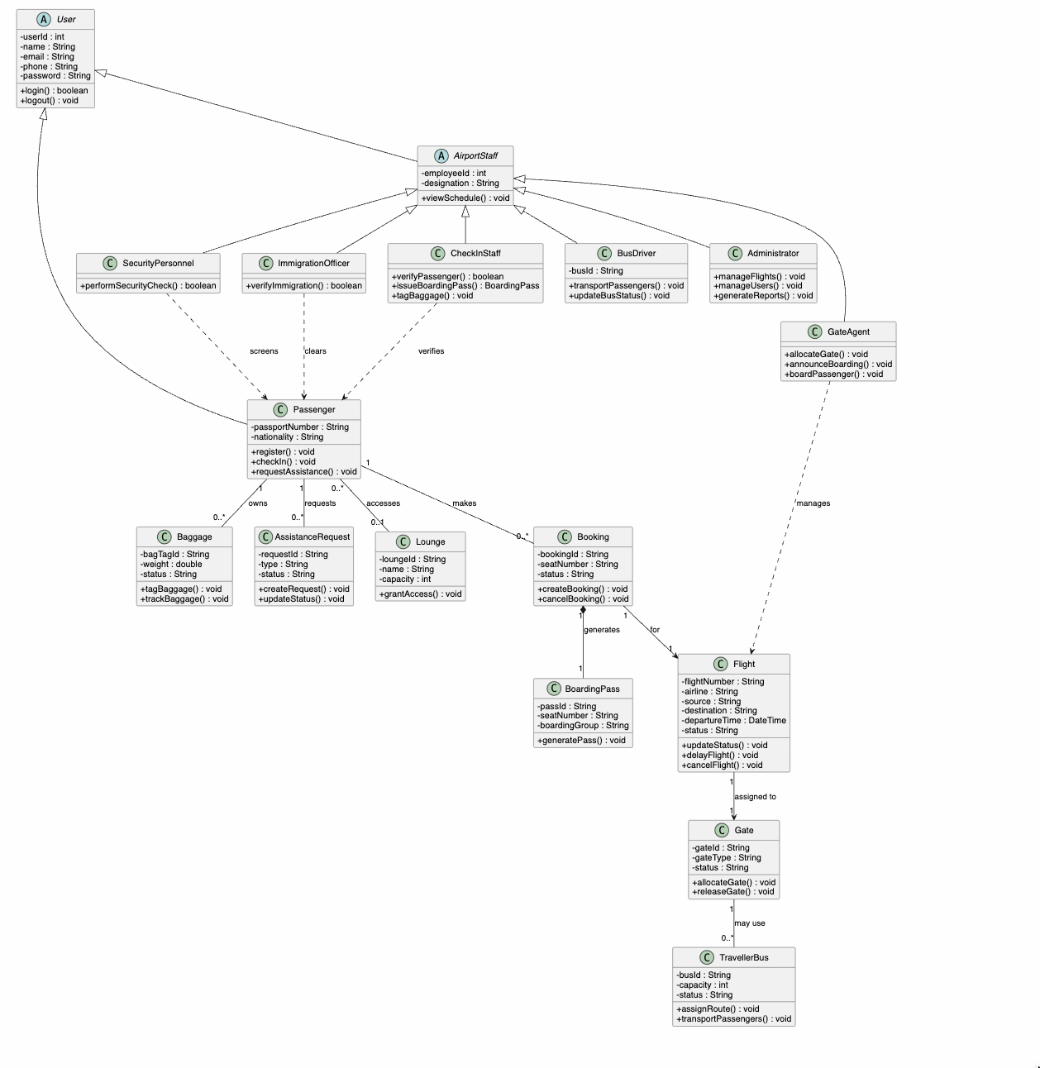
Class Diagram
Notes:
Cover key elements, relationships, and a class diagram example.

Slide 9
Sequence Diagram
Sequence Diagram
A Sequence Diagram represents the time-ordered interaction between actors and objects.
Components
Actor
Lifeline
Message
Activation
Return Message
Combined Fragment
Airport Operations
We can model sequences such as:
Passenger Check-in
Baggage Processing
Security Clearance
Boarding
Traveller Bus Transportation
Notes:
Show sequence diagram with step‑by‑step explanation.

Slide 10
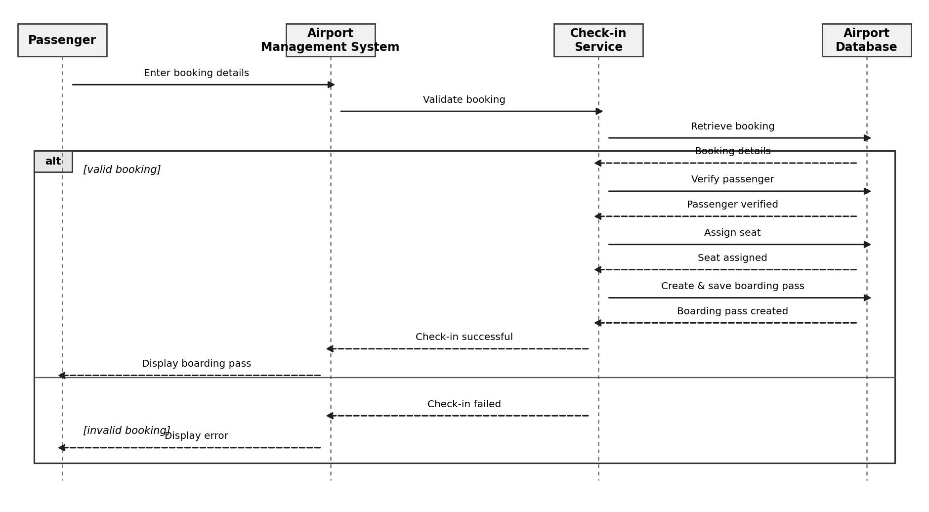
Sequence Diagram – ( check-in)
Notes:
Show sequence diagram with step‑by‑step explanation.

Slide 11
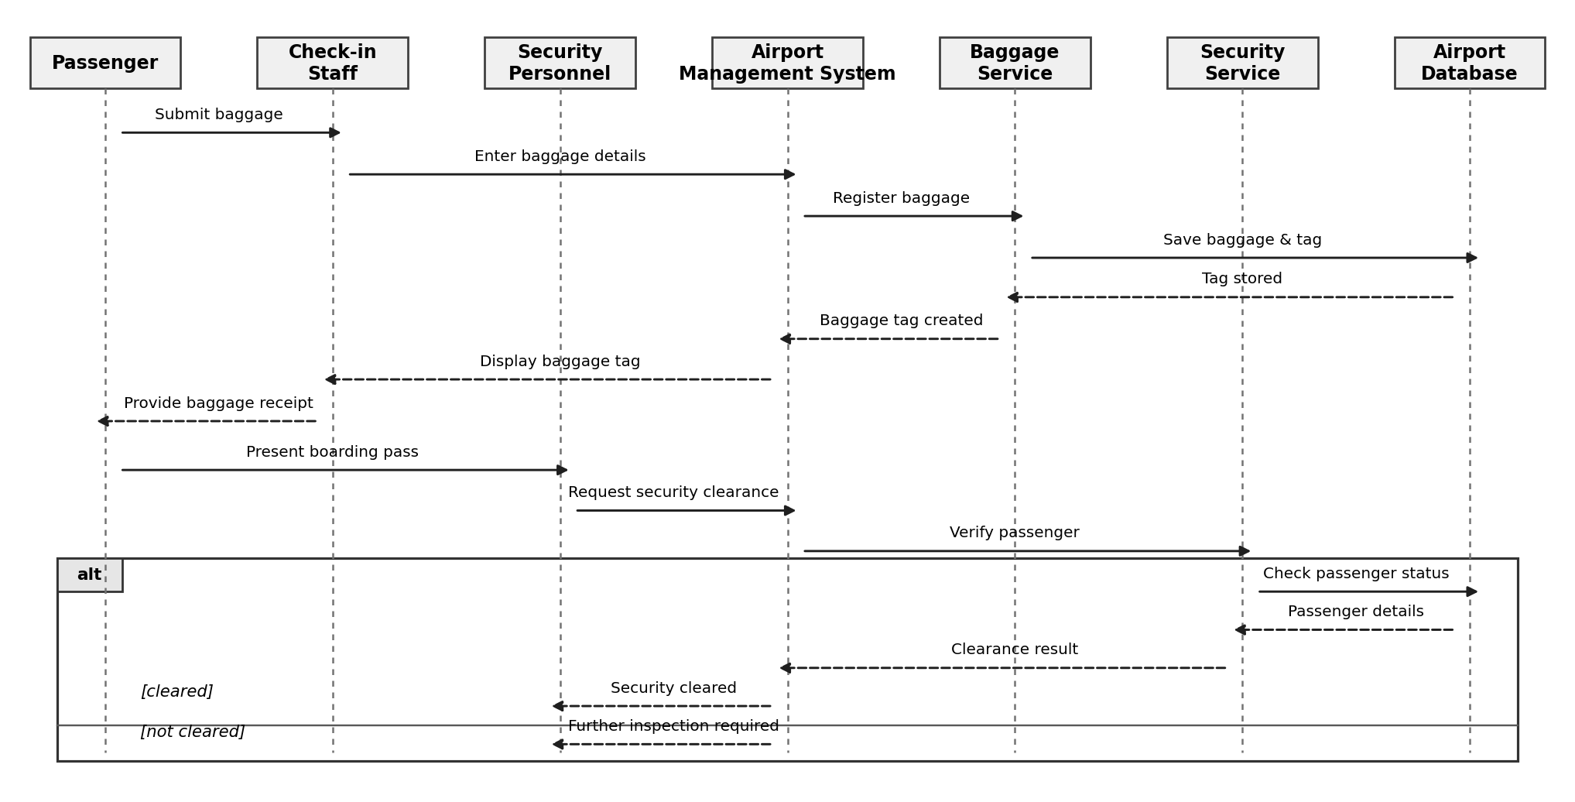
Sequence Diagram – ( baggage & security clearance )
Notes:
Show sequence diagram with step‑by‑step explanation.

Slide 12
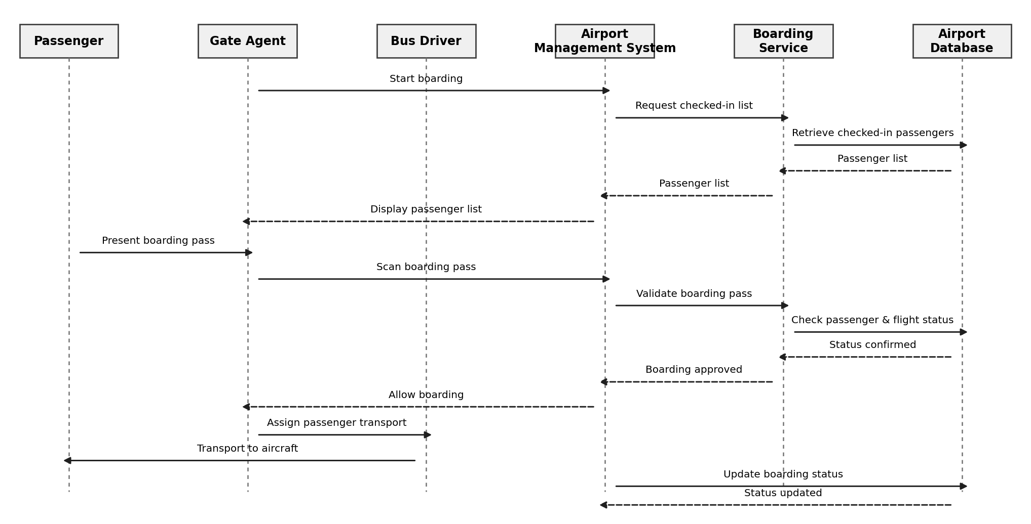
Sequence Diagram – ( boarding )
Notes:
Show sequence diagram with step‑by‑step explanation.

Slide 13
State Chart Diagram
The State Chart Diagram represents the different states of a flight during its lifecycle and the events that cause it to move from one state to another.
In our Airport Management System, a flight initially starts as Scheduled. Based on airport operations, it can become Delayed or Cancelled. Once the flight is ready, boarding begins, followed by departure and finally arrival.
Flight States
Scheduled → Boarding → Departed → Arrived
Possible alternate states:
Scheduled → Delayed → Boarding
Scheduled → Cancelled
Boarding → Cancelled
Notes:
Explain state chart components and a sample diagram.

Slide 14
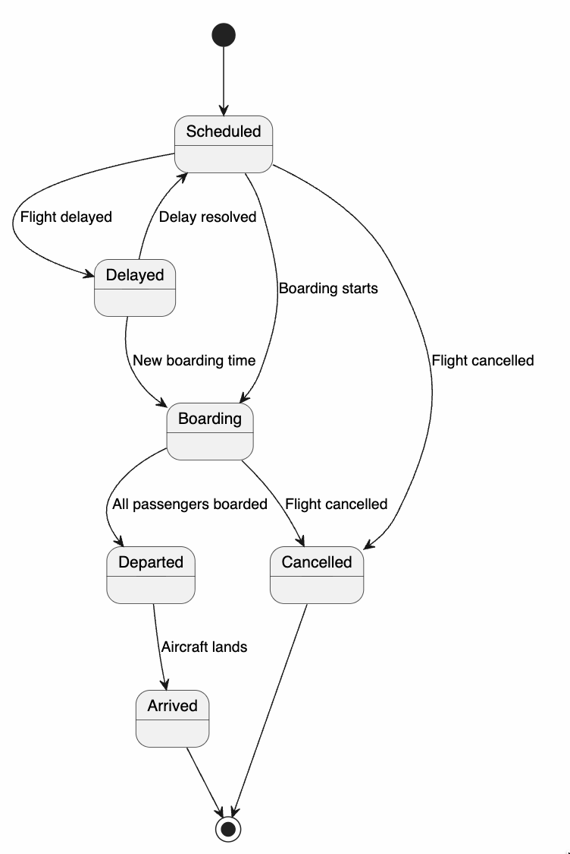
State Chart Diagram
Notes:
Explain state chart components and a sample diagram.

Slide 15
Review – 2
Activity Diagram:
The Activity Diagram helps us understand the step-by-step workflow of a passenger in the Airport Management System.
Deployment Diagram:
The Deployment Diagram helps us understand how the Airport Management System is physically deployed across devices, servers, databases, and communication networks.
Component Diagram:
The Component Diagram helps us understand the major software components of the Airport Management System and how they interact with each other.
Notes:
Explain state chart components and a sample diagram.

Slide 16
Activity
The Activity Diagram represents the complete passenger journey in the Airport Management System, starting from login and flight search through booking, check-in, boarding-pass generation and security verification. Based on the security verification result, the passenger either proceeds to the gate and boards the flight or the process terminates due to failed verification.
Notes:
Explain state chart components and a sample diagram.

Slide 17
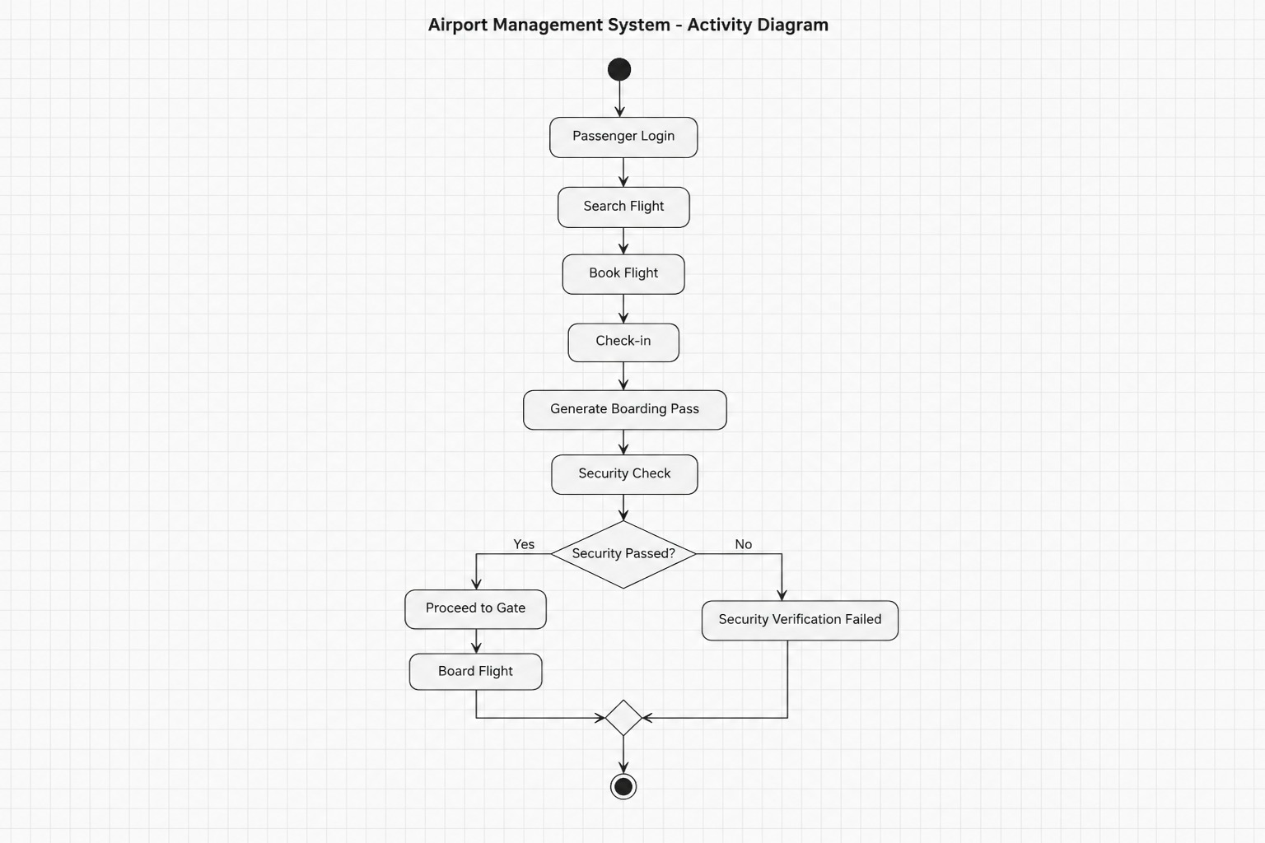
Activity Diagram
Notes:
Explain state chart components and a sample diagram.

Slide 18
Deployment
The Deployment Diagram represents the physical deployment of the Airport Management System. Passengers, airport staff and administrators access the system through web browsers, mobile applications and dedicated terminals. All client devices communicate with the Airport Management API through HTTPS. The application server hosts the major airport services such as authentication, flight management, passenger management, baggage management, gate management, reporting and notifications. These services access the Airport Management Database for storing and retrieving operational data. The Notification Server provides SMS and email communication services.
Notes:
Explain state chart components and a sample diagram.

Slide 19
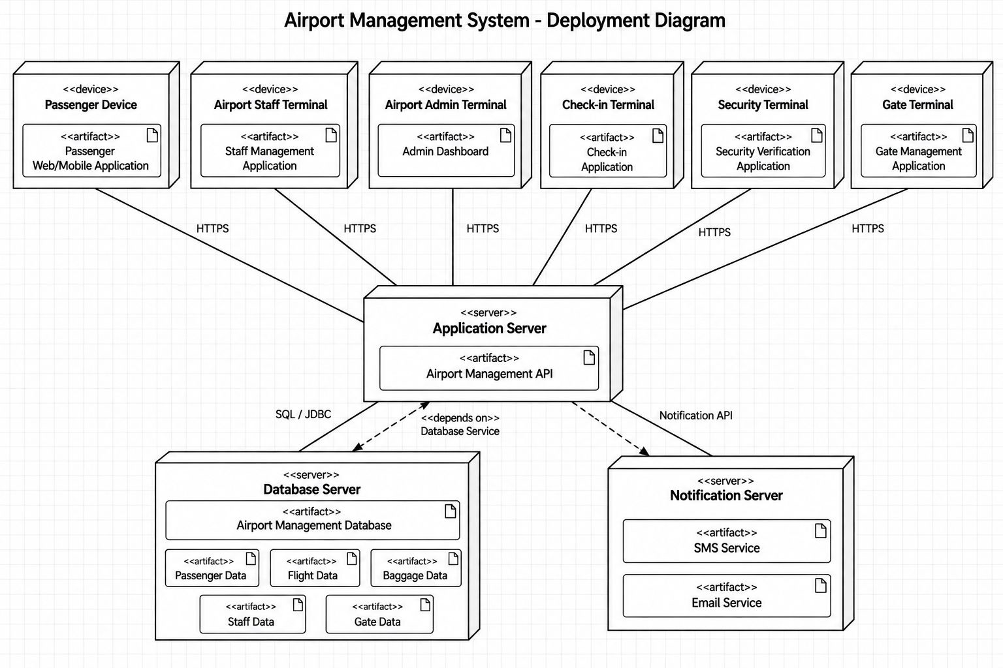
Deployment Diagram
Notes:
Explain state chart components and a sample diagram.

Slide 20
Component
The Component Diagram represents the logical components of the Airport Management System and their interactions. The system provides separate components for passenger management, booking, security, baggage, boarding passes, gates, staff, reports and authentication. Passengers, airport staff, security officers, gate staff and administrators interact with the appropriate system components. The components communicate with the Airport Database for persistent storage, while the Notification Service provides SMS and email notifications.
Notes:
Explain state chart components and a sample diagram.

Slide 21
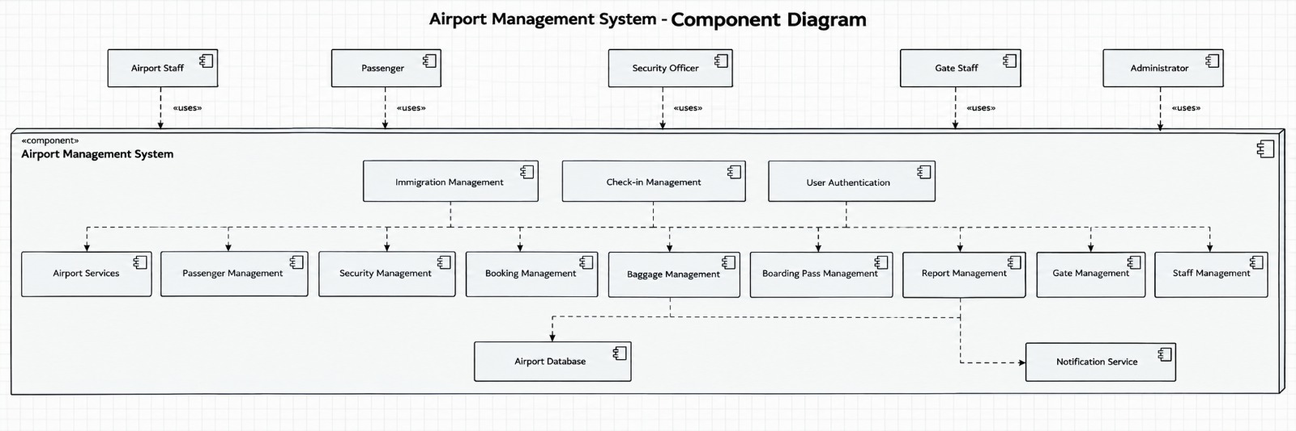
Component Diagram
Notes:
Explain state chart components and a sample diagram.

Slide 22
Conclusion
The Airport Management System provides an integrated solution for managing airport operations from passenger check-in to final boarding.
By applying Object-Oriented Analysis and Design (OOAD), the system clearly models passengers, flights, baggage, gates, airport staff, traveller buses and other important entities.
The UML diagrams help us understand the system's functional requirements, structure, interactions, workflows and flight lifecycle.
Key Benefits
Reduces passenger waiting time and gate congestion
Improves coordination between airport departments
Enables efficient passenger, baggage and flight management
Supports real-time flight and gate status updates
Provides organized handling of security, boarding and transport services
Creates a structured and scalable foundation for implementation
Notes:
Summarize key takeaways for exam preparation.

Slide 23
Any Q&A
Notes:
Invite audience questions and wrap up.

