Slide 1
PROJECT
LUMINAR
The Augmented Reality Data Projector
Visualizing the Unseen. Directly on the World Around Us.
From Vision to Viability

Slide 2
THE CHALLENGE
Data is Trapped on Screens
Critical data is isolated
👷
👥
Thermal, structural, and logistical data confined to small, disconnected screens.
VS
Cognitive gap
Engineer + tablet
+ tool = errors
Team sharing
tiny screens
Technicians constantly look away from their work—creating errors and safety risks.
Collaboration barrier
Impact
Teams huddle around tiny screens, unable to share a common data view.
Inefficiency · Errors · Safety Risks
Isolation · High Cost · Poor UX
AR headsets fall short
Expensive, cumbersome, isolating, and impractical in rugged field environments.

Slide 3
OUR VISION
d
Break data free from the screen
"What if a team could see, share, and interact with the same data overlay — in the same physical space — at the same time?"
🚀
Data belongs in the world, not behind glass.
🔮
Shared spatial awareness
👁
A team sees, shares, and interacts with the same overlay—simultaneously.
Intuitive & collaborative by design
🤝
Context-aware data that makes sense right where the work happens.
The LUMINAR Promise

Slide 4
THE PRODUCT
A portable, handheld device that Scans, Analyzes, and Projects data directly onto any surface.
📡
🧠
✨
SCAN
ANALYZE
PROJECT
→
→
LiDAR · Infrared · RGB Camera
Captures geometry and properties of the environment with precision sensor arrays.
Onboard System on a Chip
Powerful SoC processes all sensor data in real-time with dedicated NPU acceleration.
Laser-based Pico Projector
High-definition overlay with perfect geometric alignment onto any surface.

Slide 5
tack
TECHNOLOGY
⚙️ HARDWARE CORE
🧠 SOFTWARE CORE (CS ENGINE)
🔦
Laser Pico Projector
Real-time OS & Firmware
High brightness, focus-free beam
Lag-free hardware communication
📏
ToF / LiDAR Depth Sensor
Sensor Fusion Engine
Precise spatial mapping
Combines LiDAR, IR, and RGB streams
🌡️
Modular Sensor Bay
SLAM Algorithm
IR/Thermal camera (swappable)
3D perception & device positioning
💻
ARM SoC with GPU & NPU
Projection Mapping Module
Real-time processing power
Warps image to uneven surfaces in real-time
🔋
Swappable Battery
Data Visualization API
Field-replaceable high-density pack
Renders compelling 'reinfographics'

Slide 6
SYSTEM REQUIREMENTS
What the system MUST DO — observable, testable behaviours expected by users and stakeholders.
FR-01
Real-Time Sensor Capture
FR-02
Surface Projection Mapping
The system shall capture thermal, depth (LiDAR/ToF), and RGB data simultaneously at ≥ 30 fps with a maximum end-to-end pipeline latency of 100 ms.
The system shall geometrically warp the projected output to conform to arbitrary non-planar surfaces in real-time, using depth data for keystone and distortion correction.
FR-03
Thermal Visualisation Overlay
FR-04
Sensor Fusion & SLAM
The system shall render a colour-coded thermal heat map (e.g. IRONBOW palette) aligned pixel-accurately to the physical object, with configurable temperature thresholds and alert colours.
The system shall fuse LiDAR, RGB, and IMU data streams using a Sensor Fusion Engine to maintain real-time 6-DoF pose estimation of the device relative to the scene.
FR-05
Modular Data Visualisation API
FR-06
Remote Database Integration
The system shall expose a documented REST/gRPC API allowing third-party developers to register custom sensor modules and define new 'reinfographic' rendering pipelines.
The system shall retrieve asset metadata (part numbers, maintenance history, schematics) from a central database via Wi-Fi/LTE within ≤ 2 seconds upon object recognition.

Slide 7
SYSTEM REQUIREMENTS
Quality attributes that govern HOW the system performs — the engineering constraints and standards it must meet.
⚡
Performance
NFR-01
🛡️
Reliability & Availability
NFR-02
Scan-to-projection pipeline latency: ≤ 100 ms end-to-end
MTBF (Mean Time Between Failures): ≥ 500 operating hours
Projection frame rate: ≥ 30 fps sustained; ≥ 60 fps target
Graceful degradation: device must continue projecting if DB connection fails
Object recognition response: ≤ 500 ms from trigger
Sensor fault detection and user alert within 200 ms
🔧
Portability & Durability
NFR-03
🎯
Usability
NFR-04
IP54 rated enclosure: dust and splash resistant for field use
A new user must reach operational proficiency within ≤ 15 minutes
Operating temperature range: −10°C to +55°C
UI must conform to WCAG 2.1 AA contrast ratio standards
Drop resistance: survive 1.2 m drop onto concrete (MIL-STD-810)
Single-handed operable interface — no two-hand interaction required
🔒
Security
NFR-05
🧩
Maintainability & Scalability
NFR-06
All data transmissions encrypted via TLS 1.3 or higher
Codebase must achieve ≥ 80% unit test coverage (CS Engine modules)
Firmware updates must be cryptographically signed (RSA-2048)
New sensor modules must be integrable without core firmware changes
Local sensor data must not persist beyond the active session by default
API versioning enforced; v1 endpoints supported for ≥ 24 months after v2 release

Slide 8
USE CASE 01
🏭
01
Technician points LUMINAR at a complex engine or industrial system.
Point & Scan
● LIVE THERMAL OVERLAY ACTIVE
02
Device projects a live thermal heat map—overheating components glow bright red instantly.
Live Thermal Projection
Component #7B | TEMP: 247°C ⚠️ CRITICAL
Part: TRB-2201-A | Last service: 47 days ago
03
Schematic Overlay
📋 Schematic overlay with maintenance history fetched from central database automatically.
One button press switches to part numbers, maintenance history, and service records.

Slide 9
USE CASE 02
🔥
01
Firefighter scans a wall in a smoke-filled room with LUMINAR.
Scan the Wall
THERMAL SCAN — SMOKE PENETRATION ACTIVE
02
See Through Smoke
Thermal image projected onto the wall reveals structural hotspots and victim locations on the other side.
VICTIM
DETECTED
HOTSPOT
⚠️
03
Entire team sees the same projection—superior shared awareness vs. individual thermal goggles.
Shared Team View
Shared situational awareness for the entire team — critical advantage over individual thermal goggles.

Slide 10
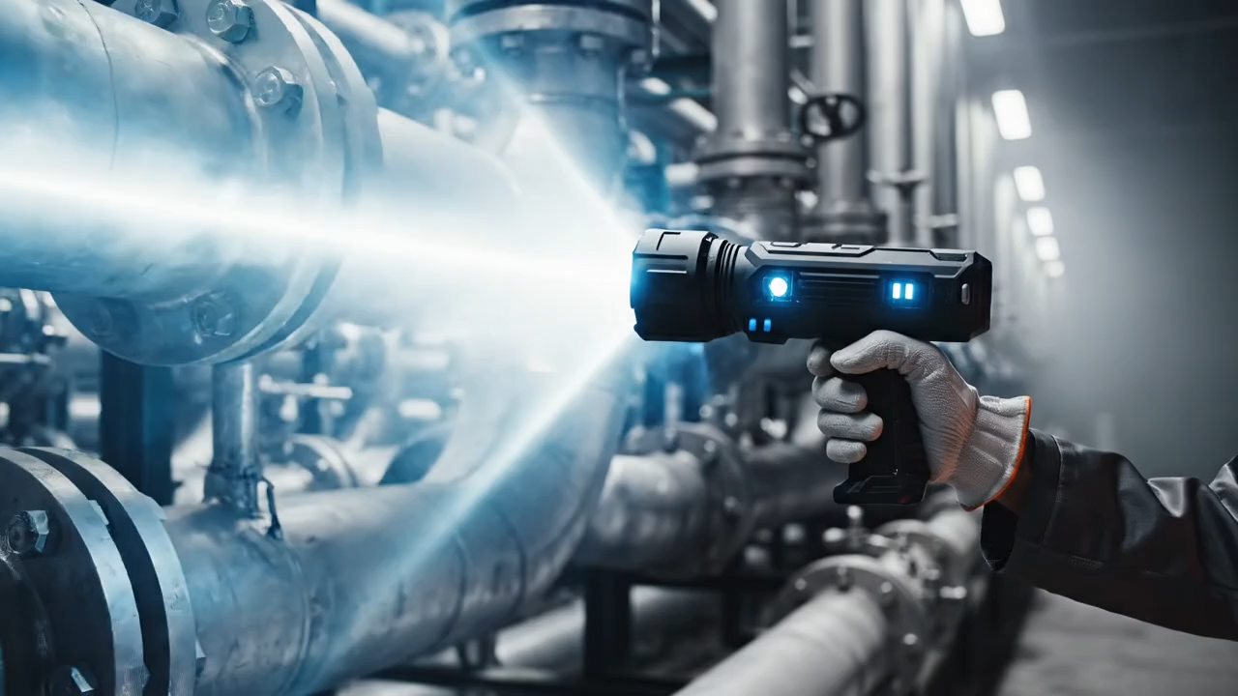

Slide 11
THE PLATFORM
The core technology is a platform. The primary sensor is modular; software is extensible via API.
🏗️
📦
Architecture
Logistics
Project blueprints and structural integrity scans onto buildings in real scale.
Scan a pallet and project contents, routing, and destination onto boxes.
Open API
🛒
🎓
Retail
Education & Medical
Project customer reviews and live product information directly onto shelf space.
Project anatomical diagrams onto training manikins for immersive learning.

Slide 12
👥
Collaborative by Design
MARKET
Unlike isolating headsets, LUMINAR creates a shared view for entire teams.
$70B+
⚡
Low Friction
No wearables, no complex setup. Point and see — instant insight.
💰
Cost-Effective
AR Enterprise Market by 2027
Lower BOM and simpler design than high-end AR glasses.
🛡️
Safety & Durability
Built as a rugged tool for demanding environments.
← Individual Use Collaborative Use →
Screen-Bound
📱 Tablets
🥽 AR Headsets
World-Integrated
✨ LUMINAR

Slide 13
TEAM
🎯
🔧
Project Lead / Manager
Hardware & Embedded Systems
Guides vision, manages agile sprints, clears roadblocks.
Designs PCB, sensor integration, and power management — architects of the physical product.
💻
👁️
Computer Science Engineers
Computer Vision & ML Engineers
Builds OS, data pipelines, and critical projection mapping algorithms — the 'brains.'
Develops perception, object recognition, sensor fusion. Teaches the device to 'see.'
🎨
✅
Graphics & UI/UX Engineers
QA & Test Engineers
Designs 'reinfographics' ensuring projected data is intuitive and interactive.
Builds automated and manual testing frameworks for reliability, accuracy, and durability.

Slide 14
DEEP DIVE
The Geometry Problem
CS / Graphics
The Speed Problem
CS / Embedded
Real-time projection mapping onto arbitrary, non-flat surfaces requires keystone correction, distortion mapping, and focus adjustment — a pure computational geometry challenge.
Processing massive LiDAR point-clouds and high-framerate thermal video with sub-second latency demands deep knowledge of data structures, memory management, and C++/GPU programming.
The Integration Problem
CS / Systems
The Scalability Problem
CS / API Design
Building stable, low-level firmware and OS that allows sensors, processor, and projector to communicate without bottlenecks is fundamental systems engineering.
A robust API is essential for our platform vision — enabling future developers to create 'reinfographic apps' for new sensors and use cases.

Slide 15
RISK MANAGEMENT
We assess risks based on Likelihood and Impact to prioritize mitigation efforts.
5
RISK KEY
Latency
4
Proj. Quality
IMPACT
Proj. Quality
Latency
Sensor Fusion
3
Battery Life
Supply Chain
Killer App
Scope Creep
Competition
2
Killer App
Scope Creep
Competition
1
BOM Cost
Supply Chain
1
2
3
4
5
LIKELIHOOD →

Slide 16
RISK DEEP DIVE
R1
Projection Quality in Ambient Light
Impact: High
Mitigation: Source state-of-the-art laser-based pico-projectors. Implement ambient light sensor to auto-adjust contrast and brightness in software.
R2
Real-Time Processing Latency
Impact: High
Mitigation: Utilize a powerful SoC with dedicated NPUs. CS team focuses on algorithm optimization using C++ and GPU shaders. Benchmark and profile relentlessly from day one.
R3
Sensor Fusion & Calibration
Impact: Medium
Mitigation: Develop rigorous, automated factory-level calibration for each device. CV/ML engineers implement advanced sensor fusion algorithms (e.g., Extended Kalman Filters) to maintain alignment in real-time.
R4
Battery Life
Impact: Medium
Mitigation: Design a robust power management system with user-swappable battery pack. Select energy-efficient components and implement multiple software power-saving modes.

Slide 17
RISK DEEP DIVE
R5
Competition from AR Headsets
Impact: Medium
Mitigation: Aggressively market key differentiators: collaboration, ease of use, and lower cost. Focus on use cases where headsets are impractical (shared-space training, quick inspections).
R6
Lack of a 'Killer App' at Launch
Impact: High
Mitigation: Laser-focus initial MVP development on the thermal imaging application for industrial/emergency services. Secure a pilot partner to co-develop features and ensure product-market fit before expanding.
R7
Scope Creep
Impact: High
Mitigation: Strict adherence to Agile methodology with a well-defined MVP. Project Manager empowered to ruthlessly defend the roadmap and push non-essential features to V2 backlog.

Slide 18
RISK DEEP DIVE
R8
High Bill of Materials (BOM) Cost
Impact: Medium
Mitigation: Engage in extensive component sourcing and negotiation early. Design for Manufacturing and Assembly (DFMA) from the start. Explore strategic partnerships with key component manufacturers.
R9
Supply Chain Disruption
Impact: High
Mitigation: Proactively identify and qualify second-source suppliers for all critical components (SoC, LiDAR, Projector). Maintain strategic buffer inventory and build relationships with multiple distributors.

Slide 19
ROADMAP
A clear, four-phase plan from concept to market — 18 months total.
Proof of Concept
Engineering Prototype
Pilot Program & Alpha Testing
Beta & Production Readiness
Months 1–4
Months 5–9
Months 10–14
Months 15–18
01
02
03
04
🎯 Key Milestone
🎯 Key Milestone
🎯 Key Milestone
🎯 Key Milestone
Thermal data projected onto non-flat surface
Functional Alpha unit in 3D-printed enclosure
Pilot partner deployment; V2 feedback incorporated
Production-ready golden sample; FCC/CE certified

Slide 20
PROJECT PLAN
P1 Proof of Concept
P2 Engineering Prototype
Objectives:
Validate core algorithms, test sensor accuracy.
Objectives:
Custom hardware design, firmware development, industrial design.
Tasks:
Develop projection mapping code; build sensor fusion model; test projector brightness.
Tasks:
PCB layout; write low-level drivers; design ergonomic enclosure; power management system.
Focus:
CS & CV/ML Engineers (algorithm dev), Hardware Engineer (component integration on dev kits).
Focus:
Hardware & Embedded Systems (primary), CS Engineers (porting PoC code to custom hardware).
P3 Pilot Program
P4 Production Readiness
Objectives:
Stability, reliability, and user feedback integration.
Objectives:
Design for Manufacturing (DFM), certification, final OS hardening.
Tasks:
Bug fixing; UI/UX refinement from field tests; build automated test suites.
Tasks:
Finalize BOM; pass FCC/CE testing; optimize boot time and battery life.
Focus:
QA & Test Engineers (primary), UI/UX & Graphics Engineers, CS Engineers (feature refinement).
Focus:
Hardware Engineers (factory liaison), Embedded Systems Engineers (final firmware).

Slide 21
BUDGET
Seed Funding
Target
$750K
Phases 1 & 2 — Proof of Concept through Engineering Prototype
Personnel (60%): Salaries for CS, Hardware, CV/ML engineers — our greatest asset.
R&D Prototyping (25%): LiDAR sensors, projectors, dev kits, PCB fabrication, 3D printing.

Slide 22
THE ASK
Seeking 750,000 in Seed Funding
to complete Phases 1 & 2 and deliver a functional handheld Alpha prototype
1
2
3
Hire Core Team
Procure & Build
Alpha in 9 Months
Recruit the 4-person engineering team (CS, Hardware, CV/ML, Embedded Systems).
Acquire all necessary components and equipment for prototyping.
Deliver a functional, handheld Alpha prototype ahead of Phase 3 pilot program.
⚡ Immediate Next Step Planned: Secure funding to begin hiring our lead Computer Science and Hardware Engineers.

Slide 23
PROJECT
LUMINAR
The Future is Projected
LUMINAR is more than a device — it's a new platform for interacting with data.
Intuitive, collaborative, and built for the real world.
We have the vision, the plan, and a clear understanding of the challenges.
Join us in liberating data from the screen.

Slide 24
Q&A
Let's discuss how we can build this future together.
PROJECT LUMINAR · From Vision to Viability
Confidential — Seed Funding Presentation

