Slide 1
Writing Engineering Reports

Slide 2
Report Format and Organization
Report generally include these sections in this order:
Abstract
Introduction/Objective
Background
Methodology/Procedure
Results
Discussion
Conclusion
Recommendations

Slide 3
Report Format and Organization
Abstract/Executive Summary
Always comes first
Is brief (one paragraph-one page)
Past tense
Content:
States research problem or main objective
Indicate the methodology used
Presents the main findings and conclusions

Slide 4
Report Format and Organization
Abstract Example:
Surface modification of aluminum powders for the purpose of flow improvement was performed and several samples were prepared. Correlations between the flow ability and reactivity for these powders as well as for the initial untreated aluminum powder were established. The powders were characterized using Scanning Electron Microscope (SEM), particle size distribution, angle of repose flow ability test, Constant Volume Explosion (CVE) combustion test, and Thermo-Gravimetric Analysis (TGA). The surface modification of micron-sized aluminum powders was done by: (1) dry coating nano-particles of silica, titania and carbon black onto the surface of spherical aluminum powders and (2) chemically and physically altering the surface properties of the same powders with methyltrichlorosilane. All surface modifications improved flow ability of the powders. CVE measurements indicate that powders with an improved flow ability exhibit improved combustion characteristics if the powder treatment does not add an inert component to aluminum. The TGA results do not show significant differences in the reactivity of various powders. Based on combined flow ability and CVE characteristics, the silane modified material gave the best results followed by the powders dry coated with carbon, titania and silica, respectively.

Slide 5
Report Format and Organization
Introduction/Objective
Explains the research problem and its context
Explains importance of the problem (why does it matter?)
Applications of the experiment or theory
Explains reason and goals for study
Motivation
Courtesy: Purdue Writing Lab

Slide 6
Report Format and Organization
Background
Includes the theory for the experiments
Any equations required for the calculations
Each equation should be numbers
Included references
Courtesy: Purdue Writing Lab

Slide 7
Report Format and Organization
Methodology/Procedure
Is in past tense and passive voice (3rd person)
Do not use “We”, “I”, or “You”
Describes the experimental procedure and data collection
Included a schematic/diagram of the apparatus
Write in complete sentence
“The tank was filled with 5 L of water”
NOT “Fill tank with 5L of water”
Incomplete sentence and present tense
Courtesy: Purdue Writing Lab

Slide 8
Report Format and Organization
Results
State the results in the text before presenting any graphs, figures or tables.
Text points out the most significant portions of research findings
Indicates key trends or relationships
Highlights expected and/or unexpected findings
Visual representation of results:
Graphs, tables or figures
Included error analysis
Past tense (these are results you measured, calculated or observed)
Courtesy: Purdue Writing Lab

Slide 9
Report Format and Organization
Discussion
Why did you observed what you observed?
Explanation for Results:
Comments on unexpected results, offering hypothesis for them
Comparison to literature
Does your research confirm previous studies? Deviate from them?
Courtesy: Purdue Writing Lab

Slide 10
Report Format and Organization
Conclusion
Discusses:
What was learned through research
Strengths and weakness of study
Possible applications of study (how it can be used)
Recommendations
Recommendation
What would you do differently?
Any changes would you recommend for the experiment
Courtesy: Purdue Writing Lab

Slide 11
Visual Design
Graphics
Should be used to illustrate specific points
Should be incorporated in a way that is natural to report’s content/context
Should be explained fully in text using references such as “Fig. 1 shows….”
Should be cited if taken from a source
Textual information should come before graphics
Courtesy: Purdue Writing Lab

Slide 12
Visual Design
Table 1: Properties of the Raw Materials
Material | Density (g/ml) | Mean Particle Size | Function
Aluminum H-5 batch 1 | 2.70 | 9.44 um | Host
Aluminum H-5 batch 2 | 2.70 | 9.09 um | Host
Silica | 2.65 | 20 nm | Guest
Carbon black | 2.00 | 50 nm | Guest
Titania | 4.23 | 21 nm | Guest

Slide 13
Visual Design
Figure 1: show the mean particle size of uncoated and surface modified Micronized APAP as a
function of dispersion pressure. The plot shows the effects of magnet ratio on attrition.

Slide 14
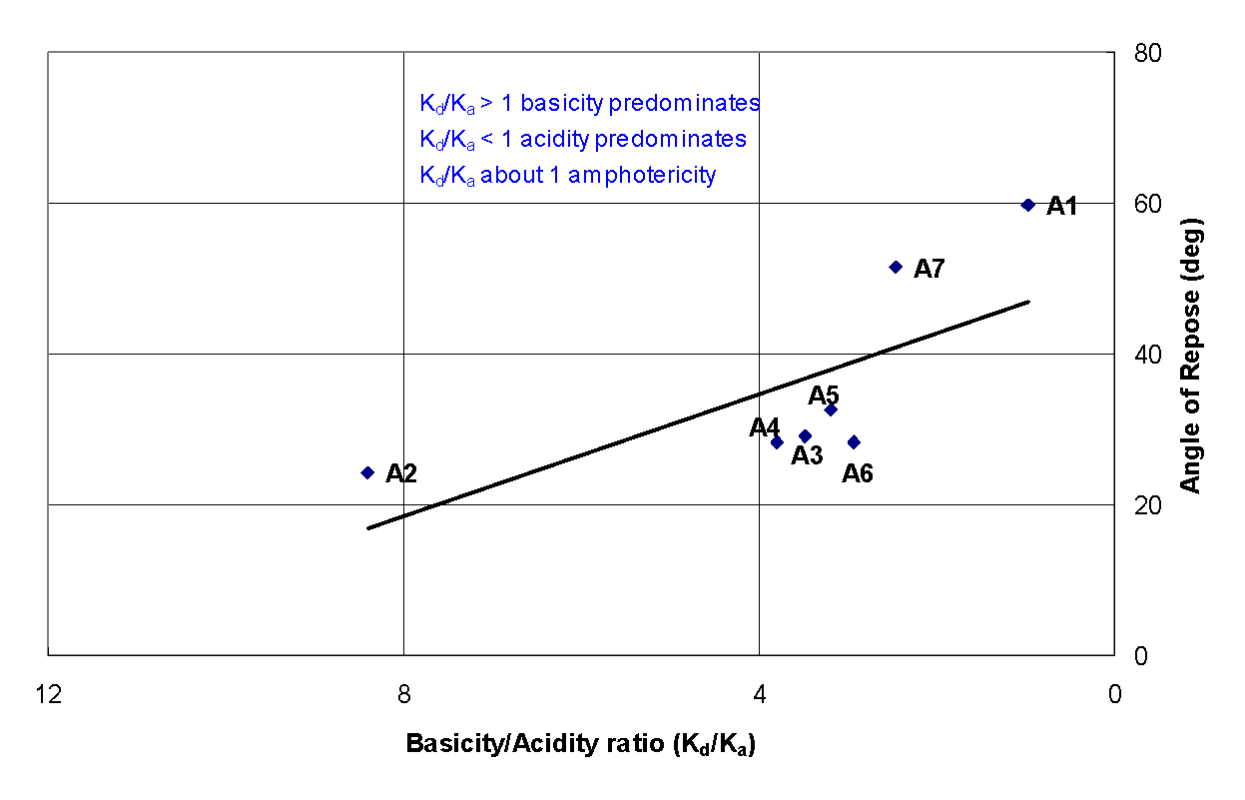
Visual Design
Figure 6.6: The relationship between the AOR and basicity/acidity ratio of the surface of the particles. The plot indicates that the more basic the surface of the aluminum powders, the lower the angle of repose which may correlate to better flowability. Note that the abscissa is plotted in a descending order so as to show the similarity with Figure 6.4.

Slide 15
Language and Vocabulary
Reports should be easily accessible
Be straightforward and concise
Use simple terms, not jargon
Keep sentences short and simple (20 words max)
No common phases (be technical)
“in the ballpark”
Be specific and not general
Not “close” or “like” or “pretty” or “roughly”
Courtesy: Purdue Writing Lab

Slide 16
Source Documentation
Cite sources :
whenever you are quoting, paraphrasing, or summarizing work that is not your own
Quote directly is discouraged
DO NOT COPY
Sources include:
Books
Journal, magazine, or newspaper articles
Interviews
Conference Proceedings
Lectures
Courtesy: Purdue Writing Lab

Slide 17
Source Documentation
Citing
Shows your credibility as a researcher
Gives proper credit to authors and researchers
Protects you from accusations of plagiarism
Courtesy: Purdue Writing Lab

