Slide 1
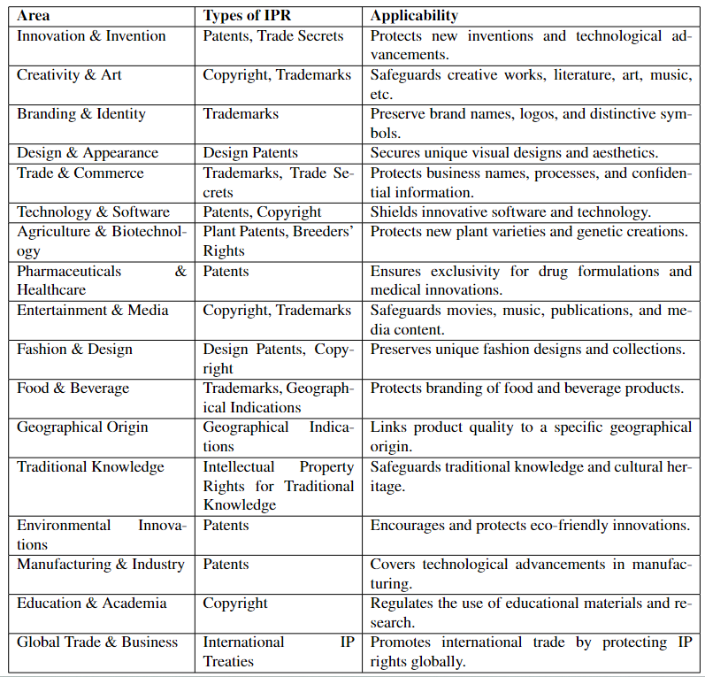
Applicability of IPR

Slide 2
IPR and Biodiversity
Protection of Genetic Resources:
IPR, particularly patents and plant breeders' rights, can be applied to protect genetic resources derived from biodiversity. This includes plant varieties, animal breeds, and microorganisms used in agriculture, medicine, and biotechnology.
Access and Benefit-Sharing (ABS) agreements aim to ensure that the benefits of commercial use of genetic resources are shared fairly with the countries and communities that provide those resources.
Traditional Knowledge:
Biodiversity-rich regions often have indigenous and local communities with valuable traditional knowledge about the use of biodiversity resources for medicine, agriculture, and cultural practices.
IPR can be used to protect traditional knowledge, and mechanisms like geographical indications and trademarks can be applied to preserve the authenticity and reputation of traditional products.
Biopiracy and Prior Informed Consent:
Concerns about biopiracy arise when individuals or organizations exploit genetic resources or traditional knowledge without the informed consent of the source community or country.
Legal mechanisms, including IPR and international agreements like the Nagoya Protocol, seek to prevent biopiracy by requiring prior informed consent and mutually agreed terms for access to genetic resources.

Slide 3
IPR and Biodiversity
Conservation and Sustainable Use:
IPR can play a role in incentivizing the conservation and sustainable use of biodiversity. By providing legal protection and potential economic benefits, IPR can encourage efforts to protect endangered species and their habitats.
Patents on Life Forms:
The grant of patents on life forms, such as genetically modified organisms (GMOs), has raised ethical and environmental concerns. Critics argue that patents on certain life forms may incentivize practices that are detrimental to biodiversity and traditional agriculture.
Medicinal Plants and Traditional Medicine:
Many medicinal plants and herbal remedies are derived from biodiversity-rich ecosystems. The protection of IPR can influence the accessibility and affordability of traditional medicines and remedies.
Conservation Agreements:
Conservation organizations and governments may enter into agreements with indigenous and local communities to protect and conserve biodiversity, often involving the sharing of benefits from IPR-related activities.

Slide 4
IPR and Biodiversity
Global and National Policies:
International agreements, such as the Convention on Biological Diversity (CBD), provide a framework for addressing the relationship between IPR and biodiversity.
National laws and policies may also establish guidelines for the use of biodiversity resources and traditional knowledge.
Biotechnological Innovations:
Biotechnology and genetic engineering, protected by IPR, have applications in agriculture and medicine that can affect biodiversity through the introduction of genetically modified organisms.
Balancing the interests of protecting biodiversity and the rights of indigenous and local communities with the potential for technological innovation and economic development is a complex challenge. Legal frameworks, international agreements, and ongoing discussions within the scientific and policy communities aim to address these complex issues.

Slide 5
IPR development process
The development process for Intellectual Property Rights (IPR) involves several key steps and considerations. Here's an overview of the typical IPR development process:
Identification of Intellectual Property:
The process begins with identifying intellectual property within an organization or as a result of individual creativity. This can include inventions, creative works, trademarks, trade secrets, and more.
Documentation and Recordkeeping:
Proper documentation is essential. Inventors, authors, and creators should maintain records that detail the creation, development, and ownership of the intellectual property.
Assessment and Evaluation:
Organizations and individuals should assess the potential value of the intellectual property. Factors to consider include market demand, uniqueness, competitive advantages, and potential for commercialization.

Slide 6
IPR development process
Legal Counsel and Expert Advice:
Seek legal advice from intellectual property attorneys and experts who can guide you through the process and help determine the appropriate type of protection (e.g., patents, copyrights, trademarks, trade secrets).
Protection and Registration:
Depending on the type of intellectual property, register or apply for the relevant protection. This may involve filing patent applications, copyright registrations, trademark applications, or implementing security measures for trade secrets.
Commercialization and Licensing:
Develop strategies for commercializing the intellectual property. This could involve licensing the rights to others, selling the IP, or using it for internal business purposes.

Slide 7
IPR development process
Enforcement and Protection:
Monitor and enforce the intellectual property rights to prevent unauthorized use or infringement. This may require legal action, cease and desist notices, or negotiations with infringing parties.
Maintenance and Renewal:
For certain types of IP, such as patents and trademarks, regular maintenance and renewal are necessary to keep the protection in force. This includes paying renewal fees and meeting regulatory requirements.
Documentation of Agreements:
If the IP is licensed or transferred, ensure that all agreements are properly documented and legally binding.
International Considerations:
If applicable, consider international protection for IP rights through mechanisms like the Madrid Protocol (for trademarks) or the Patent Cooperation Treaty (PCT) for patents.

Slide 8
IPR development process
Monitoring Changes in Law:
Stay informed about changes in intellectual property law, as regulations and requirements may evolve over time.
Record of Use:
For trademarks, maintaining a record of use can be important to prove continuous and bonafide use of the mark.
Strategic Portfolio Management:
Manage your intellectual property portfolio strategically, ensuring that it aligns with your business goals and objectives.
Collaboration and Partnerships:
In some cases, collaborations and partnerships may be beneficial for developing and utilizing intellectual property. Careful consideration of IP ownership and rights is essential in such cases.
Dispute Resolution:
Be prepared to address disputes or challenges related to intellectual property. This may involve negotiation, alternative dispute resolution, or legal action.

Slide 9
WIPO
WIPO stands for the World Intellectual Property Organization. It is a specialized agency of the United Nations responsible for promoting and protecting intellectual property (IP) rights worldwide. WIPO serves as a global forum for IP services, policy development, information dissemination, and cooperation among its member states. Here are key aspects of WIPO:
Establishment: WIPO was established in 1967 and became a specialized agency of the United Nations in 1974. Its headquarters are located in Geneva, Switzerland.
Mission: The primary mission of WIPO is to encourage and facilitate the use and protection of intellectual property around the world. It aims to balance the interests of creators and innovators with the broader public interest.
Member States: WIPO has a large and diverse membership of countries, currently numbering over 190 member states. Member states work together to develop international treaties, agreements, and policies related to intellectual property.

Slide 10
Core functions of WIPO
WIPO primarily functions to promote and protect intellectual property (IP) globally.
It fosters innovation and creativity by setting international IP standards, offering services for IP registration and protection, and resolving IP disputes.
WIPO also plays a crucial role in building IP capacity in developing countries, maintains extensive IP data and information resources, and administers international IP treaties and agreements.
Through its activities, WIPO facilitates international cooperation, coordinates efforts, raises public awareness about IP, and supports technical assistance and policy development, contributing to the advancement of IP and innovation on a global scale.

Slide 11
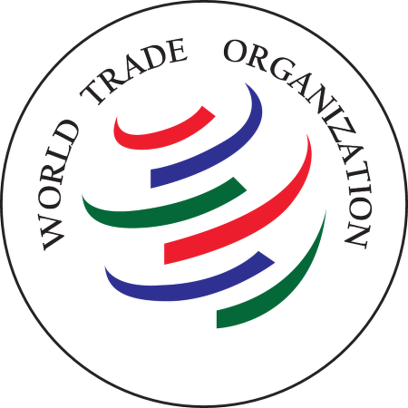
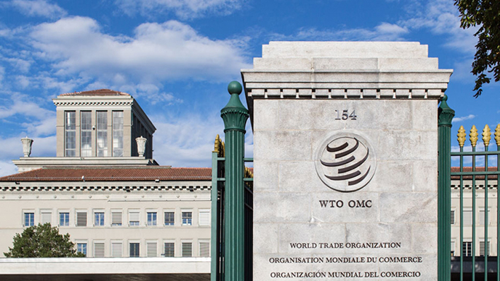
WTO
The World Trade Organization (WTO) is an international organization that deals with the global rules of trade between nations. It was established on January 1, 1995, and is headquartered in Geneva, Switzerland. The WTO is the only global international organization that deals with the global rules of trade between nations.

Slide 12
Key aspects of the WTO
Trade Agreements: The primary goal of the WTO is to facilitate and regulate international trade. It does so by negotiating and implementing trade agreements between its member countries. These agreements cover a wide range of trade-related issues, including tariffs, non-tariff barriers, trade in services, intellectual property, and dispute resolution.
Multilateral Trade System: The WTO operates on the basis of the most-favored-nation principle, which means that countries treat each other equally in trade. This principle encourages nondiscriminatory trade policies.
Non-Discrimination: The WTO also upholds the principle of national treatment, which requires member countries to treat imported and domestically produced goods and services in the same way, without discrimination.

Slide 13
Key aspects of the WTO
Trade Facilitation: The WTO promotes the simplification and harmonization of customs procedures to facilitate trade. It encourages transparency and predictability in trade regulations.
Market Access: The organization aims to reduce trade barriers, including tariffs and quotas, to provide market access to goods and services from other member countries.
Dispute Settlement: The WTO has a dispute settlement mechanism to resolve trade disputes between member countries. This mechanism is designed to ensure a fair and impartial process for resolving disputes.
Intellectual Property: The WTO's Agreement on Trade-Related Aspects of Intellectual Property Rights (TRIPS) establishes minimum standards for the protection of intellectual property rights, including patents, copyrights, trademarks, and trade secrets.

Slide 14
Key aspects of the WTO
Development Focus: The WTO recognizes the need for special and differential treatment for developing countries, taking into account their economic development needs.
Transparency and Notifications: Member countries are required to notify the WTO about their trade-related policies and activities to ensure transparency and compliance with WTO rules.
Trade Policy Reviews: The WTO conducts periodic reviews of member countries' trade policies to evaluate their compliance with WTO rules.
Ministerial Conferences: The highest decision-making body of the WTO is the Ministerial Conference, which meets approximately every two years to make decisions on various trade-related issues.
Director-General: The WTO is led by a Director-General who is responsible for the organization's day-to-day operations and administration.
Members: The WTO has over 160 member countries, making it one of the largest international organizations. Member countries represent a significant portion of the global economy.

Slide 15
WIPO and WTO
The World Trade Organization (WTO) and the World Intellectual Property Organization (WIPO) are two distinct international organizations with separate mandates, but they share a connection through their focus on international trade and intellectual property rights (IPR).
Distinct Organizations:
WTO: The WTO is primarily concerned with international trade and the regulation of trade between member countries. Its core mission is to establish and enforce global trade rules to facilitate the smooth flow of goods and services across international borders.
WIPO: WIPO, on the other hand, is exclusively dedicated to intellectual property rights. Its mission is to promote and protect intellectual property rights, including patents, copyrights, trademarks, industrial designs, and more, on a global scale.
Overlapping Interests:
While the primary mandates of WTO and WIPO differ, there is an overlap in their interests, particularly with respect to the Trade-Related Aspects of Intellectual Property Rights (TRIPS) Agreement. TRIPS is an international agreement administered by the WTO, and it sets minimum standards for the protection of intellectual property. The agreement covers various aspects of intellectual property, such as patents, copyrights, trademarks, and trade secrets.

Slide 16
WIPO and WTO
TRIPS Agreement:
The TRIPS Agreement is a pivotal connection between the two organizations. It was negotiated under the auspices of the General Agreement on Tariffs and Trade (GATT) and later incorporated into the WTO when the WTO was established in 1995. This agreement obliges WTO member countries to adopt and enforce certain intellectual property protection standards within their national legal systems.
Cooperation and Dialogue:
WTO and WIPO maintain a cooperative relationship and engage in dialogue on matters related to international trade and intellectual property. They collaborate to ensure that the TRIPS Agreement is effectively implemented and that intellectual property rights are protected and enforced in the context of international trade.
Policy Coordination:
WTO member countries and WIPO member states work together to harmonize their trade and intellectual property policies. This coordination is essential to address issues related to the intersection of trade and intellectual property, including access to medicines, technology transfer, and the protection of traditional knowledge and genetic resources.

Slide 17
Common rules and principles of Intellectual Property Rights (IPR)
Non-Discrimination: IPR should be administered without discrimination, meaning that foreign and domestic entities should be treated equally. This principle is often referred to as "national treatment" and applies to various forms of IPR, such as patents, trademarks, and copyrights.
Most-Favored-Nation Treatment: The principle of most-favored-nation (MFN) treatment means that a country should treat the nationals of all other member countries equally. This principle encourages non discriminatory trade practices in the context of IPR.
Minimum Standards: International agreements often establish minimum standards for the protection of intellectual property. For example, the Trade-Related Aspects of Intellectual Property Rights (TRIPS) Agreement sets out minimum standards for the protection of patents, copyrights, trademarks, and other forms of IPR.
Public Disclosure: Many forms of IPR require public disclosure. For example, patent applications typically involve disclosing detailed information about an invention in exchange for exclusive rights. This disclosure contributes to the dissemination of knowledge.

Slide 18
Common rules and principles of Intellectual Property Rights (IPR)
Term of Protection: IPR protection is typically time-limited. For example, copyright protection usually lasts for the lifetime of the author plus a certain number of years. Patents have a fixed term, after which the invention enters the public domain.
Fair Use and Exceptions: Many national laws and international agreements include provisions for fair use or exceptions to IPR protection. These provisions allow for the limited use of copyrighted works for purposes such as education, research, and criticism without infringing on the rights of the creator.
Enforcement: Effective enforcement mechanisms are crucial for protecting IPR. This includes legal procedures for addressing IPR violations, as well as the ability to seek remedies such as injunctions and damages.
International Cooperation: Many IPR issues are global in nature, so international cooperation is vital. International organizations like the World Intellectual Property Organization (WIPO) and the World Trade Organization (WTO) facilitate cooperation and the development of international agreements.

Slide 19
Common rules and principles of Intellectual Property Rights (IPR)
Technology Transfer: Encouraging the transfer of technology and knowledge across borders is an important IPR practice. Licensing agreements and technology transfer arrangements help disseminate innovations.
Protection of Traditional Knowledge and Genetic Resources: In recent years, there has been a focus on protecting traditional knowledge and genetic resources, especially in the context of biodiversity and indigenous communities.
Balancing Interests: IPR rules aim to strike a balance between the interests of creators and inventors and the broader public interest. This balance can be particularly important in areas such as access to essential medicines and cultural heritage preservation.
Deterrence of Misuse: Rules against the misuse of IPR are essential to prevent practices like patent trolling and copyright infringement. Laws and regulations are in place to deter and penalize such activities.

