Slide 1

Strategic use of the Patent Cooperation Treaty (PCT) by Universities and Start - ups
Silvija TRPKOVSKA
Senior Program Officer, Offices Services Section
PCT International Cooperation Division

Slide 2


Patents in a research environment
Why patents matter
Ways of benefiting from patents
General features of the patent system
Patents nationally and internationally
The Patent Cooperation Treaty (PCT)
  the main route for obtaining patents internationally

Slide 3
General economic effects
Are patents a pre-condition for innovation? – no
Can patents encourage innovation? – yes
Do economists agree on the economic effects? – no
Do economically successful countries have or develop strong patent systems? – yes

Slide 4
A strategic tool for enterprises
Can patents aid commercial success? – yes
Do many innovative enterprises use patents? – yes
Do (potential) investors like patents? – yes
Do patents guarantee profits? – no

Slide 5
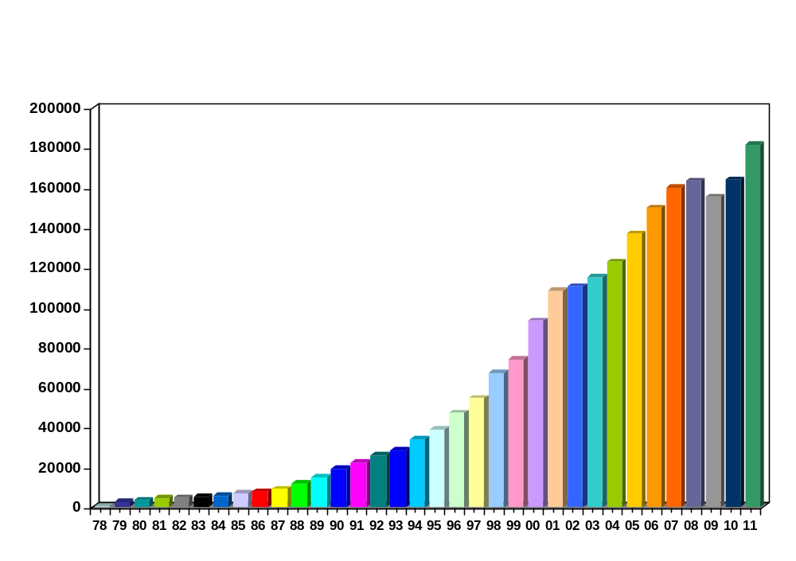
PCT Applications 2011
CN: +33.4%
JP: +20.9%
CA: +8.3%
KR: +8%
US: +8%
CH: +6.8%
FR: +4.8%
SE: +4.1%
DE: +4.1%
RU: +17.8%
BR: +15.6%
IN: +13.1%
+10.7% in 2011

Slide 6
General Statistics
Number of PCT Filings by Receiving Office/TR,
for the year 2011: 276
Number of PCT Filings by Country of Origin for TR,
for the year 2011: 541
From the top 15 ROs of middle income countries, for the year 2011, Turkey was on the 4 place by number of filings, after IN, RU and BR. The same applies for the number of PCT filings by Country of Origin.

Slide 7
Top PCT Applicants 2011
ZTE Corporation—CN(2826)
Panasonic—JP (2463)
Huawei—CN (1831)
Sharp—JP (1755)
Bosch—DE (1518)
Qualcomm—US (1494)
Toyota—JP (1417)
LG Electronics—KR (1336)
Philips—NL (1148)
Ericsson—SE (1116)
11. NEC—JP (1056)
12. Siemens—DE (1039)
13. Mitsubishi Electric—JP (834)
14. BASF—DE (773)
15. Samsung Electronics—KR (757)
16. Nokia—FI (698)
17. IBM—US (661)
18. HP—US (591)
19. 3M—US (563)
20. Hitachi—JP (547)

Slide 8
Main features of patent rights
Exclusive right to stop others from making, using or selling the invented product or process
In the nature of a property right
  may be sold or licensed
Only available for new inventions in a field of technology
  but small improvements can be enough
Geographically limited under national patent laws
  but there are regional and international treaties
Must file a patent application to obtain rights
  fully describing invention
  description is published
Limited duration, 20 years from filing date
Annual renewal or maintenance fees (increasing with time)

Slide 9
Conditions for grant of a (valid) patent
Patent application must be filed
Invention must be new (“novel”) and involve an inventive step (“non‑obvious”)
Invention must be “industrially applicable”
Application must fully describe the invention (in the description and drawings), sufficiently to enable performance of the invention
Application must define the patent rights sought, in patent “claims” that are fairly based on what is described

Slide 10
Filing patent applications abroad
National patent systems
Regional patent system (EPO, EAPO, OAPI, ARIPO, GCC)
Patent Cooperation Treaty (PCT) system
(Multiple) national Patent Offices
(Several) regional Patent Offices
Patents
National Offices
(Single) receiving Office
[National phase]
[International phase]
File application
International publication
- International search
- International preliminary
examination
Regional Offices

Slide 11
PCT procedure overview
(Usually)
filing of a first
application
at a national
office
Filing of a single
“international application”,
at a single “receiving Office”,
designating all PCT States
Patents granted by “designated” national and regional Offices
Priority period
Publication
(months)
0
12
18
International phase
30
International processing,
including centralized search, examination and publication
National phase
=
added value,
improving and
facilitating ...
…subsequent
national
processing

Slide 12
Significance of the PCT
A patent application filing system
  the only truly international filing system
  not a patent granting system
  each “designated Office” makes its own decision on patent grant
Impetus for improving the international patent system
  “bottom-up” harmonization of patent laws
A model of international cooperation
  built on cooperation between Patent Offices
A wealth of scientific and technical information

Slide 13
Some dates and numbers
Treaty concluded in 1970
  78 signatory countries, 11 IGOs, 11 NGOs
In 1978 (start of practical operations)
  18 member countries and 500 applications
In 2011
  181,900 applications – growth of 10.7% over 2010
In 2012
  146 member countries

Slide 14
PCT general features
Rationalized filing and processing
  for both applicants and Patent Offices
Single application with legal effect in all PCT countries
  146 countries and 4 regional patent systems
International and national phases

Slide 15
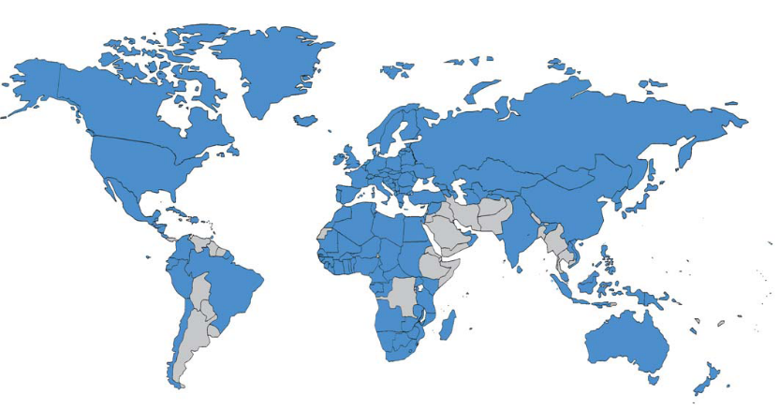
PCT Contracting States (146)
AE United Arab Emirates
AG Antigua and Barbuda
AL Albania
AM Armenia (EA)
AO Angola
AT Austria (EP)
AU Australia
AZ Azerbaijan (EA)
BA Bosnia and Herzegovina
BB Barbados
BE Belgium (EP)
BF Burkina Faso (OA)
BG Bulgaria (EP)
BH Bahrain
BN Brunei Darussalam
BJ Benin (OA)
BR Brazil
BW Botswana (AP)
BY Belarus (EA)
BZ Belize
CA Canada
CF Central African Republic (OA)
CG Congo (OA)
CH Switzerland (EP)
CI Côte d’Ivoire (OA)
CL Chile
CM Cameroon (OA)
CN China
CO Colombia
CR Costa Rica
CU Cuba
CY Cyprus (EP)
CZ Czech Republic (EP)
DE Germany (EP)
DK Denmark (EP)
DM Dominica
DO Dominican Republic
DZ Algeria
EC Ecuador
EE Estonia (EP)
EG Egypt
ES Spain (EP)
FI Finland (EP)
FR France (EP)
GA Gabon (OA)
GB United Kingdom (EP)
GD Grenada
GE Georgia
GH Ghana (AP)
GM Gambia (AP)
GN Guinea (OA)
GQ Equatorial Guinea (OA)
MZ Mozambique (AP)
NA Namibia (AP)
NE Niger (OA)
NG Nigeria
NI Nicaragua
NL Netherlands (EP)
NO Norway (EP)
NZ New Zealand
OM Oman
PA Panama
PE Peru
PG Papua New SE Sweden (EP)
SG Singapore
SI Slovenia (EP)
SK Slovakia (EP)
SL Sierra Leone (AP)
SM San Marino
Guinea
PH Philippines
PL Poland (EP)
PT Portugal (EP)
QA Qatar
RO Romania (EP)
RW Rwanda (AP)
RS Serbia
RU Russian Federation (EA)
SC Seychelles
SD Sudan (AP)
SN Senegal (OA)
ST Sao Tome and Principe
SV El Salvador
SY Syrian Arab Republic
SZ Swaziland (AP)
TD Chad (OA)
TG Togo (OA)
TH Thailand
TJ Tajikistan (EA)
TM Turkmenistan (EA)
TN Tunisia
TR Turkey (EP)
TT Trinidad and Tobago
TZ United Republic of Tanzania (AP)
UA Ukraine
UG Uganda (AP)
US United States of America
UZ Uzbekistan
VC Saint Vincent and the Grenadines
VN Viet Nam
ZA South Africa
ZM Zambia (AP)
ZW Zimbabwe (AP)
GR Greece (EP)
GT Guatemala
GW Guinea-Bissau (OA)
HN Honduras
HR Croatia (EP)
HU Hungary (EP)
ID Indonesia
IE Ireland (EP)
IL Israel
IN India
IS Iceland (EP)
IT Italy (EP)
JP Japan
KE Kenya (AP)
KG Kyrgyzstan (EA)
KM Comoros
KN Saint Kitts and Nevis
KP Democratic People’s Republic of Korea
KR Republic of Korea
KZ Kazakhstan (EA)
LA Lao People’s Democratic Republic
LC Saint Lucia
LI Liechtenstein (EP)
LK Sri Lanka
LR Liberia
LS Lesotho (AP)
LT Lithuania (EP)
LU Luxembourg (EP)
LV Latvia (EP)
LY Libyan Arab Jamahiriya
MA Morocco
MC Monaco (EP)
MD Moldova (EA)
ME Montenegro
MG Madagascar
MK The former Yugoslav Republic of Macedonia
ML Mali (OA)
MN Mongolia
MR Mauritania (OA)
MT Malta (EP)
MW Malawi (AP)
MX Mexico
MY Malaysia
Regional designations:
AP = ARIPO patent, EA = Eurasian patent, EP = European patent, OA = OAPI patent

Slide 16
The PCT system – typical use
Enter
national
phase
International
publication
Suplementary
International
Search (optional)
(months)
0
12
16
18
19
22
28
30
File local
application
File PCT
application
International
search report & written opinion
(optional)
File
demand for
international
preliminary
examination
(optional)
International
preliminary report on patentability
Typically a national patent application in the home country of the applicant

Slide 17
Typical use (2)
Enter
national
phase
International
publication
Suplementary
International
Search (optional)
(months)
0
12
16
18
19
22
28
30
File local
application
File PCT
application
International
search report & written opinion
(optional)
File
demand for
international
preliminary
examination
(optional)
International
preliminary report on patentability
Typically also filed with local Patent Office.
One set of fees, one language, one set of formality requirements.
Legal effect in all PCT States.

Slide 18
Typical use (3)
Enter
national
phase
International
publication
Suplementary
International
Search (optional)
(months)
0
12
16
18
19
22
28
30
File local
application
File PCT
application
International
search report & written opinion
(optional)
File
demand for
international
preliminary
examination
(optional)
International
preliminary report on patentability
Report on state of the art (prior art documents and their relevance) + initial opinion on patentability

Slide 19
Typical use (4)
Public disclosure to the world of content of application in standardized way
International
publication
Suplementary
International
Search (optional)
Enter
national
phase
(months)
0
12
16
18
19
22
28
30
File local
application
File PCT
application
International
search report & written opinion
(optional)
File
demand for
international
preliminary
examination
(optional)
International
preliminary report on patentability

Slide 20
Typical use (5)
Suplementary
International
Search (optional)
Enter
national
phase
International
publication
(months)
0
12
16
18
19
22
28
30
File local
application
File PCT
application
International
search report & written opinion
(optional)
File
demand for
international
preliminary
examination
(optional)
International
preliminary report on patentability
Request an additional patentability analysis on basis of amended application

Slide 21
Typical use (6)
Suplementary
International
Search (optional)
Enter
national
phase
International
publication
(months)
0
12
16
18
19
22
28
30
File local
application
File PCT
application
International
search report & written opinion
(optional)
File
demand for
international
preliminary
examination
(optional)
International
preliminary report on patentability
Additional patentability analysis, designed to assist in national phase decision-making

Slide 22
Typical use (7)
Express intention and take steps to pursue to grant in various States
International
publication
Enter
national
phase
Suplementary
International
Search (optional)
(months)
0
12
16
18
19
22
28
30
File local
application
File PCT
application
International
search report & written opinion
(optional)
File
demand for
international
preliminary
examination
(optional)
International
preliminary report on patentability

Slide 23
Certain PCT Advantages:
- postpones the major costs associated with “internationalizing” a patent application
Translations of the patent application (a highly technical document) into various national languages
Official fees for payment to national/regional Patent Offices (for example, filing fees, claims fees, etc.)
Fees for the services of local patent agents/attorneys in the designated states

Slide 24
Costs in traditional and PCT filing routes
File applications abroad
(months)
Costs for:
– translations (≈ 18–36% of total)
– Patent Office fees (≈33%)
– local agents (≈ 25-50%)
Traditional route
0
12
File local
application
18 months
Enter
national
phase
International
publication
(months)
PCT route
0
12
16
18
22
28
30
File local
application
File PCT
application
International search report & written opinion
(optional)
File demand for international preliminary examination
International
preliminary report on patentability

Slide 25
Cost savings
For a single invention
  PCT not cheaper than direct applications in <15 countries
  PCT international phase costs are <5% of total patenting costs
For a portfolio of applications at 30 months
  abandon 20% of applications by not entering national phase
  drop 30% of designated countries cf. original plan
National phase entry decisions really matter

Slide 26
Turkey – main PCT fees
Payable upon filing (Chapter I):
  Transmittal fee (for RO/TR) None
  International filing fee (for IB) CHF 1,330
  + supplement per sheet > 30 CHF 15
  Search fee (for ISA/EP) EUR 1,875
Payable upon filing demand for IPE (Chapter II):
  Preliminary examination fee EUR 1,850
  (for IPEA/EP)
  Handling fee (for IB) EUR 165

Slide 27
Time ~ information ~ decisions
18 months more time
Patentability information
  international search report and written opinion
  (optional) international preliminary report on patentability
Prospects of commercial success
  production costs, market appeal, profitability
  potential partners, licensees, buyers
  competitors
Result: better decisions
  better spent money

Slide 28
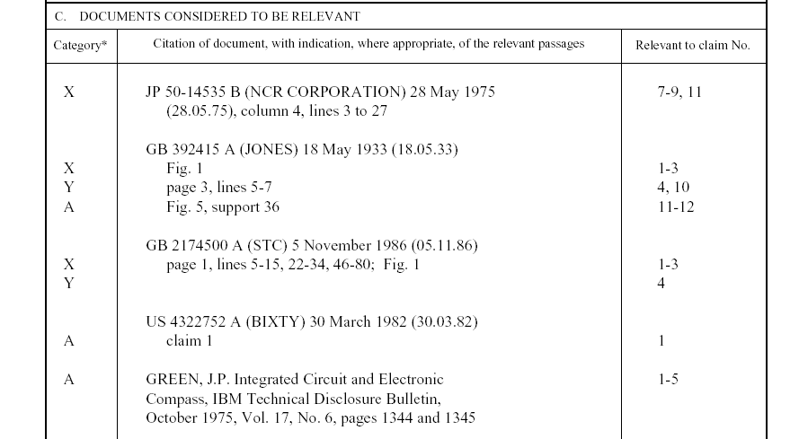
Example: PCT International Search Report
Example: PCT International Search Report
Symbols indicating
which aspect of patentability
the document cited is
relevant to (for example, novelty, inventive step, etc.)
The claim numbers
in your application to
which the document is
relevant
Documents relevant to whether or not your invention may be patentable

Slide 29
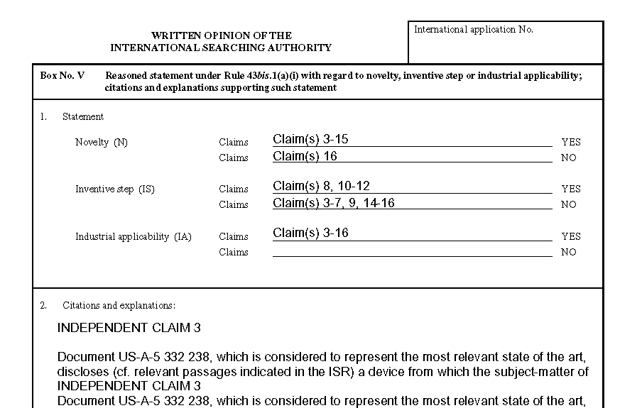
Example: PCT Written opinion of the International Searching Authority
Reasoning supporting the assessment
Patentability assessment
of claims

Slide 30
PCT decision points
Should I file applications abroad?
Should I file a
PCT application?
Should I enter the
national phase in view of:
(1) assessment of the prospects of commercial success?
(2) likelihood of patent grant?
In which countries should I
enter the national phase?
Should I file a
national patent application?
Should I manufacture or assign or license the invention?
Can I find a partner or buyer or licensee?
$
Priority period
Publication
$$$$$$
(translations, official fees, foreign agents)
(months)
0
12
18
$$
International phase
($$)
30
Should I withdraw the application to prevent publication? Should I withdraw the priority claim to delay publication?
Do I want international preliminary examination to enable amendment of the application before the national phase?
National phase
More information about patentability
More information about commercial prospects

Slide 31
Thank you for your attention
Silvija Trpkovska
Senior Program Officer, PCT International Cooperation Division
WIPO
Tel: +41 22 338 8539
Fax: +41 22 338 7160
E-mail: silvija.trpkovska@wipo.int

