Slide 1


STOCK MARKET PRICE PREDICTION
Name : Pranav Kathar
Name : Harshwardhan Khotkar
Roll Numbers:AI3060
Roll Numbers:AI3072
Guide Name: Prof.A.S.Gavali
Date of Presentation:18-01-202
Department of Artificial Intelligence and Data Science
AY 2022-23

Slide 2
Introduction
Stock market prediction is the act of trying to determine the future value of a company stock or other financial instrument traded on an exchange. The successful prediction of a stock's future price could yield significant profit.
The efficient-market hypothesis suggests that stock prices reflect all currently available information and any price changes that are not based on newly revealed information thus are inherently unpredictable. Others disagree and those with this viewpoint possess myriad methods and technologies which purportedly allow them to gain future price information.

Slide 3
Objectives of project
This Project proposes a novel method for the prediction of stock market closing price
It is an attempt to determine whether the NSE(BSE) market news in combination with the
historical dataset can efficiently help in the calculation of the BSE closing index for a
given trading day.

Slide 4
1. Working of Project - Explanation
Import Python libraries : numpy , pandas, mathplot, sklearn,matplotlb
Dataset of Tesla
Visual the graph of dataset
Create a variable future_days for storing the prediction.
Implement Train Test Split Function.
Implement Models Such As Decision Tree, Linear Regression
Visualization Of Decision Tree And Linear Regression Model

Slide 5
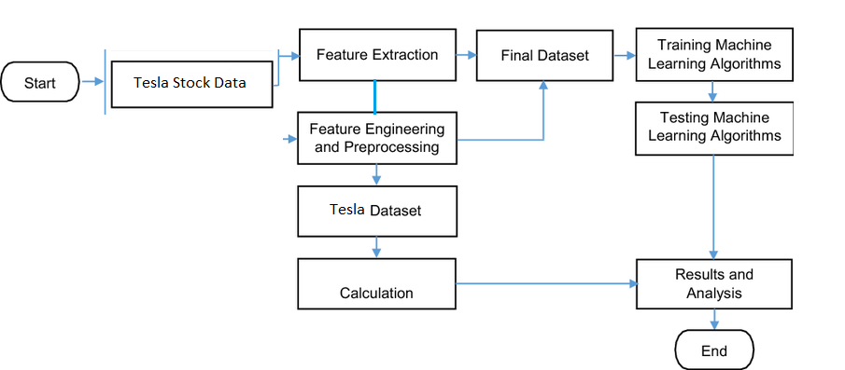
2. Working of Project - Block Diagram

Slide 6
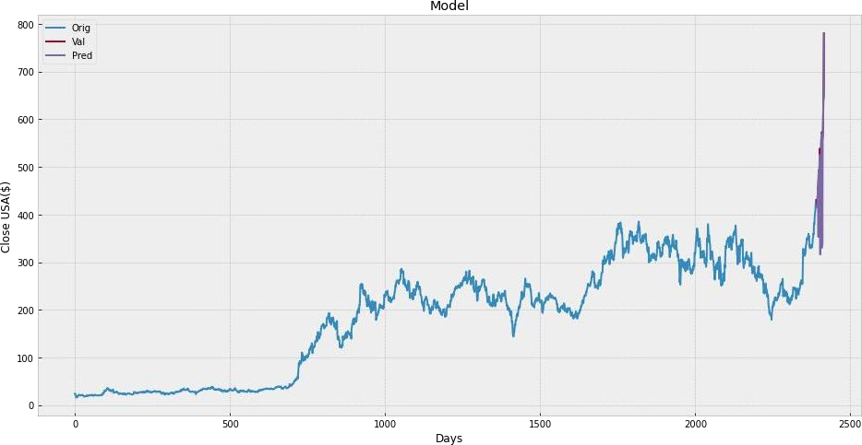
3. Working of Project – Results 1

Slide 7
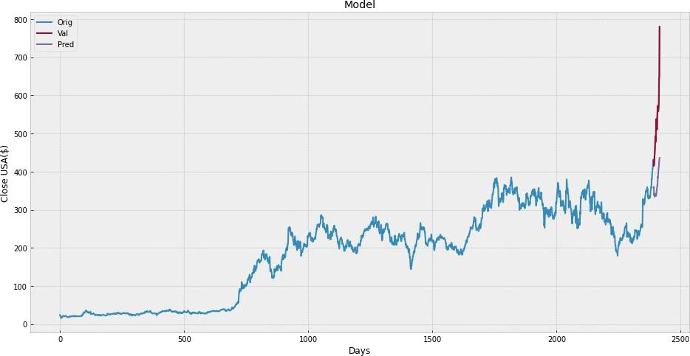
Result 2

Slide 8
Conclusion
We are predicting the closing stock price of any given organization, we have developed an application for predicting close stock price using LR and Decision tree algorithm.
We have used datasets belonging to Tesla Stocks and achieved above 93% accuracy for these datasets. In the future, we can extend this application for predicting cryptocurrency trading and also,
we can add sentiment analysis for better predictions.

Slide 9

Questions?
Thank you!

Slide 10
References
[1]Stock Price Prediction Using LRM on Indian Share Market by Achyut Ghosh, Soumik Bose1,GiridharMaji, Narayan C. Debnath, Soumya Sen
[2] Murtaza Roondiwala, Harshal Patel, Shraddha Varma, ―Predicting Stock Prices Using LRM in Undergraduate Engineering Students, Department of Information Technology, Mumbai University, 2015.
[3] www.geeksforgeeks.org

