Slide 1
B+ Trees in Cloud Databases
01
BLAST · CSC-6021
1034
1058
Indexed cloud-record search in C++
1003
1005
1034
1038
1058
1063
internal node = signpost · leaves = data, linked
Pranav Anil Singh
CSC-6021 Data Structures and Algorithms II · Dr. Victor Govindaswamy
Notes:
[~30 seconds]
Hi, I'm Pranav Anil Singh, and this is my BLAST 01 project for CSC-6021, Data Structures and Algorithms II, with Dr. Victor Govindaswamy.
My assigned data structure is the B-tree — specifically the B+ tree — and my emerging-technology area is Cloud and Databases.
In this video I'll explain how a B+ tree works, why almost every database uses one to index its records, and then I'll demo a C++ application I built from scratch that uses a B+ tree to search cloud records.

Slide 2


Finding one record among millions
01
THE PROBLEM
Without an index: full table scan
With a B+ tree index
1,000,000
3
rows read in the worst case (e.g. an ID that does not exist)
node reads per lookup for the same 1,000,000 records
Measured: 108,098 ns per lookup at 1M records
Measured: 296 ns per lookup · 365× faster
In the cloud, every read is a network round trip — fewer reads mean faster, cheaper queries.
Notes:
[~50 seconds]
Let's start with the problem.
A cloud provider can store billions of records — object metadata, VM snapshots, database backups, customer rows. When someone asks for one record by its ID, they expect an answer in milliseconds.
Without an index, the only option is a full table scan: read every row until you find the one you want. In the worst case — for example, when the ID doesn't exist at all — that means reading every single row. In my program, with a million records, that took about 108 thousand nanoseconds per lookup.
With a B+ tree index on those same million records, my program finds any record in just three node reads — about 365 times faster.
And in the cloud this matters even more, because the data lives on network storage. Every read is a round trip over the network, so the fewer reads we need, the faster and cheaper the query.

Slide 3
What this video covers
00
ROADMAP
01
02
03
04
05
06
07
08
The problem
What is a B+ tree
Operations
Complexity
Real world & cloud
C++ design
Live demo
Results
Linked left to right — just like the leaves of a B+ tree.
Notes:
[~20 seconds]
Here's the plan.
First I'll explain what a B+ tree is and how its operations work, then look at its complexity. Next I'll show where B+ trees are used in real systems and in the cloud. Then I'll walk through my C++ design, do a live demo of the application, and finish with the performance results.
Notice the boxes are linked left to right, like the leaves of a B+ tree — that idea is going to come back.

Slide 4
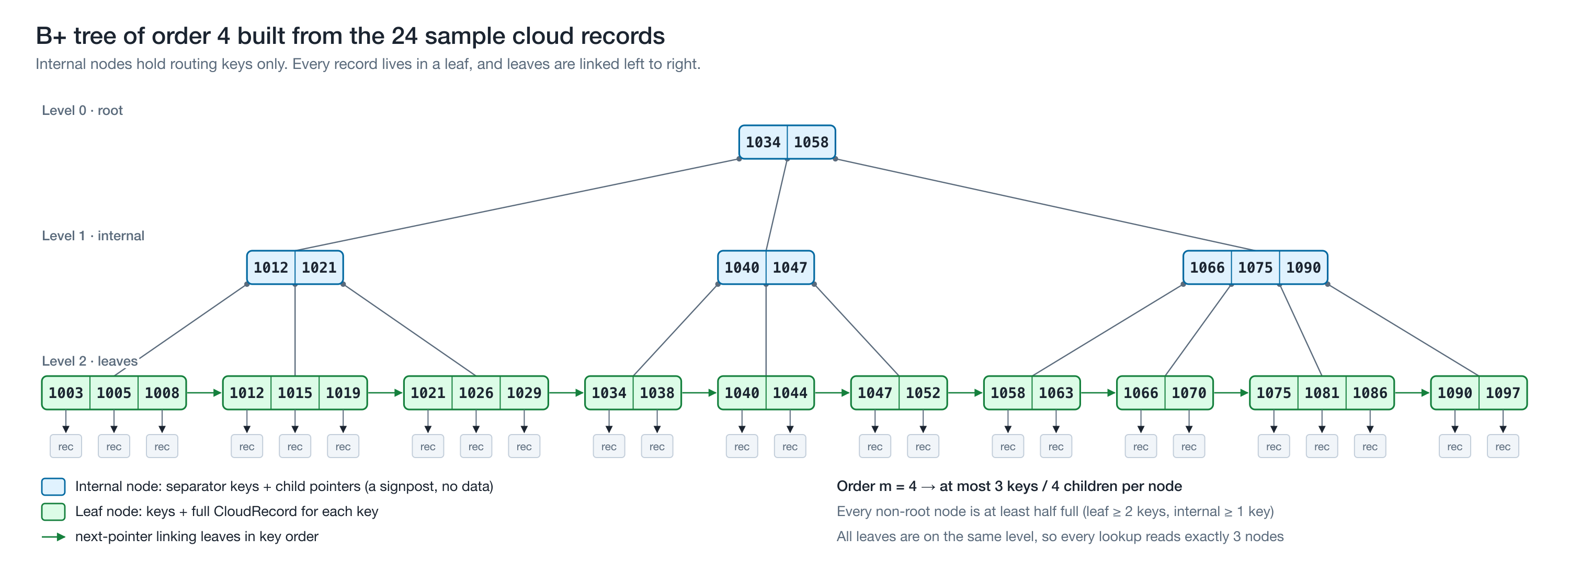
A wide, shallow, always-balanced search tree
02
WHAT IS A B+ TREE
Notes:
[~60 seconds]
A B+ tree is a balanced search tree where each node holds many sorted keys and has many children — not just two, like a binary search tree.
This is the real tree my program builds from its 24 sample records. It has order 4, which means each node can hold at most three keys.
The blue nodes at the top are internal nodes. They hold only separator keys and pointers — they're signposts. For example, the root says: anything below 1034, go left; from 1034 up to 1058, go to the middle; 1058 or more, go right.
The green nodes at the bottom are the leaves. They hold the keys and the actual records — I've drawn the records as the little "rec" boxes.
The green arrows show that the leaves are linked together, left to right, in sorted order.
And every leaf is at the same depth, so any lookup in this tree reads exactly three nodes.

Slide 5




Four rules that keep it fast
02
WHAT IS A B+ TREE
Wide nodes
Internal nodes are signposts
Order m = up to m children and m − 1 sorted keys per node. In a database one node is one disk page (8–16 KB), so it holds hundreds of keys.
They store only separator keys and child pointers — no records. Small, so they stay cached in memory.
Data lives in linked leaves
Always balanced
Every record is in a leaf, and each leaf points to the next one, so all data can be read in sorted order.
Every node except the root stays at least half full. Height only grows when the root splits, so all leaves are at the same depth.
Notes:
[~45 seconds]
Four rules make this work.
One: wide nodes. The order m is the maximum number of children, so a node holds up to m minus 1 keys. In a real database, one node is one disk page — 8 or 16 kilobytes — so it holds hundreds of keys.
Two: internal nodes are only signposts. They hold separator keys and pointers, no data, so they're small and they stay cached in memory.
Three: all the data lives in the leaves, and the leaves are linked.
Four: it's always balanced. Every node except the root stays at least half full, and the tree only gets taller when the root splits — so all leaves stay at the same depth. That's why the height stays around log base m of n.

Slide 6
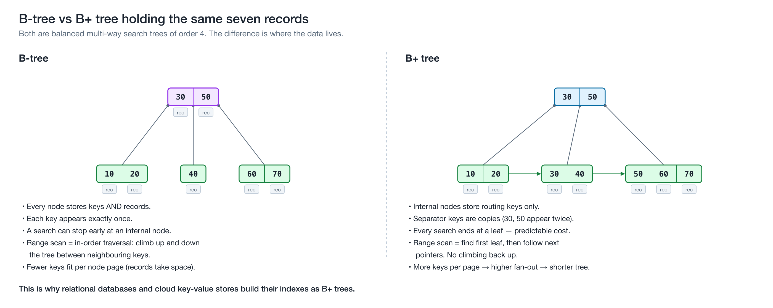
B-tree vs B+ tree: where the data lives
02
WHAT IS A B+ TREE
Notes:
[~45 seconds]
How is this different from a plain B-tree?
In a B-tree, on the left, every node stores records, and each key appears only once. A search can sometimes stop early at an internal node, but range queries are awkward — you have to climb up and down the tree between neighbouring keys.
In a B+ tree, on the right, internal nodes store only copies of keys — notice 30 and 50 appear twice — and all of the records sit in the linked leaves.
Because internal nodes hold no data, more keys fit in each page. That means a higher fan-out and a shorter tree. And a range query just finds the first leaf and walks sideways.
That's why databases use the B+ version.

Slide 7
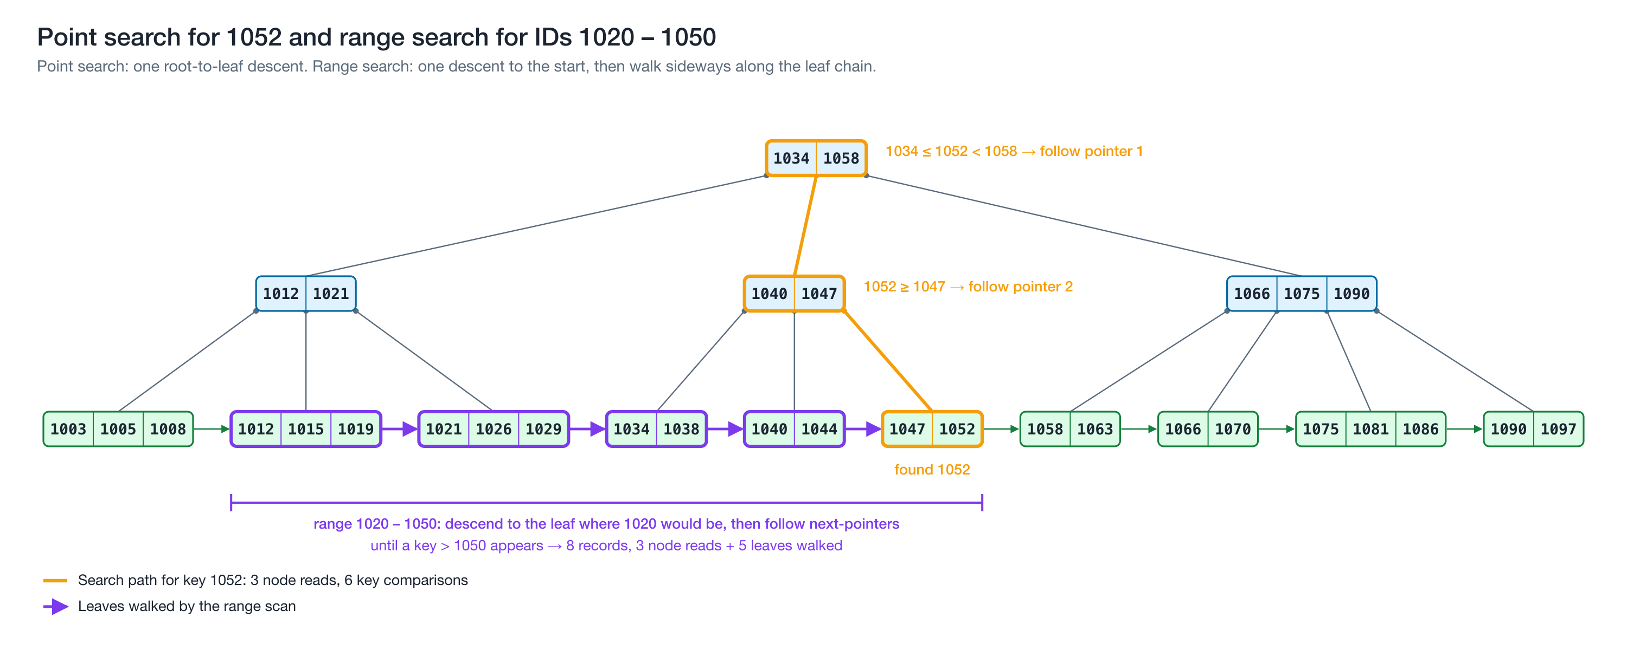
Search: one trip down, then sideways for ranges
03
OPERATIONS
Notes:
[~50 seconds]
Searching is a single walk from the root down to a leaf.
To find record 1052: at the root, 1052 is between 1034 and 1058, so I follow the middle pointer. At the next node, 1052 is at least 1047, so I follow the last pointer — and I land on the leaf that holds 1047 and 1052. Found it: three node reads and six key comparisons.
A range search — say all IDs from 1020 to 1050 — makes one descent to the leaf where 1020 would be, then simply follows the next pointers to the right until it passes 1050.
That returns eight records for three node reads plus a walk across five leaves. There's no climbing back up the tree.

Slide 8
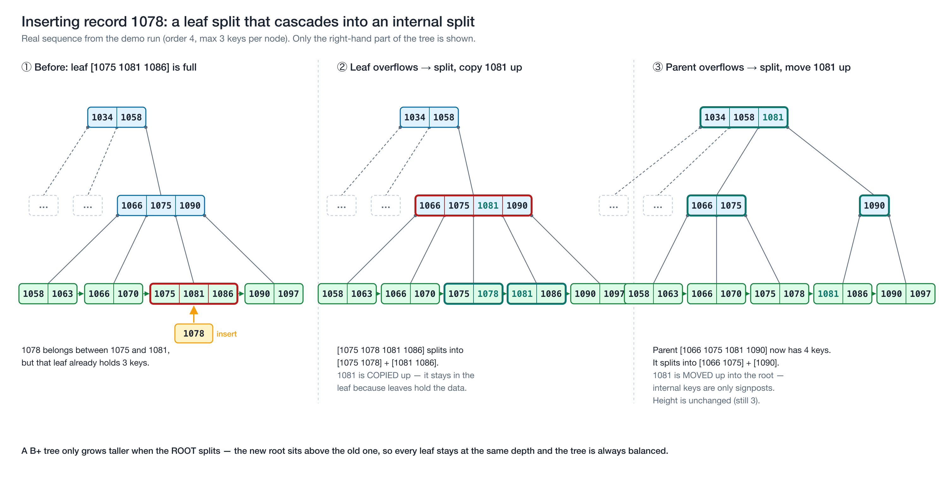
Insert: split when full, grow only at the root
03
OPERATIONS
Notes:
[~60 seconds]
Inserting is where the balancing happens. This is a real sequence from my demo: inserting record 1078.
Step one: I find the leaf where 1078 belongs — but that leaf already has three keys, the maximum for order 4.
Step two: the leaf overflows and splits into two leaves of two keys each. The first key of the new right-hand leaf, 1081, is COPIED up into the parent. It's copied, not moved, because the leaves have to keep all the data.
Now the parent has four keys — one too many — so in step three it splits too. For an internal node, the middle key is MOVED up, because internal keys are only signposts. So 1081 goes up into the root.
The root had room, so the height stays at three. If the root itself had split, a new root would be created above it — and that's the only way a B+ tree ever grows taller. That's exactly why every leaf always stays at the same depth.

Slide 9
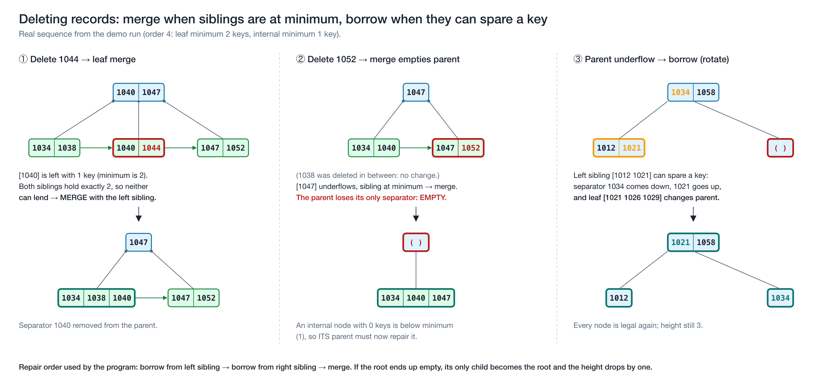
Delete: borrow from a sibling, or merge
03
OPERATIONS
Notes:
[~60 seconds]
Deletion is the mirror image. Every node except the root must stay at least half full — for order 4, a leaf needs at least two keys.
Step one: I delete 1044, which leaves its leaf with only one key. Both siblings have exactly the minimum, so neither can lend a key. The leaf merges with its left sibling, and the separator 1040 is removed from the parent.
Step two: I delete 1052 and the same thing happens — another merge. But now the parent has lost its only separator, so it's empty.
Step three: the parent's left sibling has a key to spare, so the keys rotate through the grandparent: 1034 comes down, 1021 goes up, and one child pointer moves across. Now every node is legal again, and the height is still three.
My program always tries to borrow first — from the left sibling, then the right — and only merges when it has to.

Slide 10
Every operation is one trip down the tree
04
COMPLEXITY
Operation | Node (page) reads | Why
Search | O(log_m n) | One node per level, always ends at a leaf
Range search (k results) | O(log_m n + k/m) | One descent, then walk the linked leaves
Insert | O(log_m n) | At most one split per level
Delete | O(log_m n) | At most one borrow or merge per level
List all in order | O(n) | Walk the leaf chain
Space | O(n) | Every node is 50–100% full
O(log_m n)
height of the tree — and the cost of every lookup
125 million
keys fit in just 3 levels when m = 500 (500 × 500 × 499)
Notes:
[~50 seconds]
Here's the complexity.
Search, insert and delete all cost O(log base m of n) node reads, because each one makes a single trip down the tree, with at most one split or merge per level. Splits and merges are rare, so on average they cost almost nothing extra.
A range query costs one descent, plus k divided by m leaves for k results. Listing everything in order is just a walk along the leaf chain. And space is O(n), because every node is between half full and completely full.
The important part is the base of that logarithm. With a realistic order of 500, three levels can index about 125 million keys. So a lookup in a table with a hundred million rows touches only three or four pages.

Slide 11





Where B+ trees run today
05
REAL WORLD & CLOUD
MySQL (InnoDB)
PostgreSQL
SQL Server & Azure SQL
Indexes are B-trees with records in the leaf pages; 16 KB pages by default.
Default index type: a multi-level B-tree; each level is a linked list of pages.
Microsoft: rowstore indexes are organized as B+ trees (8 KB pages).
SQLite
Btrfs (Linux)
Amazon DynamoDB
Interior pages hold only keys; all table data is in the leaves. Runs on almost every phone.
The “B-tree file system”: all metadata kept in copy-on-write B-trees.
Each storage node keeps its partition data in a B-tree (USENIX ATC 2022).
Notes:
[~50 seconds]
This isn't just a textbook structure — it's everywhere.
MySQL's InnoDB engine stores its indexes as B-trees with the records in the leaf pages, and its pages are 16 kilobytes by default.
PostgreSQL's default index is a multi-level B-tree where each level is a linked list of pages.
Microsoft's documentation says SQL Server and Azure SQL rowstore indexes are organized as B+ trees.
SQLite — which runs on basically every phone — keeps only keys in its interior pages and all the table data in the leaves. That's a B+ tree.
Linux's Btrfs file system is literally the "B-tree file system".
And in the cloud, Amazon's 2022 DynamoDB paper explains that each storage node keeps its partition data in a B-tree.

Slide 12
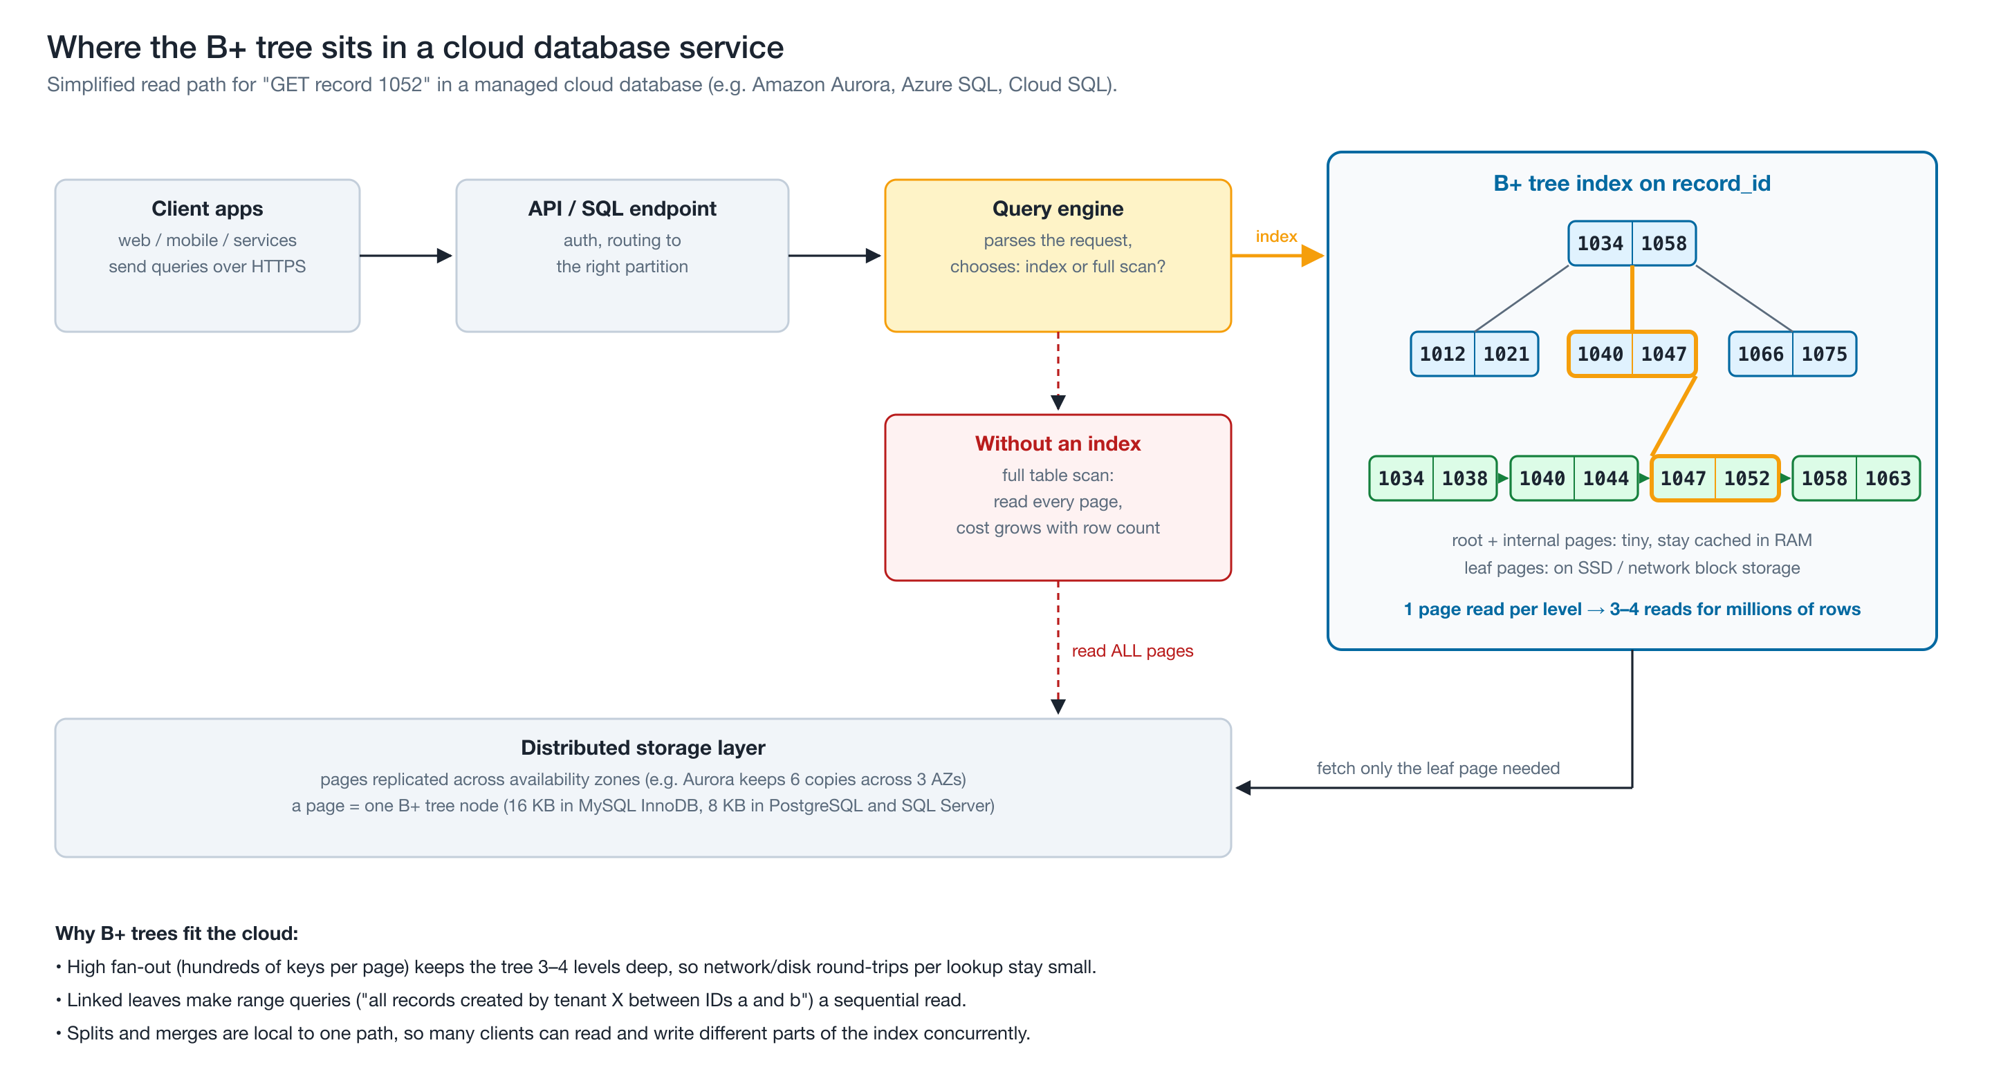
Why cloud databases depend on it
05
REAL WORLD & CLOUD
Notes:
[~60 seconds]
So why does the cloud need it? Here's a simplified read path for "get record 1052" in a managed cloud database.
The request goes through the API to the query engine, which decides whether to use the index or do a full scan.
With the index: the root and internal pages are tiny, so they stay cached in memory, and usually only ONE leaf page has to be fetched from the distributed storage layer. Amazon Aurora, for example, keeps six copies of every page across three availability zones, so each fetch really is a network operation.
Without an index, the engine would have to read every page.
The linked leaves also make typical cloud queries cheap — like "all of this tenant's backups between two IDs". And because a split or merge only touches one path down the tree, many clients can read and write different parts of the index at the same time.

Slide 13
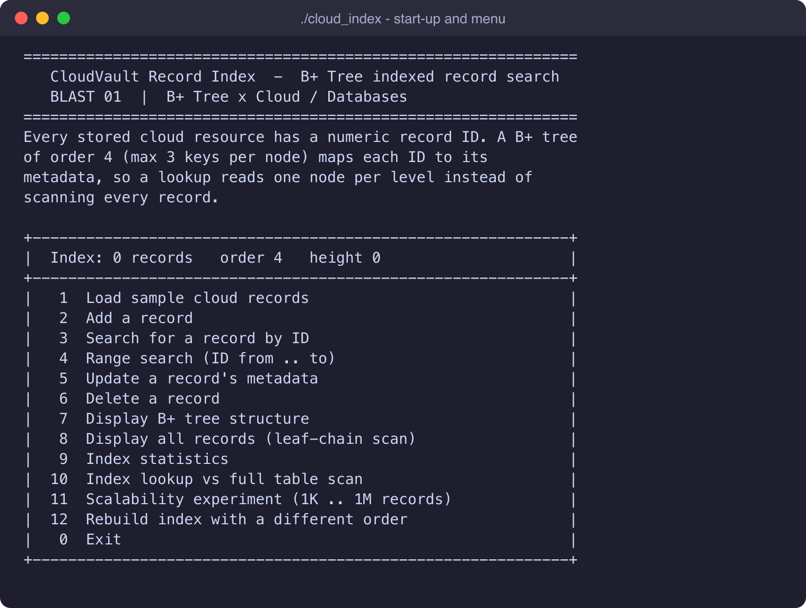



CloudVault Record Index
06
C++ APPLICATION
Simulates a cloud metadata index
Each record is a cloud resource — tenant, type, region, size, date — keyed by a numeric ID.
12 menu operations
Load, add, search, range search, update, delete, display, stats, index vs scan, 1M benchmark, rebuild.
Shows the tree working
Prints the search path and every split, merge and borrow as it happens.
Never crashes on bad input
Every input is validated and re-prompted; edge cases are handled with clear messages.
Notes:
[~40 seconds]
My application is called CloudVault Record Index. It simulates the metadata index of a cloud storage service.
Each record is a cloud resource — the tenant that owns it, the resource type, the region, its size and its creation date — and it's keyed by a numeric record ID. The B+ tree plays the role of the database's primary-key index.
It's menu-based, with twelve operations: load sample data, add, search, range search, update, delete, display the tree, list everything, statistics, an index-versus-full-scan comparison, a scalability experiment up to a million records, and rebuilding the tree with a different order.
What I like most is that it doesn't just give answers — it prints the search path and every split, merge and borrow as it happens. And every input is validated, so bad input never crashes it.

Slide 14
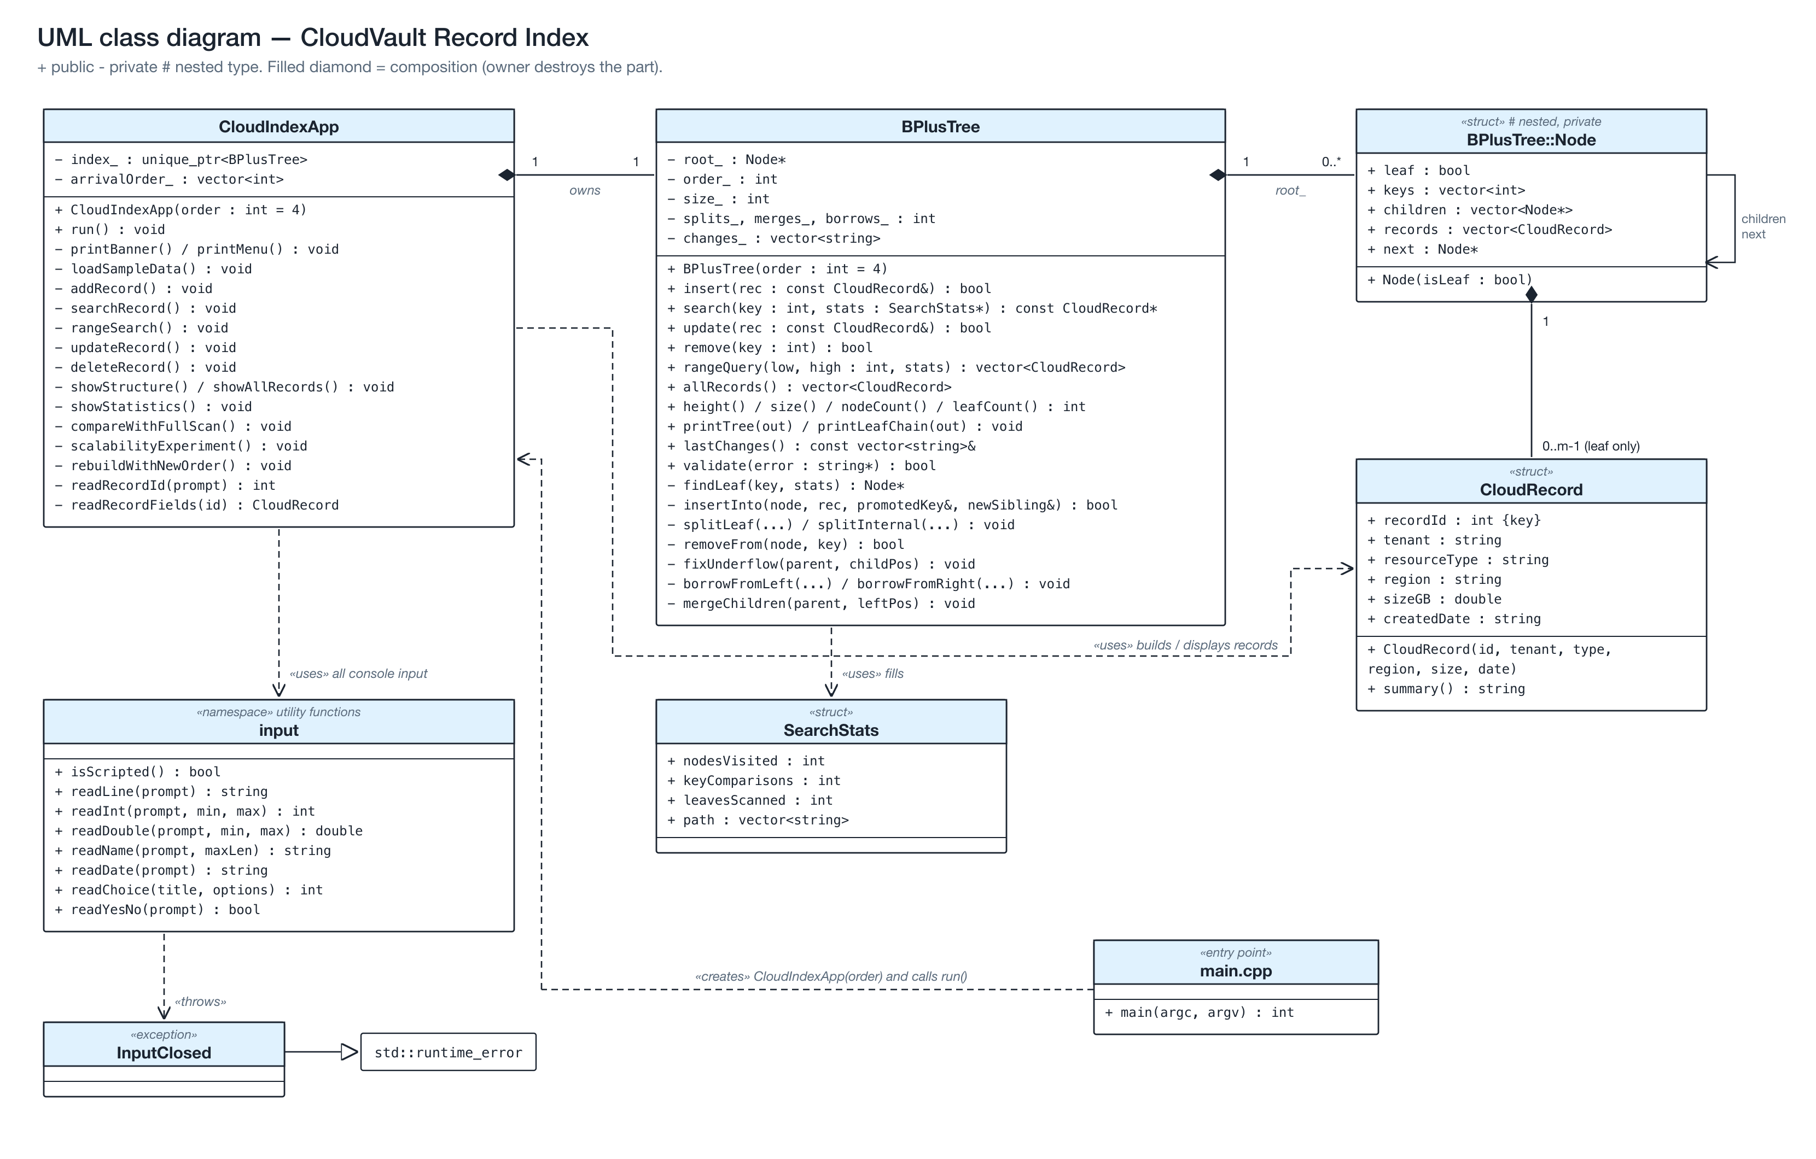
Design: data structure separate from the menu
06
C++ APPLICATION
BPlusTree
The data structure: nested Node, recursive insert/delete, split, borrow, merge, validate()
CloudIndexApp
The menu and scenario; owns the tree through a unique_ptr
CloudRecord · SearchStats
What the leaves store, and the cost of each lookup
input namespace
All validated console input in one place
Notes:
[~45 seconds]
Here's the design as a UML class diagram.
BPlusTree is the data structure itself, and it knows nothing about menus. It has a private nested Node struct with the keys, child pointers, records and the next-leaf pointer; recursive insert and delete helpers; and a validate method that checks every B+ tree rule.
CloudRecord is what's stored in the leaves, and SearchStats carries the cost of each lookup back to the menu.
CloudIndexApp is the menu, and it owns the tree through a unique pointer.
All console input goes through one input namespace, which re-prompts on bad input.
I also wrote a separate test program that compares the tree with std::map after every single operation — I'll come back to that at the end.

Slide 15
Live demo
07
LIVE DEMO
make && ./cloud_index
1
7
3
4
2
6
10
9
Load sample
Show tree
Search
Range
Add → split
Delete → merge
Index vs scan
Self-check
Menu option numbers shown on top of each step
Notes:
[~3 minutes — switch to the terminal now; keep the font large]
BUILD: run "make clean" and then "make". Say: "It compiles with no warnings." Then run "./cloud_index".
1) Choose 3 FIRST, on purpose. Say: "The index is empty — that's my first edge case: it explains instead of crashing."
2) Type "abc" at the menu. Say: "Not a number, so it re-asks." Then choose 1 to load the 24 sample records. Point out: 11 node splits while loading, and the height is 3.
3) Choose 7. Say: "This is the same tree as my diagram." Point at the root, the internal level, the leaves and the leaf chain at the bottom.
4) Choose 3 and search 1052. Read the path: root, internal node, leaf. "3 node reads, 6 comparisons." Then search 1050: NOT FOUND — "and it still only took 3 reads."
5) Choose 4, from 1020 to 1050: "8 records — one descent, then 5 leaves along the next pointers." Then try from 1090 to 1080: "The bounds were reversed, so the program swaps them."
6) Choose 2 and try ID 1052: "Duplicate — rejected." Choose 2 again and add 1078:
- tenant "acme retail" (with a space) → rejected; then "acme-retail"
- resource type 3, region 2
- size "lots" → rejected; then 48.5
- date 2026-02-30 → rejected (February has no 30th); then 2026-08-21
Read the two structural changes out loud: "The leaf split and 1081 was COPIED up; then the internal node split and 1081 was MOVED up."
7) Choose 7 again: "1081 is now in the root."
8) Choose 6 and delete 1044: "Leaf underflow — merged." Delete 1038: "No change needed." Delete 1052: "Another merge, and the empty internal node borrowed through its parent." Delete 9999: "Doesn't exist — nothing deleted."
9) Choose 10 with ID 4242: "The index proves it's missing in 3 node reads; a full scan had to read all 22 rows."
10) Choose 9: point at "Structural self-check: PASSED". Say: "Even after all those splits, merges and borrows, every rule of the B+ tree still holds."
Then switch back to the slides.

Slide 16
1000× more data, just one more level
08
RESULTS
+1 level
from 1,000 to 1,000,000 records (height 2 → 3 at order 128)
365×
faster than a linear scan at 1M records
13 vs 3
node reads per lookup at order 4 vs order 128 (1M records)
Notes:
[~60 seconds]
Option 11 runs my scalability experiment. It builds B+ trees with one thousand up to one million random record IDs, and times a hundred thousand lookups against a plain linear scan. Note that the chart uses a logarithmic scale.
The scan, in grey, gets about ten times slower for every ten times more data — that's linear growth.
The B+ tree, in green, barely moves. Going from a thousand to a million records — a thousand times more data — added just ONE level to the tree. At a million records the index was about 365 times faster.
I also ran it with order 4. Then a million records needs 13 levels instead of 3, and lookups were about three times slower — even though everything was in RAM. On cloud storage, each of those extra levels would be a network round trip. That's exactly why real databases use wide nodes.
These timings are from my M1 Max laptop. They'll vary by machine, but the trend won't.

Slide 17

Tested, not just demoed
08
RESULTS
22 runs
Edge cases handled cleanly
Non-numeric or out-of-range menu input
Duplicate record ID
randomized tests across orders 3–9 and 64
4,000
Search / update / delete a missing ID
Operations on an empty index
Range with From > To (bounds swapped)
Tenant name with spaces
random inserts, deletes and searches per run, checked against std::map
100%
Size that is not a number
Impossible date like 2026-02-30
of B+ tree rules re-validated after every single operation — all pass
Deletes that merge down to an empty tree
End of input (Ctrl-D)
Notes:
[~30 seconds]
I didn't just demo it — I tested it.
My test program does 22 randomized runs across tree orders 3 to 9 and 64, with 4,000 random inserts, deletes and searches in each run. It checks every answer against std::map, and it calls validate after every single operation to re-check every B+ tree rule. All of the tests pass.
The application also handles all of these edge cases cleanly: bad menu input, duplicate IDs, missing IDs, an empty index, reversed ranges, bad names, sizes and dates, deletes that merge all the way down to an empty tree — and even the input stream ending.

Slide 18
Key takeaways
✓
WRAP-UP
Wide nodes · linked leaves · always balanced
Shallow by design
Ranges for free
Built for the cloud
Hundreds of keys per node keep even huge tables 3–4 levels deep.
Linked leaves turn range queries into one descent plus a sequential scan.
Few storage reads per lookup — what DynamoDB, Aurora and Azure SQL rely on.
Code, report, UML and diagrams: github.com/Pranavxoxo/BLAST01-BPlusTree-Cloud-Index
Notes:
[~30 seconds]
To wrap up.
A B+ tree keeps its data in linked leaves, and uses wide, at-least-half-full nodes to stay shallow and balanced. That gives you logarithmic search, cheap range queries, and very few storage reads per lookup — which is exactly what cloud databases like DynamoDB, Aurora and Azure SQL need.
All of the code, the report, the UML and the diagrams are in my GitHub repository — the link is on screen and in the video description — along with my LinkedIn post.
Thanks for watching!

