Slide 1



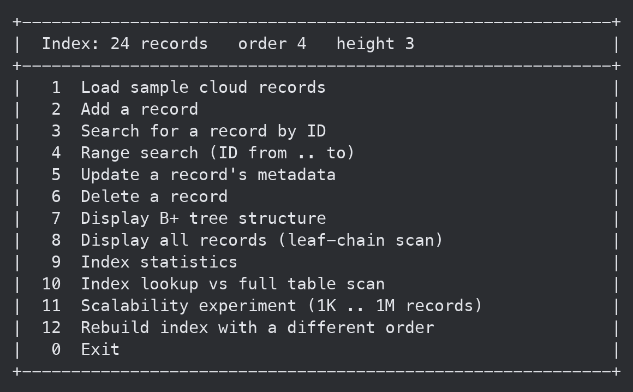
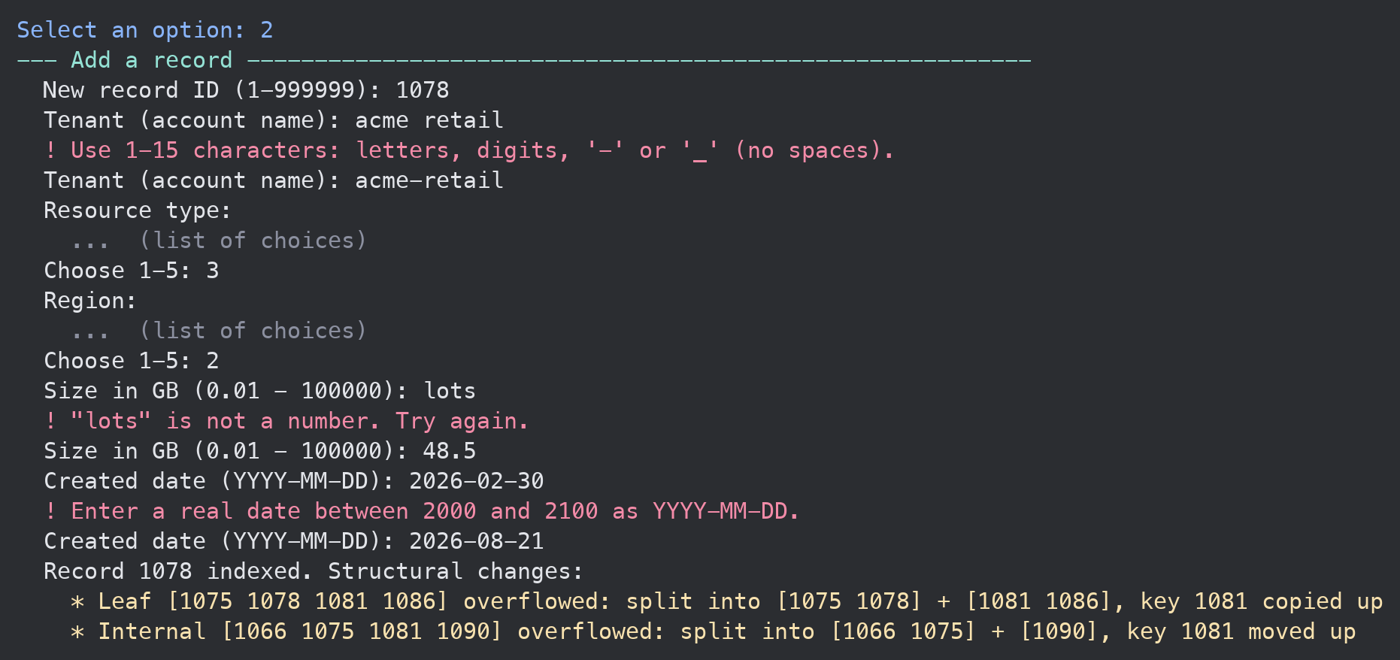
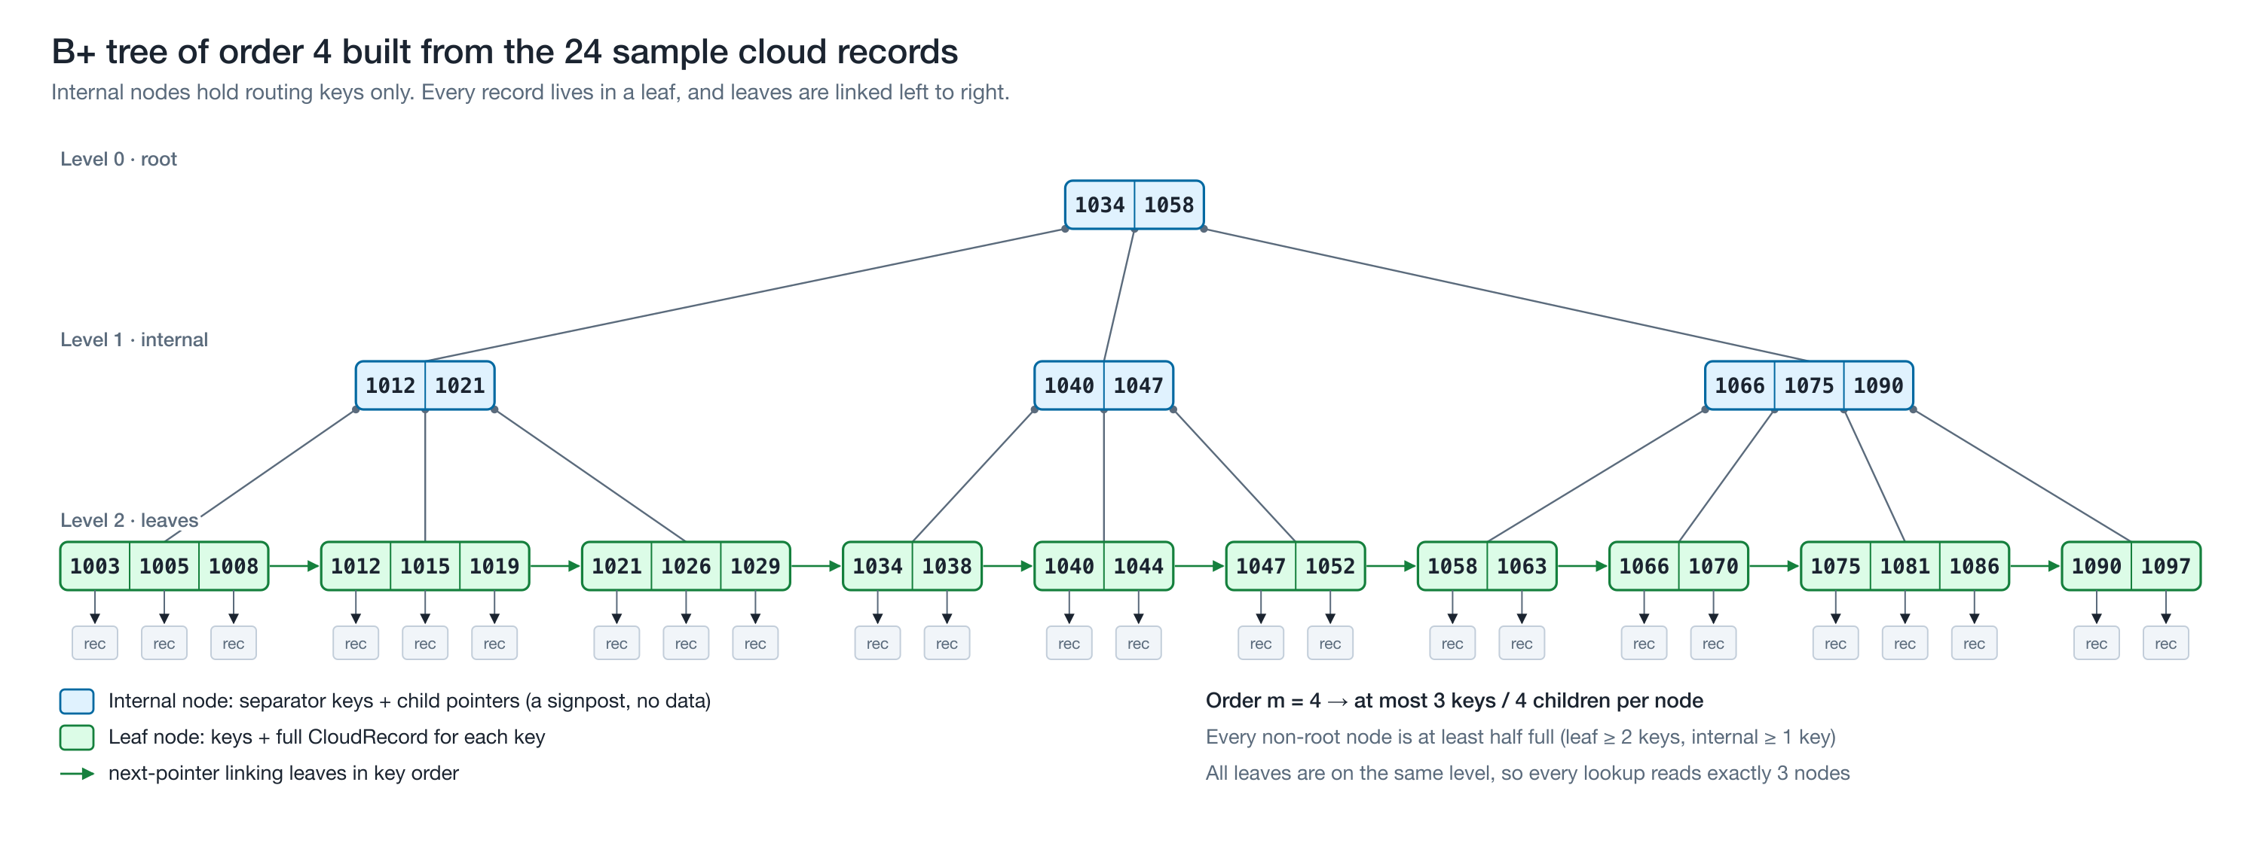
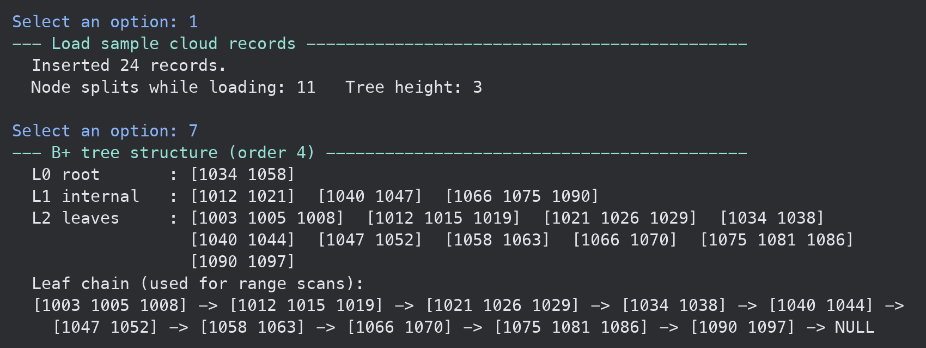
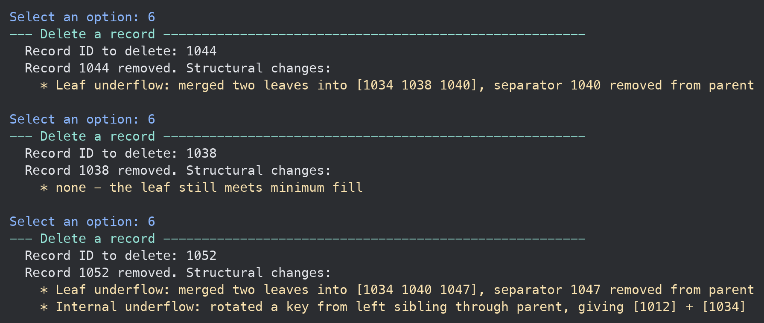
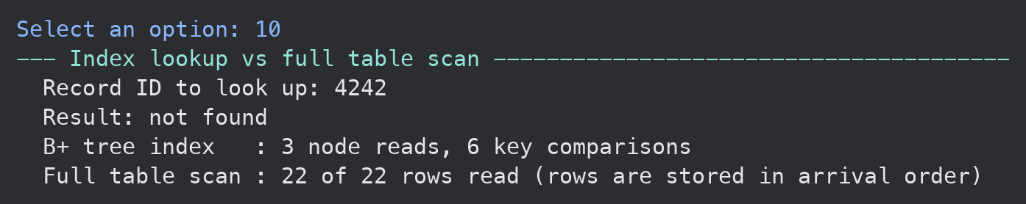
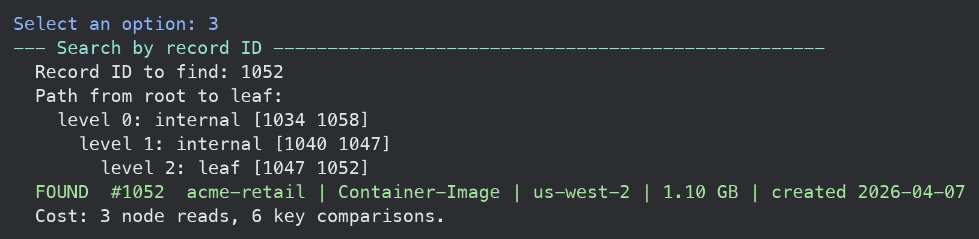
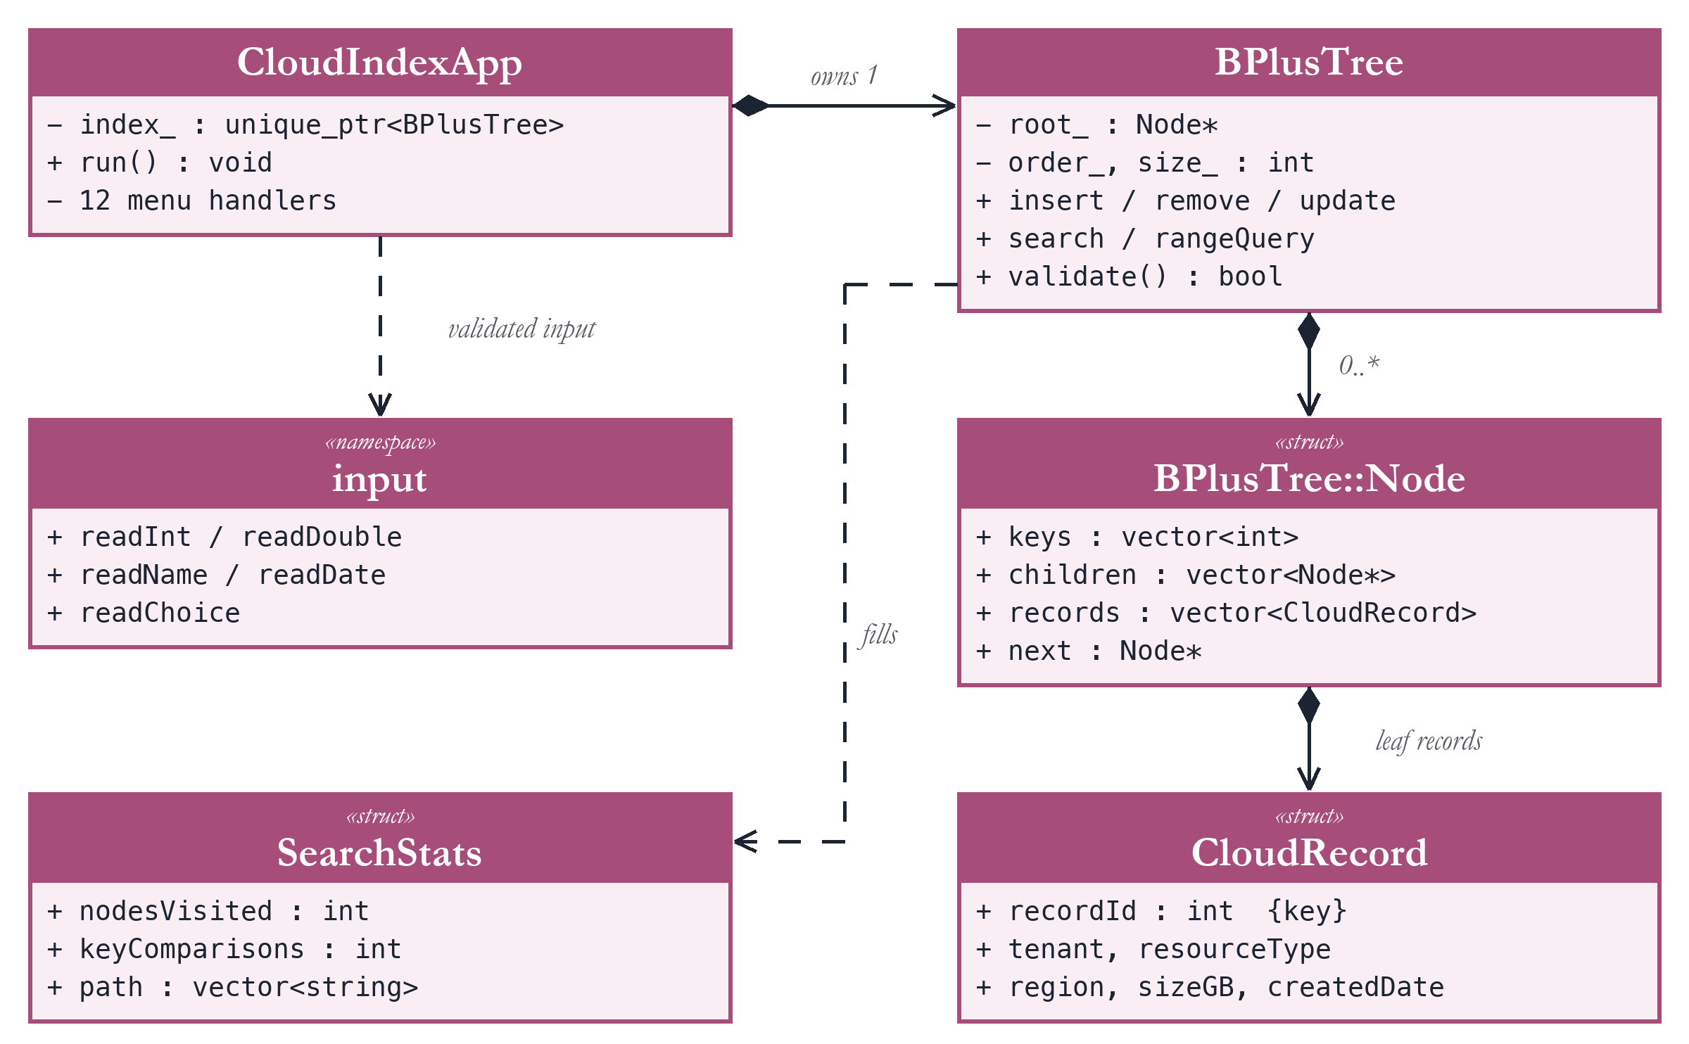
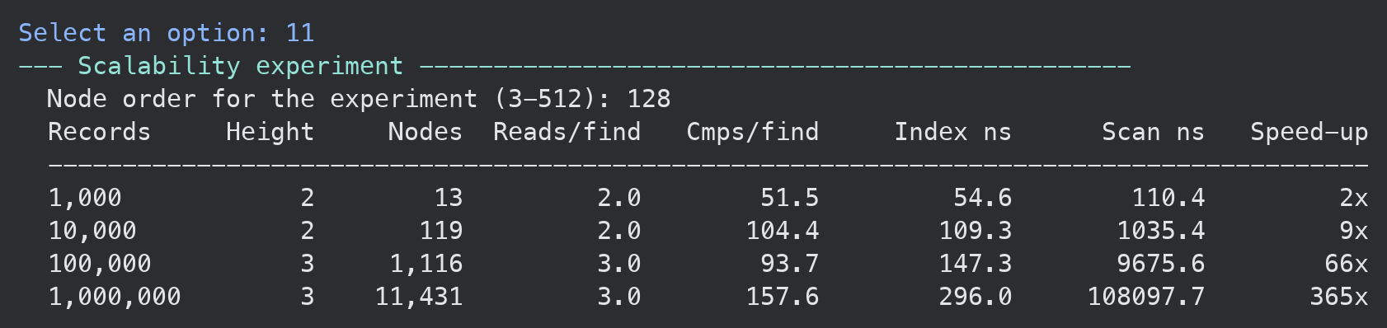
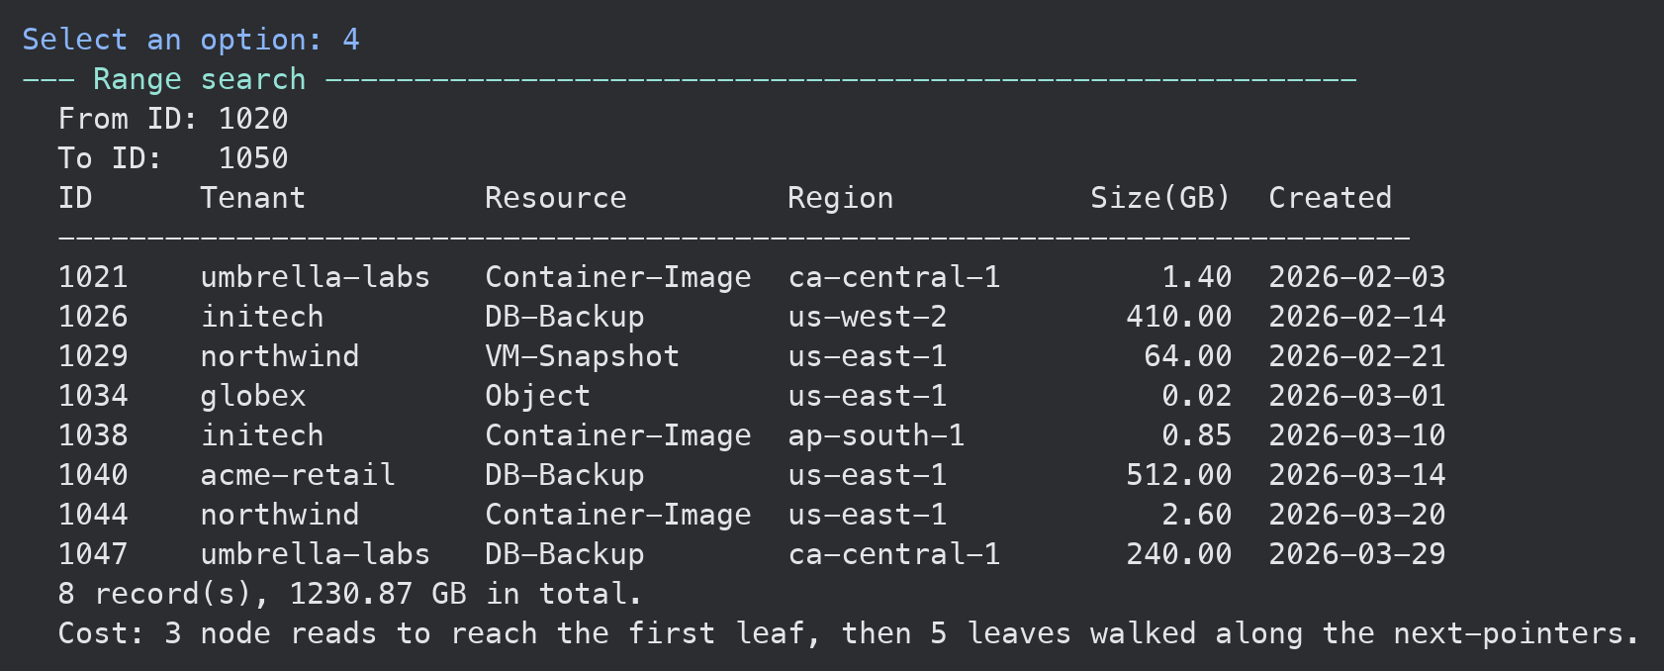
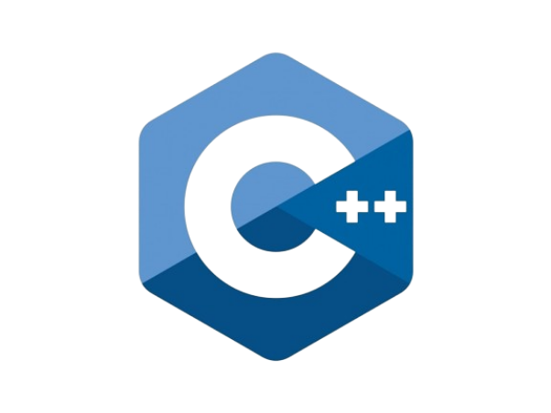


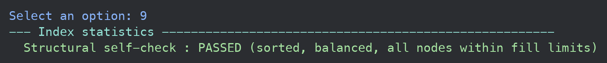
Design and Implementation of an Indexed Cloud-Record Search System
using a B+ Tree called CloudVault
PRANAV SINGH
Faculty Advisor: Dr. Victor Govindaswamy
Concordia University Chicago
Abstract
B+ Tree
Menu Functionality
2: Add a Record (Node Splits)
Field: This project, situated within Computer Science, focuses on data structures and their role in cloud computing and databases. It studies the B+ tree, the balanced multi-way search tree behind most database indexes.
Purpose: The aim is to show how a cloud service can find one record among millions in only a few storage reads. CloudVault is a menu-based C++ application that indexes cloud resource records (tenant, type, region, size and date) by record ID using a B+ tree built from scratch.
Method: The tree supports search, range search, insertion with node splits, and deletion with borrowing and merging. The program prints every search path and structural change, and a built-in self-check verifies all B+ tree rules.
Results: Every lookup costs one node read per level. Growing the index from 1,000 to 1,000,000 records added only one level, and lookups were 365× faster than a linear scan.
Future enhancements include storing each node as a fixed-size disk page, saving the index to a file between runs, and supporting many users reading and writing at the same time.
A B+ tree is a balanced search tree whose nodes hold many sorted keys. Internal nodes only route a search; every record lives in a linked leaf. Nodes stay at least half full and all leaves sit at the same depth, so a lookup reads one node per level.
Every operation is a numbered menu option. The status line shows the record count, the tree's order and its height.
Every field is validated first. Adding 1078 overfills a leaf, which splits and copies 1081 up; its parent then splits and moves 1081 into the root.
Real-World Application: Cloud Databases
1 & 7: Load Data and Display the Tree
6: Delete a Record (Merge & Borrow)
Cloud databases keep data on network storage, where every page read is a round trip. One B+ tree node is one storage page holding hundreds of keys, so even billions of rows are only 3–4 levels deep. MySQL, PostgreSQL, Azure SQL and SQLite index with B-trees or B+ trees, and Amazon DynamoDB's storage nodes keep partition data in a B-tree.
Option 1 loads 24 sample records out of order, causing 11 node splits. Option 7 prints the tree level by level, then the linked leaf chain.
A leaf that drops below half full borrows a key from a sibling or merges with one; an emptied internal node is repaired the same way.
Complexity & Results
Search, insert, delete: O(log_m n) node reads, with at most one split or merge per level.
Range search: O(log_m n + k/m), one descent then a walk along the linked leaves.
Space: O(n), since every node is half to completely full.
Measured: 1,000 → 1,000,000 records added only one level; lookups were 365× faster than a linear scan.
3: Search by Record ID
10: Index Lookup vs Full Scan
Option 3 prints the root-to-leaf path and the cost of the lookup: 3 node reads, found or not.
UML Class Diagram
Error Handling
11: Scalability Experiment
Every input is read as a full line and validated before use, so a typo can never crash the menu or corrupt the tree. Menu choices, sizes and dates are range-checked, tenant names allow only letters, digits, '-' and '_', and impossible dates such as 2026-02-30 are rejected.
4: Range Search
Lookups timed on 1K to 1M records against a linear scan.
Option 4 descends once to the start of the range, then follows the leaf chain; reversed bounds are swapped.
Object-Oriented Design
Each class has one job: BPlusTree is the data structure, CloudIndexApp runs the menu, CloudRecord holds a resource, and the input functions validate every entry. The tree owns and frees its own nodes.
Contacts
Bioinformatics And Technology Laboratory (BAT Lab)
- Programming Application Implementation and Design (PAID)
Computer Science Department (CSC@CUC)
Member: PRANAV SINGH
Advisor: Dr Visvasuresh (Victor) Govindaswamy
Email: Victor.Govindaswamy@cuchicago.edu
Address: Concordia Chicago University
7400 Augusta Street
River Forest, IL, 60305-1499
Technologies Used
Further Future Work
9: Structural Self-Check
Disk-based pages: save nodes to a file so the index survives restarts.
Concurrency: many users searching and updating at once.
Cloud service: expose the index through a web API.
Option 9 re-checks every B+ tree rule on the live index.

