Slide 1
Flipkart Price Fluctuation &
Deceptive Discount Analysis
Review 2 — Progress Presentation
An automated scraping pipeline, exploratory analysis, and predictive modeling
built on live e-commerce pricing data

Slide 2
Problem & Objective
Core Question
Extended Scope
How do Flipkart prices fluctuate
around weekends, festivals, and holidays?
Does time of day or product category change the pattern?
Are discounts shown on the page real?
Cross-checking Flipkart's displayed discount against
what MRP and Selling Price actually imply — a
quantitative signal for deceptive pricing patterns.
2

Slide 3
Pipeline Overview
Scraper
(Playwright +
JSON-LD)
→
Automated
Collection
(3x / day)
→
Data
Cleaning
→
Feature
Engineering
→
Exploratory
Analysis
→
Predictive
Model
Every stage was built and independently verified against real data — including several real bugs found and fixed along the way (see next slide).
3

Slide 4
Data Collection at a Glance
40
7
3x/day
3,463+
Products tracked
Subcategories
Scrape frequency
Rows collected so far
Collection window: Aug 22 – Oct 31 (ongoing) • Automated via GitHub Actions, no manual scraping required
Categories covered
Smartphone
Laptop
Television
Audio
Home Appliance
Fashion / Footwear
Beauty
4

Slide 5
Engineering Challenges Solved
Selectors broke without warning
Flipkart's hashed CSS classes shift on redeploy → switched to JSON-LD structured data as the primary source, with CSS as fallback
Mixed timestamp formats in the data
An earlier Excel round-trip silently reformatted some rows → built a multi-format parser that recovers both
GitHub Actions' scheduler proved unreliable
Native cron silently skipped runs → replaced with an external trigger (cron-job.org) calling the same workflow reliably
Timezone drift between local runs and cloud runs
Cloud runner defaulted to UTC → timestamps now explicitly locked to IST regardless of host
5

Slide 6
Dataset Snapshot (as of this review)
Overview
Missing Values (explained, not just noted)
3,463 rows across 40 products
3 categories, 7 subcategories
Date range: Aug 22 – Sep 23, 2026
Mean price: ₹42,551
Mean discount: 29.6%
Mean rating: 4.37 / 5
MRP / discount %: 12.9%
→ products with no strikethrough price shown
Bank offer price: 1.5%
→ products with no bank offer configured
Festival flag: 40.7% (not a festival day)
6

Slide 7
Feature Engineering
Calendar features
day_of_week, is_weekend, is_festival — festival windows verified against real 2026 dates (Onam, Raksha Bandhan, Janmashtami, Ganesh Chaturthi, Navratri, Dussehra)
Time-of-day
Each scrape mapped to its nearest scheduled run (midnight / morning / afternoon), tolerant of scheduler drift
Price fluctuation measures
price_change, price_change_pct, and a 3-day TIME-based rolling mean/std — excludes the current observation, so a price is compared to its own recent history
Discount honesty check
computed_discount_percent (from MRP−SP) vs. discount_percent shown → discount_discrepancy
7

Slide 8
EDA — Price Volatility by Subcategory
Measured using Coefficient of Variation (std ÷ mean), not raw ₹ std — so expensive products don't automatically rank “most volatile” just because their swings are bigger in absolute terms.
Beauty
Laptop
Fashion / Footwear
Audio
Television
Home Appliance
Smartphone
Beauty and Laptop fluctuate most, proportionally — despite Smartphone showing more visual movement in raw ₹ terms.
8

Slide 9
EDA — Discount Behaviour by Subcategory
Fashion/Footwear runs a consistently high ~58–61% discount baseline regardless of festival — a category-level pricing strategy, not a festival effect.
9

Slide 10
EDA — Correlations & Discount Honesty
Correlation highlights
Discount discrepancy
Price ↔ Rating
+0.55
discrepancy = shown discount − computed discount
A quantitative, per-row signal for whether Flipkart's displayed discount matches what MRP and SP actually imply — independent of any manual/LLM judgment.
Cross-checked further against a Subcategory × Festival heatmap to see where discrepancy concentrates.
Discount % ↔ Rating
−0.35
Price ↔ Discount %
−0.24
Price ↔ Rolling Volatility
+0.23
Higher-rated products tend to be pricier and discounted less aggressively.
10

Slide 11
Predictive Model — Methodology
Target
next_price_change_pct — the % price change at a product's NEXT scraped observation
Features
Current product state:
discount_percent, price_change_pct, rolling_price_mean, rolling_price_std
Static product info:
subcategory, mrp
Next timestamp's calendar:
day_of_week, is_weekend, is_festival, time_slot — legitimately known in advance
Validation
Chronological train/test split (not random) — train on earlier dates, test on later dates, to avoid leaking future information
Models
Random Forest Regressor → XGBoost Regressor, evaluated with RMSE and MAE against an explicit naive baseline
11

Slide 12
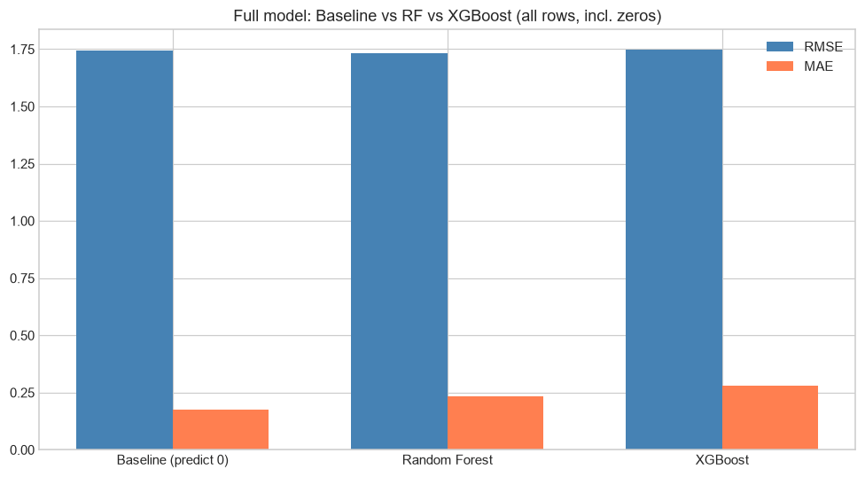
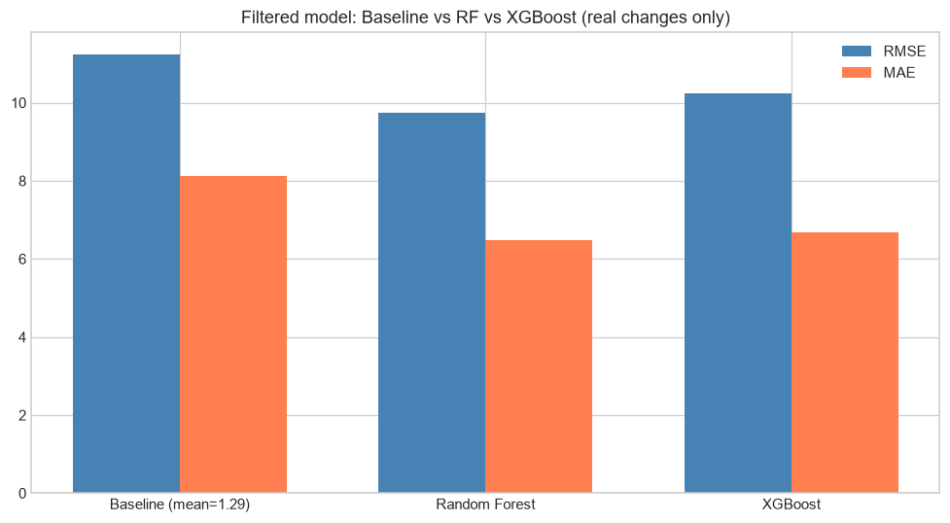
Model Results — Checking Against a Baseline
On the FULL dataset (98% zero-change rows), models roughly tie a naive “predict 0” baseline.
Once FILTERED to rows with a real price change, Random Forest clearly beats a mean-prediction baseline.
Checking against baseline — not just training a model — revealed that price changes are rare, discrete events best modeled separately from the “nothing happened” majority.
12

Slide 13
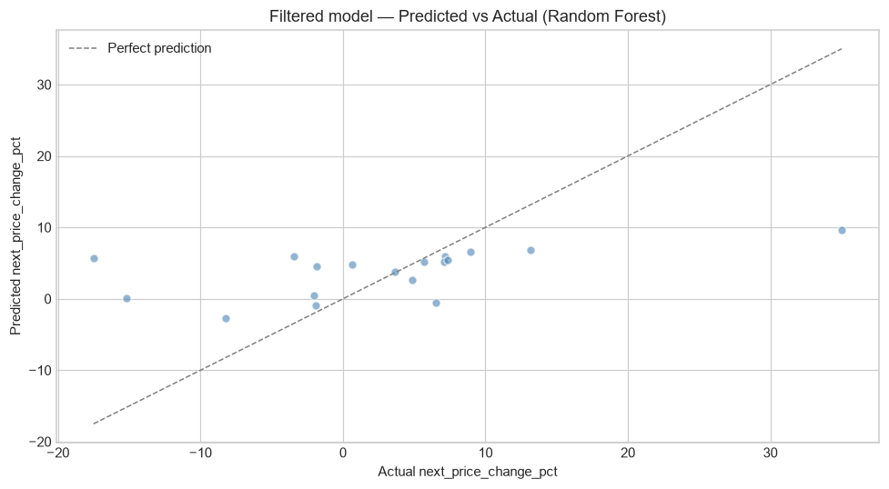
Predicted vs Actual — An Honest Look
Predictions cluster in a narrow band while actual swings range far wider — the model (trained on just 69 rows) underestimates extreme jumps. A known, stated limitation of the current sample size, not a hidden flaw.
13

Slide 14
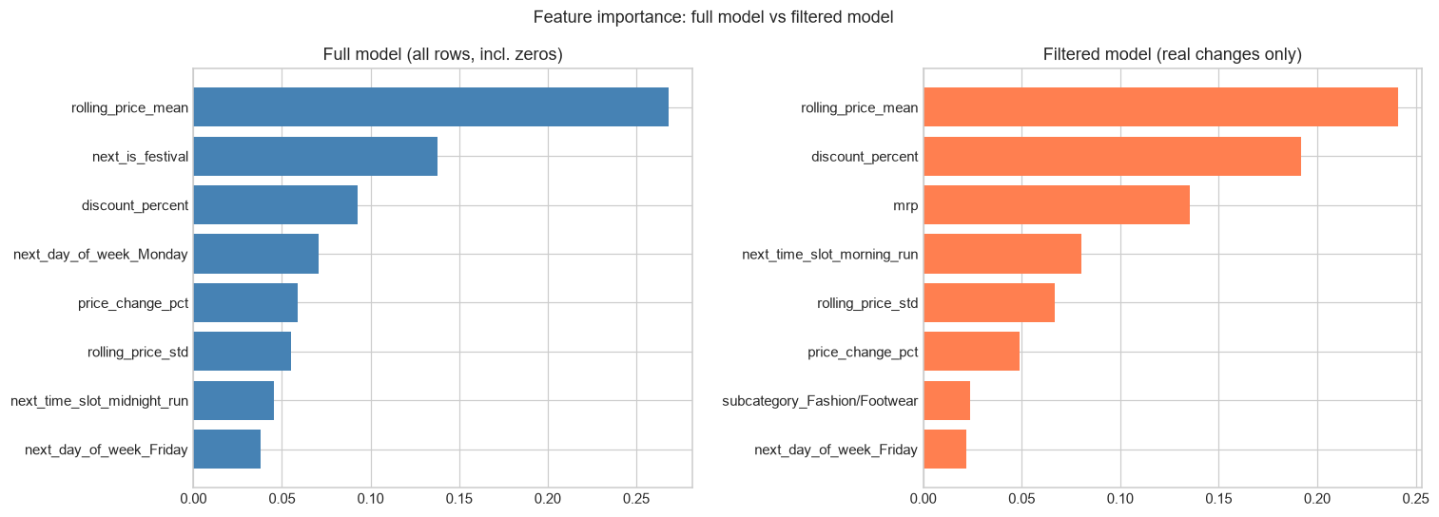
Key Insight — What Festivals Actually Affect
next_is_festival ranks #2 in the full model — but disappears from the filtered model's top features entirely.
Festivals appear to drive WHETHER a price changes at all — not HOW LARGE the change is once it happens. A specific, model-backed finding, not just an EDA impression.
14

Slide 15
Key Findings So Far
✓
Beauty and Laptop are proportionally the most volatile subcategories — driven by a handful of specific SKUs, not a uniform effect
✓
Fashion/Footwear maintains a ~58–61% discount baseline regardless of festival timing — a category strategy, not a festival effect
✓
Festivals influence WHETHER a price changes, more than HOW MUCH it changes when it does — confirmed by two separate model runs
✓
The full pipeline — scraping through modeling — runs automatically, unattended, with verified data quality at every stage
15

Slide 16
Limitations & Next Steps — Review 3
Honest limitations, right now
Planned for Review 3
• Filtered model trained on only 87 real-change rows (18 test)
• Extreme price jumps under-predicted — small sample
• Data doesn't yet include Navratri/Dussehra — the biggest sale window of the whole project
• Full dataset through Oct 31 (~3x current volume)
• Navratri/Dussehra data — peak sale season
• Multi-window chronological validation, at scale
• Gemini-based deceptive pattern classification (urgency, scarcity)
16

Slide 17
Thank You
Questions & Discussion

