Slide 1
Chronic Kidney Disease Classification
Machine Learning Case Study
Using Clinical Measurements

Slide 2
Problem Statement & Objectives
Goal: Classify patients as having CKD or Not CKD using ML.
  Objectives:
    Clean and preprocess clinical data
    Handle significant missing values
    Identify key disease predictors
    Compare 5 ML algorithms
    Deploy the best model via Web App

Slide 3
Dataset & Preprocessing
UCI CKD Dataset: 400 Patients, 24 Features
  Challenge: Up to 38% missing data in some features.
  Solution: Robust Imputation Strategy
    Numerical: KNN Imputation (k=5)
    Categorical: Mode Imputation

Slide 4
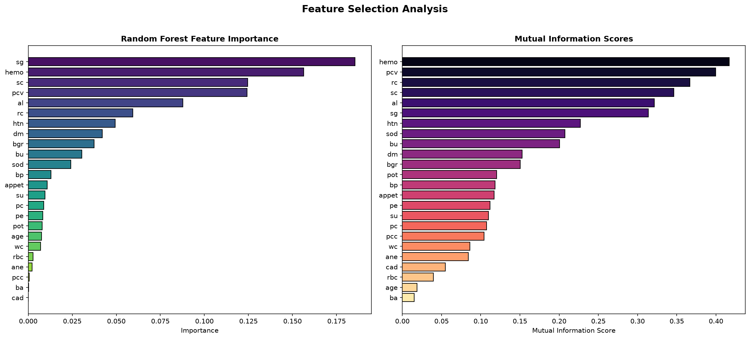
Key Clinical Predictors

Slide 5
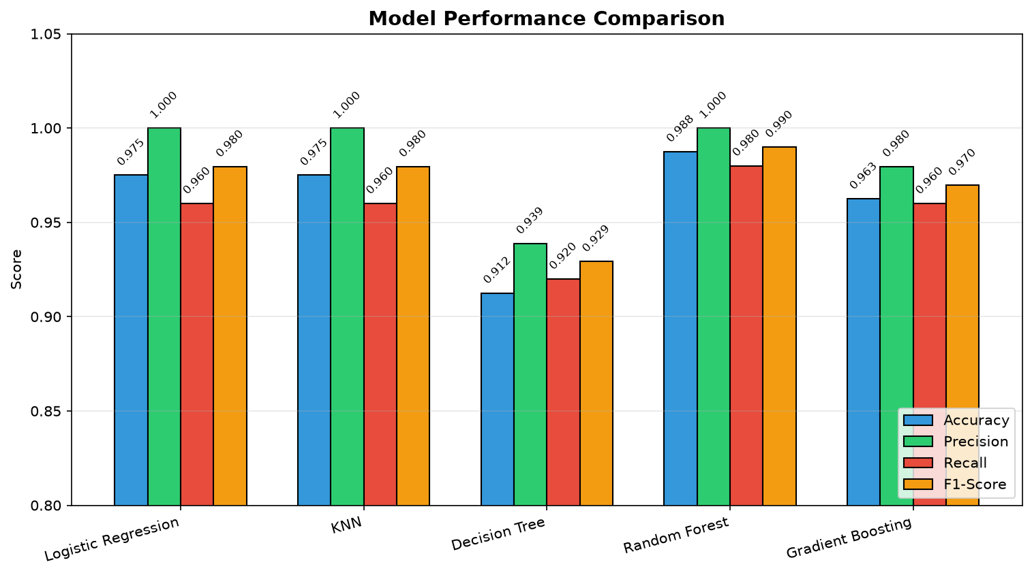
Model Evaluation & Comparison

Slide 6
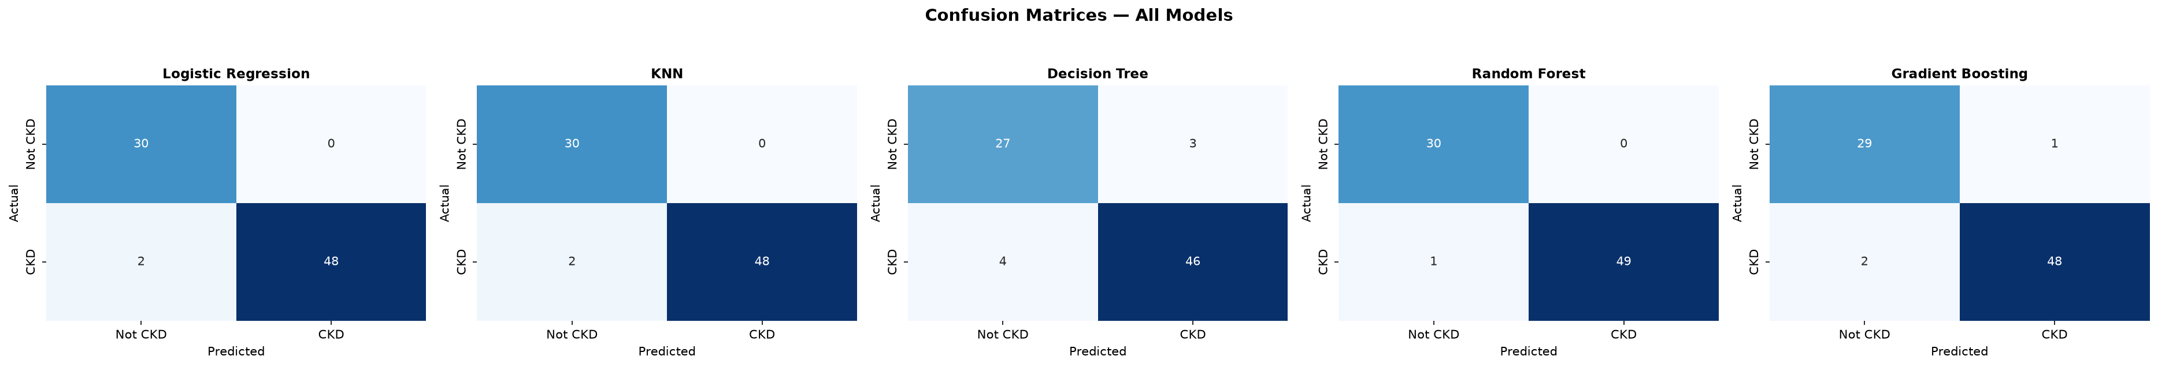
Confusion Matrices (False Positives/Negatives)

Slide 7
Conclusions
Random Forest is the winning model.
  Performance: 98.75% Accuracy, 98% Recall
  Why Recall matters: Minimizes False Negatives (missing a sick patient).
  Deployment: Model successfully integrated into a Streamlit Web Application for real-time clinical use.

