Slide 1
RANDOM POSITIONING MACHINE
Project Guide : Dr. V S Sooraj
Presented by : M-Tech Manufacturing Technology | Batch of 2025 - 2027

Slide 2
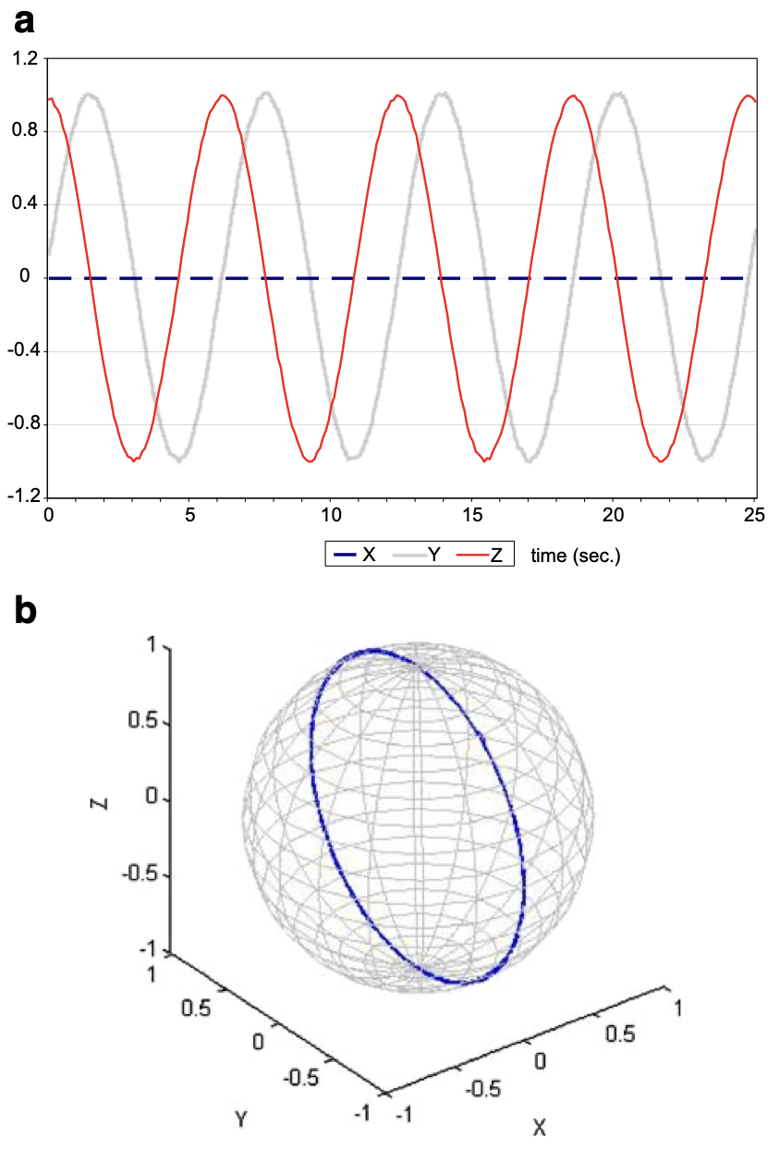
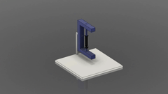
Systems for Microgravity Demonstration
2D Clinostat
Constant Speed
Single Frame Rotation
Rotation along Y-Axis
Fig 1B : Gravity values in a 2D clinostat mode. Y and Z
are changing sinusoidal between +1 g and−1 g.
Fig 1C : The clinostat mode results in a 2D motion trajectory, in this graph projected on an imaginary sphere. The abscissa in a as well as the three axes in b are accelerations expressed as ‘g’. Time displayed in seconds is displayed at the ordinate in b
Fig 1A : Operation of 2D Clinostat
Slide : 1
Notes:
- Aeroelasticity leads to safety and performance, S

Slide 3
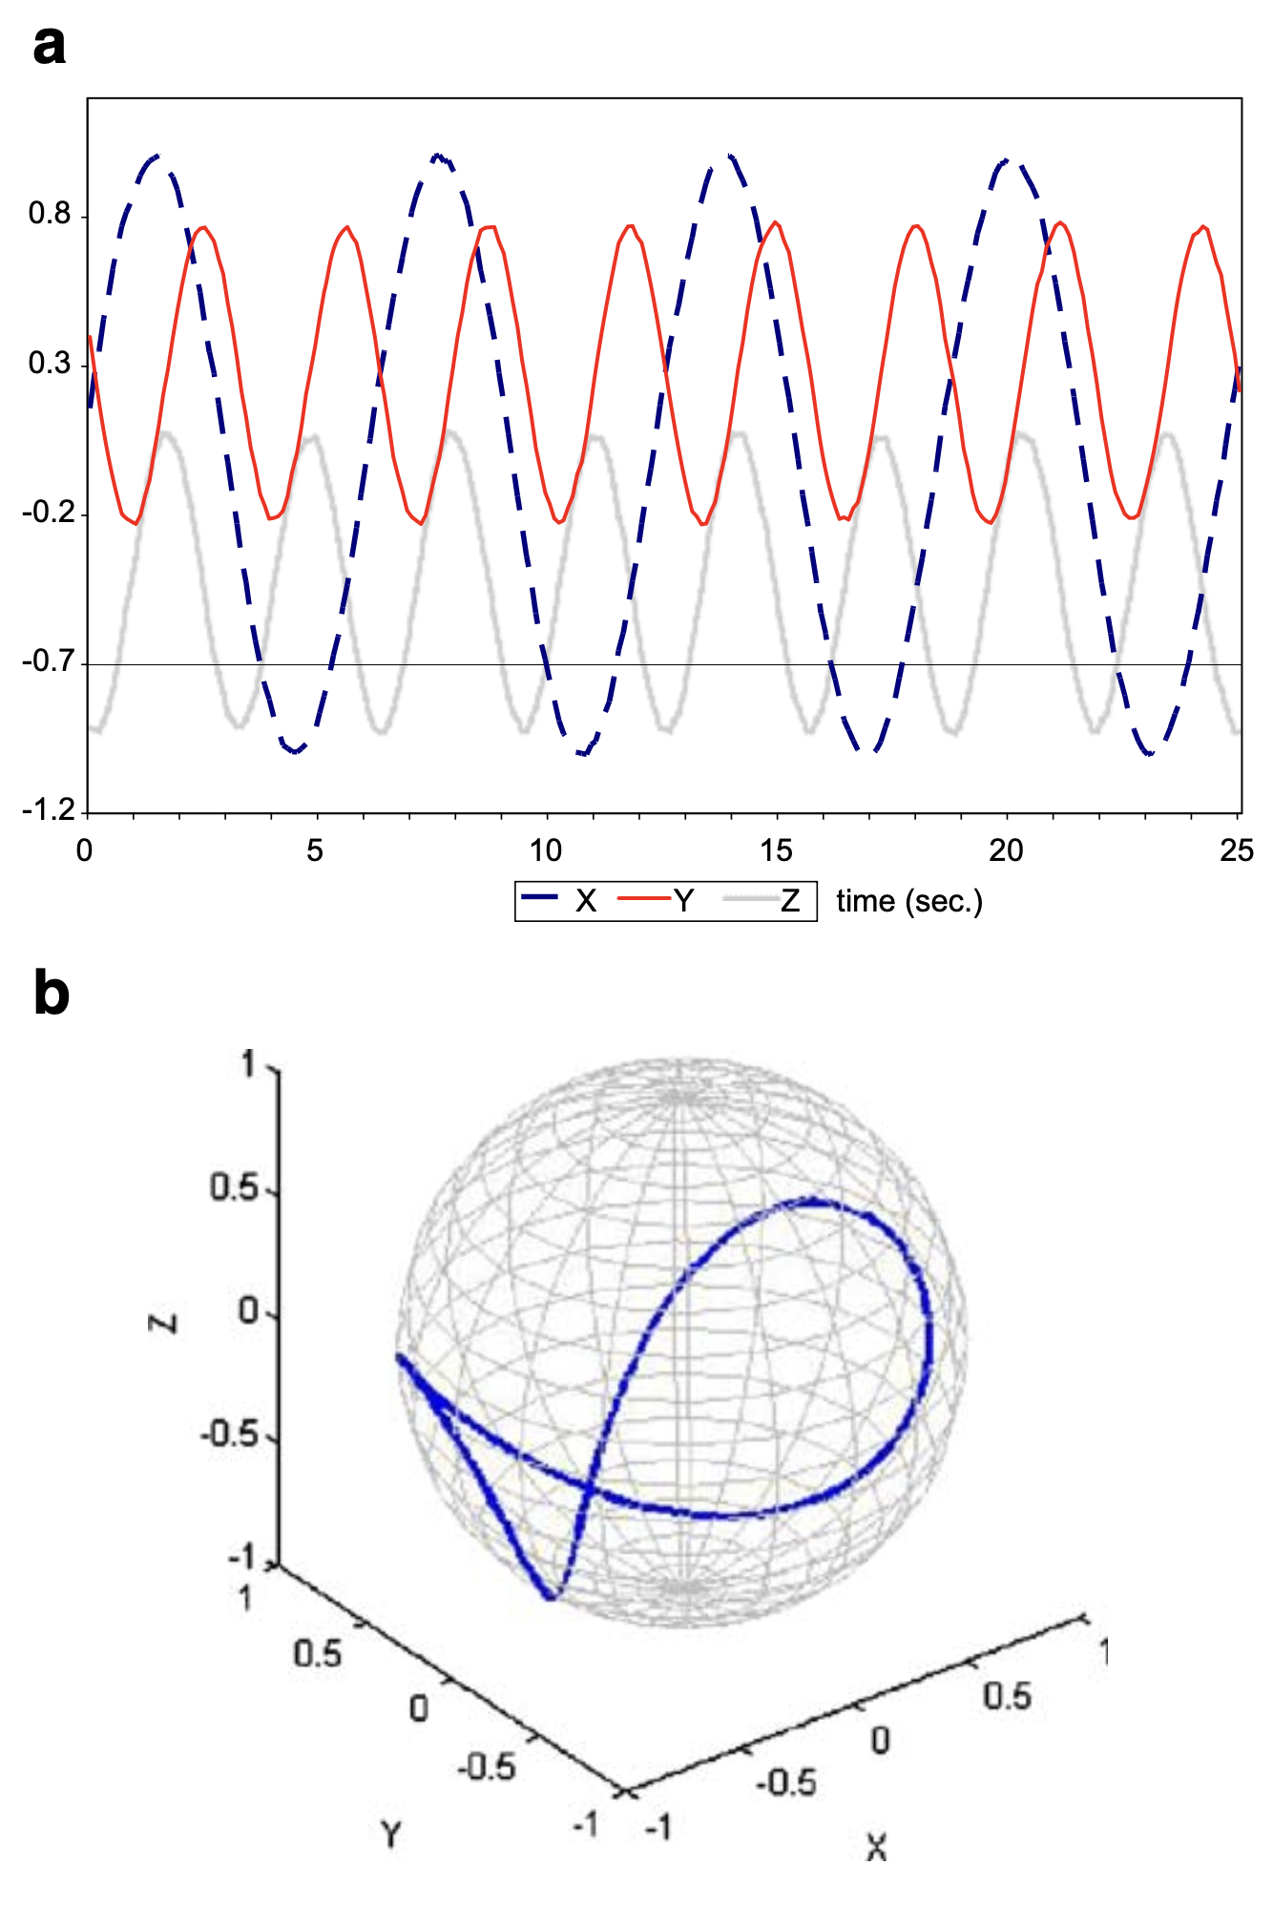
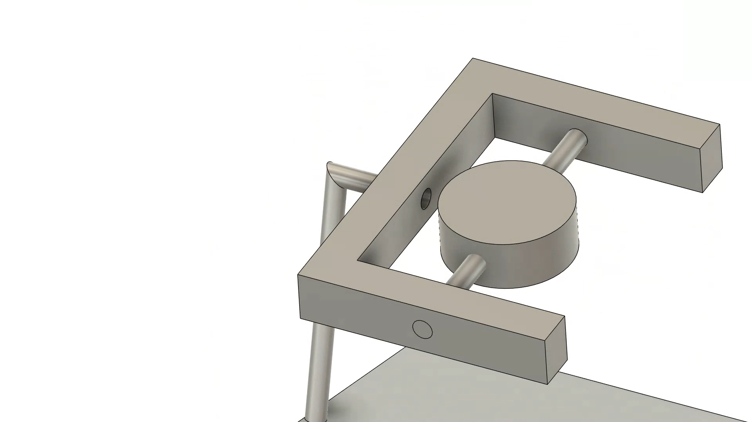
Systems for Microgravity Demonstration
3D Clinostat
Constant Speed
Two Axis/Frames Rotation
Repetitve & Predictable Trajectory
Fig 2B :Gravity values measured on the RPM, rotated in 3D clinostat mode, the inner and outer frame rotate both at a constant speed of 60◦/s.
Fig 2C : Motion trajectory 3D clinostat mode with constant speed for both frames of 60◦/s, displayed on an imaginary sphere. The abscissa in a as well as the three axes in b are accelerations expressed as ‘g’. Time displayed in seconds is displayed at the ordinate in b
Fig 2A : Operation of 3D Clinostat
Slide : 2

Slide 4
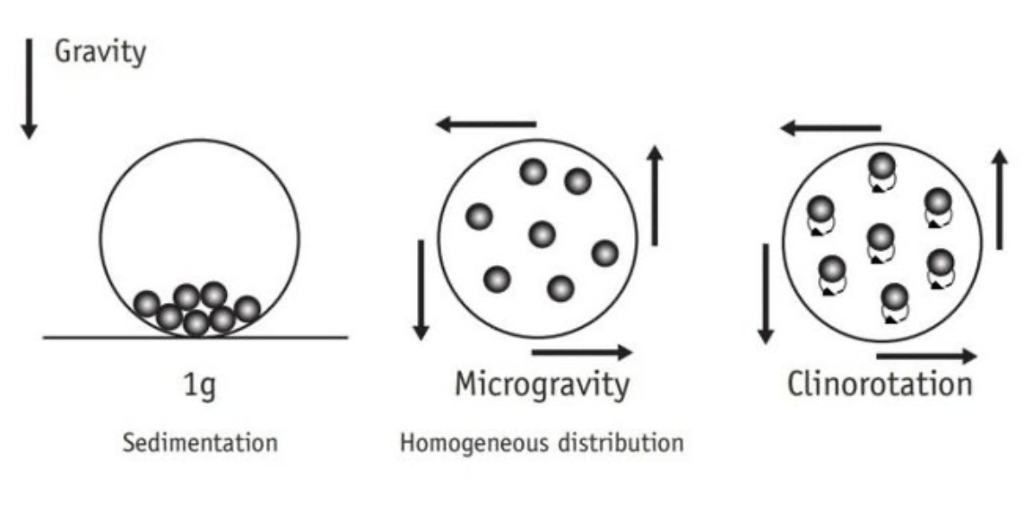
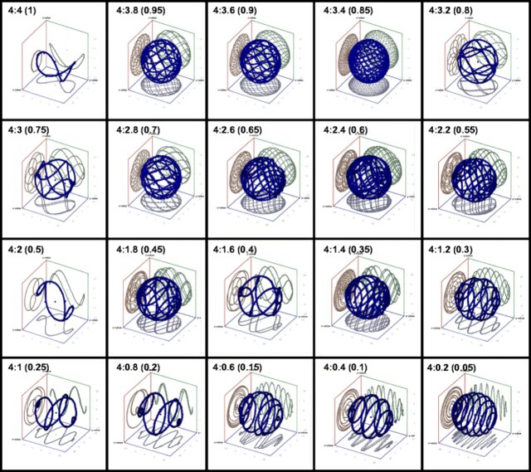
x
Something to Visualize Further
Fig : Representation of the rotational movement of a 2-D Clinostat.
Adapted From : United Nations, 2013, Teacher’s Guide to Plant Experimentsin Micro-g. UNOOSA,Newpace Applications. UNOOSA,New York. 45 p
Fig: A 3D clinostat can produce different patterns of motion by varying the revolution. The rotational speed of the primary axis was fixed, while the speed of the second axis varied as shown in the figure. The data of the 3D acceleration sensor were recorded for five minutes and are shown in the 3D graph
An Experimental and Theoretical Approach to Optimize a Three-Dimensional Clinostat for Life Science Experiments
Slide : 3

Slide 5
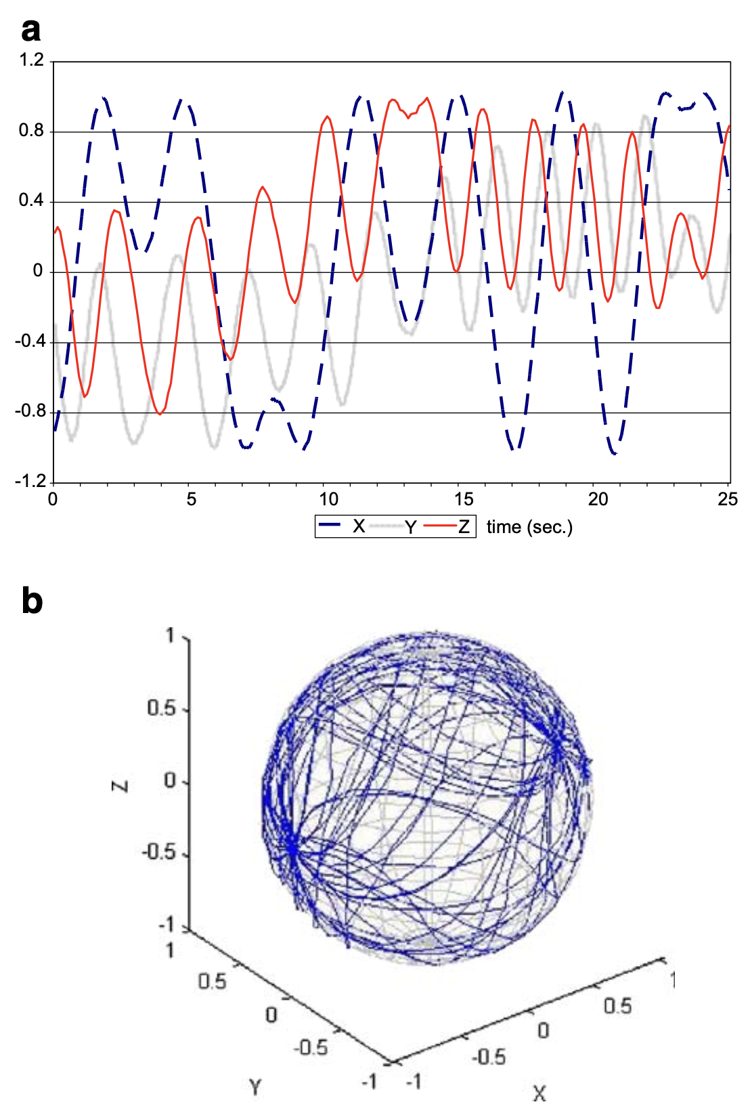
Systems for Microgravity Demonstration
RPM
Random Mode in both Direction & Speed
~ Relate by Random Walk
Necessitates Centre-Placement for Limiting the Centripetal Acceleration induced (needs further study?)
Fig 3B : Gravity values measured on the RPM, rotated in random speed and random direction mode, the inner and outer frame rotate (in this example) are at a varying speed between 60–120◦/s.
Fig 3C : b Motion trajectory in random speed and random direction mode, displayed on an imaginary sphere. The abscissa in a as well as the three axes in b are accelerations expressed as ‘g’. Time displayed in seconds is displayed at the ordinate in b
Slide : 4

Slide 6
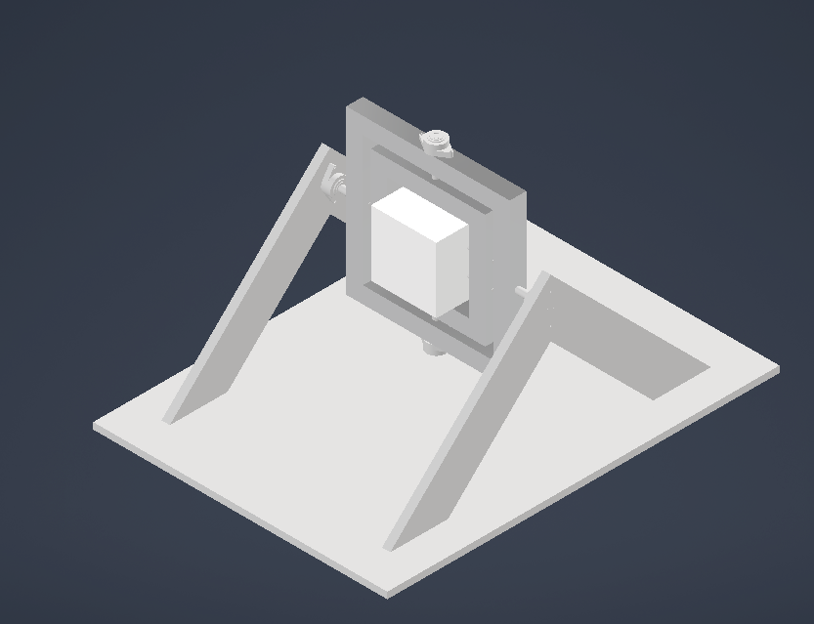


CAD Designs
Fig 4A : CAD of the Complete Assembly
Fig 4B : CAD of the Payload Sub-Assembly
Fig 4C : CAD of the Payload
Slide : 5
Notes:
- Aeroelasticity leads to safety and performance, S

Slide 7


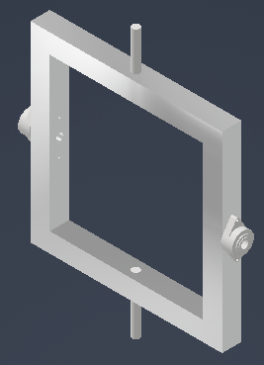
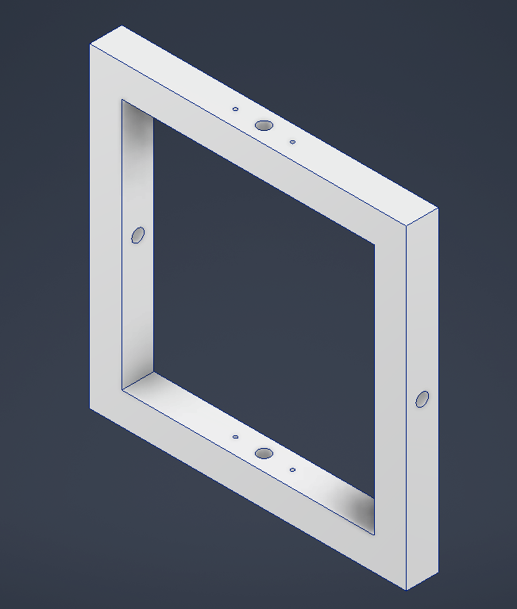

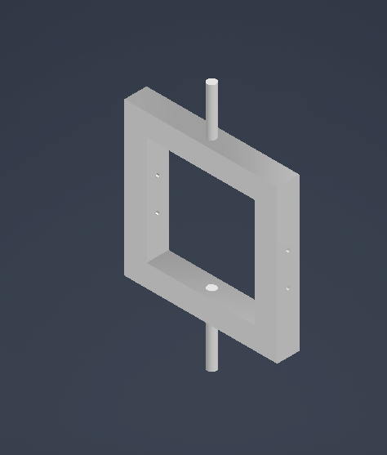
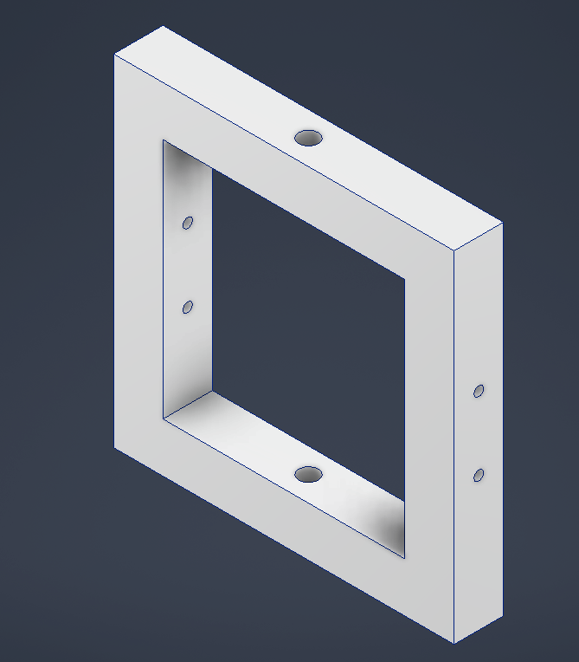
CAD Designs
Fig 4D : Base Sub-Assembly
Fig 4E : Model of Stand
Fig 4F : CAD Outer Frame Sub-Assembly
Fig 4G : CAD of the Outer Frame
Fig 4H : CAD of the Base Plate
Fig 4I : Inner Frame Sub-Assembly
Fig 4J : CAD of the Inner Frame
Slide : 6

Slide 8
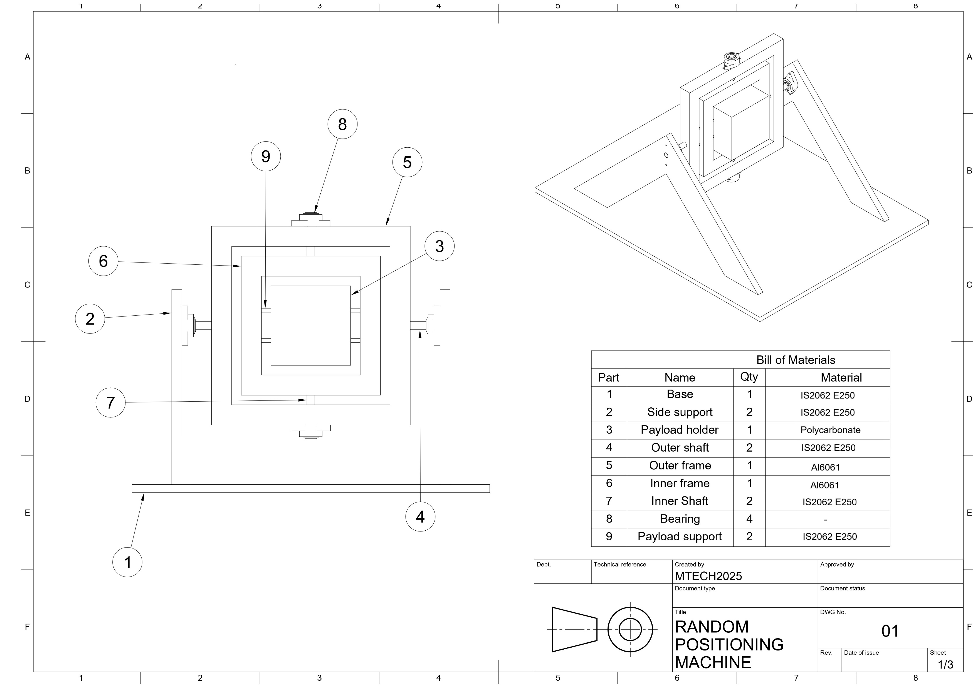
CAD Designs
Fig 4K : Assembly Drawing
Slide : 7

Slide 9
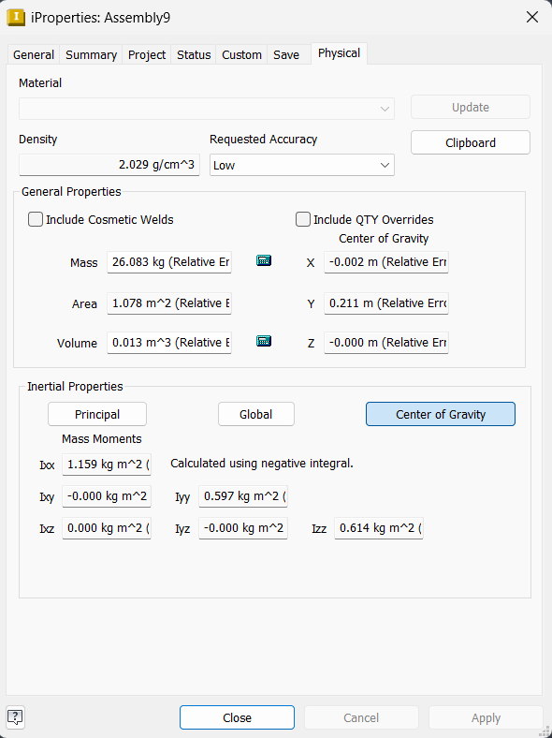

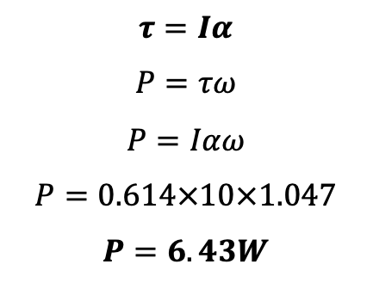
Torque & Motor Calculations
Information Derived From the Software
I_{ZZ} = 0.614kg/m²
N = 10 rpm
ω = 1.047rad/s (maximum)
Α = 10rad/s²
$$τ=Iα$$
$$P=τω$$
$$P=Iαω$$
$$P=0.614×10×1.047$$
$$P=6.43W$$
Fig 5A : CAD of the Parts to be rotated by the Outer motors
Fig 5B : Physical Properties of the Assembly as calculated by the CAD software
Slide : 8

Slide 10
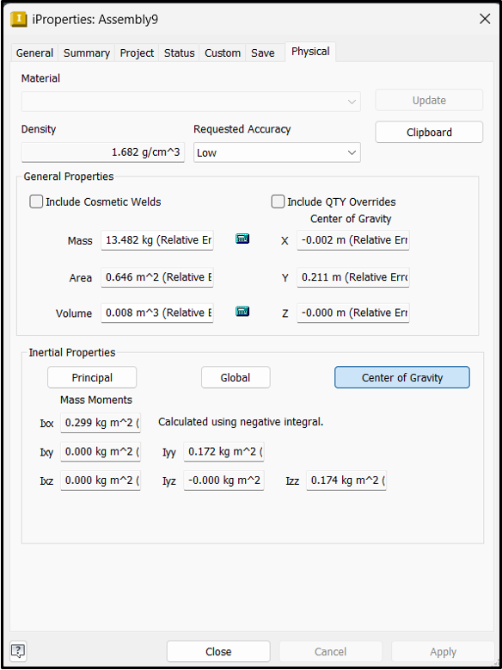

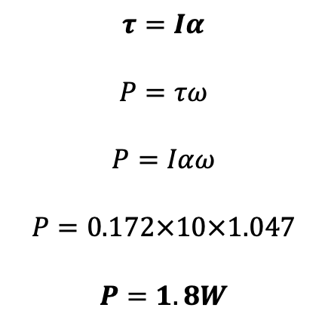
Torque & Motor Calculations
Information Derived From the Software
I_{YY} = 0.172 kgm²
N =10 rpm
ω = 1.047 rad/s
Α = 10rad/s²
$$τ=Iα$$
$$P=τω$$
$$P=Iαω$$
$$P=0.172×10×1.047$$
$$P=1.8W$$
Fig 5C : CAD of the Parts to be rotated by the Outer motors
Fig 5D : Physical Properties of the Assembly as calculated by the CAD software
Slide : 9
Notes:
- Aeroelasticity leads to safety and performance, S

Slide 11
Torque & Motor Calculations
Conclusion
As maximum ω is 1rad/s, assuming α to be 10rad/s² gives us adequate timeline for changing the speeds even from 1rad/s CW to 1rad/s CCW.
The Moment of Inertia is low because of how well balanced the cad model is which is in turn bringing the power level to be very low.
NEMA 34 stepper is found to be adequate for our requirements of the outer frame
NEMA 23 stepper is found to be adequate for our requirements of the inner frame
Given the torque requirements, we can infact go with direct drive options.
Slide : 10
Notes:
- Aeroelasticity leads to safety and performance, S

Slide 12
Bill of Materials
Base Assembly Components
Sr No | Part Name | Number | Material
1 | Stand | 2 | 1inch structural steel sheet
2 | Base | 1 | 1inch structural steel sheet
Outer Frame Assembly Components
Table 1: Bill of Materials of the Base Sub-Assembly
Sr No | Part Name | Number | Material
1 | Frame | 1 | 2x2 inch aluminium beam
2 | Axle | 2 | Φ20 150.8mm Structural Steel Shaft
3 | Flange Bearing | 2 | Φ 20mm ID flange bearing
Inner Frame Assembly Components
Table 2: Bill of Materials of the Outer Frame Sub-Assembly
Sr No | Part Name | Number | Material
1 | Frame | 1 | 2x2 inch aluminium beam
2 | Axle | 2 | Φ20 160.3mm Structural Steel Shaft
3 | Flange Bearing | 2 | Φ 20mm ID flange bearing
Payload Assembly Components
Table 3: Bill of Materials of the Inner Frame Sub-Assembly
Sr No | Part Name | Number | Material
1 | Payload Assembly | 1 | 4 180*180*20 Polycarbonate Sheets
2 | Pins | 2 | Φ10 350mm Structural Steel Shaft
Table 4: Bill of Materials of the Payload Sub-Assembly
Slide : 111

Slide 13
Bill of Materials
Electrical Components
Sr No | Part Name | Number
1 | Slip Rings | 2
2 | Nema 23 | 2
3 | Nema 34 | 2
4 | Arduino Uno Microcontroller | 1
5 | Raspberry Pico | 1
6 | Motor Driver | 2
7 | Jumper Wires
8 | Wires
Table 5 : Bill of Materials of the Electronic Componets
Slide : 12

Slide 14
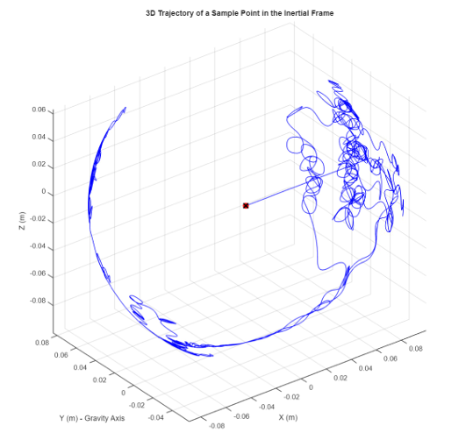
Sample Point Trajectory Analysis in a Random Positioning Machine
Inputs: Simulation inputs include time settings, motor speed/acceleration limits, gravity direction, and the sample point’s initial position.
How it Was Done: The model randomly updates motor rotations, computes the resulting orientations, transforms gravity, calculates centripetal effects, and logs the sample point’s 3D position at every timestep.
Key Code Snippet (Description): The main loop updates angular velocities, constructs rotation matrices, transforms gravity into the payload frame, and computes the sample point’s inertial-frame coordinates.
Fig 6 : Key code snippet.
Slide : 13

Slide 15
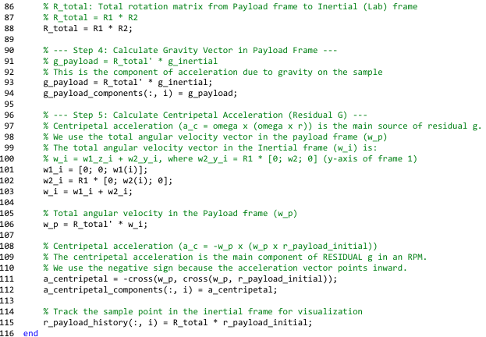
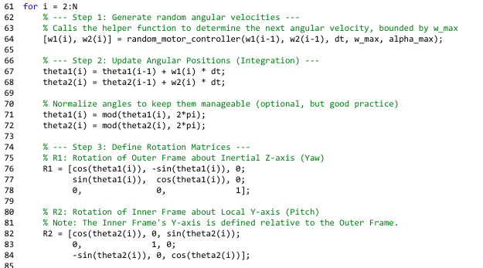
Sample Point Trajectory Analysis in a Random Positioning Machine
Fig 7 : Key code snippet.
Slide : 14

Slide 16
Roles
Name | Role
Anushyant | CAD Drafter
Bishodeep
Shivam | Modelling
Aniket | Material Procurement, Design Conformance
Laxmi
Abdullah Rishad
Juveria | Simulation and Validation
Pranay
Slide : 15

Slide 17
References
https://www.riverpublishers.com/pdf/ebook/chapter/RP_9788793237544C14.pdf
https://link.springer.com/content/pdf/10.1007/s12217-008-9043-2.pdf
https://ntrs.nasa.gov/api/citations/20160013279/downloads/20160013279.pdf
https://www.researchgate.net/publication/290479023_Facilities_for_Simulation_of_Microgravity_in_the_ESA_Ground-Based_Facility_Programme?_tp=eyJjb250ZXh0Ijp7ImZpcnN0UGFnZSI6InB1YmxpY2F0aW9uIiwicGFnZSI6InB1YmxpY2F0aW9uIn19
https://link.springer.com/protocol/10.1007/978-1-0716-1677-2_18
https://github.com/wahabk/Clinostat
Slide : 16

Slide 18
THANK YOU :-)
Glad to assist with doubts if any :-)

