Slide 1
Movie Recommendation WebApp using Content based Recommendation System
Pranay Gore_24
Rahul Shah_34
Lokesh Sharma_35
Guide:
Dr. Megha Trivedi

Slide 2
INTRODUCTION
Content-Based Filtering is one of the fundamental approaches to movie recommendation, offering a personalized movie selection process that relies on the intrinsic characteristics of movies and the user's historical preferences.

Slide 3
Problem Statement
This problem statement seeks to address the need for a robust content-based movie recommendation system that leverages the intrinsic characteristics of movies, such as genres, directors, actors, and plot keywords, to offer personalized recommendations.

Slide 4
Objective
The primary scope of the content-based filtering movie recommendation system lies in offering a personalized movie discovery experience for users. This system will focus on the analysis of content attributes, including genres, actors, directors, and plot keywords, to generate movie recommendations

Slide 5
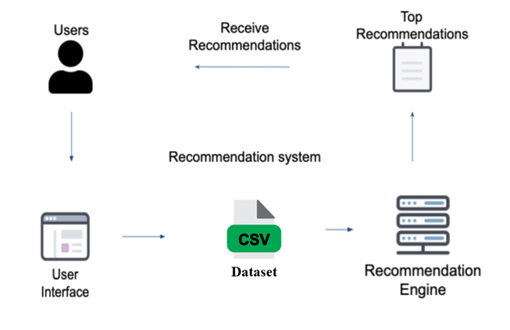
Block Diagram

Slide 6
THANK YOU!!

