Slide 1



SwiftCab
Pranay Patel
Roll:60
En:22002170210079

Slide 2
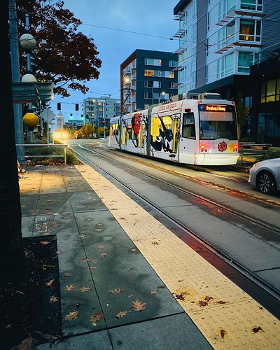
Project Overview
2
Objective: Develop a transportation service platform using React for the frontend and Django for the backend.
22002170210079
22002170210079
This Photo by Unknown Author is licensed under CC BY-NC

Slide 3

Technology Stack
3
Frontend: React.js for dynamic UI and user interaction.
Backend: Django (Python) for handling API requests and JWT
Axios/Fetch: For API calls and backend communication.
22002170210079

Slide 4
Core Features
4
Login & Signup Pages: Authentication
Driver Registration :include Vehicle Information and legal Details
UI :Fixed Navbar and Footer
Trip Details :User can book trip and Download Trip data as pdf
22002170210079

Slide 5
Future Goal
5
Real Time Tracking
Payment Gateaway
22002170210079

Slide 6
Conclusion
6
Successfully developed a react and Django connection
Clean and responsive design for user friendly.
22002170210079

Slide 7
Thank You
22002170210079

