Slide 1
AIRLINE DATA ANALYSIS
Presented by Pranay Bangar
Trends and challenges

Slide 2

WHAT IS
EXPLORATORY
DATA ANALYSIS ?
Exploratory Data Analysis (EDA) is an analysis approach that identifies general patterns in the data. These patterns include outliers and features of the data that might be unexpected. EDA is an important first step in any data analysis.

Slide 3
DETAILS OF PROJECT
01.
For this project dataset sourced from kaggle.com
This dataset contains an airline passenger satisfaction survey. What factors are highly correlated to a satisfied (or dissatisfied) passenger?
02.
We are going to conduct an analysis of customer satisfaction, with a focus on customers who are dissatisfied with the airline service
03.
Link of dataset https://www.kaggle.com/datase ts/teejmahal20/airline- passenger-satisfaction

Slide 4

OBJECTIVE
01
02
We have airline passenger satisfaction data so our first objective is to check passengers who are dissatisfied or neutral
Second objective is to check why they are dissatisfied or neutral.

Slide 5
LEVEL 0 :
UNDERSTANDING OF DATA
This level consists primary understanding of data Visually inspect the first few and last few rows of the data.
Check the shape of the data frame.
Check the count of null values in each column. Inspect all the column names and cross check with the data dictionary.
Check the information of the data frame using the info() function.

Slide 6

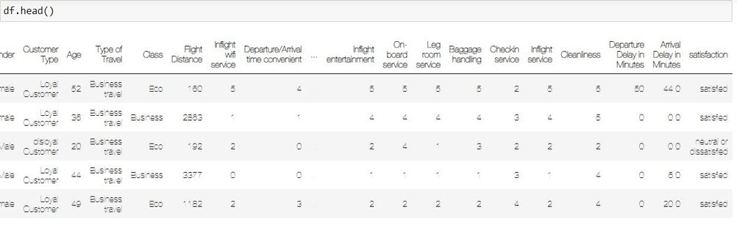
SCREENSHOTS OF LEVEL 0 ANALYSIS

Slide 7
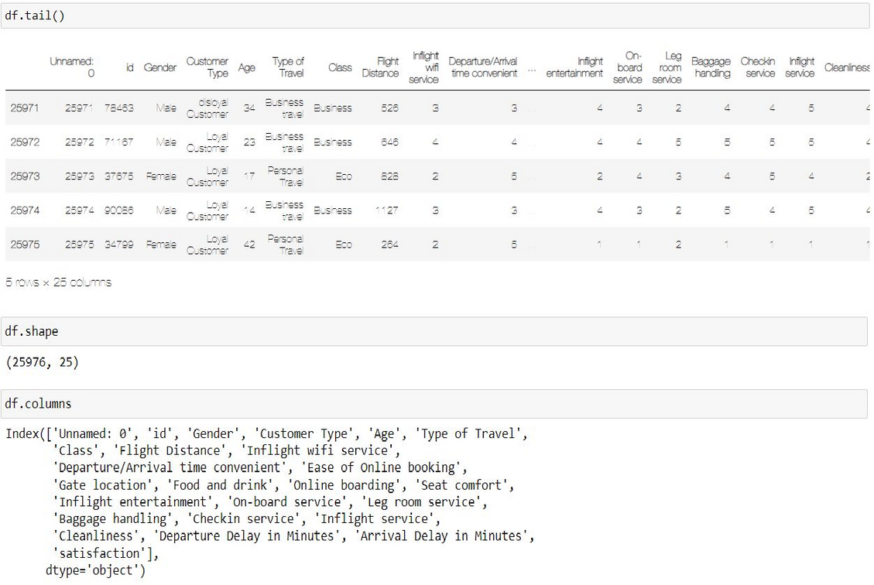

Slide 8
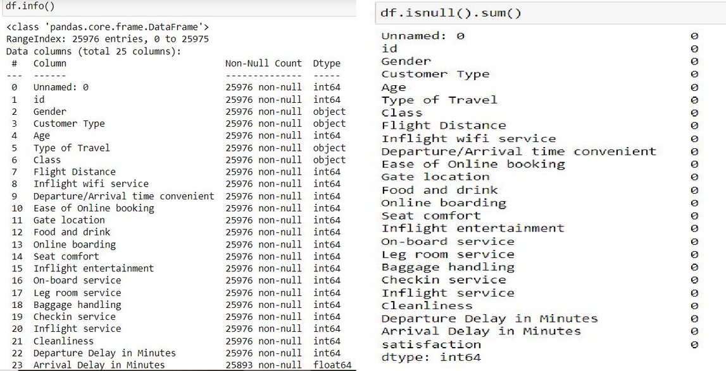

Slide 9
LEVEL 1 :
Univariate
Analysis
Check if it is Nominal or Ordinal
Check how many categories are present
Check the Mode
Check for Missing values
Think about how the missing values could be treated Think about the kind of graph/chart that can be plotted using this data

Slide 10
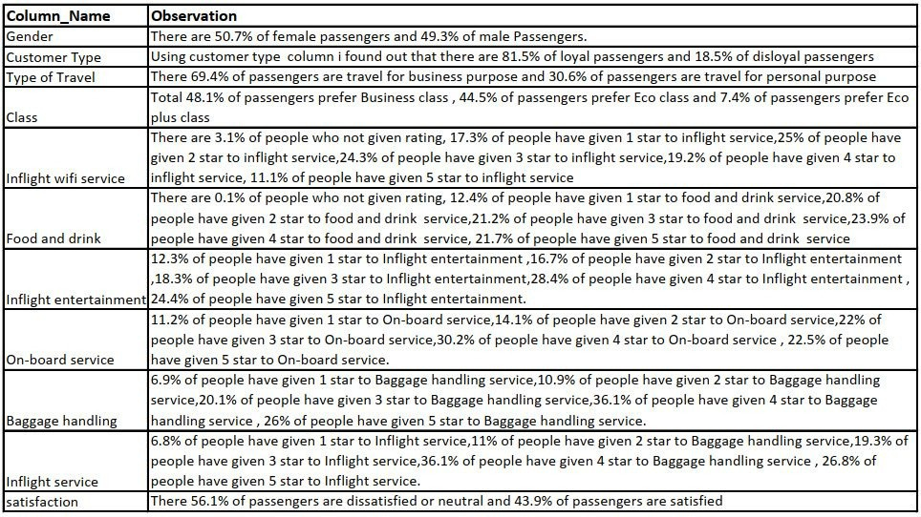
LEVEL 1 ANALYSIS :-

Slide 11
LEVEL 2 :
Bivariate
Analysis
Bivariate analysis is a statistical method that involves the analysis of two variables simultaneously to determine the
relationship between them. The primary goal is to investigate whether there is a s gnificant association or correlation between the two variables. This analysis is crucial for understanding the patterns, trends, and dependencies that may exist between the variables.

Slide 12
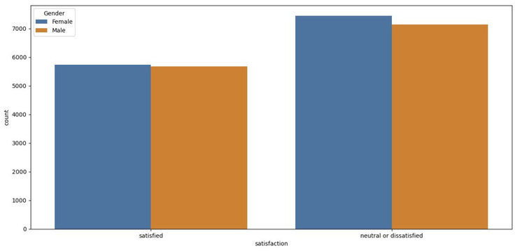
SCREENSHOTS OF LEVEL 2 ANALYSIS
Here i did analysis of
Dissatisﬁed or neutral vs Gender and i found out That there are 44 % of Dissatisﬁed males and 56% females

Slide 13
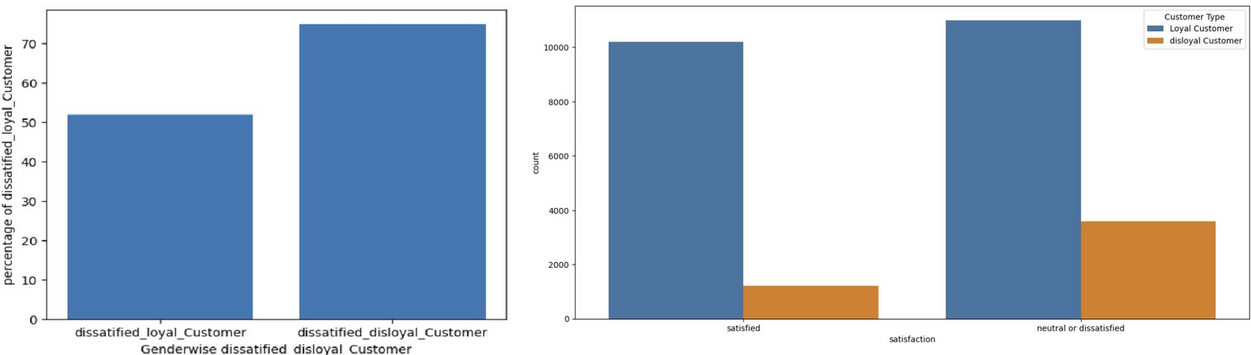
There are 51 % dissatisﬁed loyal Customer and 74% dissatisﬁed disloyal Customer

Slide 14
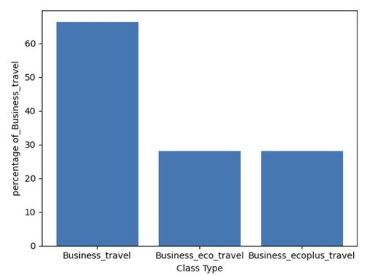
Total 18038 people are travel for business purpose In that
Total 11,979 people travel for business purpose ans using business class means 66.40%
5047 people who are travelling for business purpose are using Eco class which is 27.97%
1012 people wwho are travelling for business purpose are using EcoPlus means 5.61%

Slide 15
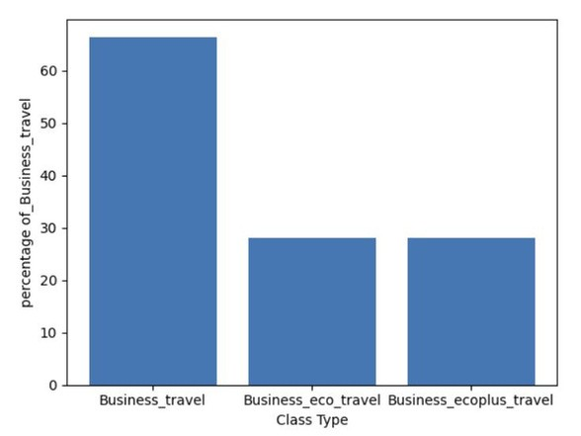
7938 people are travel for personal reasons
There are 516 people are travelling for personal reasons are using Business class means 6.50%
6517 people are travelling for personal reasons are using Eco class means 82.098% 905 people are travelling for personal reasons are using Ecoplus class means 11.40%

Slide 16
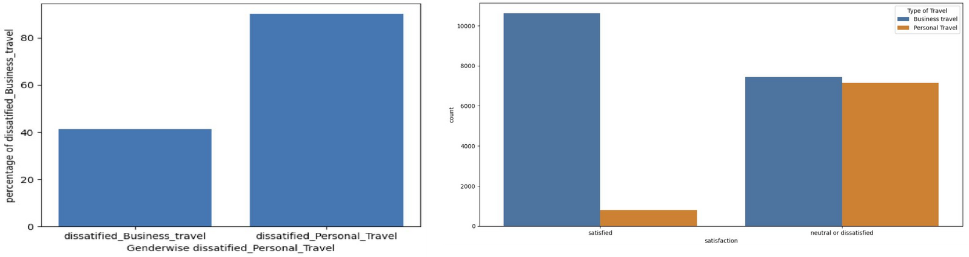
There 40% dissatisﬁed business travel passengers and 90% dissatisﬁed personal travel passengers

Slide 17
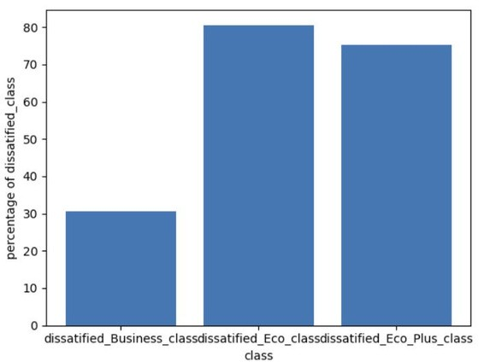
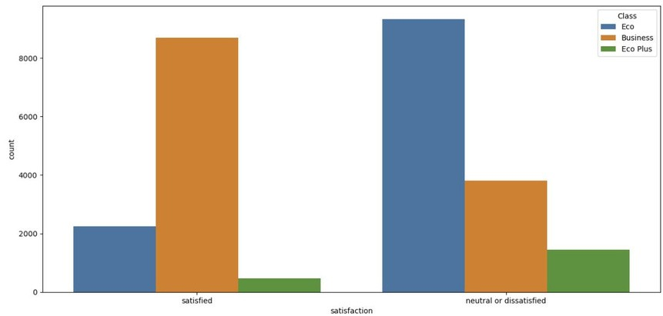
There are 30% of passengers from business class are dissatisﬁed , 80% of passengers from Eco class are dissatisﬁed and 75% of passengers from Eco plus class are dissatisﬁed

Slide 18
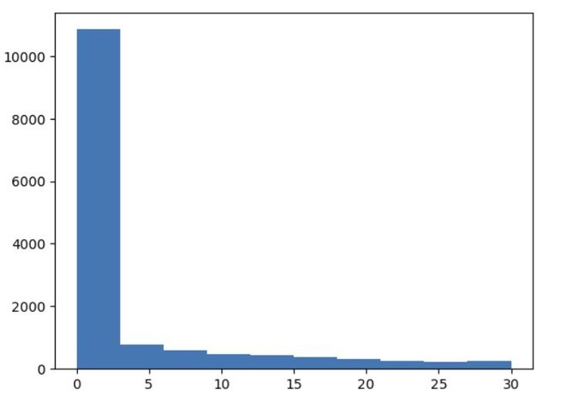
While checking relation of departure time delay for dissatisﬁed passengers i found out that most of the ﬂight are on time so this will not affect on customer satisfaction

Slide 19
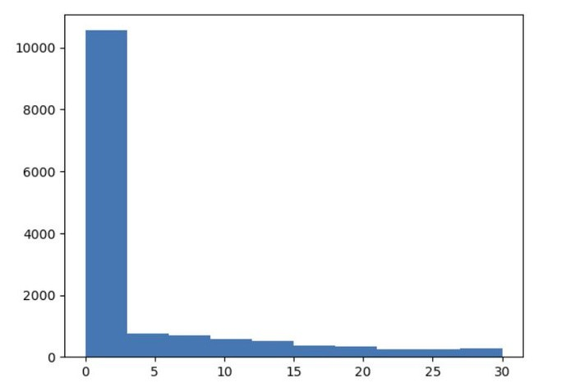
While checking relation of Arrival time delay for dissatisﬁed passengers i found out that most of the ﬂight are on time so this will not affect on customer satisfaction

Slide 20
LEVEL
3:Multivariate
analysis
Multivariate analysis is based in observation and analysis of more than one statistical outcome variable at a time. In design and analysis, the technique is used to perform trade studies across multiple dimensions while taking into account the effects of all variables on the responses of interest.

Slide 21
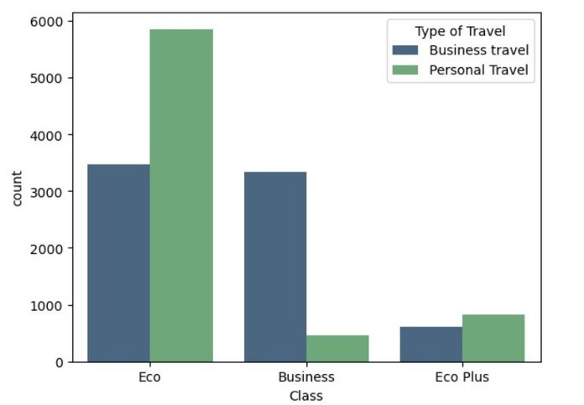
This graph is showing distribution of class and type of travel of dissatisﬁed passangers
Which showing passengers who are dissatisﬁed and traveling from business class are 3342 for business purpose and 467 are for personal reason
passengers who are dissatisﬁed and traveling from Eco class for business purpose are 3468 and 5853 are for
personal reasons
passengers who are dissatisﬁed and traveling from Ecoplus class for business purpose are 617 and for personal reasons are 825

Slide 22
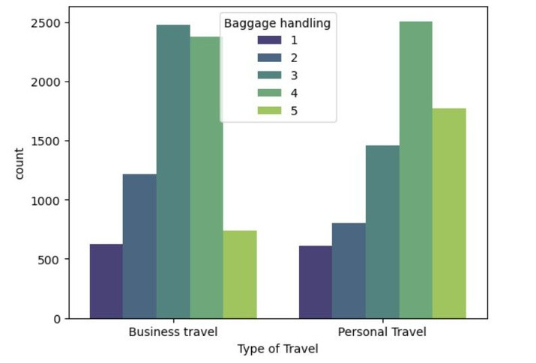
This graph is showing us that most of people giving 3 & 4 star rating for Business travel and personal travel passengers are giving highest 4 star rating

Slide 23
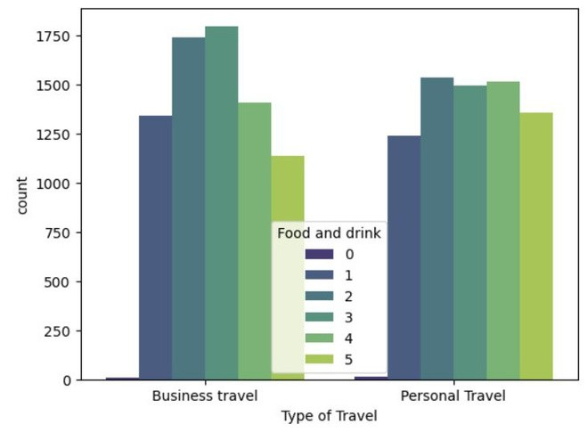
This graph is showing us that most of people giving 2&3 rating for food and drink in business travel and in personal travel people are giving 2,3,4 star rating for maximum time

Slide 24
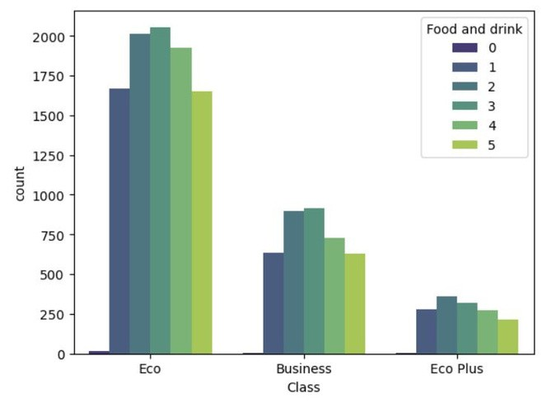
This graph is showing in Eco class 2,3 star rating are high and also there are many 1 star rating. In business class most of people giving 2&3 star rating for food and drink . In Eco Plus class most of people are giving 2&3 star rating

Slide 25



CONCLUSION :
After performing Exploratory Data Analysis (EDA) on airline data i conclude that there are dissatisfied and neutral passengers are more than satisfied and most of them are travel from Eco class or Eco plus class and most of personal travel passengers are dissatisfied or neutral
Also i found out that many business travel passengers are dissatisfied or neural for business class and many personal travel passengers are dissatisfied or neutral with eco class
Also when i check class wise satisfaction passengers
30.48% of passengers are dissatified with business class means total 3809 passengers and 80.61 % of people are dissatisfied with Eco class total 9322 passengers and 75.22 % of people are dissatisfid with Ecoplus class means 1442 paasengers
Also there are very average rating for food and drinks in business class eco class and ecoplus class this can be the reason for many passenger are giving dissatisfied or neutral review as flight departure and arrival time are one time and there very good rating for baggage handling

Slide 26


Thank you very much!

