Slide 1
E-Grampanchayat
Web Application for the rural areas
Presented By :- Pranay Dhanke
Internship ID: UMIP14496

Slide 2
About Project
Project Link - https://e-gram.vercel.app/
GitHub Link - https://github.com/PranayDhanke/e-panchayat.git

Slide 3
Overview
E-Gram Panchayat aims to digitize the application and management process for various schemes, providing a streamlined and efficient way for end users to apply for schemes and for administrators to manage them. The application enhances transparency, accessibility, and efficiency in rural governance.
With E-Gram Panchayat, rural governance is transformed, making scheme application and management processes more transparent, accessible, and efficient.

Slide 4
Technology Used
Frontend:
Nextjs: Framework for building the user interface.
Tailwind CSS: Utility-first CSS framework for styling.
React Icons: Library for including icons in the application.
React Toasts: For displaying notifications and alerts.
Skeleton Loader: For displaying loading placeholders.
Different Features In react and next Js like : React Hooks , Next js Router , etc

Slide 5
Database:
Firebase Fire store: NoSQL database for storing user data
Firebase Authentication: For handling user sign up and sign in
Firebase Realtime : For storing Admin login , staff login , Schemes data , applied schemes data
Firebase Storage : For storing the profile images of user and the applied document for the schemes
Hosting:
Vercel Hosting : For deploying and serving the web application.

Slide 6
Workflow's
Workflow's in the Web Application

Slide 7
User Roles
Sign up or sign in: Users create an account or log in to the system.
Apply for schemes: Users browse and apply for available schemes.
View applied schemes: Users can view the status and details of their applications.
View profile information: Users can view and update their personal information.

Slide 8
Admin Role
Create new schemes: Admins can introduce new schemes in the system.
Edit existing schemes: Admins can update details of existing schemes.
Delete schemes: Admins can remove outdated or irrelevant schemes.
Approve or reject applications: Admins have the final say on application approval.
Add new Admin and Staff Member: Admins have the Access the add the new admin as wall as new staff member

Slide 9
Staff Member Role
Approve or reject applications: Staff members review applications and make preliminary approval/rejection decisions.
View all available schemes: Staff can see all schemes to assist citizens and ensure proper application handling.

Slide 10
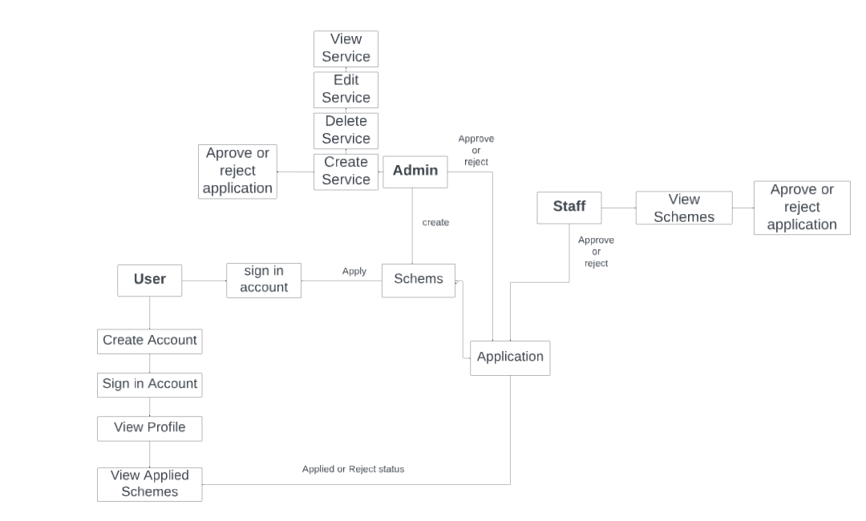
Dataflow Diagram

Slide 11
System Snapshot

Slide 12
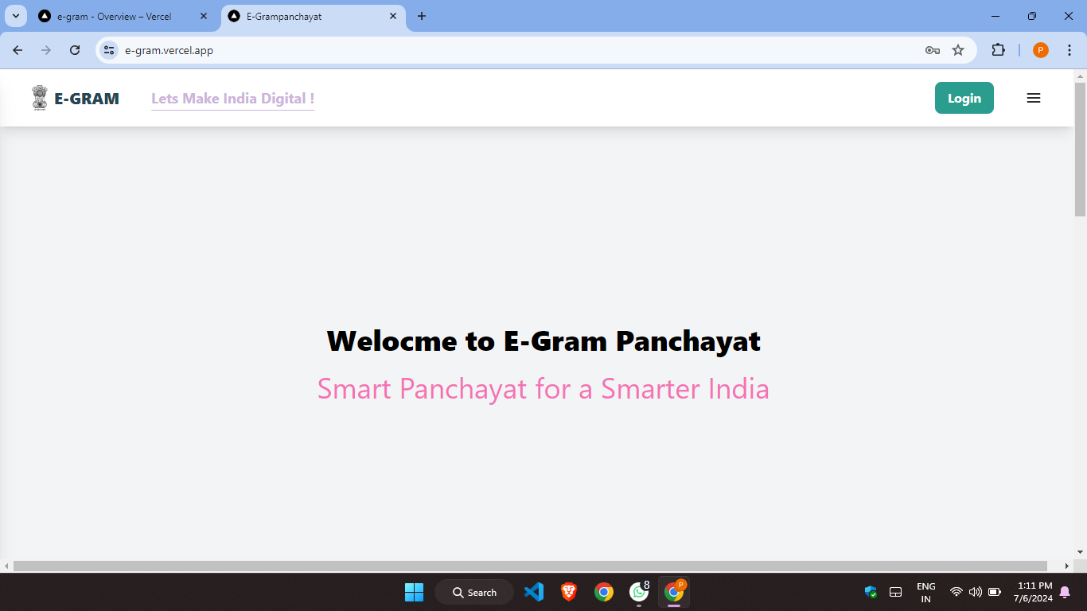
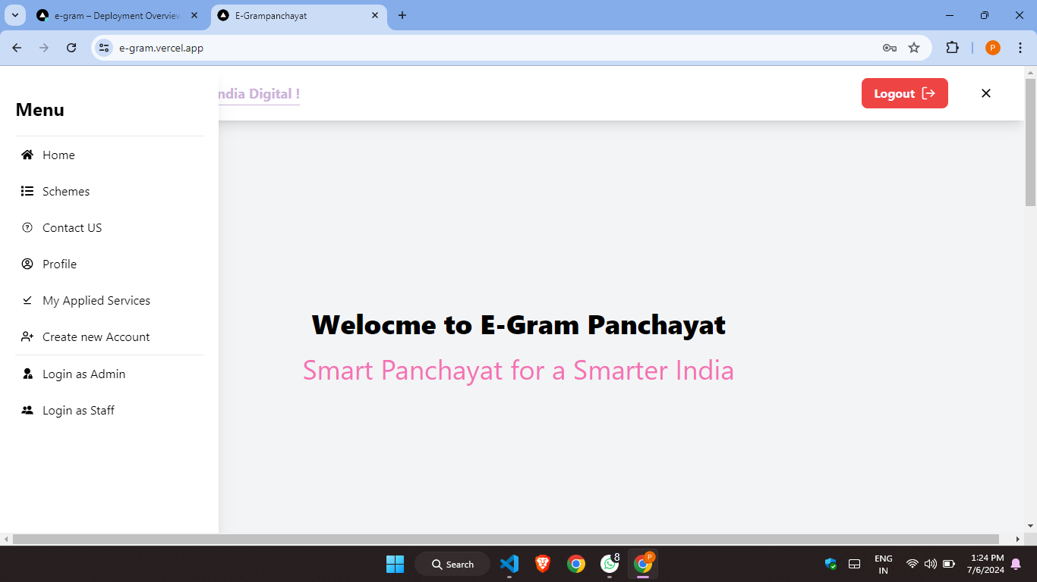
Main Interface
Main Screen
Slide Window

Slide 13
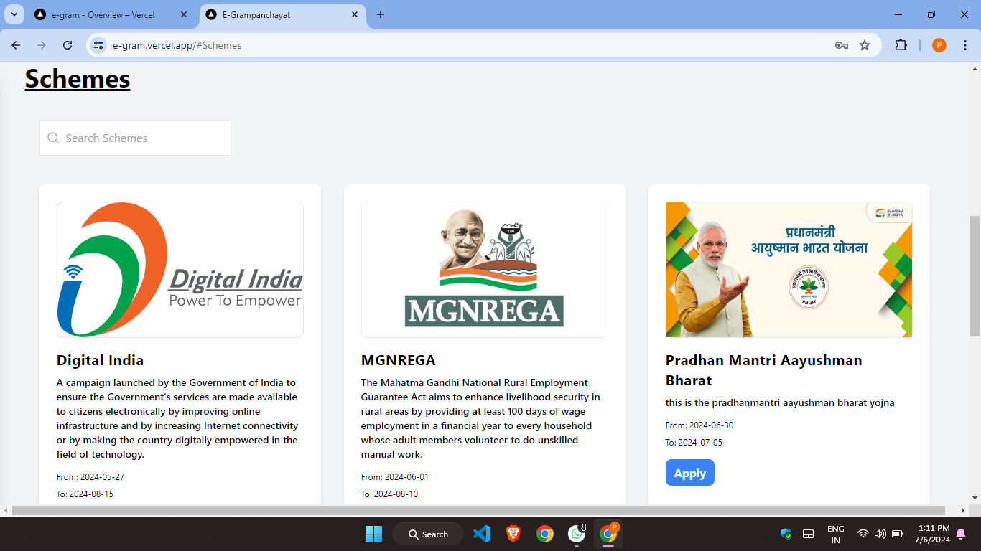
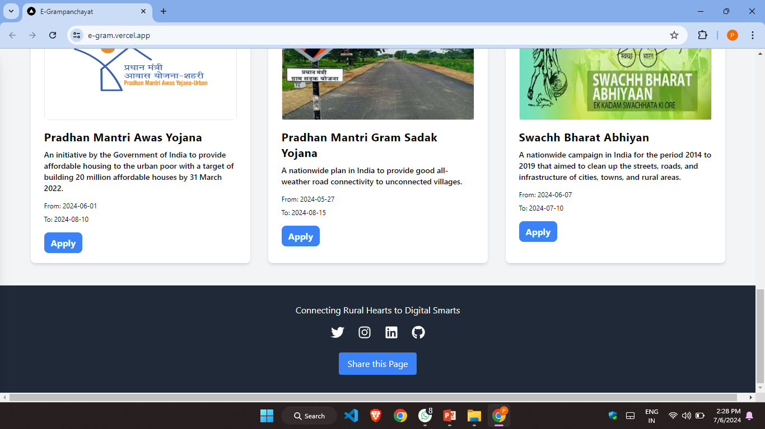
Schemes section
Footer/Contact Me

Slide 14
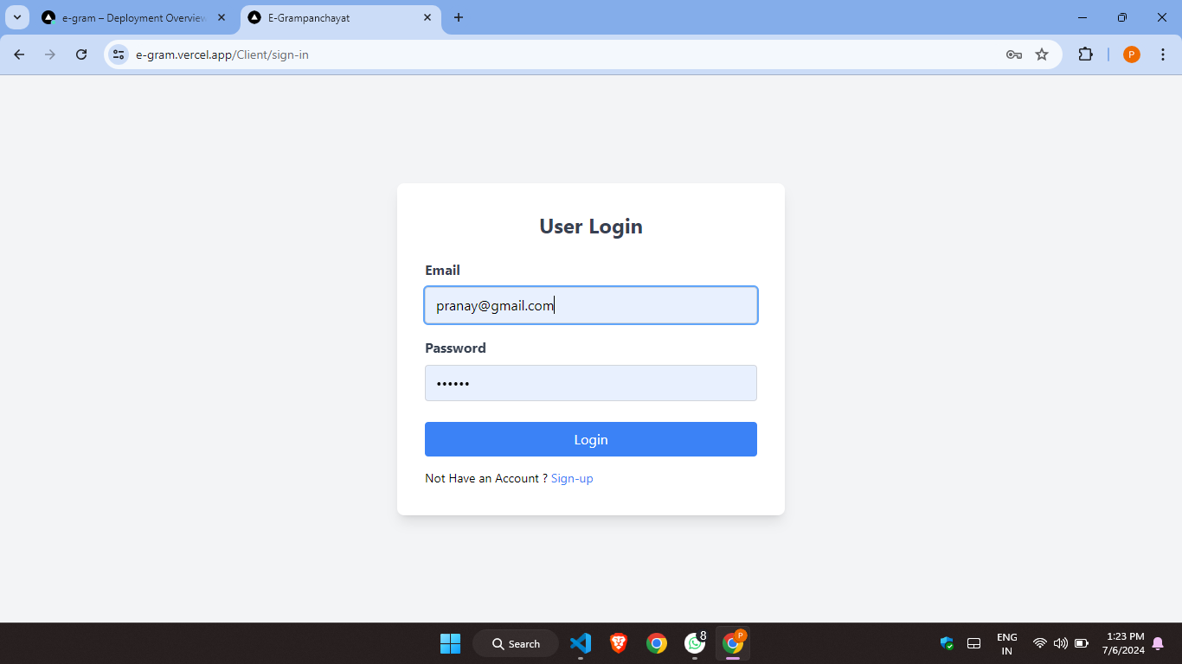
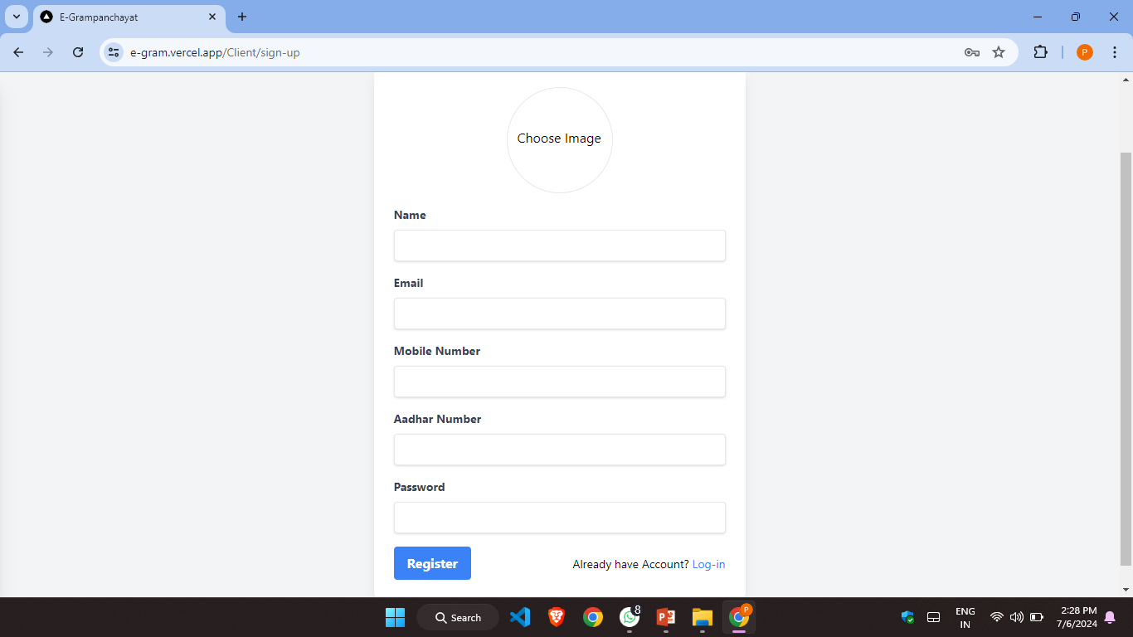
User Interface
User Login
User Register

Slide 15
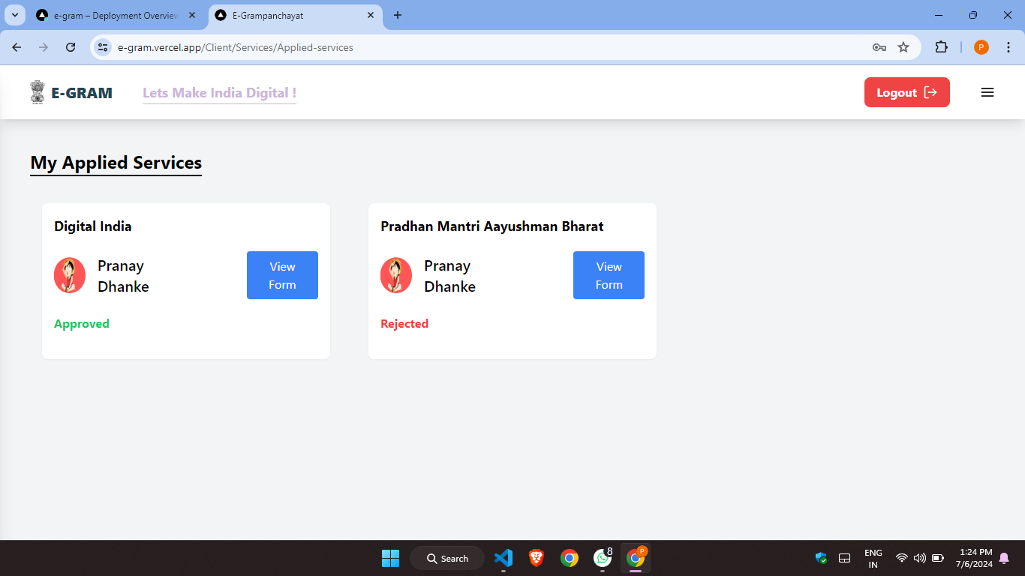
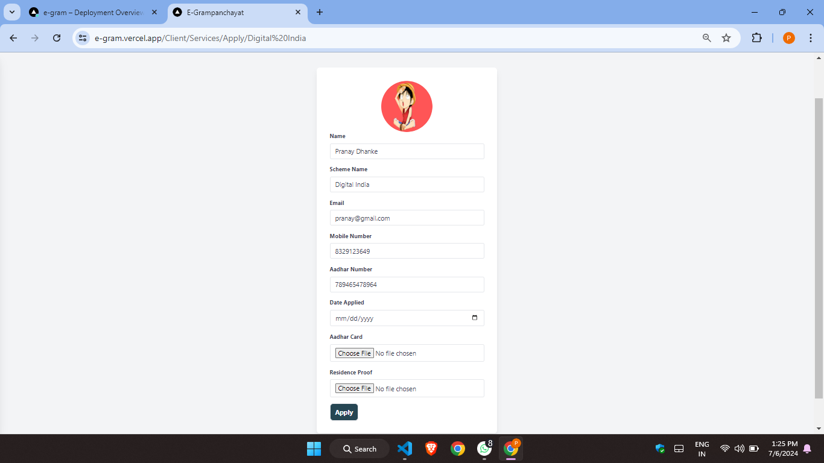
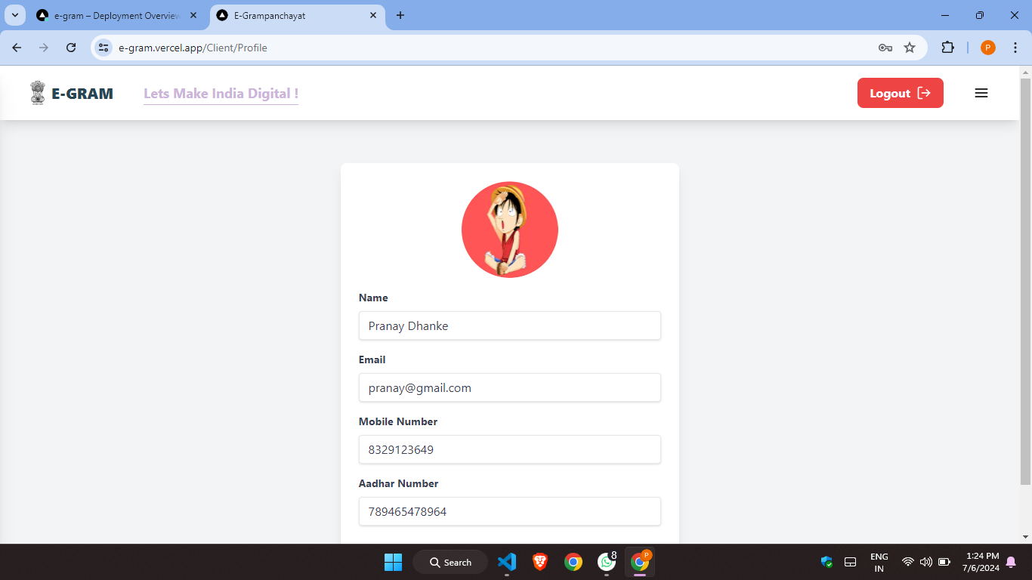
My applied Schemes
Apply form for the schemes
Profile Page

Slide 16
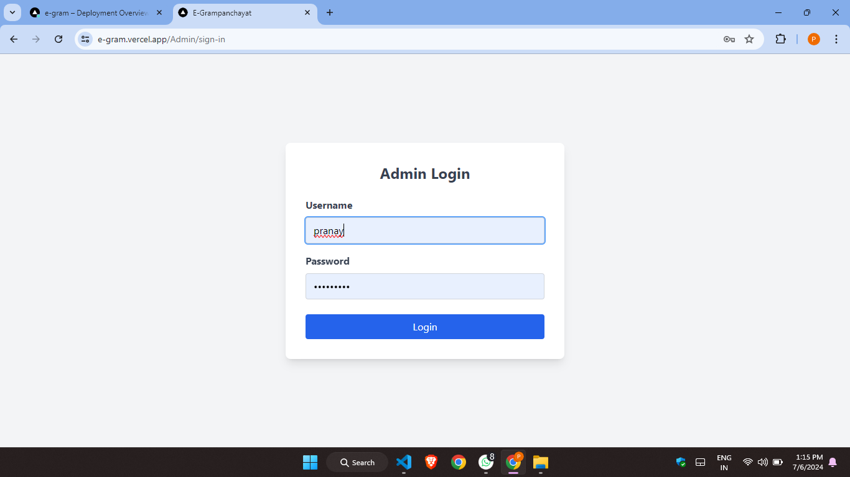
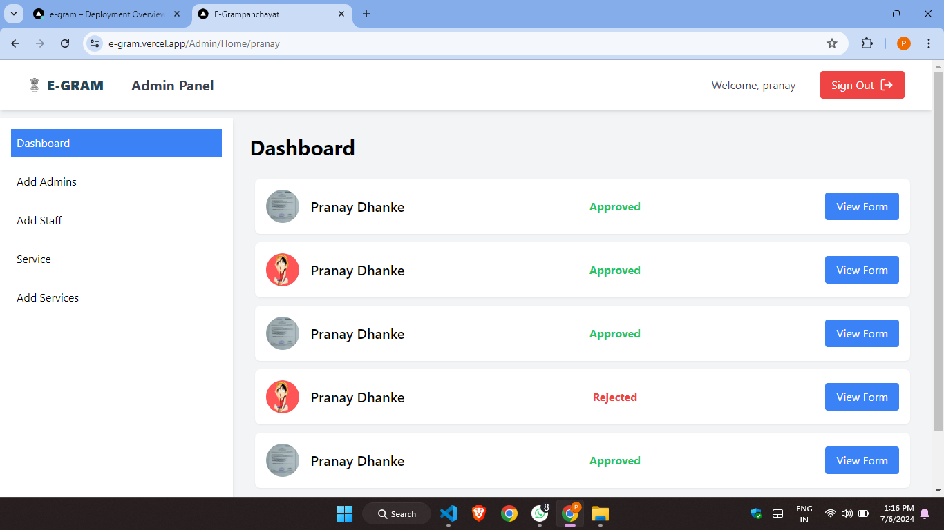
Admin Interface
Admin Login
Admin Dashboard

Slide 17
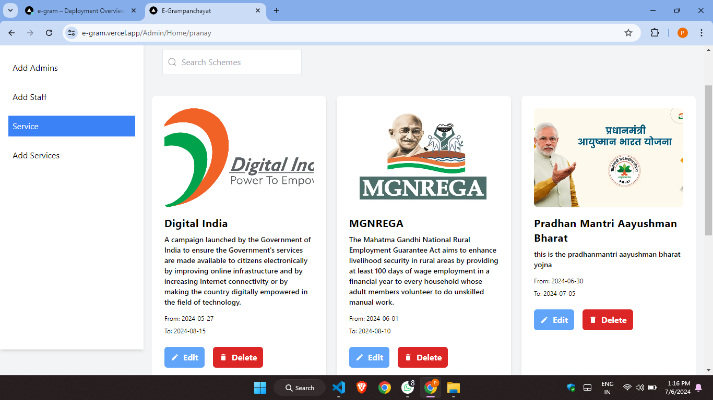
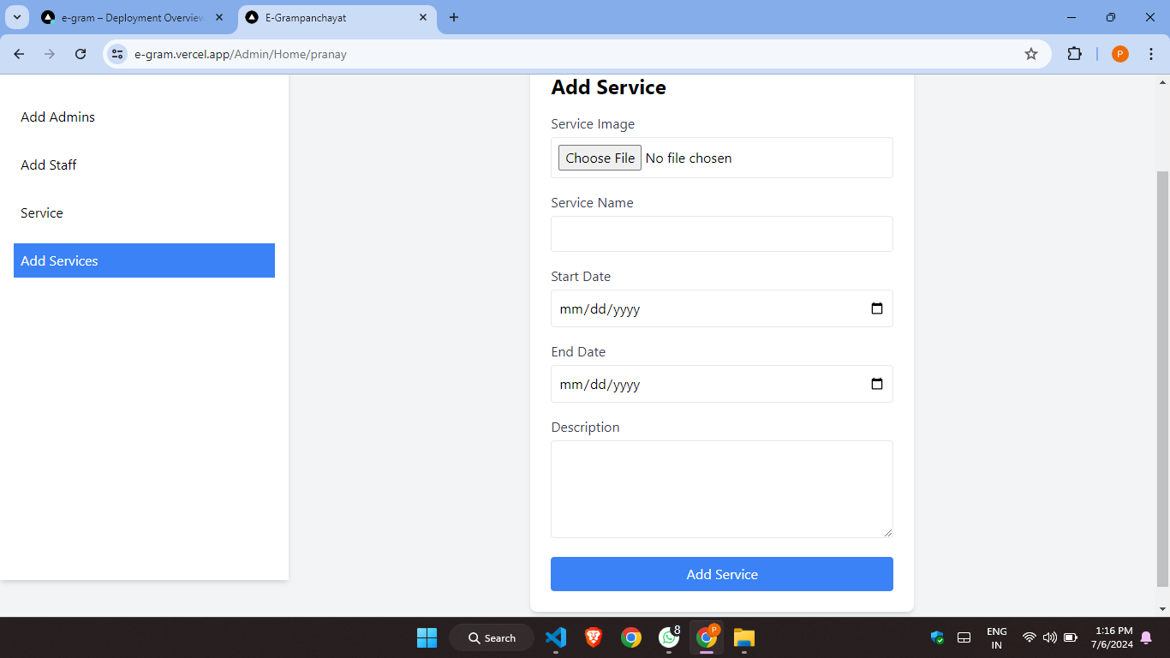
Admin panel for schemes
Add scheme panel

Slide 18
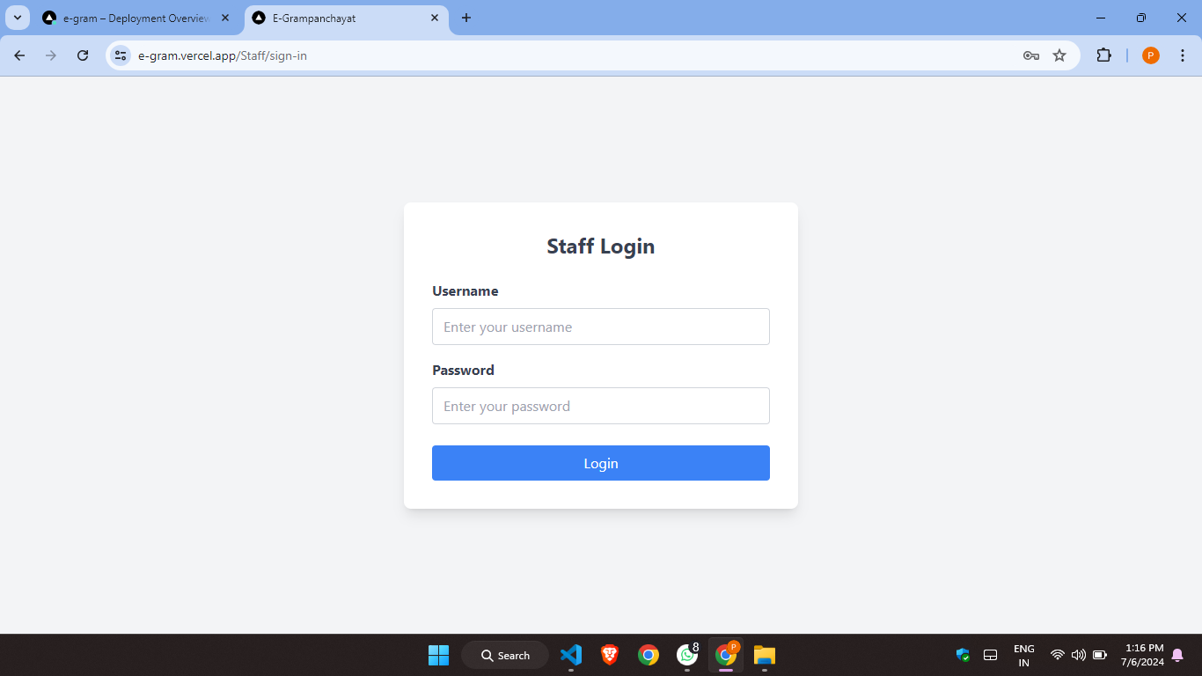
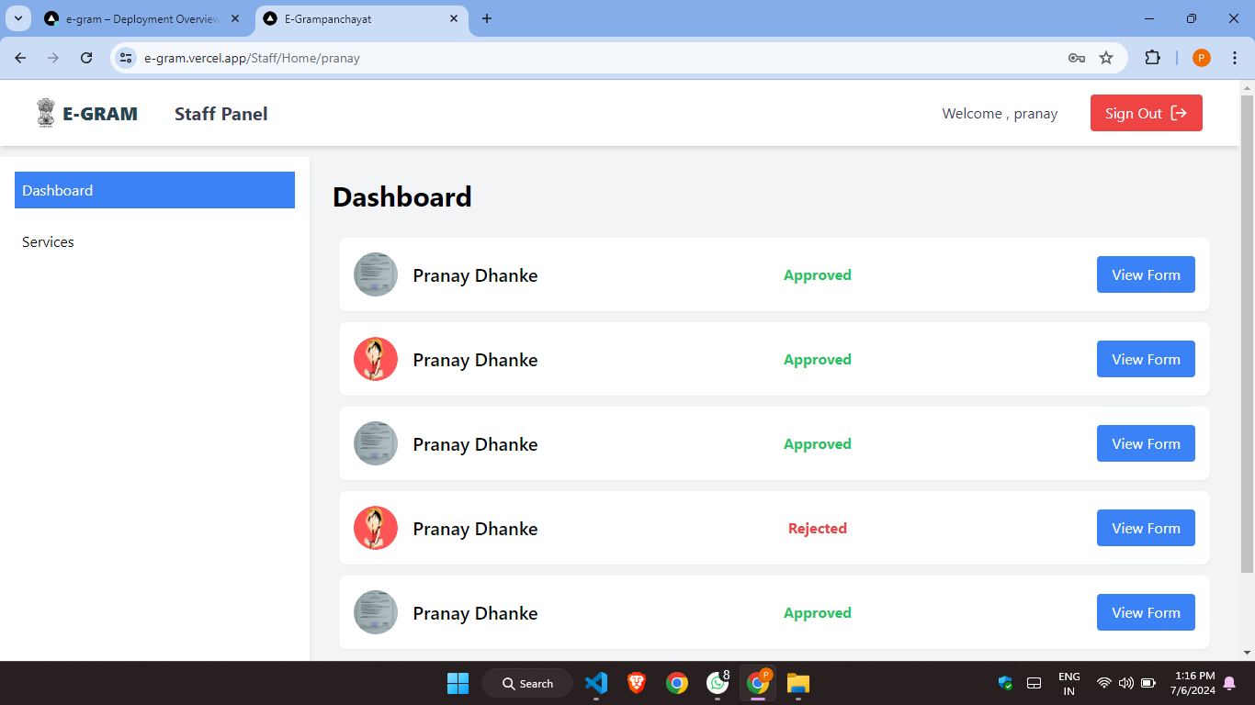
Staff Interface
Staff Login
Staff Deshboard

Slide 19
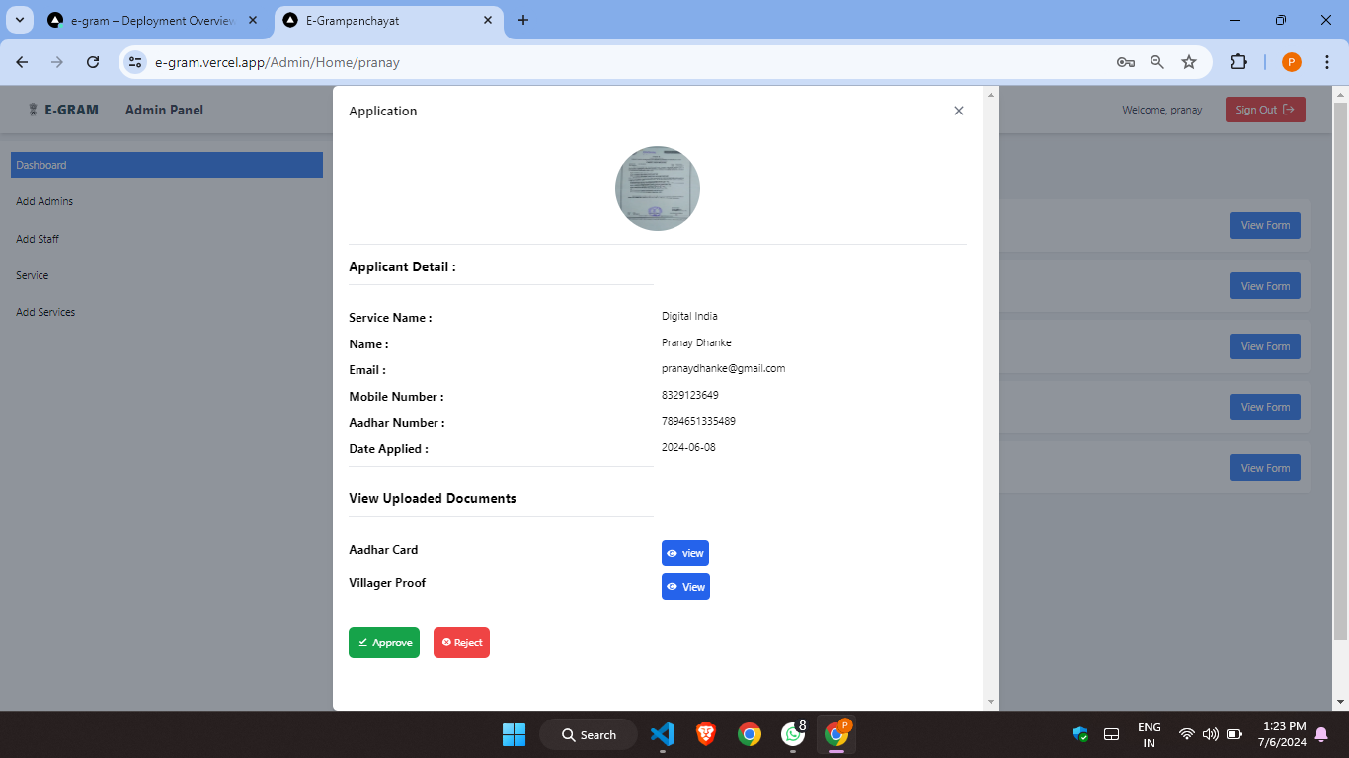
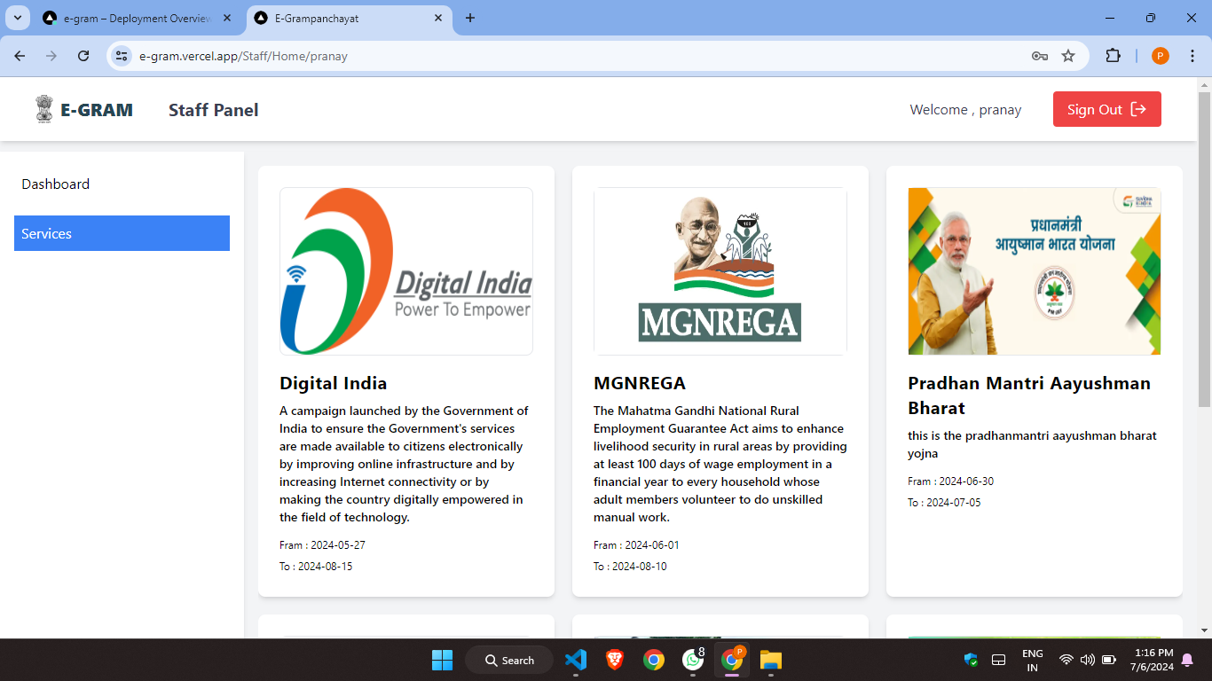
Approve/Reject scheme panel
Scheme Panel

Slide 20
Thank You

