Slide 1
Diffractive SH-WFS
How to set the detector pixel scales right

Slide 2
Pixel definitions
The sampling of the electric-field and the detector sampling, although both are referred to as “pixels”, have different meanings
nPixElecField is the number of numerical samples we chose to discretise the electric field
nDectPixels is the number of detector pixels we nominally use to sample an image (a spot in SH-WFS)
nPixElecField >= nDectPixels

Slide 3
Spot sampling definitions
The detector pixel size can be adjusted considering the following
The FoV of a sub-aperture is at most nPixElecField*loD, where
nPixElecField = number of pixels per sub-aperture used to sample the electric field. This is tel.resolution/wfs.nLenslet
loD is the diffraction limit of the sub-aperture
the wfs.lenslets.fieldStopSize is the lenslet field of view given in diffraction FWHM units
wfs.lenslets.nyquistSampling gives the 2x number of pixels per loD; controls the angular size of the electric-field pixel
wfs.camera.resolution bins the electric field pixels to a smaller number; controls the binning of the detector camera pixels
We can upsample the EF and get more output pixels
E.g. increase wfs.lenslets.nyquistSampling
The detector pixels then need be re-adjusted to avoid binning at the detector level

Slide 4
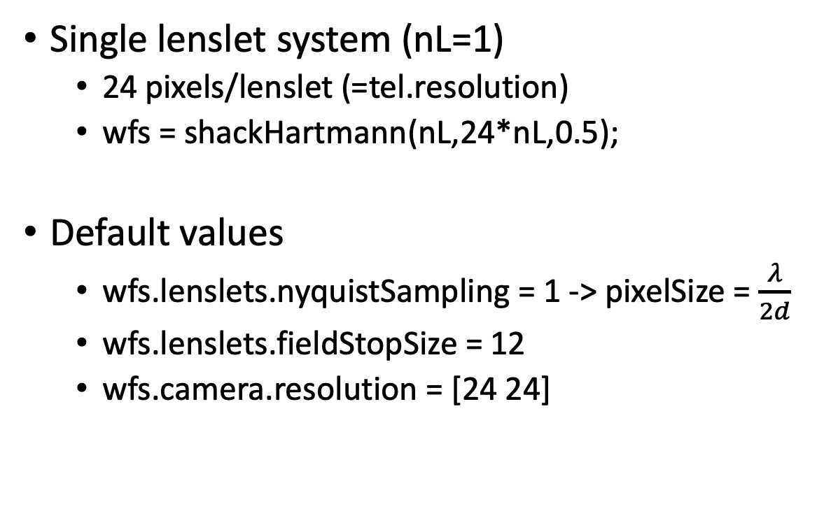
Examples
Single lenslet system (nL=1)
24 pixels/lenslet (=tel.resolution)
wfs = shackHartmann(nL,24*nL,0.5);
Default values
wfs.lenslets.nyquistSampling = 1 -> pixelSize = $\frac{λ}{2d}$
wfs.lenslets.fieldStopSize = 12
wfs.camera.resolution = [24 24]

Slide 5
Examples
Single lenslet system (nL=1)
24 pixels/lenslet
wfs = shackHartmann(nL,24*nL,0.5);
Default values
wfs.lenslets.nyquistSampling = 1
wfs.lenslets.fieldStopSize = 24
wfs.camera.resolution = [24 24]
Since the FoV is twice, yet camera still has 24 pixels, a binning of two is obtained-> pixelSize = $\frac{λ}{d}$

Slide 6
Examples
Single lenslet system (nL=1)
24 pixels/lenslet
wfs = shackHartmann(nL,24*nL,0.5);
Default values
wfs.lenslets.nyquistSampling = 1
wfs.lenslets.fieldStopSize = 24
wfs.camera.resolution = [48 48]
Since the FoV is twice, and camera has 48 pixels, no binning is done and FoV is twice -> pixelSize = $\frac{λ}{2d}$

Slide 7
Examples
Cases with wfs.lenslets.nyquistSampling < 1 are not properly handled.
E.g. the fftPhasor is instantiated with the SH-WFS and lensletArray which assumes wfs.lenslets.nyquistSampling = 1.
When the user changes it to <1 the fftPhasor has already been defined.
The output PSF is not properly centred.
If need be this can be worked out by making adaptations in the code

