Slide 1

RAJEEV GANDHI MEMORIAL COLLEGE OF ENGINEERING AND TECHNOLOGY
Nandyal-518501,Nandyal-Dt,AP. India.
DEPARTMENT OF COMPUTER SCIENCE AND ENGINEERING (DATA SCIENCE)
An Analytical Model to Identify Cervical Conditions Using Digital Colposcopy Images and Convolutional Neural Network Algorithms
Under The Guidance of:
Supervisor : Dr.M. Suleman Basha, M.Tech,Ph.D
Associate Professor,
Dept. of CSE (Data Science)
Co-Supervisor: Ms. A. Annapurna, M. Tech (Ph. D)
Assistant Professor,
Dept. of CSE (Data Science)
Team Members:
W. Pranay Kumar Reddy (22095A3204)
M. Sai Lakshmi (21091A3237)
B. Bhavana (21091A3209)

Slide 2
CONTENTS
ABSTRACT
INTRODUCTION
OBJECTIVES
LITERATURE REVIEW
EXISTING SYSTEM
PROPOSED SYSTEM
EXTENSION
DATASET INFORMATION
WORKFLOW
SOFTWARE REQUIREMENTS
HARDWARE REQUIREMENTS
RESULTS
REFERENCES

Slide 3
ABSTRACT
Cervical diseases, including cervical cancer, are a significant global health challenge, and early detection is crucial. Existing methods have limitations in accurately detecting early stages of cervical diseases due to equipment limitations and the type of medical detection tests used .The project proposes a predictive model using deep learning algorithms and colposcopy images to detect different classes of cervical diseases, including different stages .The project utilizes CNNs and colposcopy images to create a predictive model for cervical disease detection..

Slide 4
INTRODUCTION
Cervical cancer develops in the cervix, mainly caused by HPV.
It can be prevented through vaccination and early screening.
Current detection methods face equipment limits and may miss early stages.
The project proposes a deep learning model using colposcopy images.
It aims to detect different stages of cervical diseases accurately.

Slide 5
OBJECTIVE
Objective : Build a deep learning model using colposcopy images to detect cervical diseases and their stages.
Aim : Overcome detection challenges caused by equipment limits and traditional tests.
Focus : Provide faster, more accurate screening for early diagnosis.
Evaluation : Perform 4 experiments assessing accuracy, precision, recall, and F1 score.

Slide 6
LITERATURE REVIEW
TITLE | AUTHOR | METHODOLOGY | CONCLUSIONS | CONS
Deep Learning in Cervical Cancer Diagnosis: Architecture, Opportunities, and Open Research Challenges (2023) | Nina Youneszade; Mohsen Marjani et.al., | The methodology reviews state-of-the-art deep learning (DL) techniques for cervical cancer (CC) screening, focusing on DL architectures, classification, and image segmentation in cytology and colposcopy. It provides insights into current algorithms and future research directions. | Deep learning enhances cervical cancer screening accuracy, addressing manual limitations. This review highlights state-of-the-art techniques, guiding future research for global prevention. | 1. Challenges include data requirements, dataset biases, and DL interpretability, limiting accessibility in low-resource areas.

Slide 7
TITLE | AUTHOR | METHODOLOGY | CONCLUSIONS | CONS
Application of EfficientNet-B0 and GRU-based deep learning on classifying the colposcopy diagnosis of precancerous cervical lesions (2023) | Xiaoyue Chen, Xiaowen Pu et.al., | Using 6002 colposcopy images, an EfficientNet-b0 + GRU model achieved 90.61% accuracy for HSIL vs. normal/LSIL and 91.18% for trichotomy classification. | Our study highlights AI's potential in accurate cervical lesion diagnosis, with high-performance HSIL and trichotomy classification for early intervention. | Challenges include generalization, image quality dependence, and the need for ongoing clinical validation.

Slide 8
Existing Methods
Pap Smear
A Pap smear involves collecting cells from the cervix and examining them under a microscope to detect abnormalities.
Colposcopy
Colposcopy uses a magnifying device to visualize the cervix and take biopsies if necessary
HPV Testing
HPV testing detects the presence of the human papillomavirus, which is a major risk factor for cervical cancer.

Slide 9
Pap Smear:
Proposed by: Dr. Georgios Papanikolaou, a Greek physician.
Introduced: 1928 (first presented) and 1940s (became widely used).
Purpose: Detects abnormal cervical cells, helping to prevent cervical cancer.
Pap Smear Advantages
Widely available
Relatively inexpensive
Detect precancerous cells
Pap Smear Limitations
Subjective Interpretation
Limited Scope
Sampling Errors

Slide 10
Colposcopy:
Proposed by: Dr. Hans Hinselmann, a German gynecologist.
Introduced: In 1925.
Purpose: Uses a colposcope (magnifying device) to closely examine the cervix for abnormal areas after an abnormal Pap smear result.
Colposcopy Advantages
Provides a more detailed view of the cervix, allowing for more accurate diagnoses.
Colposcopy Disadvantages
Limited Accessibility
Sampling Bias

Slide 11
HPV Testing:
Proposed by: Evolved from research by Harald zur Hausen, a German virologist, who linked HPV to cervical cancer (he later won the 2008 Nobel Prize for this discovery).
Introduced: 1990s (first commercial tests became available).
Purpose: Detects high-risk HPV strains that cause cervical cancer, often done alongside or after a Pap smear.
HPV Testing Advantages
Highly accurate in detecting HPV infection, a major risk factor for cervical cancer.
HPV Testing Disadvantages
Time Sensitivity
Uncertain Progression
Limited Predictive Value

Slide 12
PROPOSED SYSTEM
The proposed system introduces a predictive model utilizing deep learning algorithms and colposcopy images to detect various classes and stages of cervical diseases. Built upon the CNN structure, the model aims to improve cervical disease detection by analyzing colposcopy images. It operates by taking images of arbitrary scales as input and generating a set of rectangular target suggestion boxes as output.
ADVANTAGES :
Enhances accuracy by identifying subtle disease indicators.
Enables early detection for timely intervention and reduced mortality.
Automates analysis, streamlining diagnostics and reducing effort.

Slide 13
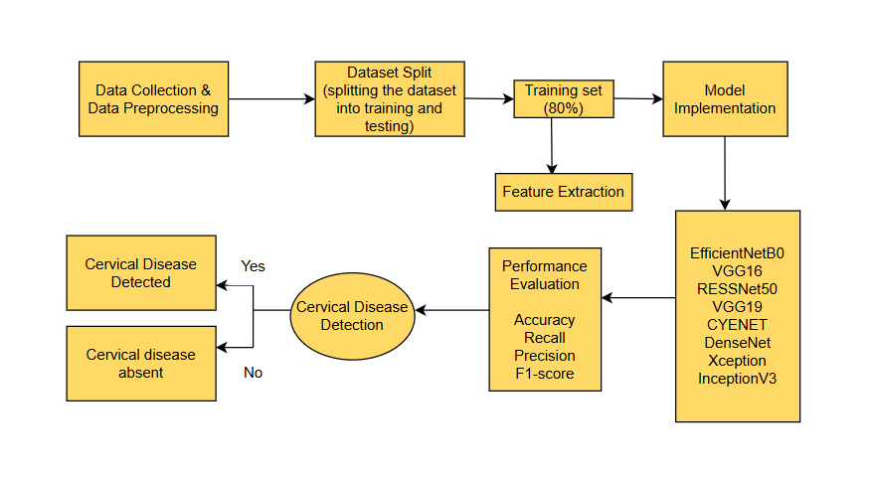
SYSTEM ARCHITECTURE:

Slide 14
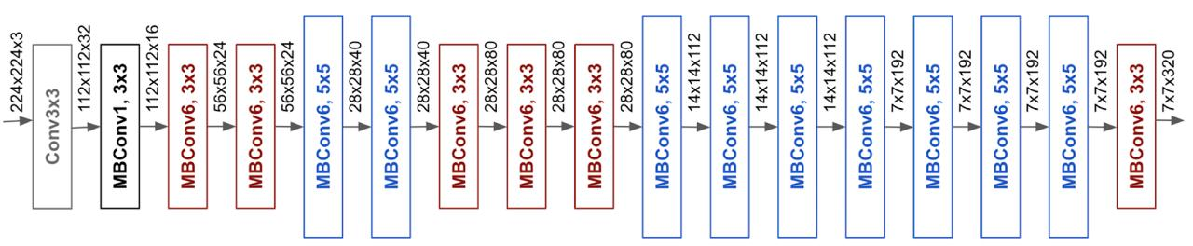
EfficientNetB0:
Proposed by researchers at Google AI.
Introduced in 2019
in the paper "EfficientNet: Rethinking Model Scaling for Convolutional Neural Networks"
Key Features:
Lightweight
Scalable
high-performance convolutional neural network.

Slide 15
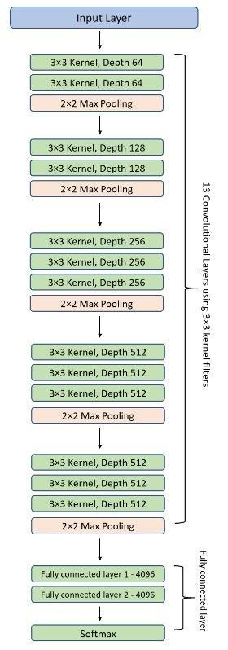
VGG16:
VGG16 is a 16-layer deep Convolutional Neural Network (CNN) designed for image recognition and classification
Proposed by Visual Graphics Group (VGG) at Oxford University, led by Karen Simonyan and Andrew Zisserman.
Published in 2014 in the paper "Very Deep Convolutional Networks for Large-Scale Image Recognition".
Key Concepts :
✅ 16 layers deep (13 convolutional layers, 3 fully connected layers).
✅ Small filters: Uses 3x3 convolutional filters
✅ Max pooling.
✅ ReLU activation.
✅ Fixed architecture.
✅ Effective for Image Classification

Slide 16
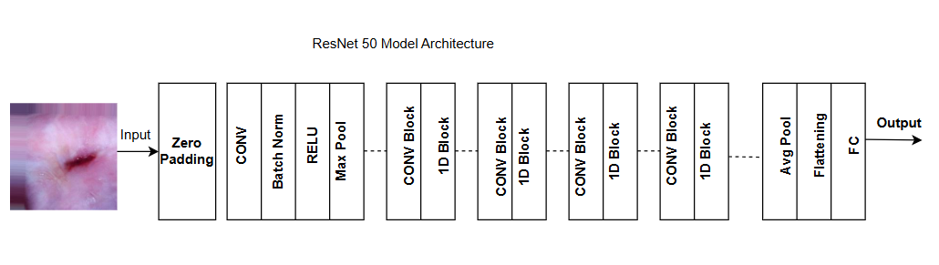
ResNet50:
Developed by Microsoft Research, led by Kaiming He, Xiangyu Zhang, Shaoqing Ren, and Jian Sun.
Published in 2015 in the paper "Deep Residual Learning for Image Recognition".
Key Concepts of ResNet50:
✅ 50 layers deep
✅ Residual learning
✅ Bottleneck design
✅ Batch normalization
✅ Global average pooling instead of fully connected layers for better generalization.

Slide 17
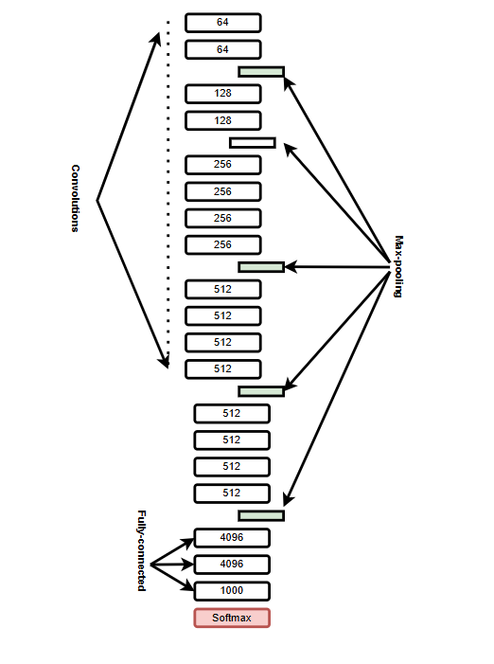
VGG19 (Visual Geometry Group Network):
VGG19 is a 19-layer deep Convolutional Neural Network (CNN), an extended version of VGG16, known for its deep architecture and strong performance in image classification and recognition tasks.
Proposed by Visual Graphics Group (VGG) at Oxford University, led by Karen Simonyan and Andrew Zisserman.
Published in 2014 in the paper "Very Deep Convolutional Networks for Large-Scale Image Recognition".
Key Features:
Depth:19 layers deep (16 convolutional layers, 3 fully connected layers).
Small filters
Max pooling
Activation function: ReLU
Large parameter count

Slide 18
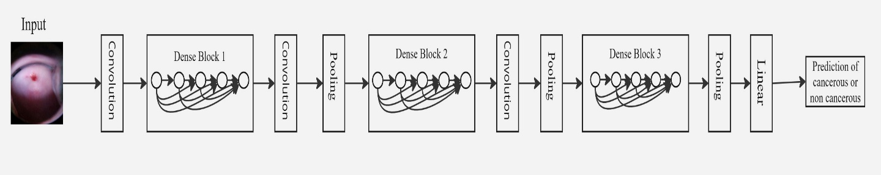
DenseNet:
DenseNet is a type of convolutional neural network (CNN) architecture where each layer is directly connected to every other layer in a feed-forward manner.
Each layer receives the feature maps from all previous layers as input.
It also passes its own feature maps to all subsequent layers.
Key Features:
Dense Layer Connectivity
Improved Gradient Flow
Parameter Efficiency

Slide 19
InceptionV3: A Proven Deep Learning Model
Proposed by: Google
Introduced in: 2015
Authors: Christian Szegedy and team
Paper: "Rethinking the Inception Architecture for Computer Vision"
Key Features:
Efficient Architecture
Factorized Convolutions .
Auxiliary Classifiers

Slide 20
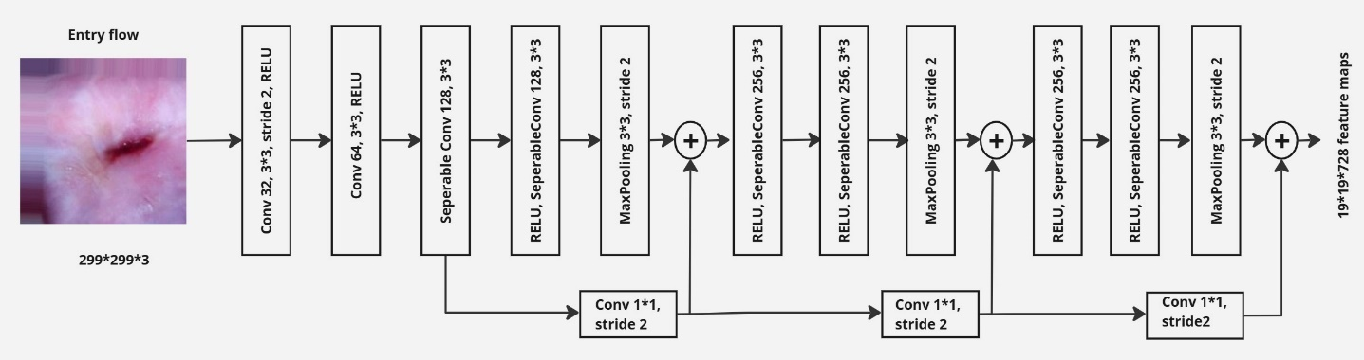
Xception: A Powerful CNN Architecture
Depth wise Separable Convolutions
Replaces standard convolutions with depth wise and pointwise convolutions for efficiency.
Extreme Inception Architecture
Enhances Inception by fully separating spatial and depthwise feature learning.
Improved Performance
Achieves higher accuracy with fewer parameters compared to Inception v3.

Slide 21
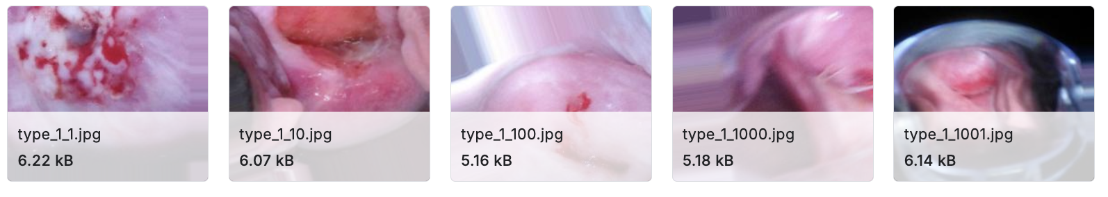
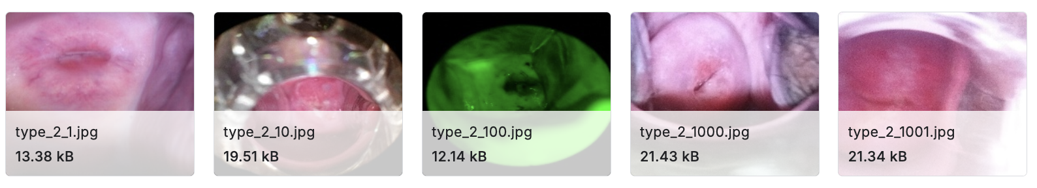
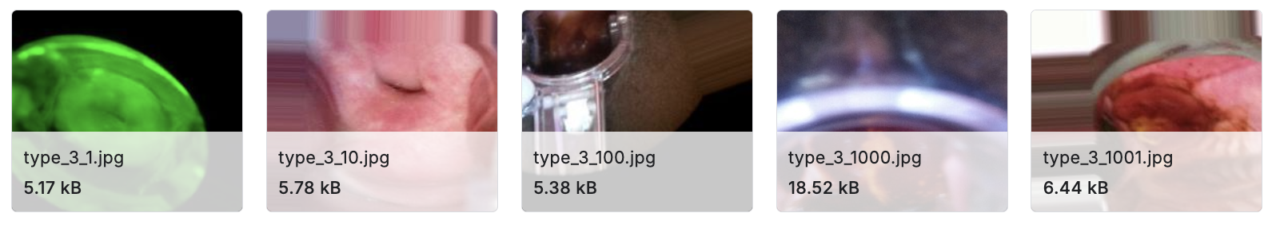
Cervical Cancer Dataset

Slide 22
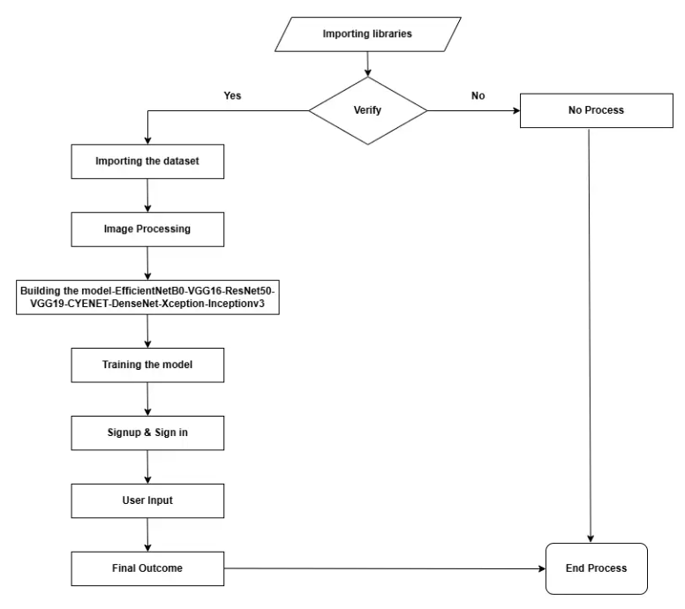
WORKFLOW
Data Collection
Data Preprocessing
CNN Model Training
Model Evaluation
Model Deployment

Slide 23
WORKFLOW
Data Collection:
Gather a large and diverse dataset of digital colposcopy images with corresponding labels indicating the presence or absence of disease.
Data Preprocessing:
Prepare the data for CNN training by resizing images, normalizing pixel values, and augmenting the dataset.
CNN Model Training:
Train a convolutional neural network using the preprocessed data to learn features and patterns associated with cervical disease.
Model Evaluation:
Evaluate the model's performance on unseen data to assess its accuracy and generalizability.
Model Deployment:
Deploy the trained CNN model for real-time analysis of new colposcopy images to support clinical decision-making.

Slide 24
SOFTWARE REQUIREMENTS
1.Application : Anaconda
2. Primary Language : Python
3. Frontend Framework : React
4. Back-end Framework : Jupyter Notebook
5. Database : Sqlite3,MongoDB
6. Front-End Technologies : HTML, CSS,
React and
Tailwind CSS.

Slide 25
HARDWARE REQUIREMENTS
1.Operating System :windows 10 and above
2. Processor : i5 and above
3. RAM : 8GB and above
4. Hard Disk : 25GB and above
5. AWS Sage Maker Instance : ml.g5.xlarge

Slide 26
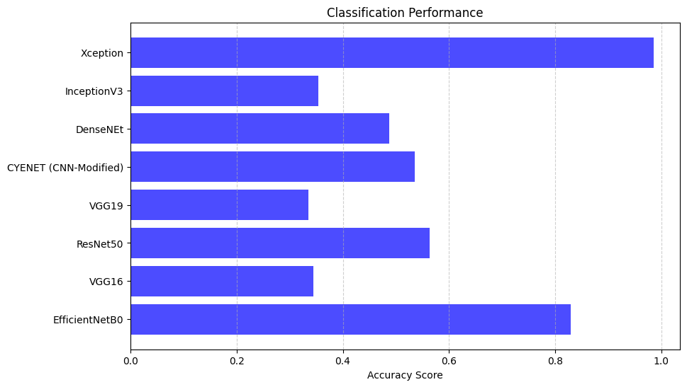
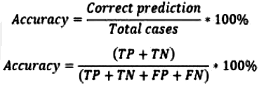
RESULTS
ACCURACY:
Accuracy refers to how close a measurement is to the true value.

Slide 27
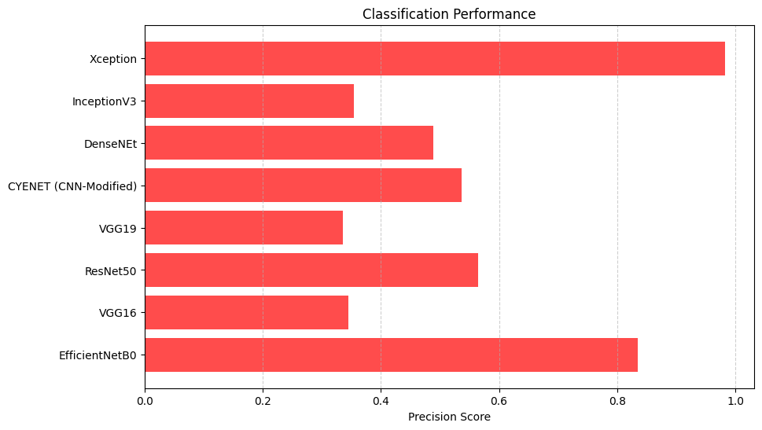
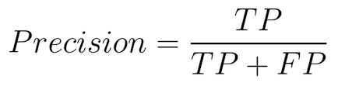
PRECISION:
Precision measures the proportion of true positive predictions among all positive predictions made by a model

Slide 28
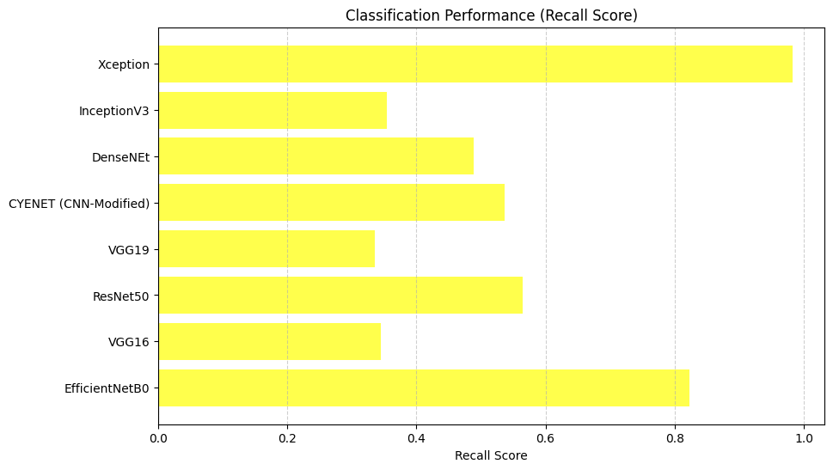
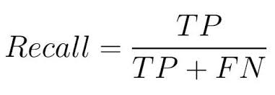
RECALL:
recall, also known as sensitivity or true positive rate, measures a model's ability to identify all relevant instances of a class, focusing on minimizing false negatives

Slide 29
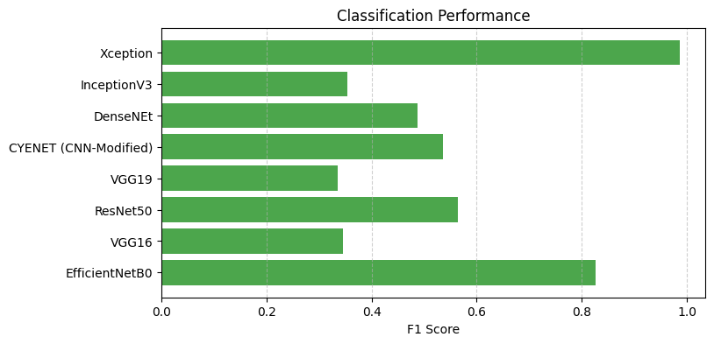
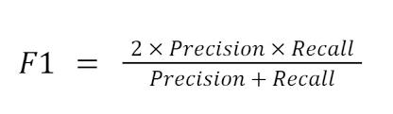
F1-SCORE;
The F-score or F-measure is a measure of predictive performance. It is calculated from the precision and recall of the test.

Slide 30
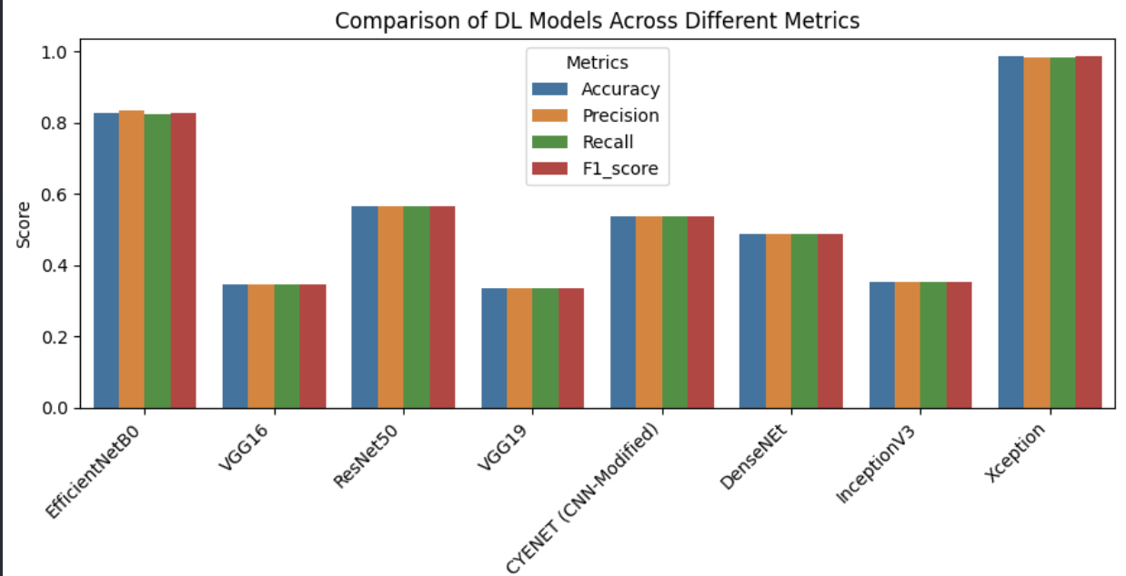
Comparison of DL Models Across Different Metrics

Slide 31
REFERENCES
N. Youneszade, M. Marjani, and C. P. Pei, ‘‘Deep learning in cervical cancer diagnosis: Architecture, opportunities, and open research challenges,’’ IEEE Access, vol. 11, pp. 6133–6149, 2023, doi: 10.1109/ACCESS.2023.3235833. [9] Z. Alyafeai and L. Ghouti, ‘‘A fully-auto.
C. M. Kumari, R. Bhavani, S. Padmashree, and R. Priya, ‘‘Identification and classification of cervical cancer using convolutional neural network based on Fisher score,’’ J. Data Acquisition Process., vol. 38, no. 2, p. 2118, 2023.

Slide 32
THANK YOU

