Slide 1
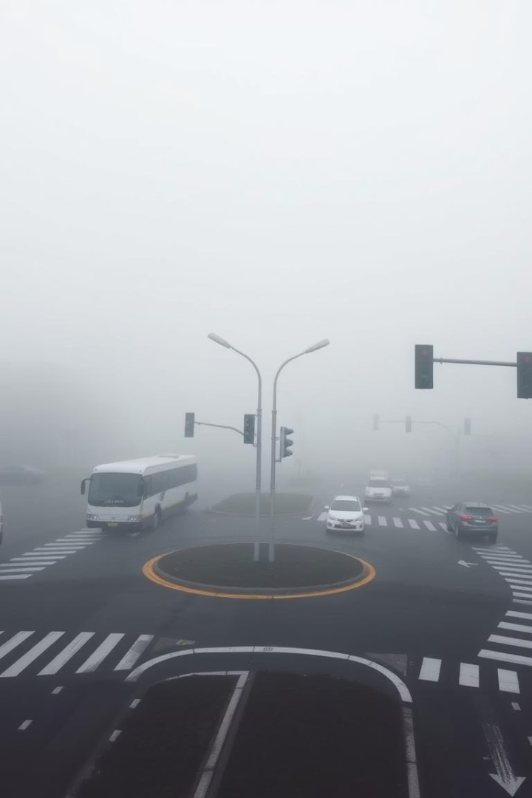
Visibility Enhancement in Foggy Traffic Surveillance
This presentation explores a video-based system designed to improve vehicle detection in foggy or low-light traffic conditions. Fog severely reduces visibility by scattering light, making vehicle detection challenging. The proposed multi-stage pipeline uses classical computer vision techniques to enhance video clarity and enable reliable vehicle detection in surveillance scenarios.
The approach integrates foggy video frame acquisition, transmission map estimation using Dark Channel Prior, Contrast Limited Adaptive Histogram Equalization (CLAHE), adaptive gamma correction, and vehicle detection via background subtraction and contour analysis.

Slide 2

Introduction and Challenges in Foggy Traffic Monitoring
Traffic Monitoring Needs
Limitations of Traditional Systems
Vision-based systems are vital for traffic control, speed estimation, and accident detection. Increasing vehicle numbers have intensified congestion and delays.
Conventional traffic control methods like fixed signals and sensors have limited coverage and require heavy infrastructure.
Fog Impact
Fog scatters light, lowers contrast, and blurs object boundaries, making vehicles indistinguishable from backgrounds and impairing detection accuracy.

Slide 3
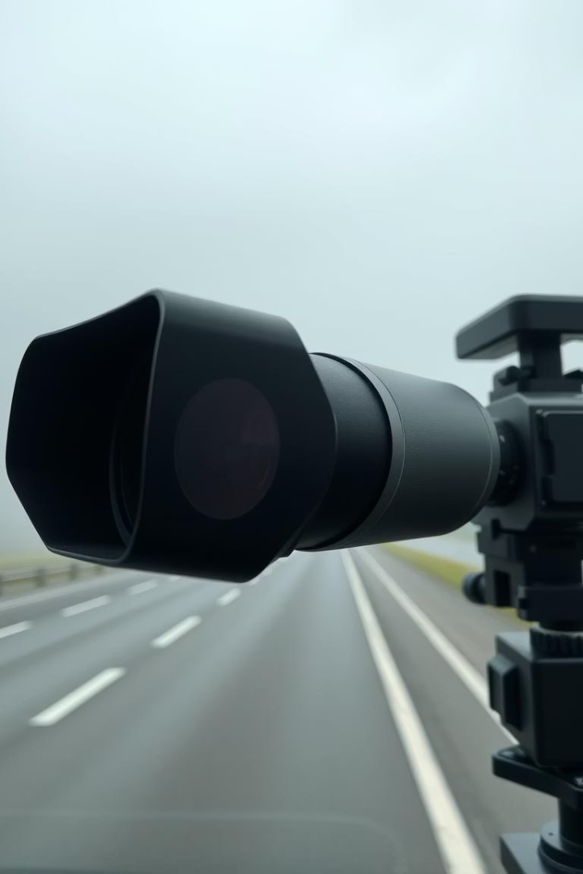
Existing Methods and Their Limitations
Polarization and Multi-Image Processing
Variable Atmospheric Conditions
Require special hardware and multiple images, limiting urban deployment feasibility.
Accuracy and robustness vary with fog density and particle scale, reducing practical application.
Need for Real-Time Video Enhancement
Most prior work focuses on still images; real-time video processing remains a challenge.

Slide 4
Proposed Enhancement Pipeline
Key Stages
Goals
Foggy video frame acquisition
Restore degraded frames, improve visibility, and enable accurate detection of moving vehicles under foggy conditions.
Transmission map estimation using Dark Channel Prior
Contrast enhancement via CLAHE
Use classical computer vision techniques for cost-effective, real-time surveillance applications.
Adaptive gamma correction for illumination
Vehicle detection using background subtraction and contour analysis

Slide 5
Image Representation and ROI Selection
Image Representation
Region of Interest (ROI)
Video from fixed cameras is digitized into frames, represented in grayscale or color spaces with pixel intensities from 0 to 255.
Processing focuses on road segments where vehicles appear, reducing computational load and enhancing accuracy.
Frames are converted from RGB to perceptually uniform color spaces like Lab or HSV for better intensity processing.

Slide 6
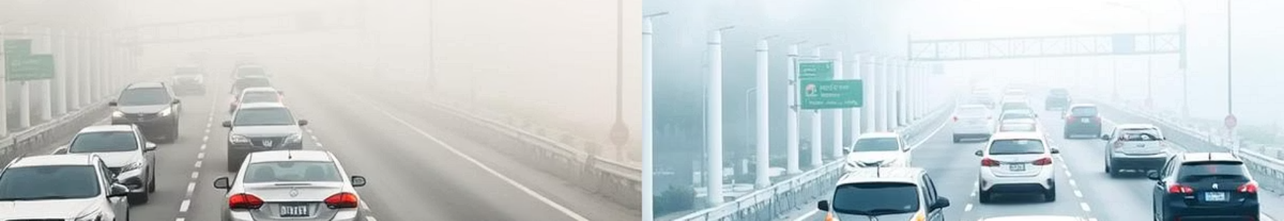



Visibility Enhancement Techniques
CLAHE
Enhances local contrast by dividing images into tiles and limiting noise amplification.
Dark Channel Prior (DCP)
Estimates haze concentration by identifying dark pixels in non-sky regions to remove fog effects.
Adaptive Gamma Correction
Nonlinear correction brightens darker regions without saturating bright areas, refining visibility.

Slide 7
Visibility Enhancement Techniques Overview
CLAHE: Enhances local contrast by dividing the image into small, non-overlapping tiles and applying histogram equalization to each tile independently. This method effectively improves the visibility of details in foggy or low-contrast areas while controlling noise amplification by clipping the histogram. The use of tiles ensures that contrast enhancement is localized, preventing over-enhancement of uniform regions.
Dark Channel Prior (DCP): A statistical approach that exploits the observation that in most fog-free outdoor images, some pixels in non-sky regions have very low intensity in at least one color channel. DCP estimates the fog density by identifying these dark pixels, which enables a precise calculation of the transmission map needed to restore the image visibility. This technique is highly effective in removing haze and fog effects from images without requiring additional hardware.
Adaptive Gamma Correction (AGC): A nonlinear image enhancement technique designed to brighten dark regions of an image adaptively while preserving the brightness of naturally bright areas. Unlike fixed gamma correction, AGC adjusts the gamma value based on local image properties, preventing overexposure and preserving image details. This results in improved visibility in shadowed or degraded areas, making it ideal for enhancing video frames captured under foggy conditions.

Slide 8
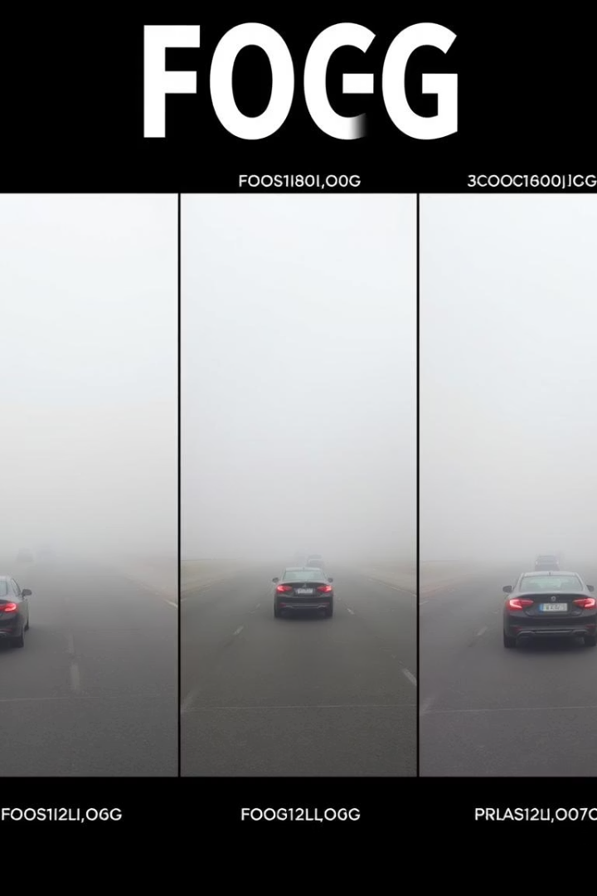
Filtering and Image Smoothing
Median Filtering
Bilateral Filtering
Removes salt-and-pepper noise while preserving sharp edges, essential for vehicle and road feature clarity.
Non-linear smoothing that considers spatial proximity and pixel intensity similarity to maintain edges.
DCP Guided Filtering
Smooths transmission maps while preserving image structure, producing natural defogged results.

Slide 9
Advanced Filtering Techniques for Foggy Images
Median Filtering: Efficiently removes salt-and-pepper noise, which is a common type of noise in digital images caused by sudden disturbances in the signal. This filtering method replaces each pixel's value with the median value of the neighboring pixels, effectively preserving sharp edges and fine details. It is crucial for maintaining the clarity of vehicles and road features in foggy traffic surveillance where noise reduction is essential for accurate detection.
Bilateral Filtering: Applies edge-preserving smoothing by considering both the spatial proximity of pixels and the similarity of their intensities. This non-linear approach smooths the image while keeping edges intact, preventing the blurring of important structures like vehicle outlines and lane markings. It is particularly effective in foggy images where maintaining fine details during noise reduction improves overall visibility and scene understanding.
DCP Guided Filtering: Enhances the quality of transmission maps used in defogging algorithms by refining and smoothing the initial estimates based on the dark channel prior. This guided filtering technique preserves the natural structure of the image, such as textures and edges, leading to more visually pleasing and realistic fog removal results. It ensures that the enhanced images retain scene details without introducing artifacts, which is important for subsequent analysis in traffic monitoring systems.

Slide 10
Step-by-Step Enhancement Algorithm
Capture video from static surveillance camera
Extract frames from video stream
Select ROI focusing on road areas
Convert frames to Lab color space
Apply CLAHE to L* channel
Estimate and remove fog using DCP
Perform adaptive gamma correction
Apply median filtering to reduce noise
Reconstruct enhanced image and convert to RGB
Repeat for all frames to produce enhanced video

Slide 11
Results and Evaluation Metrics
Shannon Entropy (SE)
Contrast Improvement Index (CII)
Measures image information content; slight decrease after enhancement indicates noise reduction with better feature visibility.
Quantifies contrast enhancement; values above 1 show improved visibility and clarity in foggy images.
It’s a metric used to quantify how much the contrast of an image has improved after applying an enhancement algorithm
Shannon Entropy is a measure of information content or uncertainty in an image.
High entropy (closer to 8) → the pixel values are spread across the full range → detailed, complex image.
if CII > 1, the contrast has improved.
If CII = 1, there’s no change.
Low entropy (closer to 0) → the pixel values are concentrated around a few levels → flat, uniform image.
If CII < 1, the contrast actually worsened
The enhanced frames reveal clearer vehicles, lane markings, and roadside boundaries, crucial for real-time traffic monitoring and detection.

Slide 12
Evaluation Metrics: SE and CII Values
Metric
Before Enhancement
After Enhancement
Interpretation
Shannon Entropy (SE)
6.9159
7.2565
Lower values indicate noise reduction
Contrast Improvement Index (CII)
1.00
1.5078
Values above 1 show better contrast

Slide 13
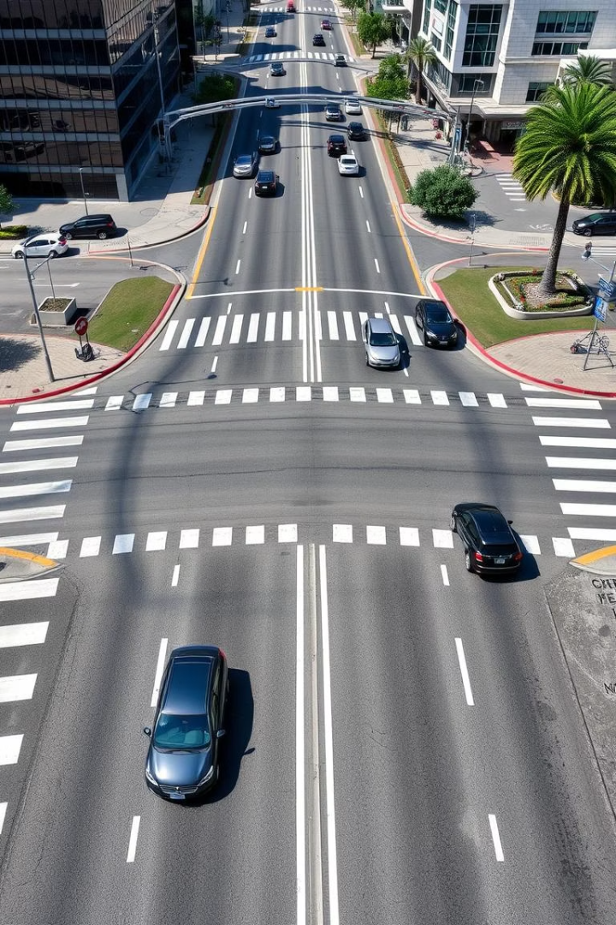
Conclusion and Future Work
Effective Enhancement
Improved Vehicle Detection
The combined use of CLAHE, DCP, and adaptive gamma correction significantly improves visibility in foggy traffic videos.
Enhanced clarity aids in distinguishing vehicles from road boundaries, supporting efficient traffic analysis.
Future Directions
Integration of segmentation and object detection modules could automate vehicle counting and further improve traffic management.

