Slide 1
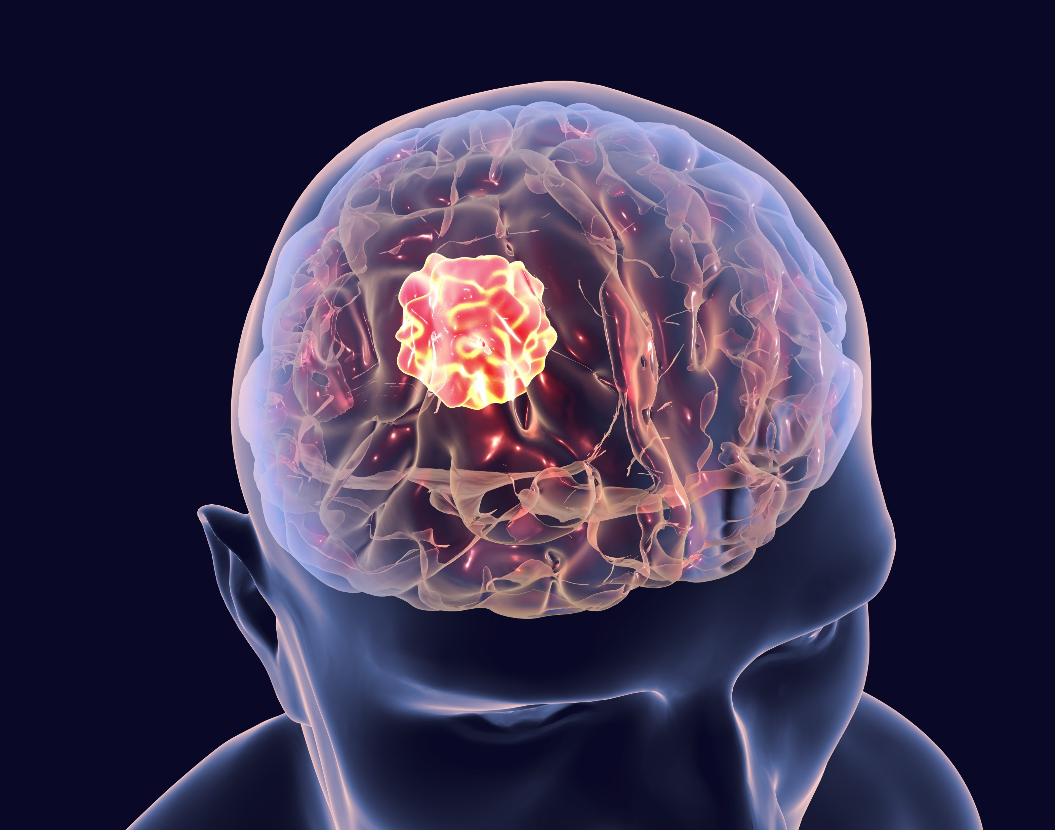
BRAIN TUMOR DETECTION AND CLASSIFICATION
BY:
PRANAY REDDY GUNDALA

Slide 2
CONTENT
Introduction
Problem Statement
Dataset
Methodology
Models
Training
Results
Conclusion
References

Slide 3
INTRODUCTION
Brain tumor is considered one of the most aggressive diseases, among children and adults. Every year, around 11,700 people are diagnosed with a brain tumor.
Brain tumors account for 85 to 90 percent of all primary Central Nervous System(CNS) tumors.
The 5-year survival rate for people with a cancerous brain or CNS tumor is approximately 34 percent for men and 36 percent for women.
The primary motivation behind this project is to contribute to the development of more accurate and efficient methods for brain tumor detection and classification.
Improved classification models can potentially aid medical professionals in diagnosing and treating patients more effectively.

Slide 4
PROBLEM STATEMENT
Defining the Problem
Classifying brain tumors into four categories: Glioma tumor, Meningioma tumor, No tumor, and Pituitary tumor.
Each class represents a specific type of abnormality or absence thereof in the brain.
Importance of Early Detection
Early detection is essential for timely intervention and treatment, significantly impacting patient outcomes.
Accurate classification assists healthcare professionals in planning appropriate treatment strategies.
Classes
Glioma tumor: Originates from glial cells in the brain.
Meningioma tumor: Originates in the meninges, the layers of tissue covering the brain and spinal cord.
No tumor: Images with no evidence of tumors.
Pituitary tumor: Develops in the pituitary gland at the base of the brain.

Slide 5
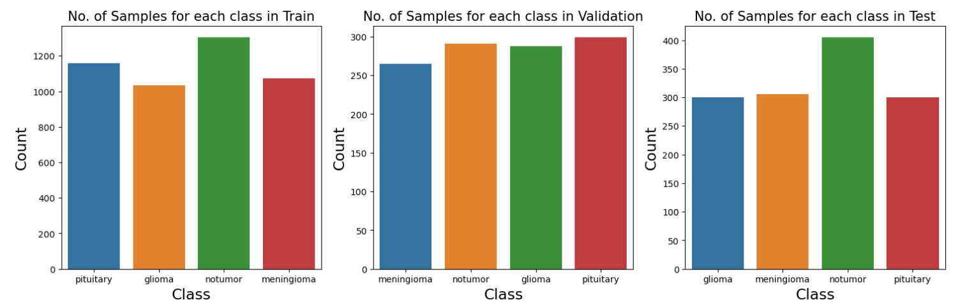
DATASET
The dataset for this project was sourced from Kaggle.
It is divided into a training set with 5712 images and a test set with 1311 images.
I subdivided training data into train and validation sets with a 20% validation split.

Slide 6
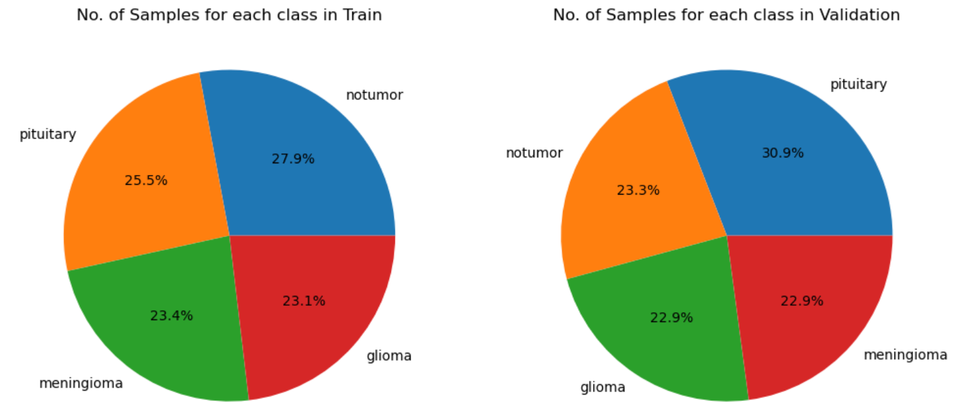
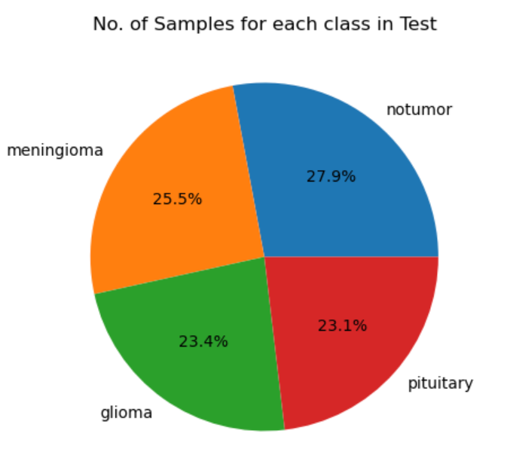
DATASET
I utilized the ImageDataGenerator to standardize and augment the data. This generator facilitates on-the-fly data augmentation during model training.
To maintain consistency in input dimensions, all images were reshaped to a standardized resolution of 224x224 pixels.

Slide 7
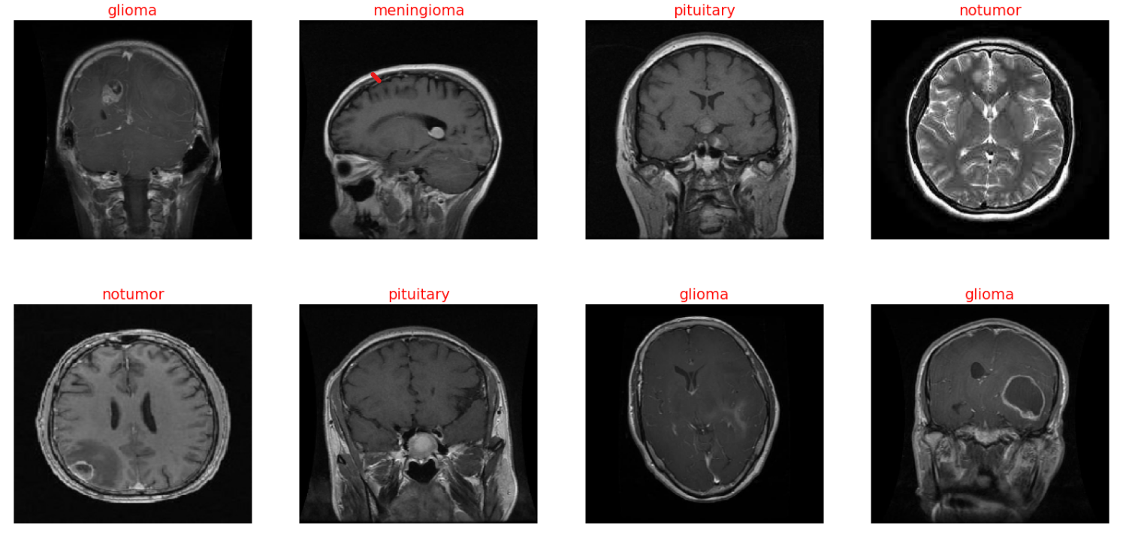
DATASET
Random images from the dataset.

Slide 8
METHODOLOGY
In this project, I employed several pre-trained models, including ResNet, EfficientNet, VGG, and MobileNet.
These models were pre-trained on ImageNet, a large and diverse dataset, to learn generic features and patterns from a wide range of images.
The knowledge gained during this initial training phase allows these models to develop a robust understanding of visual features, textures, and object hierarchies.
Transfer learning then comes into play, enabling the pre-trained models to be fine-tuned on specific tasks or datasets with limited labeled examples.
This approach is particularly advantageous in scenarios where collecting a large amount of task-specific data is challenging.

Slide 9
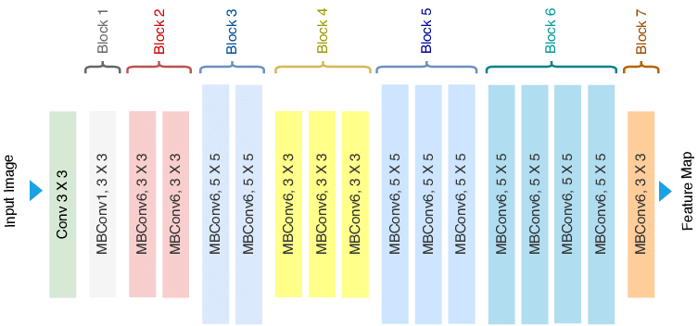
MODELS
EfficientNet is a versatile deep-learning model meticulously crafted for optimal balance between accuracy and computational efficiency across different model sizes. Its unique compound scaling strategy harmonizes depth, width, and resolution to deliver superior performance, making it a robust choice for tasks requiring high efficiency and accuracy, and adaptable to various computing environments.

Slide 10
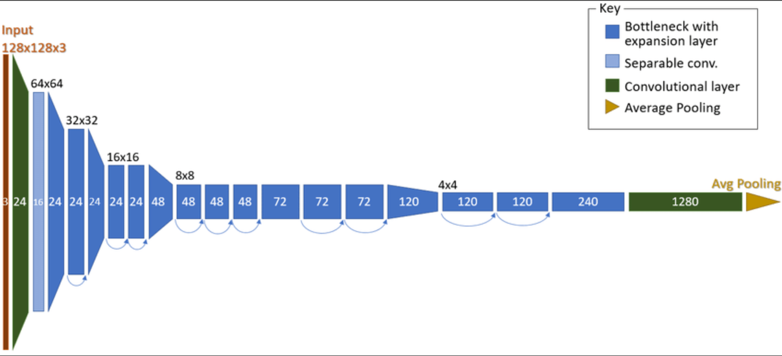
MODELS
MobileNet is a lightweight deep-learning architecture tailored for mobile and edge devices. Utilizing depth-wise separable convolutions, it optimizes computational resources without compromising accuracy, making it ideal for deployment in resource-constrained environments.

Slide 11
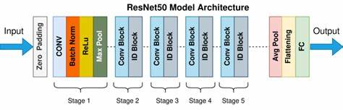
MODELS
ResNet, or Residual Networks, revolutionized deep learning by introducing residual learning to address the vanishing gradient problem. With the use of residual blocks and skip connections, ResNet enables the training of very deep networks, promoting superior feature extraction and representation.

Slide 12
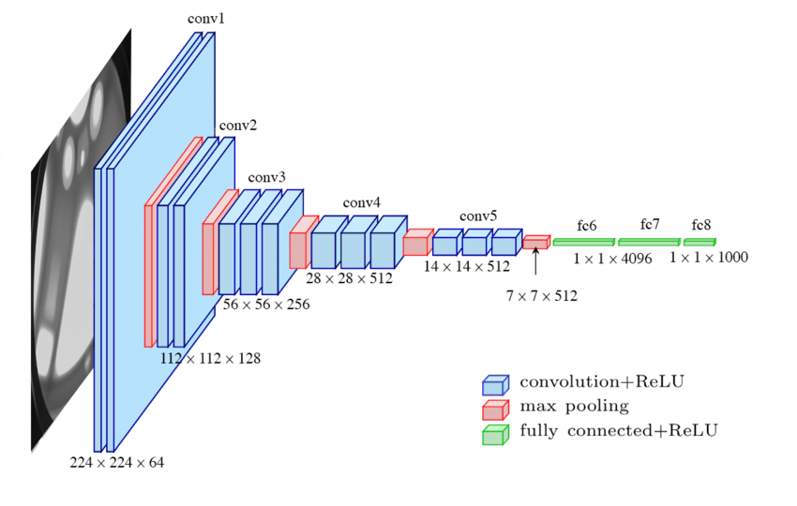
MODELS
VGG, from the Visual Geometry Group, is celebrated for its simplicity and uniform structure. Characterized by repeated blocks of convolutional layers, ReLU activations, and max pooling, VGG's straightforward design makes it a popular choice for image classification tasks, facilitating both understanding and implementation.

Slide 13
TRAINING
Early stopping was used while training the models. It is a crucial technique in the training of machine learning models, including neural networks, to prevent overfitting and optimize generalization performance.
Techniques like Batch Normalization, Global Average Pooling, and Dropout layers were also used.
Batch Normalization is a technique that stabilizes and speeds up the training process by normalizing the activations of the previous layer, reducing training difficulties associated with internal covariate shifts.
Dropout is a regularization method during neural network training where a random fraction of input units is set to zero, preventing overfitting by discouraging reliance on specific neurons.
The GlobalAveragePooling2D layer is a downsampling operation that calculates the average value for each feature map across all spatial positions. It's commonly used as a replacement for the flattening operation before the fully connected layers in convolutional neural networks (CNNs).

Slide 14
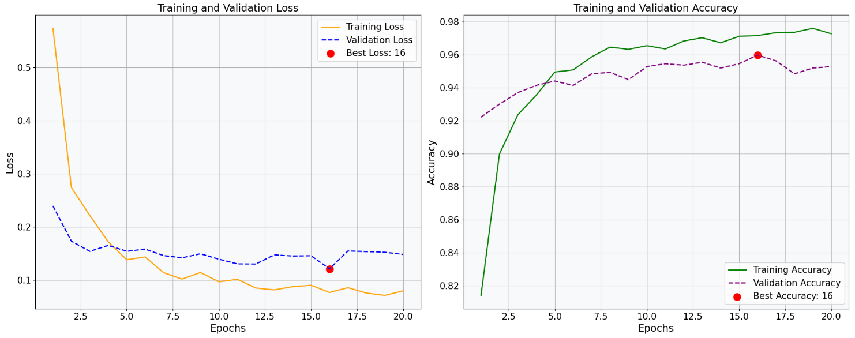
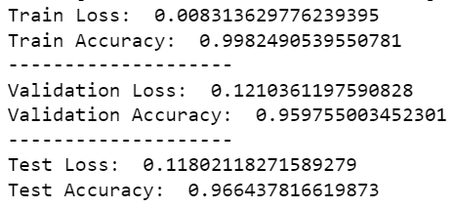
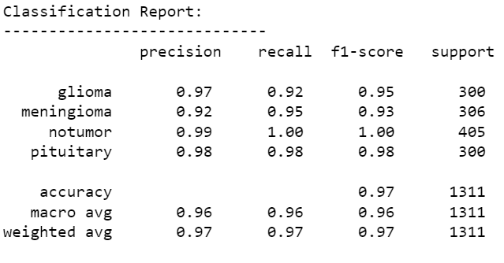
RESULTS
EfficientNetB3

Slide 15
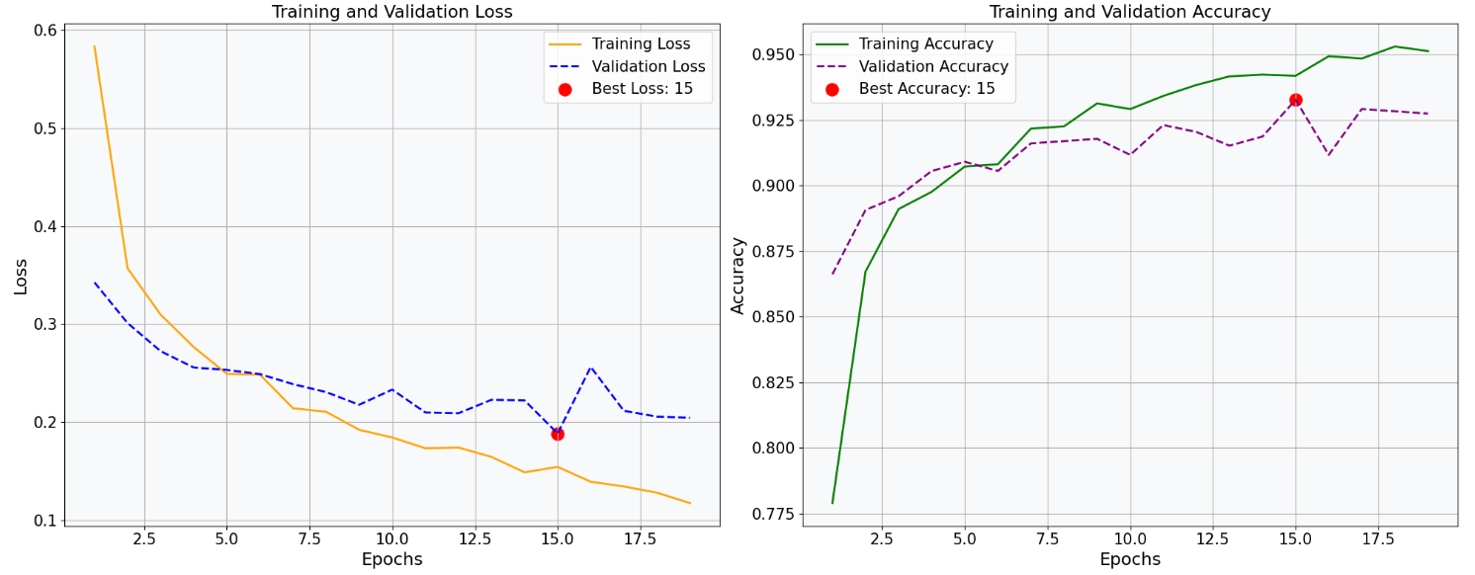
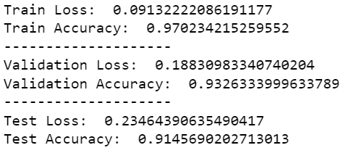
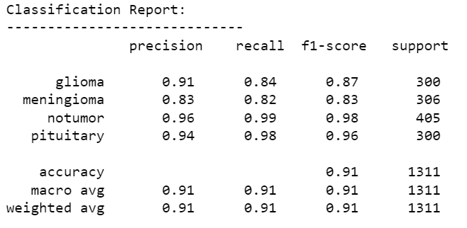
RESULTS
MobileNetV2

Slide 16
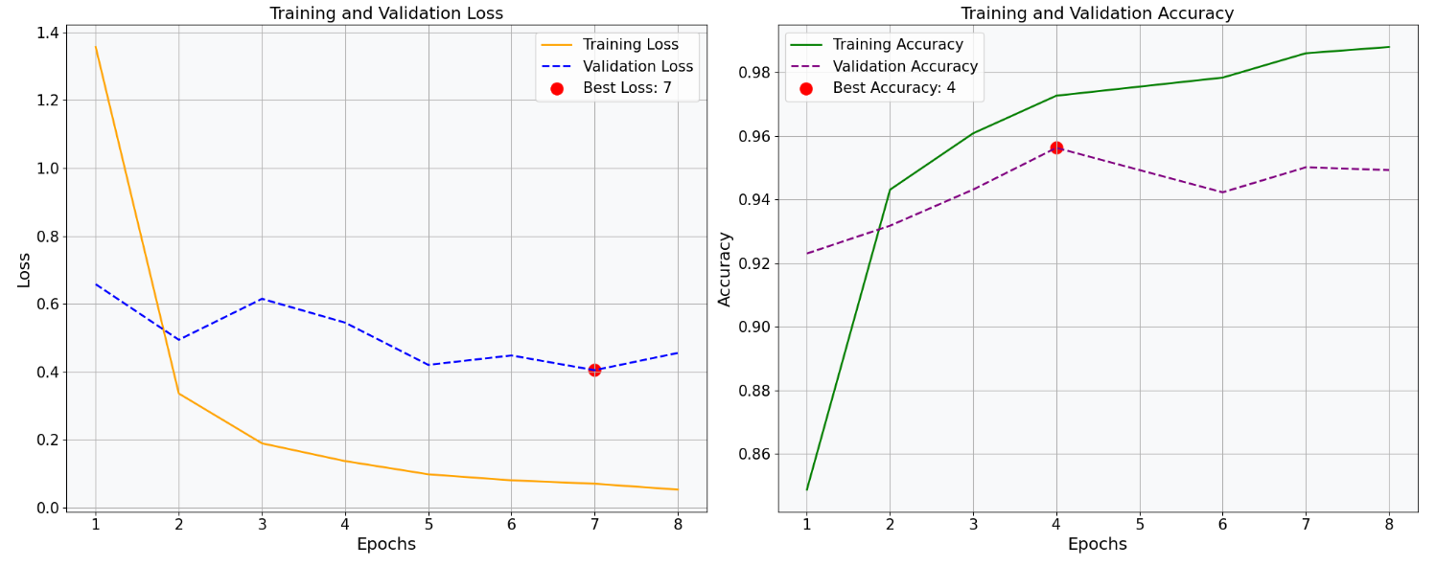
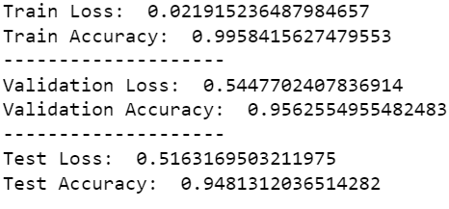
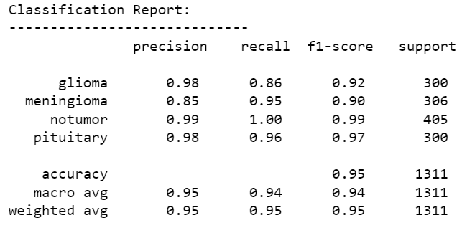
RESULTS
VGG16

Slide 17
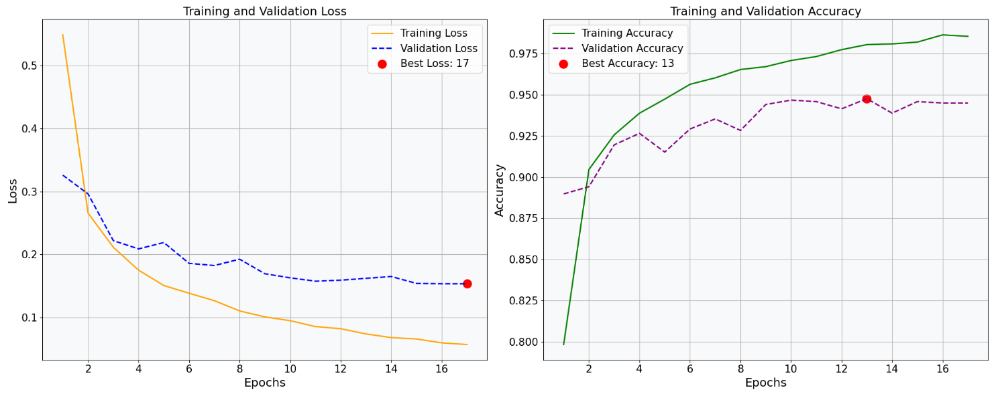
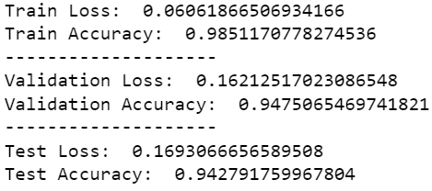
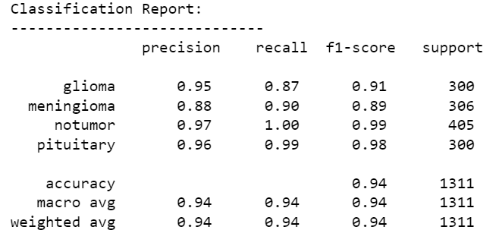
RESULTS
ResNet50

Slide 18
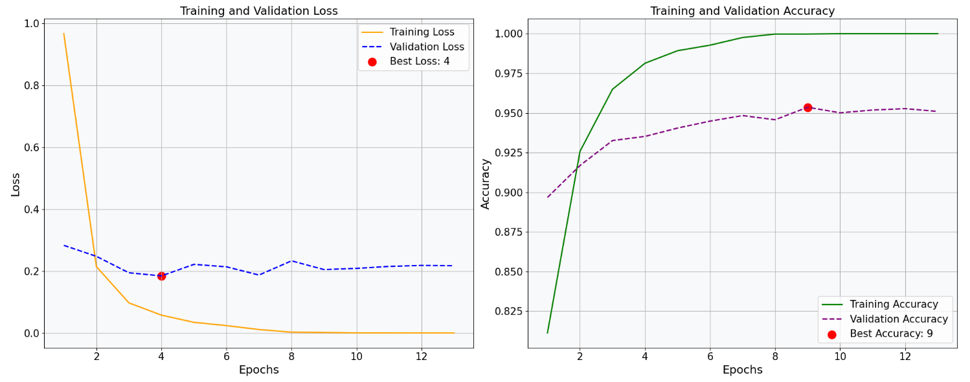
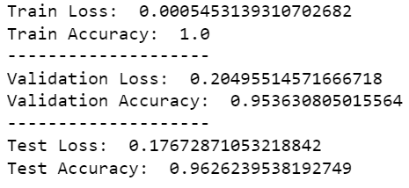
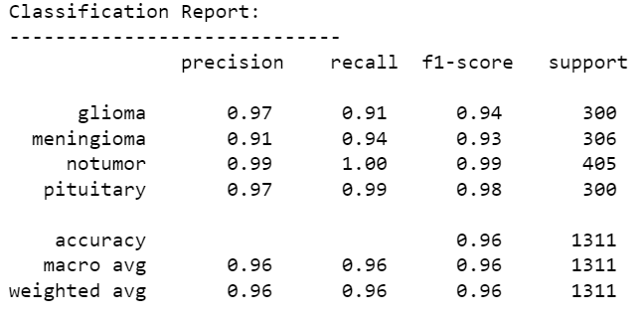
RESULTS
VGG16 with additional Convolutional layer

Slide 19
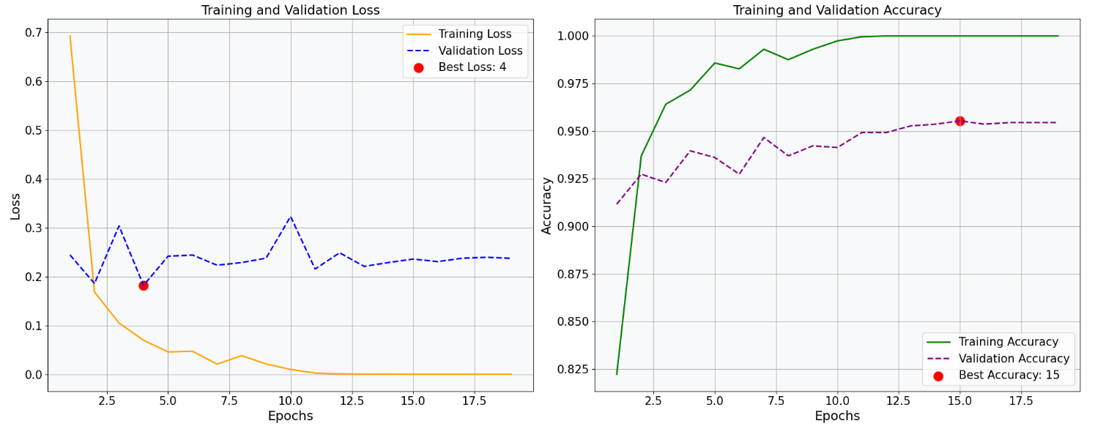
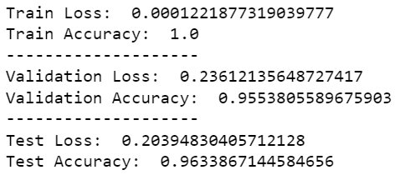
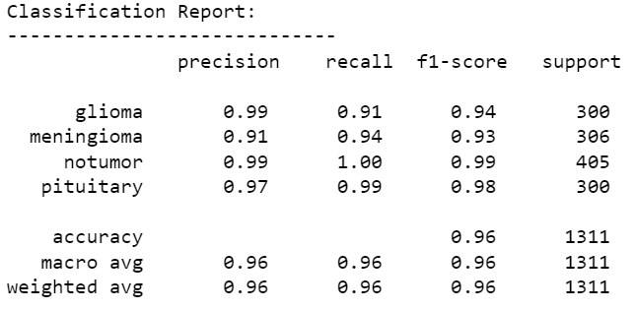
RESULTS
ResNet50 with additional Convolutional layer

Slide 20
CONCLUSION
The project successfully achieved its objective and the implementation of the deep learning models resulted in a high level of accuracy on the test dataset.
EfficientNet performed the best among all the models tested, with a test accuracy of 96.64%.
the addition of a convolutional layer to VGG and ResNet models improved their performance by 1.5 - 2%.
The main difference between the models was the time taken to train and infer. Although MobileNet did not perform better than other models, it was the fastest with shorter training and inference times, whereas VGG was the slowest.
The choice of model would depend on the available time and computing resources.

Slide 21
REFERENCES
https://www.kaggle.com/datasets/sartajbhuvaji/brain-tumor-classification-mri/data
https://www.kaggle.com/datasets/masoudnickparvar/brain-tumor-mri-dataset

Slide 22

THANK YOU
X

