Slide 1

Exploratory Data Analysis
(AMCAT Dataset)
Submitted By,
Palle Pranay Reddy,
Intern ID: IN9240549.

Slide 2
www.linkedin.com/in/
About me
Hi there!! I am Palle Pranay Reddy(IN9240549) currently working as a Data Science Intern at Innomatics Research labs. Graduated with a B-Tech in Data Science from Sphoorthy Engineering College.
I’ve always been fascinated by the power of data in making informed decisions. Learning data science allows me to merge my technical skills with problem-solving abilities to derive actionable insights from raw data.
Feel free to reach out! You can do this by following links:
LinkedIn : LinkedIn profile link
GitHub : GitHub Link

Slide 3
Business Problem and Use case domain understanding
The project is designed to investigate salary disparities among engineering graduates based on gender across various specializations. Given that companies are increasingly focusing on diversity, equity, and inclusion (DEI) initiatives, it becomes crucial for HR teams to ensure fair pay practices and identify any potential gender-based salary gaps. This study will help in determining whether gender, combined with factors like specialization, plays a significant role in determining salary outcomes for recent engineering graduates. Addressing these disparities can support organizations in building more equitable compensation systems, ultimately contributing to better employee satisfaction and retention.
This project fits within the Human Resources (HR), Compensation Analysis, and Education Outcomes domains. The dataset, provided by Aspiring Minds from the Aspiring Mind Employment Outcome (AMEO) 2015 study, focuses on employment outcomes of engineering graduates, such as salary and job titles. This analysis will provide insights into how salary differs by gender within various engineering specializations. It will assist businesses in the tech, engineering, and HR sectors in making data-driven decisions about salary structures, promoting fair compensation, and ensuring gender equity in the workforce. Additionally, this analysis can offer valuable information for academic institutions to understand the salary expectations of their graduates and adjust curriculum or career services accordingly.

Slide 4
Objective of the Project
Identify Salary Disparities:
To determine whether there are significant salary differences between male and female graduates across various engineering specializations.
Analyze Gender Imbalance:
To explore which specializations exhibit the most significant gender imbalances in terms of representation and pay.
Uncover Salary Trends:
To identify specializations where female graduates earn salaries comparable to or higher than male graduates and those where males are predominantly paid more.
Provide Insights for Equity:
To deliver valuable insights for organizations and academic institutions on gender equity in salaries, supporting the development of fair compensation policies and fostering diversity and inclusion within the engineering workforce.

Slide 5
Summary of the Data
There are 38 columns in total that are used to find the individual impacts on salary.
Out of 38 columns, there are 29 numerical columns and 9 categorical columns.
With 3998 Datapoints that make our analysis to the optimal insights with all the necessary information.

Slide 6
Exploratory Data Analysis:
Data Cleaning Steps & Data Manipulation Steps
Checked for null values, identifying nulls represented as -1 and 0.
Replaced these with the mode of their respective columns.
Ensured that no duplicate values were present in the dataset.
Dropped any unwanted columns that did not contain relevant information.
Renamed certain columns for better readability and understanding.
Corrected typos in values across key columns such as designation, specialization, and job city.
Verified that each column has the correct data type for accurate analysis.
Extracted the "period" from the "Date of Joining" and "Date of Leaving" columns to facilitate further analysis.
Organized the dataset to ensure consistency and clarity, making it more suitable for analysis and visualization.

Slide 7
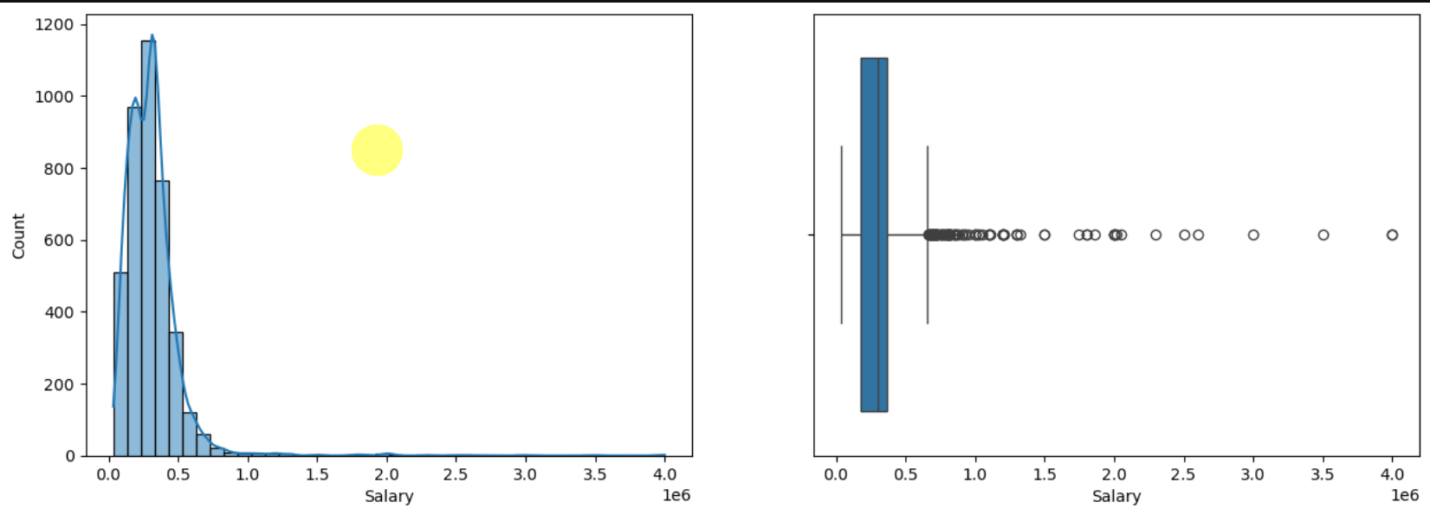
Univariate Analysis Steps Analysis of Target Variable (Salary)
The Salary of the graduated ranges from 0 to 4 million.
Most of the graduates having salary in between 0 to 5 lakhs
Two graduates has secured the highest package i.e 4 million, their ID's are 48107 and 41147
50% of Engineering graduates in the dataset earn less than 3 lakh rupees
There are several outliers above the upper whisker, indicating that some graduates earn significantly higher salaries than the rest. These salaries extend up to nearly 40 lakhs (4 million). This suggests that while most graduates have moderate salaries, a small number of graduates earn much higher salaries, likely due to specialized skills, job roles, or locations.
The absence of outliers below the lower whisker shows that there are no extreme low salaries (less than 50,000) in the dataset.

Slide 8
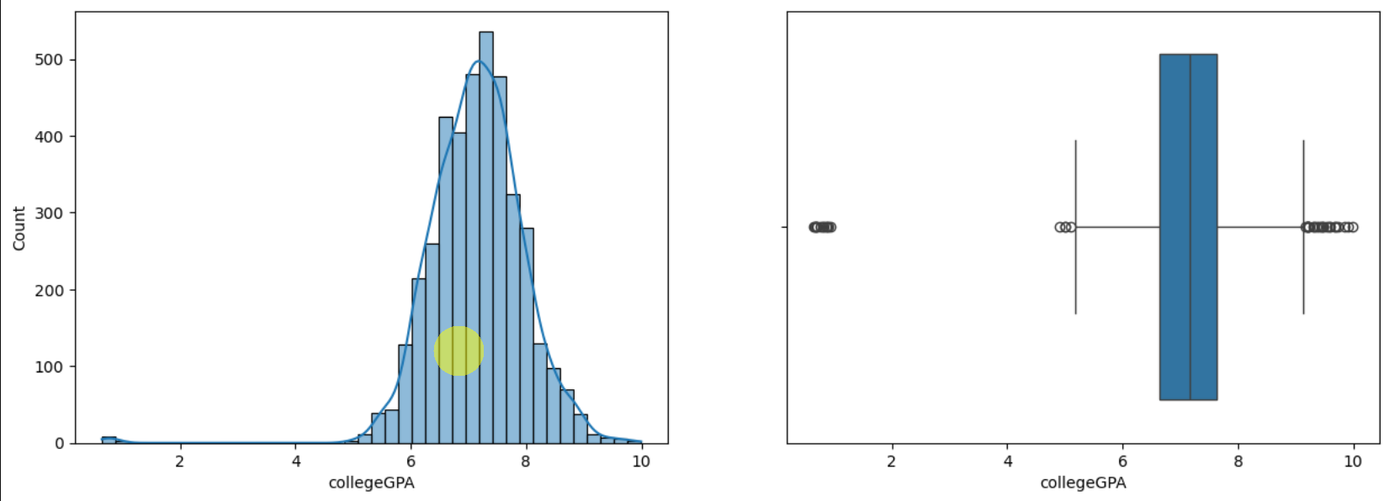
Analysis of collegeGPA
Most of the graduates scores in between 6.0 to 8.0 CGPA indicating that the majority of students perform in the above-average range.
There are few students scored less than 2.0 CGPA considered as low performers and indicating a potential struggle in academic performance.
Maximum CGPA i.e(9.993) scored by ID of 609356 showing peak academic success and she should be the top 1% of the data.
50% of graduates scored more than 7.0 CGPA, this suggests that overall performance trends toward good to excellent grades.

Slide 9
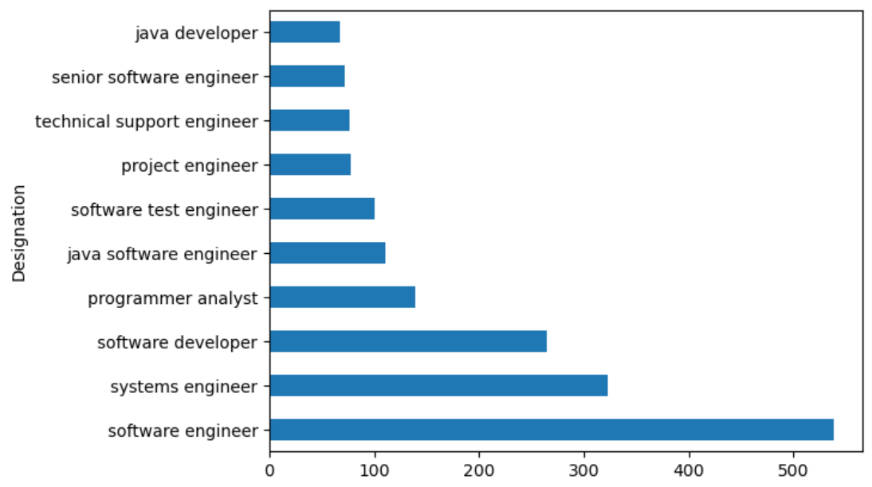
Analysis of Designation
These are the top 10 Designations
Software Engineer Designation is leading with the count of above 500 among all job roles.

Slide 10
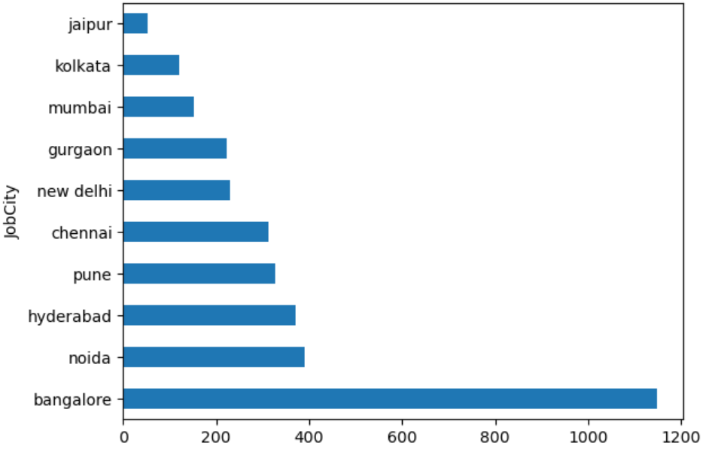
Analysis of Job City
Above 686 graduates are employeed in Bangalore, then Noida and them Hyderabad.
Noida and Hyderabad are in almost same place

Slide 11
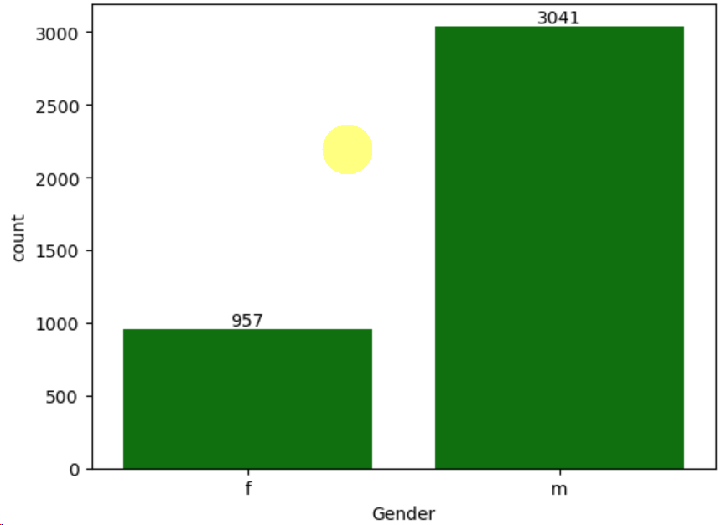
Analysis of Gender
Male Graduates are higher than females

Slide 12
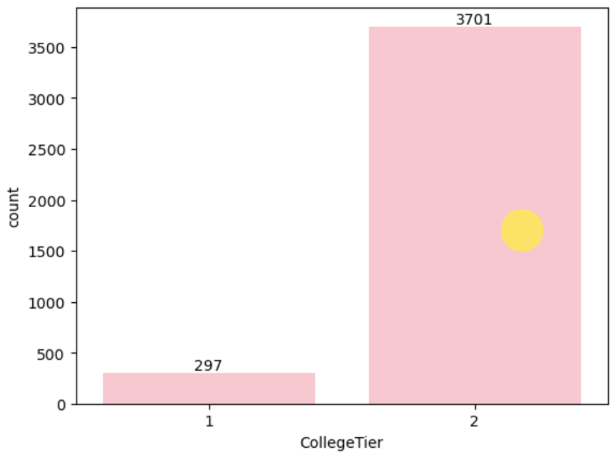
Analysis of CollegeTier
Tier 2 colleges are dominating tier 1 colleges
More no.of graduates for m tier 2

Slide 13
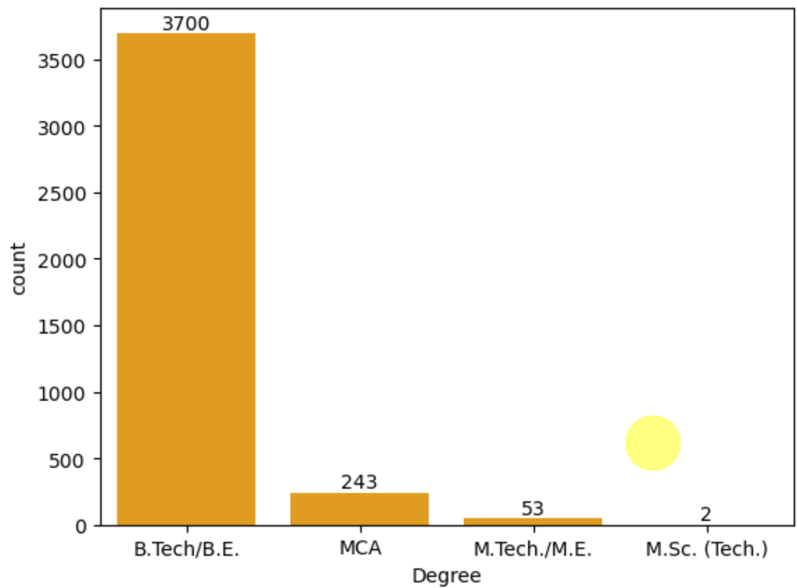
Analysis of Degree
92% i.e(3700) of the graduates form B.Tech/B.E
MCA graduates are 243 and then M.Tech/M.E are with 53 graduates and M.Sc. (Tech.) with 2 graduates

Slide 14
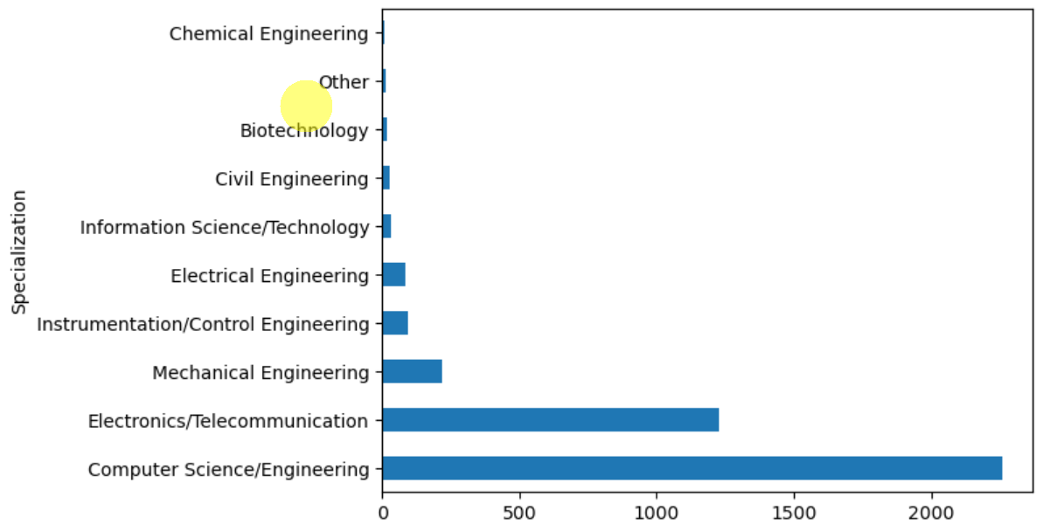
Analysis of Specialization
computer science & engineering is in 1st place with graduates of 2258
1225 Graduates are from electronics and communication engineering in 2nd place and follows…..

Slide 15
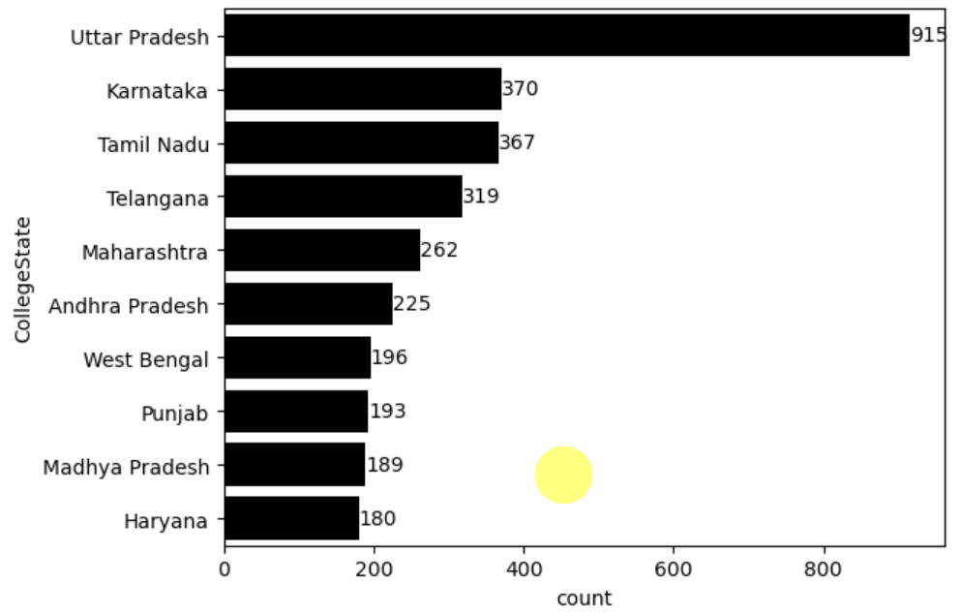
Analysis of CollegeState
Most of the Graduates i.e 915 form Uttar Pradesh then Karnataka with 370 and then Tamil Nadu with 367 and follows..

Slide 16
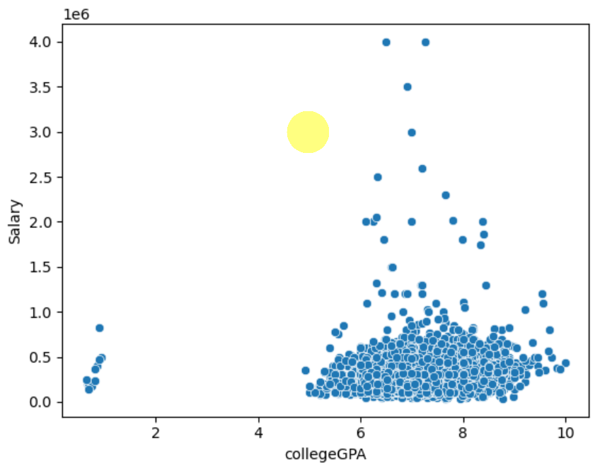
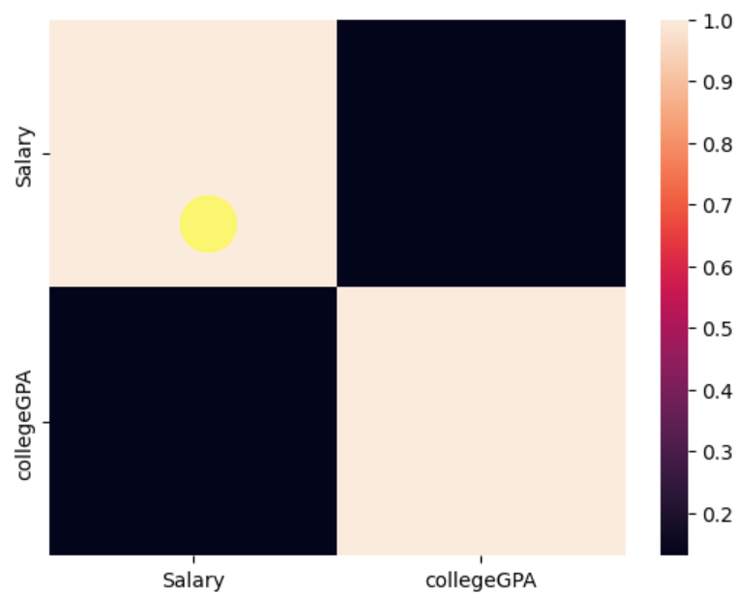
Analysis of CollegeGPA vs Salary
There is a weak correlation between College GPA and salary, indicating that higher GPA does not guarantee a higher salary.
Graduates with top GPA (i.e., 9.993) received moderate packages like 4,40,000.
Mid-range GPAs (i.e., 7.2 and 6.5) secured much higher packages of up to 4 million, showing GPA is not the only deciding factor.
The majority of graduates are placed with packages ranging from 35,000 to 1 million.
These insights suggest that factors beyond academic performance, such as skills and demand, significantly influence salary.

Slide 17
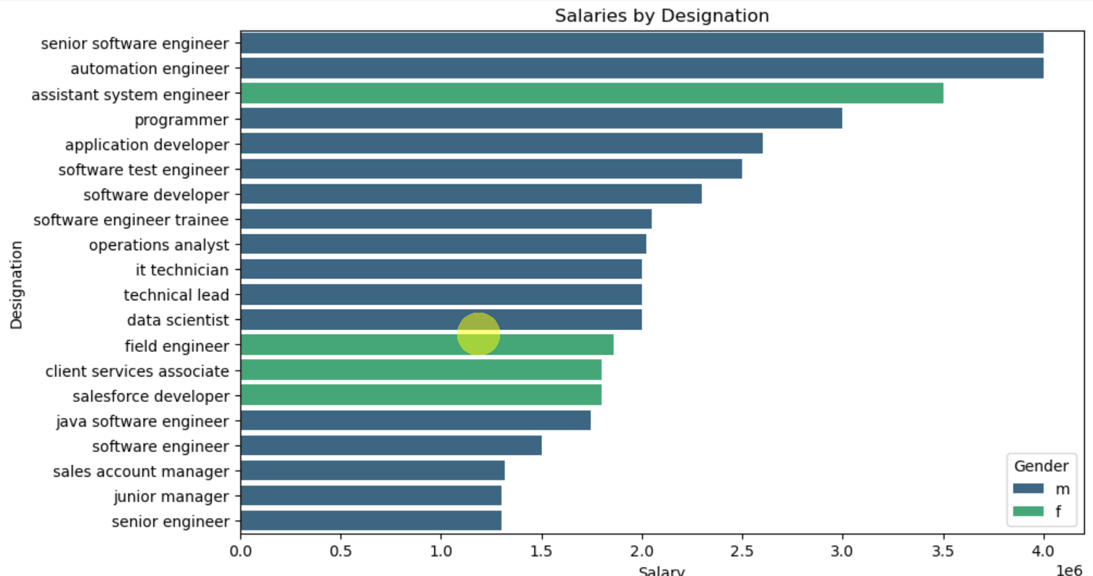
Salary by Designation
These are the top 20 highest salaries.
Males(i.e., 16) are higher than females(i.e., 4) in top 20 high paying salaries.
senior software engineer and automation engineer has highest salary (i.e., 4 million) cracked by males.
Assistant system enginneer has second highest salary i.e., 3.5 million cracked by female
software engineer trainee, operations analyst and technical lead having the almost salaries(i.e, 2 million).

Slide 18
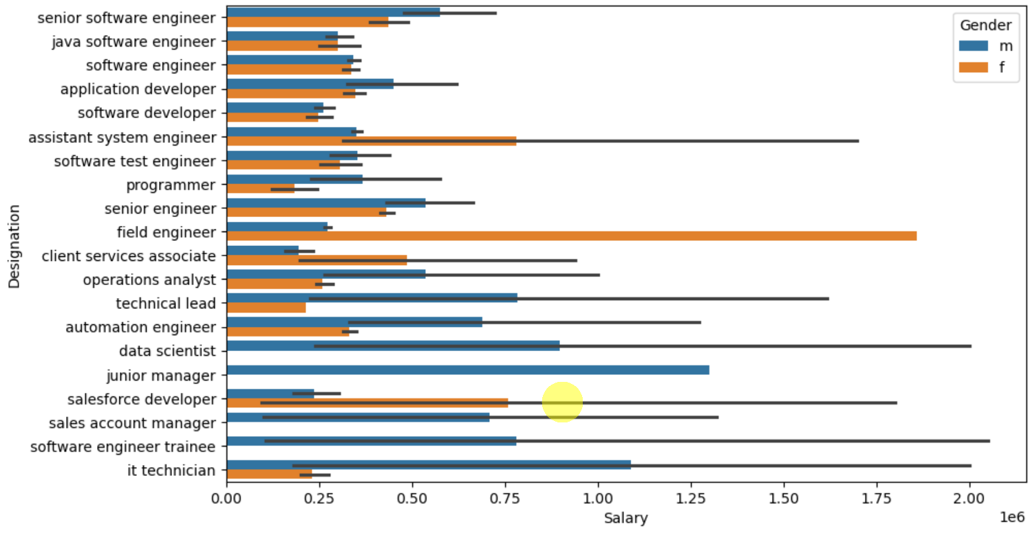
Analysis of top 20 Salaries vs Designation
A significant portion of the highest-paying jobs are within the IT domain
In 45% of the top-paying roles, men are generally compensated more than women
Conversely, in 20% of the top-paying roles, women earn higher salaries compared to men
Certain positions, such as Junior Manager, Sales Account Manager, and Software Engineer Trainee, have no female representation Among men, the role of Junior Manager offers the highest salary, while for women, the highest-paying role is that of Field Engineer
The gender pay disparity may be influenced by other factors such as experience and specialization
Software Engineer and Software Developer roles are the most common and also rank among the highest-paying positions.

Slide 19
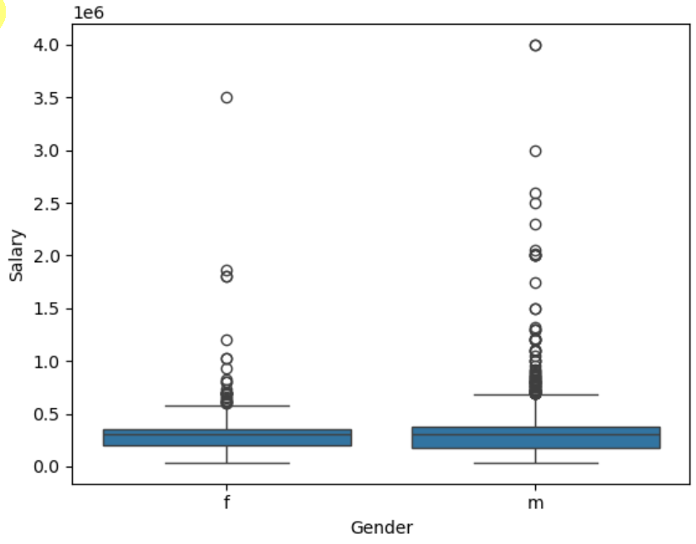
Gender vs Salary
Class imbalance between male and female, males are higher(i.e.,3041) than females(i.e.,957)
Minimum and median salaries are same for males and females.
Mean salary high for males because of count of males is high.
In males highest salary is 4 million and in females is 3.5 million

Slide 20
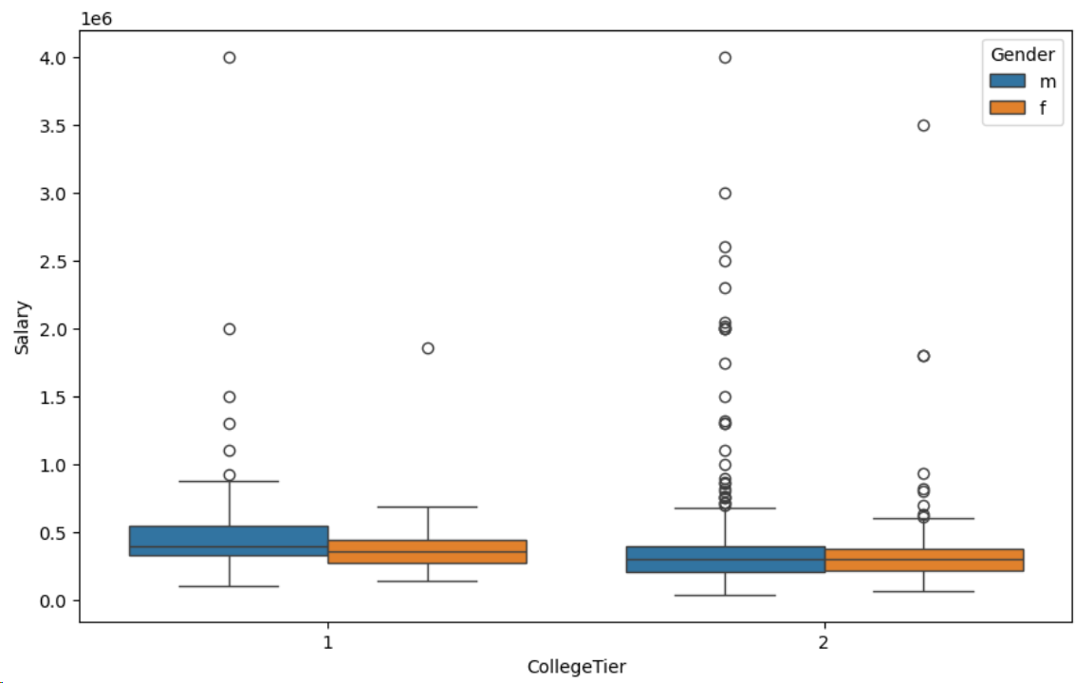
CollegeTier vs Salary vs Gender
From the above bar graph,we can see that students from tier1 colleges have higher salary.
We can see more men are from tier1 colleges than women and overally most students are from tier2 colleges
This might be a reason for women being paid less than men in high paying jobs because as most of women are from tier-2 colleges

Slide 21
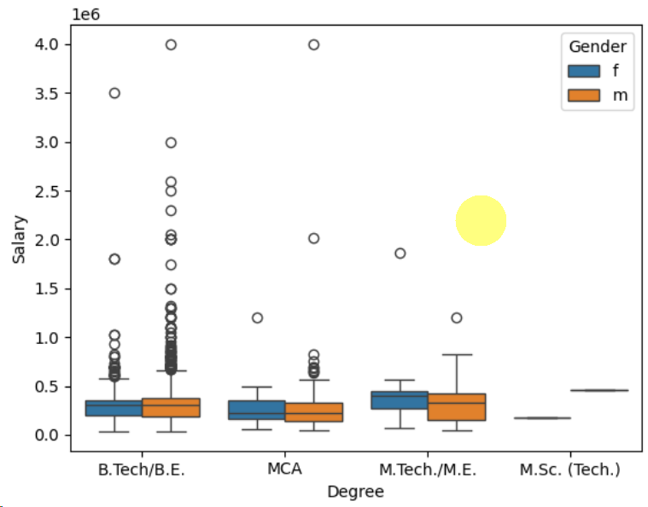
Degree vs Salary vs Gender
Most of the Graduated are form B.Tech/B.E
The average salary of males and females are same in B.Tech/B.E and MCA, males has high avg salary in M.Tech/M.E
In Every Degree males are higher than females, Except M.Sc.

Slide 22
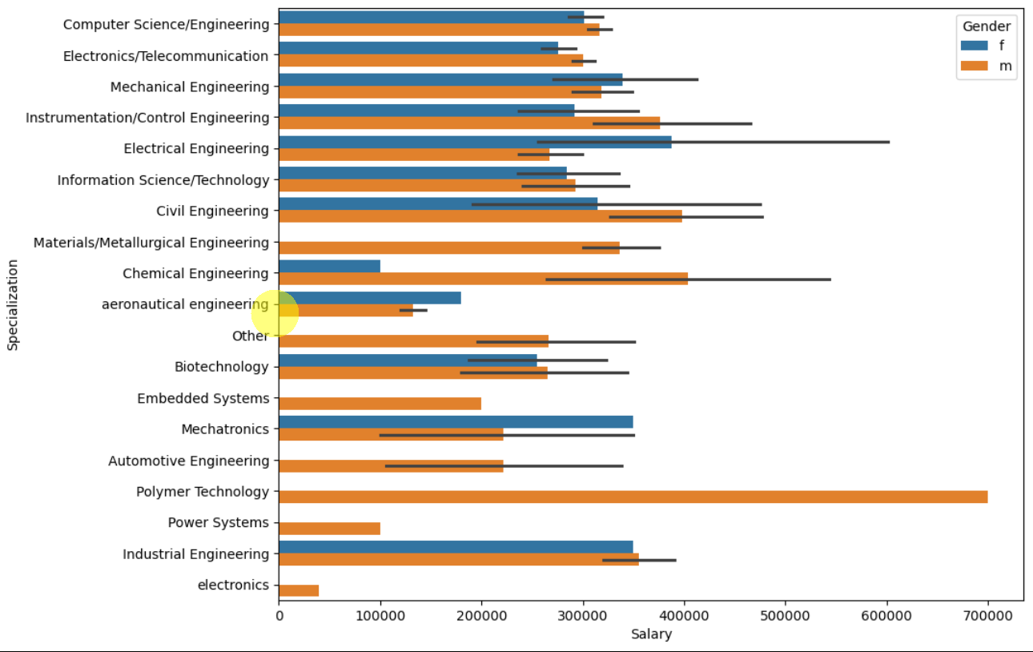
Salary vs Specialization vs Gender
In some specializations like Information Science/Technology, it seems both genders are more equally represented.
In fields like Mechanical Engineering and Civil Engineering, male graduates seem to be more dominant, as indicated by the longer orange bars compared to blue.
In specializations such as Computer Science/Engineering, Information Technology, Bio Technology and Industrial Engineering the blue and orange bars are more balanced, indicating more gender balance in these fields.

Slide 23
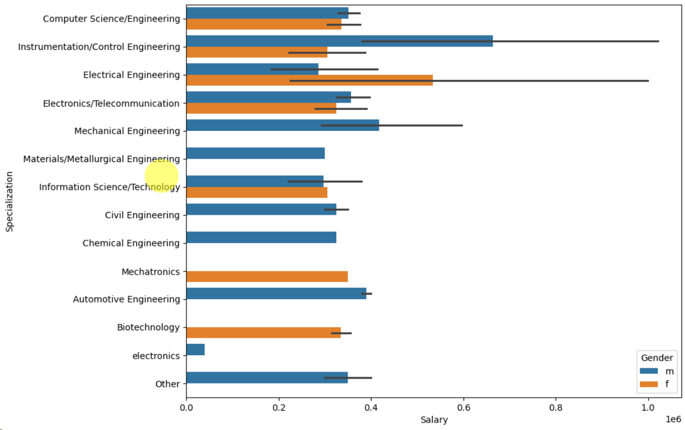
High Salaries vs Specialization vs Gender
Mostly Male salaries are higher than females.
In some specializations there are no females like Mechanical Engineering, chemical Engineering, Automative Engineering.
In Electric Engineering Female salaries are more than males.

Slide 24
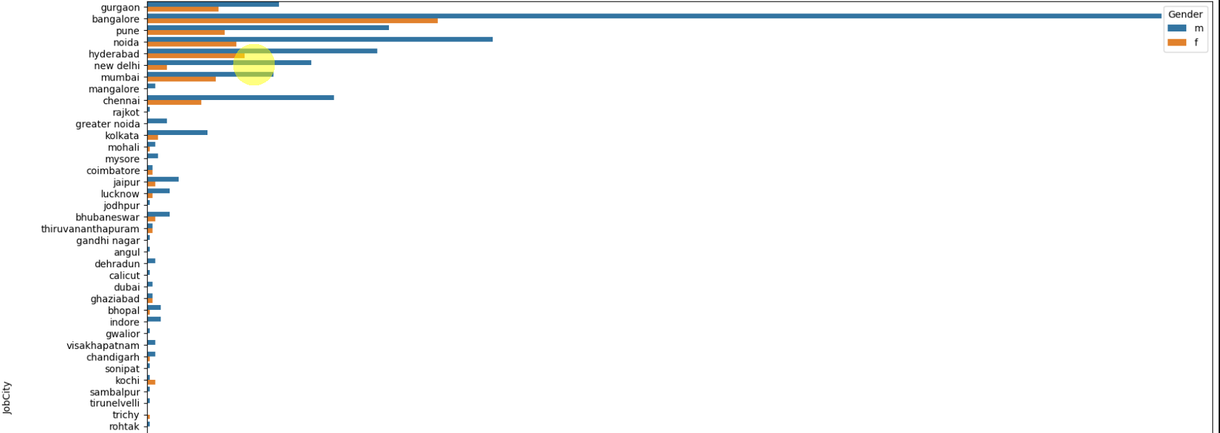
JobCity
Most amcat aspirants work in bengaluru,Noida,hyderabad and pune.
It is because most of them are from IT domain so majority of them work in these cities

Slide 25
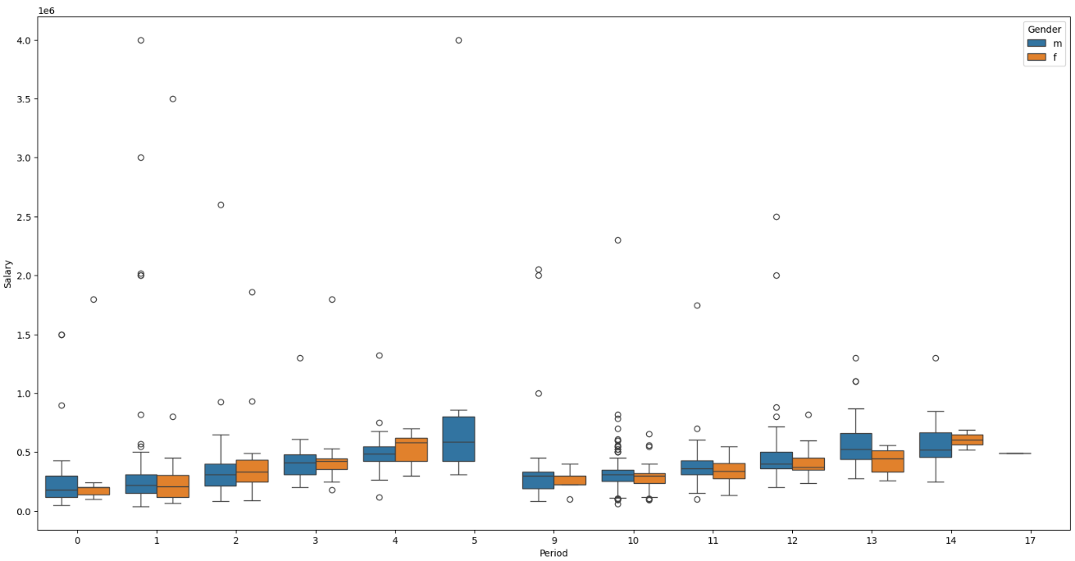
Salary vs Period
Median salary of both males and females have increased slightly with exp for first five years and Decreased suddenly on the 6th year and then same pattern for the following years
We can see that men and women having same experience are paid nearly equally around 3.5-5 lak
s we need to further see the distribution of experience with respect to Designation for both men and wo en to check whether women are being paid less in a role due to experience.

Slide 26
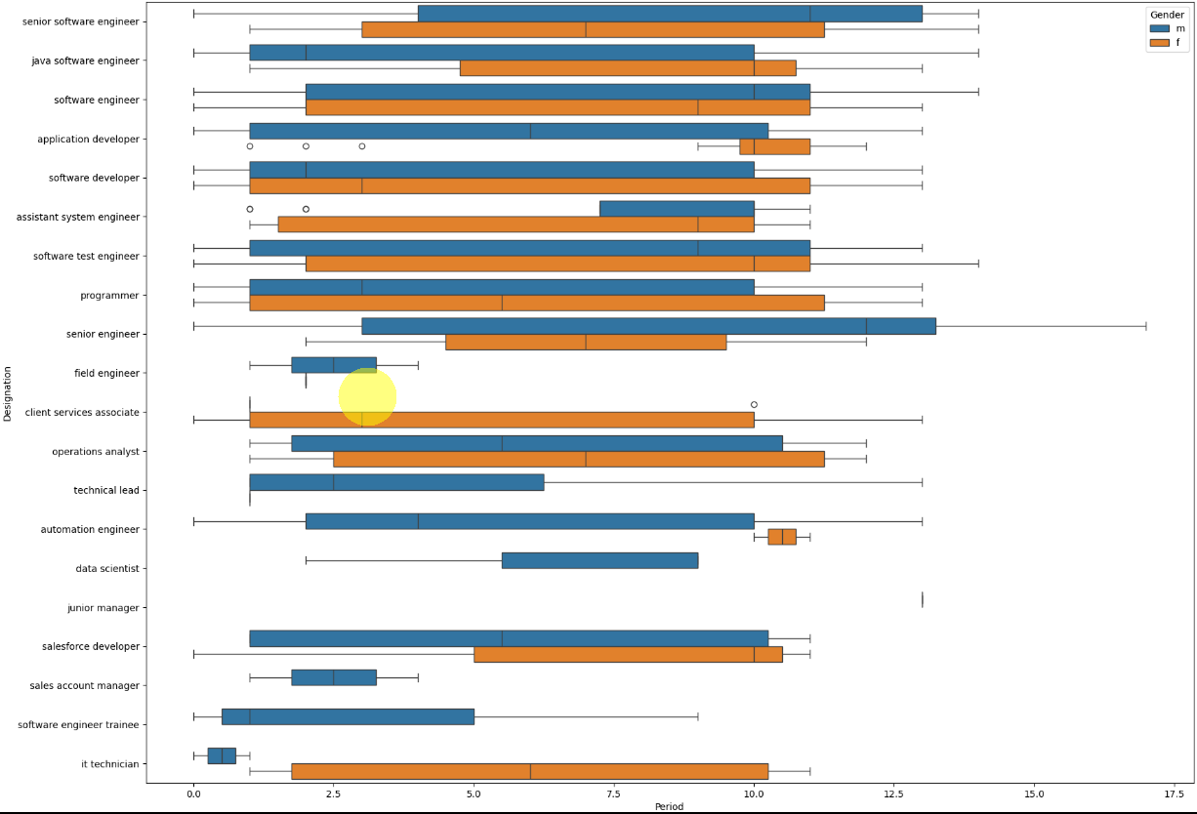
Designation vs Period
The experience distribution across most designations is skewed, indicating that individuals in each designation have a wide range of both high and low experience levels.
There is a noticeable difference in the median experience between males and females across all designations.
However, this alone is not enough evidence to conclude that salary differences between men and women are primarily due to experience.
In some roles, women with more experience are still paid less than men, and the reverse is also true.

Slide 27
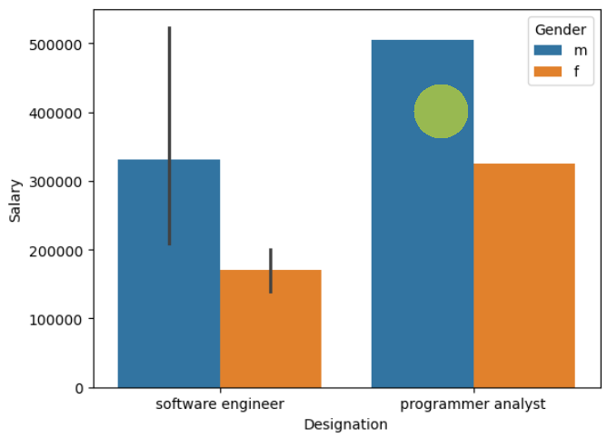
Research Questions
Times of India article dated Jan 18, 2019 states that “After doing your Computer Science Engineering if you take up jobs as a Programming Analyst, Software Engineer, HardwareEngineer and Associate Engineer you can earn up to 2.5-3 lakhs as a fresh graduate.”Test this claim with the data given to you.
After analysing the the data I came to know that the average salary of a fresh graduate is in between 250k to 300k

Slide 28
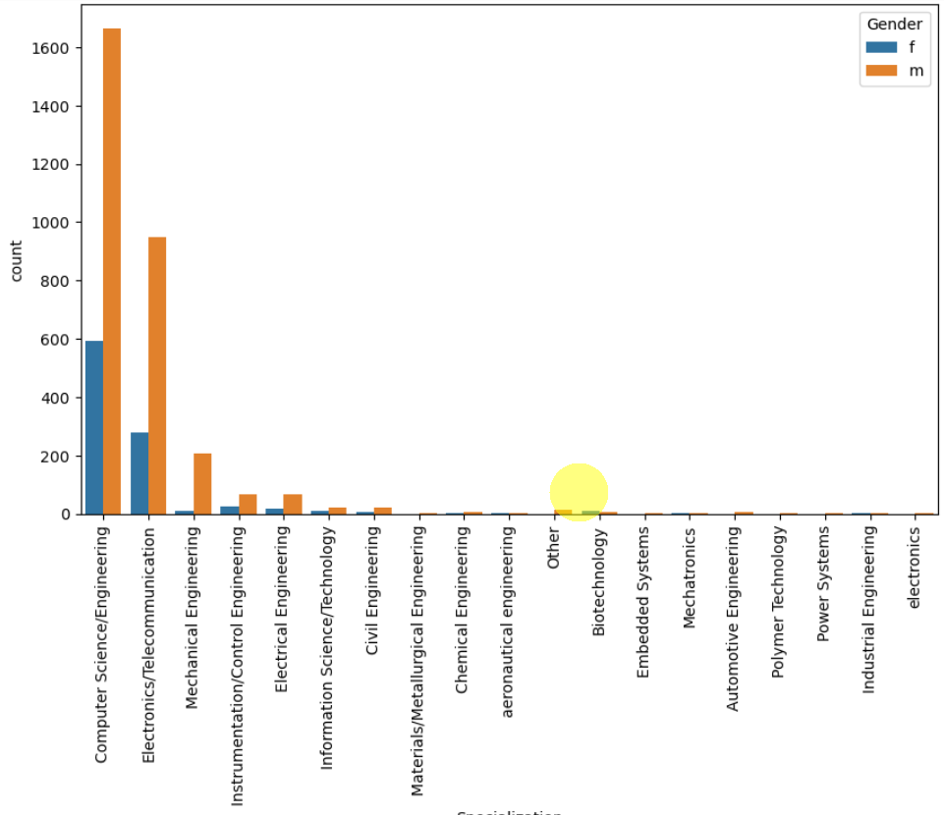
Is there a relationship between gender and specialization? (i.e. Does the preference of Specialisation depend on the Gender?) Selection deleted
After Doing the chi-square test, the claim is true
Gender impacts on specialization

Slide 29
Key Questions to Ask: 1. Which specializations have the most significant gender imbalance in terms of salaries? 2. Are there specializations where female graduates earn salaries comparable to or higher than male graduates? 3. Which specializations show more representation of one gender over the other?
Some roles (e.g., Electrical Engineering) show a higher median salary for women than men, while in many others, men earn more.
In Computer Science/Engineering, men earn slightly more than women, but the difference is relatively small.
In certain specializations (e.g., Automotive Engineering, Polymer Technology, Power Systems, Embedded Systems), salary data is available only for males, showing a gender imbalance.
The most significant salary gaps favor men in fields like Chemical Engineering and Instrumentation/Control Engineering.
However, women earn more in specializations like Electrical Engineering, Mechatronics, and Aeronautical Engineering.
Despite these positive deviations for women, there are still significant gaps in high-paying roles, mostly favoring men.
These specializations show significant salary advantage for women, suggesting that they might excel in these fields despite traditional gender imbalances.
However, these could also be outliers due to smaller sample sizes for women.
Biotechnology is the most female-dominated specialization, with nearly two-thirds of graduates being women.
Mechanical Engineering and Chemical Engineering are male-dominated, with women making up a small percentage of graduates.
Despite fewer women in Mechatronics, they seem to earn significantly more than men in this field, highlighting the potential for gender-based salary inequality even in fields with low female representation.

Slide 30

THANK YOU

