Slide 1

object oriented programming (INheritance) presented By Rachana P [ CAPG48LSRB353 ]

Slide 2
Introduction
Inheritance
Program on inheritance
Types of inheritance in java
.

Slide 3
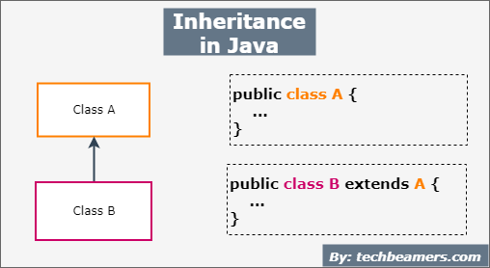
inheritance
Inheritance is one of the key features of OOP that allows us to create a new class from an existing class.
We can reuse the fields and methods of the existing class
Example : child inherits the traits of his/her parents.

Slide 4
inheritance
Inheritance represents the IS-A relationship which is also known as a parent-child relationship.
Why use inheritance?
For Method Overriding
For Code Reusability.

Slide 5
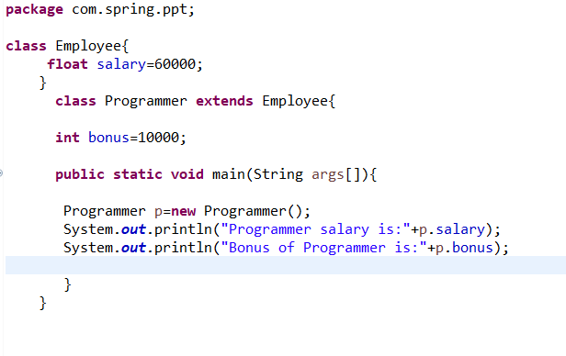
Inheritance program
Employee is the superclass
Programmer is the subclass

Slide 6
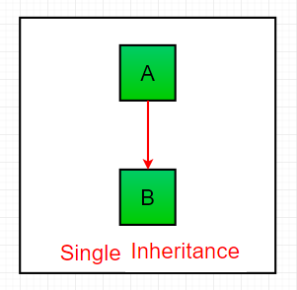
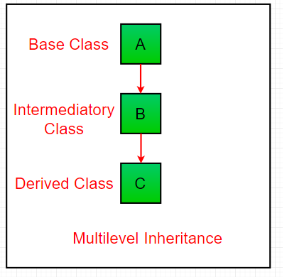
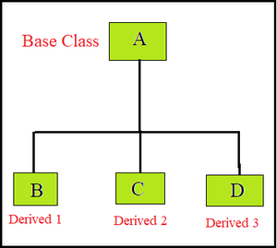
Types of inheritance
1. Single Inheritance: In single inheritance, subclasses inherit the features of one superclass.
2. Multilevel Inheritance: In Multilevel Inheritance, a derived class will be inheriting a base class and as well as the derived class also act as the base class to other class.
3. Hierarchical Inheritance: In Hierarchical Inheritance, one class serves as a superclass (base class) for more than one subclass.

Slide 7
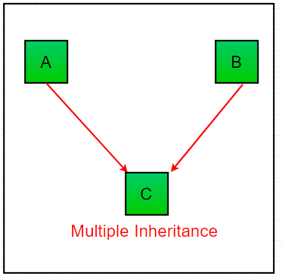
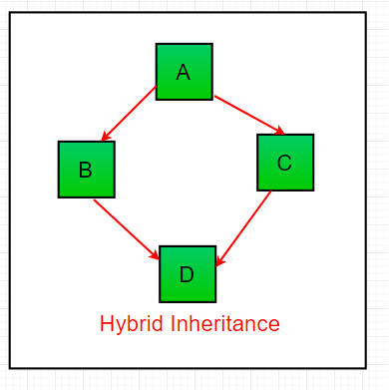
Types of inheritance
4. Multiple Inheritance (Through Interfaces): In Multiple inheritances, one class can have more than one superclass and inherit features from all parent classes. Please note that Java does not support multiple inheritances with classes. In java, we can achieve multiple inheritances only through interfaces.
5. Hybrid Inheritance(Through Interfaces): It is a mix of two or more of the above types of inheritance. Since java doesn’t support multiple inheritances with classes, hybrid inheritance is also not possible with classes. In java, we can achieve hybrid inheritance only through interfaces.

Slide 8
Thank you

