Slide 1

Zepto Product Analytics
SQL-Driven Exploratory Data Analysis for Quick Commerce Optimization
Pranay Sadawarti
Zepto SQL Project | June 2026

Slide 2
Agenda:
Project Objective
Dataset Overview
Data Exploration
Data Cleaning & Transformation
Key Business Insights
Visualizations & Findings
Business Recommendations
Challenges & Learnings
Future Enhancements

Slide 3
Business Problem
Quick commerce platforms like Zepto face challenges in:
Optimizing product pricing & discounts
Managing inventory efficiently
Identifying revenue opportunities
Reducing stockouts on high-value items
Project Goal
Perform comprehensive SQL analysis on Zepto’s product catalog to generate actionable insights that drive revenue growth, better inventory decisions, and pricing strategy.

Slide 4
Dataset Overview
Source: Zepto Inventory Dataset (https://www.kaggle.com/datasets/palvinder2006/zepto-inventory-dataset/data?select=zepto_v2.csv)
Total Records: ~3,000+ SKUs
Columns: 10 (sku_id, category, name, mrp, discountPercent, discountedSellingPrice, weightInGms, availableQuantity, outOfStock, quantity)
Granularity: SKU Level
Key Features: Pricing, Inventory, Stock Status, Product Weight & Category
Business Value: Rich dataset to understand pricing, discount effectiveness & inventory health.

Slide 5
Data Exploration
Key Findings:
Total Products Analyzed: [Run SELECT COUNT(*)]
Unique Categories: [Run SELECT COUNT(DISTINCT category)]
Stock Status: In-stock vs Out-of-Stock distribution
Multiple SKUs with same product name (duplicate naming issue)
Price Range: MRP & Discounted Selling Price variation

Slide 6
Data Cleaning & Transformation
Cleaning Steps Performed:
Removed records with MRP = 0 (invalid entries)
Converted price from Paise to Rupees (/100)
Validated NULL values across critical columns
Ensured data consistency and quality

Slide 7
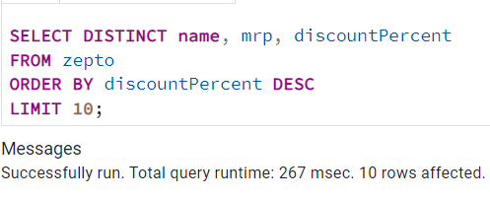
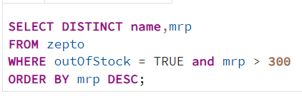
Top Discount Offers
Business Question: Which products are giving the highest discounts?
SQL Used:
High MRP Out-of-Stock Products
Business Question: Which high-value products are out of stock?
SQL Used:
Finding: Top 10 products with maximum discount percentage identified.
Action: Focus marketing & promotion on these high-discount items to drive volume sales.
Finding: Several high MRP products (> ₹300) are currently out of stock.
Business Impact: Potential revenue loss. Priority restocking recommended.

Slide 8
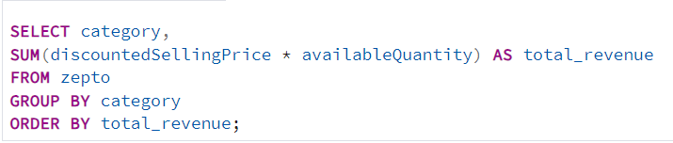
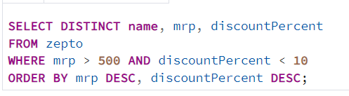
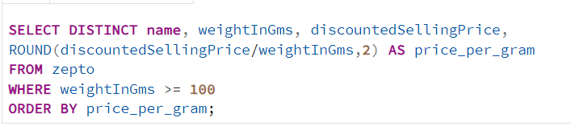
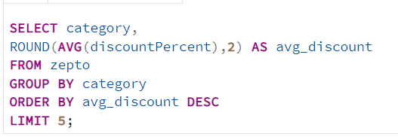
Category Performance
Business Question: Estimated Revenue for each category?
SQL Used:
Pricing Efficiency
High MRP + Low Discount Products:
SQL Used:
Top Categories by Average Discount
Business Question: Which high-value products are out of stock?
SQL Used:
Best Value Products (Price per Gram)
SQL Used:

Slide 9
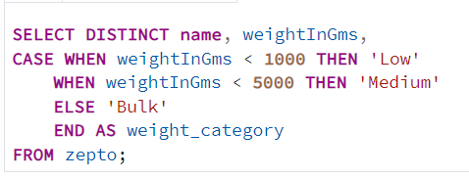
Inventory Weight Analysis
Total Inventory Weight by Category
SQL Used:
Weight Categorization:
Low (< 1kg)
Medium (1kg - 5kg)
Bulk (> 5kg)
Use Case: Logistics & delivery cost optimization.

Slide 10
Business Recommendations
Restock high MRP out-of-stock products immediately
Aggressive promotion on top discount items
Optimize pricing for high MRP + low discount products
Category-focused strategy based on revenue & discount performance
Improve inventory planning using weight analysis
Expected Impact: Higher revenue, lower stockouts, better customer satisfaction

Slide 11
Challenges & Learnings
Challenges:
Prices stored in paise → conversion required
Duplicate product names across SKUs
Limited features (no time-series/sales data)
Learnings:
Business context is crucial while writing SQL
Data quality directly impacts insight quality
Always think from stakeholder perspective

Slide 12
Thank You

