Slide 1

Cloud Computing- 2

Slide 2
AWS Global Infrastructure

Slide 3
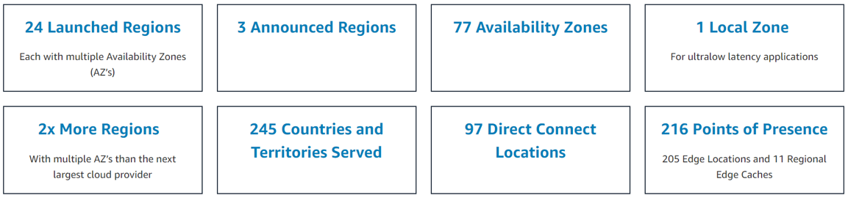
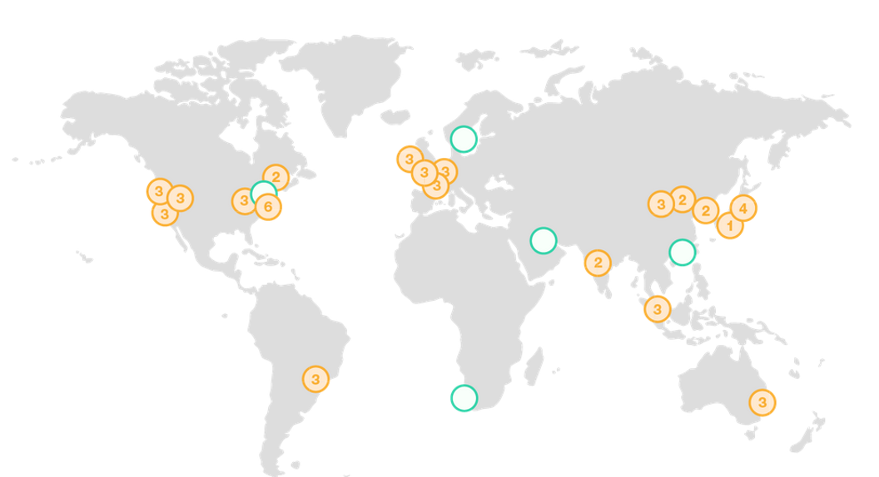

Slide 4
AWS EC2 Elastic Cloud Compute

Slide 5

What?
Amazon Elastic Compute Cloud, EC2 is a web service from Amazon that provides
re-sizable compute services in the cloud. They are re-sizable because you can
quickly scale up or scale down the number of server instances you are
using if your computing requirements change.
• Amazon EC2 provides scalable virtual servers in the cloud.
• An EC2 virtual server is known as an "instance" and can be made up of different instance types and sizes.
• The virtual servers can run different operating systems but most commonly run a flavor of Linux or Windows.

Slide 6
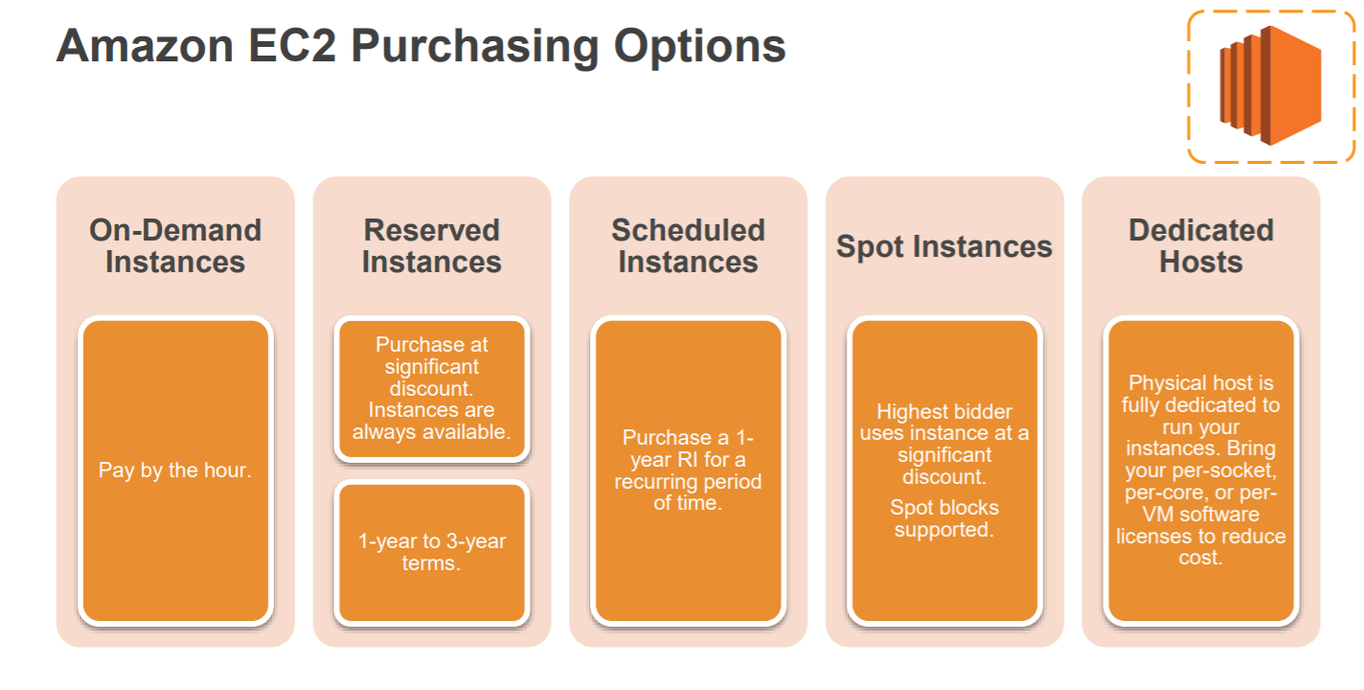

Slide 7
Launching an Amazon EC2 Instance via the Web
Console
1. Determine the AWS Region in which you want to launch the
Amazon EC2 instance.
2. Launch an Amazon EC2 instance from a pre-configured
Amazon Machine Image (AMI).
3. Choose an instance type based on CPU, memory, storage,
and network requirements.
4. Configure network, IP address, security groups, storage
volume, tags, and key pair.

Slide 8
Connect to Ec2 instance
PEM to PPK using puttyGen
Using putty connect to ec2 with hostname
SSH>> AUTH>> Browse– OPEN
Login as:ec2-user

Slide 9
Lets create an instance

Slide 10
TO-DO
Create instances and connect from your local machines
Read about EC2

Slide 11
Next
S3 - Simple Storage Service

Slide 12
Thank You!!

