Slide 1

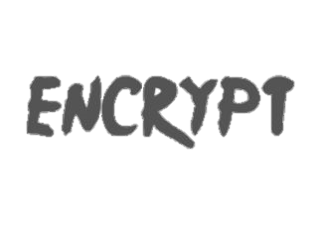

NGO CONTACT MANAGEMENT

Slide 2
Team and Roles
SRIPADA PRANAY(TL)
AKSHAT SONI
DRUVA KUMAR
GANDLA SRAVYA
SAI PRANEETH
:
:
:
:
:
QA TEAM , SCRUM MASTER
DEV TEAM
BA TEAM
BA TEAM
DEV TEAM

Slide 3
About Project
Our Project title is “NGO CONTACT MANAGEMENT”
It is a simple GUI based project which is very easy to understand and use.
The system, it contains all the required functions which include:
Adding, Viewing, Deleting and Updating lists.
While adding the details of a person, he/she has to provide first name, last name, gender, address and contact details.
The user can also update the list if he/she wants to.
The system shows the contact details in a list view. And also the user easily delete any contact details.

Slide 4
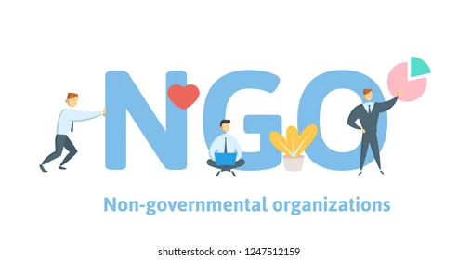
Key Takeaways from Project Brief
Any one can view and the data in the site and easy to use.
Data can be update or delete are done properly

Slide 5
User Stories
In older days we stored all our important details in books and papers.
Here we proposed a new system using this application we can store all the details .
In manual method if we forget information book then it very difficult to get the details .
So that we are storing the data in the system.

Slide 6
User Tasks(In order after prioritizing)
To create a particular record user must enter the first name, last name, gender, address and contact details.
After entered all the above information the particular person record will be created.
Any one can be accessed from the webpage.
We can update the particular record and delete the record also.

Slide 7
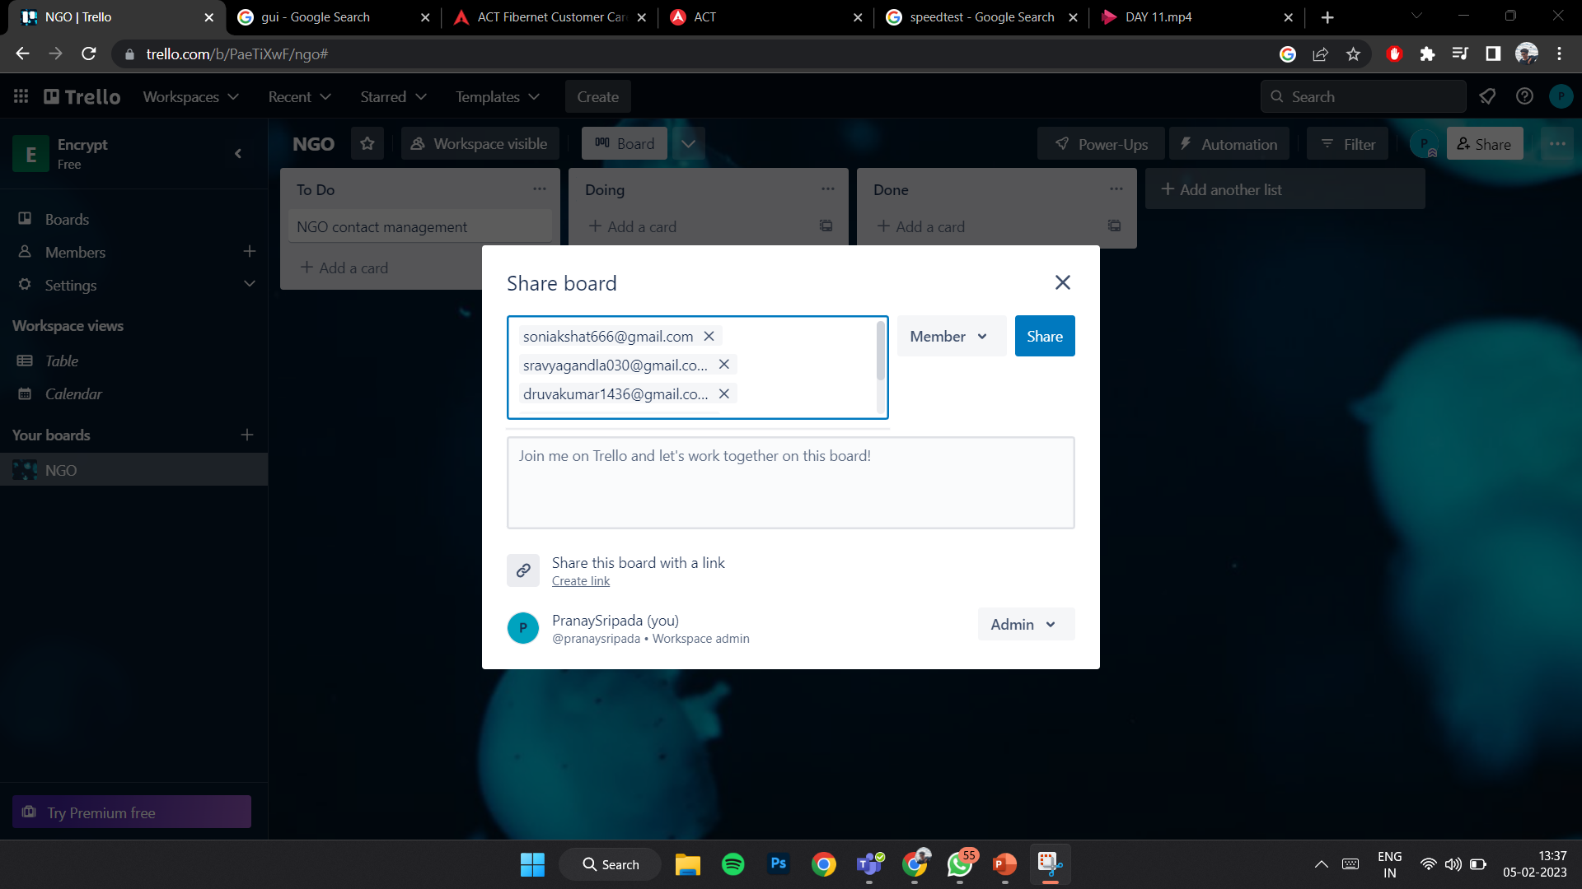
Trello(Scrum Master)

Slide 8
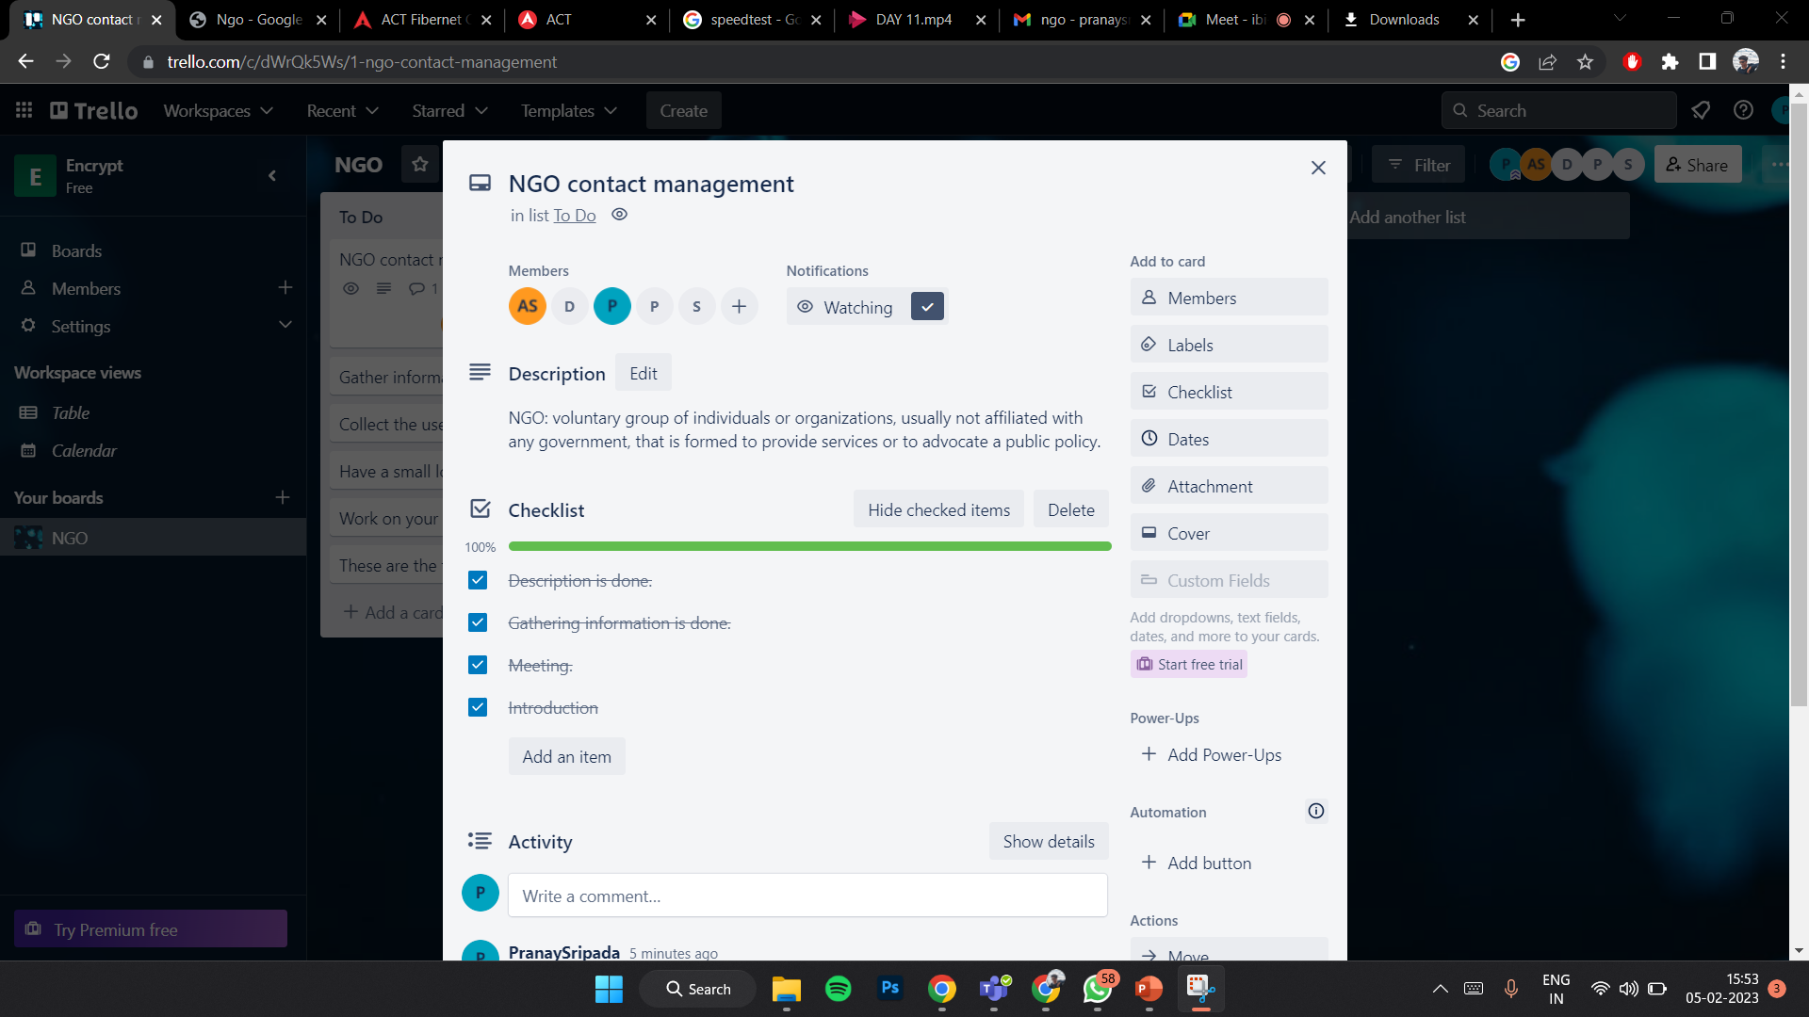
Trello

Slide 9
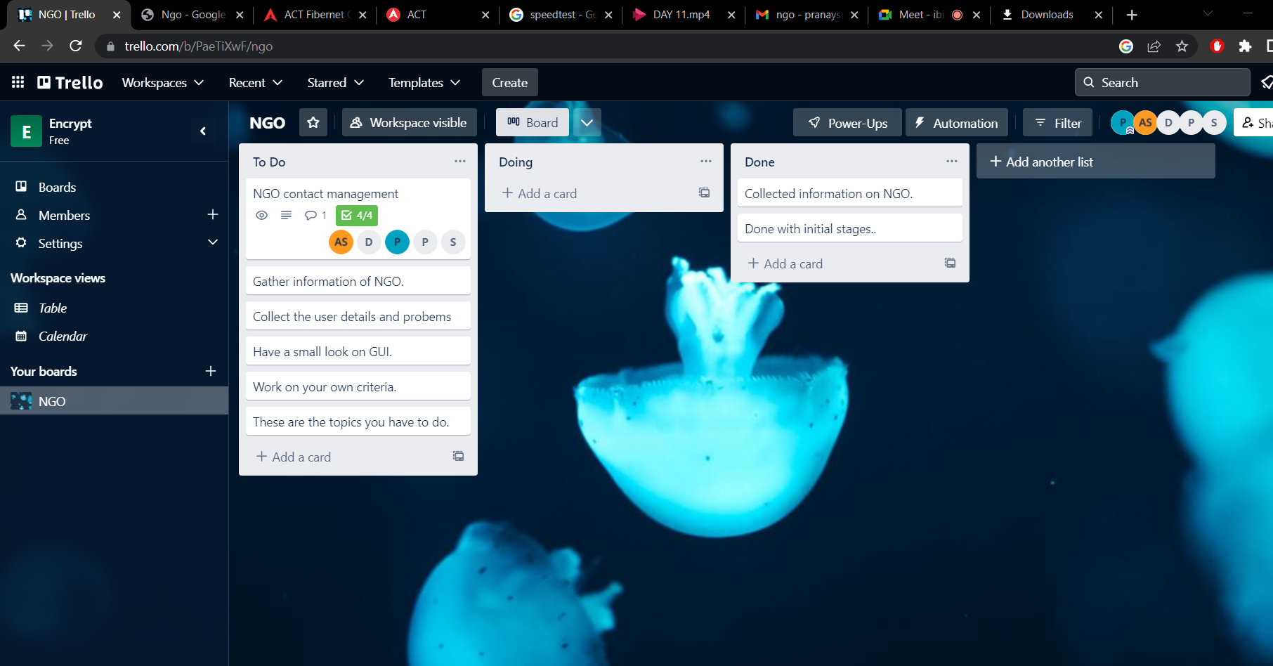
Trello

Slide 10
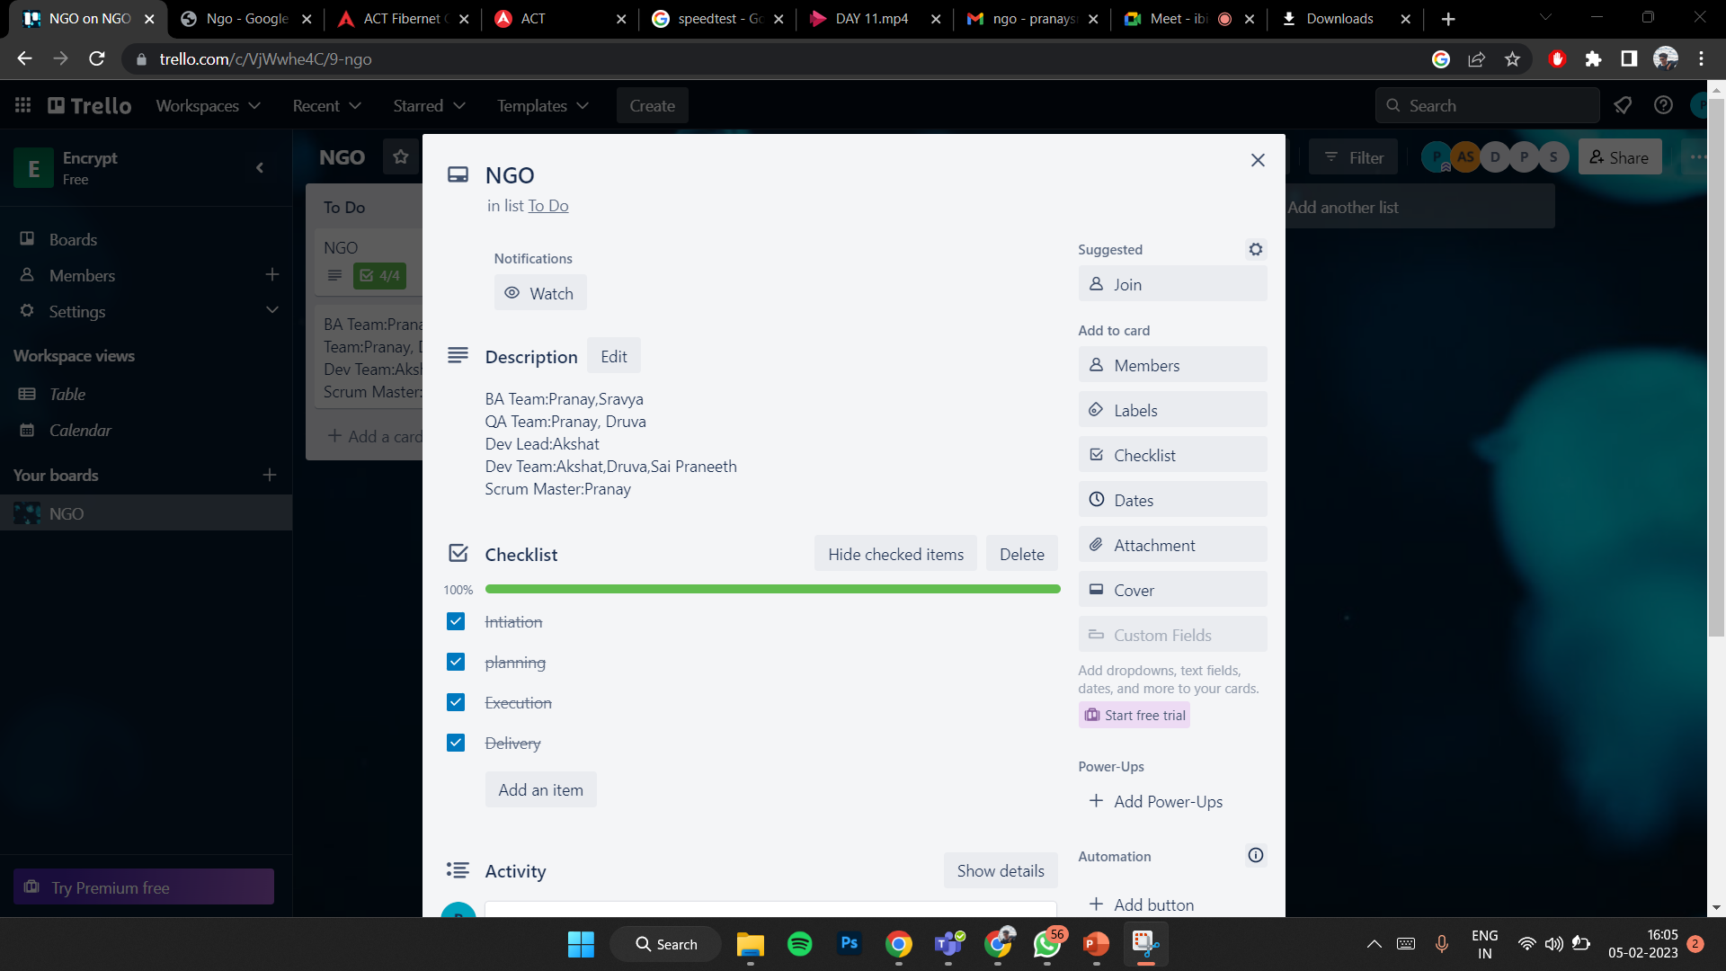
Trello

Slide 11
Implementation
Databases were used in our project for storing, maintaining and accessing any sort of data. They collect information of NGO’s. That information is gathered in one place so that it can be observed and analyzed. IT can be used as an organized collection of information.
SQLite is a library that provides a lightweight disk-based database that doesn’t require a separate server process and allows accessing the database using a nonstandard variant of the SQL query language.
The Python GUI Project or PyGUI framework, is a simple API for developers to create user interfaces using native elements for Python applications. As a lightweight API, not a lot of code is needed between the app and the target platform, making it far more efficient than many of the other frameworks on this list.

Slide 12
Testing
The first test case is we have checked whether the interface is formed properly or not.
The second test case was to see whether our interface or framework is ready to accept all the input or not.
The third test case was to see whether an error is generated or not when all the details are not filled.
The fourth test case was to check whether data given is displayed on the database or not.
The fifth test case was to check whether the data base is able to store the given data.
The sixth test case was to check whether we can able to access the data from the database.

Slide 13
Project Demo
At first when we run the code we can able to see an interface.
The interface is user friendly, people could understand just by seeing at it. The interface is to get the information or contact details of NGO
It asks for our name, phone number and address We must enter all our details or else an error is generated.
After entering all the details when we click on submit, all the contact details of NGO are stored in database.
From now all can be able access the contact details stored in the database.

Slide 14
Retrospective Meet
We enjoyed doing this project by using databases and sql concept we struggled to create an interface using GUI.
The operations in the NGO contact management are performed properly.

Slide 15
Thank you

