Slide 1


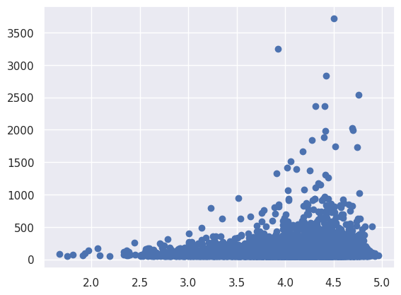

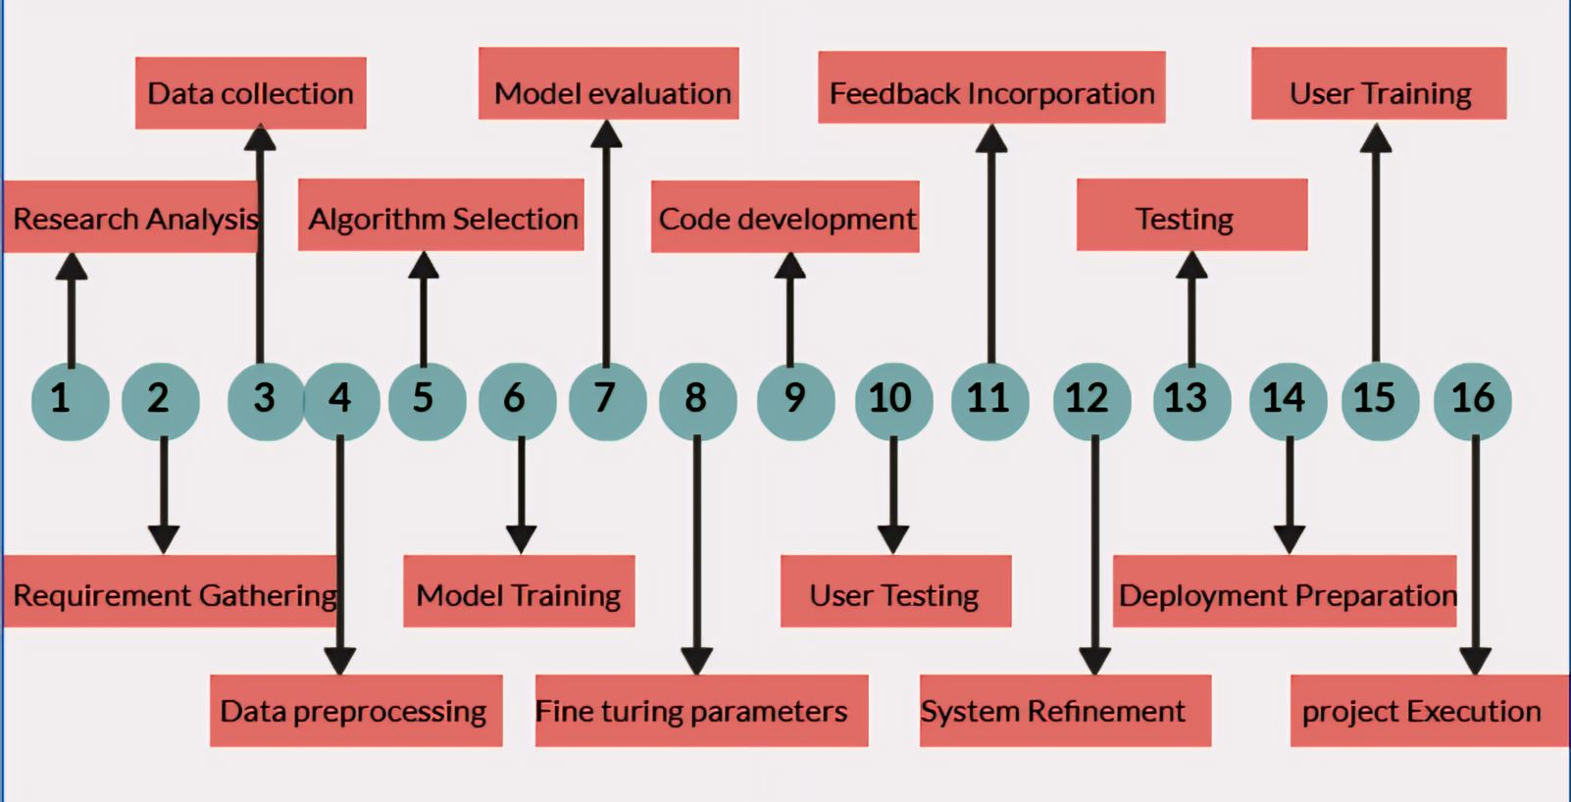
E-COMMERCE RECOMMENDATION SYSTEM
2103A52070-T.SRIRAM, 2103A52167-P.HARSHINI, 2103A52148-K.SANJAY SIDDARTHA,
2103A52170-S.PRANAY, 2103A52039-V.AKSHAY KUMAR
Under the guidance of
Dr. Mohammed Ali shaik
ABSTRACT
Unlocking the potential of e-commerce user activity logs, our project employs clustering and correlation analysis to extract invaluable insights from purchase-rich data. By harnessing these techniques, we aim to revolutionize product recommendations, driving sales growth and enhancing user experience.
INTRODUCTION
METHODOLOGY
RESULTS
CONCLUSION
In the dynamic landscape of e-commerce, understanding user behavior and delivering personalized recommendations are paramount for success. Our project delves into this realm, focusing on leveraging user activity logs to enhance the recommendation system. By extracting valuable insights from purchase-rich data through clustering and correlation analysis,.
The implemented solution successfully integrated collaborative filtering, clustering, and boosting algorithms into the e-commerce recommendation system. Evaluation metrics such as precision, recall, and RMSE demonstrated significant improvements in recommendation accuracy compared to baseline approaches.
Through the integration of collaborative filtering, clustering, and ensemble learning techniques, our project has developed a robust e-commerce recommendation system. By analyzing user activity logs, we've gained insights into user preferences, enabling more accurate and personalized recommendations. The segmentation of users using clustering has further enhanced the relevance of suggestions. Additionally, the incorporation of ensemble learning methods like XGBoost and AdaBoost has improved the predictive capabilities of our models.
Our approach encompasses collaborative filtering to understand user preferences, clustering to group similar user data, and ensemble learning techniques such as XG Boost and AdaBoost for robust recommendation model development. By integrating these methods, we aim to harness the power of diverse algorithms to enhance the accuracy and effectiveness of our e-commerce recommendation system. This multi-faceted methodology integrates diverse techniques to optimize the e-commerce recommendation system effectively.
WEEK WISE DEVELOPMENT

