Slide 1


SmartHive
John Bellarmine G A, INT/III
Hemanath B, INT/III
Pranay V, ECE/III
Ref. No: INC25ETN095130
Mentors:
Ms. Saktheeswari R M.E., AP/INT
Institute:
Sri Venkateswara College of Engineering, Sriperumbudur
Date: 18/08/2025

Slide 2
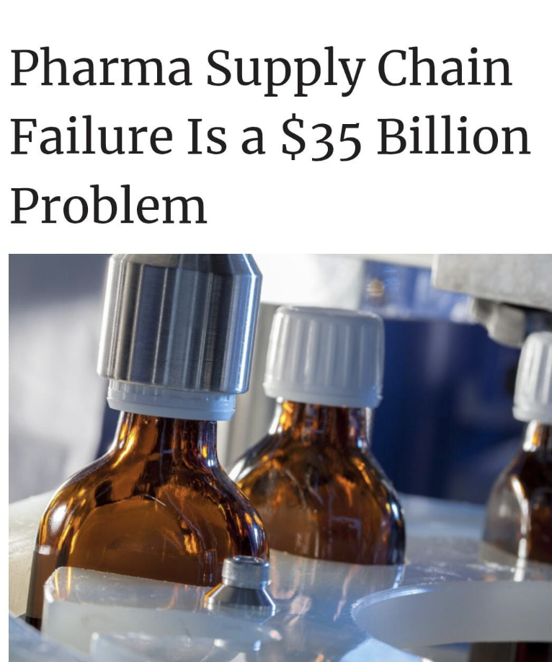

Market Pain
Pain Point: Failures in temperature-controlled logistics within the pharmaceutical supply chain.
Problem: Annual losses of $35 billion due to spoilage, inefficiencies, and lack of real-time monitoring.
Scale: This is a global issue, with particularly high impact in regions like India where pharma exports are critical.
Who is Affected:
  Pharmaceutical companies (lost revenue, compliance risks)
  Healthcare providers & patients (delayed/ineffective medicines)
  Logistics partners (reputational and financial loss)
Core Insight: Losses are largely preventable if the cold chain is made smarter, digital, and agile.
Source: www.supplychainbrain.com
18/08/2025
SmartHive

Slide 3
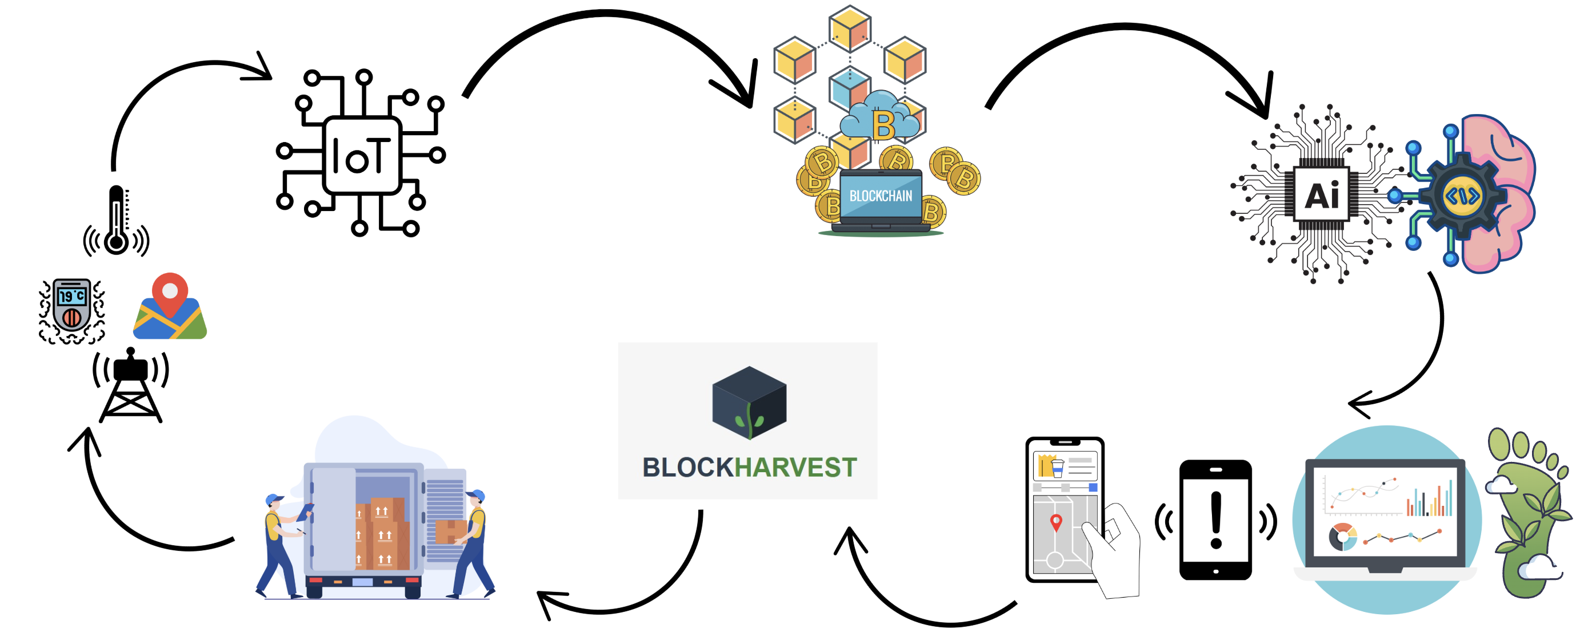
Technology/Process Solution
SmartHive
Unique / Innovative
First-of-its-kind blend: IoT + Blockchain + AI/ML for trusted, intelligent, and sustainable cold-chain monitoring.
Predictive intelligence: ML models don’t just monitor — they forecast failures and optimize supply-chain decisions.
Green supply chain: Tracks and minimizes carbon & toxin footprints → aligns with ESG & sustainability goals.
How it’s Different
Existing systems only monitor & report.
Our solution predicts, automates, and verifies in real-time, while ensuring data integrity.
Adds a sustainability layer by measuring and reducing carbon emissions, making pharmaceutical logistics both resilient and eco-friendly.
18/08/2025
SmartHive

Slide 4
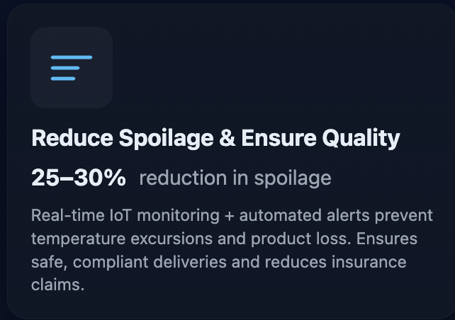
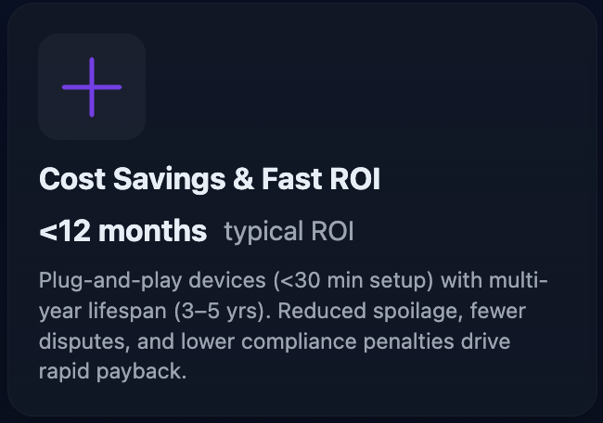
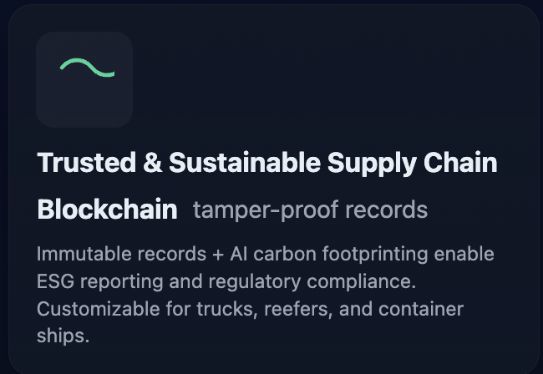
Value Proposition
18/08/2025
SmartHive

Slide 5
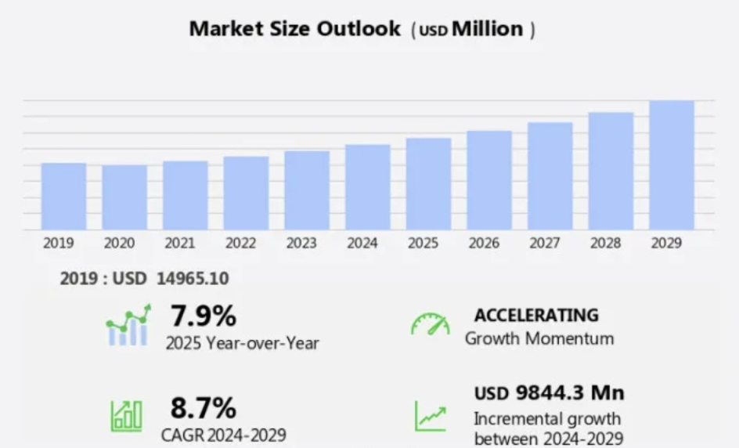
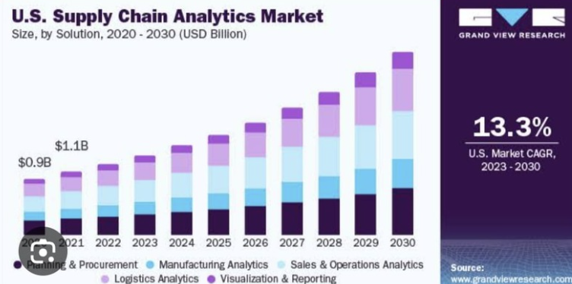
Market
IN 2030
WORLD: $2.8B
USA: $9.84B
Source: www.grandviewresearch.com
Target Beachhead Market (Pilot)
Pharmaceutical supply chains in India & Southeast Asia – high sensitivity to spoilage, compliance, and counterfeit issues.
Focus on temperature-sensitive drugs and vaccines where monitoring is critical.
Target Customers
Pharmaceutical manufacturers, distributors, and cold chain logistics providers.
Hospitals & government health departments requiring regulatory compliance + sustainability reporting (carbon footprint, ESG).
Scalability
Start with Pharma sector pilot → Expand to Perishable food chains (dairy, seafood, fruits, vegetables) → Scale globally across logistics, retail, and FMCG industries.
SaaS-based dashboard + blockchain backend makes the solution highly adaptable to multiple industries.
18/08/2025
SmartHive

Slide 6
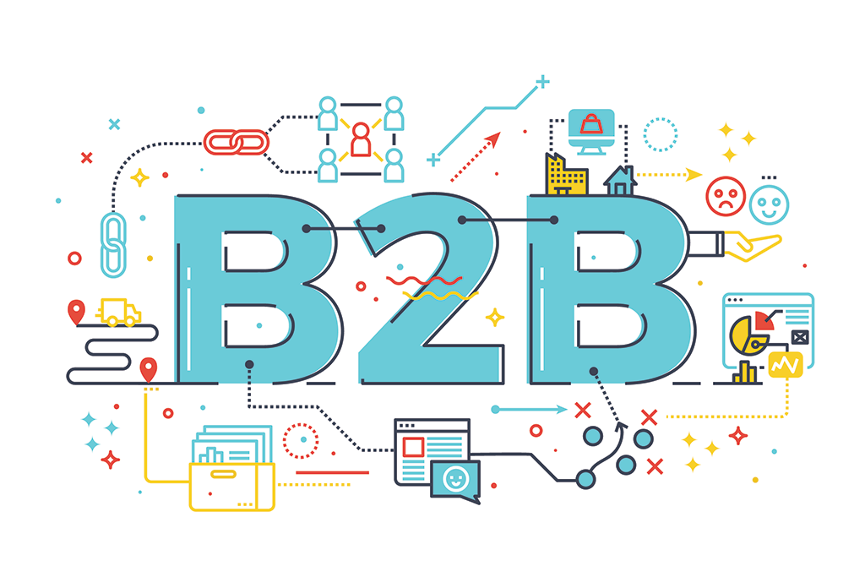



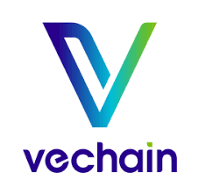


Channels (Marketing)
Customer Reach (Cost-Effective Channels)
Leverage existing business networks & industry partnerships to directly connect with pharma supply chains.
Use online platforms and supply chain consortiums to expand reach efficiently.
Marketing Strategy
Thought leadership & trust building through sustainability/ESG case studies.
Targeted digital campaigns (LinkedIn, industry blogs, whitepapers).
Word-of-mouth referrals & pilot showcases to build credibility.
Mass awareness via TV ads, webinars, and conferences on pharma & logistics innovation.
Scalability of Marketing
Start with regional partnerships + pilot campaigns.
Scale via global partnerships & co-marketing with industry leaders.
18/08/2025
SmartHive

Slide 7
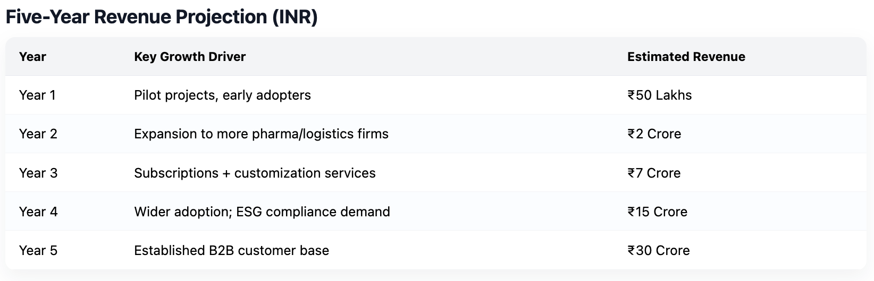
Revenue Model
Primary Revenue Streams
Subscription Model: Companies pay a monthly/annual fee for access to the Smart Hive platform (IoT + Blockchain + AI).
Customization Services: Additional charges for tailored solutions to match individual supply chain needs.
Data & Analytics as a Service: Revenue from providing predictive insights, ESG reporting, and carbon footprint analysis.
Hardware Integration Fees: One-time or recurring fees for setting up sensors, IoT devices, and integrations.
Partnership Ecosystem Revenue: Co-marketing and joint solutions with AWS, IBM, Siemens, DHL, etc.
Social & Environmental Impact (with Revenue)
By promoting sustainable supply chains through carbon footprint tracking, Smart Hive helps companies achieve ESG goals while generating revenue.
Customers reduce wastage, spoilage, and fraud, creating both cost savings and positive climate impact.
18/08/2025
SmartHive

Slide 8
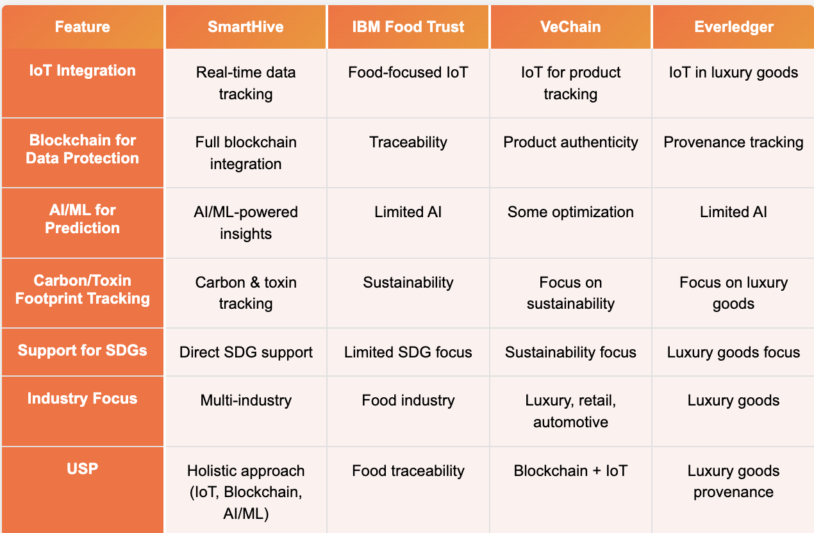



COMPETITORS
18/08/2025

Slide 9
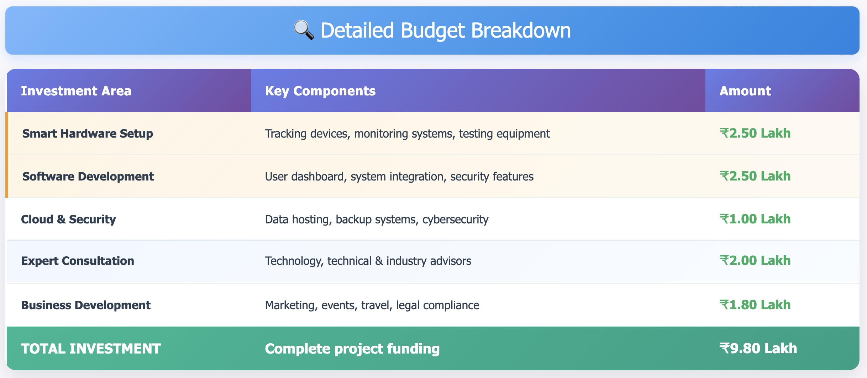
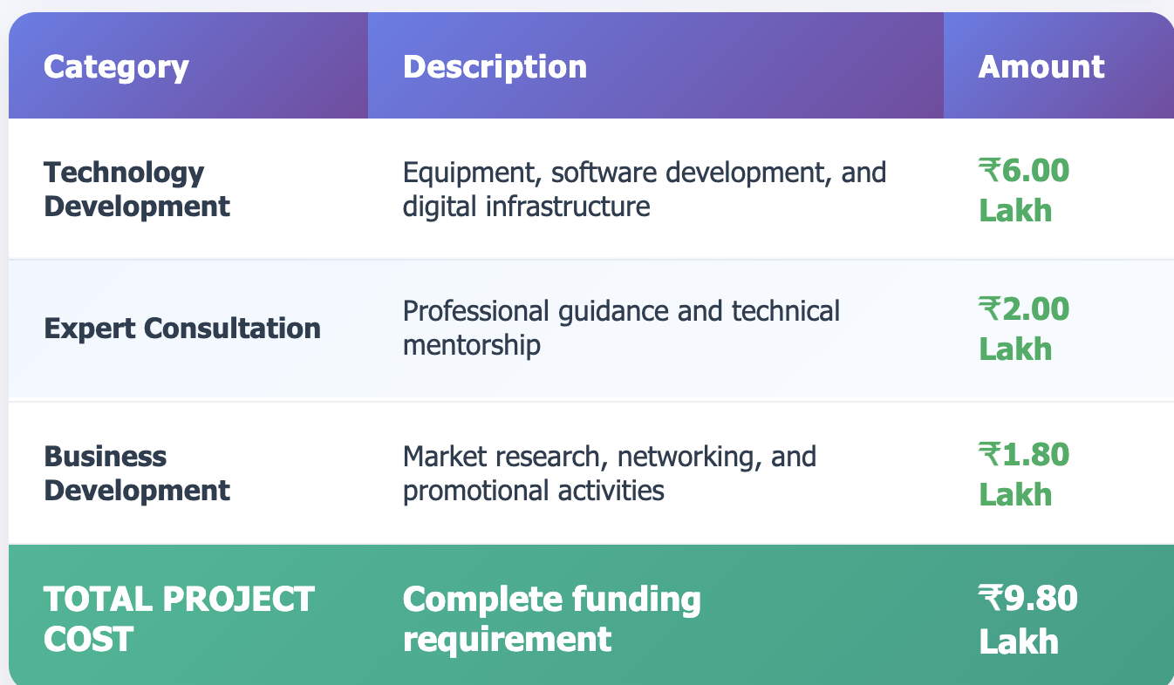
MSME funding break down
18/08/2025
SmartHive

Slide 10

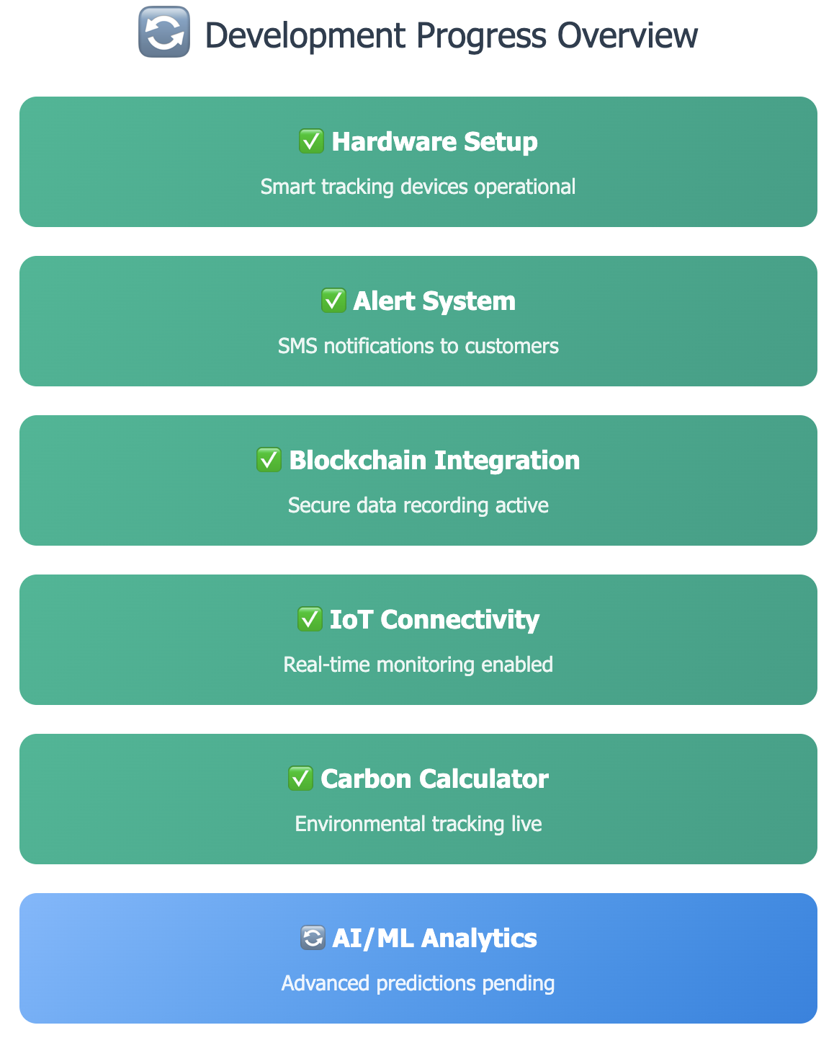
Current Development Status of Innovation
Prototype Objectives
Validate core tracking functionality
Test blockchain data integrity
Measure system reliability & accuracy
Gather user feedback for improvements
Optimize power consumption & costs
Development Timeline Breakdown
Phase 1 (Months 1-3): Core Enhancement - Optimize performance & security
Phase 2 (Months 4-7): AI/ML Integration - Predictive analytics & intelligent alerts
Phase 3 (Months 8-10): Testing & Validation - Field testing & certifications
Phase 4 (Months 11-12): Market Launch - Production scaling & customer onboarding
18/08/2025
SmartHive

