Slide 1
Final assessment excel
LVADSUSR176

Slide 2
Task 1
work-completion | Yes
Average of lead time
28.01631702

Slide 3
Task 2
Rush | Yes
Row Labels | Count of Rush
Northwest | 45
Central | 17
Southeast | 13
North | 10
West | 5
East | 4
South | 4
Southwest | 3
Northeast | 2
Grand Total | 103
Northwest district has highest rush jobs

Slide 4
Task 3
Row Labels | Average of LbrHrs
No | 0.792267366
Yes | 0.586842105
The non rush jobs have higher labour hours on average

Slide 5
Task 4
Count of Payment | Payment mode
Service | Account | C.O.D. | Credit | P.O. | Warranty | Grand Total
Assess | 43.73% | 36.36% | 0.49% | 16.22% | 3.19% | 100.00%
Deliver | 52.63% | 31.58% | 0.00% | 10.53% | 5.26% | 100.00%
Install | 38.10% | 39.68% | 0.00% | 14.29% | 7.94% | 100.00%
Repair | 27.91% | 59.30% | 1.16% | 6.98% | 4.65% | 100.00%
Replace | 45.28% | 38.19% | 0.79% | 12.20% | 3.54% | 100.00%
Grand Total | 44.10% | 38.10% | 0.50% | 13.20% | 4.10% | 100.00%
Most service types prefer account followed cod mode of payment, repair service prefers COD over account by a significant margin.

Slide 6
Task 5
Over time the use of cash on delivery has increased significantly.
Account transfer usage has also increased over time.
P.O has not had any increase in usage
Recently credit and warranty usage has begun.

Slide 7
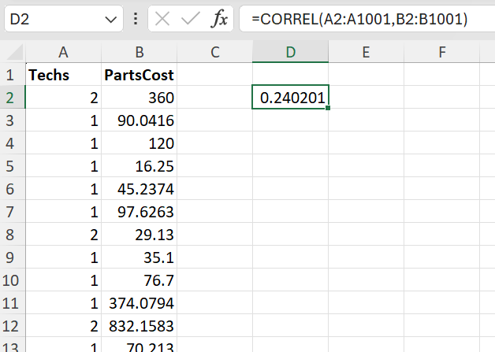
Task 6
FORMULA:
=CORREL(A2:A1001,B2:B1001)
We get 0.24 as correlation which implies a mild positive relation between the two variables.

Slide 8
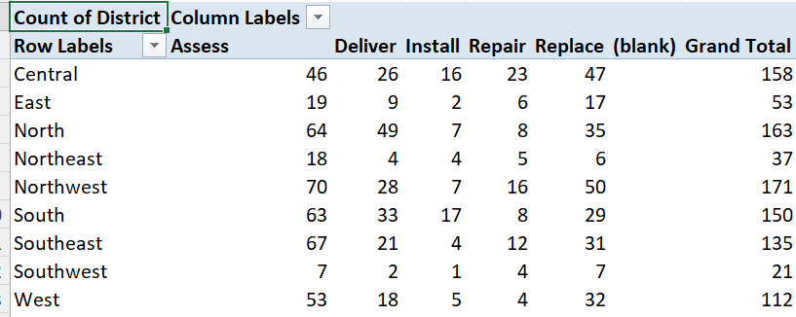
Task 7
The most common service across all regions is ASSESS SERVICE

Slide 9
Task 8
WtyLbr | No
Row Labels | Count of Payment
Account | 441
C.O.D. | 381
Credit | 5
P.O. | 132
WtyLbr | Yes
Row Labels | Count of Payment
Warranty | 41
If warranty of labour is available then the only mode of payment is warranty.

Slide 10
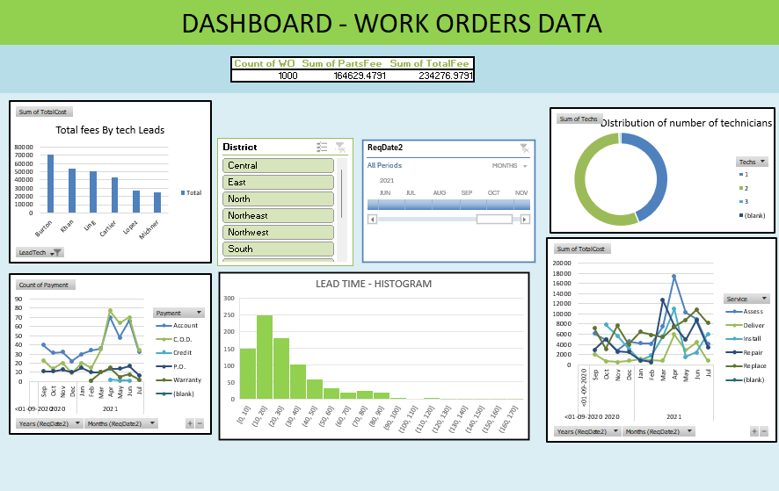

Slide 11
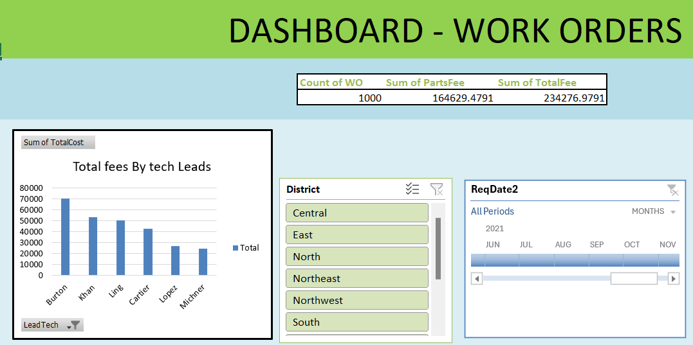

Slide 12
