Slide 1

Gokaraju Rangaraju Institute of Engineering and Technology (Autonomous) Department of Artificial Intelligence and Machine Learning
Study Hub
Presented by:
1.Pranayaa Mansani (23241A6140)
2.Ashitha Praisy Aluri (23241A6109)
3.Ananya Emani (23241A6105)
Under the Guidance of:
Ms.A.Samatha

Slide 2
Recap of Project
Brief summary
Study Hub is a web-based platform tailored for tech journey beginners, designed to simplify their academic and learning experience. It offers essential tools like curated tech resources, task management, and a smart calendar, helping users stay organized and focused. With Study Hub, beginners can easily access relevant learning materials, manage assignments, and track their progress in one place. The platform’s user-friendly interface makes it an ideal solution for anyone starting their tech journey, ensuring they stay on track and motivated as they develop their skills.

Slide 3
Problem Statement
Beginners in the tech field often struggle to find reliable learning resources, manage their study tasks, and stay consistent in their learning journey. Existing tools are either fragmented, overly complex, or not tailored to beginners, making it difficult for them to stay organized and motivated. There is a need for an all-in-one, beginner-friendly platform that offers curated learning materials, task tracking, and schedule management to help tech learners build strong foundations and progress with confidence.

Slide 4
Existing solutions lack a unified platform that integrates study resources, task management, and personalized learning support.
It helps students stay organized, improves productivity, and enhances learning outcomes.
Addresses the gap between study resources and efficient task management.
A well-structured, AI-powered study assistant can significantly reduce student stress and improve academic performance.
Current Challenges: | Proposed Solution:
Google Calendar helps with reminders but lacks educational content. No platform offers a fully integrated system combining study resources, task tracking, and personalized AI assistance. | A single platform combining task organization, academic resources, chatbot assistance, and collaborative study rooms.

Slide 5
Objectives
To create a unified digital workspace for students that enhances academic productivity and collaboration using modern web technologies.
Primary Objective:
Develop a student-focused website that integrates study materials, task management, calendar reminders, and a collaborative study environment.
Sub-objectives:
Provide Study Resources – Offer categorized materials like notes, videos, quizzes, and interactive learning tools.
Task & Time Management – Implement a calendar with reminders, to-do lists, and scheduling features.

Slide 6
Expected Outcomes
Improved Learning Efficiency Beginners can easily access structured, beginner-friendly tech resources, reducing time spent searching for reliable content.
Better Task Organization Users will manage assignments, goals, and daily study tasks more effectively through built-in task and schedule management tools.
Increased Learning Consistency The calendar and progress tracking features will help students stay consistent and committed to their tech learning journey.
Higher Engagement and Motivation A streamlined, beginner-focused interface and milestone-based tracking will boost motivation and reduce learning fatigue.
Stronger Tech Foundations By following a guided, organized approach, users will build stronger fundamental skills in tech, preparing them for more advanced topics.

Slide 7
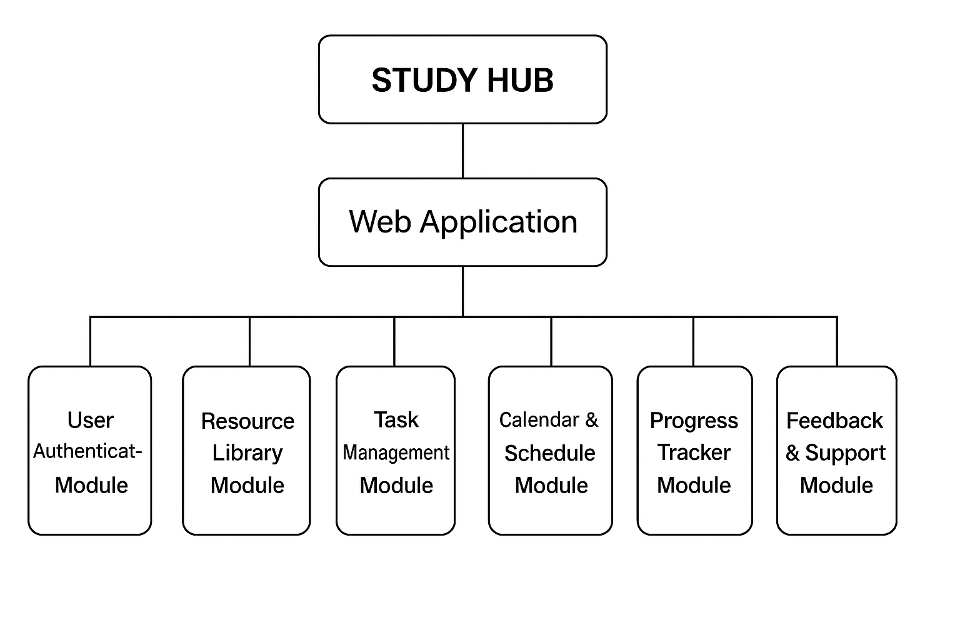
Architecture Diagram

Slide 8
Modules
Modules Overview:
Resource Library Module
Provides curated learning materials specifically for tech beginners.
Features: Categorized tech resources (e.g., HTML, Python), filtering by topic or difficulty, bookmarks.
Task Management Module
Helps users create, track, and manage study tasks or goals.
Features: To-do lists, progress tracking, task priorities, reminders.
Calendar & Schedule Module
Enables users to plan and visualize their study timeline.
Features: Daily/weekly/monthly views, event reminders, deadline tracking.
Progress Tracker Module
Tracks user progress across resources and tasks.
Features: Completion status, badges/achievements, visual progress bars.
Feedback & Support Module
Offers help and gathers user feedback to improve the platform.
Features: FAQs, chat support/contact form, feedback submission.

Slide 9
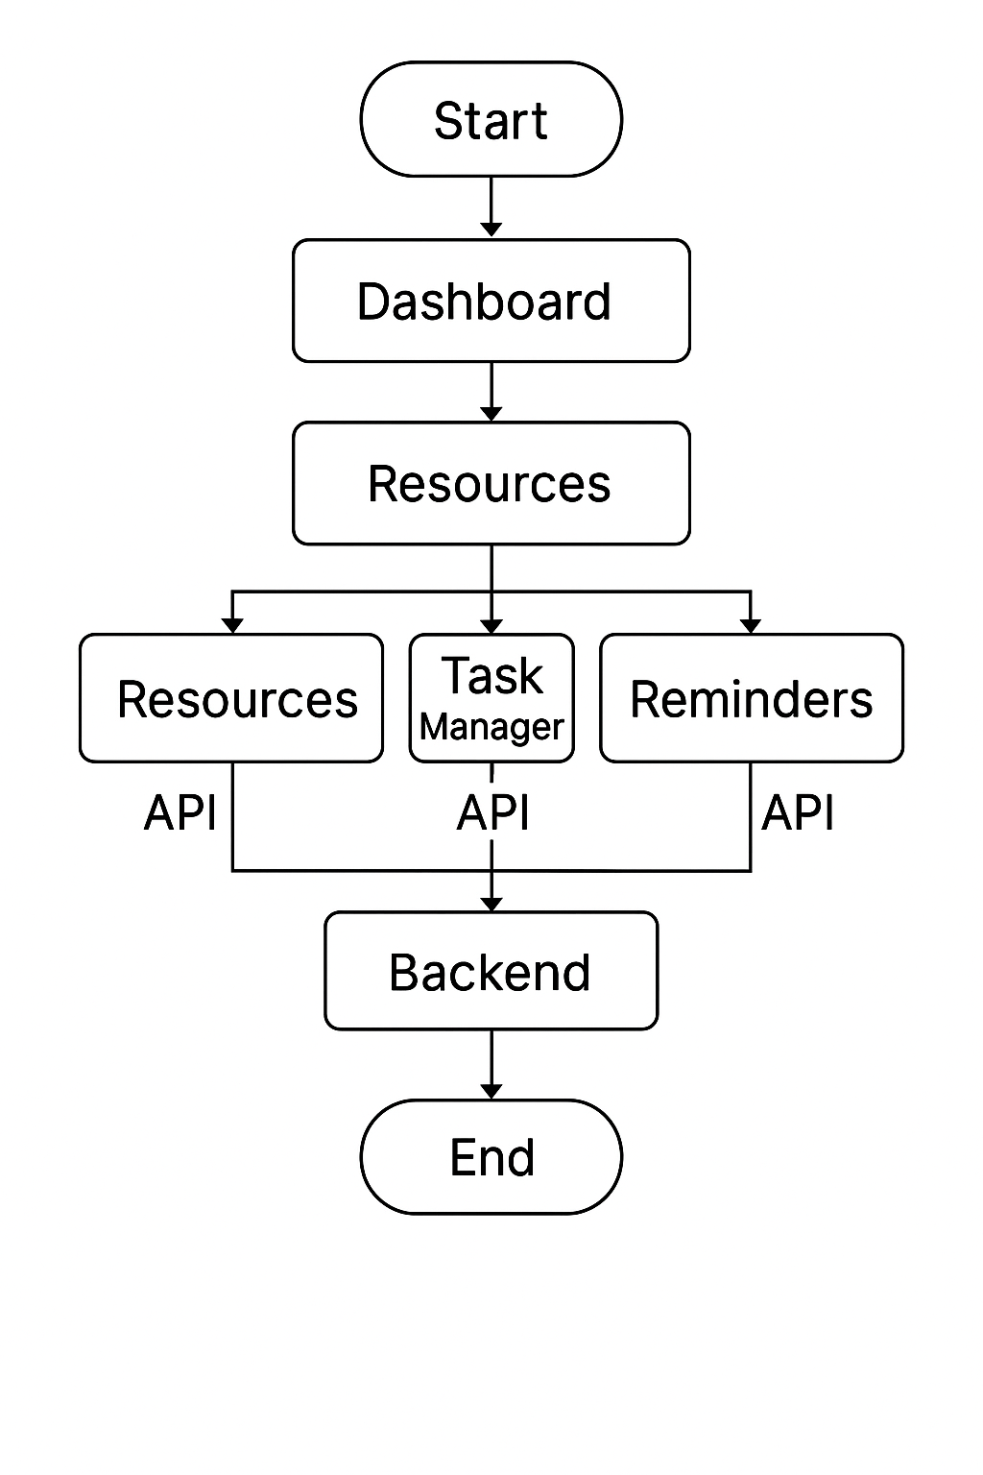
Module-Wise Flow Diagram

Slide 10
Work Done in Each Module
Module | Features | Issues Faced | Solutions Applied | Status
User Interface | Responsive UI, Dashboard | Alignment bugs | Used flexbox, media queries | Completed
Resources Section | YouTube API integration | Filtering content | Categorized tags & APIs | completed
Task Manager | Reminders, calendar UI | Time conflicts | Validation & alerts | Completed
Calender Reminders | Reminders & Notifications | Limited Customization | Custom Labels & Notes | Completed
Feedback and Support | Contact Form | Email Integration | Third-party email API | completed

Slide 11
Challenges
Technical Challenges:
Calendar and Reminders Sync
Navigation Confusion
Resource Access
Solutions Implemented:
Integrated Google Calendar API and automated reminders to ensure students stay on track with deadlines.
Simplified the interface with clear labels
Organized study resources in a searchable format for quick access.

