Slide 1
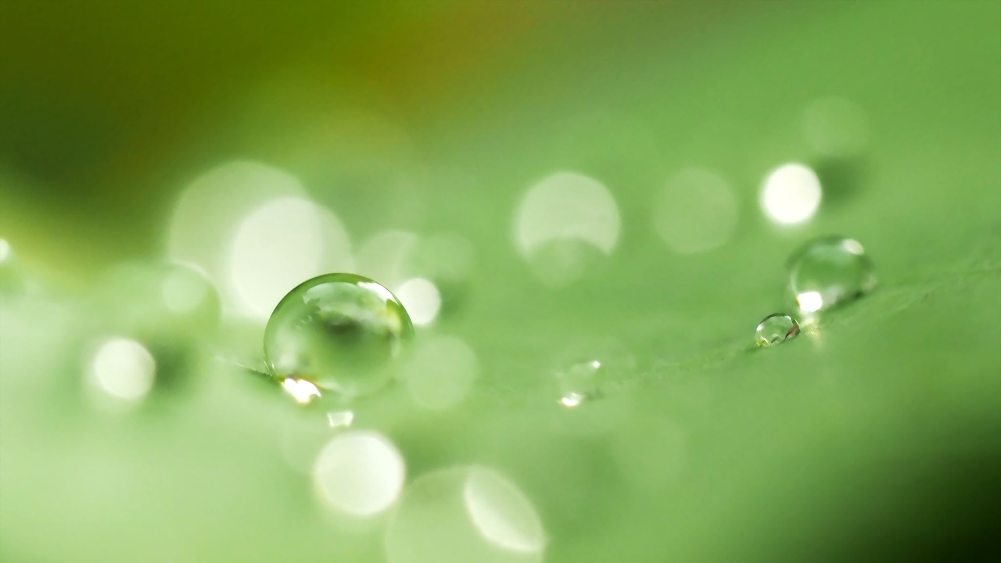
Decorators and Generators in Programming
Presenter: Pranay Pentaparthy

Slide 2
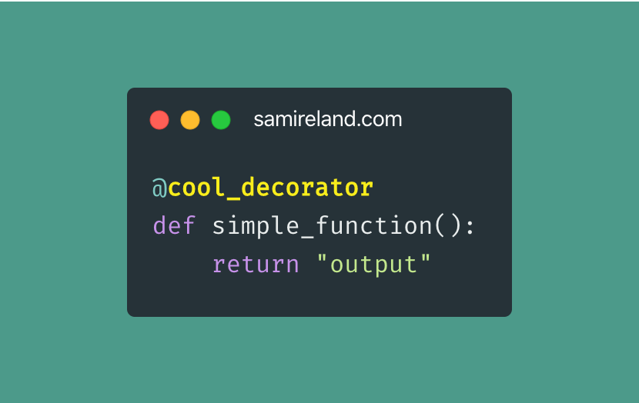
What are decorators?
In Python, decorators are special functions that can add new features or change how existing functions or methods work, without needing to change the original code of those functions. They are applied using the '@' symbol above the function definition and can take arguments

Slide 3
USING A DECORATOR
Step 1: Create a basic function like this:
def my_function():
print("Hello, World!")

Slide 4
Step 2: Define the decorator that will take a function as an argument:
def my_decorator(func):
def wrapper():
print("Something is happening before the function is called.")
func() # Call the original function
print("Something is happening after the function is called.")
return wrapper

Slide 5
Step 3: Apply the decorator to the function using the @decorator_name syntax:
@my_decorator
def my_function():
print("Hello, World!")

Slide 6


Practical applications of decorators
Access Control
Caching results
Implementing decorators for access control allows developers to restrict function execution based on user permissions or roles, enhancing security by centralizing authentication logic in a reusable manner.
By using decorators for caching, functions can store previously computed results, significantly improving performance for expensive operations by avoiding redundant calculations on repeated calls with the same arguments.

Slide 7
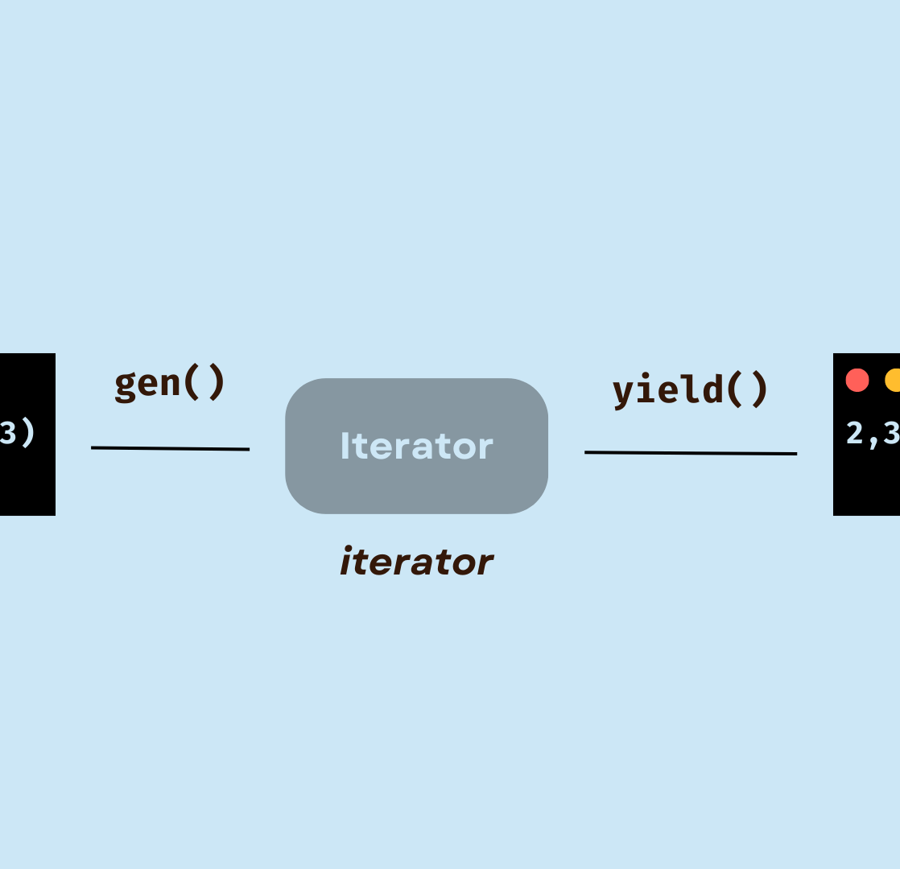
WHAT are generators?
In Python, generators are a type of iterable that allow for the creation of iterators in a more memory-efficient way. This step is done using the `yield` statement, which pauses the function's execution and saves its state, enabling it to resume later after it yields or generates one value at a time.

Slide 8
USING a generator
Step 1: Define a generator function
def my_generator():
yield 1
yield 2
yield 3

Slide 9
Step 2: Call the generator function
gen = my_generator() # `gen` is a generator object
Step 3: Iterate over the generator using a for loop or the next() function:
a) for loop
for value in gen:
print(value)

Slide 10
b) using next function
print(next(gen)) # Output: 1
print(next(gen)) # Output: 2
print(next(gen)) # Output: 3
# If you call next again, it raises StopIteration
# print(next(gen)) # Uncommenting this line will raise StopIteration

Slide 11
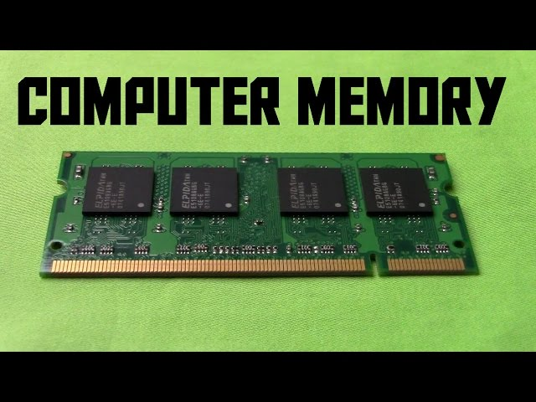

Practical APPLICATIONS OF GENERATORS
Memory Efficiency
Data Streaming and Processing
Generators allow you to handle large datasets without loading everything into memory. This is done by reading the file one line at a time.
Generators can be used to process streamed data in real-time, such as from network connections or IoT devices.

