Slide 1
Amazon Reviews Historical and Real-time Analysis
By: Pranay Pentaparthy

Slide 2
Project Goals
Scenario 1: Figure out factors related to a company, Best Buy, whom has been selling electronic gadgets to Amazon for the last four years up to now and has noticed a decline in sales recently.
Scenario 2: Understand drivers for Amazon detecting a rise in potentially fraudulent reviews and mitigate this activity

Slide 3
Tech Stack
PostgreSQL
Hadoop
Spark
Kafka
Hive
Python

Slide 4
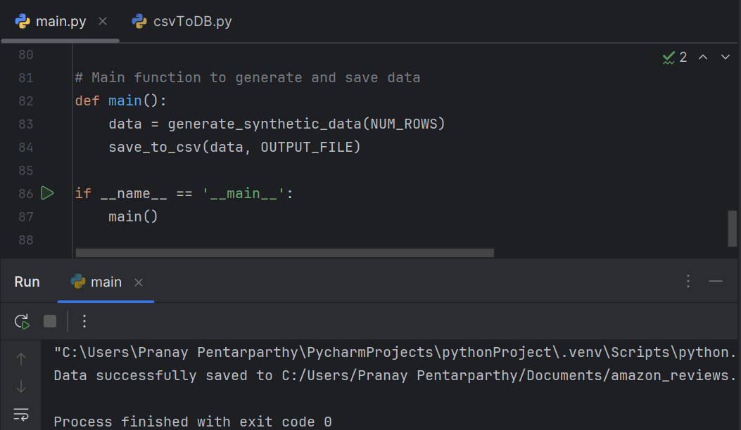
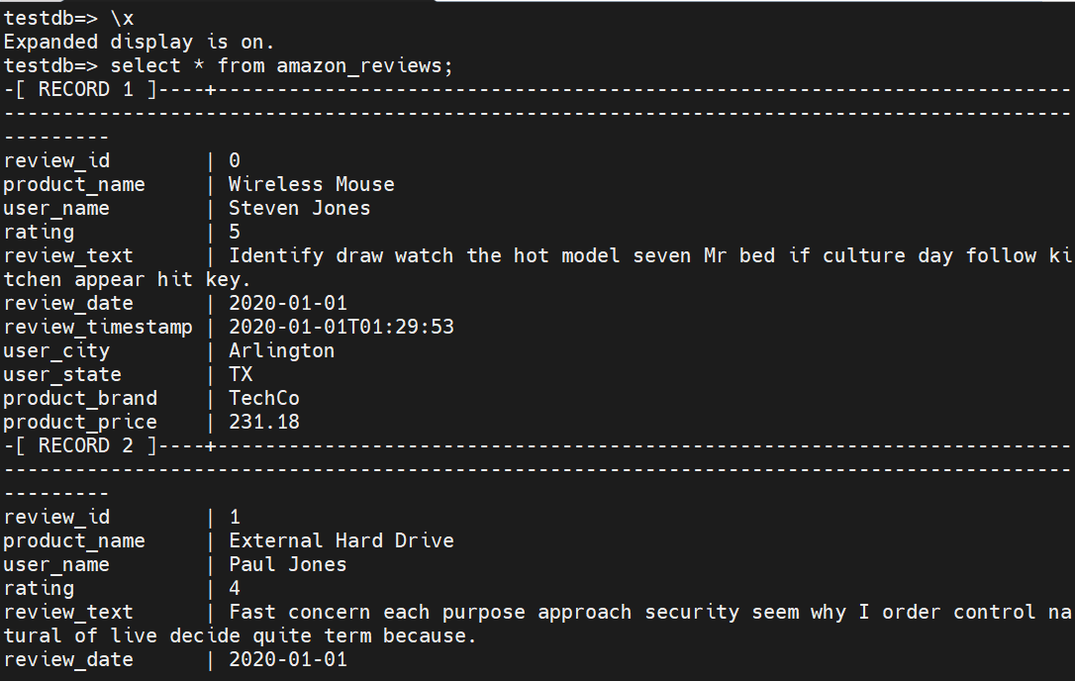
Big Date Pipeline Steps (Scenario 1)
Step 1: Ingest data into Hadoop
  Create amazon reviews csv dataset in Python (main.py)
  Move data from csv file to PostgreSQL server after testing dataset.

Slide 5
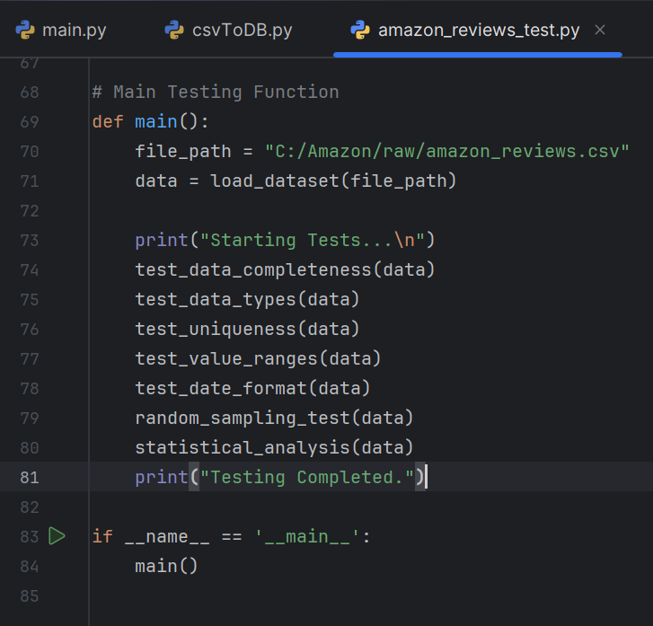
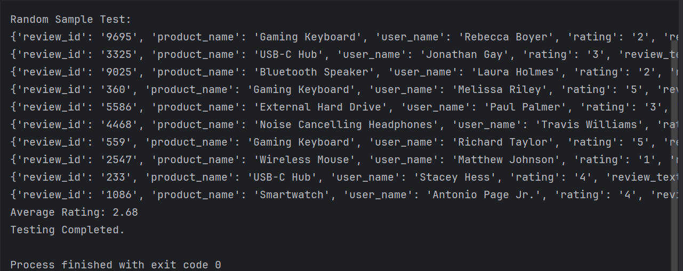
  Before uploading dataset onto Hadoop, check data for missing or null values, remove duplicates, etc.

Slide 6

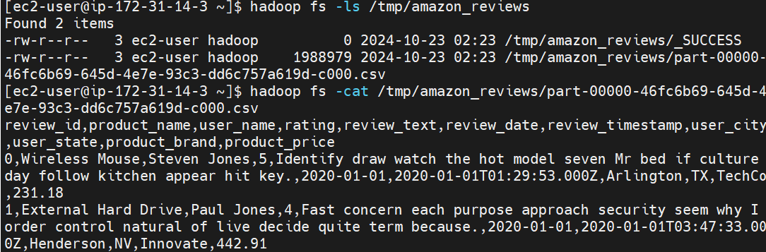
Step 2: (Batch Processing)
a) Full Load
  Load amazon reviews dataset from PostgreSQL onto Hadoop with Spark.

Slide 7
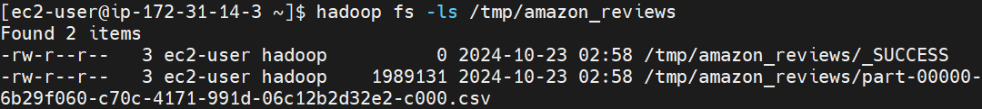
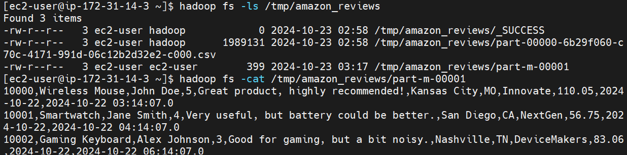
b) Incremental Load
  Load newly inserted data from PostgreSQL onto amazon reviews csv file in Hadoop.

Slide 8
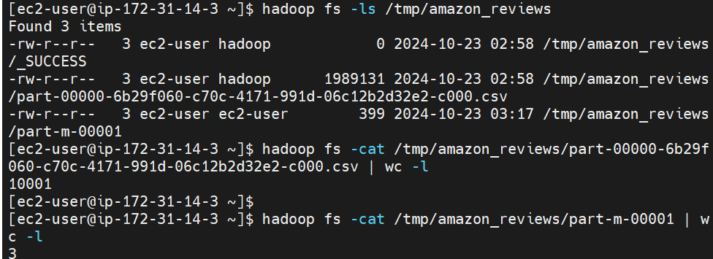
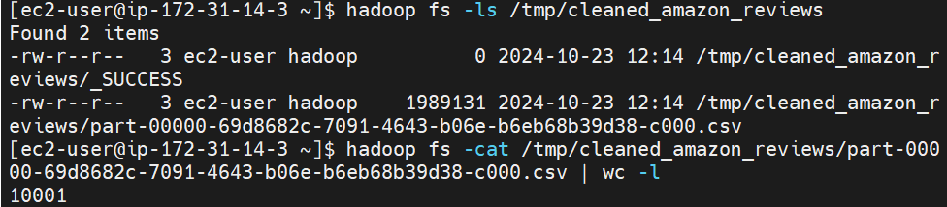
c) Pre-processing
  Transform data by removing null/duplicate values, trimming whitespace characters, etc.

Slide 9
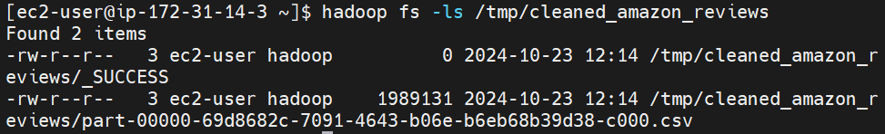
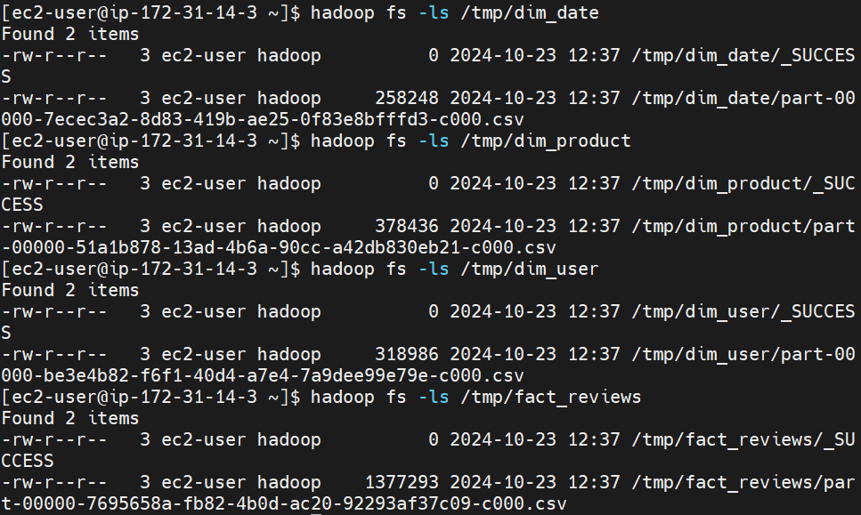
d) Dimensional Modeling
  Split amazon reviews dataset into fact table and dimensional tables.

Slide 10
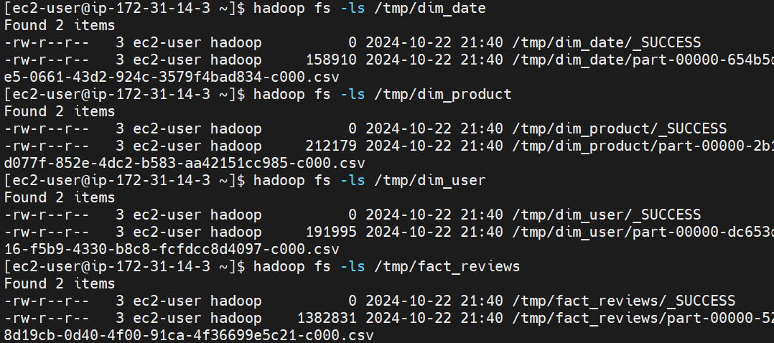
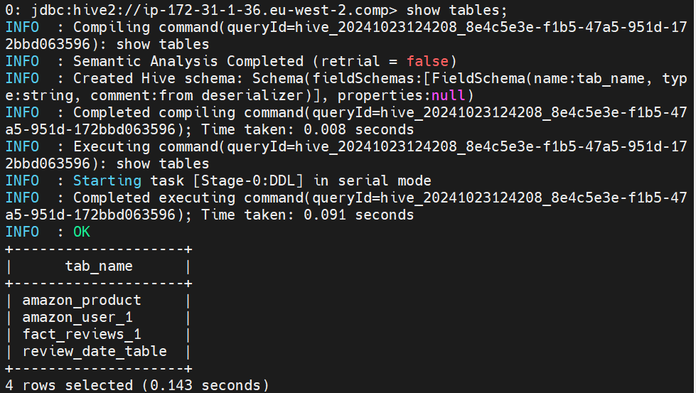
Step 3: Load tables on Hive
  Load tables onto Hive using `create database` and `create external table` statement.

Slide 11
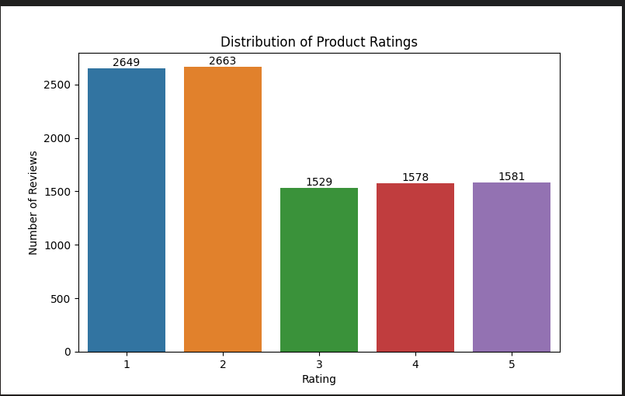
Final step: ( Analyze data)
  a) Bar chart showing the number of reviews for each rating.

Slide 12
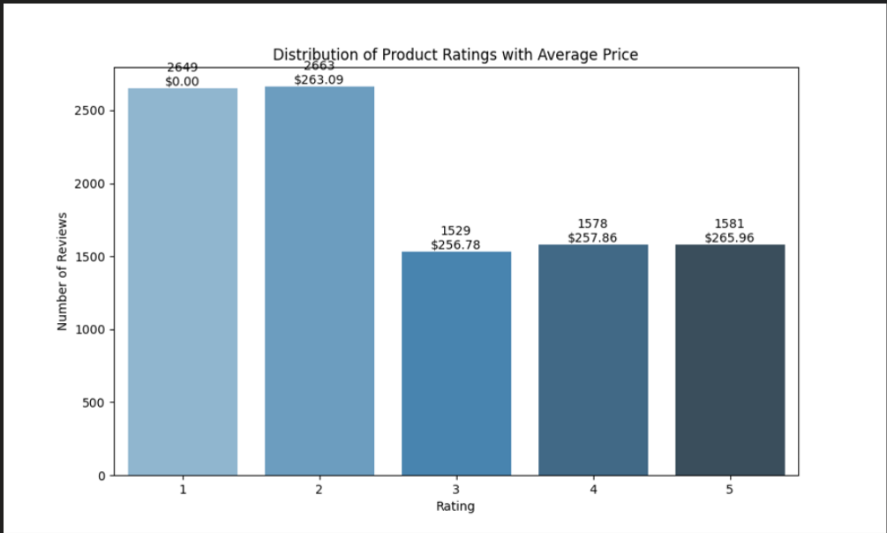
b) Bar chart showing the distribution of ratings with average price

Slide 13
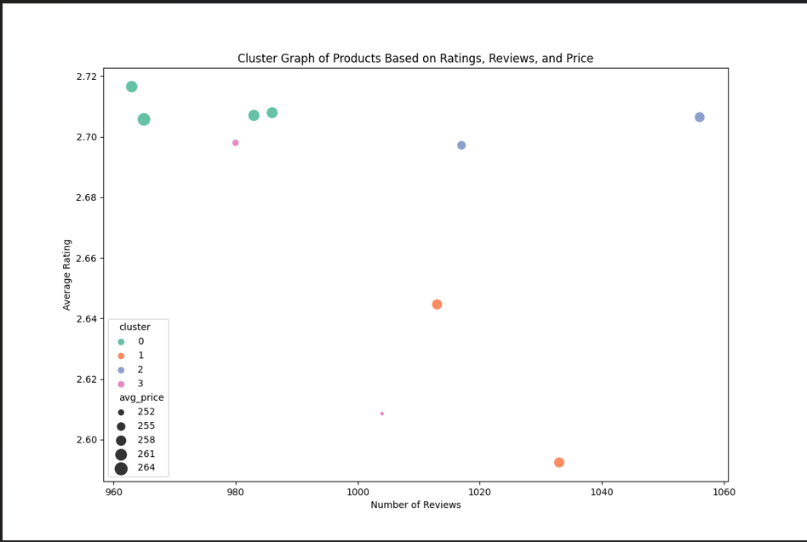
c) Cluster graph of products according to ratings, reviews, and price

Slide 14
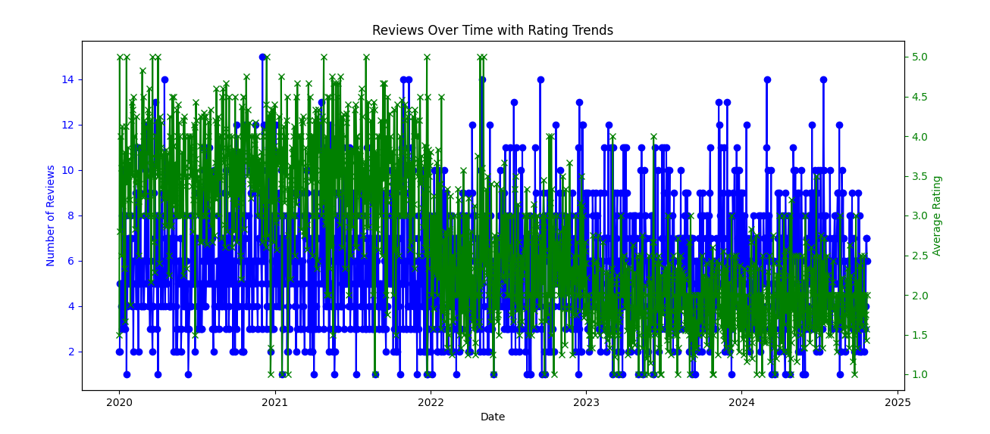
d) Reviews over time with rating trend

Slide 15
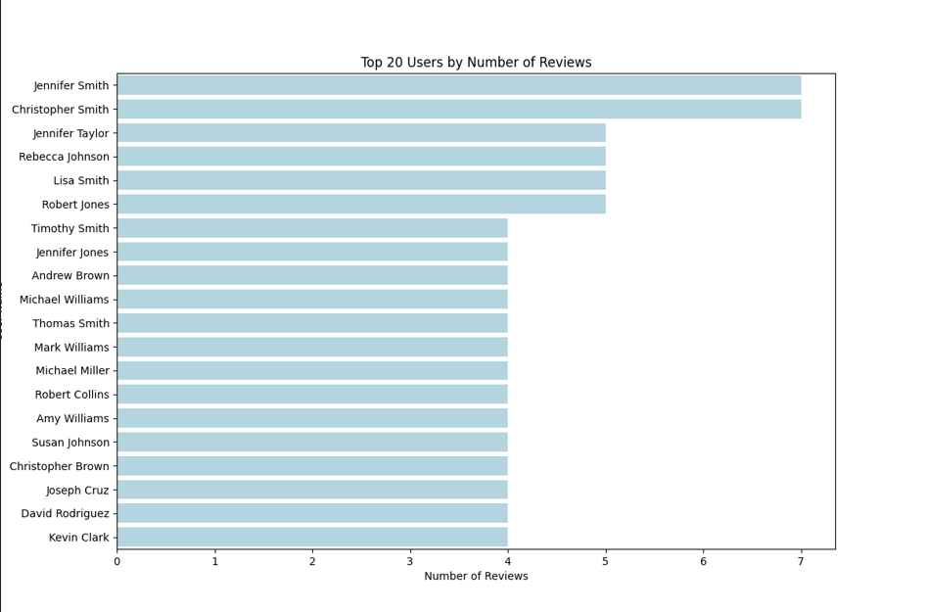
e) Top 20 users by reviews

Slide 16
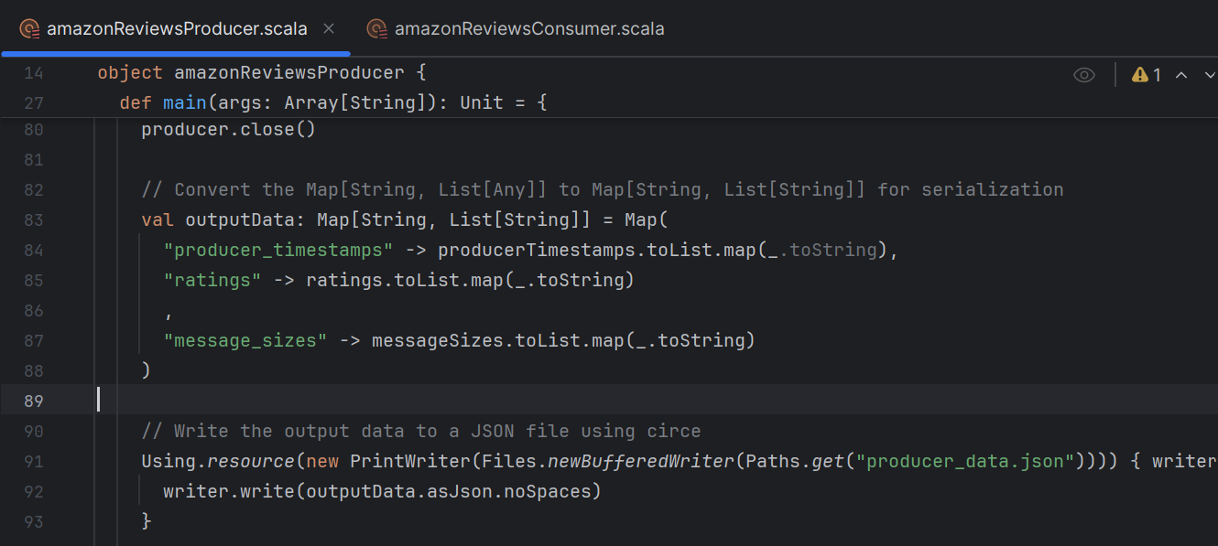
Big Date Pipeline Steps (Scenario 2)
Step 1: Create Kafka producer file
  Create a Scala project and write a Kafka producer file in it.

Slide 17
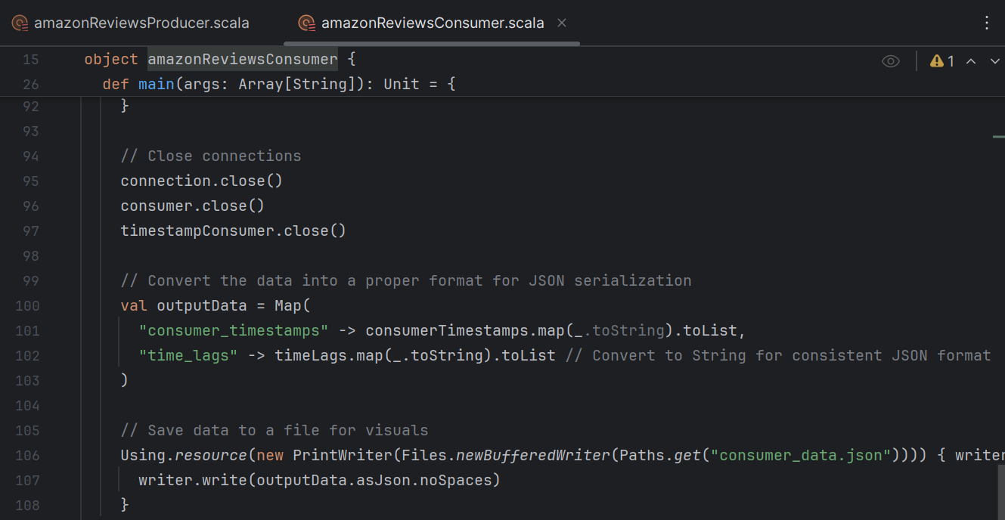
Step 2: Create a Kafka consumer file
  Create a Kafka consumer file within the same directory above

Slide 18
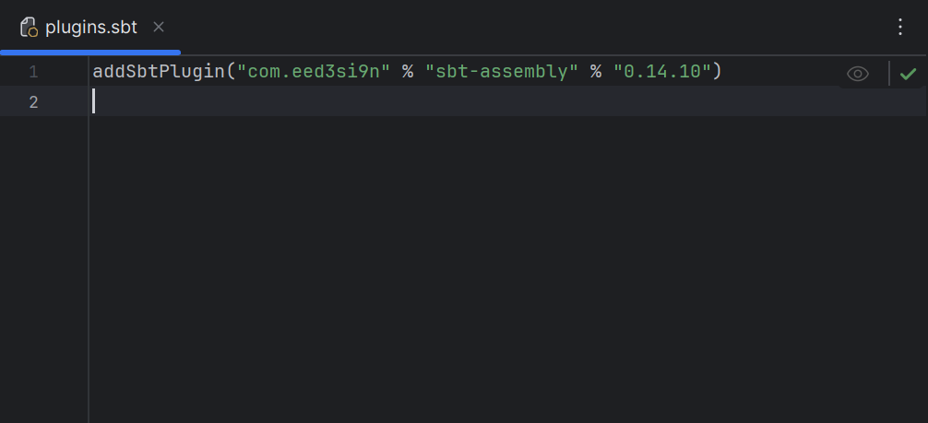
Big Date Pipeline Steps (Scenario 2)
Step 3: (Create plugins sbt file)
- Create a file named plugins.sbt under the project folder of your Scala project.

Slide 19
Step 4: (Modify build sbt file)
Go to the file, build.sbt, and add this code after libraryDependencies like this:
`assemblyMergeStrategy in assembly / = {
case path: String if path.startsWith("META-INF") => MergeStrategy.discard
case _ => MergeStrategy.first
}`

Slide 20
Step 5: (Create assembly jar file)
Refresh your sbt build changes. Then, use a tool like ‘Terminal’ or ‘Windows PowerShell’ to navigate to the Scala project directory and run the command `sbt assembly`.

Slide 21
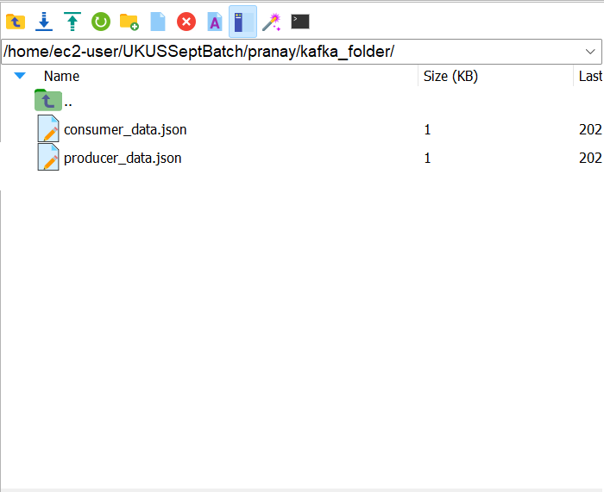
Final step: ( Analyze data )
Follow the same steps from scenario 1.

Slide 22
Challenges
Creating a jar files for PostgreSQL server and scala files for batch processing took much time.
Not able to run Python file to create visuals for both scenarios outside Mobaxterm.
Running incremental load on synthetic amazon reviews dataset created a few days ago.
Deciding the use case to focus on for my project scenarios.

Slide 23
Future enhancements
Automate big data pipeline for my scenarios on AWS or Azure.
Use more machine learning features to generate better insights to data.
Being able to run Kafka successfully to process real-time data.
Make sure curated data is stored on a warehouse that provides low latency like HBase.

