Slide 1
Amazon Reviews Historical and Real Time Analysis
By: Pranay Pentaparthy

Slide 2
Project Goals
Scenario 1: Figure out factors related to a company, Best Buy, whom has been selling electronic gadgets to Amazon for the last four years up to now and has noticed a decline in sales recently.
Scenario 2: Understand drivers for Amazon detecting a rise in potentially fraudulent reviews and mitigate this activity.

Slide 3
Tech Stack
Python
PostgreSQL
Amazon S3
AWS Lambda
Amazon Kinesis
Amazon DynamoDB
AWS Glue Data Catalog
Amazon Quicksight

Slide 4
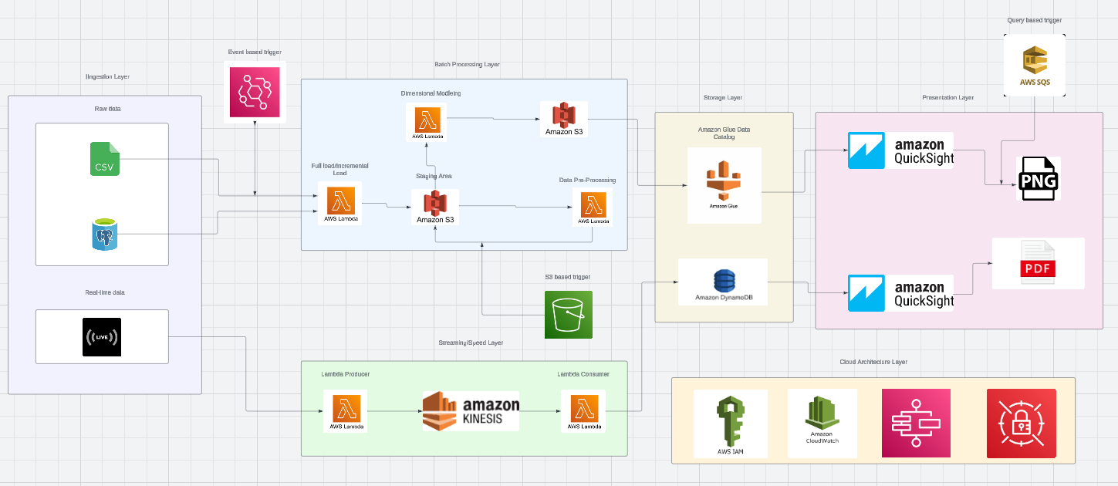
Big Data Pipeline

Slide 5
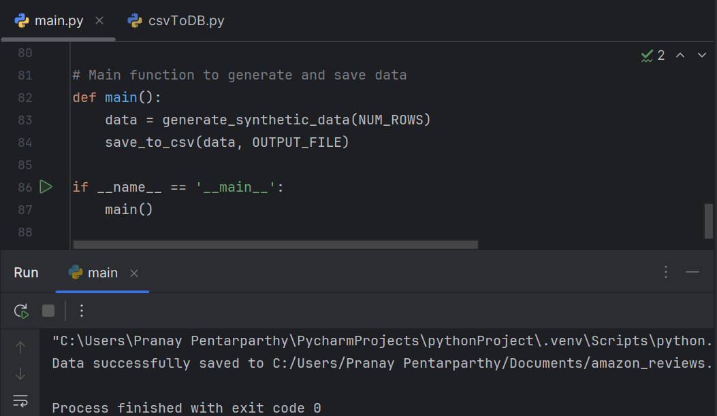
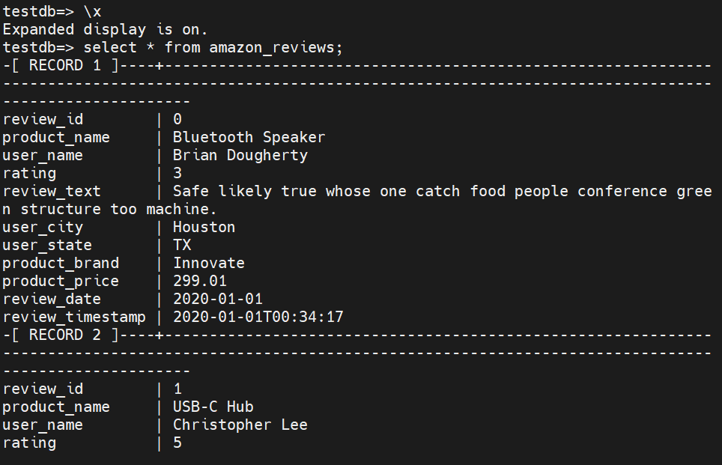
Big Data Pipeline Steps (Scenario 1)
Step 1: Ingest data into Hadoop
  Create amazon reviews csv dataset in Python (main.py)
  Move data from csv file to PostgreSQL server after testing dataset.

Slide 6
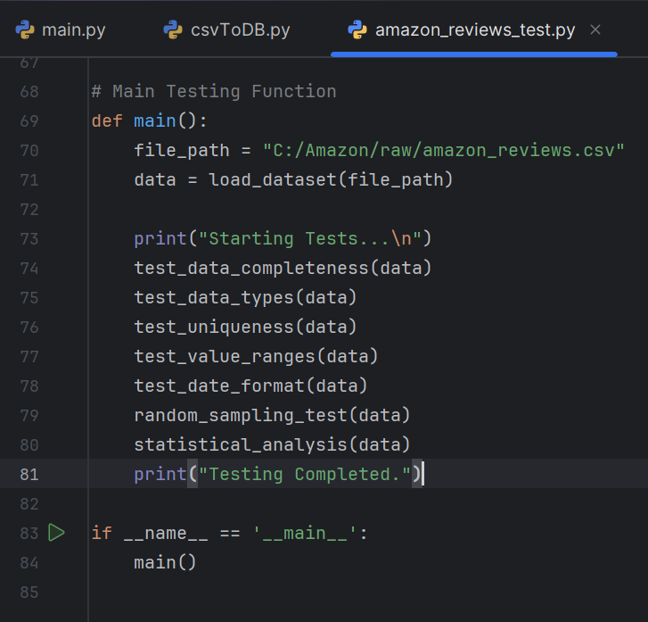
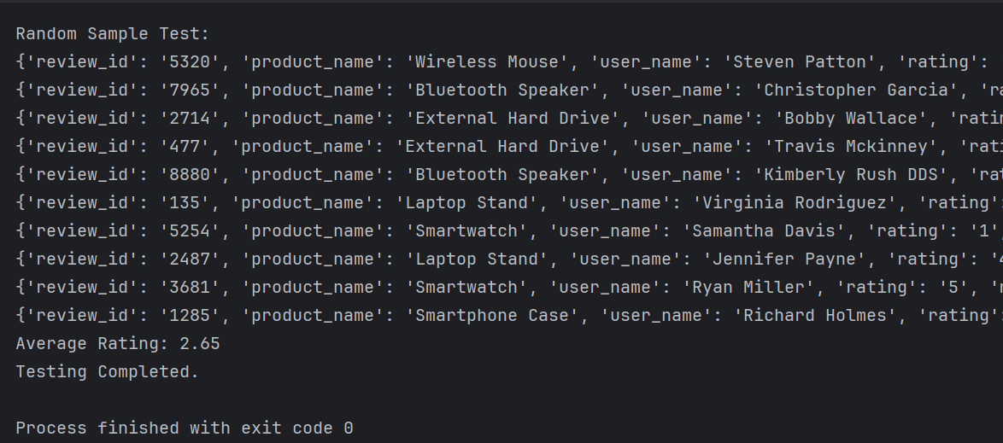
Before uploading dataset onto Hadoop, check data for missing or null values, remove duplicates, etc.

Slide 7
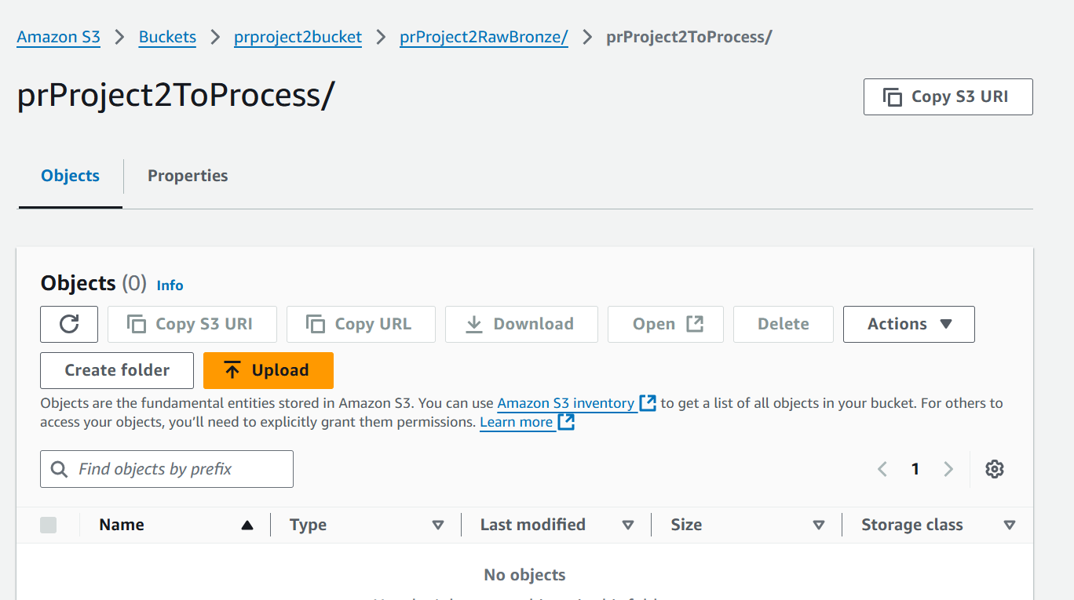
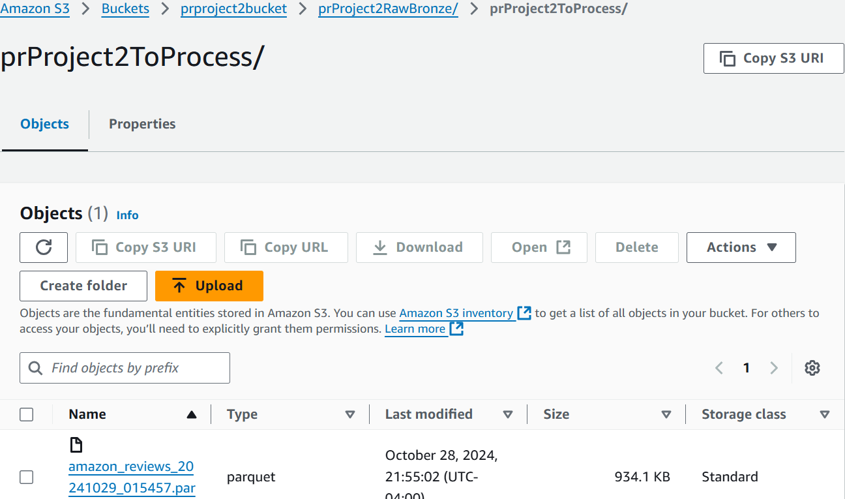
Step 2: (Batch Processing)
a) Full Load
  Load amazon reviews dataset from PostgreSQL onto Amazon S3 with a Lambda function

Slide 8
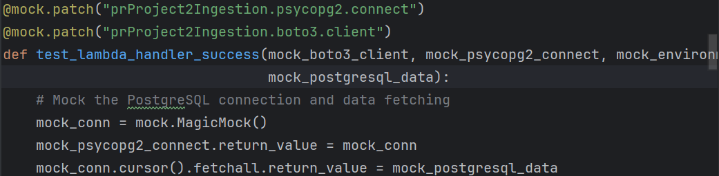
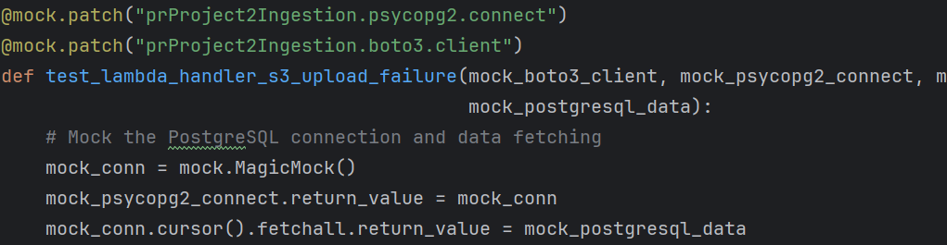
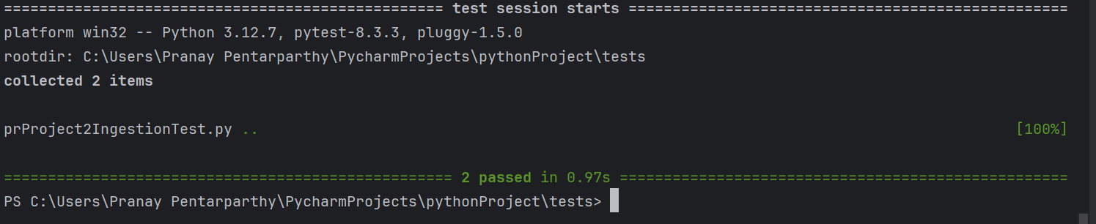
Full Load Test:
Create full load test script and run with pytest.

Slide 9
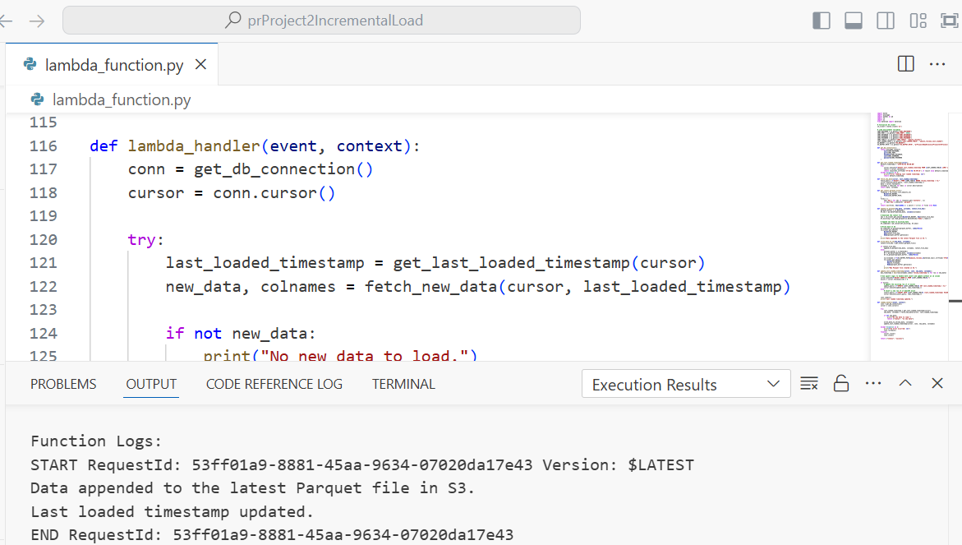
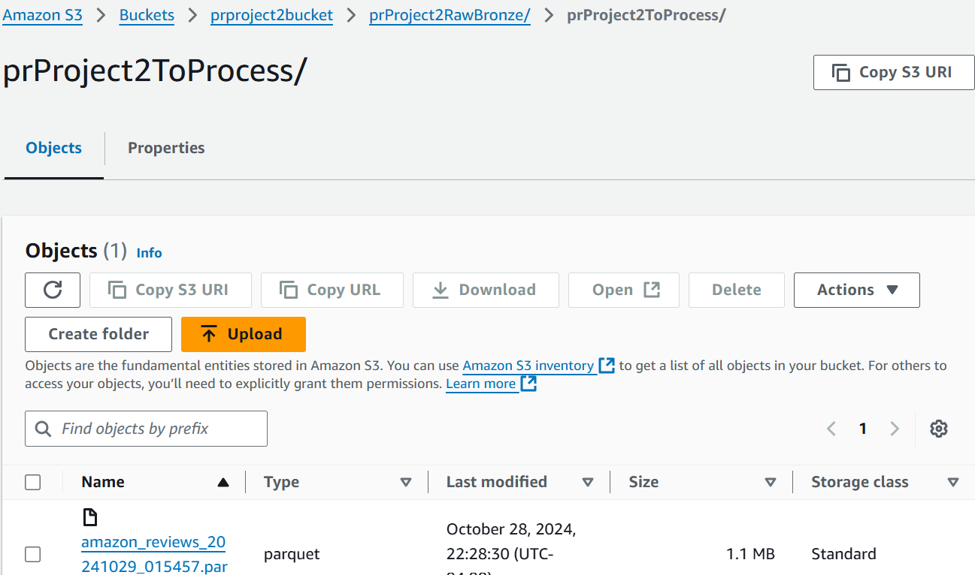
b) Incremental Load
- Load newly inserted data from PostgreSQL onto amazon reviews csv file in Amazon S3.

Slide 10

c) Pre-processing
  - Transform data by removing null/duplicate values, trimming whitespace characters, etc.

Slide 11
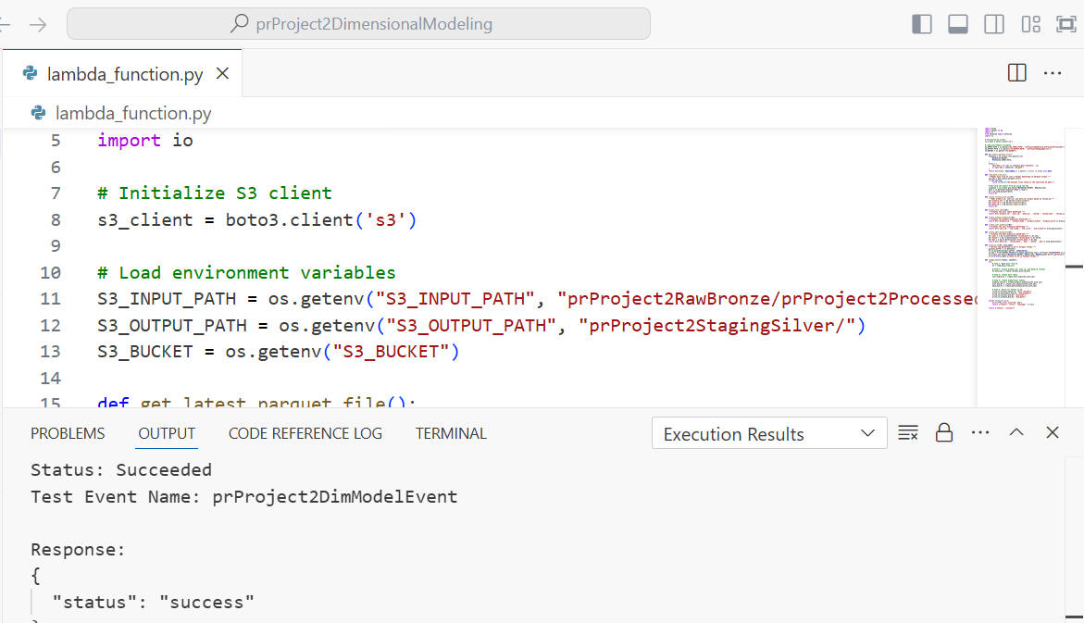
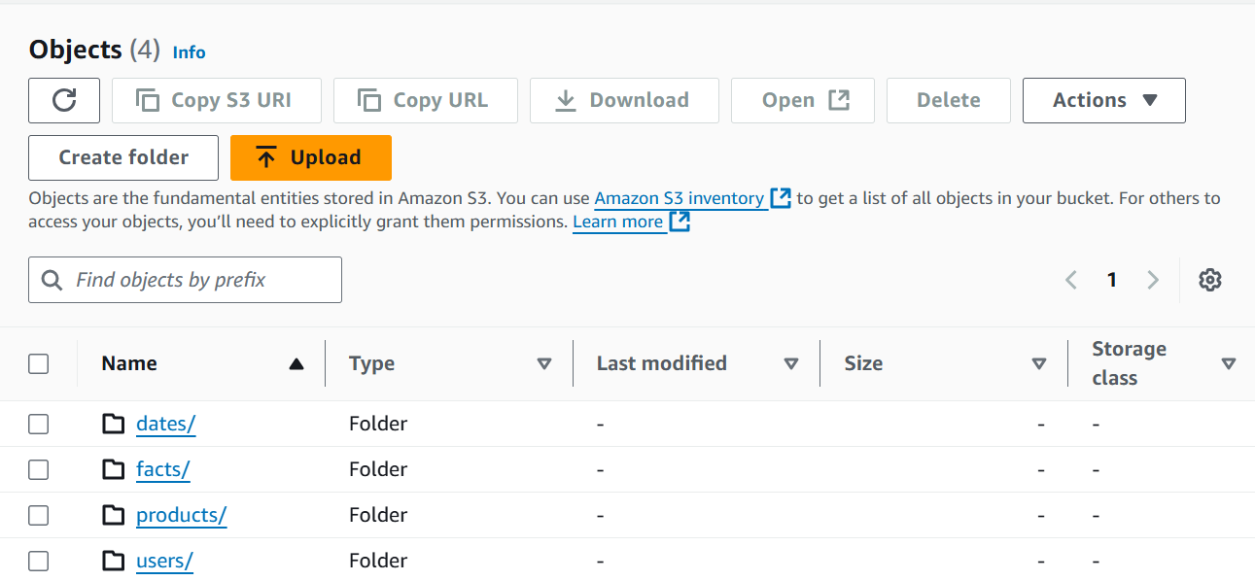
d) Dimensional Modeling
  - Split amazon reviews dataset into fact table and dimensional tables.

Slide 12
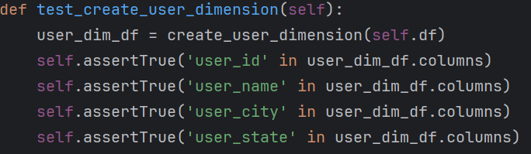
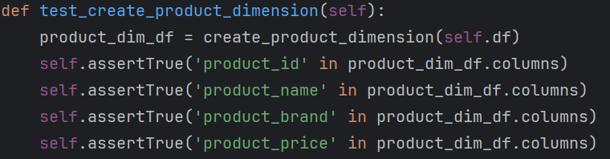
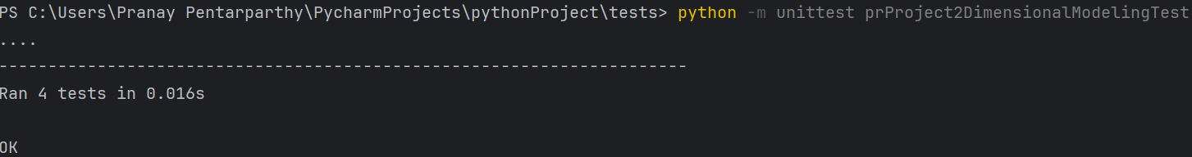
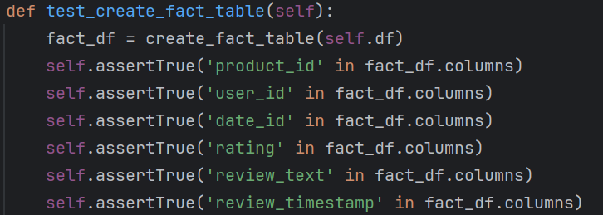
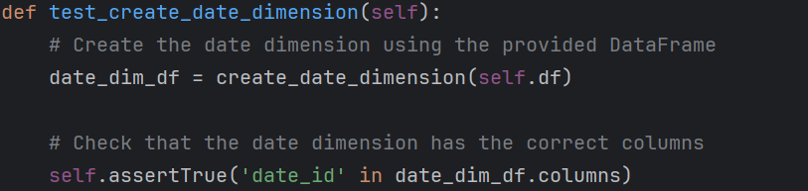
Dimensional Modeling Test:
Run unit test on dimensional modeling script

Slide 13
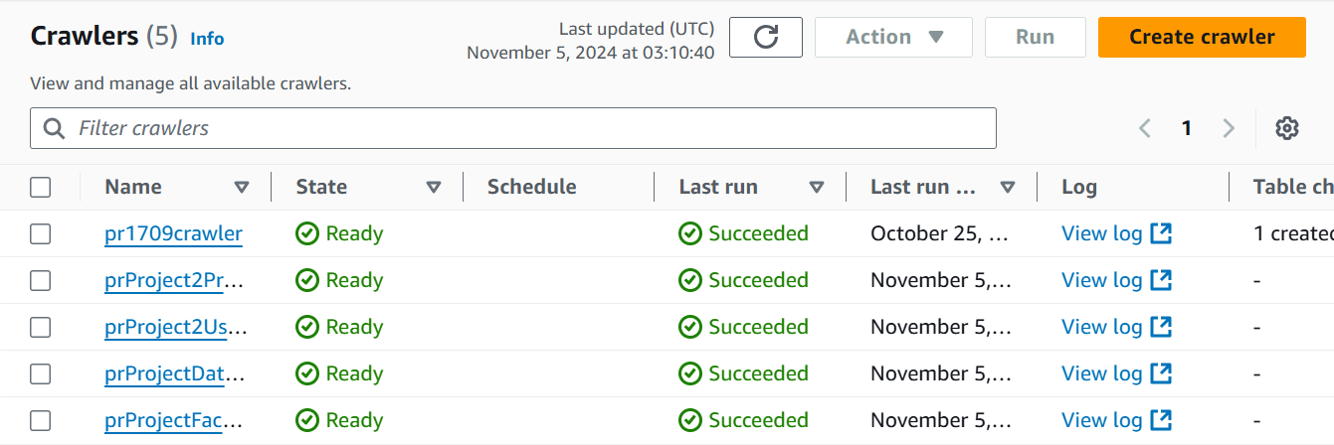
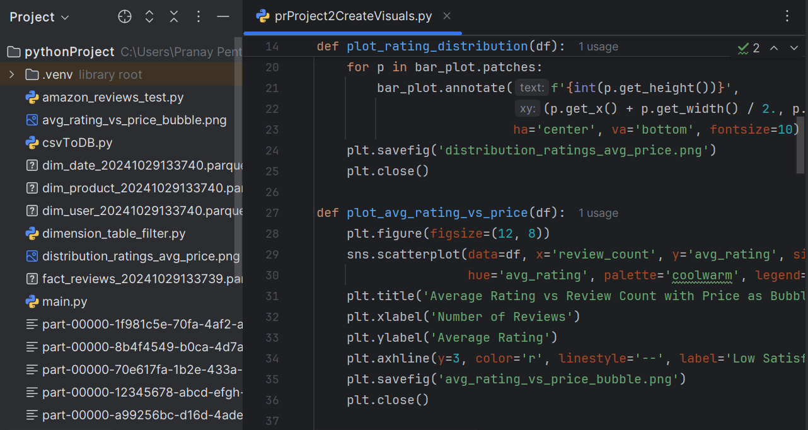
Step 3: Use Amazon Quicksight
- Create crawlers for fact and dimensional table files with AWS Glue Data Catalog and use Amazon Quicksight to analyze and visualize the data.

Slide 14
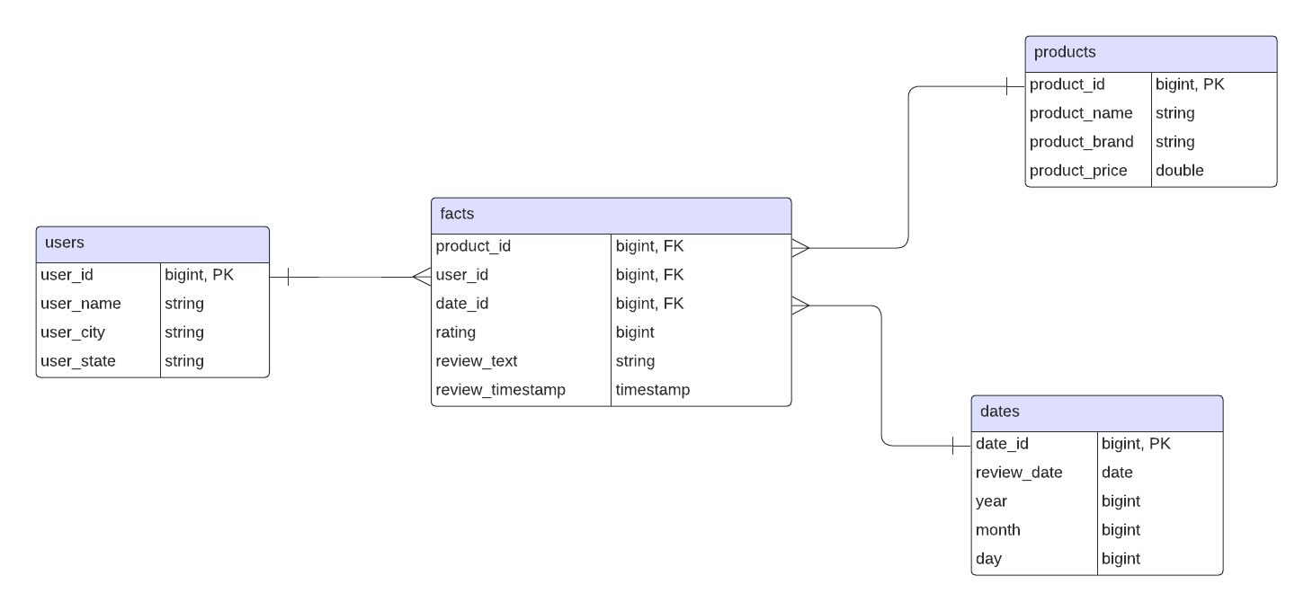
ER Diagram

Slide 15
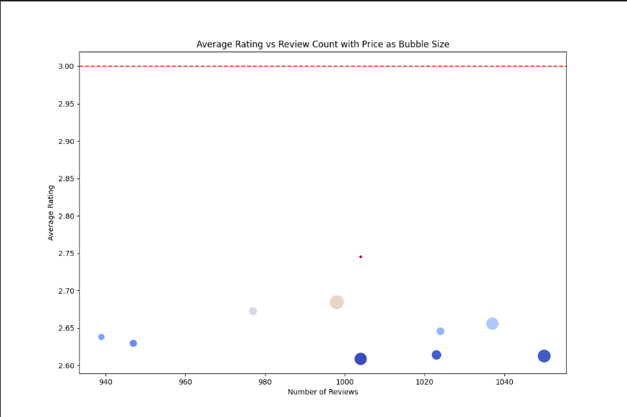
Final step: ( Analyze data)
a) Bubble chart of average rating versus bubble size

Slide 16
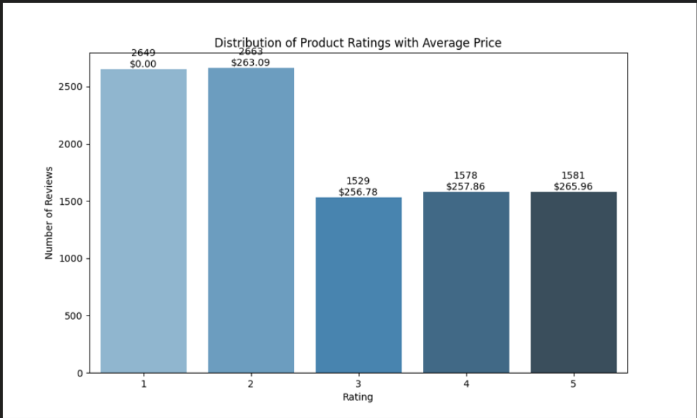
b) Bar chart showing the distribution of ratings with average price

Slide 17
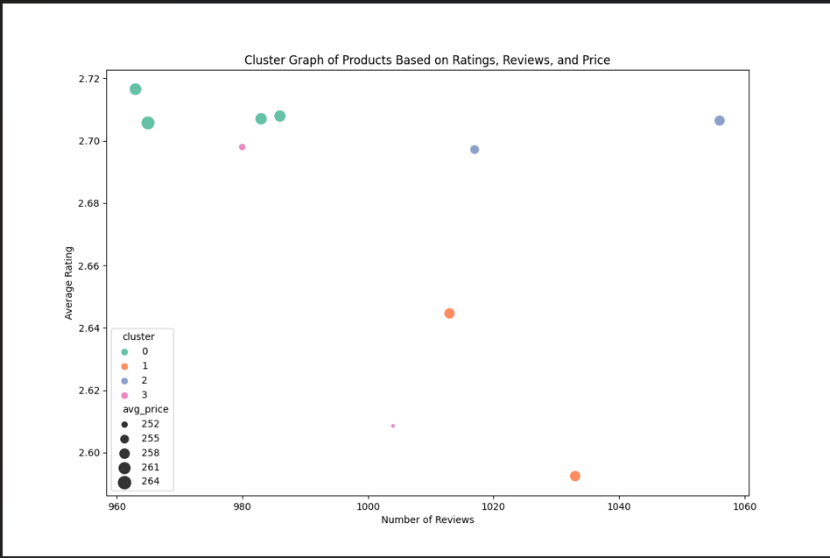
c) Cluster graph of products according to ratings, reviews, and price

Slide 18
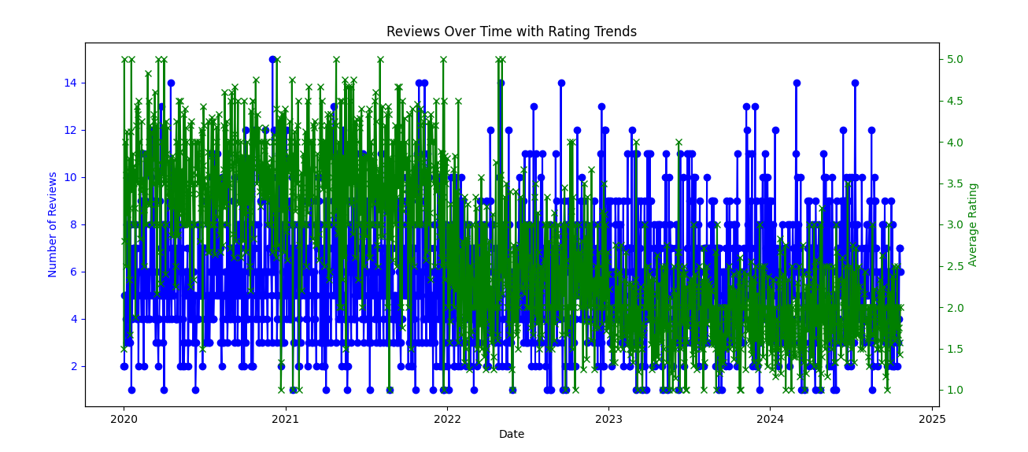
d) Reviews over time with rating trend

Slide 19
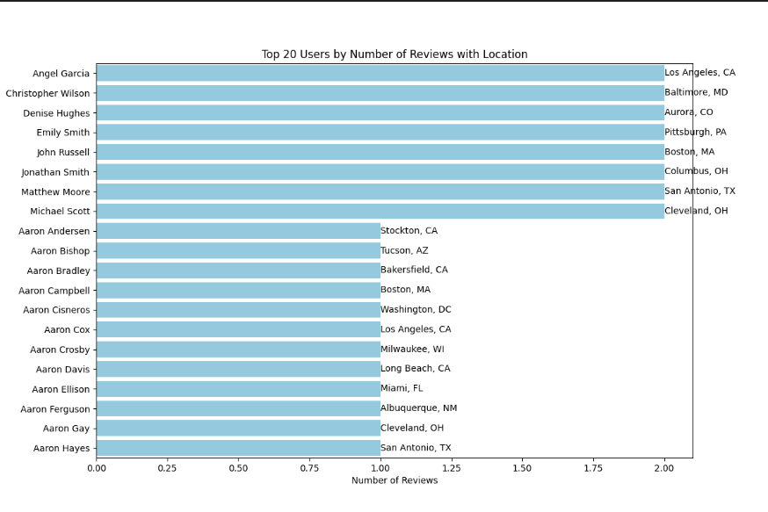
e) Top 20 users by reviews with location

Slide 20
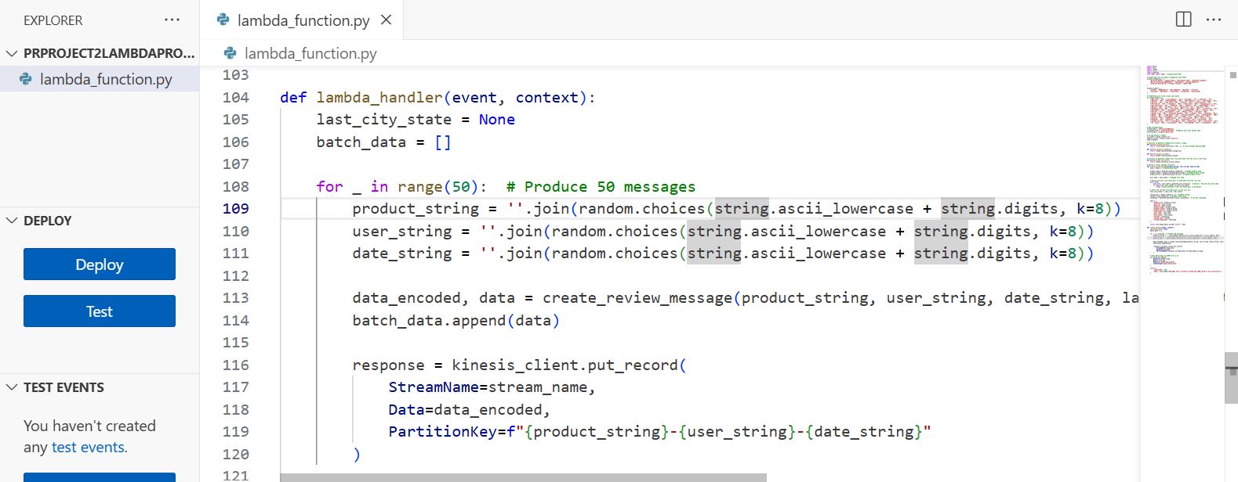
Big Date Pipeline Steps (Scenario 2)
Step 1: Create Lambda producer file
- Create a Lambda producer file on AWS.

Slide 21
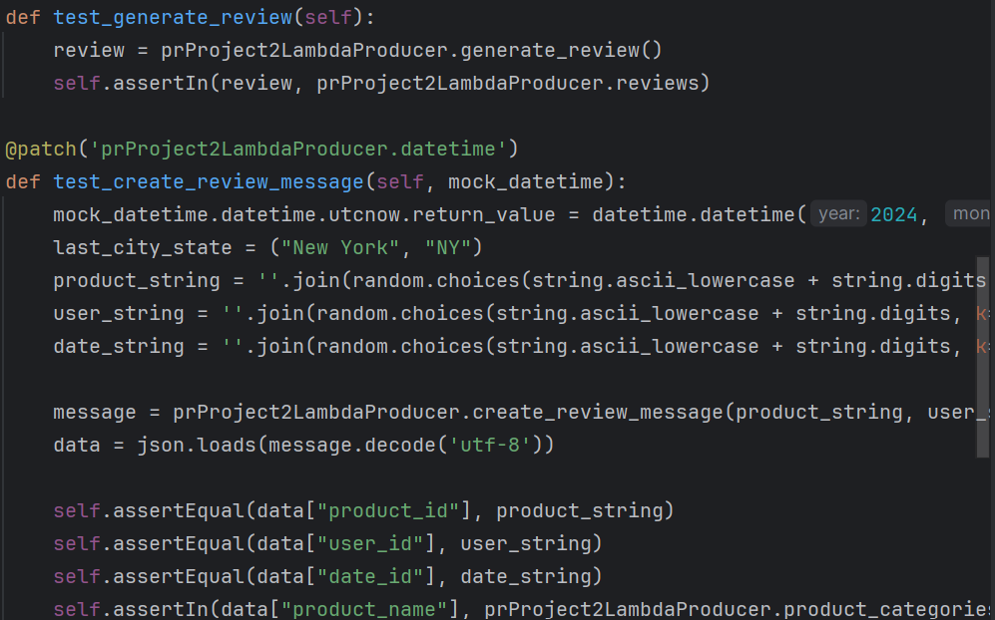
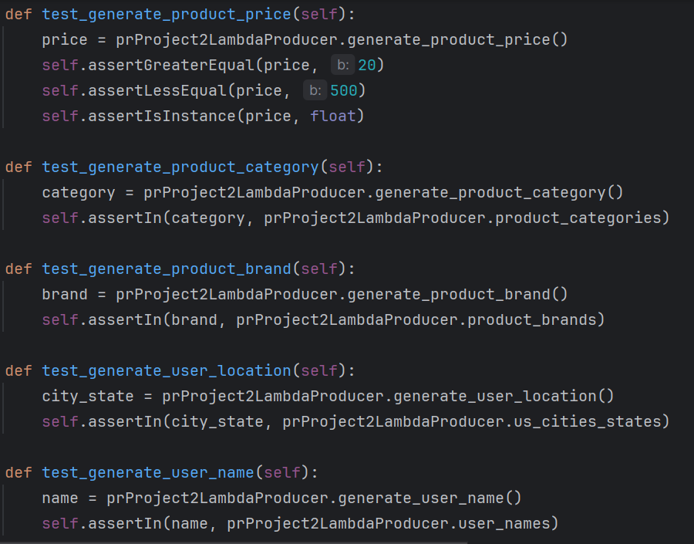
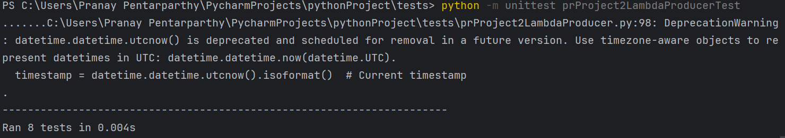
Lambda Producer Test:
Run unit test on lambda Producer script.

Slide 22
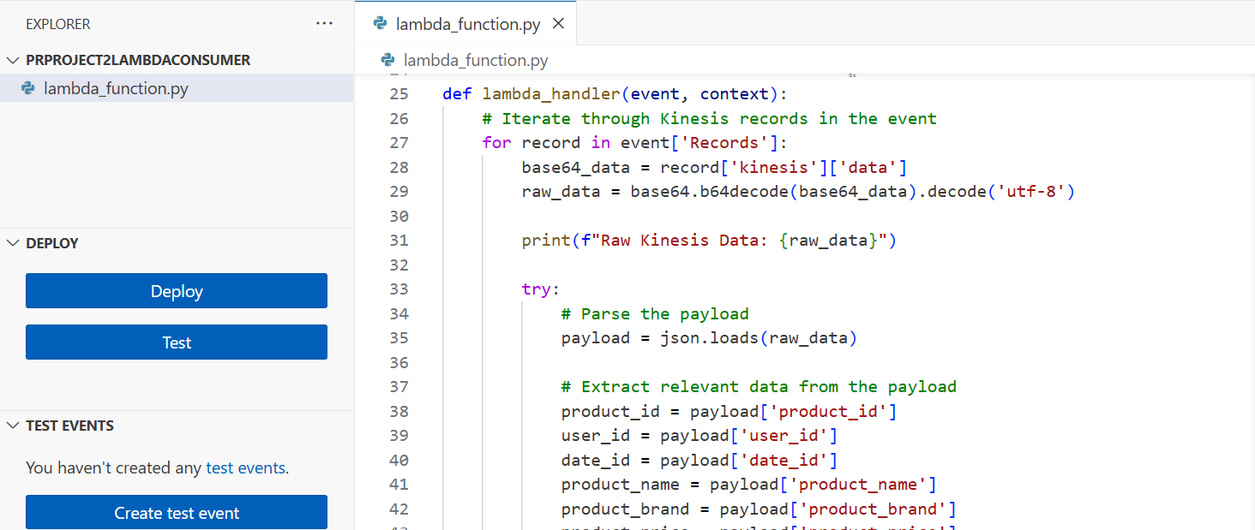
Step 2: Create a Lambda consumer file
- Create a Lambda consumer file on AWS.

Slide 23
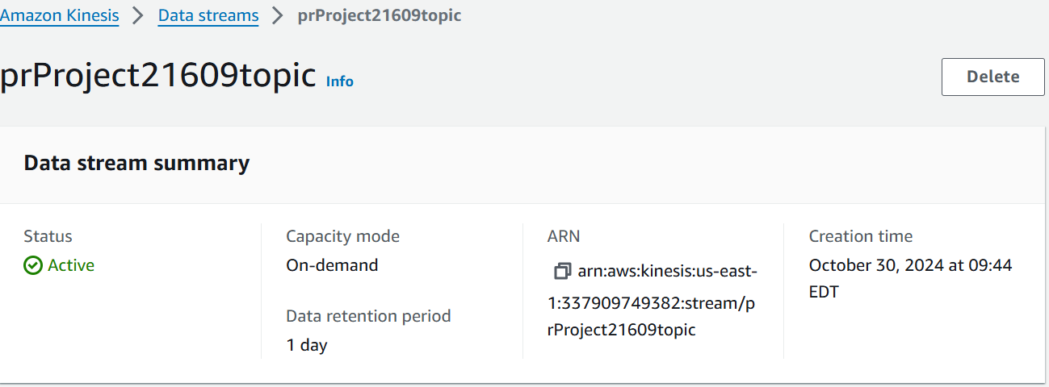
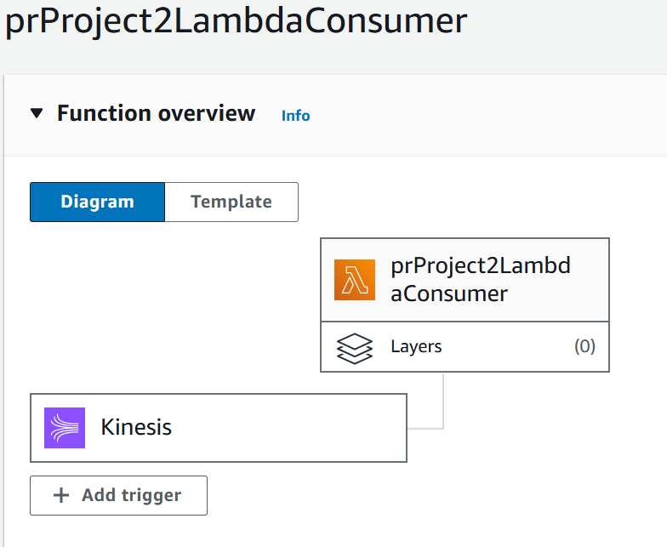
Step 3: Create a Kinesis Stream
- Create a Kinesis Stream and go to your Lambda consumer file to configure the stream as a trigger.

Slide 24
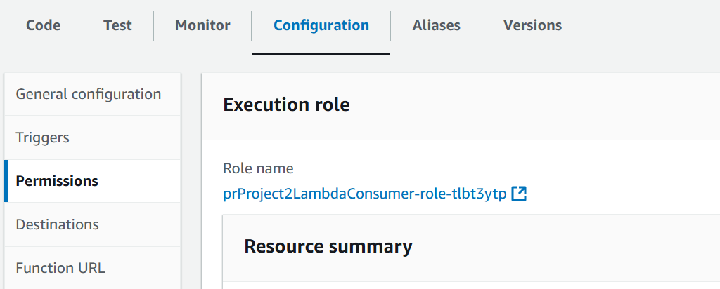
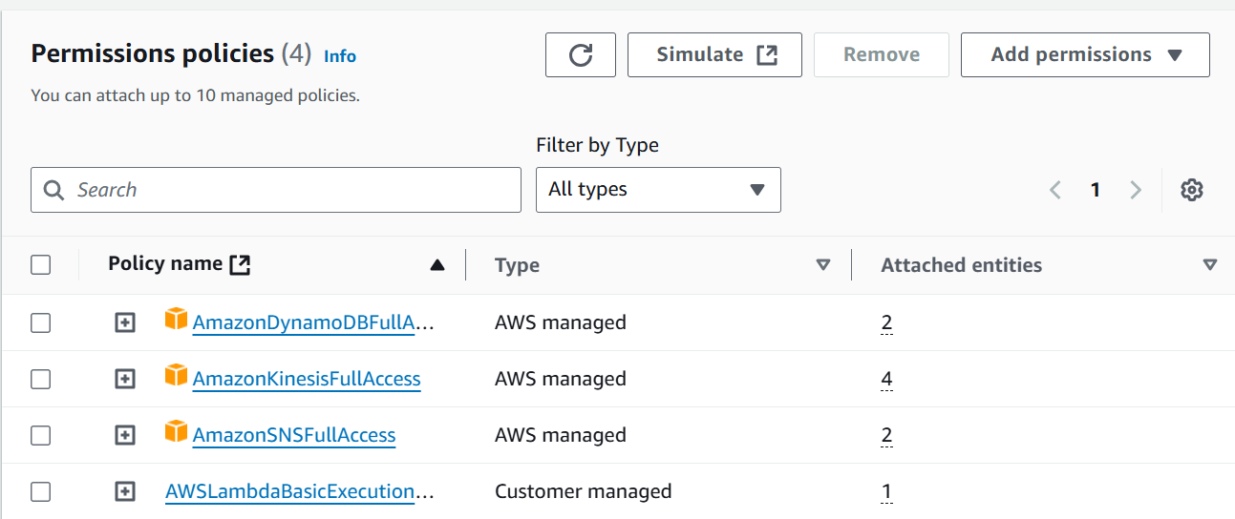
Step 4: Set up permissions
Set up an IAM role for the Lambda consumer file, allowing it to read from and write to the Kinesis stream.

Slide 25
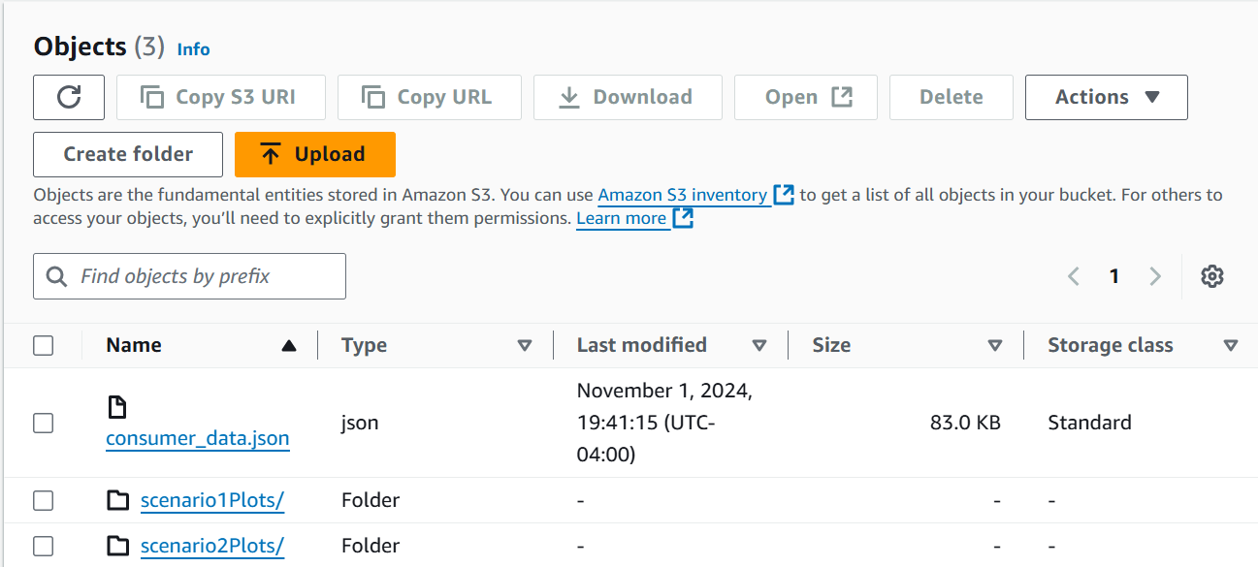
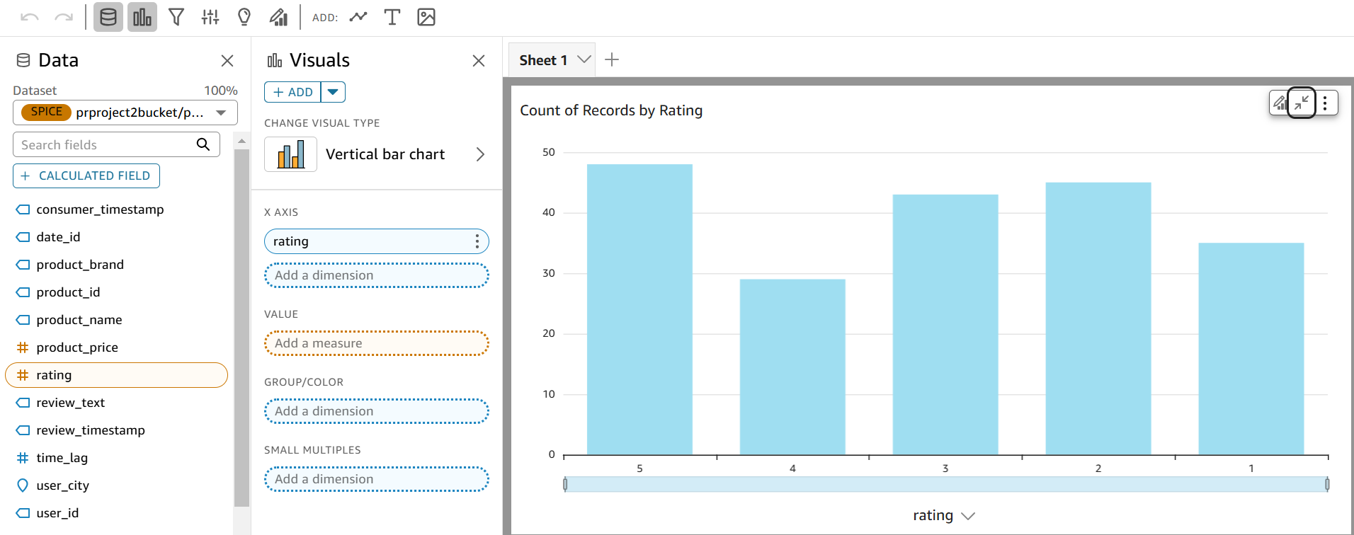
Step 5: Visualize the data
Use Amazon Quicksight to visualize the consumer JSON file created from the lambda consumer file.

Slide 26
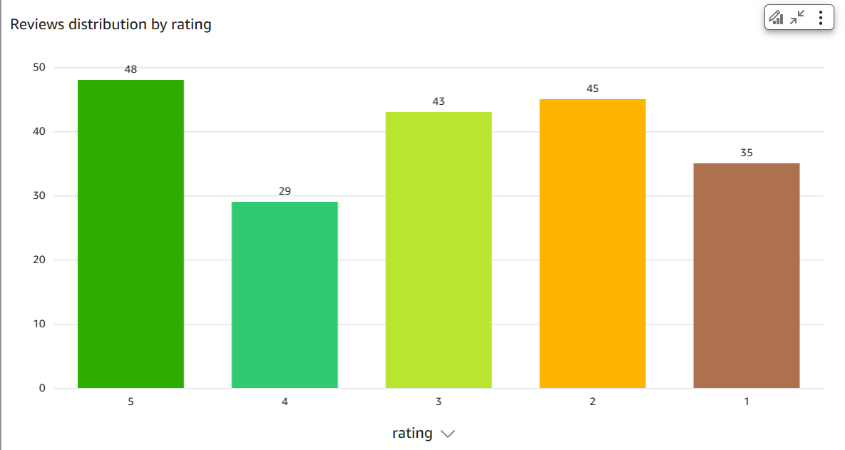
Final step: ( Analyze data )
a) Bar char showing the number of reviews for each rating.

Slide 27
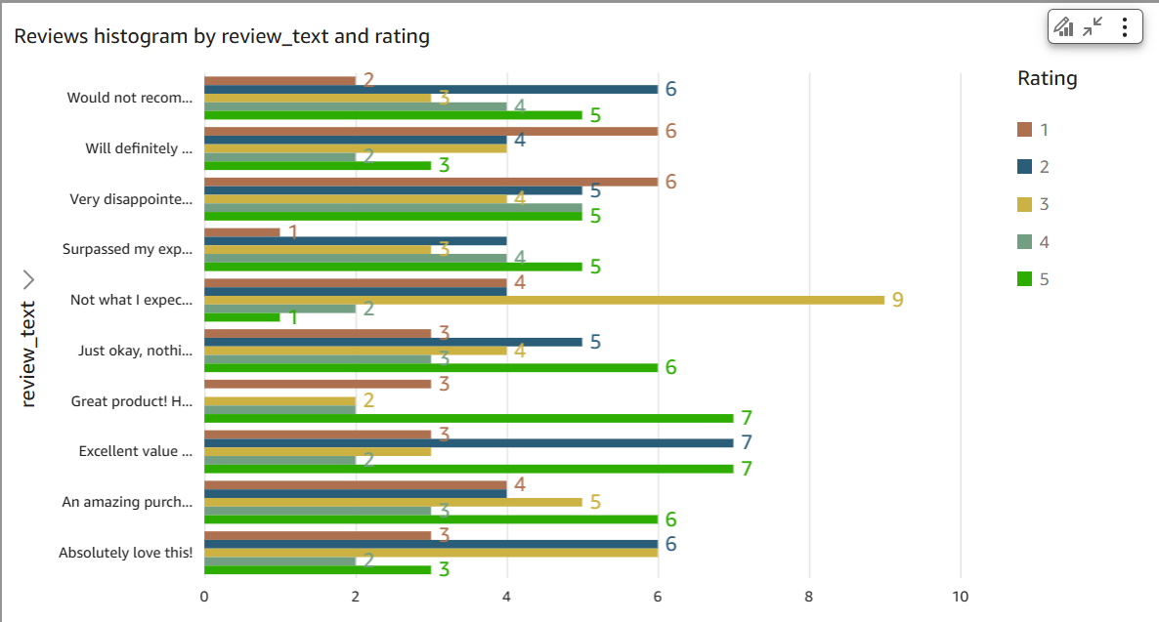
b) Reviews histogram by review text and rating

Slide 28
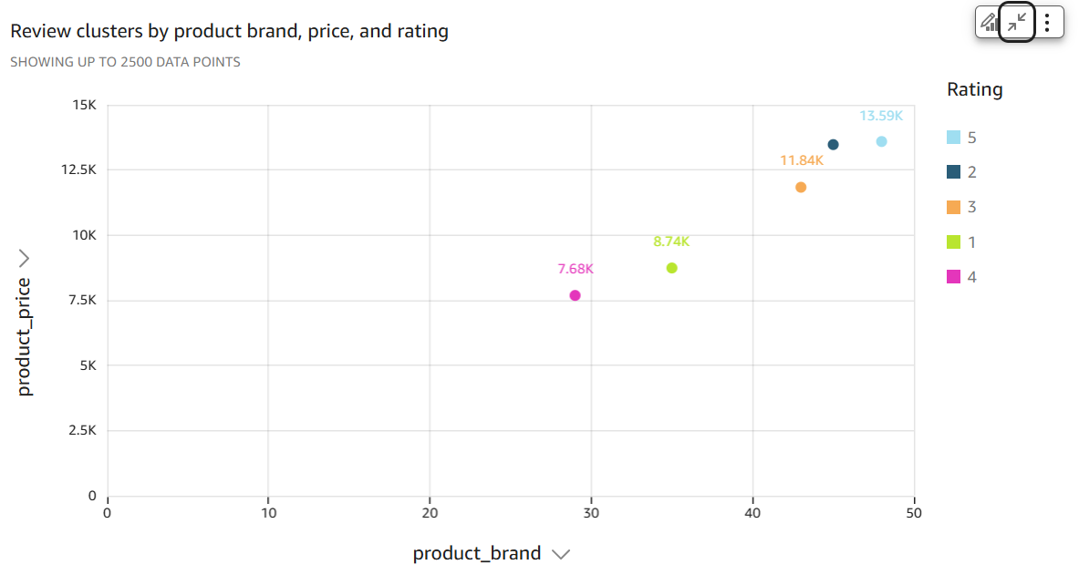
c) Cluster plot of reviews according to product brand, price, and rating

Slide 29
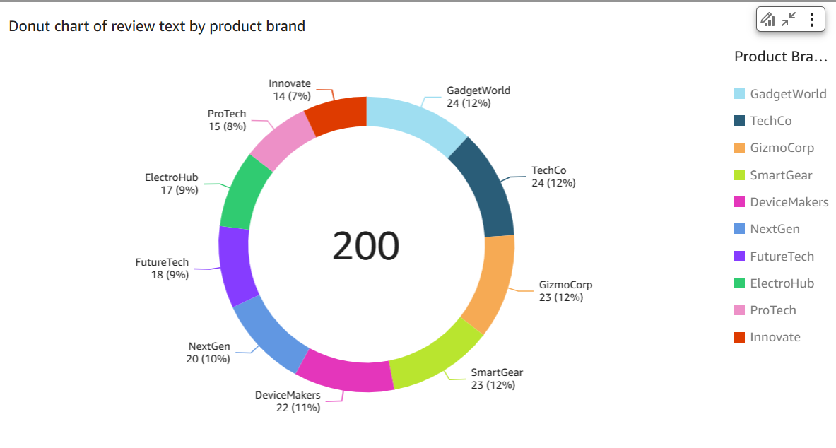
d) Donut chart of reviews by product brand

Slide 30
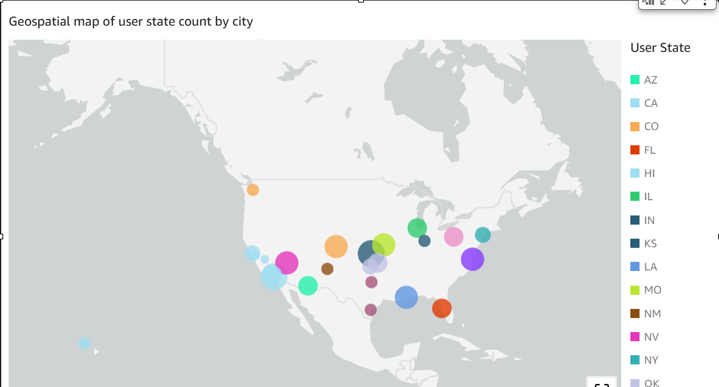
e) Geo spatial map of user state count by city

Slide 31
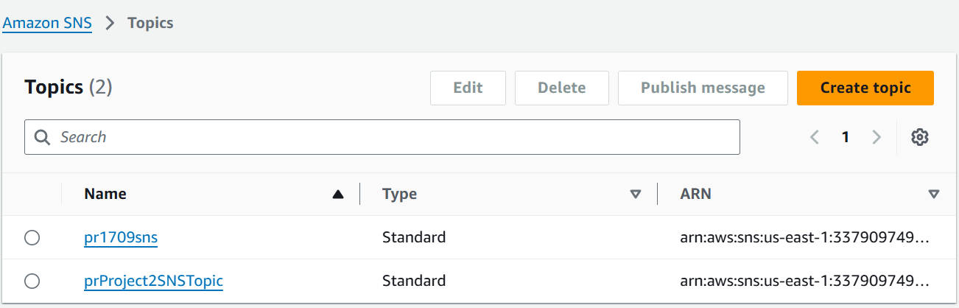
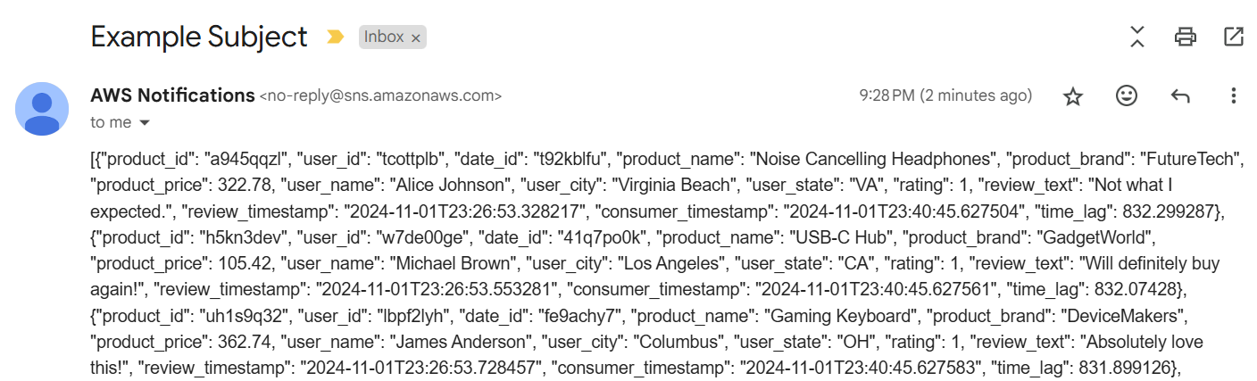
Additional tool: E-mail notification
Create SNS topic and subscription
Run Lambda Producer file

Slide 32
Challenges
Some libaries, such as psycopg2, had to be in a specific version before they could be used in an AWS layer.
Keeping track of permissions for lambda functions not easy.
Migration of on-premise database to AWS with Amazon RDS difficult.

Slide 33
Future enhancements
Migrate on-premise database to AWS for ease of creating big data pipeline for client business needs.
Use more machine learning features to generate better insights to data.
Make sure curated data is stored on a warehouse that provides low latency like HBase if working on different cloud service like Microsoft Azure.

Slide 34
Q&A
Thank You!

