Slide 1


CMR TECHNICAL CAMPUS UGC (Autonomous) Kandlakoya, Medchal Road, Hyd-501401 Department of Computer Science and Engineering
ESTD: 2009
A
Mini Project On
Price Negotiation Chatbot on e-commerce website
BATCH NO: 17
GROUP MEMBERS :
207R1A0562 Hariharan Ummadisetti
207R1A0597 Nikhila Manthena
207R1A0579 Pranay Gogurla
UNDER THE GUIDANCE OF:
Sai Krishna
(Assistant Professor)

Slide 2
CONTENTS
Abstract
Existing System
Disadvantages in Existing System
Proposed System
Advantages of Proposed System
Hardware and Software Requirements
Novelty
Architechture
Modules
UML Diagrams
Sample code
Result
Future Scope
Conclusion

Slide 3
ABSTRACT
We present a price negotiation chatbot for e-commerce websites to enhance the online shopping experience.
The chatbot interacts with customers, allowing them to negotiate and obtain satisfactory prices for desired products.
Our system incorporates machine learning algorithms, specifically Support Vector Regression (SVR) and K-Nearest Neighbors (KNN), to predict prices based on historical data. The chatbot considers seller profitability and customer budget constraints to reach mutually agreeable prices.

Slide 4
EXISTING SYSTEM
The existing system that can be taken over by the proposed system (price negotiation chatbot for an e-commerce website) is a traditional online shopping platform without price negotiation capabilities. The proposed system addresses the limitations of the existing system by introducing the following improvements:
Price Negotiation Capability.
Personalized Pricing
Sentiment Analysis
Voice-Based Interaction
User Management and Order Tracking

Slide 5
DISADVANTAGES IN EXISTING SYSTEM
Lack of Price negotiation
Limited Personalization
Limited Understanding of Customer Sentiment
Limited Interaction method
Lack of Comprehensive User Management

Slide 6
PROPOSED SYSTEM
The sentiment analysis is performed using the Sentiment_Intensity_Analyzer from the vader_Sentiment library. Our chatbot system provides an interactive platform for negotiation, ensuring fair outcomes and improving the online shopping experience.
Additionally, the system handles dynamic changes in data and updates models accordingly.
Web technologies, such as Flask, are used for API routing to enable functionalities like viewing, placing orders, and posting reviews.

Slide 7
ADVANTAGES OF PROPOSED SYSTEM
Price negotiating capability
Personalized pricing
Sentiment Analysis
Voice-Based Interaction
User management
Enhanced User Experience

Slide 8
NOVELTY
The novelty of the project lies in the combination of price negotiation, real-time prediction, sentiment analysis, voice-based interaction, and user management features within an e-commerce context.
By integrating these functionalities, the project aims to provide users with a unique and enhanced online shopping experience.
Great improvement in Sentiment analysis than the existing models.

Slide 9
HARDWARE & SOFTWARE REQUIREMENTS
HARDWARE REQUIREMENTS:
System : Pentium IV 2.4 GHz.
Hard Disk : 40 GB.
Monitor : 15 inch VGA Color.
Mouse : Logitech Mouse.
Ram : 512 MB
Keyboard : Standard Keyboard
SOFTWARE REQUIREMENTS:
OS : Windows 8 or above.
Tool : Spyder, Python 3.5
Front End : HTML, CSS
Back End : Python anaconda script, Flask

Slide 10
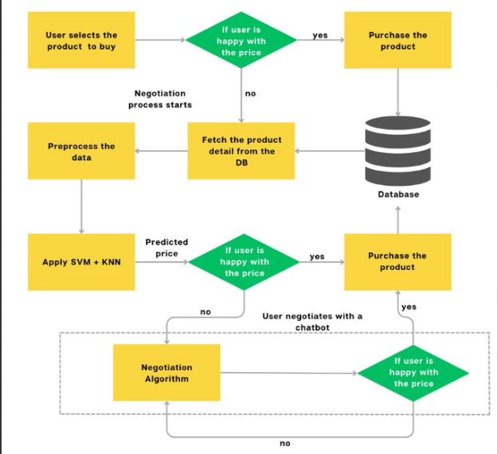
ARCHITECHTURE

Slide 11
MODULES
The modules used in the provided project code are as follows:
Managing Templates and using API’s to manage HTTP requests
Data manipulation and database connectivity
Deep Learning Model and Data Preprocessing Libraries
Interacting with Operating System and Commands to run sub process
These modules provide various functionalities and capabilities required for building the chatbot, handling user interactions, database connectivity, data preprocessing, sentiment analysis, and more.

Slide 12
Flask :- A web framework used for building the application and handling HTTP requests and responses.
Pymysql: A Python library for connecting and interacting with a MySQL database
Datetime: A module for working with dates and times.
Pandas: A data manipulation and analysis library used for reading and processing CSV data.
Numpy: A library for numerical computations and array operations.

Slide 13
sklearn.svm: A module from scikit-learn library for Support Vector Machines (SVM) related tasks, including SVR (Support Vector Regression).
sklearn.preprocessing: A module from scikit-learn library for data preprocessing tasks, including MinMaxScaler for feature scaling.
sklearn.neighbors: A module from scikit-learn library for k-nearest neighbors related tasks, including KNeighborsRegressor.
vaderSentiment: A library for sentiment analysis using the VADER (Valence Aware Dictionary and sEntiment Reasoner) model.

Slide 14
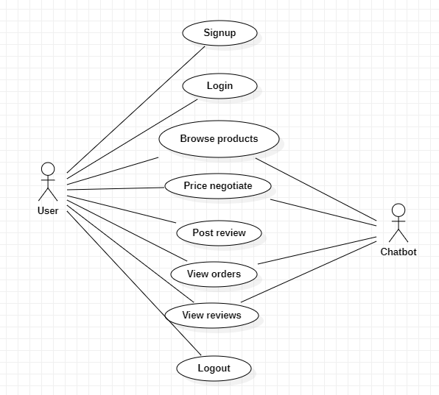
UML DIAGRAMS
1. USECASE DIAGRAM :

Slide 15
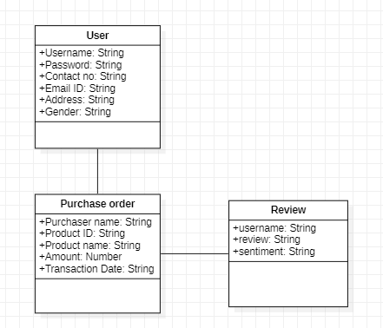
2 . CLASS DIAGRAM

Slide 16
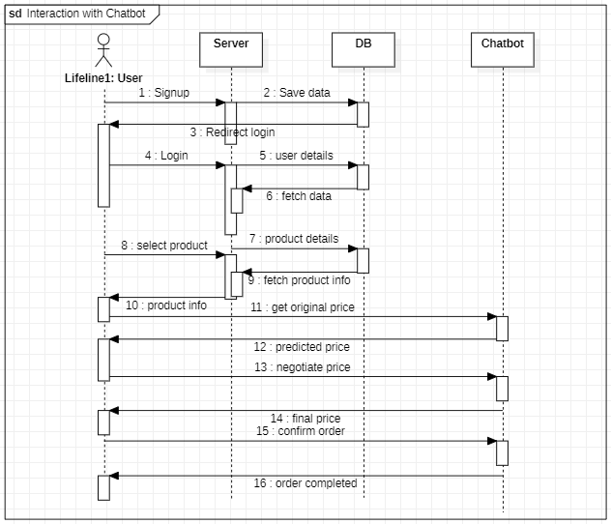
3. SEQUENCE DIAGRAM:

Slide 17
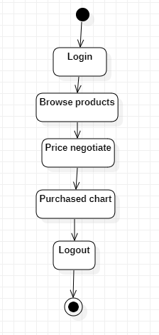
4. ACTIVITY DIAGRAM

Slide 18
Sample Code

Slide 19
from flask import Flask, render_template, request, redirect, url_for, session, make_response
import pymysql
import datetime
import pandas as pd
import numpy as np
from sklearn.svm import SVR
from sklearn.preprocessing import MinMaxScaler
from sklearn.neighbors import KNeighborsRegressor
from vaderSentiment.vaderSentiment import SentimentIntensityAnalyzer
import os
import subprocess
import speech_recognition as sr

Slide 20
app = Flask(__name__)
app.secret_key = 'welcome'
global uname
global original_price, predicted_price, final_price, product_name, product_id
sid = SentimentIntensityAnalyzer()
recognizer = sr.Recognizer()
@app.route('/ViewReview', methods=['GET', 'POST'])
def ViewReview():
if request.method == 'GET':
global uname
font = '<font size="3" color="black">'
output = '<table border="1" width="100%">'
output += '<tr><th><font size="3"

Slide 21
color="black">Username</font></th>'
output += '<th><font size="3" color="black">Review</font></th>'
output += '<th><font size="3" color="black">Sentiment</font></th></tr>'
con = pymysql.connect(host='127.0.0.1',port = 3306,user = 'root', password = '', database = 'negotiate',charset='utf8')
index = 0
with con:
cur = con.cursor()
cur.execute("select * FROM reviews")
rows = cur.fetchall()
for row in rows:
output += "<tr><td>"+font+str(row[0])+"</td>"
output += "<td>"+font+str(row[1])+"</td>"
output += "<td>"+font+str(row[2])+"</td>"
return render_template('ViewReview.html', msg=output)

Slide 22
@app.route('/ViewOrders', methods=['GET', 'POST'])
def ViewOrders():
if request.method == 'GET':
global uname
font = '<font size="3" color="black">'
output = '<table border="1" width="100%">'
output += '<tr><th><font size="3" color="black">Purchaser Name</font></th>'
output += '<th><font size="3" color="black">Product ID</font></th>'
output += '<th><font size="3" color="black">Product Name</font></th>'
output += '<th><font size="3" color="black">Amount</font></th>'
output += '<th><font size="3" color="black">Purchase Date</font></th></tr>'

Slide 23
@app.route('/ViewOrders', methods=['GET', 'POST'])
def ViewOrders():
if request.method == 'GET':
global uname
font = '<font size="3" color="black">'
output = '<table border="1" width="100%">'
output += '<tr><th><font size="3" color="black">Purchaser Name</font></th>'
output += '<th><font size="3" color="black">Product ID</font></th>'
output += '<th><font size="3" color="black">Product Name</font></th>'
output += '<th><font size="3" color="black">Amount</font></th>'
output += '<th><font size="3" color="black">Purchase Date</font></th></tr>'

Slide 24
con = pymysql.connect(host='127.0.0.1',port = 3306,user = 'root', password = '', database = 'negotiate',charset='utf8')
index = 0
with con:
cur = con.cursor()
cur.execute("select * FROM purchaseorder where username='"+uname+"'")
rows = cur.fetchall()
for row in rows:
output += "<tr><td>"+font+str(row[0])+"</td>"
output += "<td>"+font+str(row[1])+"</td>"
output += "<td>"+font+str(row[2])+"</td>"
output += "<td>"+font+str(row[3])+"</td>"
output += "<td>"+font+str(row[4])+"</td>"
return render_template('ViewOrders.html', msg=output)

Slide 25
@app.route('/CompleteOrder', methods=['GET', 'POST'])
def CompleteOrder():
global uname
global original_price, predicted_price, final_price, product_name, product_id
if request.method == 'POST':
if predicted_price != 0:
now = datetime.datetime.now()
current_time = now.strftime("%Y-%m-%d %H:%M:%S")
status = "Error in cinfirming order"
db_connection = pymysql.connect(host='127.0.0.1',port = 3306,user = 'root', password = '', database = 'negotiate',charset='utf8')
db_cursor = db_connection.cursor()

Slide 26
student_sql_query = "INSERT INTO purchaseorder(username,product_id,product_name,amount,transaction_date) VALUES('"+uname+"','"+product_id+"','"+product_name+"','"+str(predicted_price)+"','"+str(current_time)+“’)”
db_cursor.execute(student_sql_query)
db_connection.commit()
if db_cursor.rowcount == 1:
status = 'Your Order completed'
else:
status = "First negotiate price from chatbot then confirm order"
return render_template('UserScreen.html', msg=status)

Slide 27
@app.route('/PostReviewAction', methods=['GET', 'POST'])
def PostReviewAction():
if request.method == 'POST':
global uname
review = request.form['t1']
sentiment_dict = sid.polarity_scores(review)
compound = sentiment_dict['compound']
result = ''
if compound >= 0.05 :
result = 'Positive'
elif compound <= - 0.05 :
result = 'Negative'

Slide 28
else :
result = 'Neutral'
db_connection = pymysql.connect(host='127.0.0.1',port = 3306,user = 'root', password = '', database = 'negotiate',charset='utf8')
db_cursor = db_connection.cursor()
student_sql_query = "INSERT INTO reviews(username,review,sentiment) VALUES('"+uname+"','"+review+"','"+result+"')"
db_cursor.execute(student_sql_query)
db_connection.commit()
status = "Error in taking review"
if db_cursor.rowcount == 1:
status = 'Your review accepted & sentiment predicted : '+result
return render_template('PostReview.html', msg=status)

Slide 29
@app.route('/PostReview', methods=['GET', 'POST'])
def PostReview():
return render_template('PostReview.html', msg='')
@app.route('/UserScreen', methods=['GET', 'POST'])
def UserScreen():
global uname
return render_template('UserScreen.html', msg="Welcome "+uname)
@app.route('/index', methods=['GET', 'POST'])
def index():
return render_template('index.html', msg='')
@app.route('/Login', methods=['GET', 'POST'])
def Login():
return render_template('Login.html', msg='')

Slide 30
@app.route('/Signup', methods=['GET', 'POST'])
def Signup():
return render_template('Signup.html', msg='')
@app.route('/ChatData', methods=['GET', 'POST'])
def ChatData():
if request.method == 'GET':
global predicted_price
query = request.args.get('mytext')
query = query.strip("\n").strip()
output = "Sorry! i am not trained for given question"
if 'price' in query.lower():
output = "You can get product at $:"+str(predicted_price)

Slide 31
if "final" in query.lower() or "discount" in query.lower() or "my" in query.lower():
discount = (predicted_price / 100) * 5
predicted_price = predicted_price - discount
output = "The final price you can get this product is $:"+str(predicted_price)
response = make_response(output, 200)
response.mimetype = "text/plain"
return response

Slide 32
@app.route('/record', methods=['GET', 'POST'])
def record():
if request.method == 'POST':
global predicted_price
data = request.files['data'].read()
if os.path.exists('static/audio/audio.wav'):
os.remove('static/audio/audio.wav')
if os.path.exists('static/audio/audio1.wav'):
os.remove('static/audio/audio1.wav')
with open("static/audio/audio.wav", "wb") as fh:
fh.write(data)
fh.close()
path = os.path.abspath(os.getcwd())+'/static/audio/'
print("====================="+path)
res = subprocess.check_output(path+'ffmpeg.exe -i '+path+'audio.wav '+path+'audio1.wav', shell=True)

Slide 33
with sr.WavFile(path+'audio1.wav') as source:
audio = recognizer.record(source)
try:
text = recognizer.recognize_google(audio, language="en-IN")
except Exception as ex:
text = "unable to recognize"
print(text)
query = text.strip("\n").strip()
output = "Sorry! i am not trained for given question"
if 'price' in query.lower():
output = "You can get product at $:"+str(predicted_price)
if "final" in query.lower() or "discount" in query.lower() or "my" in query.lower():
discount = (predicted_price / 100) * 5
predicted_price = predicted_price - discount

Slide 34
output = "The final price you can get this product is $:"+str(predicted_price)
response = make_response("Your Query : "+query+"\nChatbot: "+output, 200)
response.mimetype = "text/plain"
return response
@app.route('/Chatbot', methods=['GET', 'POST'])
def Chatbot():
if request.method == 'GET':
global original_price, predicted_price, final_price, product_name, product_id
product_id = request.args.get('t1') #user will select product for which he want negotiate
types = request.args.get('t2')
dataset = pd.read_csv("Dataset/model.csv") #read dataset
dataset.fillna(0, inplace = True) #replace missing values in dataset with 0

Slide 35
products = dataset.loc[dataset['index'] == product_id] #read all rows from dataset which is matches with user selected product
products = products.values #convert dataframe to array
print(products)
original_price = products[0,5] #get original price from dataset
product_name = products[0,2] #get product name from dataset
X = products[:,5:6] #get original prices as X training data
Y = products[:,6:7] #get negotiating prices as Y data
sc = MinMaxScaler(feature_range = (0, 1)) #can be used to normalize dataset
X = sc.fit_transform(X) #normalize the X values
Y = sc.fit_transform(Y) #normalize the Y values
svr_regression = SVR(C=1.0, epsilon=0.2) #create SVM object
#training SVR with X and Y data

Slide 36
svr_regression.fit(X, Y.ravel()) #trained SVM with X and Y data
#performing prediction on test data
predict = svr_regression.predict(X) #perform prediction to get best price
predict = predict.reshape(predict.shape[0],1)
predict = sc.inverse_transform(predict)
predict = predict.ravel()
labels = sc.inverse_transform(Y)
labels = labels.ravel()
knn = KNeighborsRegressor(n_neighbors=2) #here we are training with KNN
#training KNN with X and Y data
knn.fit(X, Y.ravel())
#performing prediction on test data
predict = knn.predict(X)
predict = predict.reshape(predict.shape[0],1)

Slide 37
predict = sc.inverse_transform(predict)
predict = predict.ravel()
labels = sc.inverse_transform(Y) #back to original values from normalization
labels = labels.ravel()
predicted_price = predict[0] #get best predicted price
output = "Hi! this is Nego.<br/>Your selected Product : "+product_name+".<br/>Its Current Price : "+str(original_price)+".<br/>"
page = 'Chatbot.html'
if types == 'voice':
page = 'VoiceBot.html'
return render_template(page, msg=output)

Slide 38
@app.route('/BrowseProducts', methods=['GET', 'POST'])
def BrowseProducts():
if request.method == 'GET':
font = '<font size="3" color="black">'
output = '<table border="1" width="100%">'
output += '<tr><th><font size="3" color="black">Product Type</font></th>'
output += '<th><font size="3" color="black">Product Name</font></th>'
output += '<th><font size="3" color="black">Description</font></th>'
output += '<th><font size="3" color="black">Product Image</font></th>'
output += '<th><font size="3" color="black">Price</font></th>'
output += '<th><font size="3" color="black"><font size="3" color="black">Text Negotiate with Chatbot</font></th>'

Slide 39
output += '<th><font size="3" color="black"><font size="3" color="black">Voice Negotiate with Chatbot</font></th></tr>'
dataset = pd.read_csv("Dataset/ecommerce.csv")
dataset.fillna(0, inplace = True)
dataset = dataset.values
for i in range(len(dataset)):
index = str(dataset[i,0])
types = str(dataset[i,1])
name = str(dataset[i,2])
desc = str(dataset[i,3])
price = str(dataset[i,5])
output+="<tr><td>"+font+types+"</font></td>"
output+="<td>"+font+name+"</font></td>"
output+="<td>"+font+desc+"</font></td>"
output+='<td><img src="static/img/'+index+'.png" width="150" height="150"></img></td>'

Slide 40
output+="<td>"+font+price+"</font></td>"
output+='<td><a href="Chatbot?t1='+index+'&t2=text">Text Based Chatbot to Negotiate</a></td>'
output+='<td><a href="Chatbot?t1='+index+'&t2=voice">Voice Based Chatbot to Negotiate</a></td></tr>'
return render_template('BrowseProducts.html', msg=output)
@app.route('/LoginAction', methods=['GET', 'POST'])
def LoginAction():
global uname
if request.method == 'POST':
user = request.form['t1']
password = request.form['t2']
con = pymysql.connect(host='127.0.0.1',port = 3306,user = 'root', password = '', database = 'negotiate',charset='utf8')
index = 0

Slide 41
with con:
cur = con.cursor()
cur.execute("select * FROM users")
rows = cur.fetchall()
for row in rows:
if row[0] == user and password == row[1]:
uname = user
index = 1
break
if index == 0:
return render_template('Login.html', msg="Invalid login details")
else:
return render_template('UserScreen.html', msg="Welcome "+uname)

Slide 42
@app.route('/SignupAction', methods=['GET', 'POST'])
def SignupAction():
if request.method == 'POST':
user = request.form['t1']
password = request.form['t2']
phone = request.form['t3']
email = request.form['t4']
address = request.form['t5']
gender = request.form['t6']
status = "none"
con = pymysql.connect(host='127.0.0.1',port = 3306,user = 'root', password = '', database = 'negotiate',charset='utf8')

Slide 43
with con:
cur = con.cursor()
cur.execute("select * FROM users")
rows = cur.fetchall()
for row in rows:
if row[0] == user:
status = user+" Username already exists"
break
if status == 'none':
db_connection = pymysql.connect(host='127.0.0.1',port = 3306,user = 'root', password = '', database = 'negotiate',charset='utf8')
db_cursor = db_connection.cursor()
student_sql_query = "INSERT INTO users(username,password,contact_no,emailid,address,gender) VALUES('"+user+"','"+password+"','"+phone+"','"+email+"','"+address+"','"+gender+"')"
db_cursor.execute(student_sql_query)
db_connection.commit()

Slide 44
if db_cursor.rowcount == 1:
status = 'Signup process completed'
return render_template('Signup.html', msg=status)
@app.route('/Logout')
def Logout():
return render_template('index.html', msg='')
if __name__ == '__main__':
app.run()

Slide 45
Results

Slide 46
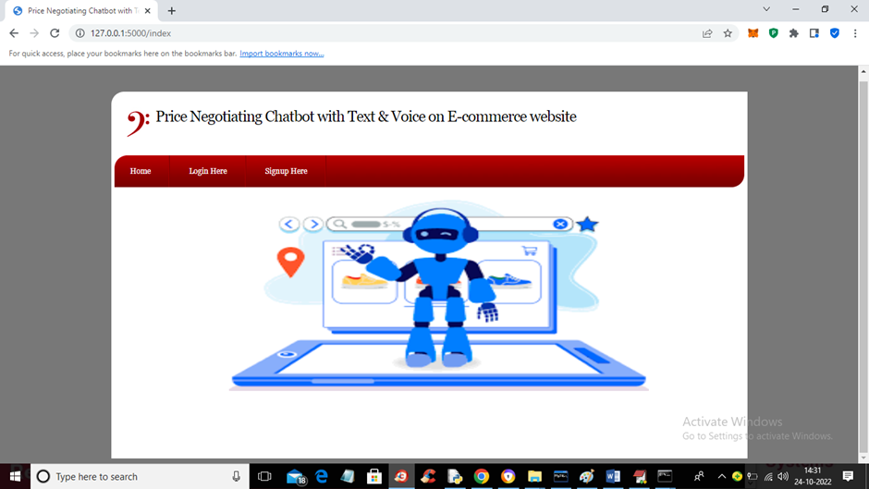
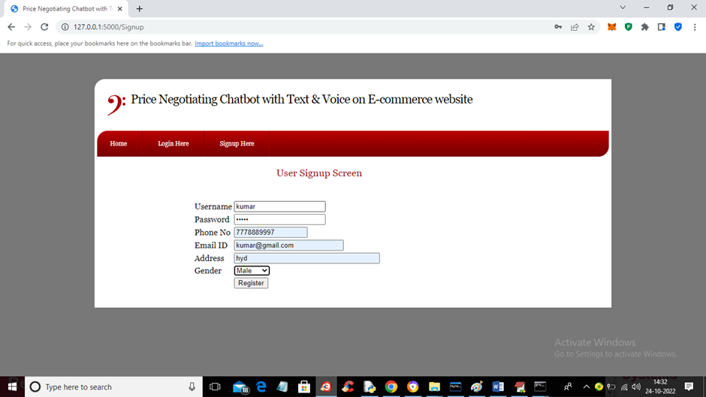
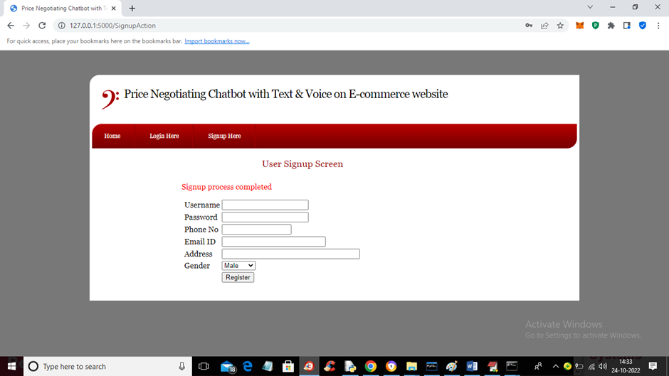
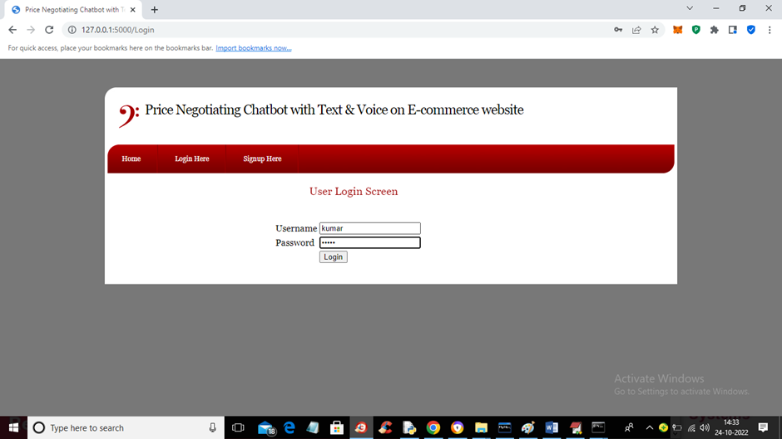
1. Login into website
2.. Signup into website and login

Slide 47
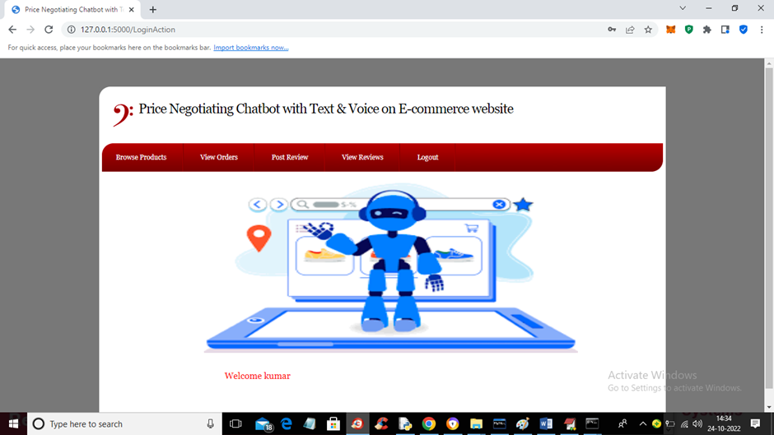
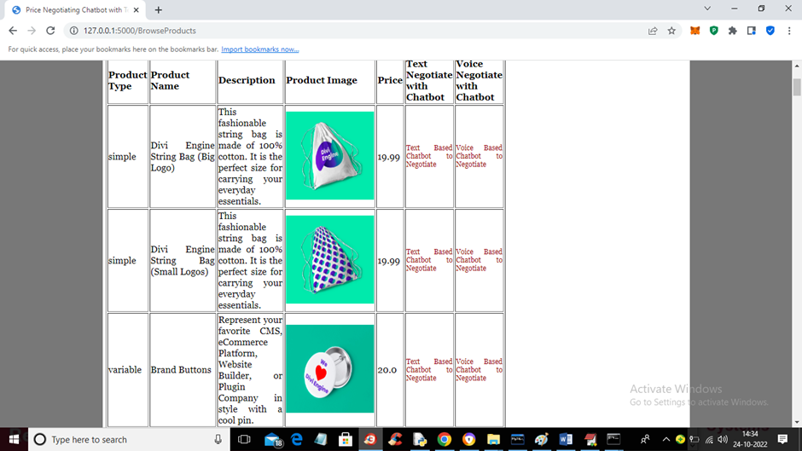
3. Successfully logged in
4. View products

Slide 48
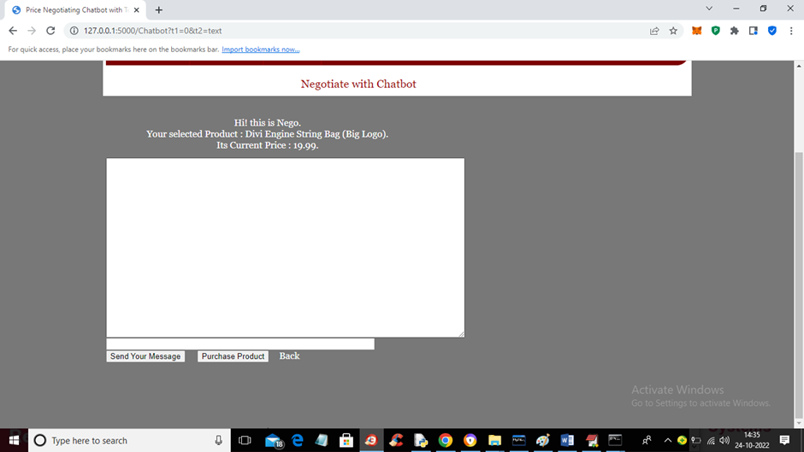
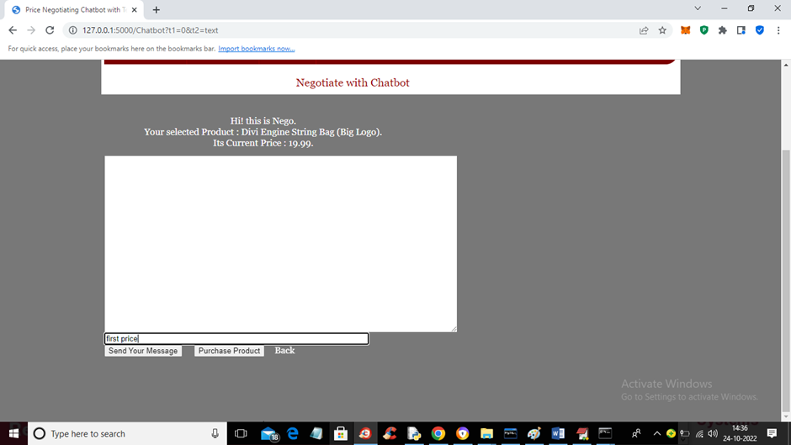
5. Negotiation with chatbot
6. Text based negotiation

Slide 49


7. Interaction with chatbot
8. Response from chatbot

Slide 50
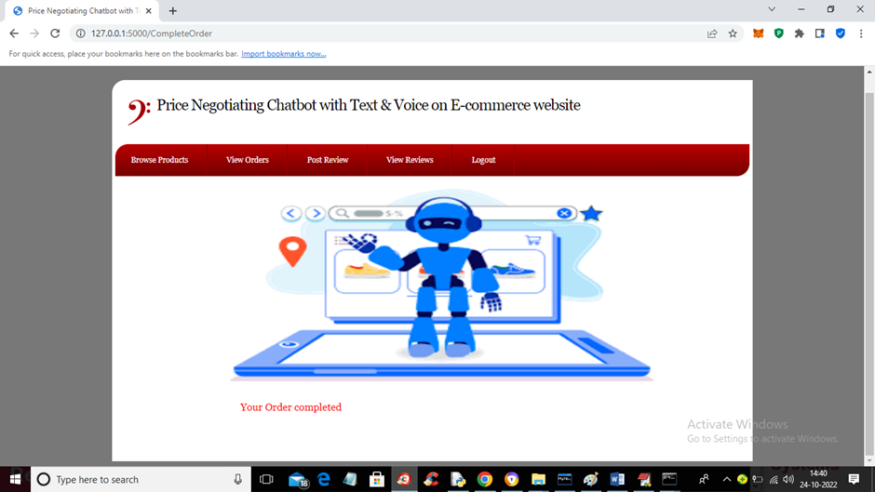
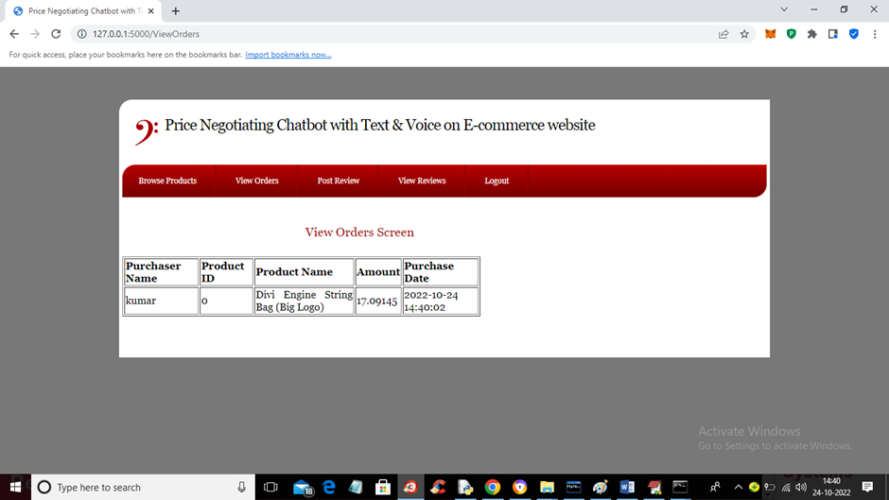
9. Ordering product
10. View order details

Slide 51
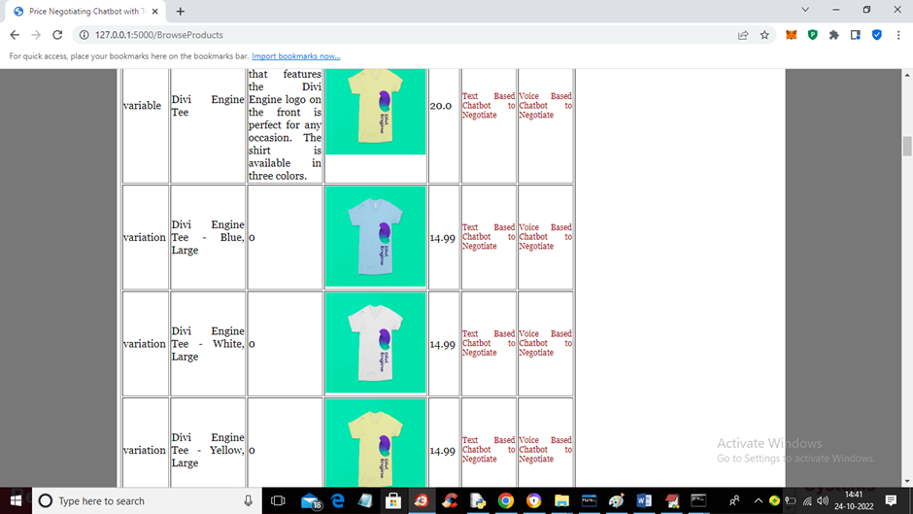
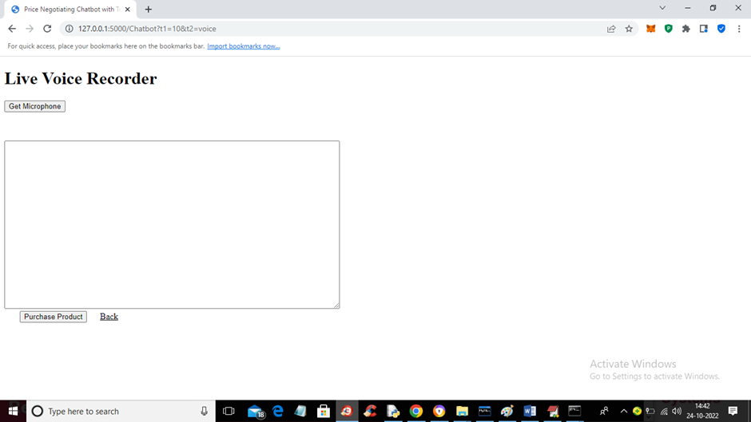
11. Choose voice interaction
12. Voice interaction web page

Slide 52
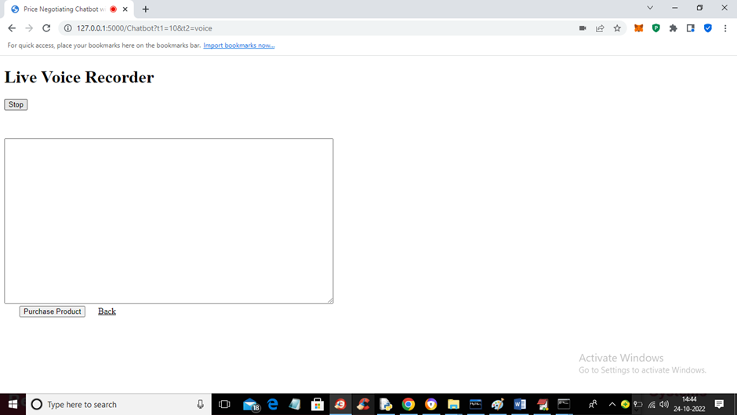
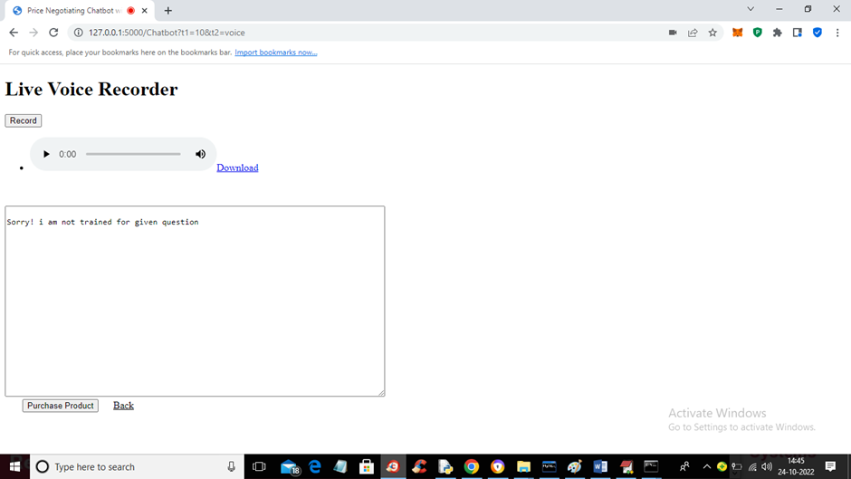
13. Hit record for input
14. Speech recognized response

Slide 53
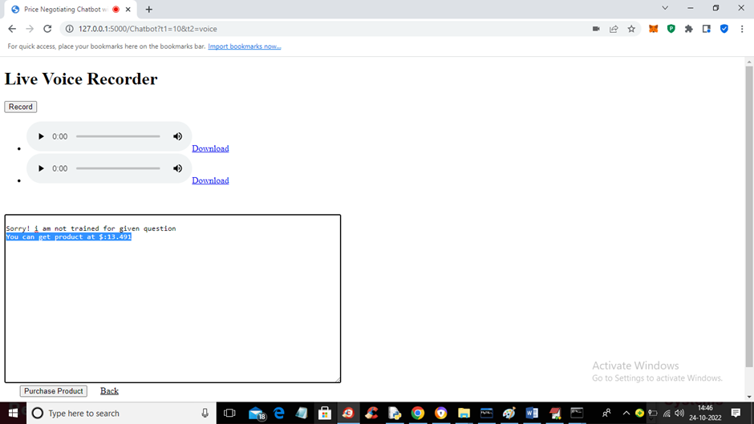

15. Responses should contain whitelisted keywords
16. Ordered using voice input

Slide 54
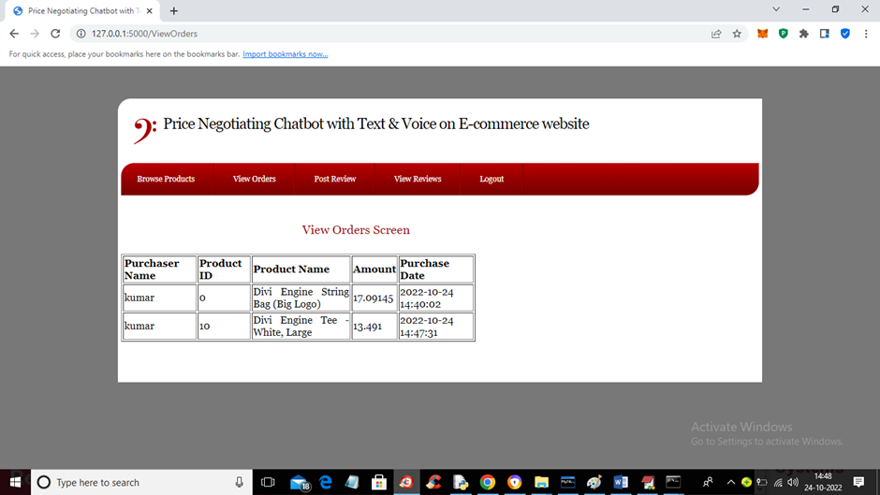
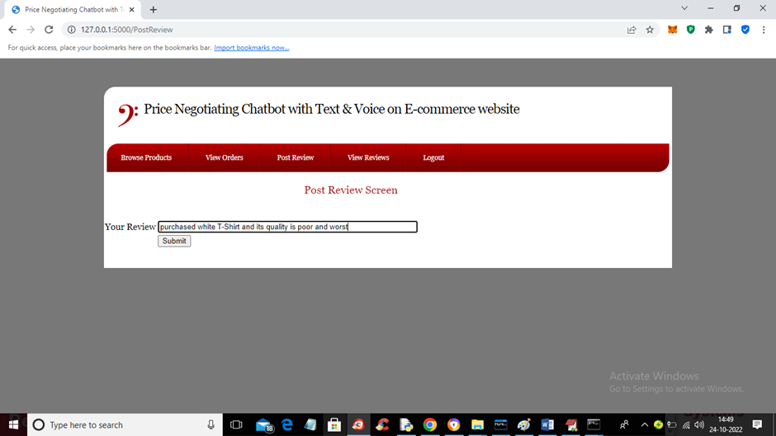
17. View order
18. Review the product

Slide 55
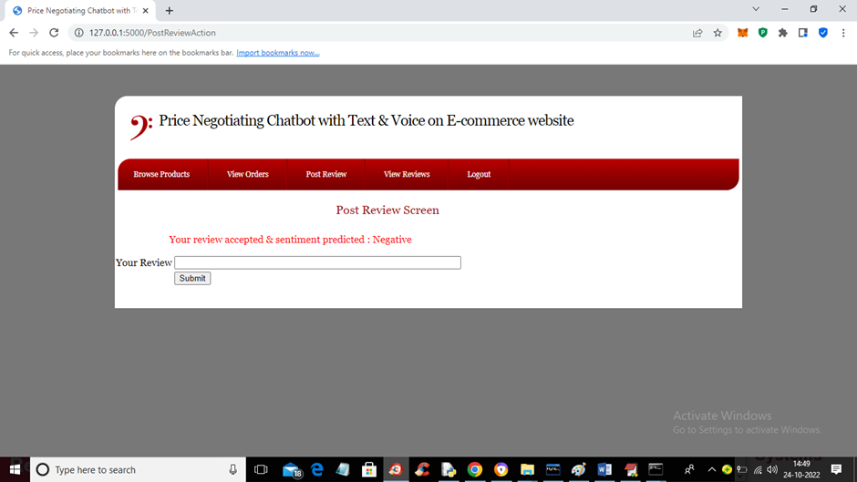
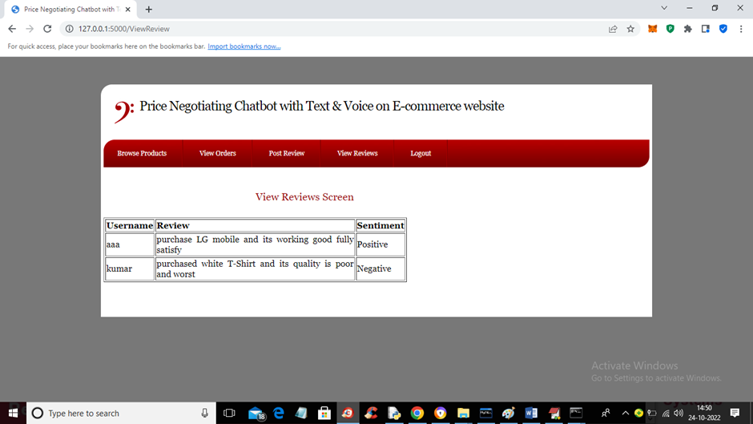
19. Review saved
20. View review

Slide 56
The key results and achievements of this project include:
Real-time Price Negotiation: Users can successfully negotiate prices with the chatbot, leading to a potential reduction in product costs.
Sentiment Analysis: The chatbot effectively analyzes user feedback and sentiments to determine the final negotiated price.
User Engagement: The chatbot engages users in interactive conversations, creating a dynamic shopping experience.
User Reviews: Users can leave reviews and receive sentiment predictions, contributing to product feedback.

Slide 57
Future Scope

Slide 58
While the project has achieved its core objectives, there is a wide range of potential future enhancements and features that can be added to further improve the user experience and functionality:
Recommendation System: Implement a recommendation system that suggests products based on user preferences and browsing history.
Payment Integration: Add secure payment integration for a seamless checkout process.
Multi-language Support: Extend language support to cater to a broader user base.
User Profiles: Develop user profiles to provide personalized product recommendations and shopping histories.

Slide 59
Inventory Management: Implement real-time inventory tracking to prevent overselling and manage stock efficiently.
Chatbot Enhancements: Continuously improve the chatbot's natural language understanding and responses.
Mobile Application: Create a mobile app version for users to shop on the go.
Analytics and Reporting: Incorporate analytics and reporting tools to monitor user behavior and sales data.
Security Improvements: Enhance security measures to protect user data and transactions.

Slide 60
Conclusion
In conclusion, the price negotiation chatbot for an e-commerce website offers a novel and innovative solution to enhance the online shopping experience.
By integrating negotiation capabilities, real-time price prediction, sentiment analysis, and voice-based interaction, the project aims to provide personalized pricing, improved customer satisfaction, and a more engaging shopping environment.

Slide 61
Any Queries ???

Slide 62
Thank You

