Slide 1

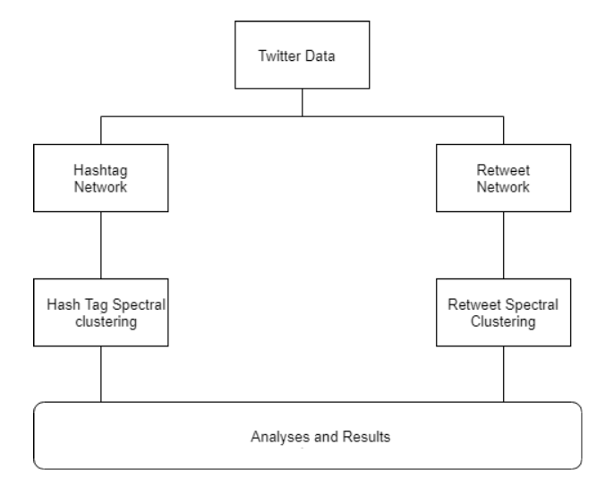
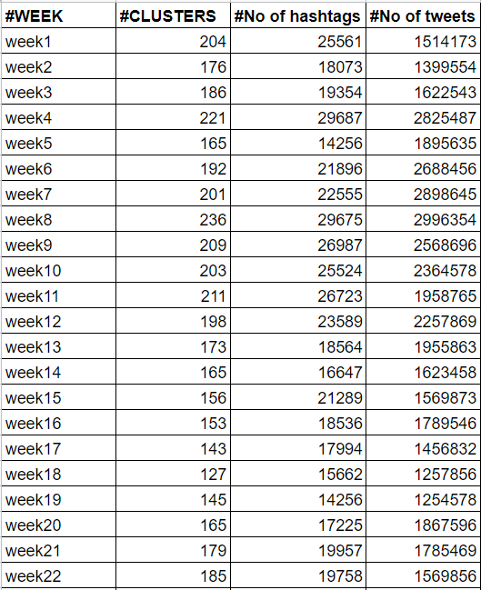
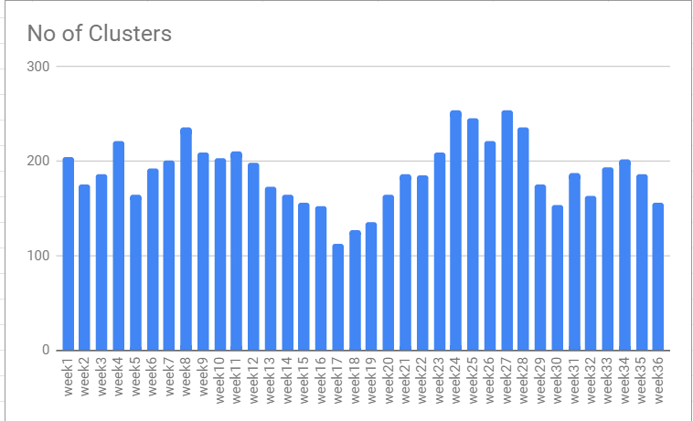
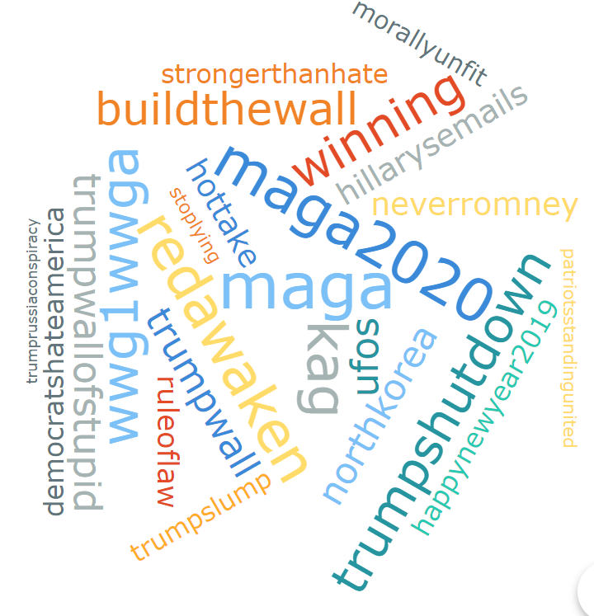
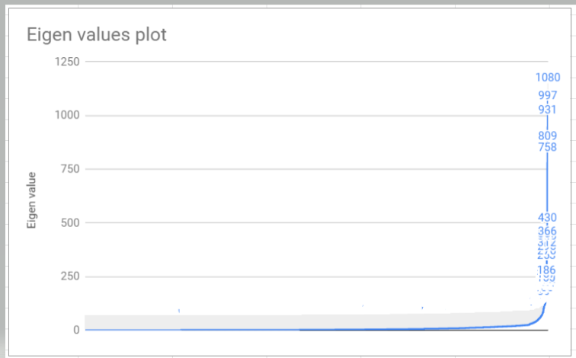
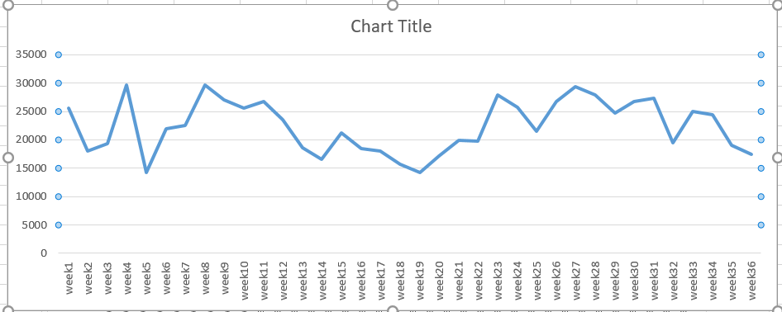
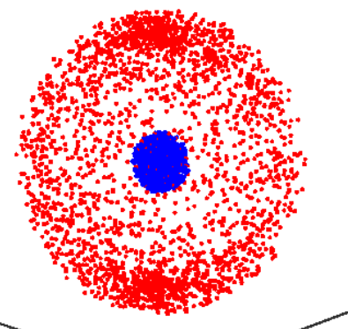
An approach to find topics change using twitter data
Pranay Gouru
Dr. K M George(Advisor and chair),Dr. Johnson Thomas, Dr. Christopher Crick
Introduction
Social Media is a central domain for dissemination of real time information. To see the information flow change over social networks, we consider text of tweets and derive results, which is computationally intensive process for the large twitter data.
Objective of this Projects to find an efficient method to compute the information flow change over a period of time using hashtags and retweets. For this,
text information of tweets is fetched and hashtags are collected among them. Similarly, Retweets and usernames are also used to see the information flow change.
Twitter API is used to collect the data using the keyword “TRUMP” and the corresponding text is parsed to collect hashtags and retweets.
Figure 3. Overview of the Framework
Statistics for clusters
Figure 6. No of Clusters vs weeks
Technical Approach
Results
We have used spectral clustering to see the hashtags spread throughout the network.
Spectral Clustering:
Input: A undirected graph with nodes and edges number k of clusters to construct.
Let W be its weighted adjacency matrix.
Compute the unnormalized laplacian L.
Compute the first k eigenvectors v1,v2..vk of L.
Let V belongs to R, N by K be the matrix containing the vectors v1,.....vk as columns.
For i = 1,....,n, let yi ∈ R k be the vector corresponding to the ith row of V.
Cluster the Points (yi)i = 1,n in R k with the k-means algorithm into the clusters C1,.....CK.
Output: Clusters with A1,.....AK.
Laplacian Matrix : L = D- A where D is the degree matrix, which is the diagonal matrix from the vertex degrees and A is the adjacency matrix.
Eigenvalues and Eigenvectors: A·v=λ·v where A be n by n matrix V is a non zero vector.
I have used spectral clustering method to cluster the data and these clusters speak about the information diffused over a period of time. As you can see from the clusters the week 17 has low number of clusters are reduced which implies that topics has been reduced from the previous weeks.
The correlation coefficient for the clusters and hashtags is 0.74958.
The clusters formed are chosen from the eigenvalues plots for every week and the first k clusters should be chosen to calculate the clusters.
Moreover, we can see the number of hashtags mentioned from each cluster which represents the mostly spoken topic over the period of time. The articles present in that are also observed and found out why the information during the time.
Figure 1. Network of hashtags
Conclusions
I have found that the information flow change can be seen through various approaches but my way choosing the clustering algorithm will help find the related topics present in the clusters.
We can also find the relation between hashtags and the number of tweets.
The choice of networks can be many ways like choosing hashtags and users, users and hashtags, retweets and users, followers count can be used to see the flow of information.
This approach can handled using the large sets of data but having followers in twitter data would have helped us to build another network to observe the relations of another choice.
Conclusions
Conclusions
Related Work
Earlier work has been done using usernames and hashtags relation where usernames are used as the nodes and hashtags for connections. Linear influence model is one such technique used where nodes be infected when they adopt the information. Influence is calculated using a selected group of nodes and results are taken accordingly. But, using this approach gives the relation between nodes without grouping.
In this approach connected components explain the connected information over the network which explains how related topics are within the cluster. From this we can explain how the information flow change can be changed over the time.
Figure 4. Eigen values plot
References
1Jaewon Yang,Jure Leskovec, Modelling information diffusion in implicit networks
2Shushen Fu,Chungjin Hu,Ying Hu,Bo Sun,Wenrui Ying,Peng Shi ,Information Diffusion mechanisms in online social networks
3,De Wang,Aibek Musaev,Calton Pu, Information Diffusion analysis over Rumor dynamics over a social-interaction based model
4,Nitin Sukhija, Mahidhar Tatineni, Nicole Brown, Mark Van Moer, Paul Rodriguez, and Spencer Callicott Topic modelling and visualization for Big data in social sciences.
Figure 2. Example for spectral clustering.
Figure 5. No of Hashtags collected

